Slide 1


Promoting Creativity
in Childhood:
Moving from why? to how? through library programs
Erica Fortescue
Associate Director, Innovative Learning
Center for Childhood Creativity

Slide 2
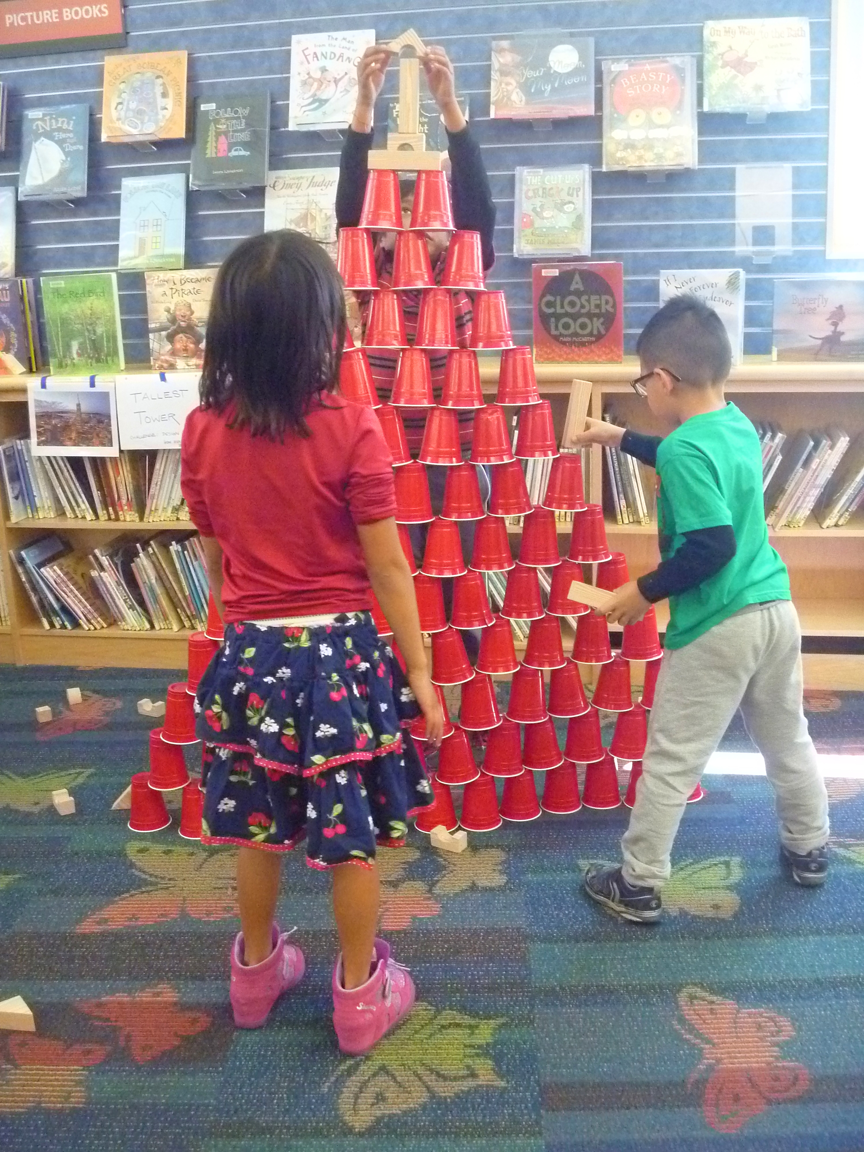
Webinar Agenda
Introductions
Research
Activities

Slide 3
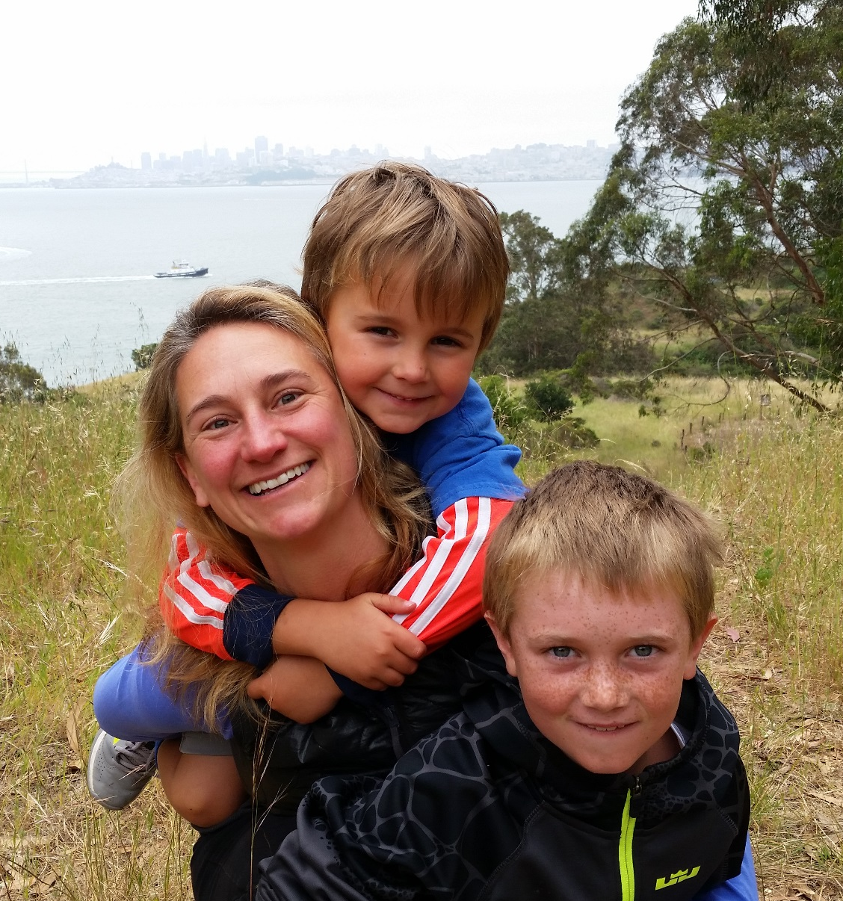
About the Presenter
Erica Fortescue
Associate Director, Innovative Learning
Center for Childhood Creativity

Slide 4

Our Mission:
To ignite and advance
creative thinking for all children

Slide 5


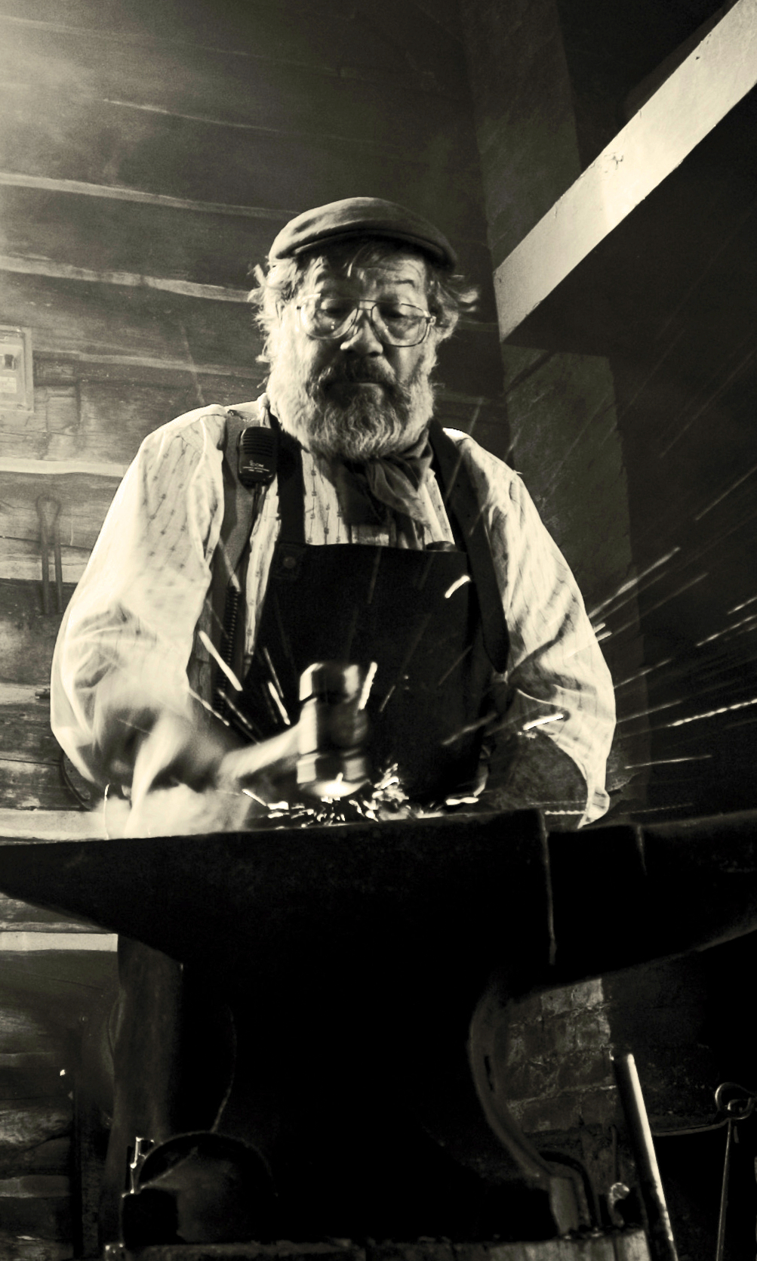
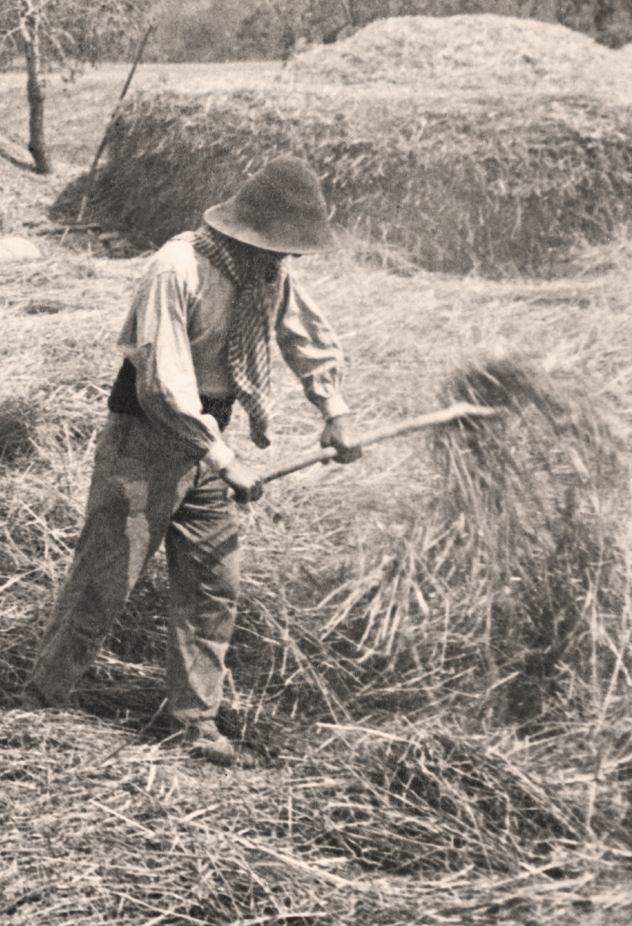
Creativity = Workforce Readiness
21st Century
Conceptual
Age
20th Century
Information
Age
19th Century
Industrial
Age
18th Century
Agricultural
Age

Slide 6
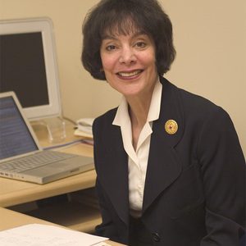





Advisory Board Members
Partnering Institutions

Slide 7
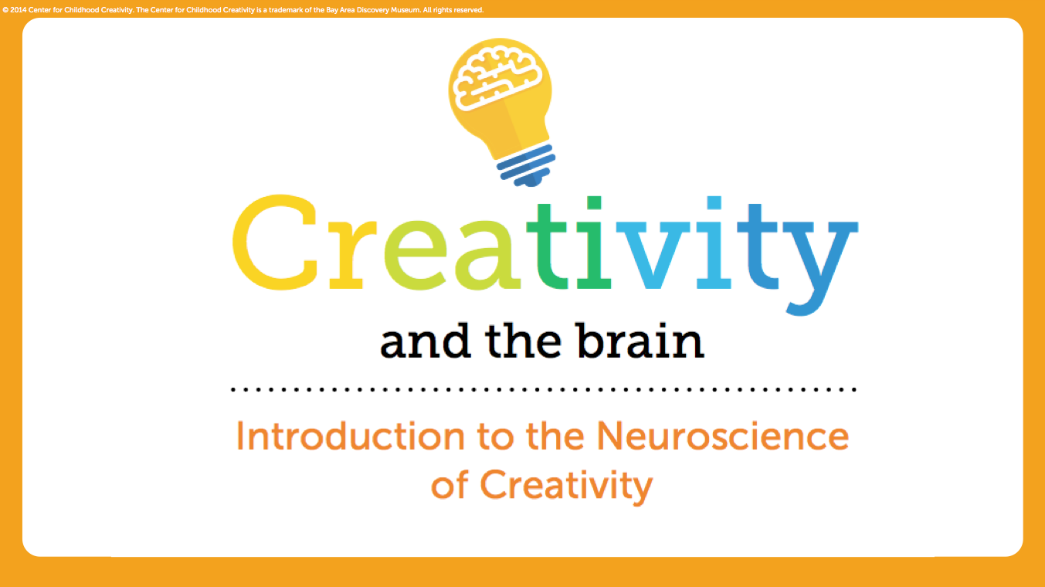
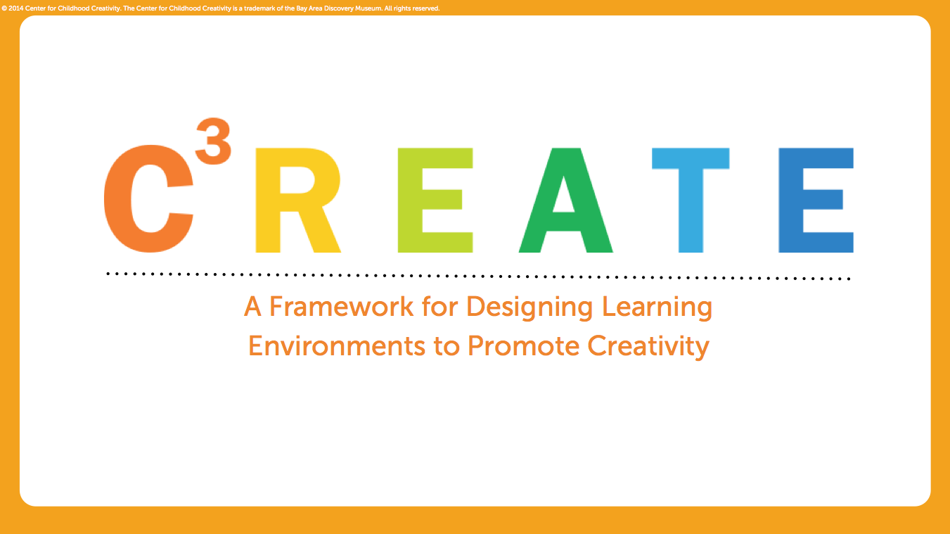
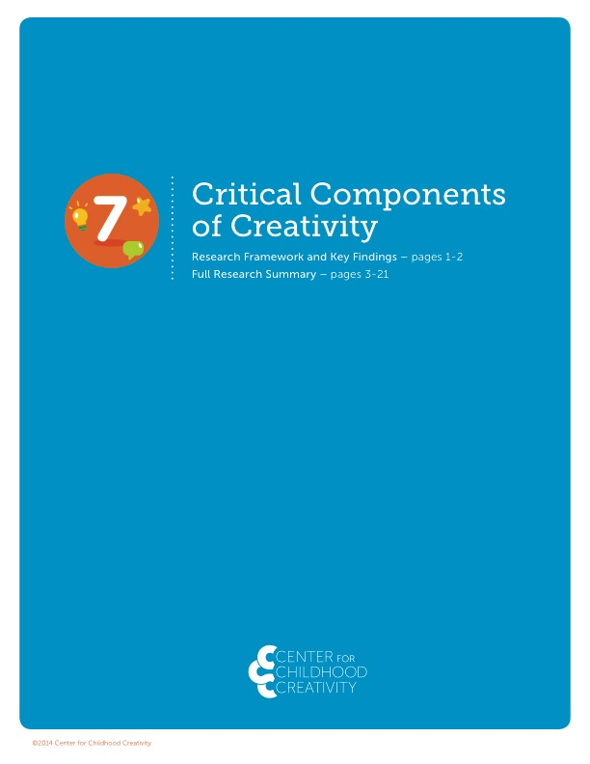

Research
Creativity and
the Brain
C³REATE
Shared Discoveries
7 Components
of Creativity
School Readiness
(in progress)

Slide 8
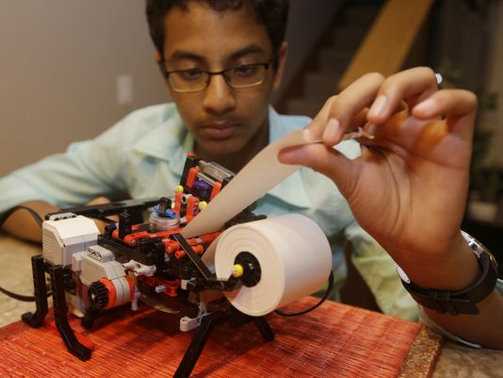
Key Research Questions
What SKILLS contribute to children’s creativity?
What types of learning ENVIRONMENTS foster creativity in children?

Slide 9
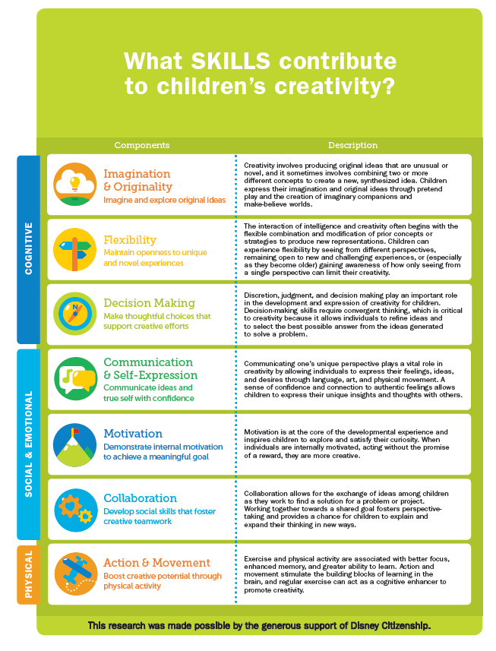
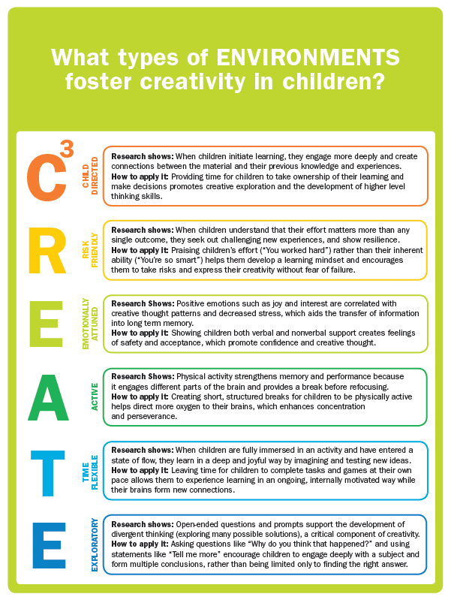

Slide 10
SKILLS: 7 Critical Components of Creativity
Imagination & Originality
Flexibility
cognitive
Decision Making
Communication & Self-Expression
Motivation
social & emotional
Collaboration
Action & Movement
physical

Slide 12
A Framework for Designing Learning
Environments to Promote Creativity
Developed by the Center for Childhood Creativity
Child-Directed
Risk Friendly
Emotionally Attuned
Active
Time Flexible
Exploratory

Slide 13
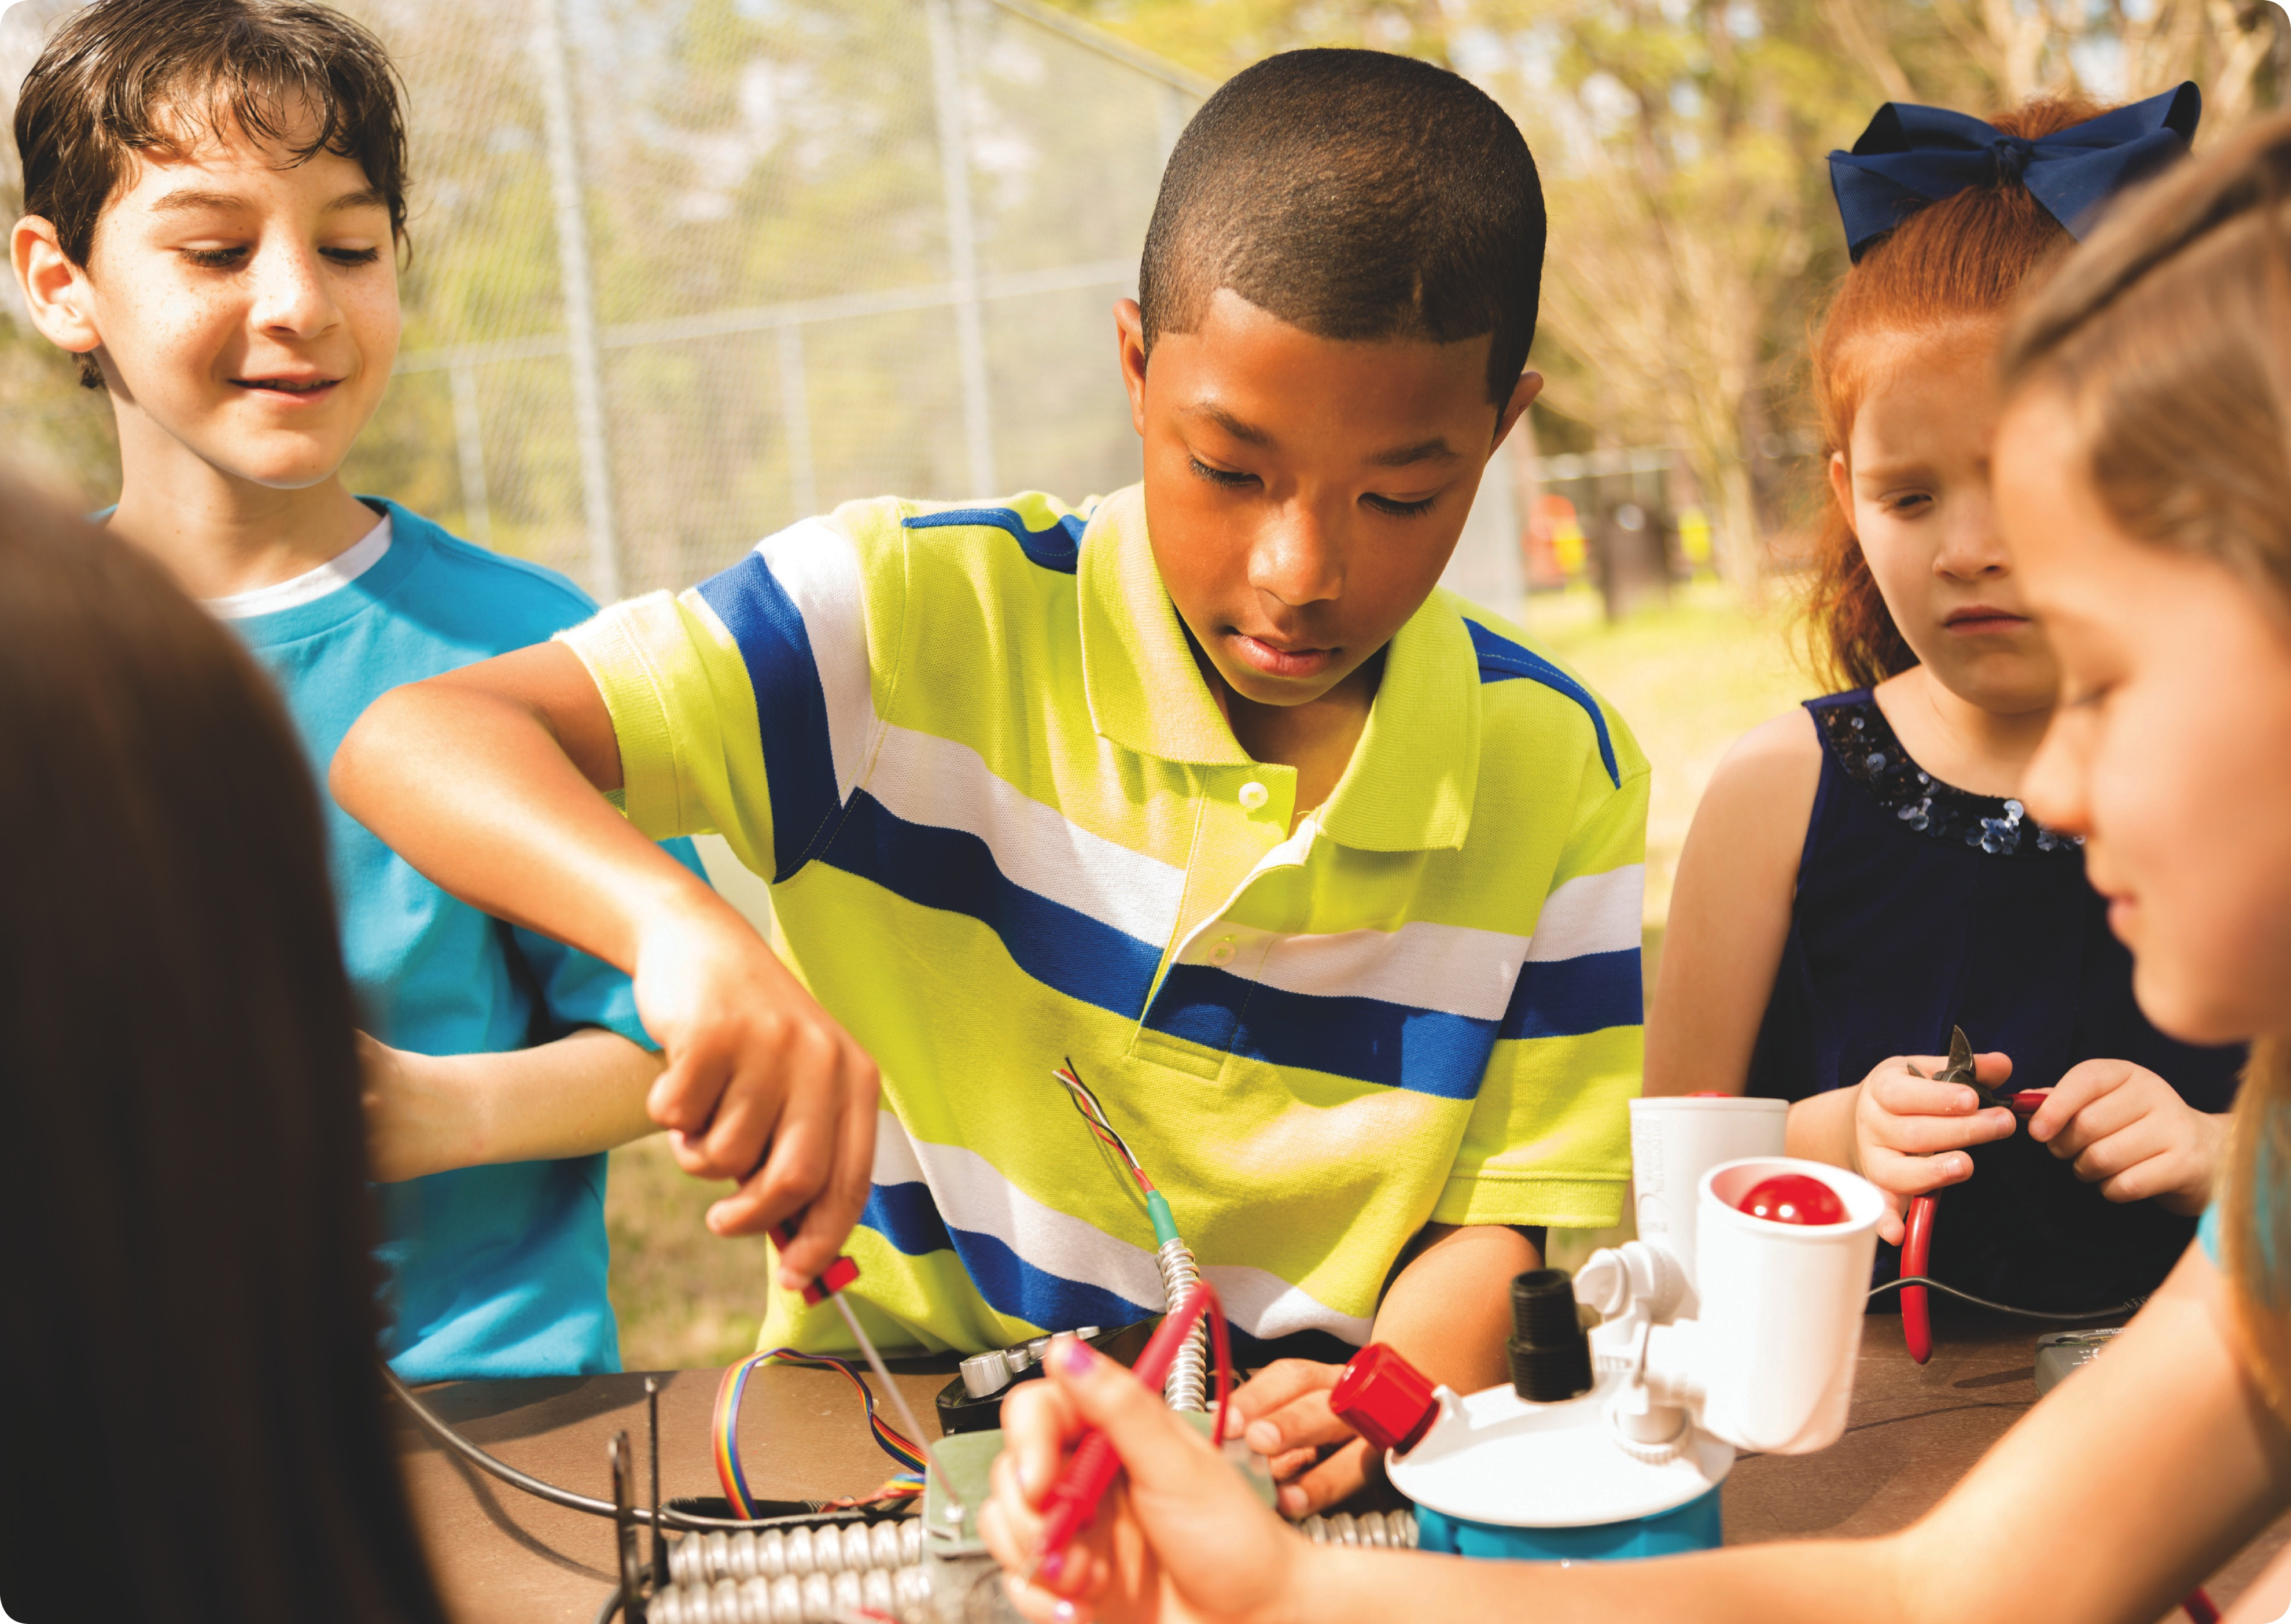

hild-directed

Slide 14
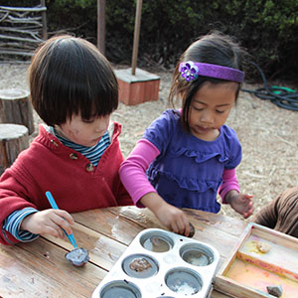
Features of Child-Directed Learning
Choice
Curiosity
Connection

Slide 15
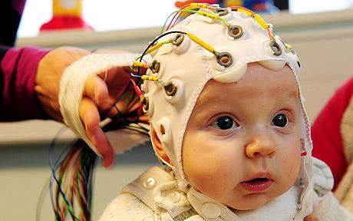
Child-Directed
Not new ideas:
Dewey, Piaget, Vygotsky, Bruner, Montessori
What is new is the neurological evidence showing why?

Slide 16
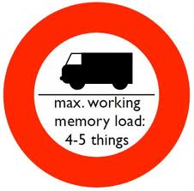
Child-Directed
Choice signals storage
from working memory to
long term memory

Slide 17
Wired for Curiosity:
Why learning feels so good
Choice signals storage
from working memory to
long term memory

Slide 18
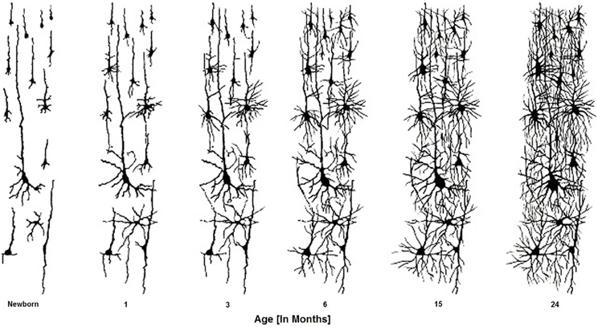
Child-Directed
New learning that CONNECTS to prior experience
facilitates neural pathway growth

Slide 19
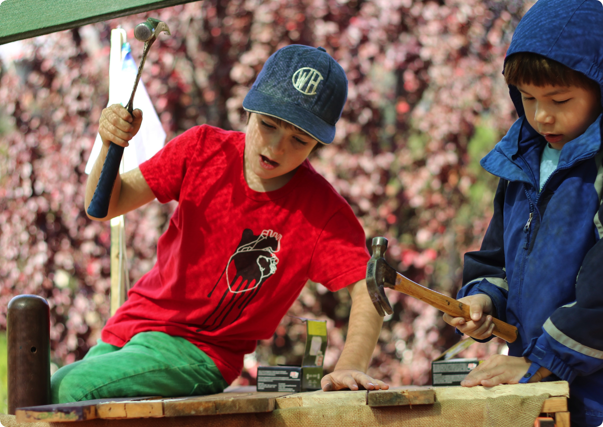

isk friendly

Slide 20
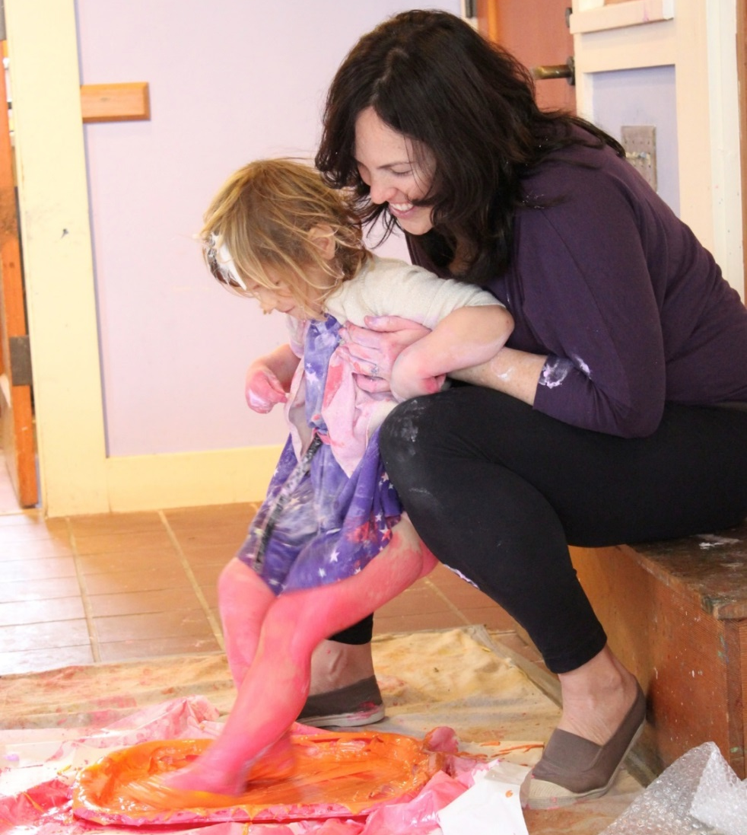
Features of Risk-Friendly Environments
Trying new things
Challenge is encouraged
Build resilience and persistence

Slide 21
Success
Fictional path to success
Actual path to success

Slide 22
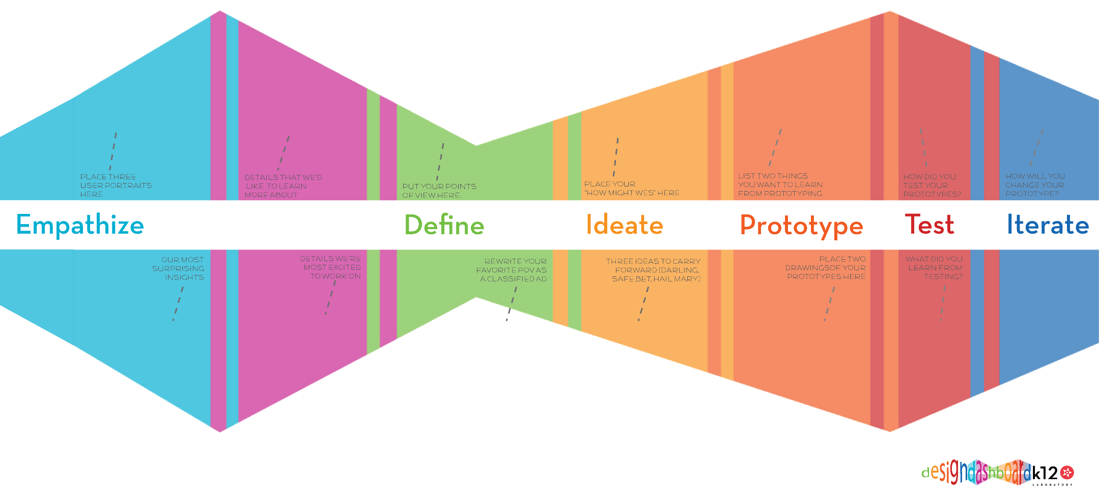
Risk Friendly Key Concept:
Design Thinking

Slide 23
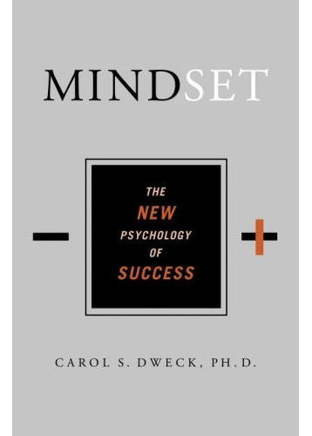
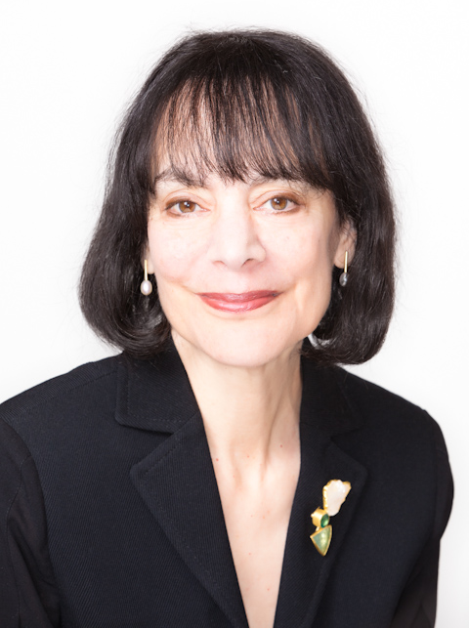
Risk Friendly Key Concept:
Growth Mindset

Slide 24
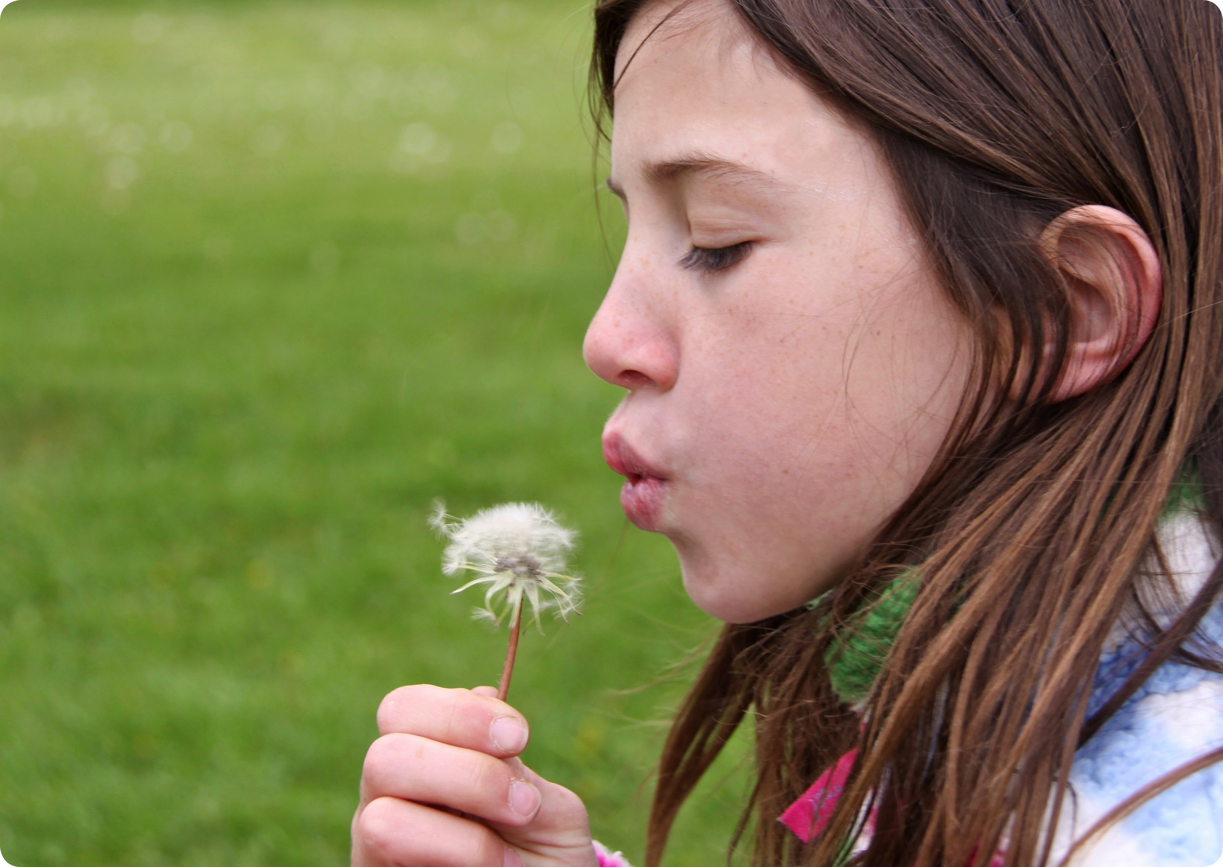

motionally attuned

Slide 25
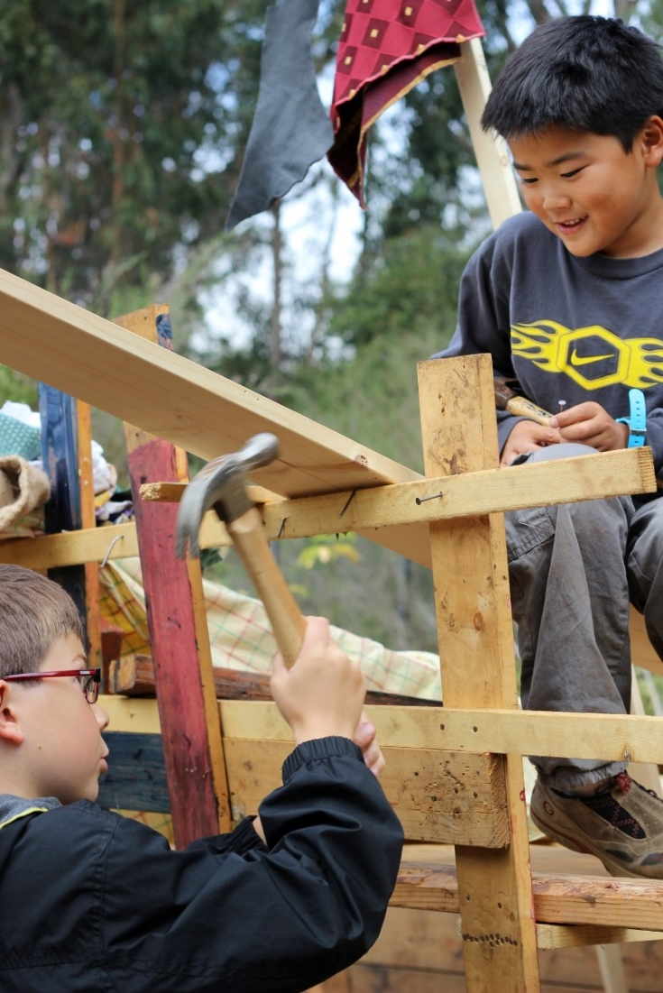
Features of Emotionally Attuned Learning
Research shows:
Positive emotions increase creativity and learning
How to apply it:
Mind feelings to build the mind

Slide 26
Emotionally Attuned:
The Amygdala as a Gateway to Learning
Sensory intakes
Amygdala
NO STRESS
STRESS
Thinking,
Reflective Brain
Reactive Brain
Fight, flight, freeze

Slide 27


ctive

Slide 28
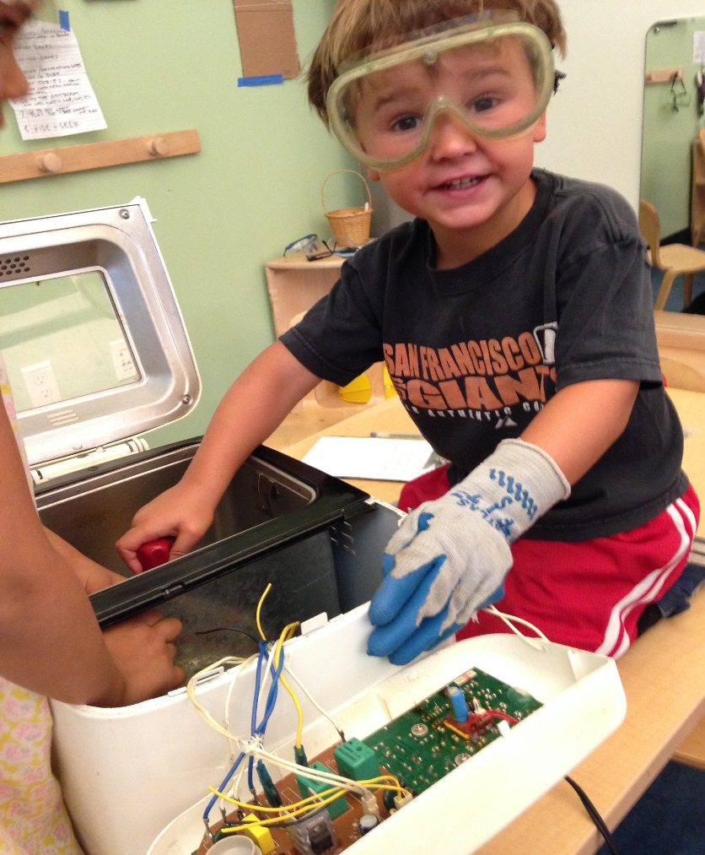
Features of Active Learning
Physical
Participatory
Playful

Slide 29
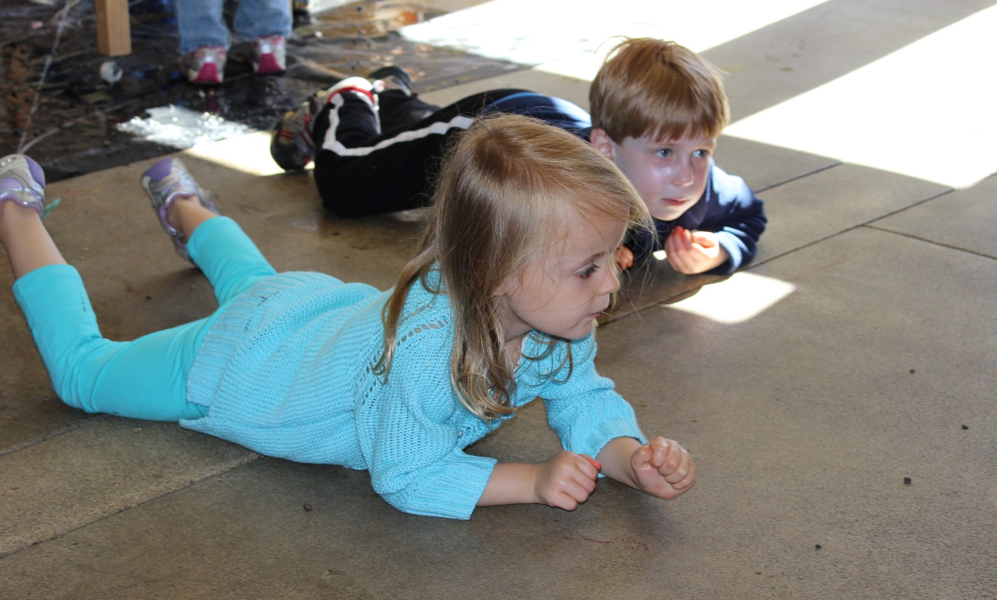
How to Apply it: Brain Breaks
Short physically active breaks help to enhance
children’s concentration and perseverance

Slide 30


ime flexible

Slide 31
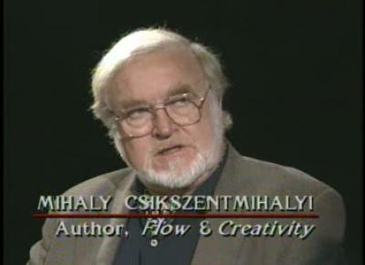

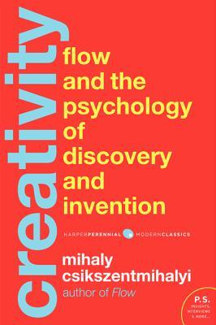
Features of Time Flexible Learning:
FLOW and Deep Learning

Slide 32
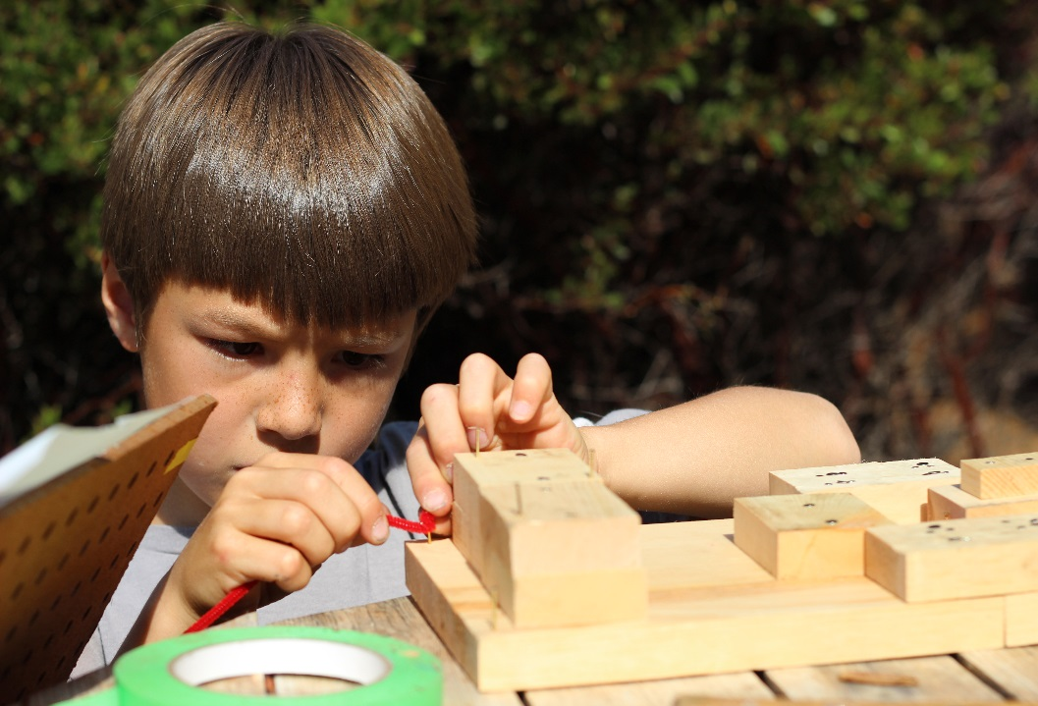
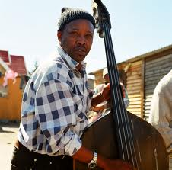
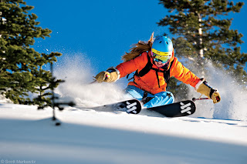
Features of Time Flexible Learning:
FLOW and Deep Learning
“You know that what you need to do is possible to do, even though difficult, and sense of time disappears. You forget yourself. You feel part of something larger.”

Slide 33
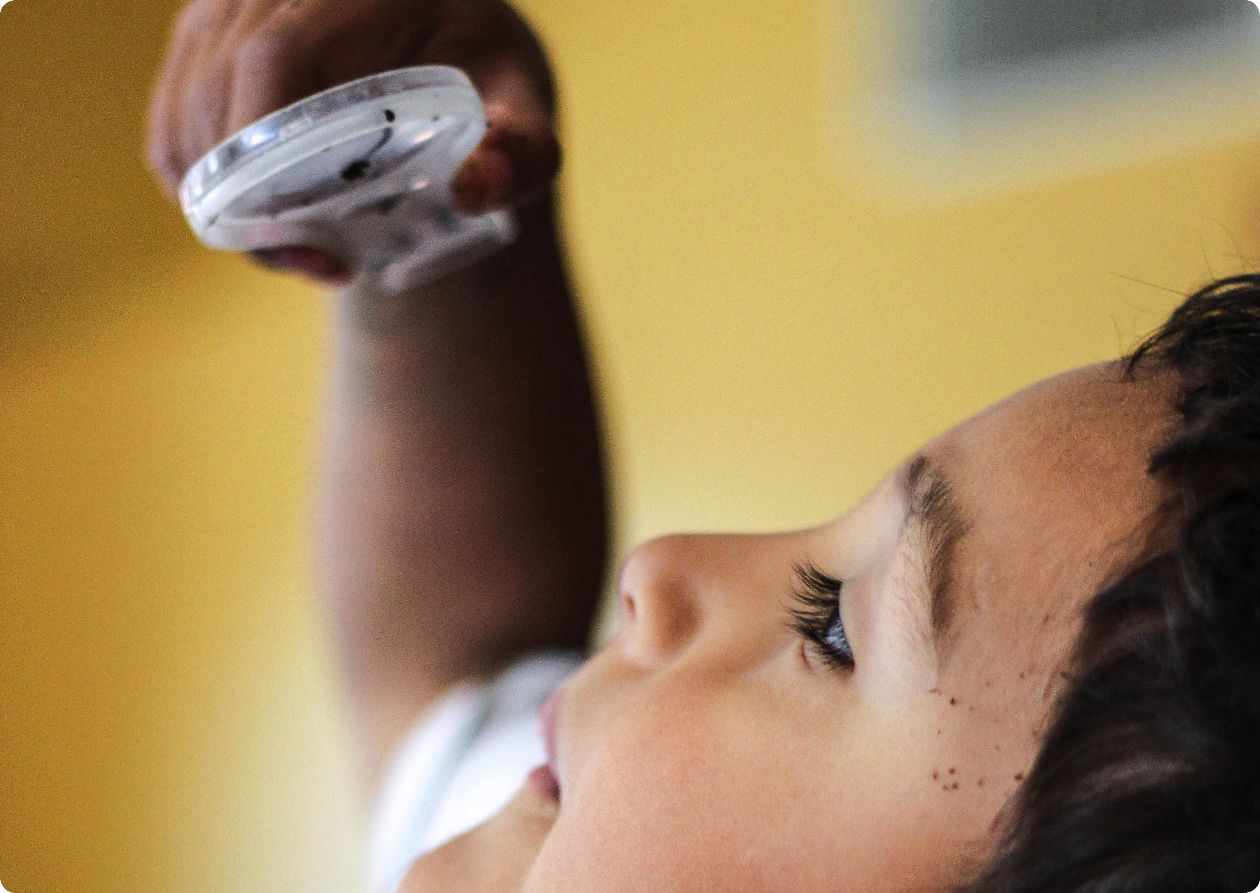

xploratory

Slide 34
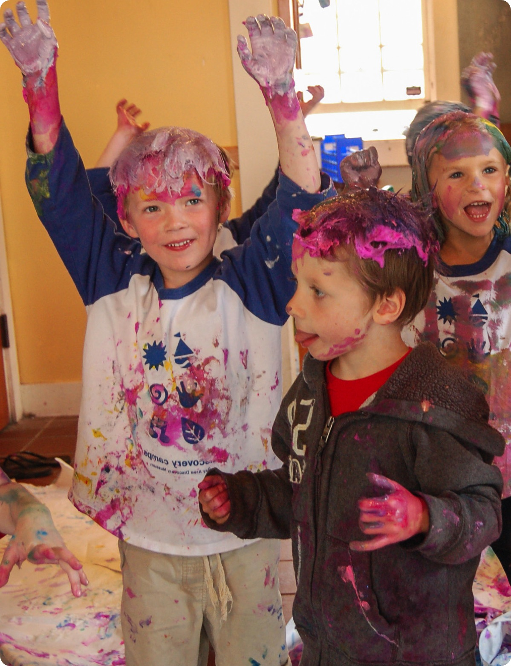
Features of Exploratory Learning
Open-ended
Divergent Thinking
Metacognition

Slide 35
Closed-Ended and Open-Ended Questions
What two
numbers combine to make ten?
5 + 5 = ?
Convergent Thinking
Divergent Thinking

Slide 36
Powerful Phrases
I wonder ...
I notice …
Tell me more…

Slide 37
Child-Directed: Give choice and follow curiosity.
Risk Friendly: Celebrate effort, process and failure.
Emotionally Attuned: Mind feelings to build the mind.
Active: Play! Move! Engage all the senses.
Time Flexible: Help children learn to flow.
Exploratory: Ask and encourage open-ended questions.

Slide 38
Questions?

Slide 39
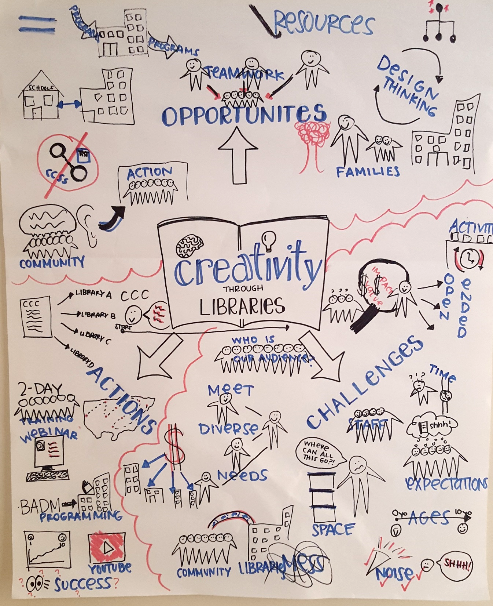
Considerations for
Programming in Libraries
Space and volume constraints
Staffing constraints
Budgetary constraints
Attendance at drop-in programs can be unpredictable, timing is inexact and ages vary
Activities should not feel like school

Slide 40
How Can We Incorporate These
Lessons into Library Programs?
Emphasize the learning process over the end product
Shift language to open-ended prompts
Choose activities for playfulness and tinkerability. Ask yourself if the activities you offer allow children to choose, be curious and lead.

Slide 41
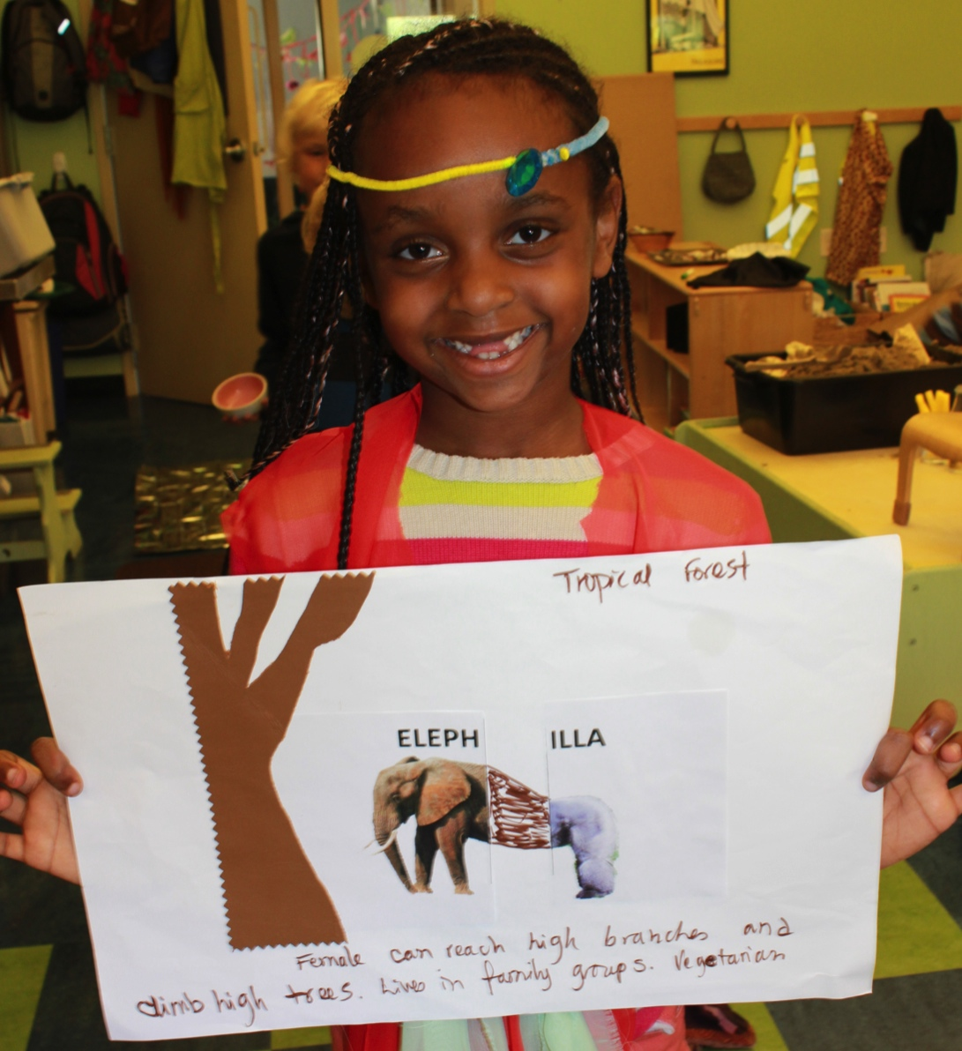
Activity: Animal Remix

Slide 42
Activity: Finish the Drawing

Slide 43
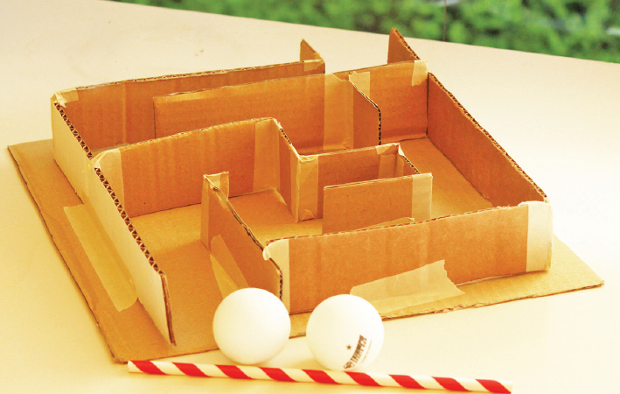
Activity: A-Maze-ing Design

Slide 44
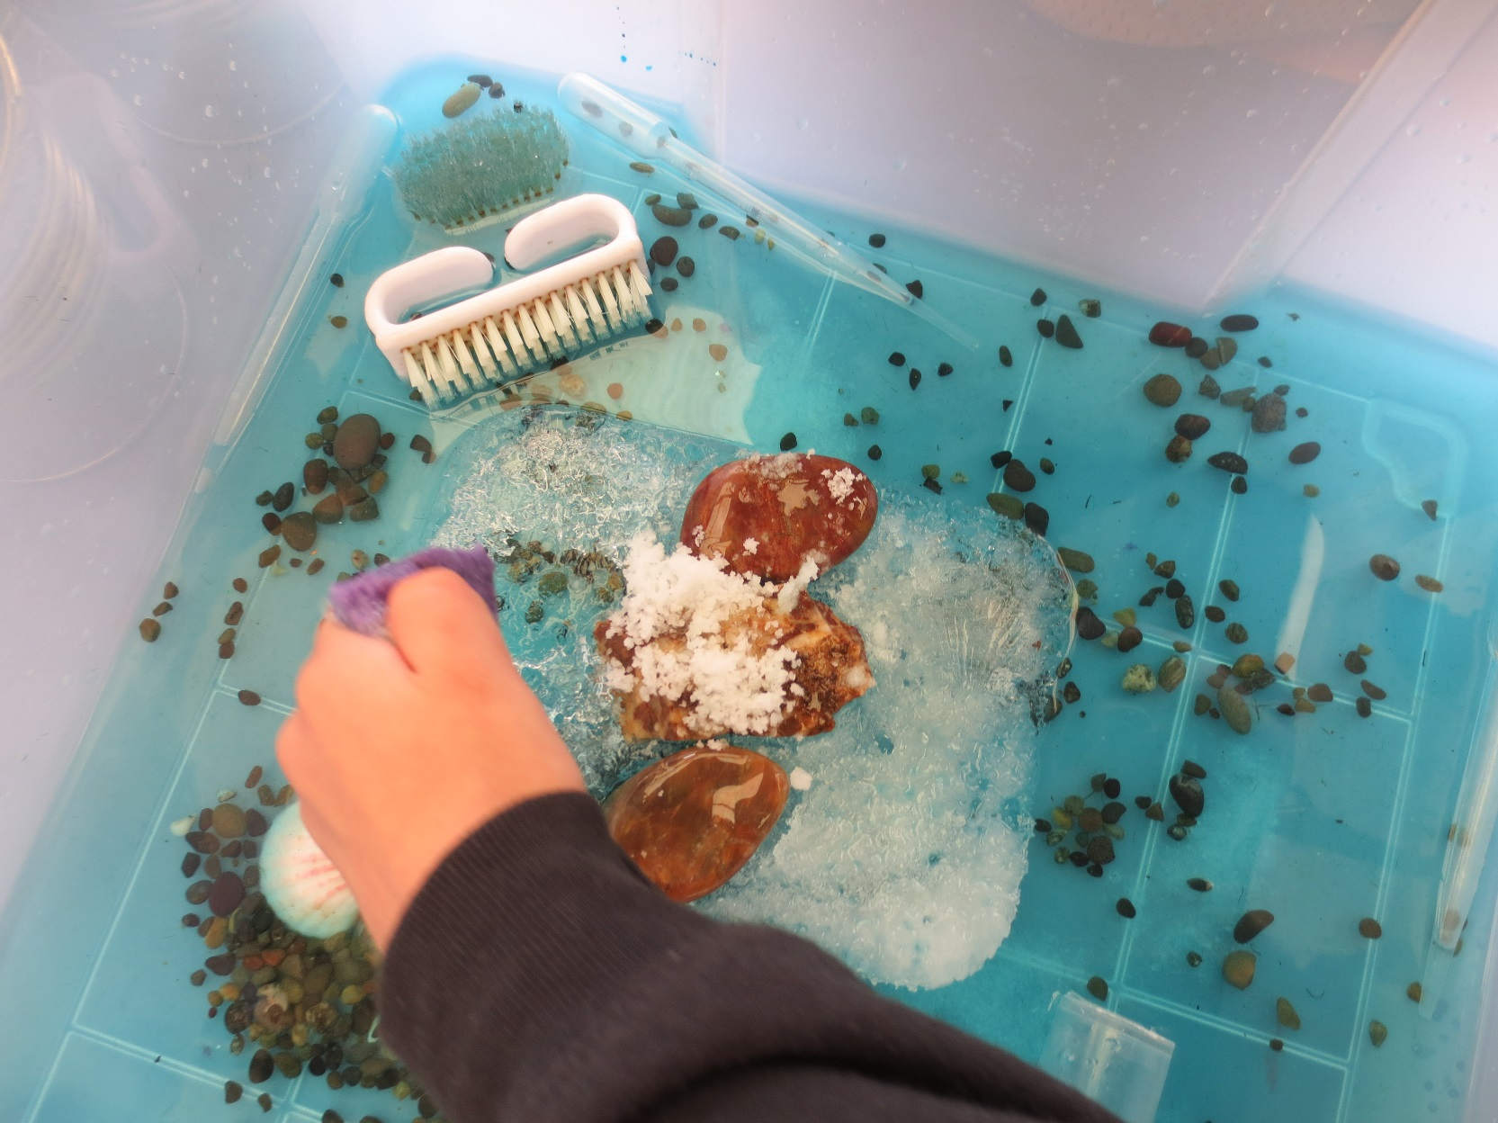
Activity: Ice Exploration

Slide 45


Resources: Register Now for Training
Building Blocks of Creative Thinking
2-Day Training Immersion
September 24 & 25, 2015
Sausalito, CA
Discounted Library Educator Rate: $115
Space is limited!
Cami Gordon: (415) 339-3963 or cgordon@badm.org
CenterforChildhoodCreativity.org/PD
facebook.com/CenterforChildhoodCreativity
@C4Creativity

Slide 46
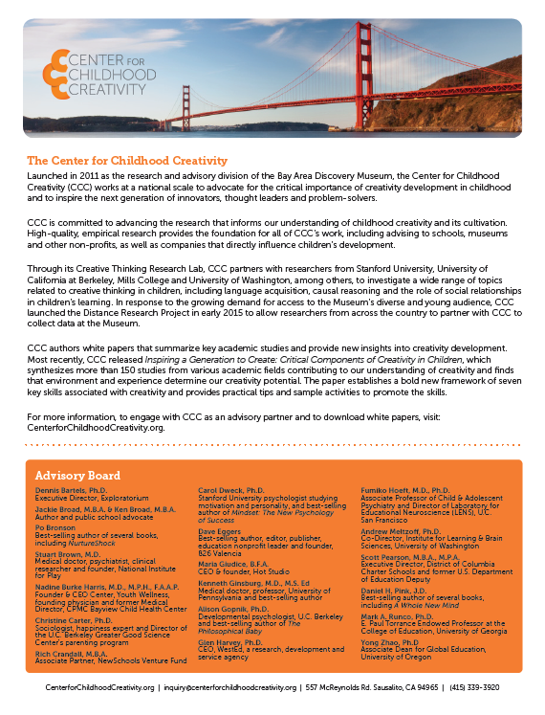
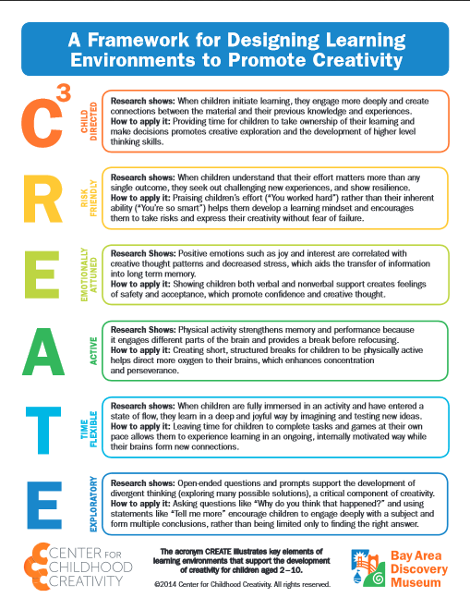

Resources: Research Available Now
facebook.com/CenterforChildhoodCreativity
@C4Creativity

Slide 47
Resources: Research Coming Soon
CenterforChildhoodCreativity.org
Library Educator Resource Kit
School Readiness Research Paper
facebook.com/CenterforChildhoodCreativity
@C4Creativity

Slide 48

Resources: Grants
ALSC grants fund creativity programming in public libraries.
Your library could be one of 77 lucky recipients of a $7,500
grant to encourage creativity for children ages 6-14.
Application Deadline: Friday, September 25, 2015
Questions? Contact ALSC
Ala.org/alsc/curiositycreates

Slide 49
Thank you!
Questions?
facebook.com/CenterforChildhoodCreativity
@C4Creativity

Slide 50

The Early Learning with Families (ELF) 2.0 (http://elf2.library.ca.gov) is supported by the U.S. Institute of Museum and Library Services under the provisions of the Library Services and Technology Act, administered in California by the State Librarian. This material is licensed under a Creative Commons 3.0 Share & Share-Alike license. Use of this material should credit the author and funding source.

