Slide 1
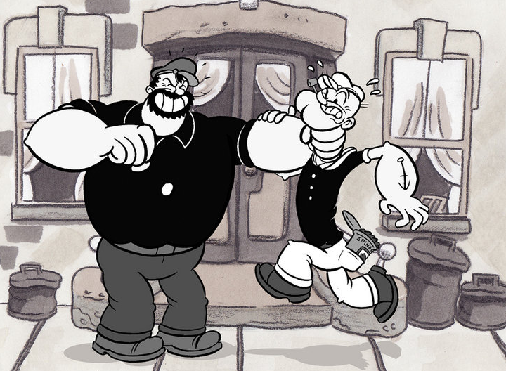
Conflict Resolution Techniques
An Infopeople Webinar with
Joan Frye Williams and George Needham
March 8, 2011

Slide 2

Beware of assumptions

Slide 3
The many flavors of conflict

Slide 4
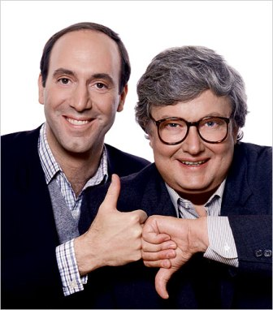
Differences of opinion

Slide 5
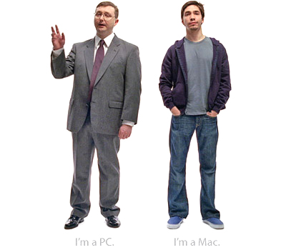
Different value systems

Slide 6

Sudden change

Slide 7
Hidden agendas

Slide 8
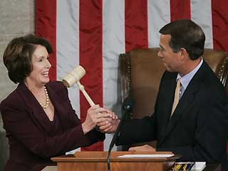
Personalities

Slide 9
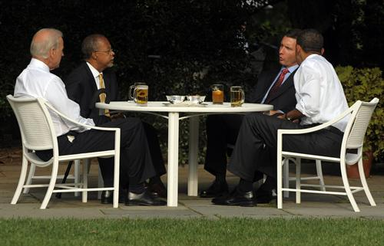
Conflict isn’t always negative

Slide 10
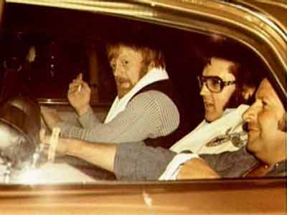
Absence of conflict isn’t always positive

Slide 11

Benefits of successful resolution

Slide 12
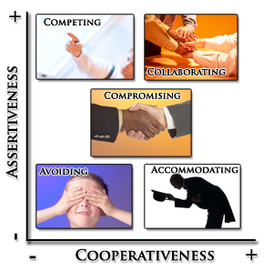
Your response to conflict: TKI
http://tinyurl.com/ThomasKilmann

Slide 13
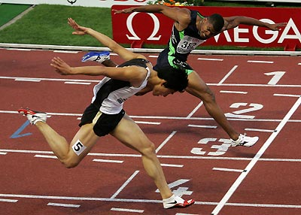
Competing

Slide 14
Accommodating

Slide 15
Compromising

Slide 16

Avoiding

Slide 17
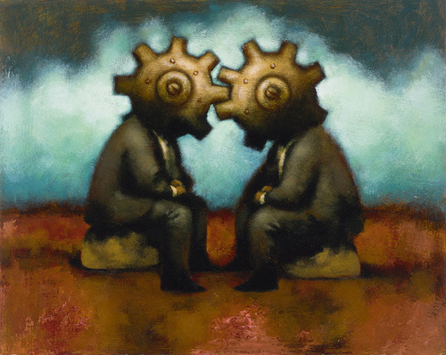
Collaborating

Slide 18

Conflict responses that never work

Slide 19

Ignore the situation

Slide 20
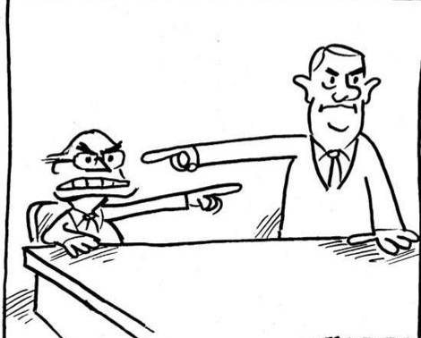
Blame others
Notes:
joan@jfwilliams.com
20

Slide 21
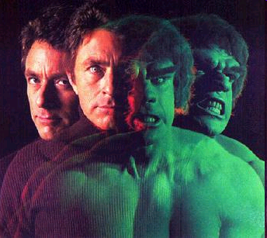
Throw a tantrum

Slide 22
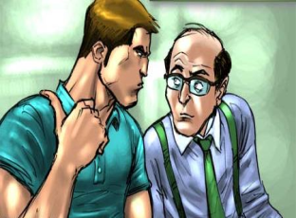
Engage in backbiting

Slide 23

Pout

Slide 24


Overindulge
Notes:
joan@jfwilliams.com
24

Slide 25
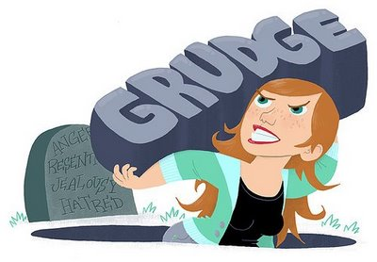
Bear a grudge

Slide 26

Seek revenge

Slide 27

Instead, be a mensch!

Slide 28
Listen actively

Slide 29
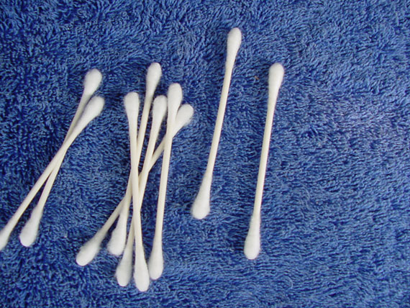
Neutralize emotions

Slide 30
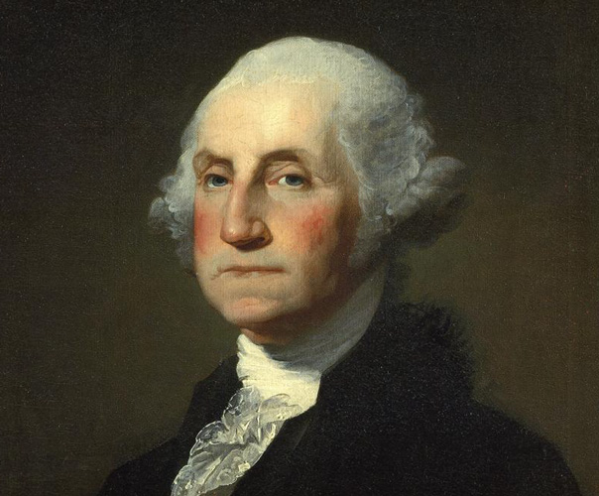
Be honest

Slide 31

Allow the other person to speak

Slide 32
Paraphrase

Slide 33
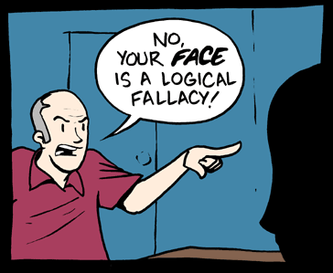
Avoid ad hominem attacks

Slide 34
Conflict resolution step-by-step

Slide 35

Acknowledge differences

Slide 36

Assess the stakes

Slide 37
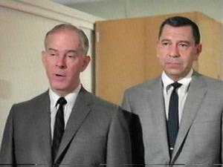
Lay out the facts

Slide 38
Identify your preferred end state

Slide 39
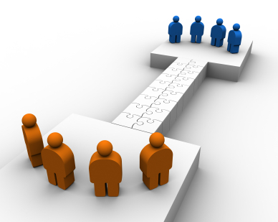
Agree on common ground

Slide 40

Specify points of disagreement

Slide 41


Brainstorm solutions

Slide 42

Negotiate

Slide 43

Take action, then move on

Slide 44

Is it ever OK to re-open a conflict?

Slide 45

Yes…when the situation changes

Slide 46
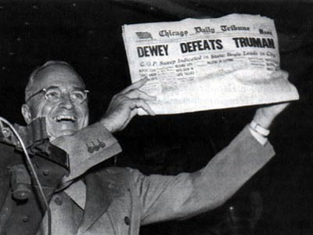
Yes…when new information arises

Slide 47

Yes…when the results don’t match what you expected

Slide 48
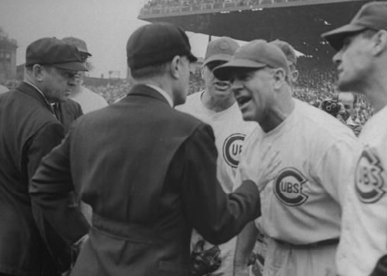
No…when people are just unhappy

Slide 49

No…when people are avoiding responsibility or blocking progress

Slide 50
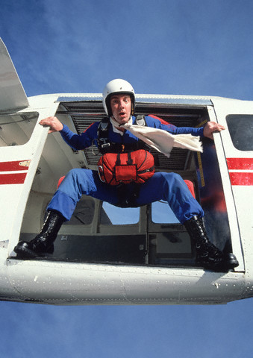
When to let go

Slide 51

Your responsibility: as a supervisor

Slide 52
Your responsibility: as a team member or colleague

Slide 53

Your responsibility: as an individual

Slide 54

Don’t lose sight of the big picture

Slide 55
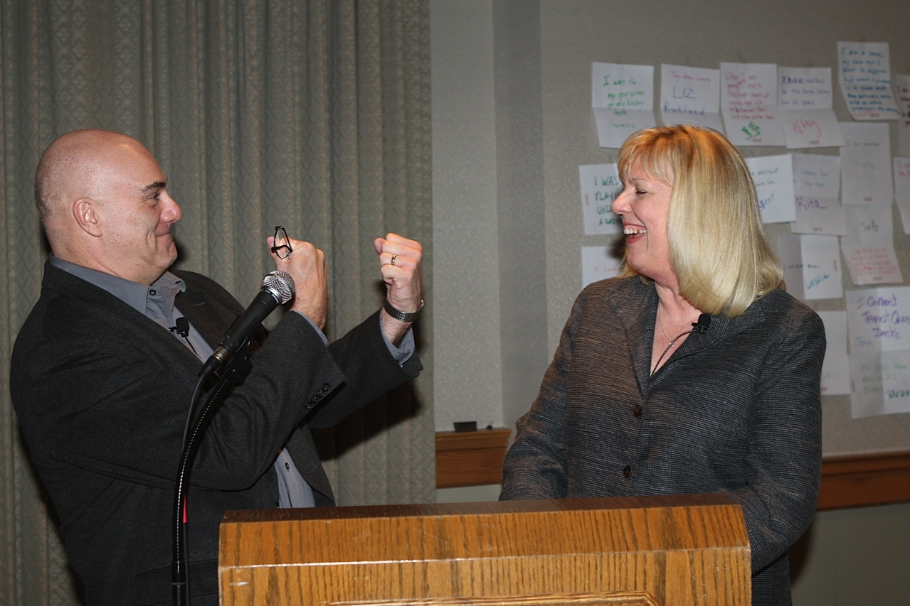
Thanks for participating! http://georgeandjoan.com

