Slide 1


Cross-Training for a Flexible Staff
An Webinar
Presenters: Gail Griffith
Paula M. Singer, Ph.D.
Tuesday, May 17, 2011
12:00 noon to 1:00 p.m.
Infopeople webinars are supported by the U.S. Institute of Museum and Library Services under the provisions of the Library Services and Technology Act, administered in California by the State Librarian.

Slide 2
Agenda
Why cross-train your staff?
Selecting employees for cross-training
Practical considerations
Cross-training for job enrichment and career advancement
Cross-training caveats

Slide 3
POLL: Are you…
Library Director
Other manager or supervisor
Front-line staff

Slide 4
What’s in it for the Library?
Use the chat to brainstorm ideas from a manager’s point of view

Slide 5
Benefits for the Library
Knowledge management
Succession planning
  Plan for retirements
  Respond to younger workers’ desire to build résumés and prepare to move up
Meet customer needs
  Manage family and medical leaves of staff
  Manage tight staffing/hiring freezes

Slide 6
What’s in it for Staff?
Use the chat to brainstorm ideas from the point of view of staff

Slide 7
Benefits for Staff
Challenge
Learning
Résumé builder for internal and external jobs
Improved teamwork

Slide 8
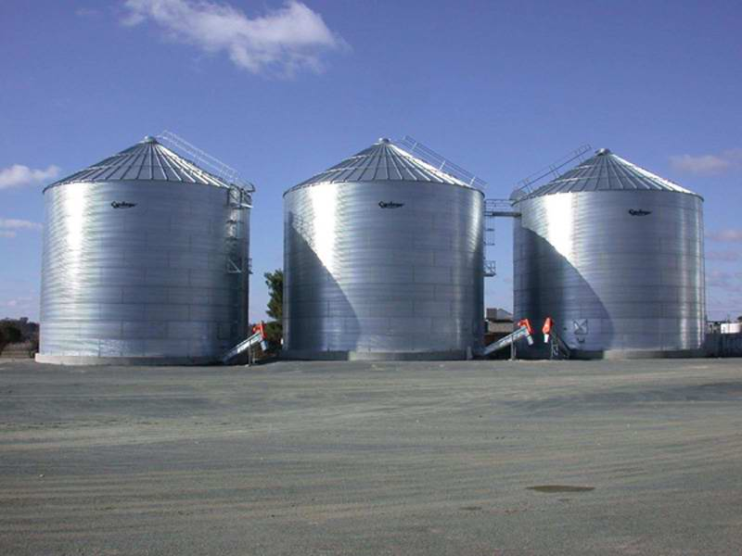
Where to Start?
Current or upcoming job vacancy
Need to correct errors or be more efficient
  Staff need or want to know more about how other departments work
  Staff want others to know what they do
Staff unable to pitch in and serve customers from other departments

Slide 9
People First, or Jobs First?
Your last name begins with A-L
Your last name begins with M-Z
Use the chat window to brainstorm the benefits of using selected PEOPLE to begin your cross-training effort
Watch the brainstorm and think about their reasons.
You’ll have an opportunity to respond in a minute.

Slide 10
Now Let’s Switch
Your last name begins with M-Z
Your last name begins with A-L
Use the chat window to brainstorm the benefits of using selected JOBS to begin your cross-training effort
Watch them brainstorm and think about their reasons.

Slide 11
Selecting Employees for Cross-Training
Where will cross-training get the job done more effectively or efficiently?
Who is likely to be successful?
    Same or similar job classification
    Pilot with champions

Slide 12
Examples
Children’s and Adult Services librarians
  Goal vs. mandate (Carroll County, MD)
Structured and scheduled job enrichment opportunities
  Voluntary, open to all levels (Yale University Library)
Core and Elective Continuing Education (Tulsa, OK)
  Handout #1: Cross Training as Continuing Education

Slide 13
Poll: Which Job Pair?
Choose a job pair you’re familiar with. We’ll use it in some examples.
Adult and Children’s Services librarians
Circulation and Technical Services clericals
ILL and Digitization paraprofessionals

Slide 14
Practical Considerations
Handout #2: Notes for Developing a Cross-Training Plan
Be clear about why
  Promoting understanding, or making lasting changes?
Tell staff what to expect: who, why, how, and when!

Slide 15
What Will Staff Learn?
Determine core functions of the jobs in which staff will be cross-trained
What is the depth of training needed?
What will success look like?
Staff involvement is key to getting it right

Slide 16
What Needs to Happen?
Determine what training resources already exist
  Handout #3 is an example of a checklist to help Adult librarians being cross trained in Children’s
Decide who is responsible and accountable for training
Provide opportunities to practice new skills
Update job descriptions and performance management tools

Slide 17
Opportunities for Staff
If you want to provide career development opportunities for staff, what else might be important?
Use chat to tell us what you think

Slide 18
Cross-Training for Job Enrichment and Career Advancement
What might be important?
  Develop a structure so it actually happens
  Can promise the opportunity to learn, have their work seen by others, and become a strong competitor for promotion (vs. promising a promotion)

Slide 19
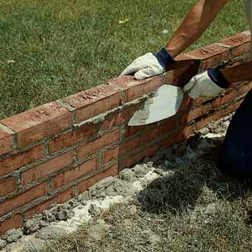
Barriers to Cross-Training
Last name begins with M-Z
Last name begins with A-L
Use the chat window to brainstorm as many barriers to cross-training as you can think of
Think about those barriers, because you’ll have a chance to respond in a minute.

Slide 20

Remove Those Barriers!
Last name begins with A-L
Last name begins with M-Z
Use the chat window to brainstorm as many ways around those barriers as you can.
Watch to see how many of the barrier-busting strategies you agree with!

Slide 21
Cross-Training Caveats
Stay within the jobs’ scope and level of responsibility
Work within union agreements
Avoid the appearance of favoritism
Keep communicating and listening

Slide 22
Q&A
Notes:
While you fill out the evaluation on your screen, I’ll begin answering any questions you’ve submitted via chat.

Slide 23
Web Links
Two examples of academic library programs
  Yale University Library Cross Training Initiative for Library Staff: www.library.yale.edu/training/stod/xtrain/crosstraining.html
  Cross Training for Professional Development—Dartmouth College: www.dartmouth.edu/~library/home/committees/.../crosstraining%20final.doc

Slide 24
Thank You!
Paula M. Singer, Ph.D.
The Singer Group, Inc.
pmsinger@singergrp.com
Gail Griffith
gail-griffith@comcast.net

