Slide 1
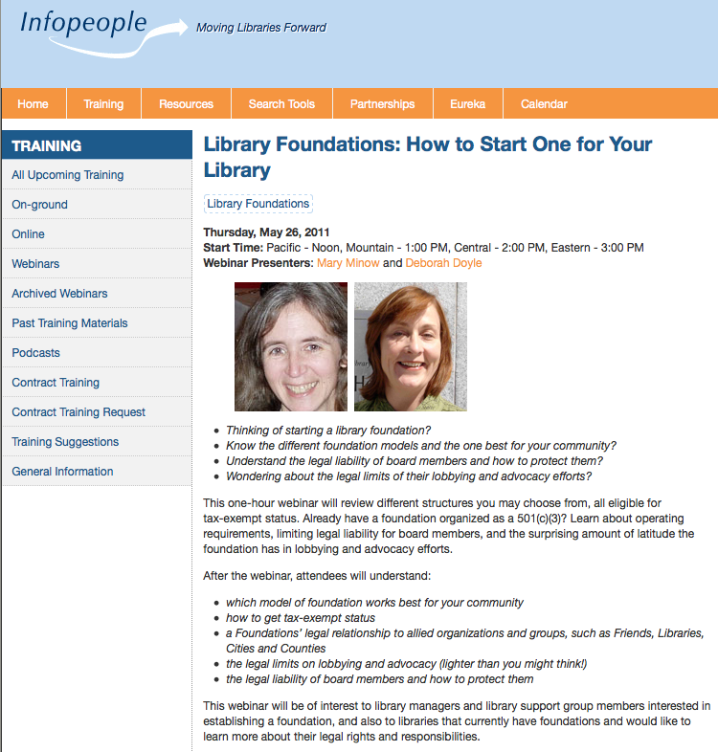

Slide 2
Legal Disclaimer
Legal information
Not legal advice!

Slide 3
Agenda
Starting a Library Foundation
State Requirements
Federal Tax Exempt Status
Ongoing Legal Requirements and Liabilities
Friends and Others

Slide 4
1. Start a Library Foundation?
Goals and objectives
Community support

Slide 5
Legal Structure – know your type
Public charities (best tax treatment) and private foundations
Most library foundations are public charities. Must have broad public support.
(Roughly one-third of dollars must come from general public or govt.)
See IRS Publication 557 (Nov. 2010) p. 29 http://www.irs.gov/pub/irs-pdf/p557.pdf
Since 2008, easier to establish public charity status. IRS Form 1023 Part X; 990 Sch. A
Trust or incorporation
Trust: fewer requirements (meetings, filings) but not as adaptable as circumstances change
Articles of incorporation, bylaws, meetings, greater protection from personal liability, greater adaptability (amend bylaws)
Community Foundation
less work, less control
… don’t forget contributions directly to library are tax-deductible I.R.C. Sect. 170

Slide 6
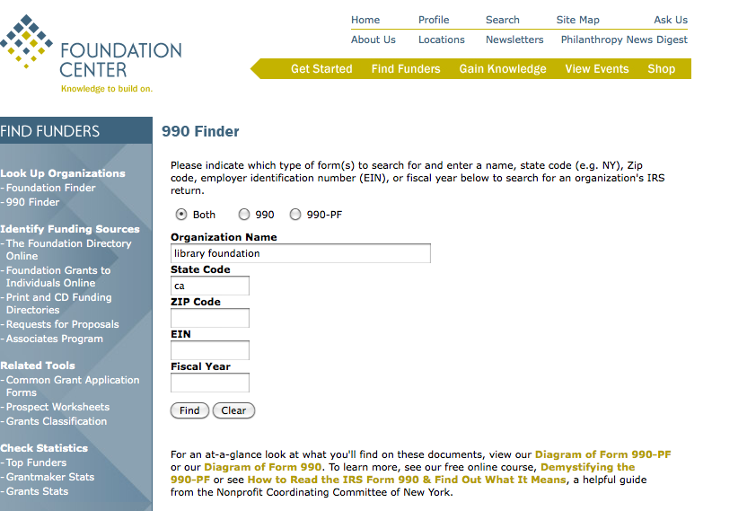
Foundation: Find Library Foundations
Search 990s
“library foundation” CA
Fewer than 5% were
private foundations
http://tfcny.fdncenter.org/990s/990search/esearch.php/

Slide 7
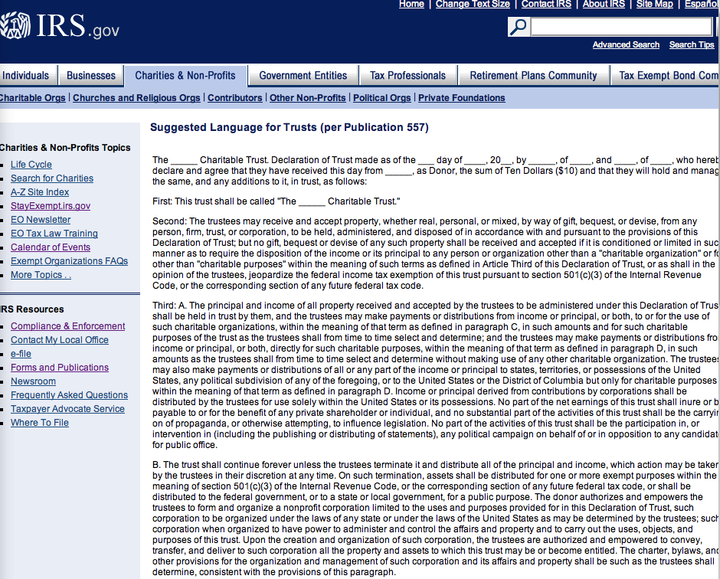
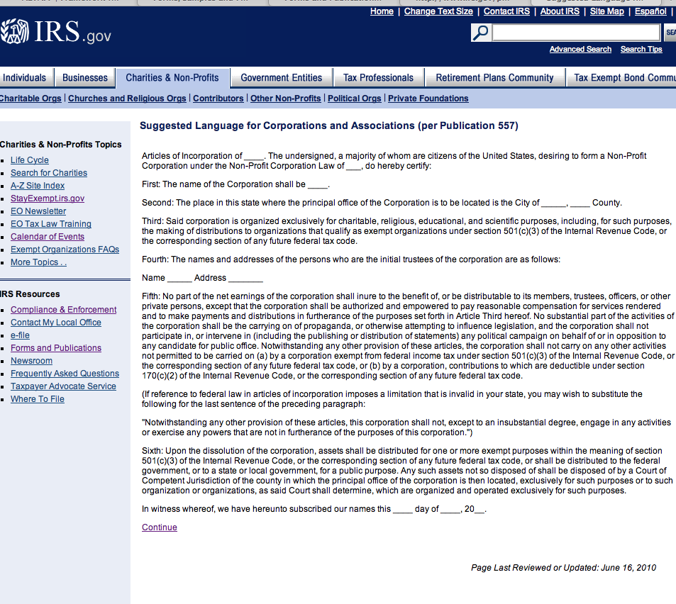
IRS Suggested Language for Trusts, Corporations
http://www.irs.gov/charities/article/0,,id=96110,00.html
http://www.irs.gov/charities/article/0,,id=96117,00.html

Slide 8
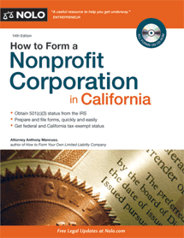
2. California State Requirements
Name http://www.sos.ca.gov/business/be/name-availability.htm
Articles of Incorporation
Bylaws – officers
membership v non-membership
State tax exemption
Insurance
Forms
May 2011, 14th Edition

Slide 9
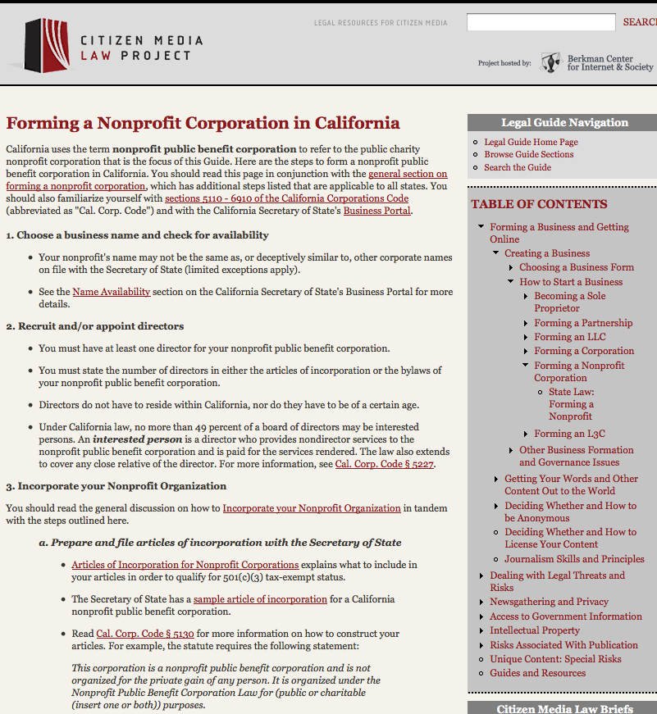
Thorough California checklist with links
http://www.citmedialaw.org/legal-guide/california/forming-nonprofit-corporation-california

Slide 10
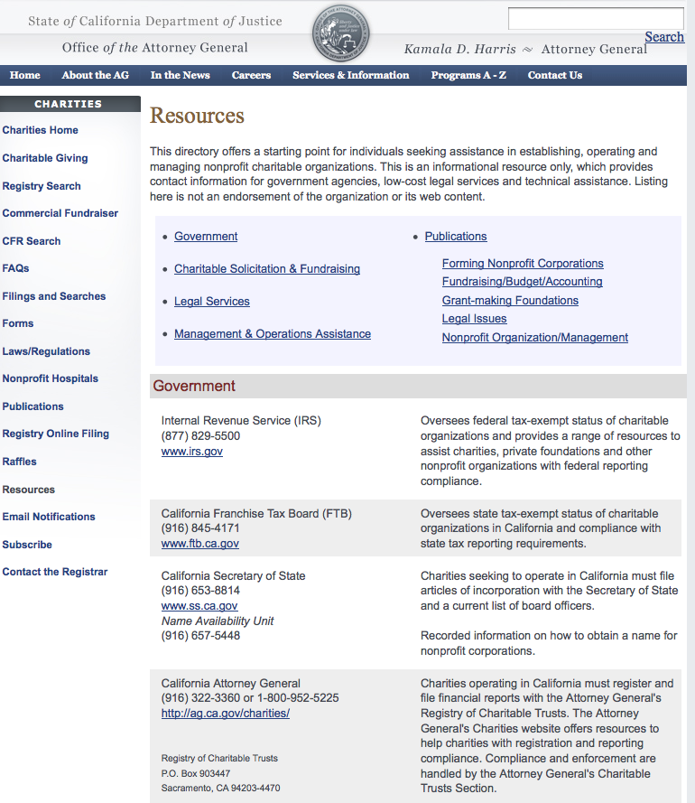
Attorney General
Referrals to
legal services
nonprofit assns
http://ag.ca.gov/charities/resources.php

Slide 11
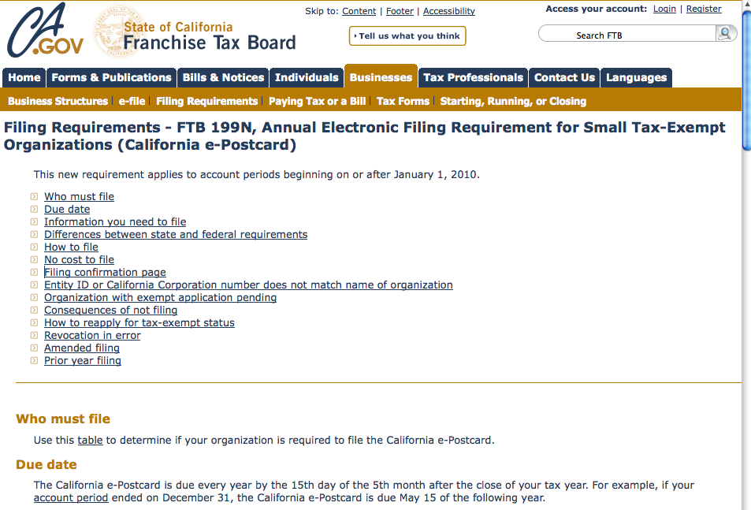
http://www.ftb.ca.gov/businesses/bus_structures/Filing_Requirements_Form_199N.shtml

Slide 12
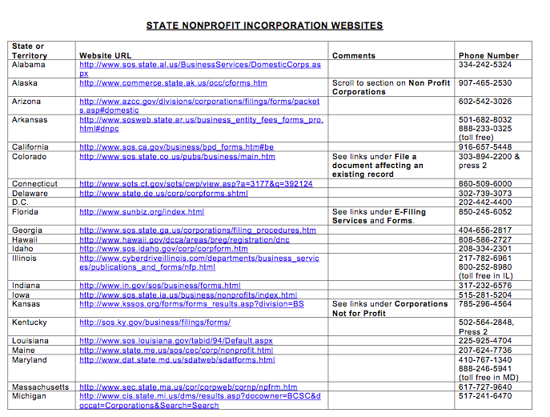
Other States
http://www.irs.gov/charities/article/0,,id=167760,00.html

Slide 13
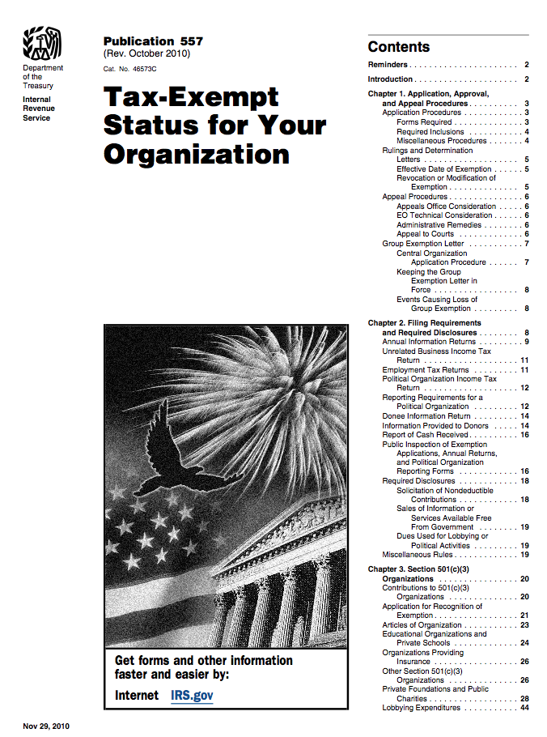
3. Federal Tax Exempt Status
http://www.irs.gov/pub/irs-pdf/p557.pdf

Slide 14
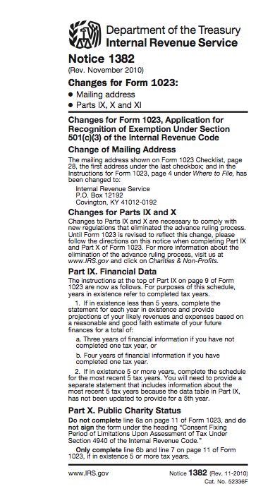
Get Employer Identification Number (EIN) even if no employees (800) 829-4933
Then Form 1023
Application for Recognition of Exemption
http://www.irs.gov/pub/irs-pdf/f1023.pdf

Slide 15
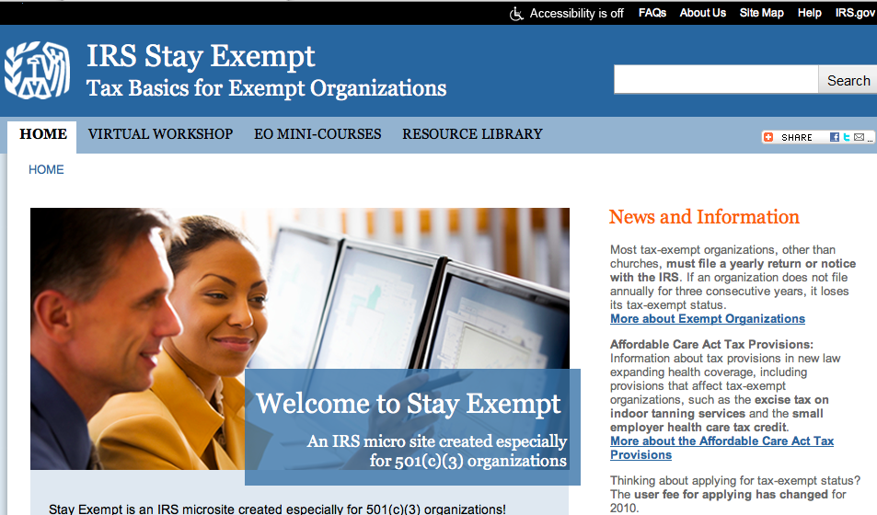
http://www.stayexempt.irs.gov/

Slide 16
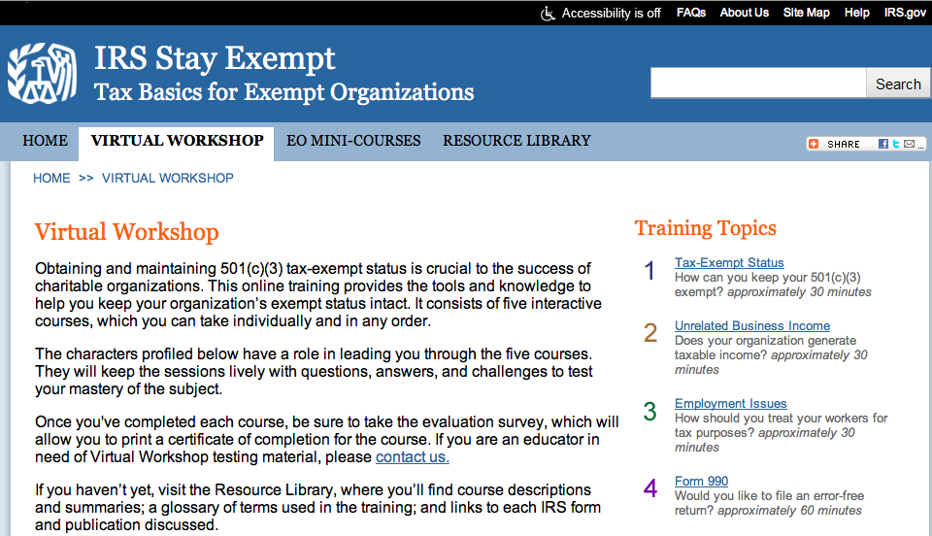
http://www.stayexempt.irs.gov/VirtualWorkshop.aspx

Slide 17
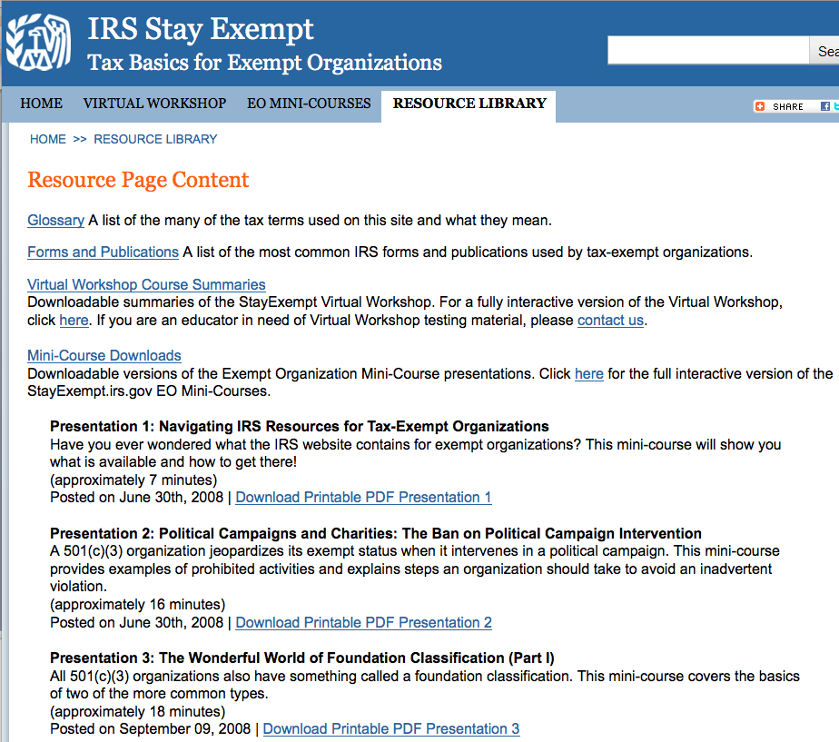
http://www.stayexempt.irs.gov/ResourceLibrary.aspx
Mini-presentations avg 15 min
Understandable
Podcast, pdf, ppt

Slide 18
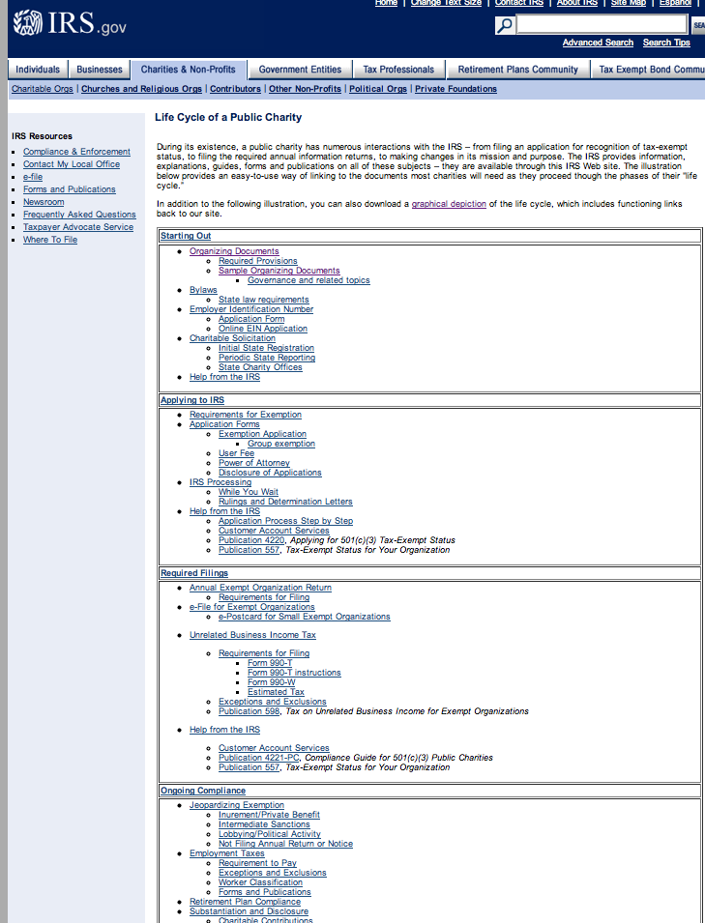
http://www.irs.gov/charities/charitable/article/0,,id=122670,00.html

Slide 19
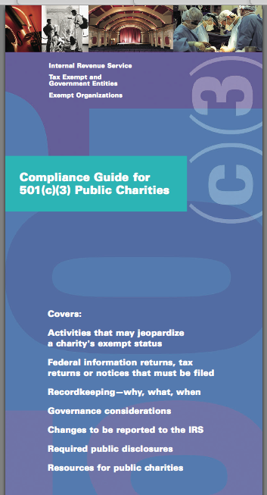
4. Ongoing Requirements and Liabilities
recordkeeping
reporting
disclosure
activities that could jeopardize status:
private benefit
political candidates
http://www.irs.gov/pub/irs-pdf/p4221pc.pdf

Slide 20
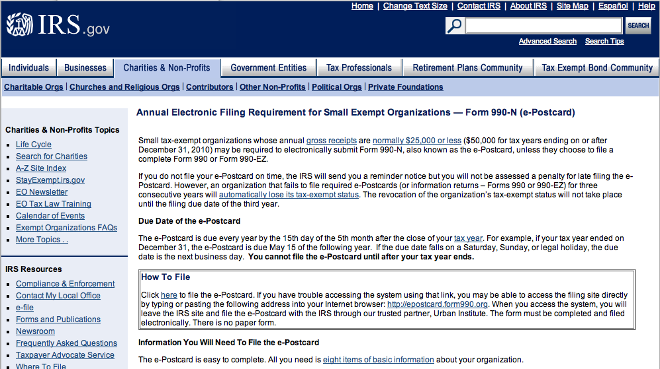
Annual Filing 990, 990-EZ or 990-N
http://www.irs.gov/charities/article/0,,id=169250,00.html

Slide 21
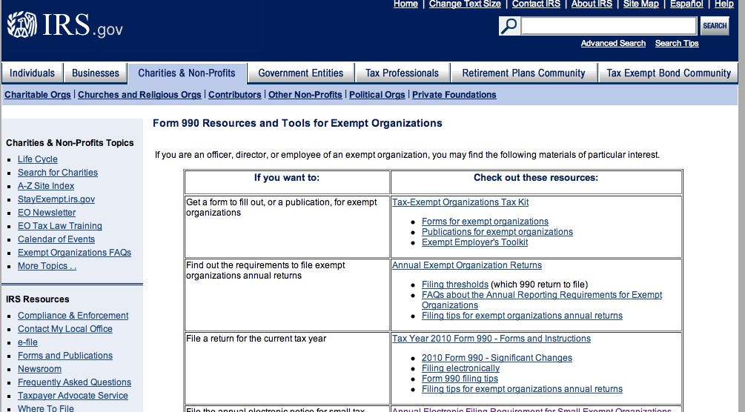
http://www.irs.gov/charities/article/0,,id=214269,00.html

Slide 22
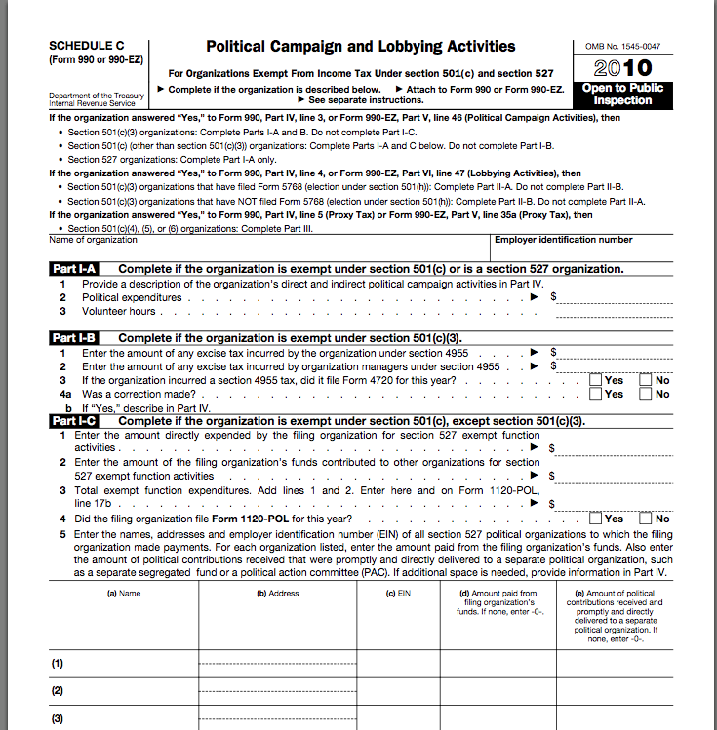
Campaign and Lobbying Activities
Absolute prohibition campaigning for political candidates
but leeway with lobbying to influence federal, state, local legislation
http://www.irs.gov/pub/irs-pdf/f990sc.pdf

Slide 23
Substantial Part Test
Based on variety of factors – time devoted (by both compensated and volunteer workers) and expenditures
Penalty: lose tax exempt status for taxable year plus excise tax of 5 percent of lobbying expenditures may be imposed against officers or directors who authorized

Slide 24
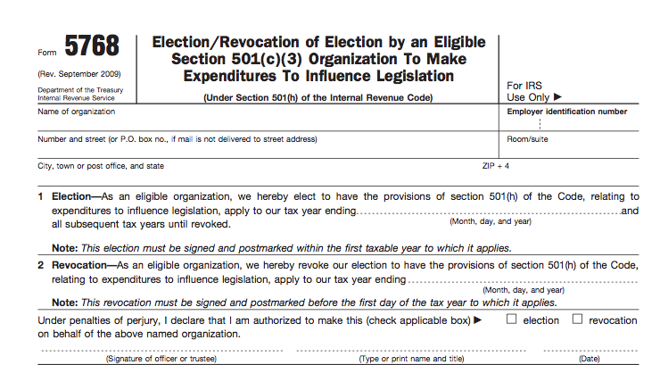
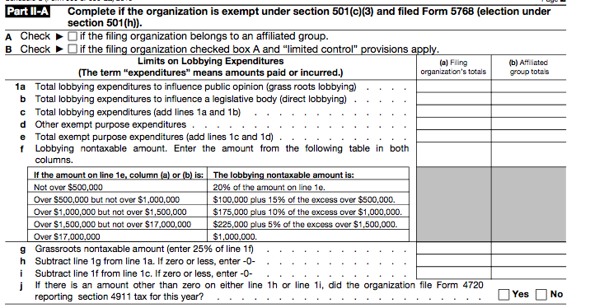
Expenditure Test (much better!)
Also known as 501(h) election
Form 990 Schedule C
Form 5768
http://www.irs.gov/pub/irs-pdf/f5768.pdf
http://www.irs.gov/pub/irs-access/f990sc_accessible.pdf
Penalty: 25% excise tax on obbying expenditures that exceed limits
May lose tax exemption for four years if 150% of the limit

Slide 25
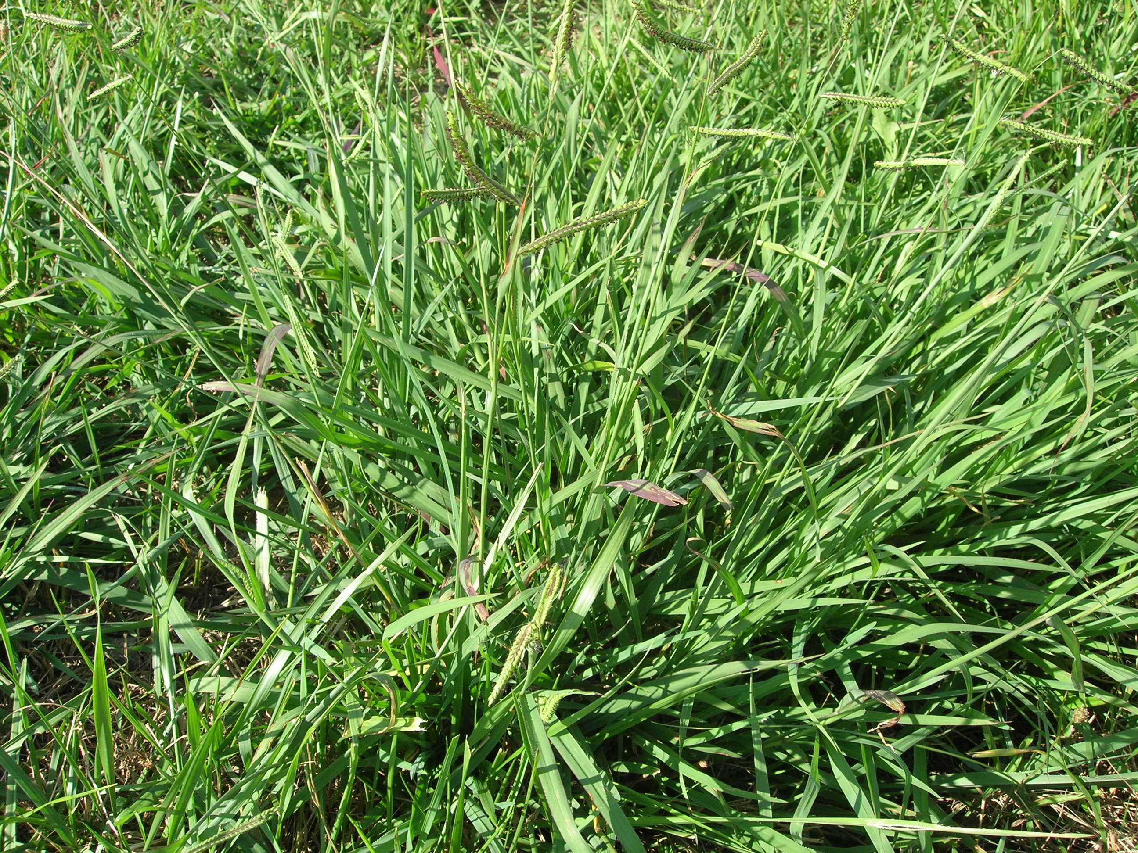
Direct and Grass Roots Lobbying
Direct lobbying
- attempts to influence a legislator
Grass roots lobbying - encourage the public to take action with respect to legislation

Slide 26
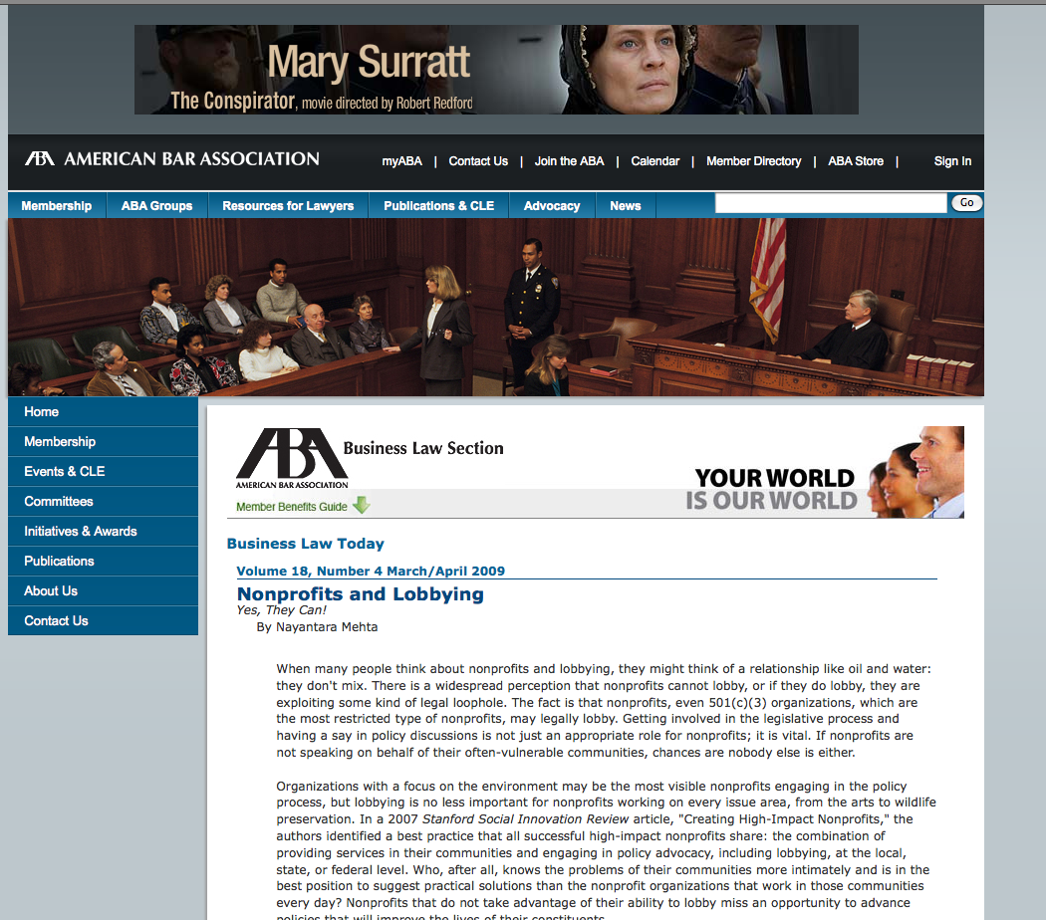
Lobbying v Advocacy
Conversation with legislator could be either
Advocacy (UNRESTRICTED $) includes educating policymakers and public about broad issues and candidate positions
http://apps.americanbar.org/buslaw/blt/2009-03-04/mehta.shtml

Slide 27
“EXPRESSLY ADVOCATES”
Words such as
'vote for‘
'elect‘
'support'
'cast your ballot'
'vote against'
'defeat'
'reject'
'sign petitions for'
or otherwise refers to clearly identified candidate or measure
… communication, taken as a whole unambiguously urges particular result in election
Cal. Code of Regs., tit. 2, § 18225(b);
Vargas v. City of Salinas, 135 Cal. App. 4th 361 (2005); reh. den. Jan. 26, 2006

Slide 28
Directors and Officers Liability Insurance
No personal liability for volunteer directors due to negligence if:
1) within scope of duties
2) good faith
3) not reckless, intentional, grossly negligent
4) liability insurance (general liability, director’s and officer’s liability policy or personal insurance) OR
made all reasonable efforts in good faith to obtain*
*if less than $25K annual budget and tax-exempt, satisfied by making one inquiry/year for less than 5% of annual budget
California Corporations Code Sect. 5239

Slide 29
5. Friends and Others
Relationship with
Friends
Library Commissioners or Trustees
Library Administration
City, County or other Officials

Slide 30
Questions?
Thanks for making it to the end!

