Slide 1
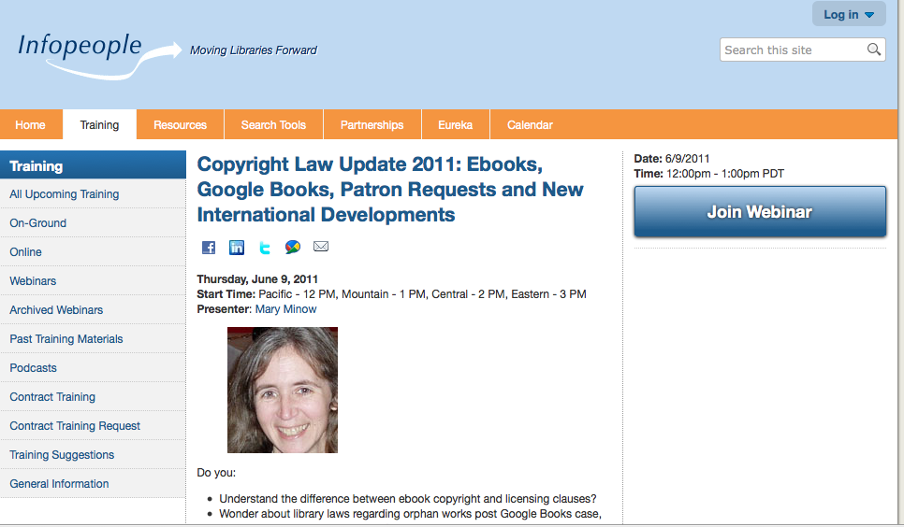

Slide 2
Legal Disclaimer
Legal information
Not legal advice!
Notes:
http://microgravity.grc.nasa.gov/6712/webpics/handshake.GIF

Slide 3
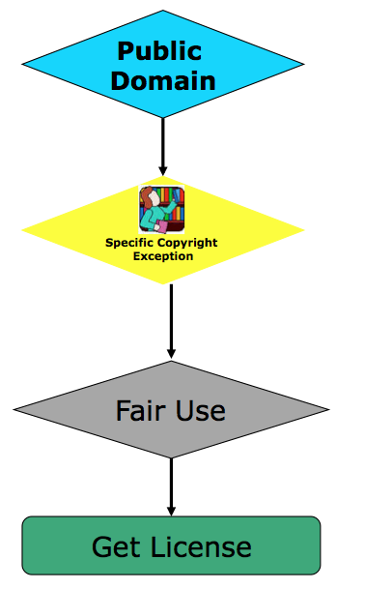
Agenda
Copyright Analysis
Ebooks
Legal Framework
Print disabled
Lending
Google Book search and orphan works
More Cases and legislation
User generated content
E-reserves (Georgia State)
Sound recordings (pre 1972)
Public domain (Golan v. Holder)
International
Print disabled
Library
Traditional cultural expression
Notes:
Copyright Analysis

Slide 4
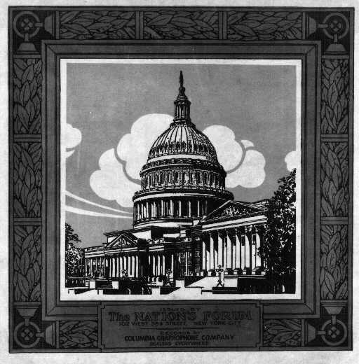
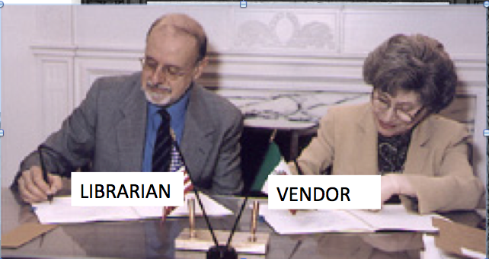
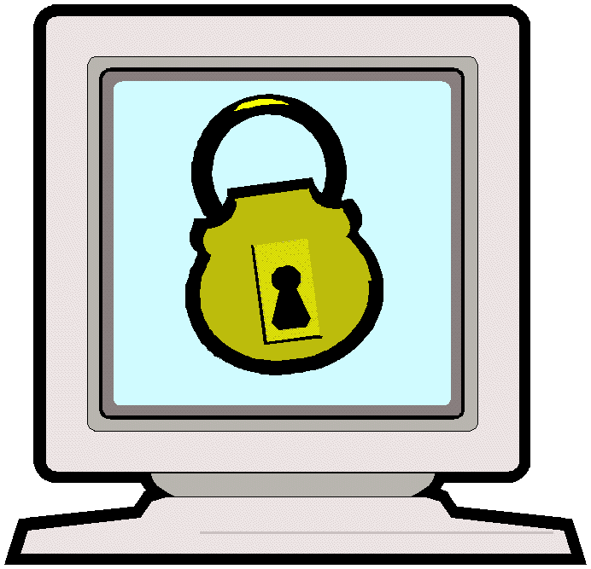
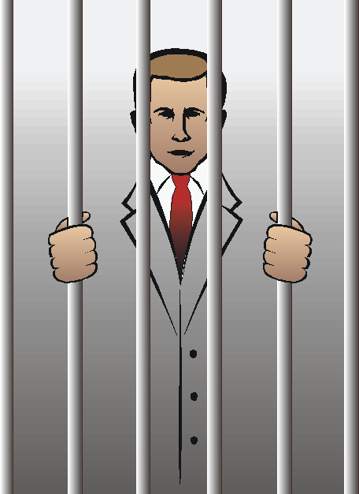
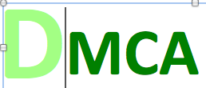
Ebooks Legal Framework Control Content – not just Copyright
Physical (old days – physical books)
Copyright
can override copyright
can be illegal to tamper with DRM
Programmer arrested at conference after speech on hacking ebooks DRM
(2001) For violating Digital Millennium Copyright Act. Acquitted.
Notes:
http://www.cdc.gov/ncidod/diseases/hanta/images/hv119m.jpg
Can override copyright

Slide 5
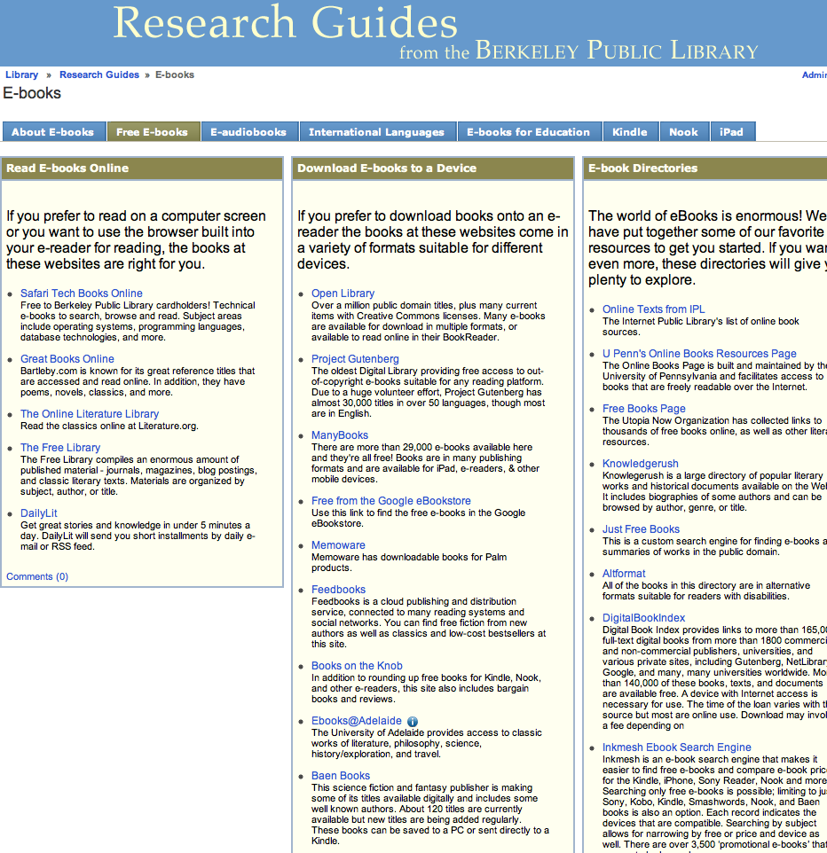
Copyright: Public Domain and ebooks
No restrictions
2 million at OpenLibrary.org
http://berkeleypubliclibrary.libguides.com/content.php?pid=175015&sid=1473142

Slide 6
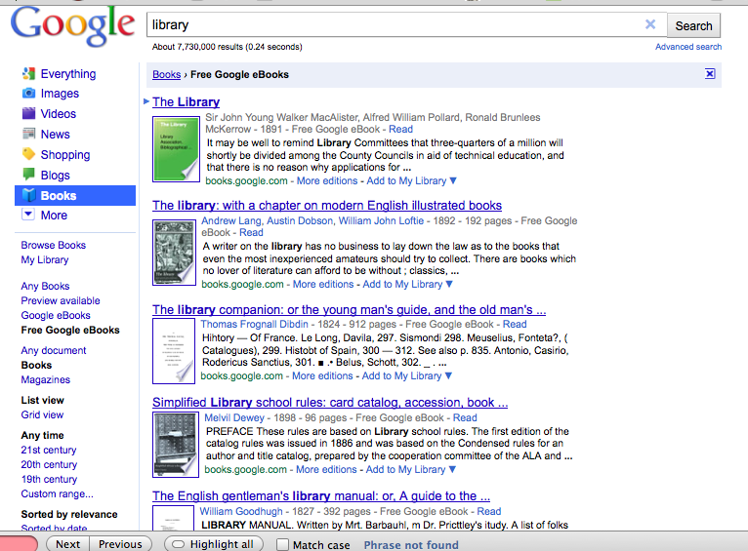
Go to Google, click on books to get to “Free Google eBooks”
Notes:
Go to google, click on books
TO DOWNLOAD .. Pdf epub sometimes other formats
Here's the answer, which has worked for me at this moment in twelve successive instances. Starting with a free ebook title in any of your categories (To Buy, My Google Ebooks, Purchased, Reviewed, etc.) click on the title and then click on the "Read now" button. Then click on the "i" (About this book) icon in the upper right hand corner. In the "About this book" pop-up screen, click on the word "change" that follows to the right of the words "In my library." You will be faced with a list of options. Choose "To read" and click on that button. Then go back (hitting your browser's "back" button several times) until you get to your "My Library" page, the one with your avatar on the upper left. Go down to the "My Library" listing of subgroups on the left side and click on "To read." When the "To read" contents page comes up, click on the title of the book you've just shifted into the "To read" category. To the immediate right of the book illustration or cover on the lefthand side should be the words: "Preview this book." Click on it. And then, on the righthand side at approximately the middle of the page, you'll see the word "Download." Click on it. You may or may not get a choice of formats, but at the least there should be a PDF download available. Click on the "PDF" button and then do as you normally do with a download on your particular browser. By the way, one reader seemed to say that the "preview" feature does not work if you're running IE9 on W7. That's not true. I'm running IE9 on W7 and, as stated, have been able to download twelve successive free ebooks from Google Books using the above steps.

Slide 7
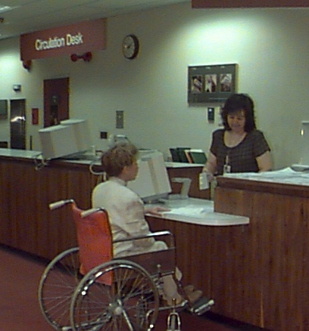
Copyright Law: Specific Provision (Section 109) allows Libraries & Friends to:
Loan books
Sell used books
also known as
“First Sale” doctrine
…the owner of an authorized copy may sell or otherwise dispose of…
17 U.S.C. Sect. 109
Notes:
http://www.nlm.nih.gov/share/image/circ_desk.jpg
17 U.S.C. Sect. 109

Slide 8
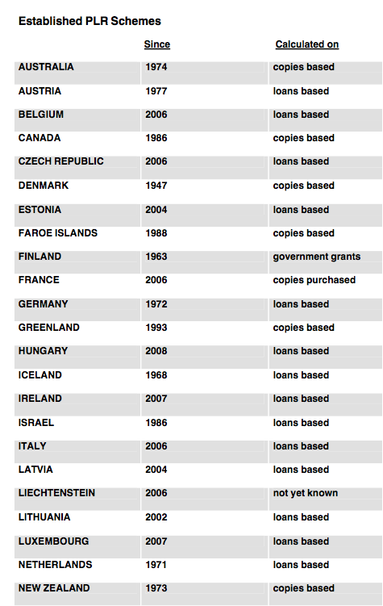
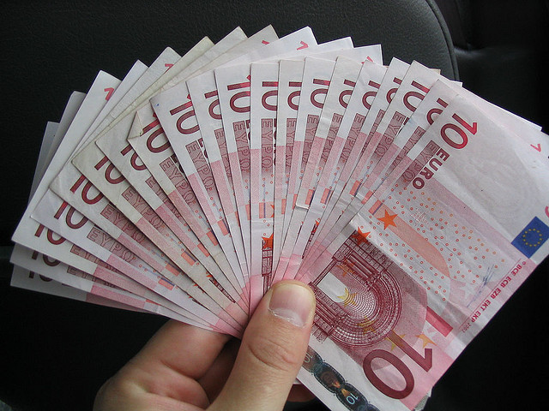
Not everywhere.
Public Lending Right
Public Lending Right = libraries pay authors when books are loaned
Euros © Will Spaetzel 2004. Some Rights Reserved. Attribution-NonCommercial-ShareAlike 2.0 Generic www.flickr.com/photos/redune/5073664/
Notes:
The two main methods of ◊calculation are as follows: (a) payment on the basis of how often an author’s works are lent out; and (b) payment per copy of an author’s work held in libraries

Slide 9
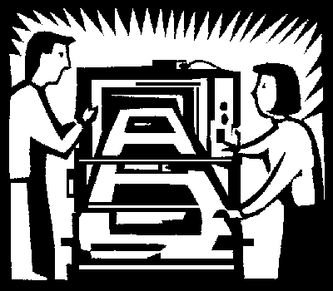
Recent Interpretations of First Sale (2010) favor rights holders
Does not apply to copies manufactured abroad
May libraries lend books manufactured abroad?
Library Content Alliance memo says likely YES
Specific allowance of five copies for educational purposes 17 U.S.C. Sect. 602(a)(3)(C)
Allowance for books bought in U.S.
(Drug Emporium )
Implied license and fair use
1. Costco v. Omega (Supreme Court 2010)
The Impact of the Supreme Court’s Decision in Costco v. Omega on Libraries, Library Content Alliance memorandum by Jonathan Band (February 2011)
http://www.arl.org/news/pr/costcoupdate31jan11.shtml
Notes:
http://www.epa.gov/dfe/images/flex-case1-image/endofpress.gif
“lawfully made under this title”
First sale doctrine critical to operation of libraries
Costco – discount retailer, sold swiss made omega watches without permission of omega or us distributor
Costco purchased in europe and imported
Omega then engraved design of a globe on back of watch and registered design
Omega sued costco for infringing its importation and distribution rights
Costco – defense – first sale
Omega – said didn’t apply to copies manufactured abroad
Ninth Circuit agreed! Ruled first sale doesn’t apply to the designs engraved in switzerland
Library Copyright Alliance, ALA, ARL< SCRL – filed amicus support of Costco, arguing threatened ability of libraries to lend materials
US publishers now print an increasing number of books in China and other countries to lower labor costs
Copyright law treats importation as a form of distribution, so this could limit libraries ability to import materials manufactured outside US
http://harare.usembassy.gov/uploads/TR/XM/TRXMlfBHjectuVuMbrkLDw/Library_Usersdesk.jpg
http://www.arl.org/news/pr/costcoupdate31jan11.shtml
Library Copyright Alliance Releases Paper on Impact of Costco v. OmegaWashington DC—The Library
Copyright Alliance today released “The Impact of the Supreme Court’s Decision in Costco v. Omega on Libraries.” Prepared by Jonathan Band, the concise, informative paper examines the much-discussed Costco v. Omega non-decision, which left in place a controversial 9th Circuit ruling that could have significant consequences for library lending practices.The first sale doctrine lets purchasers of lawful copies of copyrighted works re-sell, donate, lend, or otherwise dispose of their copy. If not for first sale, or some other balancing exception, copyright holders could ban purchasers from all of these practices, essentially controlling how individuals or institutions such as libraries use cultural products that they own.In his analysis, Band explains that libraries are still on sound footing in lending foreign-made copies in their collections. He gives a range of alternative justifications for lending that should cover the vast majority of situations that institutions face on a regular basis:For libraries in the 9th Circuit, first sale still applies if a foreign-made copy was sold domestically by an authorized party. Libraries in other circuits can also rely on the Ninth Circuit's Drugstore Emporium exception. The §602(a)(3)(C) provision for importation by scholarly, educational, and religious organizations should make it possible to lend materials lawfully imported for the purpose of lending.Implied license and fair use are powerful and flexible doctrines that should capture many library uses.To download a copy of the paper, please visit http://www.arl.org/bm~doc/lcacostco013111.pdf.
Drug Emporium exception – (cite in memo)(9th cir 1991)
Lets parties raise First Sale defense in cases with foreign manufactured copies so long as an authorized domestic sale occurs – i.e. if publisher authorizes import and sale, library purchase have first sale rights
But limits – applies only to copies purchased IN the US. Libraries or agent spurchase books directlly from foreign publishers/distributors
Library would need to maintain records that it purchased in US
Also, case lacks clear statutory basis… in fact a district court in NY has questioned its validity (cite in memo)
Taken together, Drug Emporium and 602(a)(3)(C) cover vast majority of copies in us libraries… but gap wrt lending two categories of foreign manufactured copies without an authorized comestic sale: copies of audiovisual works
Copies of other kinds in excess of five copies
FILL GAP
IMPLIED LICENSE – say library purchases direct from publisher or exclusive distributor that knows purchaser is library – argue that knew library intended to lend… without explicit prohibition, consent (assuming retailer had legal authority to grant license to lend)
FAIR USE – library lending identified purposes criticism comment news reporting teaching scholarshpu or rsearch
Library lencing also purpose character in first factor - nonprofit educational purposes. ABSENCE in US of LENDING LICENSES indicates lending liesne does not constitute a traditional market for purposes of fourth factor –
Additionally, library lending facilitiates users exercise of their First Amendment right to receive information (me – weak!)
400 year tradition of libraries lending books and materials and privileged status congress has accorded ibraries in title 17, buttress argument that it’s a fair use
Apply even more when rightsholder doesn’t distribute work in US

Slide 10
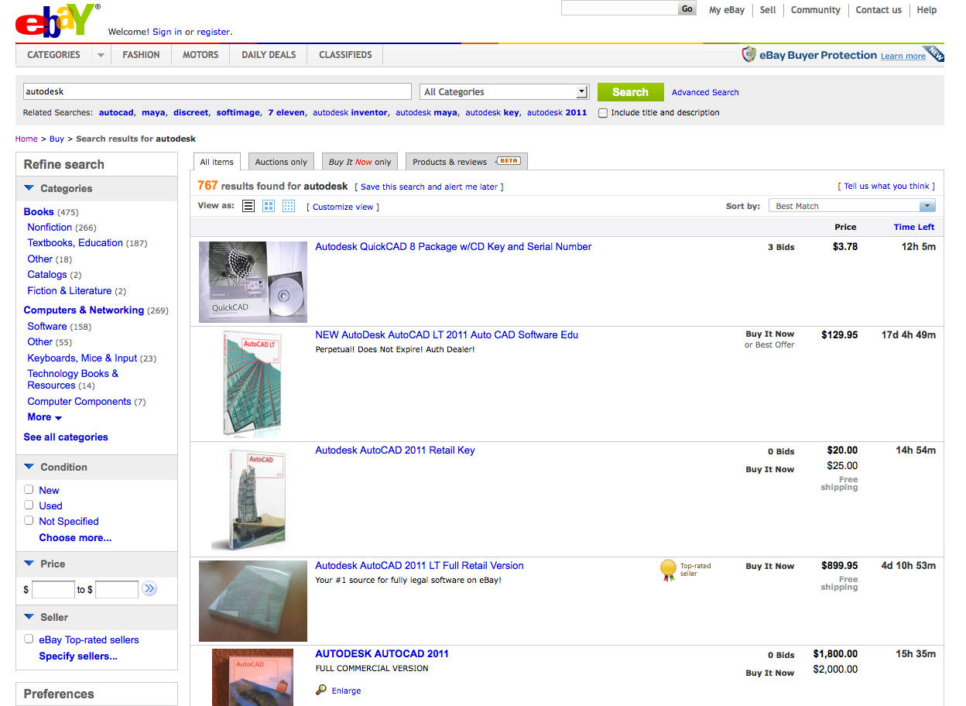
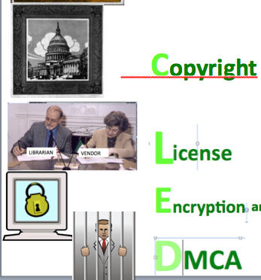
License Trumps Copyright
2. Vernor v. Autodesk (9th Cir. 2010)
Owning physical copy of software doesn’t mean you own the software. A license, not a sale.
Man bought sealed software at garage sale and then sold it on eBay. Sued by licensor. Man lost.
LIBRARIES? Even if someone donates a “used” ebook, license likely to prevail. Limits uses.
Vernor v. Autodesk, 2010 U.S. App. LEXIS 18957 (9th Cir. Wash. Sept. 10, 2010)
Notes:
See also http://blog.ericgoldman.org/archives/2010/09/vernor_v_autode.htm

Slide 11
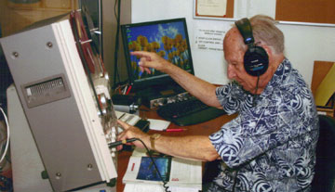
Patrons with Print Disabilities Copyright specific exception (Section 121)
”Chafee amendment”
Authorized entity
may copy and distribute
published works
(except plays)
specialized format
notice of no
further distribution
Library of Congress Fact Sheet http://www.loc.gov/nls/reference/factsheets/copyright.html 17 U.S.C. Sect. 121
Notes:
http://www.loc.gov/nls/newsletters/news/2010/images/bob_roberts.jpg
SEC.121. Limitations on exclusive rights: reproduction for blind or other people with disabilities"(a) Notwithstanding the provisions of sections 106 and 710, it is not an infringement of copyright for an authorized entity to reproduce or to distribute copies or phonorecords of a previously published, nondramatic literary work if such copies or phonorecords are reproduced or distributed in specialized formats exclusively for use by blind or other persons with disabilities."(b)(1) Copies or phonorecords to which this section applies shall--"(A) not be reproduced or distributed in a format other than a specialized format exclusively for use by blind or other persons with disabilities;"(B) bear a notice that any further reproduction or distribution in a format other than a specialized format is an infringement; and"(C) include a copyright notice identifying the copyright owner and the date of the original publication."(2) The provisions of this subsection shall not apply to standardized, secure, or norm-referenced tests and related testing material, or to computer programs, except the portions thereof that are in conventional human language (including descriptions of pictorial works) and displayed to users in the ordinary course of using the computer programs." (c) For purposes of this section, the term--"(1) 'authorized entity' means a nonprofit organization or a governmental agency that has a primary mission to provide specialized services relating to training, education, or adaptive reading or information access needs of blind or other persons with disabilities;"(2) 'blind or other persons with disabilities' means individuals who are eligible or who may qualify in accordance with the Act entitled 'An Act to provide books for the adult blind', approved March 3, 1931 (2 U.S.C. 35a; 46 Stat. 1487) to receive books and other publications produced in specialized formats; and"(3) 'specialized formats' means braille, audio, or digital text which is exclusively for use by blind or other persons with disabilities.”.
303 Definition: nondramatic literary works.A nondramatic literary work is one that explains, describes, or narrates a particular idea, theme, or subject: it does not usually employ dialog or action to represent or give directions for representing all or a substantial portion of a story as actually occurring.

Slide 12
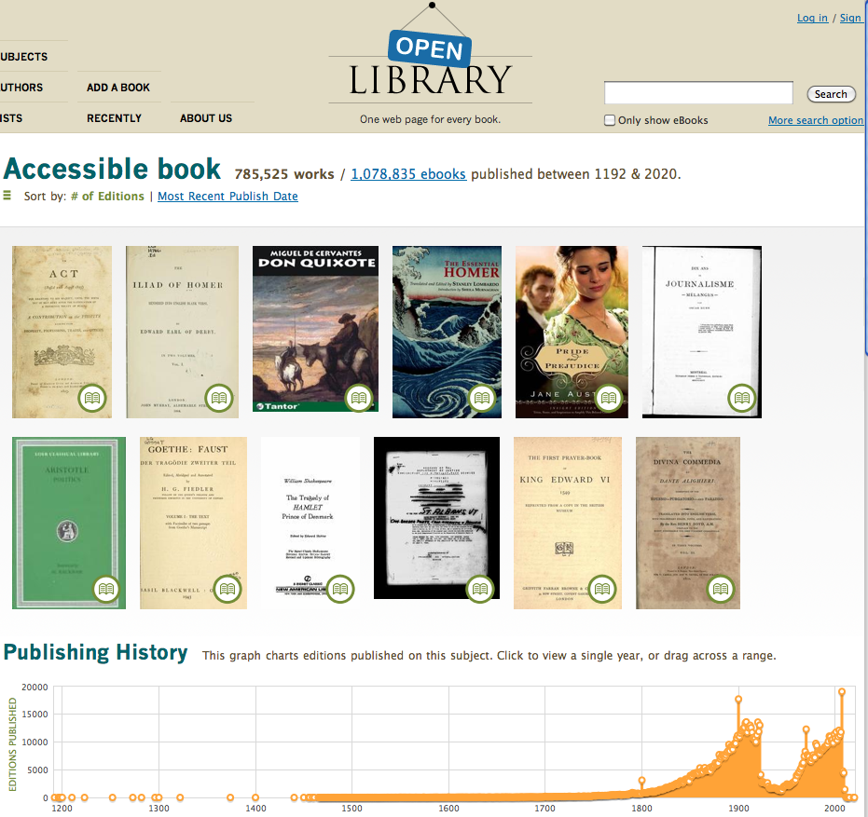
DAISY format
National Library Service for the Blind and Physically Handicapped (NLS)
users qualify.
2 million DAISY
150,000
modern ebooks
http://openlibrary.org/subjects/accessible_book

Slide 13
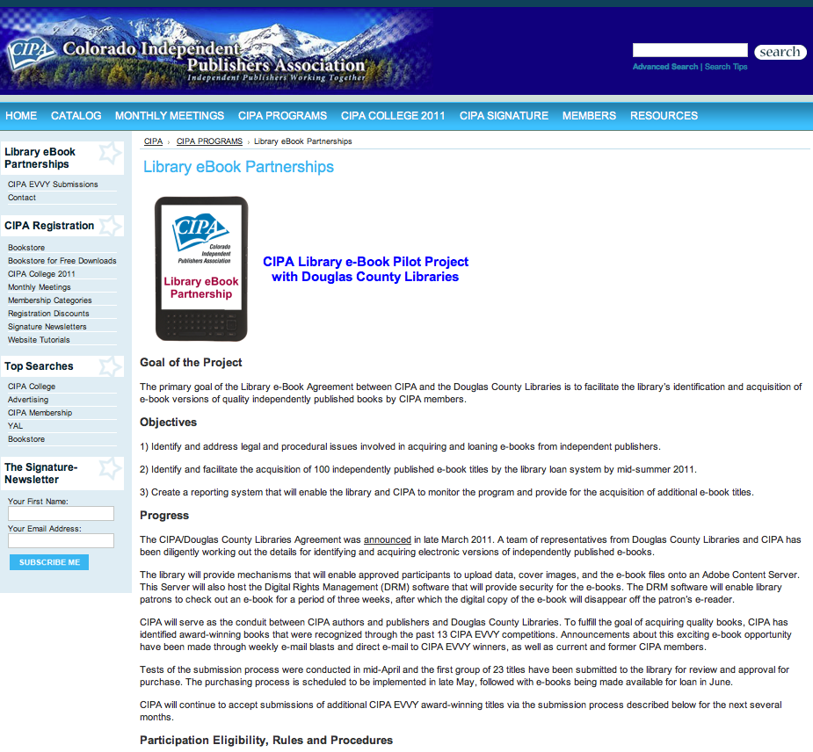
Douglas County Libraries (CO) buys ebooks
Initiative to OWN not License ebooks

Slide 14
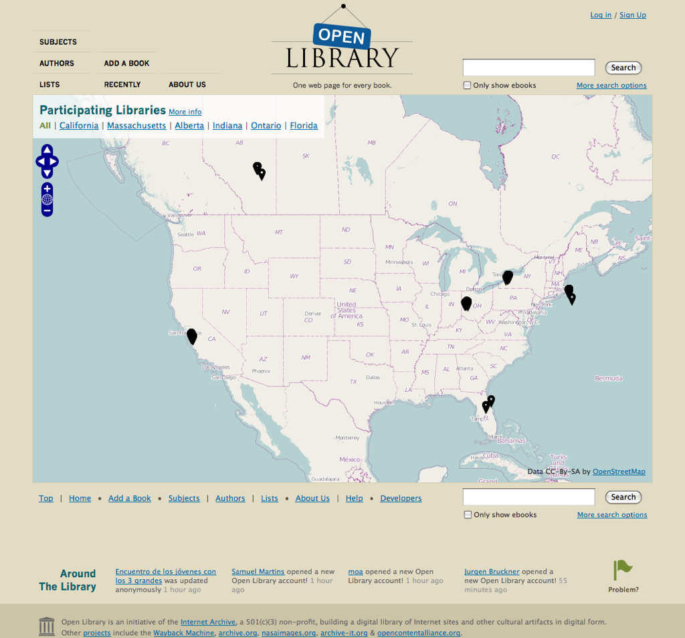
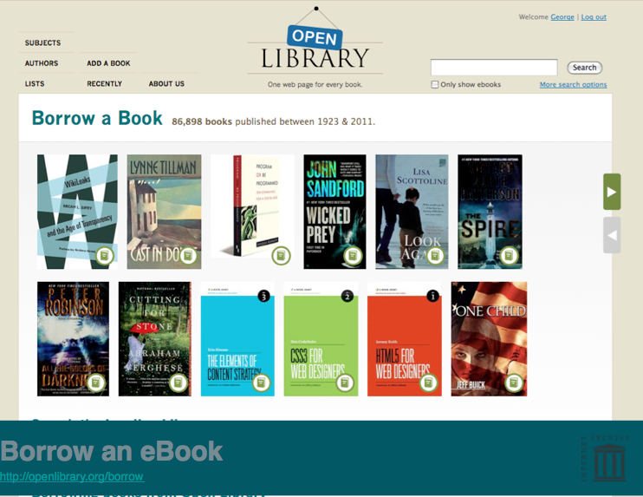
Open Library (Internet Archive)
100,000 modern ebooks
plus 2 million public domain
Contact: robert@archive.org
Launched February 22, 2011
http://blog.openlibrary.org/2011/02/22/get-thee-to-a-library/
Notes:
Launched February 22, 2011
http://blog.openlibrary.org/2011/02/22/get-thee-to-a-library/
100,000 modern ebooks (plus 2 million public domain)

Slide 15
Lending ebooks
Most prevalent is licensing
Emerging is buying and/or scanning
still must comply with copyright
….but no additional restrictions
Scans of books
loaned to one-person-at-a-time
likely to be FAIR USE

Slide 16
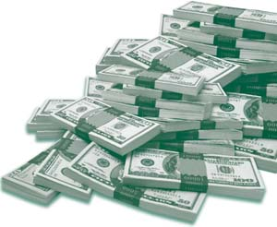
Twist on older ebooks: authors may own copyright, not publishers
Default: author owns copyright
Sells (in whole or in part) to publisher
If publisher contract silent, electronic rights generally remain with author
Implications for libraries negotiating directly with authors
New York Times Co. v. Tasini, 533 U.S. 483 (2001)
Notes:
http://www.fdic.gov/consumers/consumer/news/cnfall08/ money image
Mention author cases

Slide 17
Google Book Search and Orphan Works
10 million books scanned
2 million public domain (full text)
2 million publisher consent (some text)
6 million in proposed settlement
(snippets now / 20 % proposed)
Notes:
On December 29, well-known Chinese fiction writer Mian Mian launched the country's first civil lawsuit against Google, seeking 61,000 yuan (8,900 dollars) in damages for scanning one of her novels.
Hartmann's statement promised Google would scan no more books without authorisation from Chinese writers but made no new offers, while expressing a desire to resolve the dispute by March.
"Fred von Lohmann entered the store at 19:42:08 and spent 2.2 minutes on page 28 of 0-486-66980-7, 3.1 minutes on page 29, and 2.8 minutes on page 30.
http://www.usoge.gov/training/module_files/oge450_wbt_06/examine.jpg
million
Now, works are only included in the Amended Settlement if they were published by January 5, 2009 and either were registered with the U.S. Copyright Office by that date or their place of publication was in the United Kingdom (“UK”), Canada or Australia. A work will be considered to have a place of publication in the UK, Canada or Australia if its printed copy contains information indicating that the place of publication was in one of those two countries. Such information may include, for example, a statement that the book was “Published in [Australia] or [the UK] or [Canada],” or the location or address of the publisher in one of those three countries.
If your work meets the criteria above, then you are a member of the Amended Settlement Class regardless of where you reside and regardless of whether your work may have been published outside the UK, Canada or Australia. However, if your works were not either (a) registered with the United States Copyright Office by January 5, 2009 or (b) published in Canada, Australia or the UK by that date, you are not a member of the Amended Settlement Class, even if you were a member of the original Settlement Class.

Slide 18
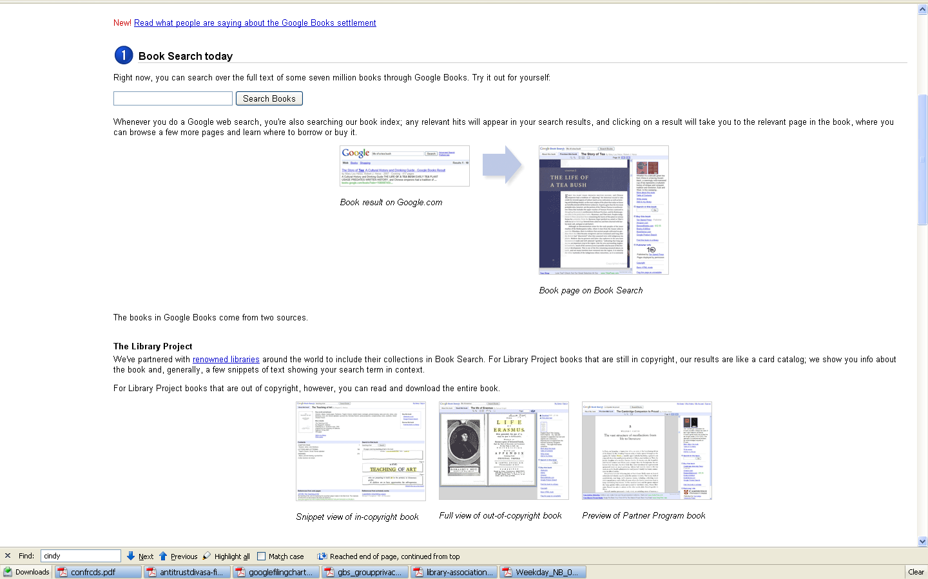
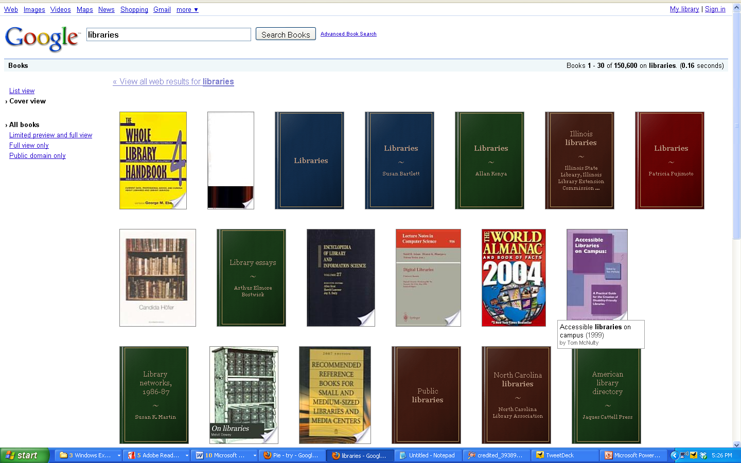
originally
Scan and Snippets
Authors Guild v. Google Inc., 05-CV-8136, U.S. District Court, Southern District of New York (March 22, 2011)
books.google.com/googlebooks/agreement/
Notes:
So let’s look at Google Book Search. To make sure we’re on the same page, a quick overview.
When you do a Google search today, you’re also searching Google books… so if you’re searching on TEA, you may get a THE LIFE OF A TEA BUSH…
If the book is in the PUBLIC DOMAIN, you can download the whole book.
If the book is from Google’s PUBLISHER PARTNER program, you can see as much as the publisher has agreed to share.
If the book is OUT OF PRINT but STILL IN COPRIGHT it is from the the LIBRARY PROJECT… those are the books that Google scans in bulk from participating libraries like Stanford and the Univ of Calif.
You get basic bibliographic info, plus a few snippets of text showing your search term in context. Google has made an INDEX to ALL OF THOSE BOOKS by scanning in the FULL TEXT.
Is that good for libraries? Unreservedly yes. Good for authors and publishers? Not necessarily. The Authors Guild and the Association of American Publishers filed lawsuit, saying that original scan, even if not made available, infringes on their copyright. [year ]
Lot of closed door negotiations and then [date ] came up with a proposed settlement that garnered a lot of objections including from the DOJ … recently revised and in February was the subject of a fairness hearing in S.D. NY heard by Judge Denny Chin.
In the end, I conclude that the ASA is not fair, adequate, and reasonable.

Slide 19
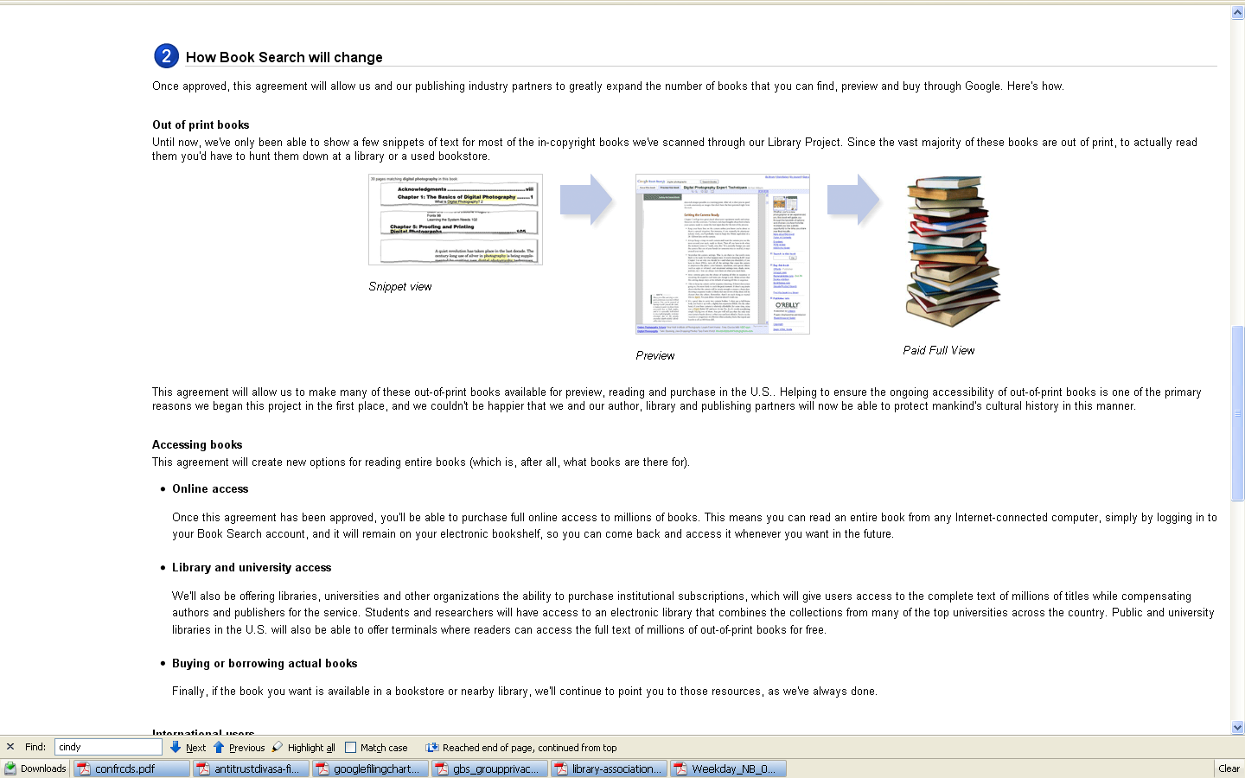
Settlement shifted to
up to 20% display
online bookstore (in cloud)
library subscriptions to full text
In the end, I conclude that the amended settlement is not fair, adequate, and reasonable.
– Judge Chin, March 23, 2011
books.google.com/googlebooks/agreement/
Notes:
Giant shift … may have happened if you weren’t looking
o.p. books (still in copyright) – overlaps with but much broader category than orphan works
Would be available to library users and consumers … full text … for a price
TURN ONLINE LIBRARY TO ONLINE BOOKSTORE.
20% , not snippets would be displayed… a books rights registry would be set up to deliver manage the 37 /63 split
And libraries could purchase institutional subscriptions for authenticated users.

Slide 20
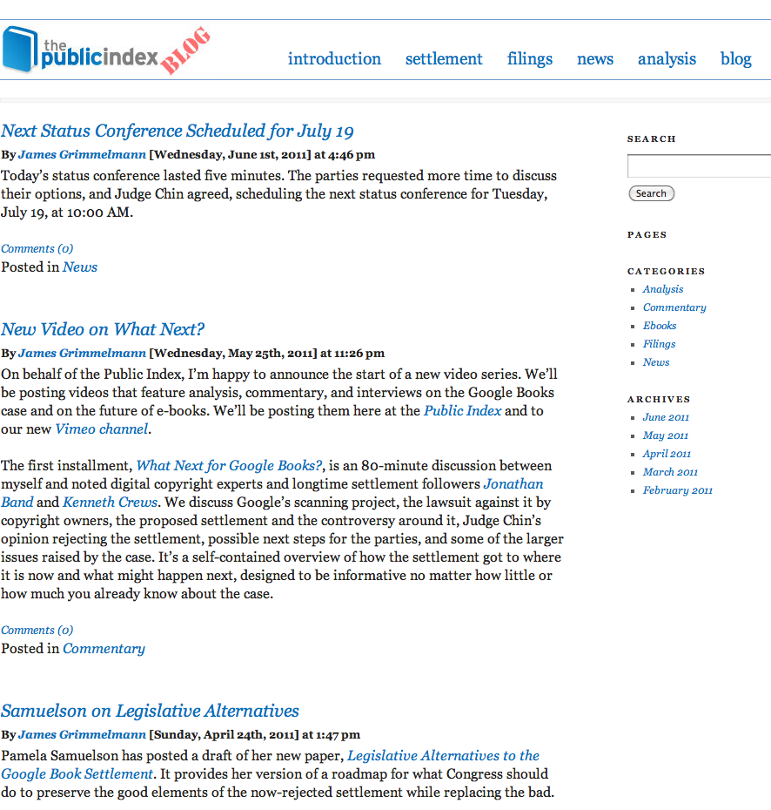
Parties re-negotiating
Next court date
July 19, 2011
Comprehensive coverage at
http://blog.thepublicindex.org/

Slide 21
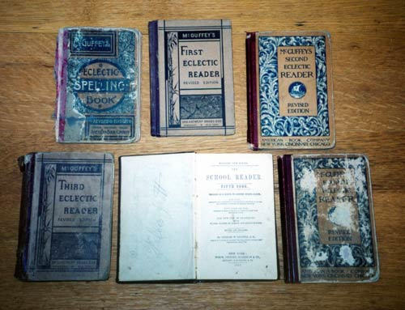
Orphan Books Legislation
110th Congress bill not helpful to libraries
Library Copyright Alliance recommends clean slate
Some options:
extended collective licensing (Nordic model)
authorized preservation
allow snippets
LIBRARY COPYRIGHT ALLIANCE STATEMENT ON COPYRIGHT REFORM (May 16, 2011) http://www.arl.org/bm~doc/lca_copyrightreformstatement_16may11.pdf
Pamela Samuelson, Legislative Alternatives to the Google Book Settlement http://people.ischool.berkeley.edu/%7Epam/LegislativeAlternativesToGBSS.pdf
Notes:
Pamela Samuelson, Legislative Alternatives to the Google Book Settlement http://people.ischool.berkeley.edu/%7Epam/LegislativeAlternativesToGBSS.pdf
http://www.hoover.archives.gov/LIW/countingbook/images/books.jpg

Slide 22
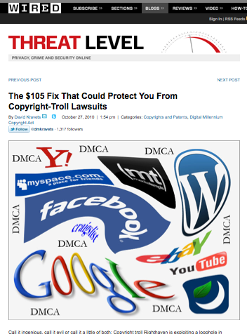
More Cases and Legislation
New wave of lawsuits based on users posting newspaper articles
…easy to protect yourself by filing $105 form
http://www.wired.com/threatlevel/2010/10/dmca-righthaven-loophole/
Notes:
http://www.wired.com/threatlevel/2010/10/dmca-righthaven-loophole/

Slide 23
Sample website language:
Peninsula Library System
www.plsinfo.org/features/copyright.htm
Form - www.copyright.gov/onlinesp/agent.pdf
Info and directory of agents www.copyright.gov/onlinesp/

Slide 24
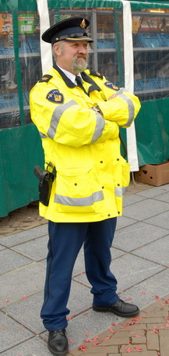
Copyright Agent
Designate agent to receive copyright complaints
File simple form with Copyright Office
Put agent contact info on your site
… Limits your copyright liability for user content
$105 one time fee
'Chinese New Year 4704 (2007)' by FaceMePLS (via Flickr). CC BY license.
Notes:
http://www.sprixi.com/i/2915423471?link=direct&size=5

Slide 25
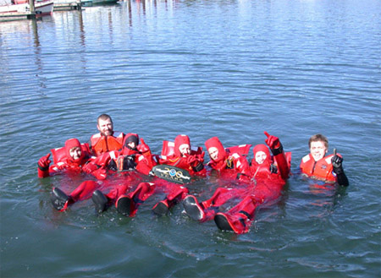
Can Provide Safe Harbor from Lawsuits
Why register?
User posts infringing content (say, from someone else’s article)
Must have no knowledge or direct financial benefit
Copyright policy
Notify users of policy
List agent for complaints
17 USC § 512
www.noaaworld.noaa.gov/postcards/postcard3_w200th.jpg

Slide 26
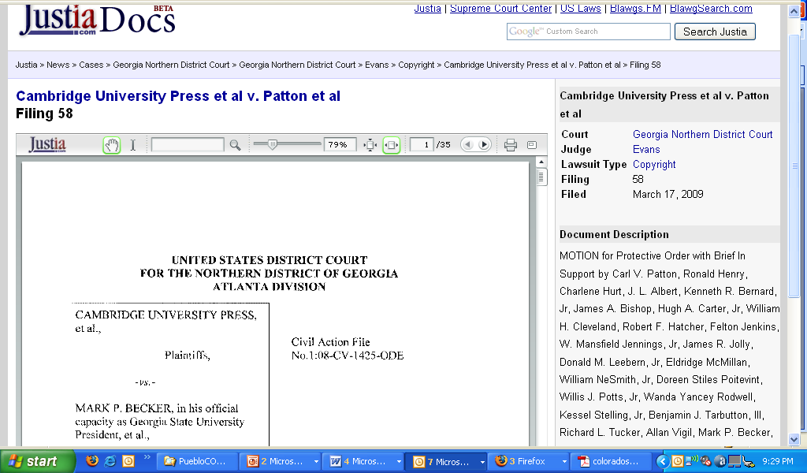
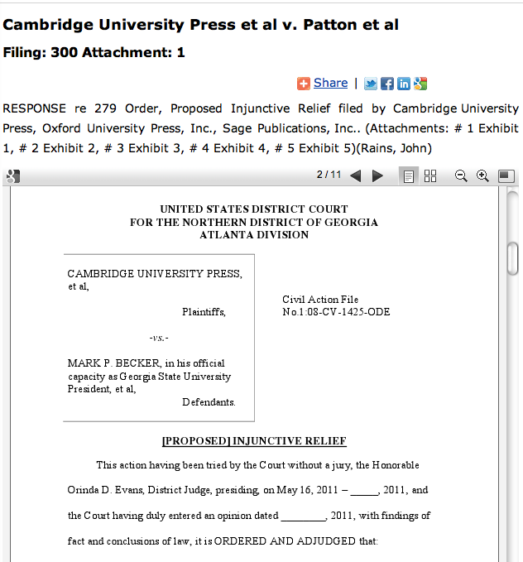
Georgia State University E-Reserves
Closely watched trial in Atlanta
Publishers asking for injunction to stop e-reserves without licensing fees
http://dockets.justia.com/docket/georgia/gandce/1:2008cv01425/150651/

Slide 27
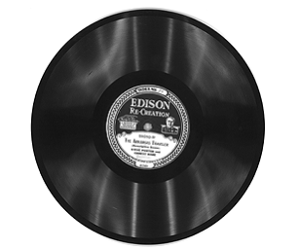
Sound Recordings (Pre- 1972)
Copyright Office roundtable June 2, 2011
Protected by state common law, not federal copyright law
Library impact
Federal law could impose stiff penalties
Stifle digitization projects
REPLY COMMENTS OF THE ASSOCIATION OF RESEARCH LIBRARIES AND THE AMERICAN LIBRARY ASSOCIATION, before the Copyright Office, Docket No. 2010-4 (April 13, 2011)
http://www.copyright.gov/.../sound/comments/reply/041211-arl-ala-reply- comments.pdf
Notes:
April 13, 2011BEFORE THE COPYRIGHT OFFICE LIBRARY OF CONGRESSRE: FEDERAL COPYRIGHT PROTECTION OF SOUND RECORDINGS FIXED BEFORE FEBRUARY 15, 1972DOCKET NO. 2010 – 4REPLY COMMENTS OF THE ASSOCIATION OF RESEARCH LIBRARIES AND THE AMERICAN LIBRARY ASSOCIATIONThe Association of Research Libraries1 and the American Library Association2 appreciate this opportunity to provide reply comments on the important question of the desirability of bringing under federal protection sound recordings fixed before February 15, 1972 (“federalization”). We appreciate the concerns raised by comments in favor of federalization; the seeming variety of state laws and uncertainty in the library community about the availability and scope of exceptions under state law are clearly deterring important preservation and access activities at libraries around the country. While federalization is one response to these concerns, we believe such a change would create significant additional challenges for libraries, which we discuss below. We also believe that the Copyright Office could do significant good for the library community by simply confirming the availability of a flexible fair use doctrine under state law in all 50 states.Federal Copyright Protection Creates Significant Challenges for Research and Preservation ActivitiesMany of the comments in this proceeding support federalization, but even these comments note the many ways that federal law fails to accommodate established library practice. The comments filed in this proceeding are consistent with what independent studies, including ARL’s own recent report “Fair Use Challenges in Academic and Research Libraries,” have argued: concerns about strictures in federal law too often operate as a hindrance to legitimate (and important) library activities.3 At the same time, any effort to change federal copyright law to the 1 The Association of Research Libraries (ARL) is a nonprofit organization of 126 research libraries in North America. Its mission is to influence the changing environment of scholarly communication and the public policies that affect research libraries and the diverse communities they serve.2 The American Library Association (ALA) is a nonprofit organization with more than 63,000 members at all types of libraries including public, academic, and K-12 school libraries. 3 See Association of Research Libraries et al., Fair Use Challenges in Academic and Research Libraries (Dec. 2010). Based on extensive interviews with working librarians, the authors conclude that uncertainty about federal copyright provisions has led to “downsizing, postponing, and shelving courses, research projects, digitization initiatives, and exhibits....” Id. at 1. Other reports that reach this conclusion include: National Recording Preservation Board, The State of Recorded Sound Preservation in the United States: A National Legacy At Risk in the Digital Age 120 (Aug. 2010) (concluding Section 108 is inconsistent with best practices in preservation, and that uncertaintyComments of ARL and ALAsignificant degree necessary to make it more accommodating is likely to be quite complicated, and could risk making the situation worse, rather than better, for libraries.4Federalization would create two specific challenges for libraries: extraordinarily high statutory damages, and cramped specific exceptions for library activities.Excessive Statutory Damages and Other Federal RemediesStatutory damages are by far the most chilling aspect of federal copyright protection. The Copyright Act provides for statutory damages of $750 to $30,000 per work infringed for registered works, and the penalty can be increased to $150,000 per work for “willful” infringement.5 Small-scale file-sharers have faced multi-million dollar penalties under this regime.6 Multiplied across a typical library mass digitization project, even per-work penalties on the lower end of the statutory spectrum could easily add up to devastating penalties. As the Electronic Frontier Foundation notes in its comments, “The potential for excessive damages can stifle creativity and innovation for fear of liability even where copyright infringement is deemed to be only a small risk.”7 Indeed, ARL found in its interviews with academic and research librarians that many librarians were especially chary of digital preservation and access activities involving music due to the multi-million dollar verdicts involved in high-profile file-sharing lawsuits brought by record company plaintiffs.8 This was true about fair use limits its usefulness for generally risk-averse institutions); J. Besek, Copyright Issues Relevant to Digital Preservation and Dissemination of pre-1972 Commercial Sound Recordings by Libraries and Archives 45 (Dec. 2005) (concluding libraries would benefit from more flexible standards for digital copying in federal law).4 See, e.g., Comments of Kenneth Crews at 2 (“[T]he decision to bring works lacking full protection under the federal system not only has implications for creators’ rights, but also for the structure and reach of statutory exceptions.”) Crews suggests a comprehensive review of these implications prior to federalization, but worries that even if such a review were to be undertaken, Congress may not pay heed, referring to the “unevenness of congressional attention” to such niceties in the past. It is also noteworthy that the Recording Industry Association of America, an influential player in copyright policymaking, believes federalization would be “prejudicial to rightsholders.” Comments of the RIAA and A2IM at 2 (“[P]rivate agreements...are much more efficient and effective means for improving preservation and access than any legislative change.”). A legislative process will necessarily involve rightsholder stakeholders, such as the RIAA, who could demand narrower rather than broader library exceptions in exchange for acquiescence to federalization. 5 17 U.S.C. § 504(c). The Copyright Act also provides for reduced damages in some cases for “innocent infringers” and employees of non-profit educational institutions who have a good faith belief that their activities constitute fair use. This reduces, but does not eliminate, the risk that a library will face high statutory damages awards. 6 For example, a graduate student convicted of sharing 30 songs on a peer-to-peer network was initially ordered to pay $675,000, which the judge reduced to $67,500. Ashby Jones, “What’s the Appropriate Punishment for Illegal Downloading?” WALL STREET JOURNAL LAW BLOG, http://blogs.wsj.com/law/2011/04/05/whats-the-appropriate-punishment-for-illegal- downloading/, April 5, 2011. 7 Comments of the Electronic Frontier Foundation at 15. 8 The Association of Research Libraries et al., supra n.3, at 3. 2 Comments of ARL and ALAdespite the fact that none of these high-profile lawsuits involved a nonprofit, educational use.9In addition to statutory damages, the Copyright Act provides for several other remedies not necessarily available at common law. Rightsholders can recover any profits of the infringer that are attributable to the infringement,10 in addition to actual damages incurred by the copyright owner. The Act also creates presumptions in favor of rightsholders demanding profits from alleged infringers: A plaintiff rightsholder need only establish gross profits of an accused infringer, then the burden shifts to the accused infringer to show deductible expenses and portions of profit not attributable to the alleged infringement. Federal law also authorizes impounding and destruction of infringing articles and any “other articles by means of which such copies or phonorecords may be produced.”11 Finally, federal law overrides the default rule that each party bears its own litigation costs, allowing rightsholders to demand that alleged infringers pay their costs and attorneys’ fees, which can be very significant.12Remedies under state common law are mild by comparison. For a tort such as copyright infringement, unfair competition, or misappropriation, the remedy will be based on the general principle that the plaintiff should be restored to the position she would have been in absent the tort. Remedies for common law infringement will thus consist primarily of awarding to the rightsholder provable lost profits attributable to the infringement. As such losses will be highly speculative or non-existent for library uses (especially preservation), it is highly unlikely libraries would face the threat of high-stakes litigation at common law that is available to rightsholders under federal law.13 Also, while it is possible that a common law court could award a plaintiff the alleged infringer’s profits from infringing, the common law does not feature a burden-shifting doctrine like the federal provision discussed above; rightsholders, not libraries, will bear the burden of showing which profits must be surrendered, if any.State civil and criminal anti-piracy statutes sometimes provide for more draconian remedies, but these typically apply to commercial behavior, using language such as “intent to sell” or “for commercial profit” to define the 9 Indeed, the RIAA and A2IM argue in their Comments that because none of their members have brought lawsuits against libraries for preservation activities, the specter of liability “is largely not a factor or hindrance, by itself, to preservation activity.” Comments of RIAA and A2IM at 19. Perhaps the absence of legal action should signal to librarians and archivists that they can go forward with important work despite the possibility that it may be a “’technical’” violation of the law, but our research suggests that this has not been the effect of the rightsholders’ forbearance. See ARL et al., supra n. 3, at 3.10 17 U.S.C. § 504(b). 11 17 U.S.C. § 503. 12 17 U.S.C. § 505. 13 As Timothy Brooks argues in his comments, most of the sound recordings that libraries would preserve and make accessible have long ago exhausted their commercial potential. Comments of Tim Brooks, Association for Recorded Sound Collections at 3. While the common law can take into consideration the negligible harm to rightsholders in these cases, statutory damages sever the connection between damages and harm. 3 Comments of ARL and ALAoffense.14 Non-profit libraries and archives are unlikely to fall on the wrong side of these laws.15Cramped Limitations for LibrariesMany of the comments in this proceeding highlight the inadequacy of the library and archives exceptions in the Copyright Act, which are found primarily in Section 108. As commenters observe, these exceptions simply do not reflect the realities of modern digital scholarship and the best practices at modern academic and research institutions. The limitations they impose are outdated and can cause real harm to libraries, archives and the public they serve. Patrick Loughney of the Library of Congress takes a representatively dim view, saying of Sections 108(b) and (c), for example, that they “are of little real benefit to libraries, archives and other institutions that preserve and provide public access to sound recordings.”16 Indeed, Section 108 suffers from several deficiencies.First, Section 108 places strict limits on when and to what extent a library or archives can make copies for preservation or access. As Loughney points out, the allowance of only three copies for preservation is inconsistent with current best practices for digitization of audio materials, which include making a variety of digital copies in a variety of formats, stored in a variety of locations. Equally frustrating is the statutory assumption that some items should not be preserved until they are already damaged, deteriorating, or otherwise endangered. Indeed, Loughney suggests that to obey the letter of the law on this point “could constitute malfeasance on the part of a professional librarian or archivist.”17 It risks the loss of important cultural artifacts, and raises the costs of preservation considerably and unnecessarily.The utility of these provisions is also significantly impaired by the requirement that digital copies be accessible only on the premises of the library or archives (if at all).18 As Eric Harbeson of the Music Library Association notes, institutions that fund preservation and digitization projects expect the resulting digital files 14 See, e.g., Jaszi, P., Protection for Pre-1972 Sound Recordings under State Law and Its Impact on Use by Nonprofit Institutions: A 10-State Analysis 9 (September 2009) (“[T]he statutes in all 10 states contain explicit language stating that the unauthorized use must be made with ‘intent to sell,’ for ‘commercial profit,’ or some other language indicating a commercial nature to the unlawful activity .”).15 See J. Besek, supra n. 3, at 22 (“On the basis of our review of statutes in states other than California, there does not appear to be a significant risk of criminal liability for nonprofit archiving and preservation activity.”) Califoria’s criminal statute has an exception for non-profit archiving and preservation, but requires institutions to make certain efforts to obtain permission before acting. See also Comments of Randy Silverman and Alison Mower at 2 (citing Utah’s Unauthorized Recording Practices Act, which includes an exception for “any person transferring any such sounds without any compensation being derived by this person or any other person from the transfer,” as more accommodating for preservation than federal law).16 Comments of Patrick Loughney at 5. See also, National Recording Preservation Board, The State of Recorded Sound Preservation in the United States: A National Legacy At Risk in the Digital Age at 120-21 (“Section 108...has failed to keep pace with best practices currently followed by the audio engineering and the federally and privately funded restoration communities.”).17 Loughney, supra n. 14, at 5. 18 See 17 U.S.C. 108(c)(2). 4 Comments of ARL and ALAto be widely accessible; limits on access discourage funding for digitization projects, including digital preservation projects.19 It also frustrates the expectations of contemporary scholars that a library’s digital resources will be easily and instantly accessible from any Internet connection. Many of the comments argue that libraries need a legal framework that will “provide certainty” for conservative funders and administrators who worry digitization activities with an access component are clouded by copyright liability.20 The limited access allowed under Section 108 falls short of that need.21Section 108(h) allows for more liberal scholarly and preservation use by libraries and archives of works during the last 20 years of their copyright term. This exemption is subject to a few conditions, however: the work must be published, and it must not be “subject to normal commercial exploitation” or obtainable (new or used) at a reasonable price, and the exception does not apply to any downstream uses by a library or archives’ patrons. The Society of American Archivists writes in its comments, “Archivists have not used 108(h) extensively as of yet,” citing the narrow scope of the provision, the ambiguity of key terms, and the administrative difficulty of tracking which works satisfy the exception.22These and other shortcomings of Section 108 prompted the Library of Congress and the Copyright Office to convene the Section 108 Study Group several years ago to consider updates to the statute. The Group produced a substantial report but was unable to achieve consensus around workable solutions, which illustrates the difficulty of framing balanced statutory exemptions in what has become a highly contentious policymaking environment. Consensus solutions to the “orphan works” problem have been equally elusive, despite considerable effort at the Copyright Office and elsewhere. These efforts suggest that while current law has clear flaws, ‘opening up’ the law is far from certain to yield improvement.In sum, federalization would raise the specter of statutory damages for libraries and archives considering digitization and other preservation and access 19 Comments of Eric Harbeson at 3. See also Comments of the Society of American Archivists at 3 (“Furthermore, the funding and scope of preservation programs are closely related to the extent to which the preserved items can be made readily available for research use.”). 20 See Comments of the Society of American Archivists at 3 (“Our worry is that as institutional lawyers and preservation funders become more aware of the uncertain legality of providing access to pre-1972 sound recordings, they will remove their support for archival access programs and everyone will suffer.”); Comments of K. Matthew Dames at 6 (“Unfortunately, the lingering legal uncertainty over the ability of scholarly institutions to make their holdings available to the communities they serve dampens ambitions and hampers initiatives.”); Comments of Tim Brooks at 3 (“The rules by which such [academic] use can be made need to be clear, uniform and rational.”); Comments of Patrick Loughney, Ph.D., at 3 (“the uncertain legal treatment even for preservation copying, much less the ability to ultimately make these materials available, makes archive and education officials reluctant to fundraise for, or allocate resources for the acquisition and preservation of the culturally valuable material.”)21 Indeed, Randy Silverman and Alison Mower of the University of Utah claim that federalization would discourage preservation activities in Utah, which has a much broader exemption for non- profit copying of sound recordings. Comments of Randy Silverman and Alison Mower at 2. Notably, Utah’s exception for non-profit uses is likely typical of state law. See J. Besek, supra n.3. 22 Comments of the Society of American Archivists at 10. 5 Comments of ARL and ALAinitiatives for pre-1972 sound recordings, while federal exceptions specifically for research and preservation are in tension with best practices currently in place at these institutions. The Copyright Office should weigh these risks as it considers whether to federalize protection for pre-1972 sound recordings.State Law Could Be Hospitable to Research and Preservation NeedsThe majority of the comments in this proceeding cite the lack of clarity and the perceived lack of exceptions in state law as the principle reasons to support federalization.23 Clarity is certainly needed, but these comments likely overestimate the importance of specific exceptions, and, in some cases, are mistaken about the lack of exceptions in state law. Specific exceptions are helpful (if hard to come by) in the federal context because federal copyright law covers a host of library activities, and the consequences for violating federal copyright can be quite dire. In the state context, however, access to a flexible fair use defense may well be all that is needed to empower libraries and archives to go forward with important preservation and access initiatives.For many aspects of state civil and criminal law, exceptions appear to be simply unnecessary. State anti-piracy statutes are typically much narrower than federal law: they bar unauthorized commercial reproduction, but do not apply to non- profit uses.24 This seems to be true of other common law tort claims that could be substitutes for copyright protection, such as unfair competition or misappropriation.25 By tailoring protection to cover only the behaviors that pose a real economic threat to rightsholders, these state regimes sidestep the thorny question of how to craft useful exceptions for non-profit activities. Only state common law copyright raises the question of whether exceptions are available to encourage preservation, research, and other important functions of libraries and archives. 23 See, e.g., Comments of the Society of American Archivists at 3 (“The explicit and broad preservation exception...in 108(b) would be a definite improvement over the current confused state of the law”); Comments of Tim Brooks, ARSC, at 2 (“The law desperately needs clarity, ‘bright lines’ that holders of these recordings (both public and private) can understand.”); Comments of the Electronic Frontier Foundation at 4 (“Federal jurisdiction, on the other hand, would offer a legal protection scheme for pre-1972 sound recordings in which clear checks on copyright exclusivities allow creative expression and add-on innovation to flourish.”); Comments of Eric Harbeson, MLA, at 4 (“Most importantly, libraries would have access to fair use defenses and exemptions provided under §108.”); Comments of K. Matthew Dames at 5 (“[T]he lack of certainty [surrounding works protected by state law] introduces a level of legal risk that should not exist given that there are clear and current Federal limitations that allow such activities.”). 24 See, e.g., J. Besek, supra n. 3, at 39 (“Our review suggests that digital preservation and streaming of pre-1972 sound recordings by nonprofit libraries is unlikely to violate state criminal laws.”). 25 Id. at 40 (“[I]t seems unlikely that activities within the bounds of what is permitted under § 107 or § 108...would be actionable under state law.... Indeed, it is unlikely that such activities would even elicit a claim.”); Jaszi, P., Protection for Pre-1972 Sound Recordings under State Law and Its Impact on Use by Nonprofit Institutions: A 10-State Analysis 18 (September 2009) (“[N]onprofit institutions that use pre-1972 sound recordings would most likely not be found to engage in unfair competition.”). To the extent that these conclusions are tentative or incomplete, the Copyright Office should consider making a stronger statement based on a more comprehensive review of the law. This could be part of the same review and declaration on the issue of fair use. 6 Comments of ARL and ALAIn this context, there would be great value if the copyright office were to affirm that the fair use doctrine is available under state common law. Fair use is a flexible doctrine that allows users to engage in an open-ended variety of activities that implicate copyright but are, because of the purpose and nature of their use, deemed to be “fair.” The Supreme Court has said fair use is one of the necessary balancing features that prevent copyright from running afoul of the First Amendment;26 without protection for criticism, commentary, and a host of educational and research uses, the copyright monopoly would be an unconstitutional burden on free expression. Since the First Amendment also applies to the states, there could be serious constitutional implications for a state copyright regime that did not recognize fair use. The limited case law that currently exists already suggests that state common law courts will recognize fair use when confronted with the issue.27 Indeed, case law suggests state courts have more freedom to reach fair and equitable results under common law than would exist under the exceptions in federal law.28Copyright scholars have conducted several partial surveys of state law protection of pre-1972 sound recordings. These surveys typically take a tentative tone, but their conclusions about the availability of fair use are consistently positive. June Besek’s conclusion is typical: “[I]t is reasonable to assume that a common law copyright court would recognize a fair use–type exception to accommodate First Amendment interests.”29 The comments in this proceeding are evidence that these partial and tentative examinations have not reassured members of the library community. The Office should take this continuing uncertainty as evidence for the utility of a clearer, perhaps more comprehensive statement about the availability of fair use under state law. 26 See, e.g., Eldred v. Ashcroft, 537 U.S. 186 (2003); Harper & Row, Publishers, Inc. v. Nation Enterprises, 471 U.S. 439, 460 (1985). 27 See, e.g., EMI Records Ltd. v. Premise Media Corp., Index No. 601209/08, Sup. Ct. N.Y. (Aug. 13, 2008), available at http://cyberlaw.stanford.edu/system/files/EMI+v.+Premise+PI+Order.pdf (“New York cases acknowledge that fair use exists at common law.”). 28 Capitol Records, Inc. v. Naxos, 4 N.Y.3d 540, 555 (N.Y. 2005) (“[T]he common law has allowed the courts to keep pace with constantly changing technological and economic aspects so as to reach just and realistic results.”). 29 J. Besek, Copyright and Related Issues Relevant to Digital Preservation and Dissemination of Unpublished pre-1972 Commercial Sound Recordings by Libraries and Archives 60 (Mar. 2009). 7

Slide 28
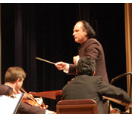
Public Domain – Big Case
Golan v. Holder (2011) Supreme Court will hear
Can Congress RESTORE copyright to public domain (foreign) works?
2009 – District Court NO
2010 – Appellate Court YES
Significant impact on library digitization projects
Erodes certainty of public domain
Examples of copyright restoration:
Gorky, Nabokov, Solzhenitsyn, Shostakovich
U.S. argument: comply with international treaty (URAA to Berne Convention) and ensure American authors reciprocal protections
http://cyberlaw.stanford.edu/node/6543
see Internet Archive amicus for examples
Notes:
http://guayaquil.usconsulate.gov/uploads/sk/Qc/skQcH6jHI_3UM98n1YnsJQ/4thofjulyconcertosgderusha320x250.jpg

Slide 29
International
Print disabled
Traditional cultural expression
Library
Draft WIPO Treaty on Exceptions and Limitations for the Persons with Disabilities, Educational and Research Institutions, Libraries and Archives NOVEMBER 2011
Notes:
http://diversity.ncifcrf.gov/travel/

Slide 30
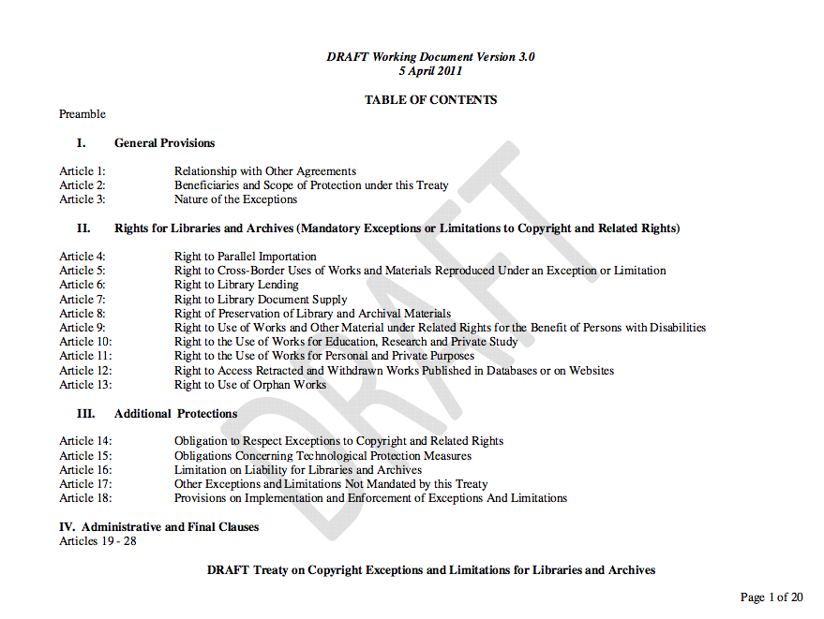
http://www.ifla.org/en/publications/draft-treaty-on-copyright-exceptions-and-limitations-for-libraries-and-archives
Notes:
http://www.ifla.org/en/publications/draft-treaty-on-copyright-exceptions-and-limitations-for-libraries-and-archives

Slide 31
Questions?
Thanks for making
it to the end!
Notes:
http://computing.fnal.gov/cdtracks/2011/april/images/hands_raised.jpg

