Slide 1
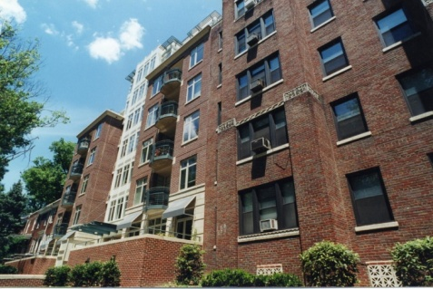
American Community Survey (ACS)
Product Types: Tables and Maps
Samples
Revised 06-07-11

Slide 2
Data Profiles
Data Profiles (5)
Social
Economic
Housing
Demographic
Narrative
Notes:
2
The following images are from 2007 data products, taken in September 2008. (Always updating.)
Data profiles are excellent for novices -- 4 profiles with 450 characteristics
Profiles are:
Social (displayed)
Economic
Housing
Demographic
There is also a Narrative profile (new)

Slide 3
Narrative Profiles
Narrative Profile
3
Notes:
3
3
This is a typical narrative profile, with easy-to-read summaries and simple bar charts.

Slide 4
Comparison Profiles
Display data from two different one-year profiles side-by-side
Include indication (asterisk “*”) of significant difference between two sets of estimates
Available for 1-year estimates only
Four types available – same characteristics as Data Profiles
Social
Economic
Housing
Demographic

Slide 5
Comparison Profiles
Comparison Profile
5
Notes:
5
Comparison profiles example shows data from two single-year estimates, side by side.
They are only available for single year estimates.
An asterisk indicates where a statistically significant difference exists between the two estimates.
A “C” (example on line: Population in Households) indicates that both estimates are controlled, thus a test of statistical significance is not appropriate.
5

Slide 6
Selected Population Profiles
Most detailed race and ethnicity data
Provide summary data for detailed groups
Race / ethnicity / tribe
Ancestry
Country of birth
Two thresholds must be met
Total population size of area = 500,000 or more
Size of group of interest
One-year estimates = 65,000 or more
Three-year estimates = 20,000 or more
Column displays: (1) area; (2) group of interest
Not available for 5-year estimates

Slide 7
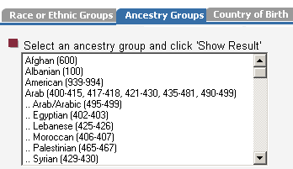
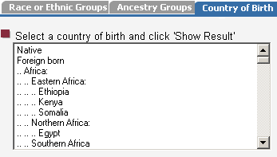
Selected Population Profiles
7
Notes:
7
The Selected Population Profiles have the most detailed race and ethnicity data.
The tabs represent choices to the data user:
Race or Ethnic Groups
Ancestry Groups
Country of Birth
Two population thresholds must be met:
Geographic area must have a population of at least 500,000 (all Congressional Districts are included) AND
The population group must have at least 65,000 population (for single-year estimate) or at least 20,000 population (for a 3-year estimate).
Resulting table after a choice is made is on the next slide . . .
7

Slide 8
Selected Population Profiles
Selected Population Profiles
8
Notes:
8
8
Note the country of birth is Japan in the heading.

Slide 9
Detailed Tables
Foundation upon which other data products are built
Most detailed data on all topics and geographic areas
Basic distributions of characteristics that show estimates and associated margins of error
Over 1,200 Detailed Tables available, with distributions for . . .
More than 500 characteristics; more than 300 race and Hispanic origin iterations
81 imputation tables
Base (B) tables may have collapsed (C) versions

Slide 10
Detailed Tables: Example of Topics
Sex by Age by Race and Hispanic Origin
Means of Transportation to Work by Travel Time to Work
Median Number of Rooms in Housing Units
School Enrollment by Level of School
Poverty Status in the past 12 Months by Sex and Age
Notes:
10
10
Detailed tables are the most versatile for data users.
There are more than 1,200 pre-formatted tables, many of which are repeated for race and Hispanic origin groups.

Slide 11
Table Name
Table Number
Universe
Data Source
Collapsed Version
Margin of Error
Detailed Tables
11
Notes:
11
11
This is a base table, indicated by the letter “B” in front of the table number
Note the callout box with a link to : “Collapsed Version,” indicating the availability of a table with less detail, where some categories are summarized.
Also note that the confidence bounds can be created by adding the margin of error to the estimate for the upper bound and subtracting the margin of error from the estimate for the lower bound.

Slide 12
Detailed Tables – Collapsed (C) Version
Base (B) Table
12
Notes:
12
Here is the collapsed version of the previous table, indicated by the same table number with a C preceding it.
The box in red indicates the categories in the base table, just for the purpose of illustration. The box won’t appear on a real collapsed table.
12

Slide 13
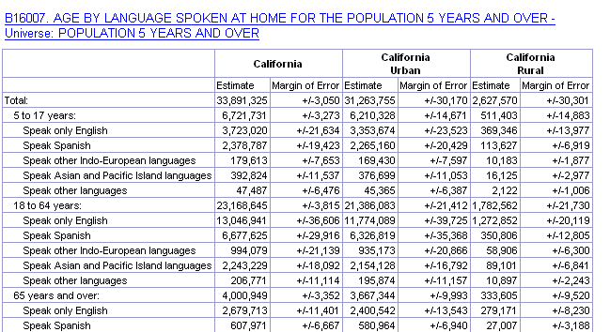
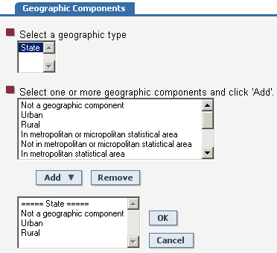
Detailed Table
Notes:
13
Using the options tab on the blue bar, one can display geographic components after selecting the initial geography.
Here we see the state of CA, followed by CA urban and CA rural.

Slide 14
Detailed Tables for Quality Measures
Detailed Tables for Quality Measures
Notes:
14
Quality measures illustrate the steps the Census Bureau takes to ensure that ACS data are accurate and reliable.
There are 10 tables in the B98 series that describe sample sizes, coverage rates, and response rates.
This was begun with the 2007 ACS data.

Slide 15
Subject Tables
Cover particular topics such as employment, education, and origins and language
Provide pre-tabulated numbers and percentages
Often available separately by age, sex, race or ethnicity
Present distributions for a few key population groups with universes displayed as numeric estimates with their margins of error
Display measures such as medians and aggregates where appropriate and include tables of imputation rates for relevant measures
Show more detail than the Data Profiles

Slide 16
Subject Table List
Subject Table List
16
Notes:
16
16
For information about a particular topic, such as employment, education, and language, users should start with Subject Tables.
They provide pre-tabulated numbers and percentages for a wide variety of topics.
This slide shows a partial list of available subjects.
The subject tables are largely derived from the detailed tables, and are similar to the Census 2000 Quick Tables.

Slide 17
Subject Tables
Subject Table
17
Notes:
17
17
The subject tables have more detail than the 4 data profiles.

Slide 18
Ranking Tables
Provide state-level rankings of key ACS variables
Each table displays a single characteristic
States “ranked” from highest to lowest
Enables users to compare different states while seeing which differences are statistically significant at a 90-percent confidence level
Displayed by clicking on “with statistical significance” in menu on left side of screen
Available for 1-year estimates only

Slide 19
Ranking Table
19
Notes:
19
19
Ranking tables display state-level rankings of key single ACS variables.
The table number is preceded by the letter “R.”
The arrow shows a link to View this table “with statistical significance.”

Slide 20
Ranking Table
20
Notes:
20
When viewing a table with statistical significance, the user can select what state they are interested in, either by clicking directly on the state of interest or by using the drop down menu above the table.
A thin column between the Rank column and the State column is where the statistical significance indicator is displayed.
In this slide, the user selected New Jersey, as evidenced by the two dots in the column to the right of the Rank column.
The presence of a single dot indicates states whose estimates are NOT statistically different from the estimate of the selected geography. So for this example, it would be incorrect to draw conclusions based on a comparison of the estimates for NJ and Nevada.
20

Slide 21
Geographic Comparison Tables
Contain a small number of population or housing characteristics for a group of related geographic areas - - examples:
All counties in a state
All census tracts in a county
Across a variety of geographic types, such as metropolitan areas, cities and Congressional districts

Slide 22
Geographic Comparison Table
Geographic Comparison Table
22
Notes:
22
22
Indicated by GCT in front of the table number.
Compares geographies other than states (which are available in the Ranking tables).
Remember the population thresholds for ACS.

Slide 23
Thematic Maps
Graphic displays of data available through the Geographic Comparison Tables and the Ranking Tables
Different shades of color used to display variations in the data
Lighter shades indicate lower values and darker shades, higher values
Users can highlight areas with statistically different values from a selected state, county, metropolitan area, or Congressional district of interest

Slide 24
Thematic Map
24
Notes:
24
24
Thematic maps are graphic displays of data.
Displays of variations are depicted by the shading of colors, with the lighter shades having lower values.
In this example, the red pin is in the state of Maine, showing that Maine is the selected geography. The states with the hash marks do NOT have significant statistical differences from the estimate for Maine.

Slide 25
PUMS
PUMS = Public Use Microdata Sample
Includes a sample of untabulated records for individuals and housing units
Provides access to custom tables that are not available through pre-tabulated ACS products
Requires users to download data and analyze with statistical software, or access through DataFerrett
Data users must calculate standard errors
Notes:
This is a further explanation of PUMS.

Slide 26
Public Use Microdata Sample (PUMS)
Notes:
26
The idea behind PUMS is do-it-yourself tabulations.
The disadvantage is the PUMS data are only available for states and large geographies called PUMAs.
The advantage is the data tabulations can be made only for the characteristics required by a researcher.
In other words, geographic detail is sacrificed for subject detail.

Slide 27
Thank you!
Seattle Regional Census Center
Partnership & Data Services
19820 North Creek Parkway
Bothell, WA 98011
Linda Clark
Information Services Specialist
linda.clark@census.gov
425-908-3060

