Slide 1
Preventing Staff Burnout
An
Webinar
Wednesday
June 22, 2011
12 noon—1:00 p.m.
Paula M. Singer, Ph.D.
pmsinger@singergrp.com
Gail L. Griffith
gail-griffith@comcast.net
Infopeople webinars are supported by the U.S. Institute of Museum and Library Services under the provisions of the Library Services and Technology Act, administered in California by the State Librarian.

Slide 2
Agenda
Burnout and Stress: What’s the Difference?
Symptoms and Stages of Burnout
What Causes Burnout?
Designing Jobs to Prevent Burnout
Strategies to Help Yourself and Others Recover

Slide 3
Who is in the room?
Library Directors
Supervisors
Front-line staff
Students
Other

Slide 4
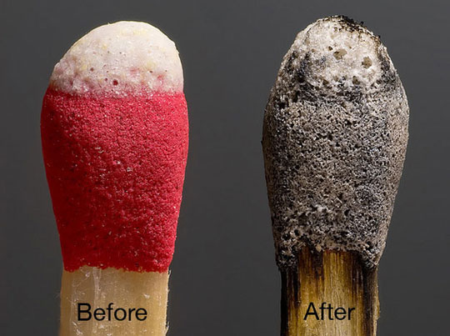
What made you choose this webinar?
Please answer using chat

Slide 5
Preventing burnout is a timely topic
Lots of workplace stress:
Shrinking resources
Can only do more with less for so long
Maybe co-workers laid off?
Public employees are sometimes undervalued and under-appreciated
Technology keeps us ‘on the clock’ 24/7—no escape!
Other?

Slide 6
Stress or Burnout?
 | Stressed Out | Burned Out
I have so much to do and so little time, I just have to push through to get it all done!
I just want to shut myself in my office and never come out.
I’ve been working 24/7 for the past month—I’m exhausted and I need some time off!
I cancelled my vacation this year to get this work done, and nobody appreciated my sacrifice.

Slide 7
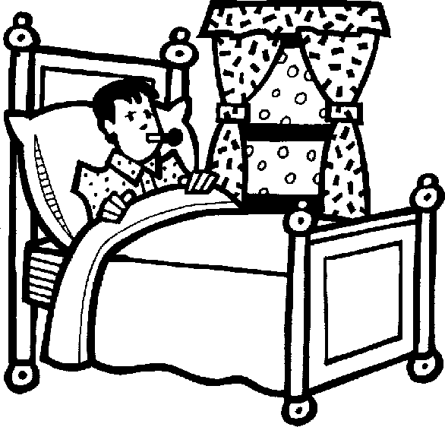
What is burnout?
Emotional
Behavioral
Physical

Slide 8
The Difference between
STRESS
BURNOUT
Characterized by over engagement
Emotions are over reactive
Produces urgency and hyperactivity
Loss of energy
Leads to anxiety disorders
Primary damage is physical
May kill you prematurely
Characterized by disengagement
Emotions are blunted
Produces helplessness and hopelessness
Loss of motivation, ideals, and hope
Leads to detachment and depression
Primary damage is emotional
May make life seem not worth living

Slide 9
Stress/Burnout
“When we expend energy, we draw down our reservoir. When we recover energy, we fill it back up. Too much energy expenditure without sufficient recovery eventually leads to burnout and breakdown (Overuse it and lose it).
Too much recovery without sufficient stress leads to atrophy and weakness (Use it or lose it).”
-Jim Loehr and Tony Schwartz
The Power of Full Engagement

Slide 10
Stages of Burnout

Slide 11
Burnout Assessment
Handout #1: Burnout Assessment

Slide 12
Causes of Burnout

Slide 13
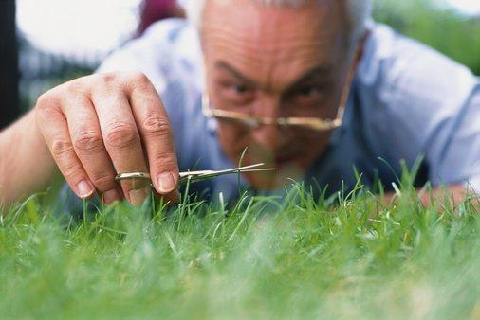
What personality traits do you think contribute to burnout?
Use chat to tell us

Slide 14
Personality traits include
Perfectionist tendencies
Pessimistic view of oneself and the world
Need to be in control
High-achieving, Type-A personality

Slide 15
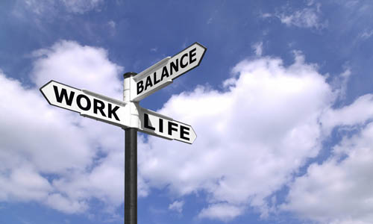
What lifestyle activities lead to burnout?
Lifestyle = choices people make about how to balance life and work
Use chat to tell us about the choices that contribute to burnout

Slide 16
Lifestyle causes include
All work and no play!
Being too many things to too many people
Taking on too many responsibilities without enough help from others
Not getting enough sleep
Lack of close, supportive relationships

Slide 17
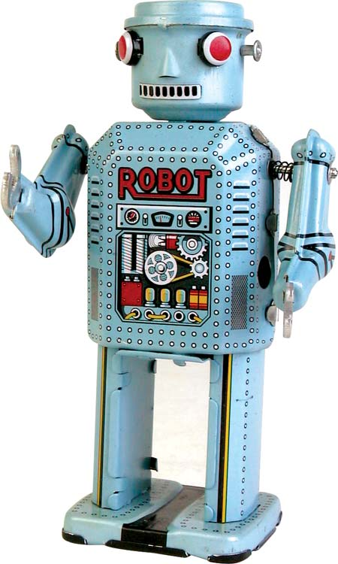
What are some work-related causes of burnout?
Use chat to tell us

Slide 18
Work-related causes include
Lack of results, rewards, recognition, and relief
Little or no control over your work
Unclear or overly demanding job expectations
Doing work that’s monotonous or unchallenging
Lack of recognition for good work
Working in a chaotic or high-pressure environment

Slide 19
Looking at your own workplace…
Use chat to suggest some ways you could minimize workplace causes of burnout

Slide 20
Designing jobs to prevent burnout
Reality check
Expectations and priorities
Is the job do-able?
Build in control
Diversify tasks
Examine fit between the person and the job
Support collaboration
Give feedback and recognition

Slide 21
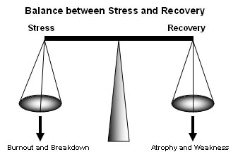
Holistic approaches include
Promote balance in the culture
Build in fun, humor
Meditation and exercise
Engage in realistic self-assessment
Break self-defeating thought patterns
Encourage others to do the same

Slide 22
Burnout Prevention tips
Unplug and take stock
Purge what’s not necessary
Play!
Pay yourself first
Take a weekly sabbath
Cultivate beginner’s mind

Slide 23
Building Resilience
Dunn, Iglewicz, and Moutier: A Conceptual Model of Medical Student Well-being:
promoting resilience and preventing burnout

Slide 24
Stress hardy Personality
Control
Challenge
Commitment

Slide 25
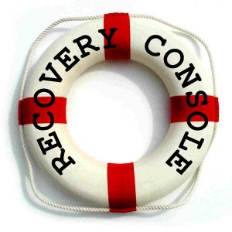
Too late for Prevention?
Slow down
Get support
Re-evaluate your goals and priorities
Acknowledge your losses

Slide 26
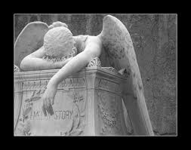
Acknowledge Losses
Idealism
Role or identity that came with your job
Physical and emotional energy
Friends, fun, sense of community
Esteem, self-worth
Control or mastery
Joy, meaning, purpose

Slide 27
Coping with job burnout

Slide 28
Action plan
Handout #2: Action Plan
What is one thing you will do to help prevent burnout in your workplace?
What is one thing you will do for yourself, so that you can keep from burning out at work?
Use the chat to share an answer to the first question.

Slide 29
Questions?

Slide 30
Resources A-f
Borysenko, Joan Z. Fried: Why You Burn Out and How to Revive Carlsbad, CA, 2011
Bring Your Life Into Balance: Helpguide’s stress-busting, mood-boosting toolkit for building emotional skills. helpguide.org/toolkit/emotional_health.htm
Burnout Self Inventory. aipm.wellnesscheckpoint.com/library/banner_main.asp?P=338992ASM2C&zsection=Burnout%20Self%20Inventory&lang=E&title=N
Dunn LB, Iglewicz A, Moutier C. A conceptual model of medical student well-being: promoting resilience and preventing burnout. Acad Psychiatry. 2008 Jan-Feb; 32(1):44-53
Employee Burnout. employer-employee.com/Burnout.html
Freudenberger, Herbert and Geraldine Richelson. Burnout: The High Cost of High Achievement New York, NY, 1981

Slide 31
Resources: G-Z
Gorkin, Mark. Four Stages of Burnout: stressdoc.com/four_stages_burnout.htm
How to Prevent Burnout From Stress: Live like a Sprinter, a Long Distance Runner. lifeevolver.com/prevent-stress-burnout-live-sprinter-long-distance-runner/
Laughter is the Best Medicine: The Health Benefits of Humor and Laughter. helpguide.org/life/humor_laughter_health.htm
Preventing Burnout. Livestrong.com/article/14719-preventing-burnout/
Preventing Burnout: Signs, Symptoms, Causes, and Coping Strategies. helpguide.org/mental/burnout_signs_symptoms.htm

Slide 32
Thank you!
Paula M. Singer, Ph.D.
pmsinger@singergrp.com
Gail L. Griffith
gail-griffith@comcast.net

