Slide 1

Cuddle Up & Read: Storytimes for Pregnant and Parenting Teens
Tuesday August 9, 2011
Presenters:
Anna Hartman &
Kirby McCurtis

Slide 2
Agenda
Introduction
Statistics and Data
Cuddle Up & Read program
Traditional lapsit storytime vs. baby storytime with teen parents
Lessons Learned: Roadblocks and Challenges
Lessons Learned: Positive Surprises
Where we go from here

Slide 3

Poll – Raise Your Hand
How many of you work with teens?

Slide 4
Definition of ADOLESCENCE
1. the state or process of growing up
2. the period of life from puberty to maturity terminating legally at the age of majority
http://www.merriam-webster.com/dictionary/adolescence
Notes:
Lets start with a definition of teen or adolescence

Slide 5
Definition of ADOLESCENCE
the state or process of growing up
the period of life from puberty to maturity terminating legally at the age of majority
http://www.merriam-webster.com/dictionary/adolescence
Of, relating to, or applicable to those aged 13 through 19.
http://www.thefreedictionary.com/teenaged
Notes:
For our purposes, teens were anyone who was in one of the enrolled high school programs. All were in grades 9-12. Some of the graduating seniors were 19 years old, but had had their children when they were younger.

Slide 6
Library Service Definition of TEEN
YALSA (Young Adult Library Service Association)
defines teens as ages 12-18
http://www.ala.org/ala/mgrps/divs/yalsa/aboutyalsab/aboutyalsa.cfm

Slide 7
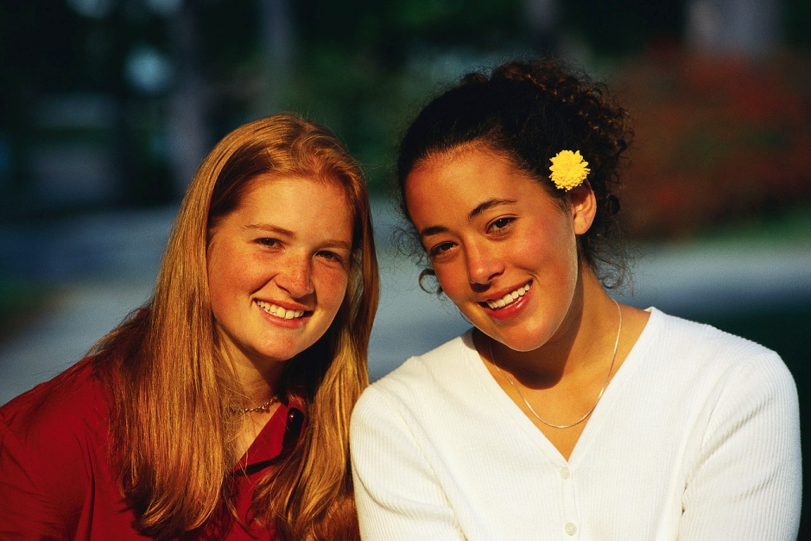
Poll – Type Your Response in Chat Box
What challenges do you face when working with teens?

Slide 8
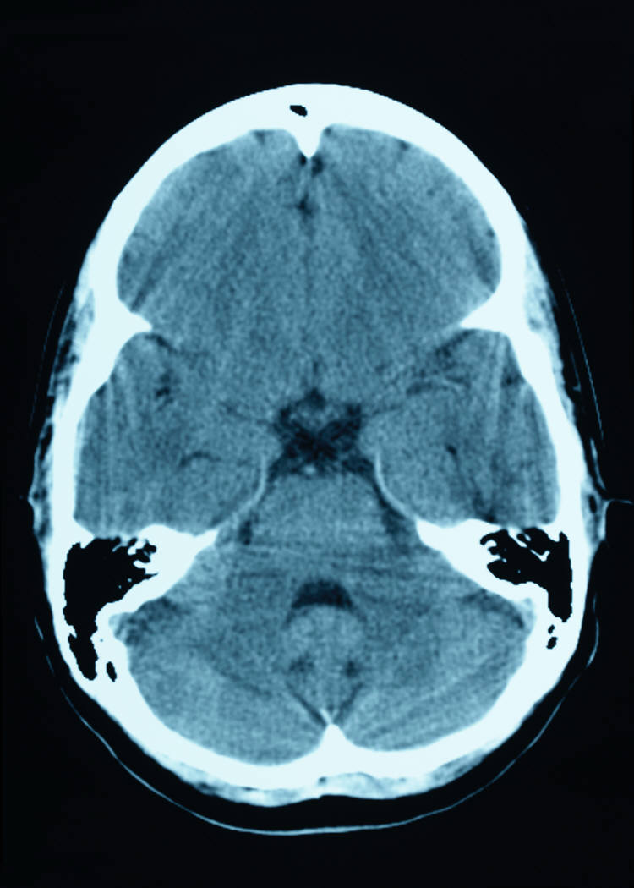
The Brain is only 80% developed in adolescents.
Ruder, Debra Bradley. A Work in Progress: The Teen Brain. Harvard Magazine [September-October 2008] http://harvardmagazine.com/2008/09/the-teen-brain.html
Notes:
Ruder, Debra Bradley. A Work in Progress: The Teen Brain. Harvard Magazine [September-October 2008]
“Time lapse MRI images of human-brain development between ages 5 and 20 show the growth and then gradual loss of gray matter, which consists of cells that process information. Paradoxically , the thinning of gray matter that starts around puberty corresponds to increasing cognitive abilities. This probably reflects improved neural organization, as the brain pares redundant connections and benefits from increases in the white matter that helps brain cells communicate.” This explains how teens can be both responsible and reckless at the same time. While the brain is developing, teens have not yet learned how to use it properly. The brain is divided into lobes that develop from back to front, with the last section to “connect” and develop fully is the frontal lobe, which is responsible for cognitive processing such as reasoning, planning, and judgment. This development is not complete until 25-30 years, much later than previously believed.

Slide 9

Teen Cognitive Development
Developing thinking skills
  Abstract thinking
  Reasoning
Adolescent Growth and Development by Novella Ruffin publication 350-850
Notes:
Adolescent Growth and Development by Novella Ruffin publication 350-850

Slide 10
Teen Cognitive Development
Developing thinking skills
  Abstract thinking
  Reasoning
This leads to:
Have a “It can’t happen to me” syndrome and participate in risky behavior
Adolescent Growth and Development by Novella Ruffin publication 350-850
Notes:
While the brain is developing, teens have not yet learned how to use it properly. The brain is divided into lobes that develop from back to front, with the last section to “connect” and develop fully is the frontal lobe, which is responsible for cognitive processing such as reasoning, planning, and judgment. This development is not complete until 25-30 years, much later than previously believed. This explains how teens can be both responsible and reckless at the same time.

Slide 11
World Teen Pregnancy and Birth Rates, 2008
Teen Pregnancy Rates per 1000 Girls Aged 15-19
Teen Birth Rates: How does the United States compare? The National Campaign to Prevent Teen and Unplanned Pregnancy Fast Facts. December 2010
Notes:
Now that we have a touched on teen cognitive development, lets look at the numbers
The United States has the highest teen pregnancy and birth rates in developed countries.

Slide 12
Teen Pregnancy and Birth Rates in
the United States, 2005
Teen Pregnancy Rates per 1000 Girls Aged 15-19
Prepared by the National Campaign to Prevent Teen and Unplanned Pregnancy, December 2007 Source for rates: Martin, J.A., Hamilton, B.E., Sutton, P.D., Menacker, F., Kirmeyer, S. & Munson, M.L. (2007). Births: Final data for 2005. National Vital Statistics Reports, 56 (1). Ranks calculated by the National Campaign to Prevent Teen and Unplanned Pregnancy.
Notes:
In 2000 California was 44 in the country with a rate of 96. In 5 years have decreased to 38.8. In 2000 the US was at a rate of 84 and has now decreased to 40.5
While the numbers are decreasing, there is still work to be done to decrease the number

Slide 13
California Teen Pregnancy and Birth Rates, 2000
Teen Pregnancy Rates per 1000 Girls Aged 15-19
California Counts: Population Trends and Profiles. Public Policy Institute of California. V 4. no.3, February. 2003

Slide 14
California Demographics of Teen Pregnancy, 2008
Centers for Disease Control and Prevention. National Center for Health Statistics. VitalStats: Birth Data Files. http://www.cdc.gov/nchs/vitalstats.htm [December 2010]

Slide 15
Number of Teen Births in CA by Age, 2008
Centers for Disease Control and Prevention. National Center for Health Statistics. VitalStats: Birth Data Files. http://www.cdc.gov/nchs/vitalstats.htm [December 2010]
Notes:
Centers for Disease Control and Prevention. National Center for Health Statistics. VitalStats: Birth Data Files. http://www.cdc.gov/nchs/vitalstats.htm [December 2010]

Slide 16
Teen Pregnancy and Societal Impact
In 2008 it cost taxpayers a total of
$1.1 billion in CA
$10.9 billion in the United States
Counting It Up: The Public Costs of Teen Childbearing in California in 2008. The National Campaign to Prevent Teen and Unplanned Pregnancy [June 2011]
Notes:
Most of the costs of teen childbearing are associated with negative consequences for the children of teen mothers, during their childhood and their young adult years. Costs covered public health care, child welfare, incarcerated adults (higher risk), and lost tax revenue due to decreased earnings and spending.
In 2004 the average annual cost in CA was $1184 per teen birth. However, the cost of births for younger teens was much more with an average annual cost of $4224 for teens under 17.

Slide 17
Teen Pregnancy and Societal Impact
Teen Parents
Lower levels of educational achievement
By the Numbers: The Public Costs of Teen Childbearing In California, The National Campaign to Prevent Teen Pregnancy, November 2006
Notes:
Centers for Disease Control and Prevention
“Only about 50% of teen mothers receive a high school diploma by age 22 versus nearly 90% of women who had not given birth during adolescence.”

Slide 18
Teen Pregnancy and Societal Impact
Teen Parents
Lower levels of educational achievement
Higher levels of single parenthood
By the Numbers: The Public Costs of Teen Childbearing In California, The National Campaign to Prevent Teen Pregnancy, November 2006

Slide 19
Teen Pregnancy and Societal Impact
Teen Parents
Lower levels of educational achievement
Higher levels of single parenthood
Less stable employment
By the Numbers: The Public Costs of Teen Childbearing In California, The National Campaign to Prevent Teen Pregnancy, November 2006

Slide 20
Teen Pregnancy and Societal Impact
Teen Parents
Lower levels of educational achievement
Higher levels of single parenthood
Less stable employment
Live in poverty
By the Numbers: The Public Costs of Teen Childbearing In California, The National Campaign to Prevent Teen Pregnancy, November 2006

Slide 21
Teen Pregnancy and Societal Impact
Teen Parents
Lower levels of educational achievement
Higher levels of single parenthood
Less stable employment
Live in poverty
Dependent on welfare assistance
By the Numbers: The Public Costs of Teen Childbearing In California, The National Campaign to Prevent Teen Pregnancy, November 2006

Slide 22
Teen Pregnancy and Societal Impact
Children of teen parents:
Have lower school achievement
By the Numbers: The Public Costs of Teen Childbearing In California, The National Campaign to Prevent Teen Pregnancy, November 2006

Slide 23
Teen Pregnancy and Societal Impact
Children of teen parents:
Have lower school achievement
More health problems
By the Numbers: The Public Costs of Teen Childbearing In California, The National Campaign to Prevent Teen Pregnancy, November 2006
Notes:
Born at lower birth rate compared to those born to parents who delay childbearing

Slide 24
Teen Pregnancy and Societal Impact
Children of teen parents:
Have lower school achievement
More health problems
Experience abuse and neglect
By the Numbers: The Public Costs of Teen Childbearing In California, The National Campaign to Prevent Teen Pregnancy, November 2006
Notes:
More likely to enter child welfare system

Slide 25
Teen Pregnancy and Societal Impact
Children of teen parents:
Have lower school achievement
More health problems
Experience abuse and neglect
Higher incarceration rates (sons)
By the Numbers: The Public Costs of Teen Childbearing In California, The National Campaign to Prevent Teen Pregnancy, November 2006

Slide 26
Teen Pregnancy and Societal Impact
Children of teen parents:
Have lower school achievement
More health problems
Experience abuse and neglect
Higher incarceration rates (sons)
Give birth as a teenager (daughters)
By the Numbers: The Public Costs of Teen Childbearing In California, The National Campaign to Prevent Teen Pregnancy, November 2006

Slide 27

Partnerships
Notes:
With schools
With each other

Slide 28


Cuddle Up & Read: San Diego County Library
California School Age Families Education Program (CAL-Safe) http://www.cde.ca.gov/ls/cg/pp/
Grossmont High School
Cuddle Up & Read
San Diego County Library
Notes:
Cal Safe goals:
“Increased number of students graduating from high school and making transition into postsecondary education or the world of work (2010 data for the program has shown a 73% graduation rate!) decreased dependency on welfare, improved parening skills, and fewer incidents of repeat births to teen mothers.”
“Children of enrolled student parents are eligible for child care and development services from birth until five years of age, or until the child is enrolled in kindergarten, whichever occurs first.”

Slide 29
Cuddle Up & Read: San Diego Public Library
San Diego Adolescent Pregnancy and Parenting Program (San Diego Unified School District)
Alternative High Schools—
Mark Twain High School
Garfield High School
Juvenile Court & Community School—
Lindsay Community Day School

Slide 30

Campus Requirements
Notes:
TB test
Parking permit
Going when they want you, not necessarily what works best with your schedule (does this count?)

Slide 31

Poll – Raise Your Hand
How many of you are incorporating Early Literacy Skills into your storytimes?

Slide 32
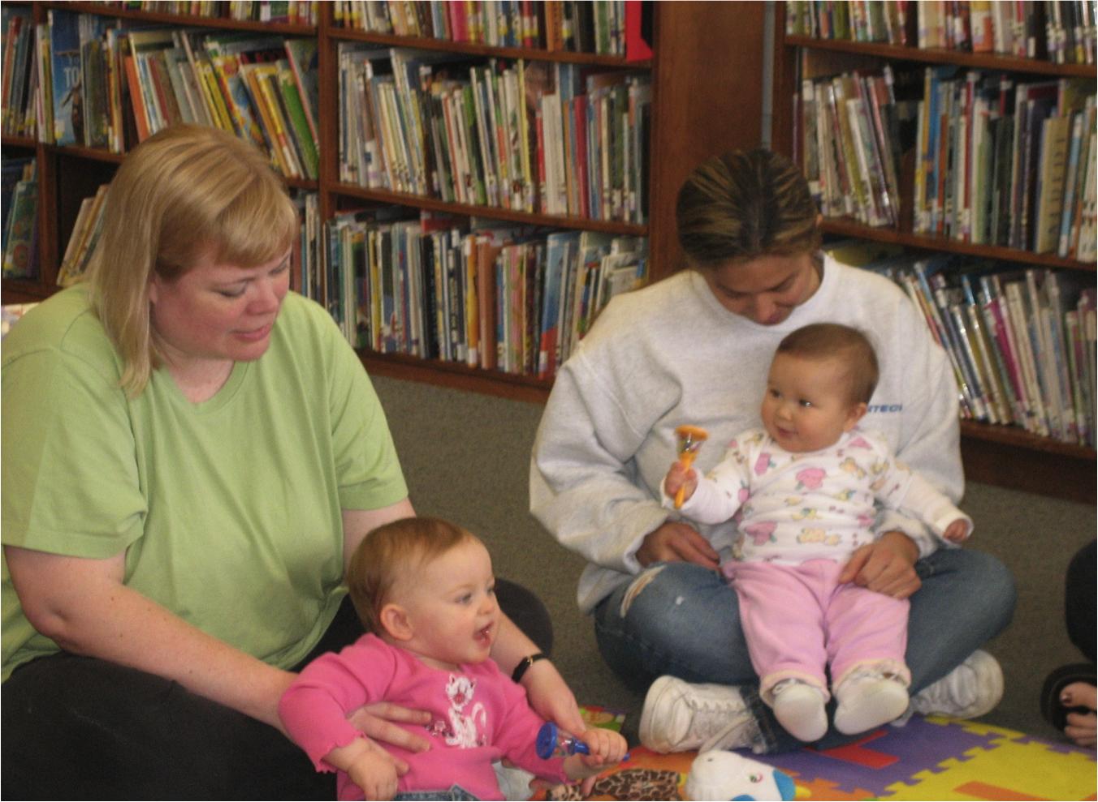
Traditional Storytime vs. Storytime for Pregnant and Parenting Teens
Taken at: La Mesa Library
Notes:
T- always have to demonstrate rhyme/songs. Almost like starting a new each week. Not always familiar with traditional rhymes/songs.
T- anna’s classes were mixed ages kids because the class was a child development class for all parents, not broken up by age
T- toddler age program (when it was separated) was more of a lapsit format with one book per family. Smaller groups
T- audience fluxuates based on attendance, school not necessarily a priority
T- parents are not always present, sometime sitting with another parent
T- teaching the Early Literacy skills in terms that the parents can understand. When asked at the end of the program, none could remember the skills, but could remember some of the concepts ie. Pointing and sharing more than just the text of the book.

Slide 33
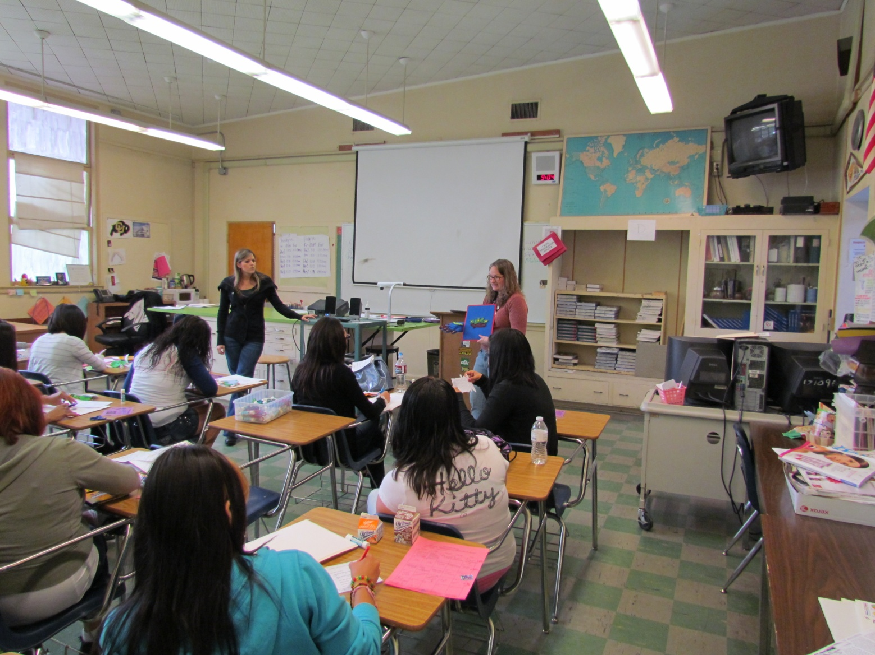
Classroom Time
Taken at: Grossmont High School
Notes:
Spending time talking about why parents read or not
How they feel about reading with their children
Discussion of why reading, why not reading, ways to increase reading with kids
Thoughts about program

Slide 34
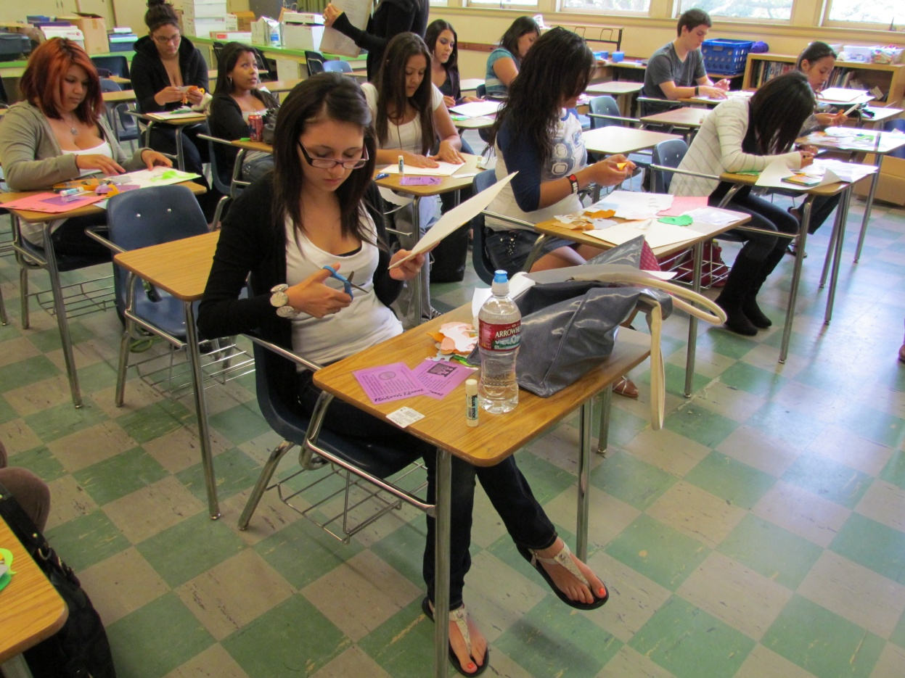
Classroom Time
Taken at :Grossmont High School
Notes:
Making Flannelboard
Teach storytelling – another way to interact with child

Slide 35
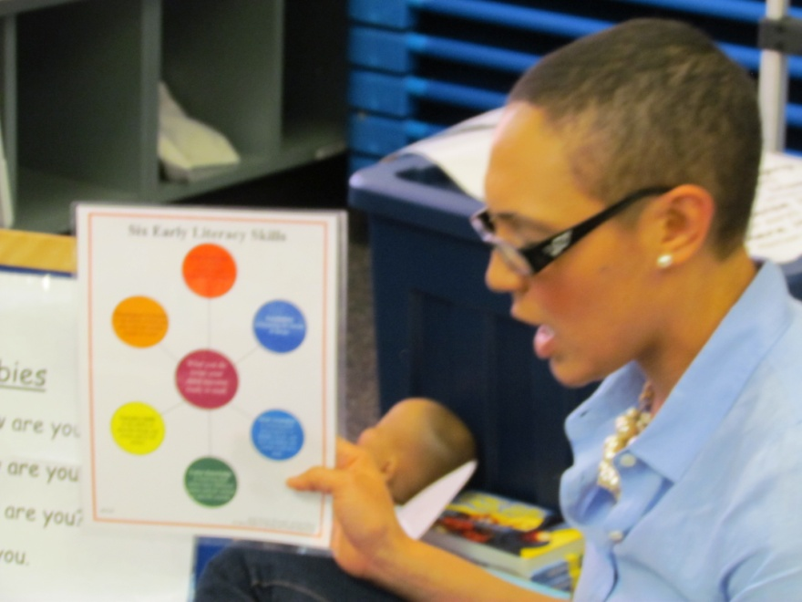
Lessons Learned: Issues
Lessons Learned: Issues
Teaching in a way that resonates
Taken at: Garfield High School

Slide 36
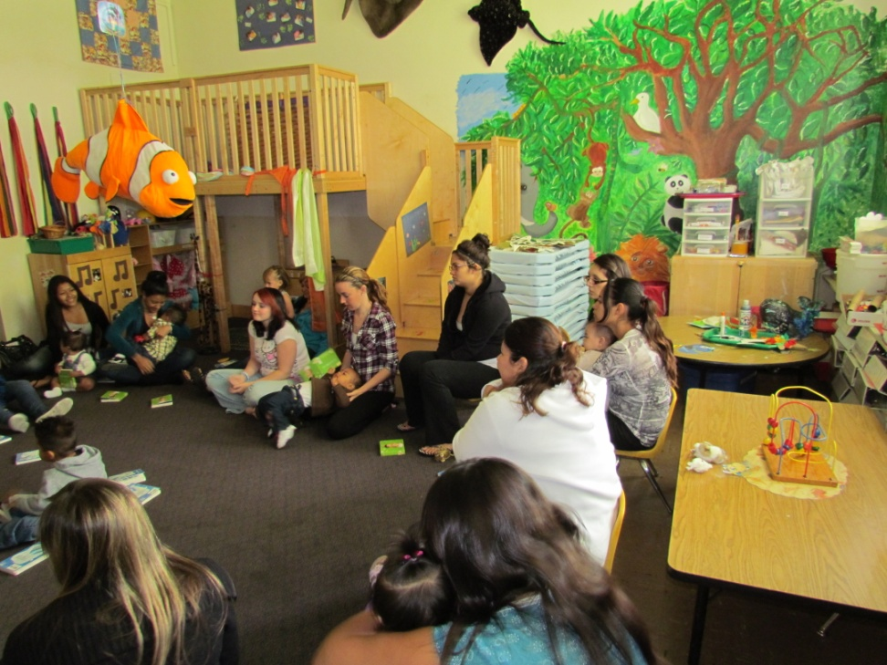
Lessons Learned: Issues
Lessons Learned: Issues
Teaching in a way that resonates
Attendance
Taken at: Grossmont High School

Slide 37
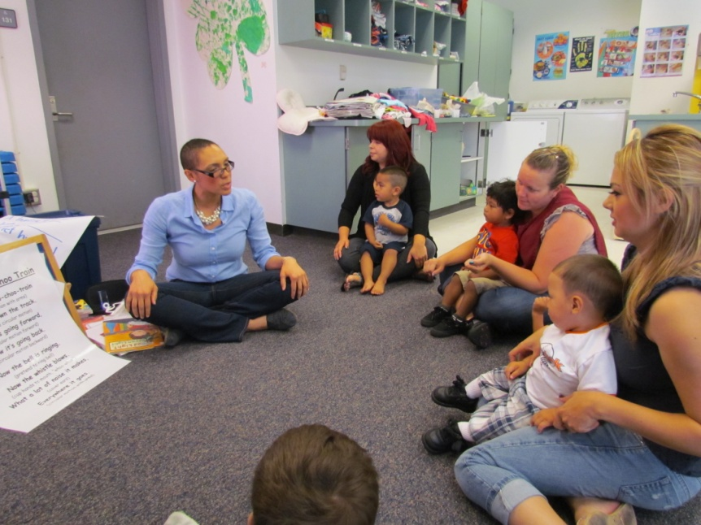
Lessons Learned: Issues
Lessons Learned: Issues
Teaching in a way that resonates
Attendance
Storytime etiquette learning curve
Taken at: Garfield High School

Slide 38

Lessons Learned: Issues
Lessons Learned: Issues
Teaching in a way that resonates
Attendance
Storytime etiquette learning curve
Teenage distractions

Slide 39
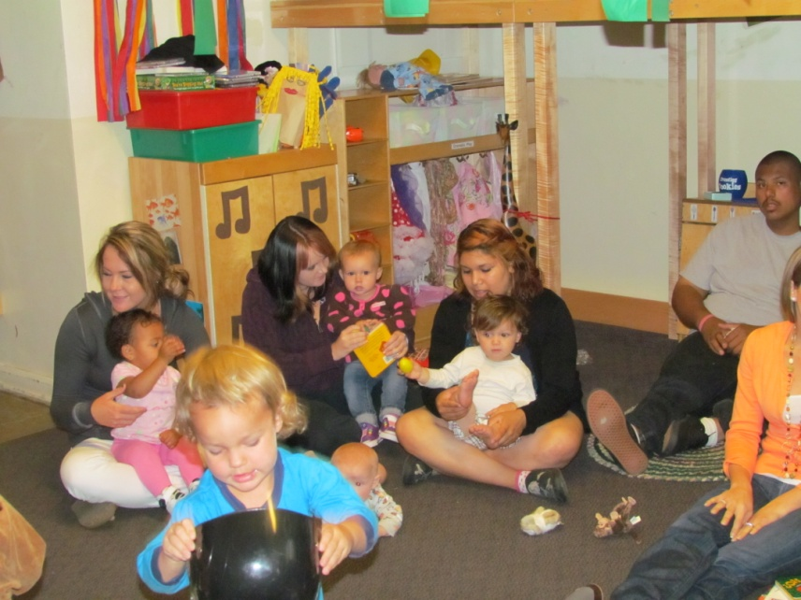
Lessons Learned: Issues
Lessons Learned: Issues
Teaching in a way that resonates
Attendance
Storytime etiquette learning curve
Teenage distractions
Communal environment
Taken at: Grossmont High School

Slide 40
Lessons Learned: Issues
Lessons Learned: Issues
Teaching in a way that resonates
Attendance
Storytime etiquette learning curve
Teenage distractions
Communal environment
Partnership support & administrative buy in

Slide 41
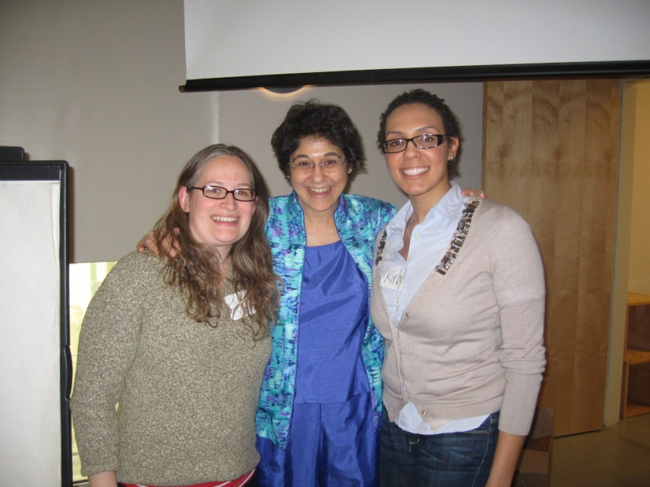
Lessons Learned: Positive Surprises
Collaboration across system lines
Taken at: Mission Valley Library

Slide 42
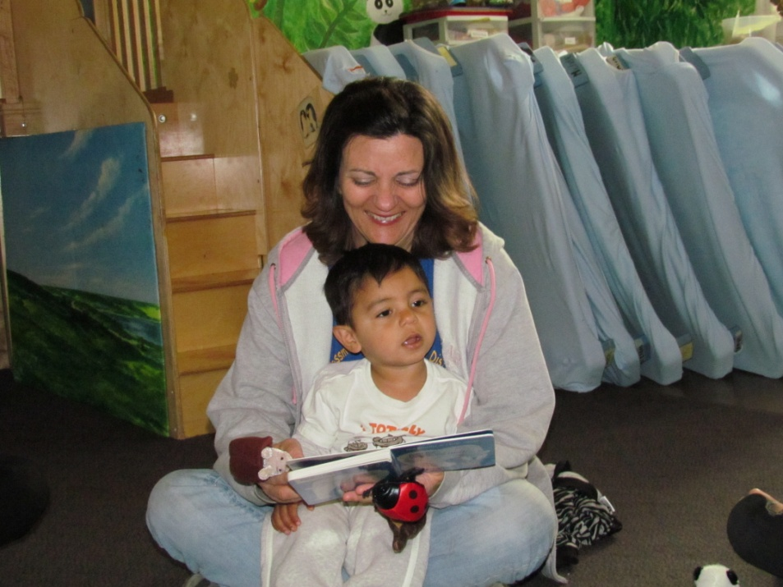
Lessons Learned: Positive Surprises
Collaboration across system lines
Teacher support at school sites
Taken at: Grossmont High School

Slide 43
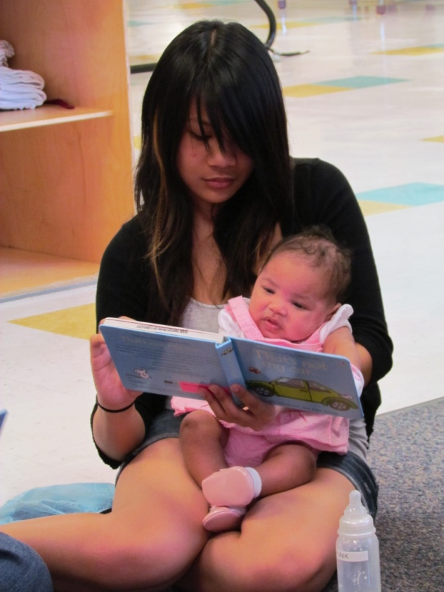
Lessons Learned: Positive Surprises
Collaboration across system lines
Teacher support at school sites
A few girls willing to model
Taken at: Garfield High School

Slide 44
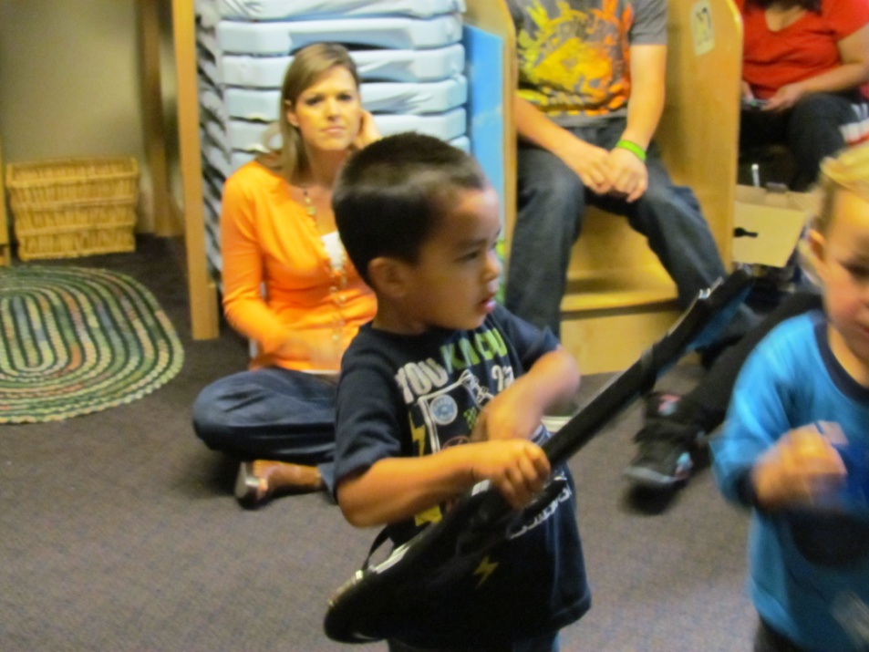
Lessons Learned: Positive Surprises
Collaboration across system lines
Teacher support at school sites
A few girls willing to model
Flexibility is key!
Taken at: Grossmont High School

Slide 45
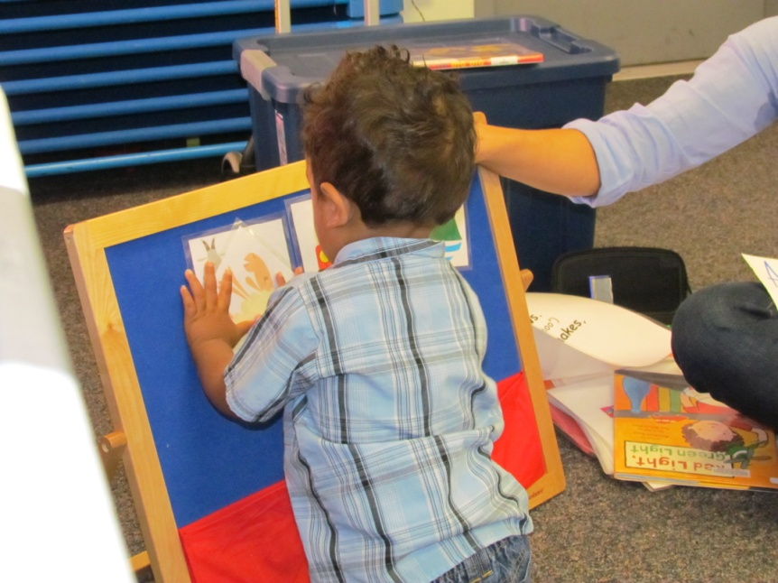
Lessons Learned: Positive Surprises
Collaboration across system lines
Teacher support at school sites
A few girls willing to model
Flexibility is key!
Be willing to try anything
Taken at: Garfield High School

Slide 46
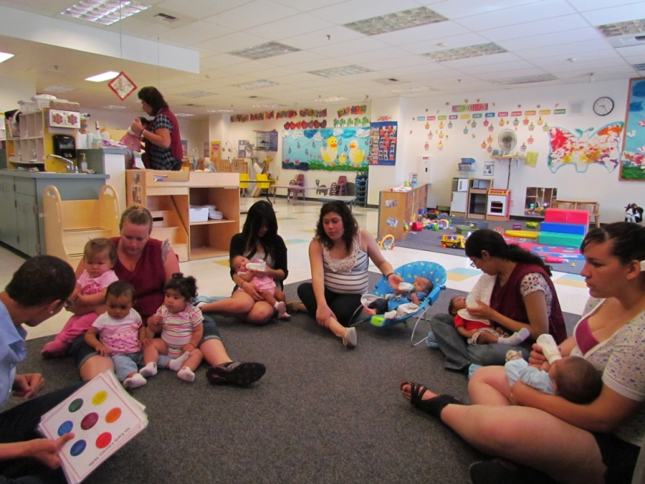
Next Up
Invitation to return to schools
Taken at: Garfield High School

Slide 47
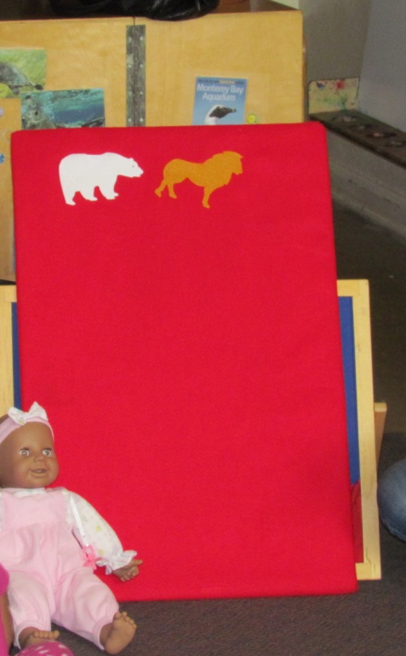
Next Up
Invitation to return to schools
Adding a few different elements to the program?
Taken at: Grossmont High School

Slide 48
Thanks!
We can take time now to field questions if you have any…
If you think of a question after the webinar ends, feel free to contact us:
Anna: anna.hartman@sdcounty.ca.gov
Kirby: kmccurtis@sandiego.gov
http://so-calconnection.blogspot.com/

