Slide 1
Using Technology For Time Management
An Webinar
Thursday, August 18, 2011 12:00 noon to 1:00 p.m.
Susie Quinn
susie.slis@gmail.com
Infopeople webinars are supported by the U.S. Institute of Museum and Library Services under the provisions of the Library Services and Technology Act, administered in California by the State Librarian.

Slide 2
Time Management
What is Time Management?
What methods of Time Management do you use? A quick survey.
Systems of Time Management.
Utilizing technology with your smart phone. Another quick survey.

Slide 3
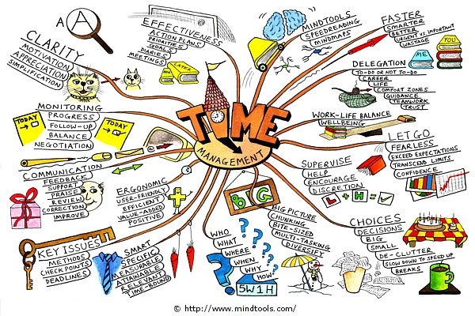

Slide 4
Methods of Time Management
What do you do? A survey.
Task/To-do list
Schedule
Setting goals
Time blocking
Goal setting software
Using calendars
Mind maps

Slide 5
What is Time Management?
The act or process of exercising conscious control over the amount of time spent on specific activities, especially to increase efficiency or productivity.
http://en.wikipedia.org/wiki/Time_management
Notes:
Time management is more than just managing time. It is more about the way we use it effectively. It is about managing yourself in relation to time. It is about setting priorities and taking charge of the situation. It also means changing bad habits and activities that cause waste of time. With time management, you will have control of your time, decrease stress, and increase your energy level. This will give you the ability to balance both your family and work life. The point of time management is to, respect yourself enough to take control of your life, respect others enough to not add to their overload, and respect the information that comes at you enough to deal with it effectively.

Slide 6
What is Time Management?
May be aided by a range of skills, tools, and techniques used to manage time when accomplishing specific tasks, projects and goals.
http://en.wikipedia.org/wiki/Time_management
Notes:
Every human being on earth has the same amount of time:
60 seconds in a minute,
60 minutes in an hour,
1,440 minutes in a day,
24 hours in a day,
168 hours in a week,
and 525,600 minutes in a year.

Slide 7
Methods of Time Management
What works for you?
Notes:
Time management is more than just managing time. It is more about the way we use it effectively. It is about managing yourself in relation to time. It is about setting priorities and taking charge of the situation. It also means changing bad habits and activities that cause waste of time. With time management, you will have control of your time, decrease stress, and increase your energy level. This will give you the ability to balance both your family and work life. The point of time management is to, respect yourself enough to take control of your life, respect others enough to not add to their overload, and respect the information that comes at you enough to deal with it effectively.

Slide 8
Time Management Systems
Pomodoro Technique
Getting Things Done (GTD)
FranklinCovey's Focus

Slide 9
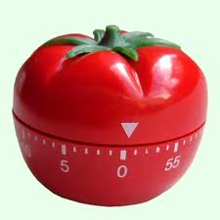
Pomodoro Technique

Slide 10
Pomodoro Technique
Choose
a task to be accomplished.
http://www.pomodorotechnique.com/

Slide 11
Pomodoro Technique
Set the Pomodoro to 25 minutes
(the Pomodoro is the timer).
http://www.pomodorotechnique.com/

Slide 12
Pomodoro Technique
Work on the task
until the Pomodoro rings.
http://www.pomodorotechnique.com/

Slide 13
Pomodoro Technique
Take a short break
(5 minutes is OK).
http://www.pomodorotechnique.com/

Slide 14
Pomodoro Technique
Every 4 Pomodoros
take a longer break.
http://www.pomodorotechnique.com/

Slide 15
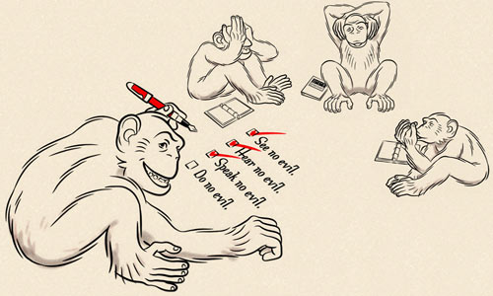
Getting Things Done (GTD)

Slide 16
Getting Things Done (GTD)
Collect
http://pigpog.com/2005/10/26/gtd-introduction/
Notes:
Book by David Allen
Series of principles to manage the day-to-day tasks and projects.
Involves clearing your mind of all the things that you keep remembering and thinking about, that are nagging you and running in your mind.
Get these things written down so you can come up with an organized system and get them out of your head.
First, we need to collect all the things that are worrying us, or that we need to do something about. David calls this a ‘Mind Sweep’ – sweeping everything that’s on our minds into our system. He suggests one idea to a sheet of paper, and throw them all into an inbox to process later, but the actual method doesn’t matter too much, as long as it doesn’t get in the way of the flow of ideas. In DA’s language, anything that holds some part of your attention is an ”open loop”.
Personally, I collect new ideas in my iPaq, either using the voice recorder, or Pocket Informant’s Alarm Notes, where you just scribble on the screen – it doesn’t convert the scribbles into text, just stores them as scribbles. Machines from palmOne have Notes, which is very similar, or you can download Diddlebug. Anything that can be used without needing to think much should do the job – index cards, sheets of paper, or whatever. A small packet of business-sized cards, with or without a preprinted template is a quick and portable capture mechanism.

Slide 17
Getting Things Done (GTD)
Process
http://pigpog.com/2005/10/26/gtd-introduction/
Notes:
Processing is the act of going through all the items in your inbox, that you collected earlier, and deciding what they are, and what you need to do with them. They might need throwing in the bin, they might need storing somewhere for later reference, they might just need reading. For many things, though, you’re going to need to actually do something about them.
The question to ask here for each item is “What’s the next action?” This is the very next thing you would do about this item, if it was the apropriate time, you were in the right place, etc. If this one action would complete the item, then it’s just an action to do. If it won’t, then it’s a project, and you’ll need an extra reminder so that when you’ve done that action, you won’t forget about the item.

Slide 18
Getting Things Done (GTD)
Organize
http://pigpog.com/2005/10/26/gtd-introduction/
Notes:
You need to keep organizedd lists of all the things you have to do, and although these could be arranged in various ways, David has specific suggestions for how to do this…

Slide 19
Getting Things Done (GTD)
Review
http://pigpog.com/2005/10/26/gtd-introduction/
Notes:
In many ways, reviewing is at the heart of GTD. If you don’t review your lists, you won’t be able to trust them, and your mind will worry about them again. That’s what we’re trying to avoid here. How often, and when, you review may depend on who you are and what you do, but David suggests a single review once a week. Many people find a smaller daily review helps a lot, too. The weekly review is where you tie up your projects with their actions, and make sure nothing has been forgotten about. It should also include getting all of your inboxes emptied, and all of your notes and messages processed.

Slide 20
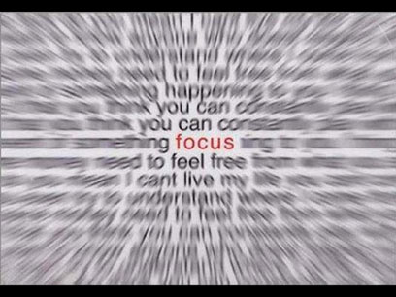
FranklinCovey's Focus
http://getorganized.franklinplanner.com/guide_to_using_your_planning_system

Slide 21
FranklinCovey's Focus
Keep all your information in one integrated system.
Notes:
Keep all your information in one integrated system Information arrives from a variety of sources—voice mail, memos, e-mail, etc. By organizing it all in one place, you'll have what you need when you need it.

Slide 22
FranklinCovey's Focus
Always carry
a walk-around tool.
Notes:
Always carry a walk-around tool Be ready to record information whenever you receive it by carrying a component of your Planning System with you—paper or electronic—always

Slide 23
FranklinCovey's Focus
Customize your system
to your needs.
Notes:
Customize your system to your needs Whether you use only your Planning Pages or combine them with technology, it is important to find the combination that works best for you.

Slide 24
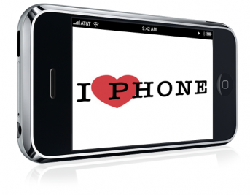
I my smart phone!

Slide 25
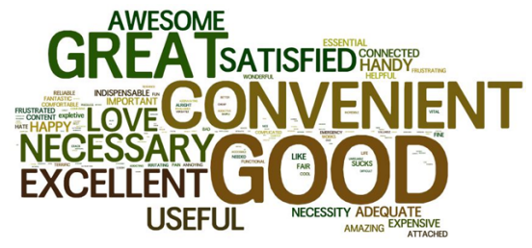
Pew Research
http://pewresearch.org/pubs/2054/smartphone-ownership-demographics-iphone-blackberry-android
Notes:
In its first standalone measure of smartphone ownership, the Pew Internet & American Life Project finds that one third of American adults -- 35% -- own smartphones. The Pew Internet Project's May survey found that 83% of U.S. adults have a cell phone of some kind, and that 42% of them own a smartphone. That translates into 35% of all adults. Our definition of a smartphone owner includes anyone who falls into either of the following two categories:
One-third of cell owners (33%) say that their phone is a smartphone.
Two-in-five cell owners (39%) say that their phone operates on a smartphone platform (these include iPhones and Blackberry devices, as well as phones running the Android, Windows or Palm operating systems).

Slide 26
Smartphone ownership and internet use summary

Slide 27
Smartphones
What smartphone do you own and what are you using it for?
A quick survey
iphone
Android
Blackberry
Windows
Palm
other
none

Slide 28
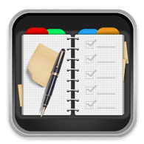
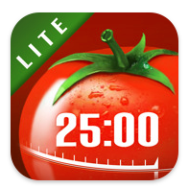
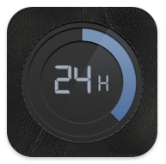
Smartphone Apps

Slide 29
https://i.doit.im/

Slide 30
Doit.im
Better manage your to-do list.
Focus on task at hand, in 5 easy steps.
Notes:
. “Collect” ideas into Inbox; 2. “Process” the 2-minute items; 3. “Organize” the left in Inbox; 4. “Review” them periodically; 5. “Do” them as scheduled.

Slide 31
Doit.im
Multi-platform

Slide 32
Doit.im
Data is stored in the cloud, making it easy to access your data anywhere, anytime, without worrying about losing your important information.

Slide 33
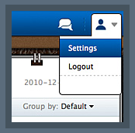
Doit.im
Top Menu

Slide 34
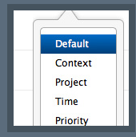
Doit.im
Quick-add

Slide 35
Doit.im
View mode

Slide 36
Additional apps to improve your productivity
Pulse Reader
Scatter Brain
Dragon Dictation
Key Pass
Google Calendar, Lists, etc.

Slide 37
Things to consider when looking for a time management app.
Will this be used with a team or for individual use?
What type of application do you need?
Do you need something that you can access anywhere, desktop /web version?
Do you need an application that will automate time tracking?

Slide 38
We will discuss these issues and more
in-depth in the
Using Technology for Time Management
Infopeople Online course.
For more information and to register, please go to:
http://infopeople.org/training/using-technology

Slide 39
Questions? Thank You!
Susie Quinn
susie.slis@gmail.com

