Slide 1
Worse than death?
Practical Tips on Public Speaking for Library Staff
Presenters: Jennifer Smith, Sally Thomas, and Erica Lansdown
Thursday, August 25, 2011 at 12 Noon
Infopeople webinars are supported by the U.S. Institute of Museum and Library Services under the provisions of the Library Services and Technology Act,
administered in California by the State Librarian.
Notes:
Have the speakers introduce themselves and where they are from, what they are going to talk about: practical tips for public speaking.

Slide 2
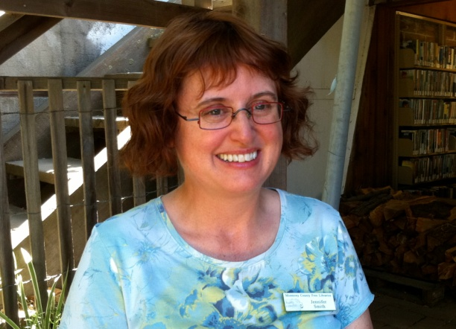
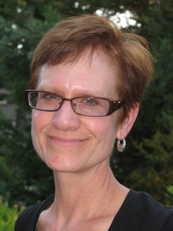
Introductions
Sally Thomas
Adult Services Librarian
Hayward Public Library
sally.thomas@hayward-ca.gov
Jennifer Smith
Supervising Librarian
Carmel Valley Branch
Monterey County Free Libraries
smithja@co.monterey.ca.us
Erica Lansdown
Adult Services Librarian
Burnett Neighborhood Branch
Long Beach Public Library
erica.lansdown@lbpl.org

Slide 3
Agenda
Agenda
~~~~~
~~~
Barriers to Effective Public Speaking
The Role of Preparation
Structure and Organization
Last Considerations
Notes:
Repeat the goals of the presentation: to provide practical tips for speaking effectively in front of an audience, including strategies for overcoming barriers to effective public speaking.

Slide 4
Why?????
Notes:
First, why public speaking? Numerous shelves of books have been written about public speaking. Public speaking is one of the top fears listed by most people, some rate it even worse than death. As library staff we may be called upon to speak in a variety of contexts, such as promoting library services in the community or providing a training workshop. For this webinar we interviewed library leaders for their insights on public speaking and came away with unique points to share. We also participated in organizations such as Toastmasters, which provide a way to build public speaking experience in a supportive environment. In this webinar we will share insights and provide tips that are relevant to most types of speaking situations.

Slide 5
Barriers to Effective Public Speaking
Notes:
Poll (in chat or have a poll slide): What emotions do any of you feel at the prospect of speaking in front of an audience? What is at stake for you? What are the main things you fear will happen?
--Nervousness may show
--Being judged poorly about public speaking skills
--Being a ‘flop’, looking like a fool
--Losing the words, forgetting what to say,
--rambling on, being incoherent, etc.
We all know that public speaking is one of the top fears listed by most people. But the fears can be overcome.

Slide 6
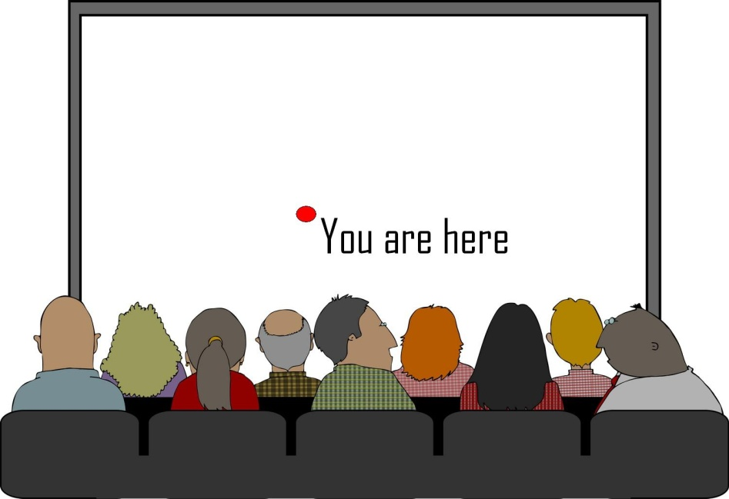
Facing Your Fear
Notes:
You might think facing the fear is easier said than done. You may be right! But all of us have had fears before public speaking and often we still do. But we have learned some techniques for dealing with fear.
1) First, you can start by being aware of your fear-provoking thoughts, identifying them, and talking back to them. Look at each fear, think about what is the worst thing that could happen, the fears gradually will become less relevant. Most people in an audience really want you to succeed.
2) Visualize (overused word we know but still true) yourself giving a successful talk. Replace faulty, catastrophic ideas about yourself and your audience with accurate, positive ideas.
3) Another way to tackle fear is focusing on preparation, one bit at a time if you have to. If you are prepared, you will know your speech better and be able to focus on that. Focus on preparation and goals, and learn as much as possible about your topic.
4) Start small. If you don’t feel confident presenting, start by leading a small-group training or being on a panel of speakers.
5) If you find yourself nervous during a speech, TAKE A BIG BREATH and SLOW DOWN. We tend to speed up when we are nervous, and not breathe correctly.

Slide 7
The Role of Preparation
The Key to Success is
Preparation.
Rehearsal is
Essential.
Notes:
If you are beginning speaker and you think you can “wing it”, you need to know that speeches by those who have prepared ahead of time are almost always better than unprepared speeches. Even those with brief preparations are usually better.
Never, never just read your speech off of a laptop, it does bore everyone, which is another reason why you need to practice.

Slide 8
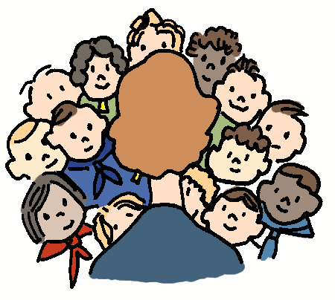
Tips on How to Rehearse
Notes:
Say your entire speech at least once. If you can, stand up while doing it.
Rehearse in front of others if you can. Your brain doesn’t know the difference. You can rehearse in front of your friends and your brain doesn’t know that they are your friends, the brain thinks they are an audience.
3) Practice your entire speech before bedtime. Retention will be better. During sleep, your brain processes your speech into your memory.
4) Practice and prepare extensively, but if you can, take advantage of the latest news stories or articles that may be relevant to your talk.

Slide 9
Apps and Tech Tools to Help You
Notes:
Great tools out there being developed all the time. Some IPhone apps to use:
Voice Memos (a voice recorder, great for practicing and for tracking the amount of time of your speech); or any voice recorder with a time clock. Play it back to hear yourself speaking.
Dragon Dictation (You can speak into this app and the program writes it out for you, and you can email it to yourself. Good for organizing your points and quickly documenting what you want to say.)
3) Videotape yourself speaking or doing a speech. Yes it may be painful but it will make you aware of repetitive gestures, things you do that may be annoying.

Slide 10
Structure and Organization
Notes:
Some people write out their entire speech and others do only an outline. How to organize and structure your speech? First, three basic considerations:

Slide 11
Three Basic Considerations:
Analyze Your Audience
Have a Main Idea
What is the Response You Want From Your Listener?

Slide 12
Analyze Your Audience
Notes:
Learn about your audience before the talk, do the research, so that you can focus your speech in a way that will speak to your audience’s interests and concerns.
Arrive early to chat with people and ask them questions. Go to the venue, sit where the audience will be, figure out where they’re from.
You can also get to the room early to get comfortable with the room.
During the speech, be in touch with your audience by making eye contact with people. Most people really want you to succeed. And smile.
If you are following another speaker or group, listen to what they said and how the audience reacted, and try to build on what they said.

Slide 13
Have a Main Idea
Notes:
Can the audience easily identify and state your main point after they have heard your speech? Is there something concrete that they can take home? Have a main idea that they will remember.

Slide 14
What is the Response You Want?
Notes:
What is the Response You Want From Your Listener?
Important to think about this before you prepare your talk, have this question guide what you say. What is your goal?

Slide 15
A Basic Structure for Your Talk
Notes:
Now you are ready to structure your talk. Use a simple and focused structure, to help your audience remember the main points. Your audience is probably going to come away with one or two of your ideas, not ten.

Slide 16
Structure Elements
Opening, middle, closing
Tell a Story
Notes:
You need an opening, a middle, a closing. Each stage should be apparent to the listener.
Have your talk tell a story. Stories are powerful and memorable. Check out YouTube features and other resources on storytelling. Books in our bibliography for this webinar.
Your opening can be an introduction to what you are going to talk about, an anecdote, a quote, a question, something to get the audience interested and focused on your main idea.
Your closing is also important; a good conclusion signals to the audience that the presentation is about to end, it reiterates both the topic and the purpose of the presentation, and it challenges the audience to respond.

Slide 17
Last Considerations:
Postures and Body Language
Technology
Humor

Slide 18
Postures and Body Language
Notes:
When presenting Webinars, such as this one, or participating in a panel, posture isn’t as much at issue as when standing in front of a group. The following suggestions may feel odd and unnatural when you try them, but with practice, you will begin to do them automatically.
The first element is to “be big.” Where you place your arms comes in to play here. Begin by standing up straight and then hold your arms slightly away from your body (see photo circled in green). Do not clasp your hands behind your back (see photo upper right), which has the effect of making you appear smaller and/or apologetic, nor should you clasp your hands in front, also known as the “fig leaf position” ( see photo upper left) as that will draw attention to…well, not necessarily where you want it.

Slide 19
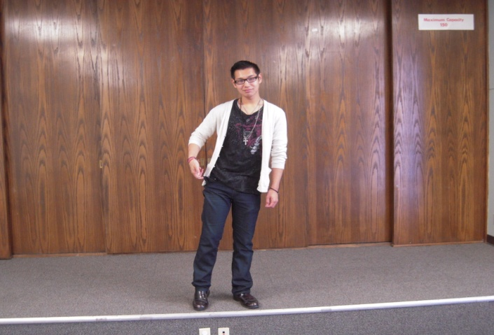
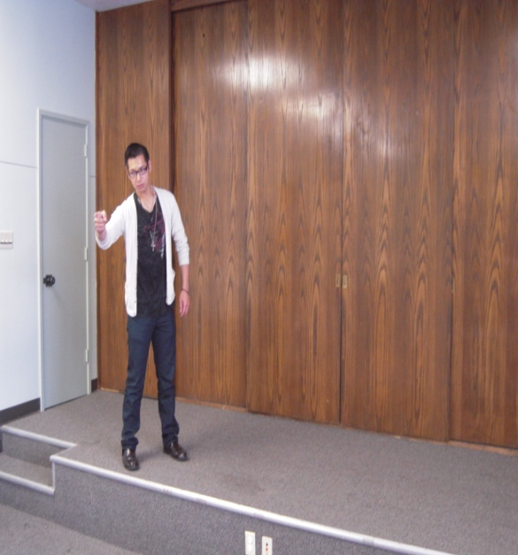
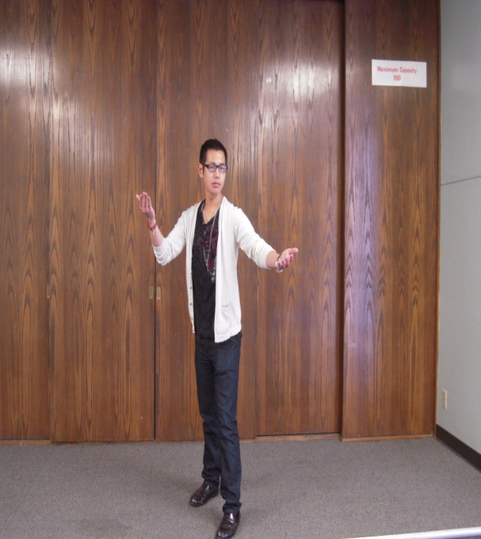
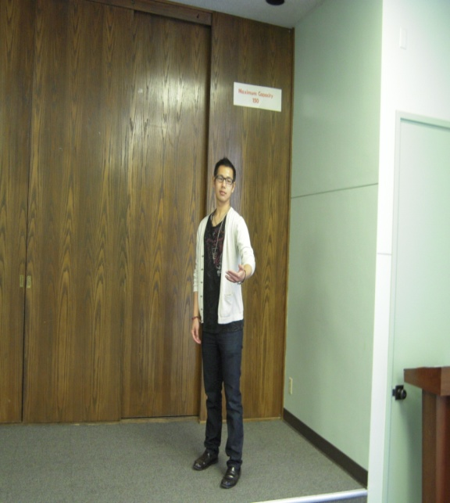
Postures and Body Language Cont.
1
3
2
Notes:
Be careful to have emptied your pockets of any change or anything else you may be tempted to jingle (see photo circled in green).
If you are on a stage of some kind and aren’t required to stay in front of a microphone, there is a technique for reinforcing the points of your talk. From the center, walk (as you continue speaking) to one side a few feet, and then stop when you make that first point in your presentation as in picture number one. Then, walk to the other side of the stage at the same time you’re presenting your second point as in picture number two. Finally, to bring home the final, most important point, return to the center of the stage and place one foot slightly in front to emphasize that point, as in picture number three, before returning, with your conclusion, to your original position. Of course, as with other aspects of public speaking, this takes practice!

Slide 20
Prepare for Technology Failures!
Notes:
Technology:
Have your presentation saved in more than one format (USB, on the Internet, etc.).
Practice with your PowerPoint and then without it in the event of technology failure.
Bring 10 feet of internet cable with you!
Very important: ask to have the room set up according to your needs. Talk to the sound people, test the microphone, look at the auditorium beforehand, move around with the microphone to make sure no loud noise feedback occurs. See how the lighting will affect how you see the audience.

Slide 21
Using PowerPoint Effectively
Notes:
Really best to use PowerPoint for visuals more than for text. You can use PowerPoint as a visual key for where you are in the presentation, but you cannot read off text from it. You will bore your audience to death. Use the PowerPoint slides to tell a visual story, and make some stylistic effort. PowerPoint lends itself to humor—cartoons, clipart, some unexpected image, like this pooch with bifocals for example.

Slide 22
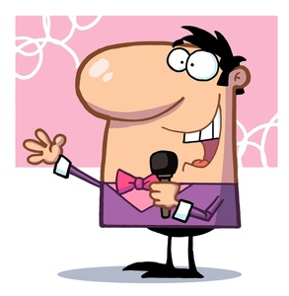
Humor
Notes:
When using humor, point it at yourself (gently) not at the audience.
Don’t try to use humor if it’s not in your nature. It’s okay not to.
Vary the emotional content of your speech if you can, a balance between humor and heart. Alternate from a humorous anecdote to an inspiring point.
If you are not up for trying humor, try to at least appear to be enjoying yourself, be passionate about what you’re talking about.

Slide 23
Questions?

Slide 24
Thank You!
Sally Thomas
Adult Services Librarian
Hayward Public Library
sally.thomas@hayward-ca.gov
Jennifer Smith
Supervising Librarian
Carmel Valley Branch
Monterey County Free Libraries
smithja@co.monterey.ca.us
Erica Lansdown
Adult Services Librarian
Burnett Neighborhood Branch
Long Beach Public Library
erica.lansdown@lbpl.org

