Slide 1
Libraries in a Post-Print World
An Infopeople Webinar with Joan Frye Williams and George Needham
Tuesday, September 13, 2011
12 Noon to 1PM
Infopeople webinars are supported by the U.S. Institute of Museum and Library Services under the provisions
of the Library Services and Technology Act, administered in California by the State Librarian.

Slide 2
We’re not psychic

Slide 3
Scenario planning
Note a trend
Extend that trend into the future
Extend our current practices
into the future
Compare the two
Assess vulnerabilities
Increase our capacity to address the vulnerabilities
Realign our practices as necessary
Persist until the changes take hold

Slide 4
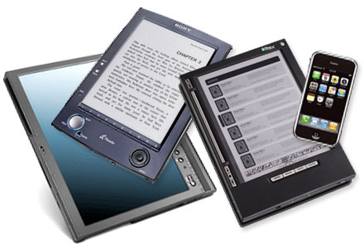
The ground is shifting

Slide 5
No one is asking our permission

Slide 6
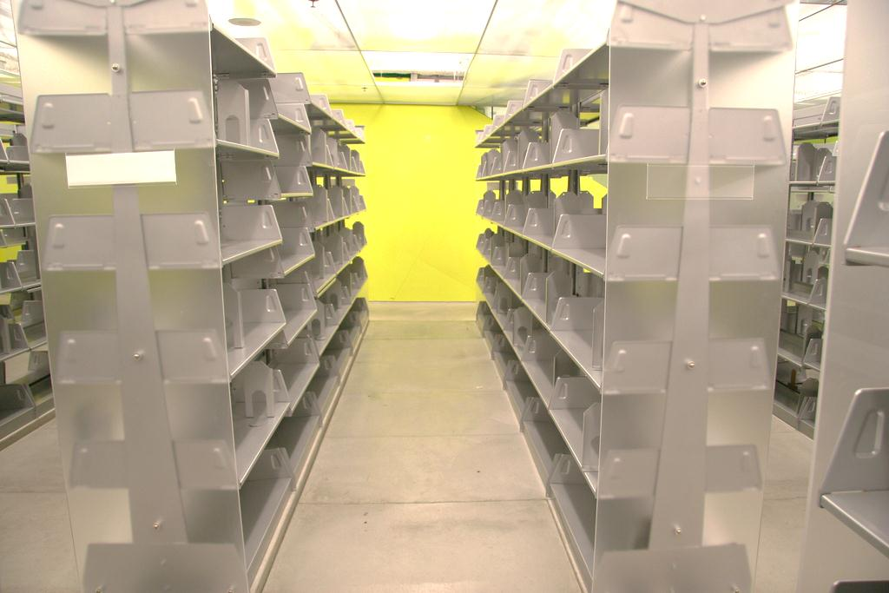
What does the library without books look like?

Slide 7
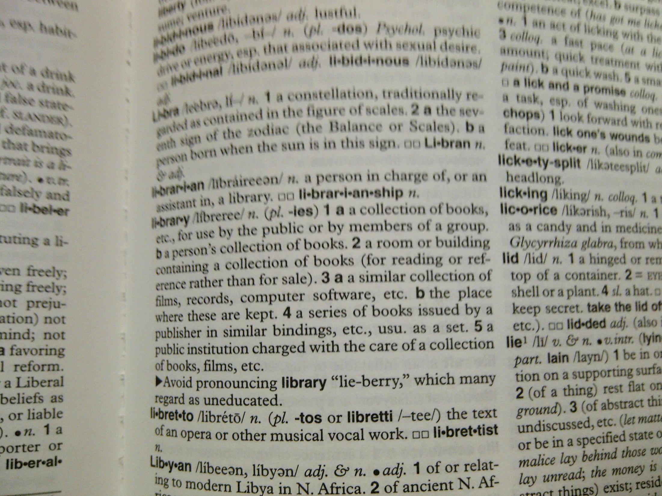
Good news/bad news

Slide 8
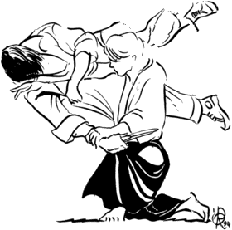
The civilians have a point
Inventory control
Transactions
Rules
Rationing
Anonymity
Remedial advocacy

Slide 9
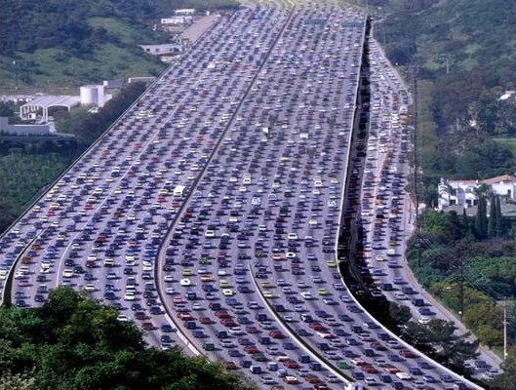
Current practice: Inventory control

Slide 10
Current practice: Transactions

Slide 11
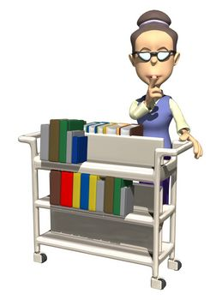
Current practice: Rules

Slide 12
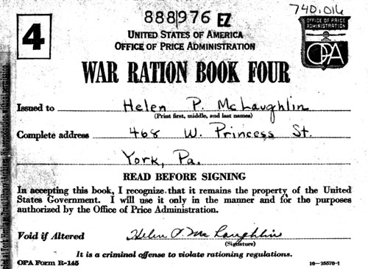
Current practice: Rationing
LIBRARY

Slide 13
Current practice: Anonymity

Slide 14
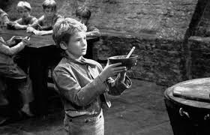
Current practice: Remedial advocacy

Slide 15
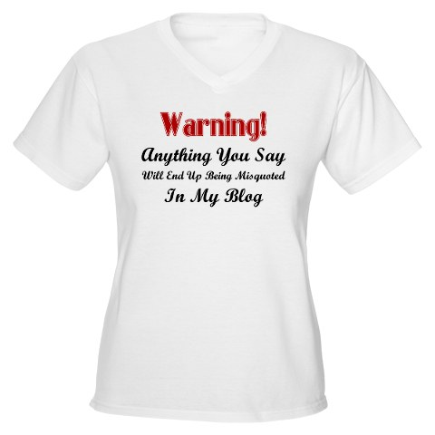

Slide 16
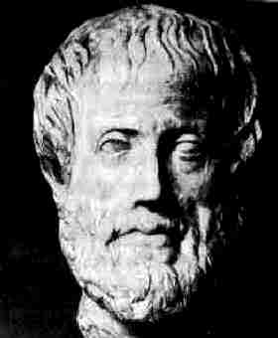
It is the mark of an educated mind to be able to entertain a thought without accepting it. --Aristotle

Slide 17
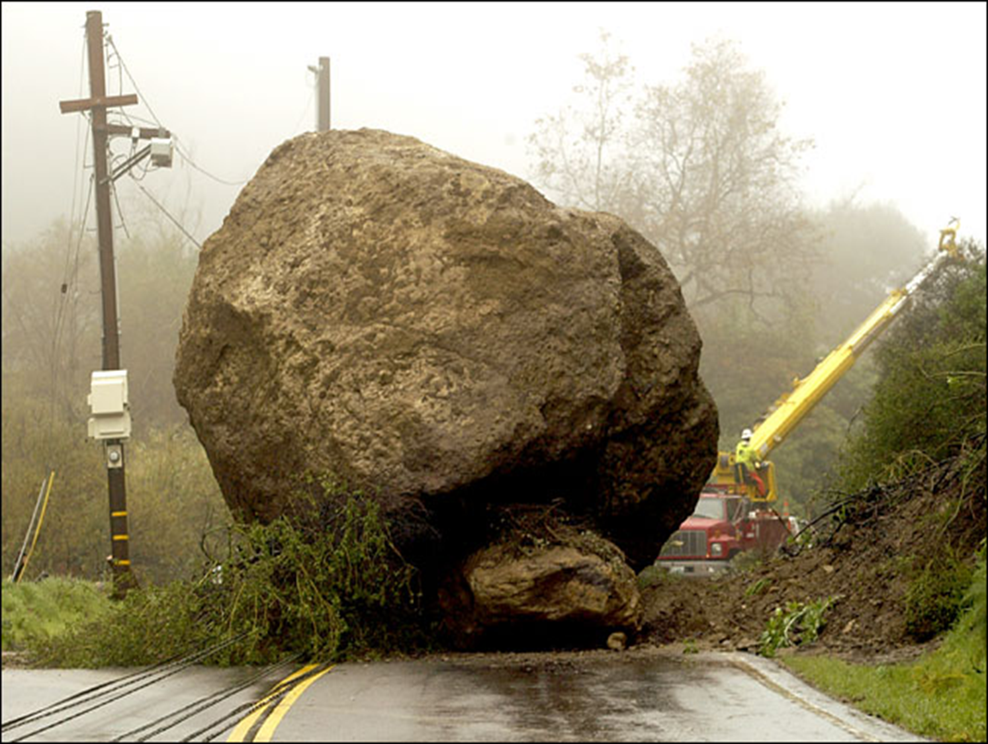
If our practices stay the same and printed books go away, we could be in big trouble

Slide 18
So where does that leave us? Vulnerable…and hopeful

Slide 19
Reframe the conversation

Slide 20
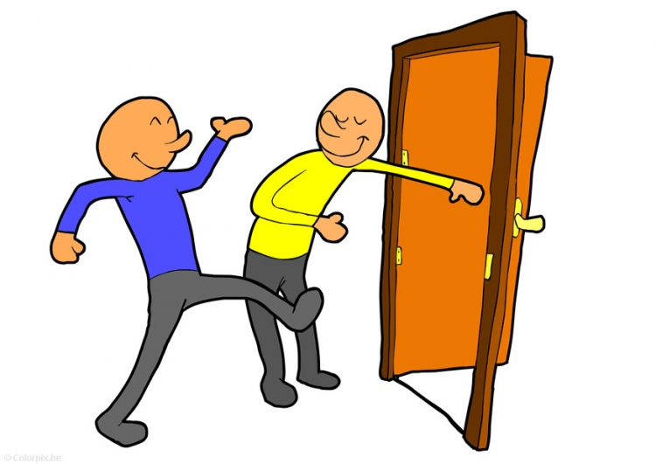
Access

Slide 21
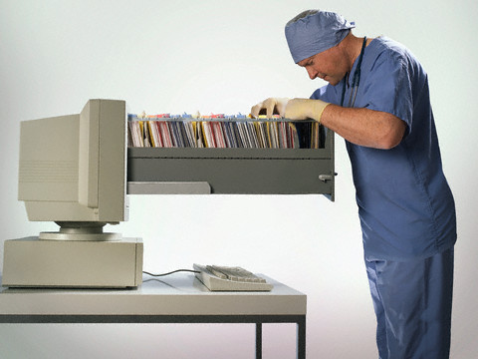
Content curation

Slide 22
Coaching

Slide 23
Co-creation

Slide 24
Community convening

Slide 25
Convergence

Slide 26
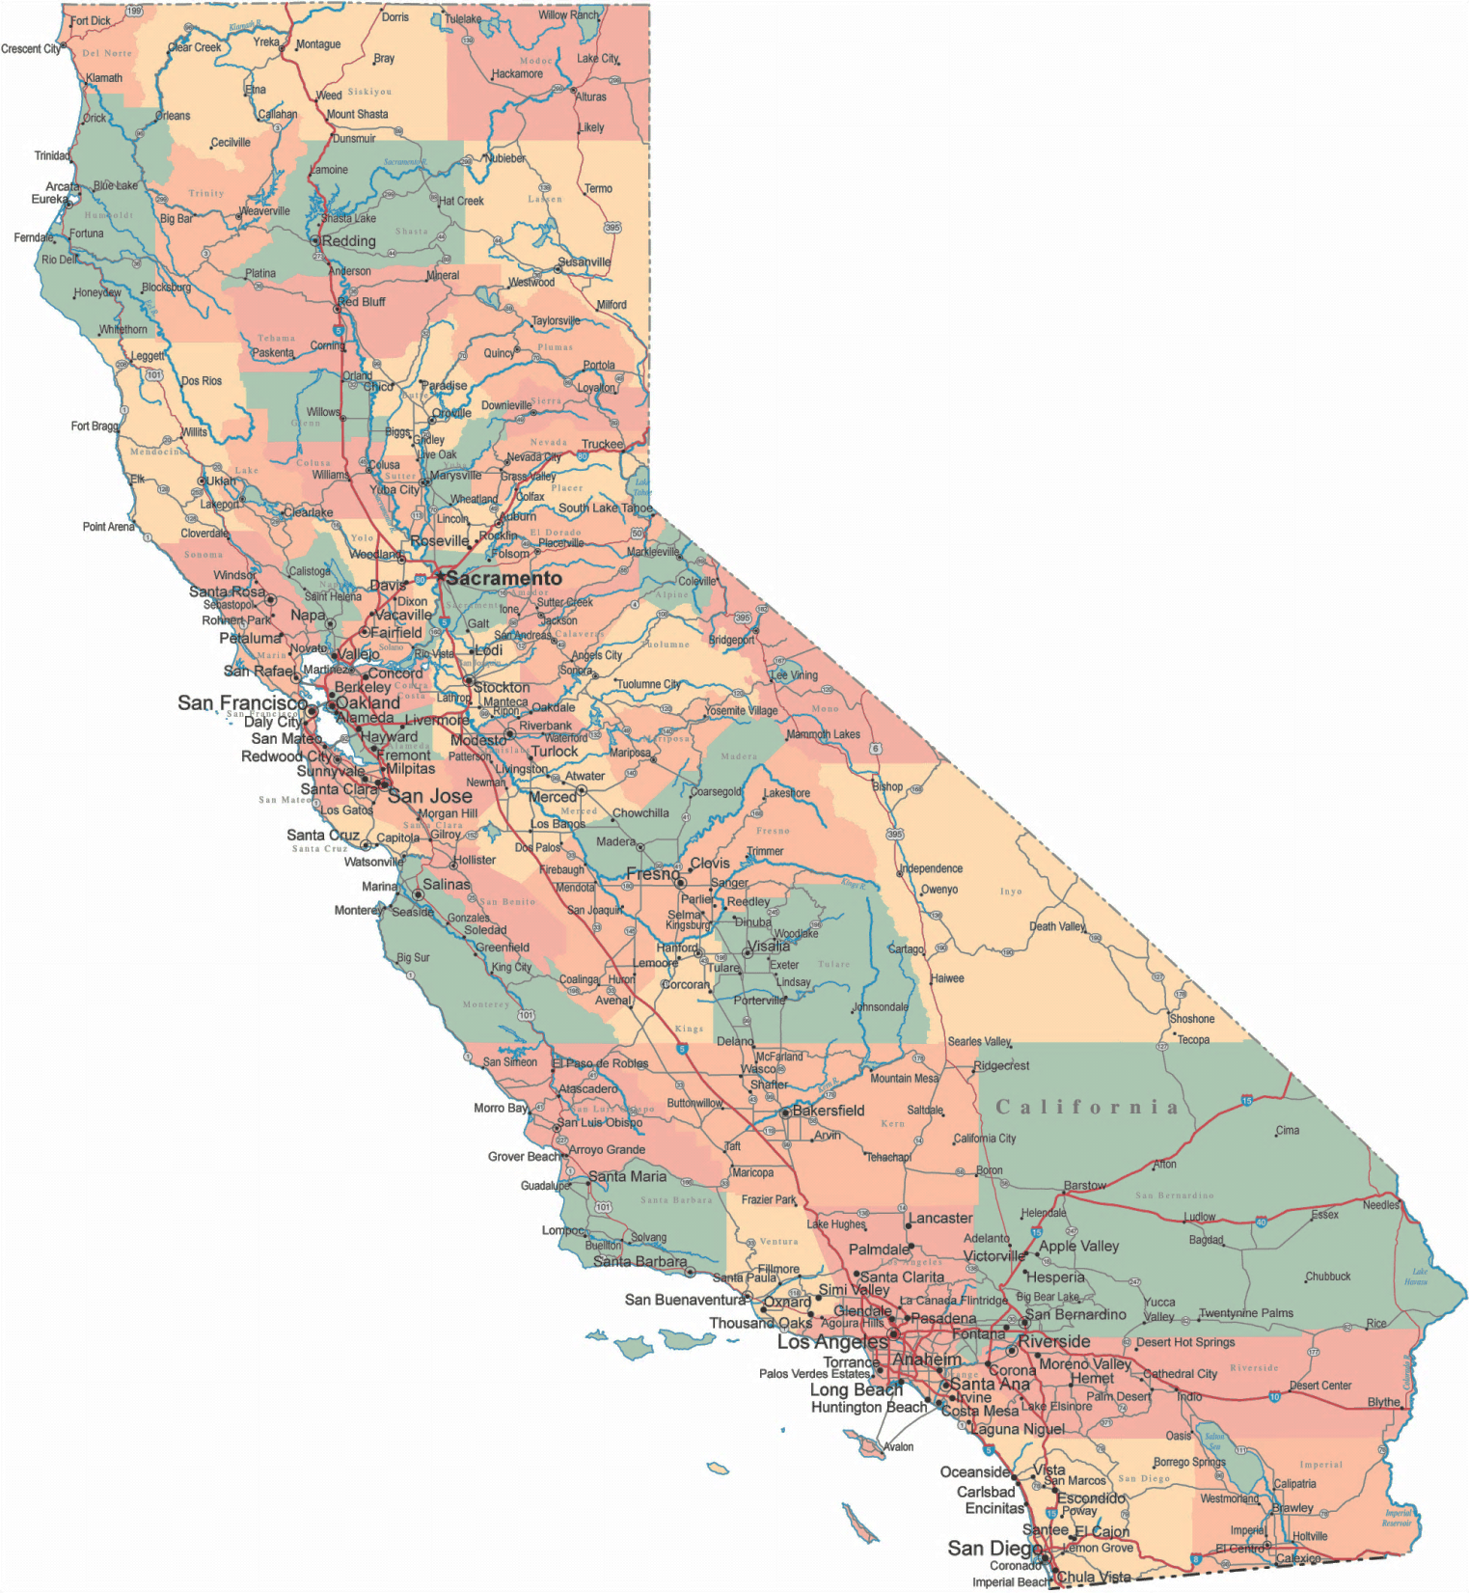
Hyperlocalism

Slide 27
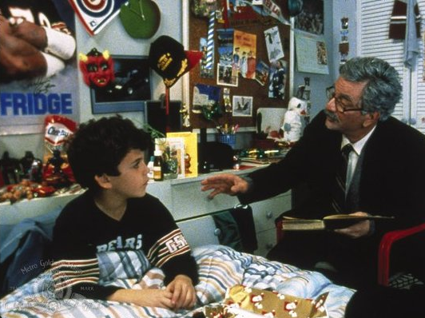
Narrative

Slide 28
Infiltration

Slide 29
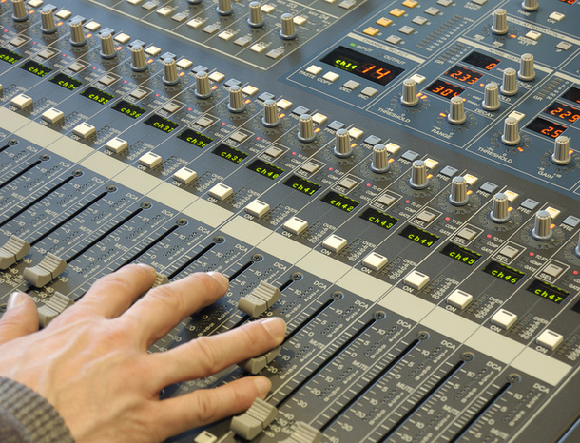
Remix

Slide 30
Build capacity: Beyond inventory control to support for learning and creativity

Slide 31
Build capacity: Beyond transactions to outcomes

Slide 32
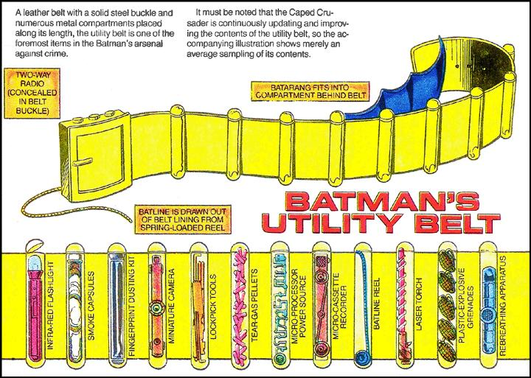
Build capacity: Beyond rules to tools

Slide 33
Build capacity: Beyond rationing to abundance

Slide 34
Build capacity: Beyond anonymity to market knowledge

Slide 35
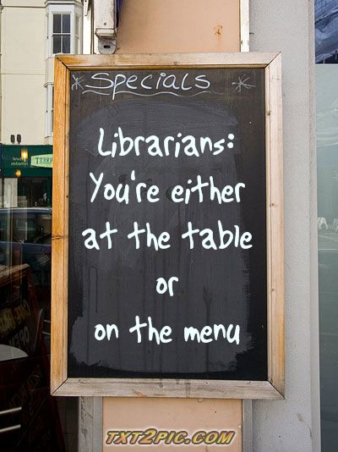
Build capacity: Beyond remedial advocacy to peer engagement

Slide 37
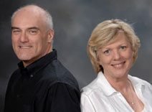
Let’s continue the conversation
http://www.georgeandjoan.com
hello@georgeandjoan.com

