Slide 1
Location-Based Social Networks
An Webinar
Wednesday, September 14, 2011
12:00 Noon – 1:00 p.m. PST
Presenter: Dawne Tortorella
drt@bellcow.com
Infopeople webinars are supported by the U.S. Institute of Museum and Library Services under the provisions of the Library Services and Technology Act, administered in California by the State Librarian.
Notes:
Location-Based Social Networks
Hello, I’m Dawne Tortorella and my location is latitude 41 degrees 3 minutes and longitude -88 degrees 6 minutes. If you are from California, your longitude will be somewhere between 116 and 124 degrees. By the end of this webinar, we can see exactly where I’ve checked in to join you today.
I am a library consultant who works with libraries of all types in technology planning, staffing, professional development, web technologies, and social media. My recent research includes study of social network analysis in organizational development and the impact of social media tools in professional development.

Slide 2
Agenda
Geo-Mapping: Get on the Map
Mobile Services and Patron Patterns
Case Studies
Additional Resources
Notes:
First we will review key location-based listing services and see how we can get our library on the map. Think back to the 1980s, was your library listed in the phone book? You need to make sure your library is listed in the major places people look for information today.
Taking a look in the mirror and examining your own patterns of behavior, you will determine if these patterns are reflective of your own patrons and the general population at large. How do people use location-based services? Do you realize how often your location is factored into new applications automatically?
There are outstanding models to follow in how location-based social networking enhances library service. We’ll examine a few.
And finally, a list of additional resources and hopefully some engaging Q&A will cap off our hour together.
------
Before we get started, let’s cover some housekeeping details. Please enter any questions or comments you have during the webinar in chat. I’ll try to keep an eye on those and incorporate them into our discussion. At the end of the webinar, while you fill out the evaluation on your screen, I’ll answer any remaining questions submitted via chat.

Slide 3
Geo-Mapping
Notes:
Through use of location services such as GPS and mobile tracking algorithms, geo-mapping allows identification of a post or status, photo, or other activity with a physical location. Depending on the service, other activities associated with the location can be seen and people can interact based on their location.
Geo-mapping matches people and places across time and space.
In 2010, many social networking pundits predicted location-based services to be the fastest growing sector of social networking. The 2011 predictions add time as a dimension to these services. Where and when do patterns of social activity occur?
Designing Social Interfaces, by Christian Crumlish and Erin Malone, discuss Geo-Mapping in relation to building a social website and engaging in the social web.
http://designingsocialinterfaces.com/patterns/Geo-Mapping#Use_When

Slide 4
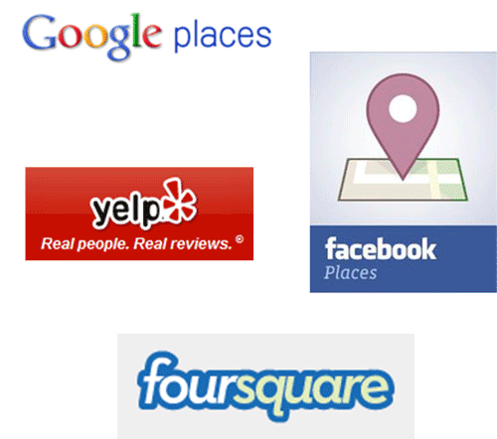
Claim Library Directory Listings
Google Places
Facebook Places
Yelp
Foursquare
Notes:
It will only take a couple of days for you to research, claim, and update your library’s directory listings on key location-based services. Once established, the listings can help identify library users connected through location-based social media.
Savvy social media users estimate the time to claim a location-based listing to be less than an hour. But, if you are like me, you might be more comfortable researching the service first and conferring with some “how-to” guides. Several are listed in the Resources listing for this webinar.
Your “places” pages give you insight into your service population and can serve as a research tool for understanding usage patterns and associations of your users.

Slide 5
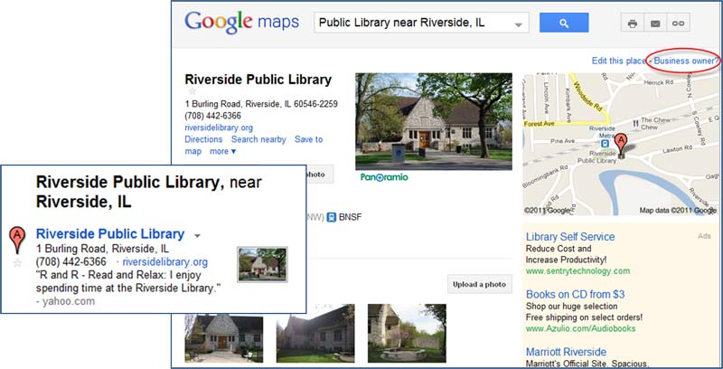
Google Places
Notes:
Google Places is an online business directory which displays within Google Maps. If you have ever used Google Maps and noticed business names or searched for “restaurants near” you have accessed the Google Places listings. Also, if you search Google, local results are optimized. They appear higher in the results list.
By having an updated Google Places listing you are guaranteed to show up on the map and your likelihood of being returned in a search by someone in your local community increases.
To get started, go to Google Maps (maps.google.com) and search for your library. A Google Maps pin marker will indicate the location. The link will bring up the Google Places page. Look in the right top, above the small location page for the “Business owner?” link.
Follow the instructions for claiming the Google Places listing. You need to login with a gmail account to claim the place and to edit contents. If your library does not use gmail, create a free account for purposes of managing your Google Places listing.
Google Places google.com/places

Slide 6
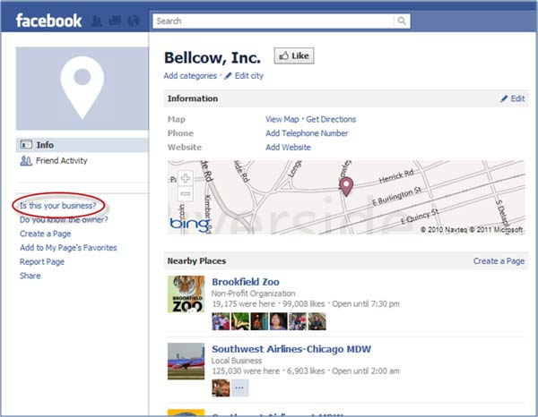
Facebook Places
Notes:
If you already have a Facebook Page for your library, complete the basic information in the page profile. The full address will be matched to a Facebook Places Page. To claim your library as a Facebook Place without a Facebook Page, you will need to add the location to Facebook Places. That process involves using the Facebook mobile app to mark your location while at the library so that you can add the “places” marker. Once added, you can update the basic information and request a claim on the property.
Instructions for claiming a Facebook Places page facebook.com/help?page=1154

Slide 7
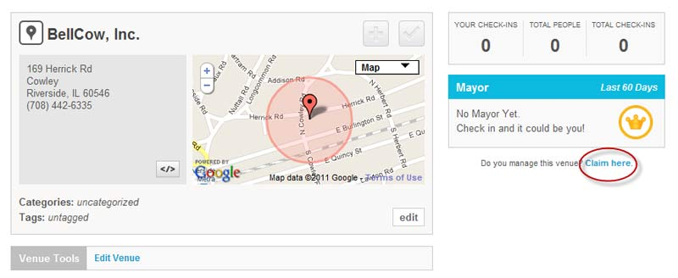
Foursquare
Notes:
Foursquare has created an automated process for adding your library to Foursquare.
Start at the “Foursquare for Business” page. foursquare.com/business
Search for your library; if it exists, claim it. If not, add your listing and then claim.
This is starting to feel a bit like the shampoo bottle instructions “lather, rinse, repeat.” The claiming strategy is similar for most location-based social networking listings.
Verify that the listing does not already exist.
Add the listing.
Claim the listing – verified through email, phone, or other verification methods.

Slide 8
Exercise - Demo
Enter Library Name, City in chat window
Search Google Places
Is it listed?
Is it owned?
Search Yelp
Listed?
Claimed?
Notes:
If you would like to volunteer your library as an example, enter your library name and city in the chat window. We will select one to check if your library has a location-based listing in Google Places and Yelp.

Slide 9
What do we use our mobile phones for?
Dining | Entertainment | Games
Maps/Search | Music | News
Video | Weather
Notes:
Let’s take a poll to see how we use our mobile phones.
Select as many as apply.
[NOTE: WebEx poll]

Slide 10
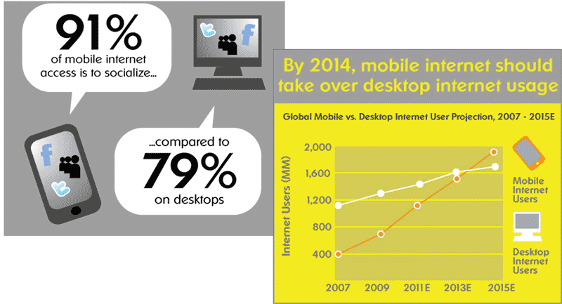
Front Door to our Library is 6 inches²
Infographic from Microsoft Tag
Notes:
Image derived from Mobile Marketing, from Microsoft Tag tag.microsoft.com/community/blog/t/The_Growth_of_Mobile_Marketing_and_Tagging.aspx
With the rise of tablet computing, more mobile options are growing. Mobile means social – people use their mobile devices to connect to people, places, and activities. By 2013, more people will visit your online library via mobile device than desktop/laptop computer.

Slide 11
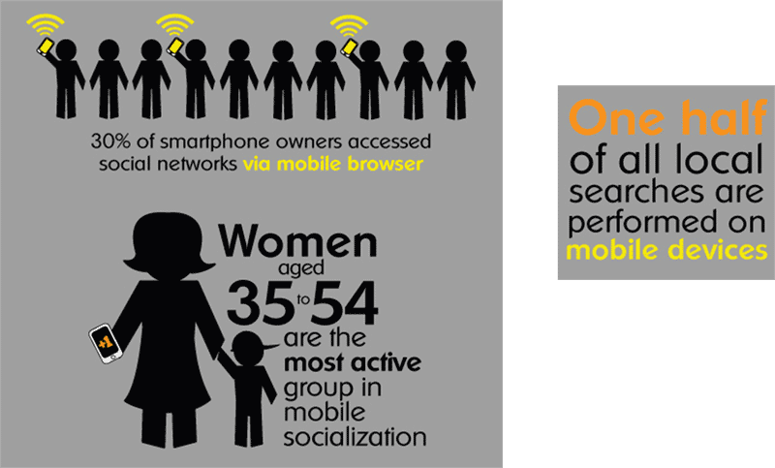
Reflection of the Mobile Demographic
Infographic from Microsoft Tag
Notes:
Image derived from Mobile Marketing, from Microsoft Tag tag.microsoft.com/community/blog/t/The_Growth_of_Mobile_Marketing_and_Tagging.aspx
You may be surprised to learn that women aged 35-54 are the most active group in mobile socialization. Add in the findings that half of all local searches are performed on mobile devices and a picture emerges of who might be connecting to our library via location-based social networks.
Looking at these demographics, I suspect many of us represent this typical user. If you own a smart phone, think back to a time before you had it. How has your searching behavior changed?

Slide 12
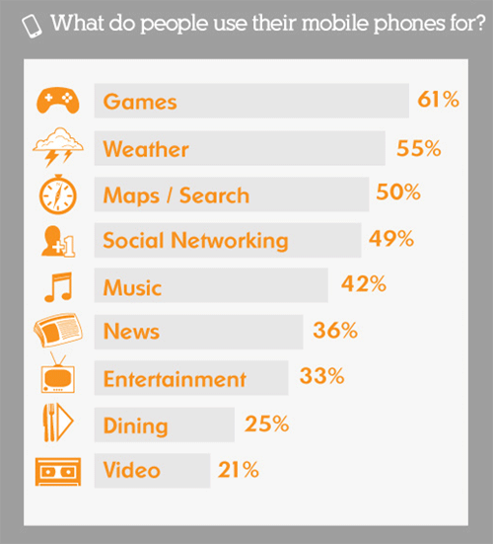
2011 Study on Mobile Phone Use
Are we reflective of the general population?
Of our users?
Infographic from Microsoft Tag
Notes:
Image derived from Mobile Marketing, from Microsoft Tag tag.microsoft.com/community/blog/t/The_Growth_of_Mobile_Marketing_and_Tagging.aspx
Our poll may show that we are quite representative of the general population or it may have illustrated the gap between our behavior and use of mobile technology and our users. While our communities may not be reflective of general population trends, it is important to understand what is happening “out there” so that we can best provide service “here.”
Mobile is big and getting bigger.

Slide 13
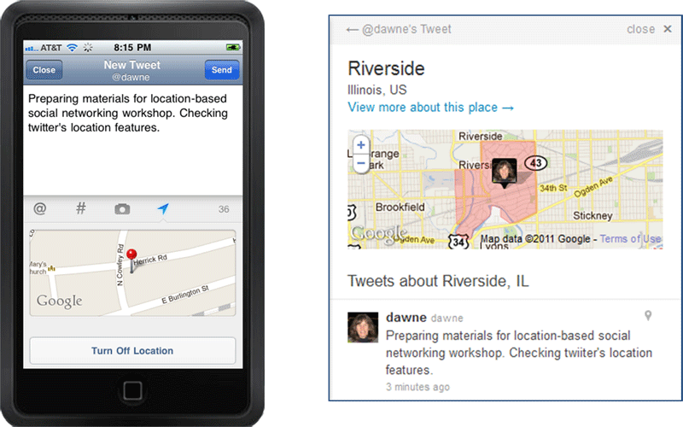
Tweet – Meeting of Time & Space
Notes:
From my personal mobile phone to the world in less than 2 seconds, my location is posted and placed in context with others at the same location.
If your library has a twitter account, take advantage of the location identification. People in the area will be reminded of the services and social interaction buzzing at your library. If you work as an ambassador for your library when you are out in the community, show your location as you tweet on the library’s behalf.
The Library of Congress is archiving all twitter traffic, further justifying the importance placed on social media in our lives and in making history.

Slide 14
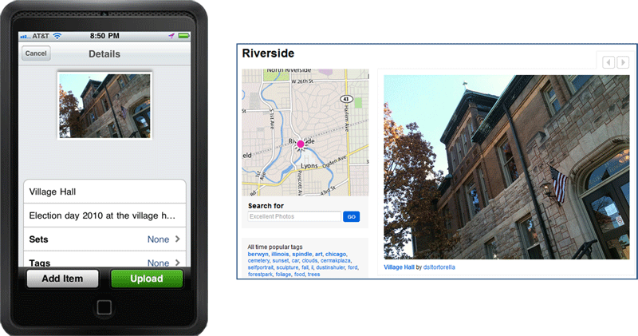
Geotag Flickr Photos
Notes:
Explore Flickr Places flickr.com/places
Check Flickr Places, searching for your library’s town. Are there representative photos of your library?
With location tracking turned on, mobile phones are able to encode location information with any photos taken on the device. Uploading directly to Flickr transfers that information creating an instant geotag. If you use a computer to upload photos to Flickr you can add the photo to a map, targeting the location of the shot.

Slide 15
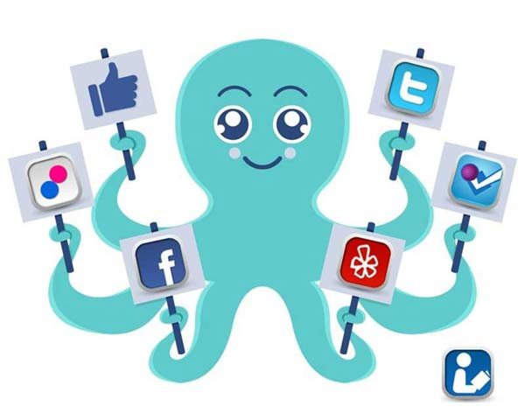
The reach of an octopus
Notes:
The goal is to be ubiquitous. The reach of social media is great and if your users are interacting with location-based social media, your library needs to be on the map and ready to welcome them with many arms!

Slide 16
The Perils
Our Ten Favorite Mashable Comics
Notes:
Comics from Our Ten Favorite Mashable Comics mashable.com/2011/07/10/top-mashable-comics/#197373-Theres-a-Badge-for-That
Concern continues on the security and privacy of location-based social networking. From a consumer perspective, it is important that we help educate our users on the risks of broadcasting personal locations inadvertently. As providers of information and services, we must also be involved in emergent technologies.
Risk to our institutions through maintenance of geo-location based “places” is minimal. Expect the occasional spam or insulting review, but don’t let it ruin your day. Users of these services easily spot such abuse and ignore it. Positive reviews with substantive comments are valuable to your business.

Slide 17
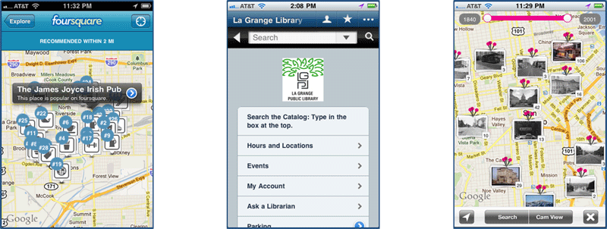
Case Studies – Library Specific Use
New York Public Library Foursquare
Library Anywhere
History Pin
Notes:
Working in the abstract is sometimes difficult. Unless you personally use location-based social networks, you might not see how these relate to the services you offer.
New York Public Library has been aggressive in establishing social media interaction with their city – patrons and visitors.
We will look at these three case examples through application sharing on a desktop computer. However, this tells only half the story. Location-based social networks are largely driven by the mobile app users. How they interact with these applications through their mobile devices is key. If you have an iphone or android, download the apps and experiment on your own.

Slide 18
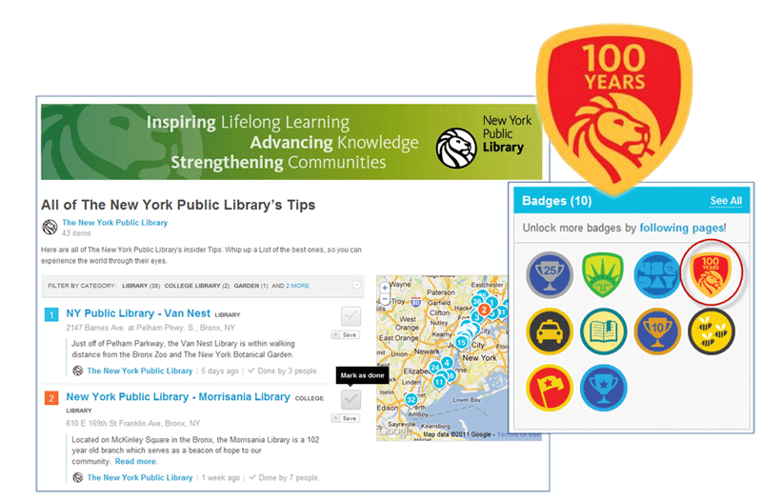
NYPL Foursquare
Notes:
Press Release: The New York Public Library Partners With foursquare To Unveil A New “Badge” nypl.org/press/press-release/2011/03/30/new-york-public-library-partners-foursquare-unveil-new-%E2%80%9Cbadge%E2%80%9D
NYPL Foursquare foursquare.com/nypl
NYPL was the first library in the world to create a custom Foursquare badge. During their 100 year celebration, they are embracing social media. To earn the badge, you have to follow the New York Public Library on foursquare and check into three NYPL venues or the New York Public Library 5 times. Since Foursquare requires a location-based service to trigger a check-in, anyone wishing to participate and earn that badge has to be within physical reach of the library. And being that close, chances are they will come through the doors.
NYPL adds tips for visiting collections and special resources of the library to maximize visits. Foursquare users can follow these tips and mark them as completed to keep a physical inventory of the tips followed.
Used strategically, Foursquare is a valuable tool to get people in the front door and to create scavenger hunts and target collections for your visitors.

Slide 19
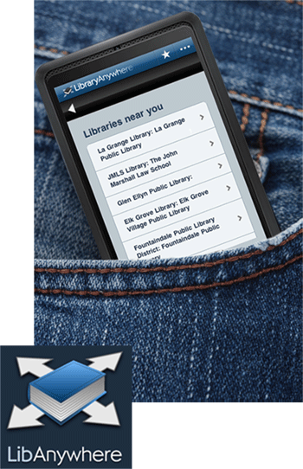
Library Anywhere
Find a library in the area
Search the catalog
Select item
Enter barcode & pin
Place a hold
Manage your account
Notes:
LibraryAnywhere, by Bowker bowkerinfo.com/offers/LibraryAnywhere/
Web interface for LibraryAnywhere libanywhere.com
I created a short video on using Library Anywhere back in March. It illustrates finding based on current location, searching the catalog and placing a hold. Depending on whether you are connecting to your home library, a local library within your consortium, or a library somewhere across the nation, your options will reflect what actions are permitted at that library.
WebJunction Workshop Demo – Developing Online Patron Tutorials, Library Anywhere
screenr.com/Dj6

Slide 20
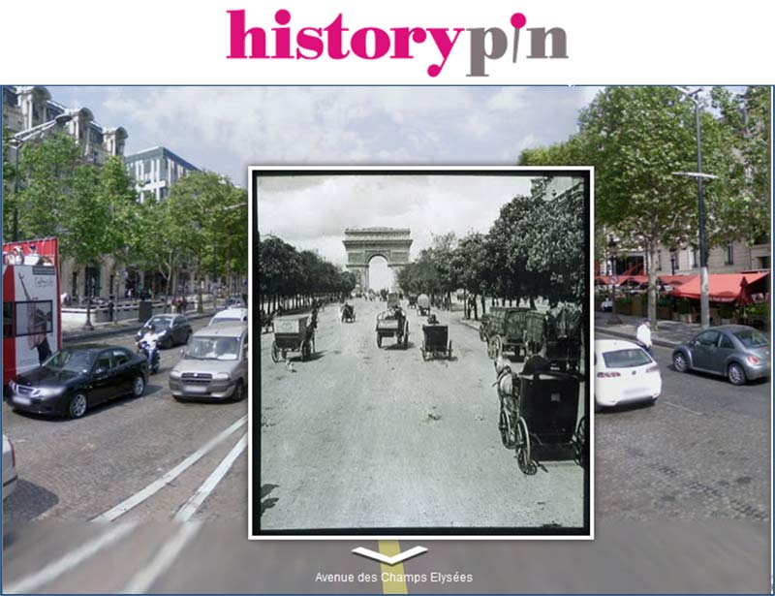
History Pin
Notes:
HistoryPin
historypin.com
History Pin is a “not-for-profit company that creates ways for millions of people to do more small, good things, helping address major social and environmental issues.” They have partnered with Google to create History Pin which has been widely discussed by libraries. It provides an opportunity to get your community involved in a worldwide effort to document history and make history using social tools.
The Library of Congress has been active adding some of their collections to History Pin and encouraging others to participate. You could launch a project in your community to feature local history.
The mobile app allows you to upload photos to History Pin, taking the location from your location. You’ve probably seen the commercials with the historic photos overlaid on a busy modern place.

Slide 21
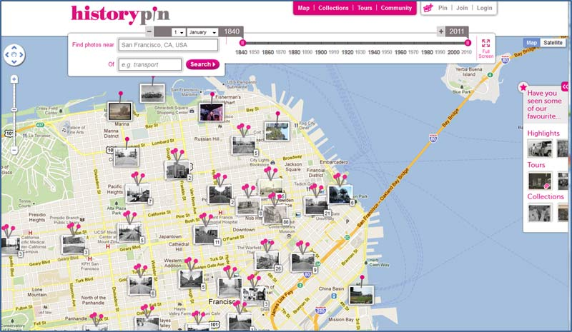
Location, Location, Location
Notes:
Like real estate, location is important.
Choose a location and a time period on the map. When you locate a pin of interest, click on that pin and “zoom and see more.” Look for an area with the option to “view in Streetview” to see how that location has changed in time.

Slide 22
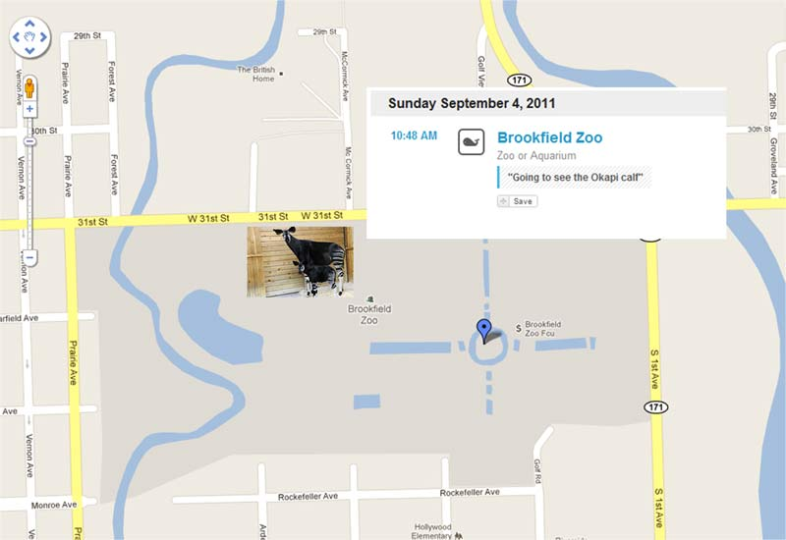
So where am I?
Notes:
Well, I’m within walking distance to the Brookfield Zoo, in Brookfield, IL which is about 8 miles west of Chicago. Here you can see my check-in from a recent visit to the zoo.

Slide 23
Infopeople Online Course
Library Marketing and Promotion
via Social Media
Instructor: Dawne Tortorella
Dates: Tuesday, October 18 – Tuesday, November 14, 2011
More information at:
http://infopeople.org/training/library-marketing-and-promotion-social-media
Notes:
Infopeople Online Course
Library Marketing and Promotion via Social Media
http://infopeople.org/training/library-marketing-and-promotion-social-media

Slide 24
Thank You!
Dawne Tortorella
Email: drt@bellcow.com
Twitter: dawne
LinkedIn: www.linkedin.com/in/dawnetortorella
Google+ Dawne.Tortorella@gmail.com
Notes:
Dawne Tortorella
Email: drt@bellcow.com
Twitter: dawne
LinkedIn: www.linkedin.com/in/dawnetortorella
Google+ Dawne.Tortorella@gmail.com

