Slide 1
Libraries and Economic Recovery: Supporting Entrepreneurs
An Infopeople Webinar presented by
Joan Frye Williams and George Needham
November 16, 2011

Slide 2
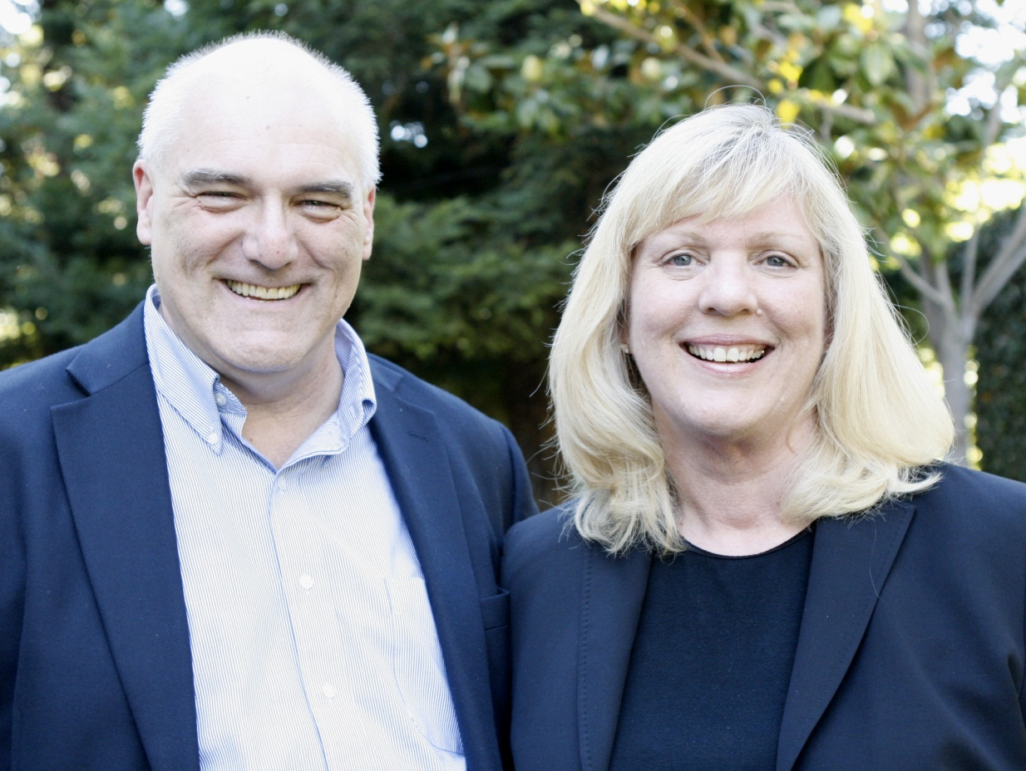
Photo by Chuck O’Shea

Slide 3
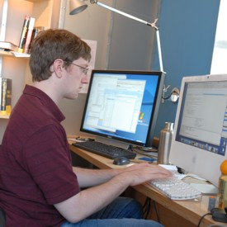
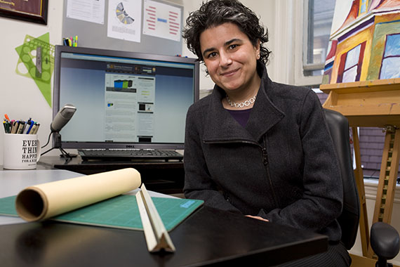
Today’s entrepreneurs

Slide 4
Remember the social entrepreneurs

Slide 5
Entrepreneurs ≠ “small business”

Slide 6
Why target this group?

Slide 7
Strengthens the local economy

Slide 8
Increases the tax base

Slide 9
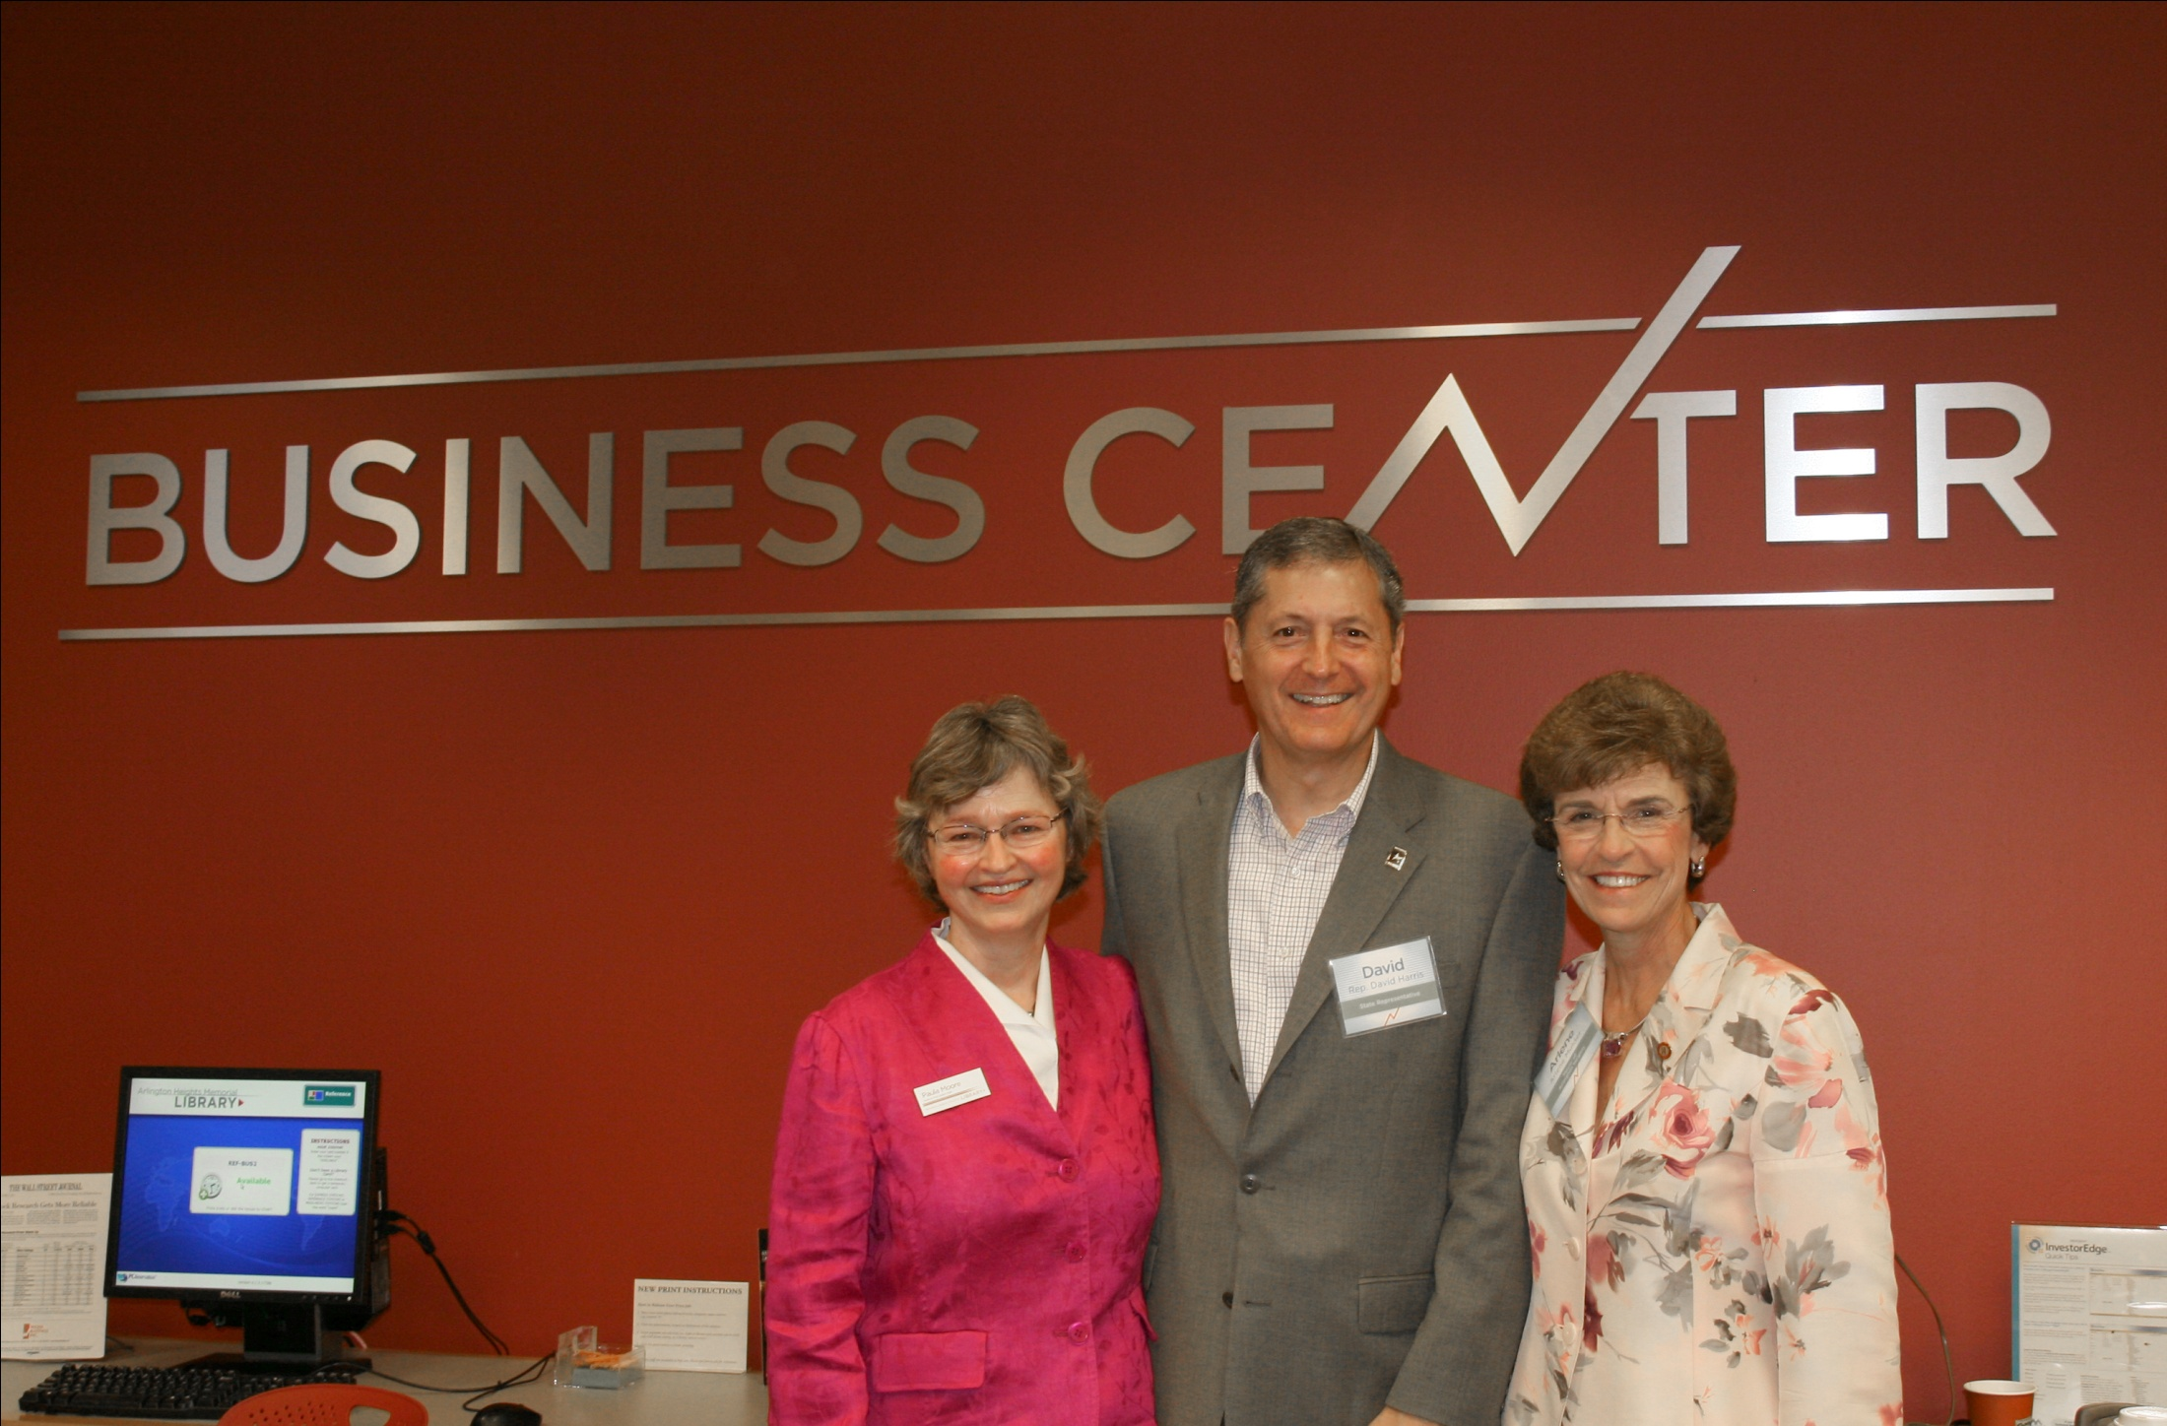
Garners bi-partisan political support

Slide 10
Cultivates a growing audience

Slide 11
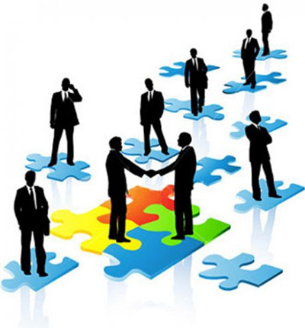
Creates allies and advocates

Slide 12
Demonstrates return on investment

Slide 13
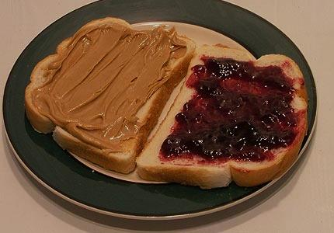
Libraries and entrepreneurs: a good match

Slide 14
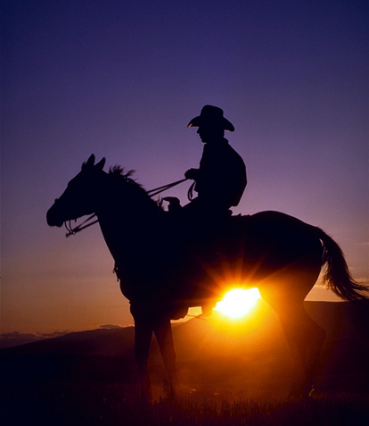
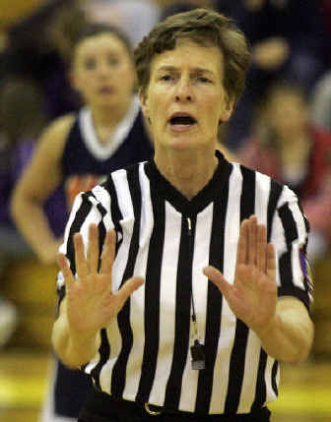
Overcome the stereotype

Slide 15
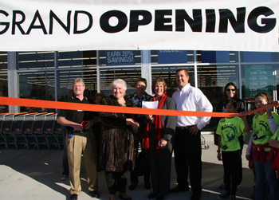
Spend time in the community

Slide 16
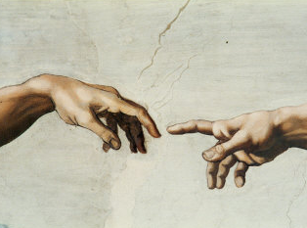
Establish personal contacts

Slide 17
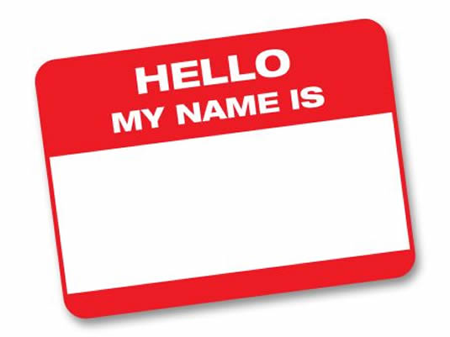
Introduce this community to itself
Yr Hometown

Slide 18
Ask the right questions

Slide 19
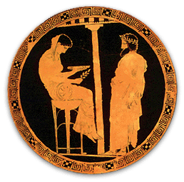
Demonstrate local knowledge

Slide 20
Rethink your work spaces

Slide 21
Build accessible collections

Slide 22
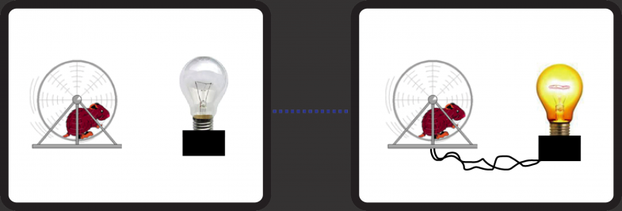
Support their use of modern office tools and technologies

Slide 23
Think “research,” not “reference”

Slide 24
Rebrand around innovation

Slide 25
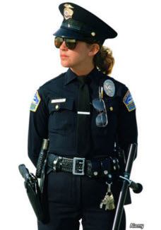
Train everyone as a first responder

Slide 26
Design for predictable situations

Slide 27
Predictable: Getting started

Slide 28
Predictable: Sizing up the competition

Slide 29
Predictable: Pricing the product

Slide 30
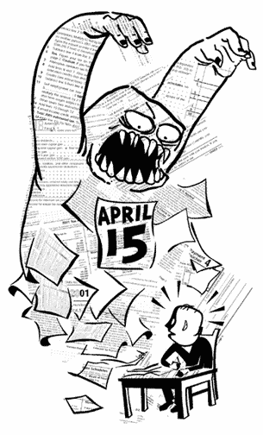
Predictable: Paying business taxes

Slide 31
Predictable: Protecting intellectual property

Slide 32
Predictable: Communicating with customers

Slide 33
Focus programs on applied problem solving
→Setting up a home office
→Time management tips for solo workers
→How to prepare a successful bid
→Using Etsy and eBay as distribution channels
→Using Facebook and LinkedIn to reach customers
→Preparing for licensing and bonding

Slide 34
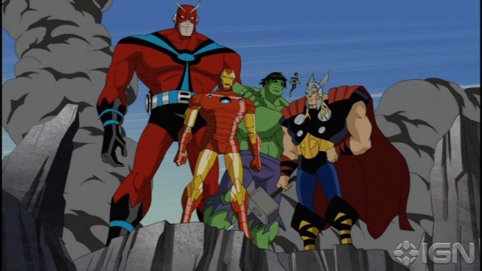
Partner for maximum effect

Slide 35
Take credit for your successes

Slide 36
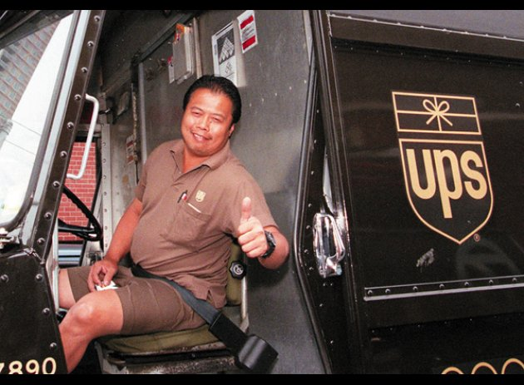
Stay in touch

Slide 37
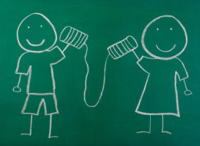
And stay in touch with us!
hello@georgeandjoan.com

