Slide 1
When the Clock strikes 50: planning for Act III-retirement?
An
Webinar
Wednesday
December 6, 2011
12 noon—1:00 p.m.
Paula M. Singer, Ph.D.
pmsinger@singergrp.com
Gail L. Griffith
gail-griffith@comcast.net
Infopeople webinars are supported by the U.S. Institute of Museum and Library Services under the provisions of the Library Services and Technology Act, administered in California by the State Librarian.

Slide 2
Agenda
Why this topic?
What we’re covering – and not covering
Emotional steps
Retirement as transition
Elements of an ideal retirement
Know thyself!
Planning Act III

Slide 3
POLL: Who’s in our Virtual Living Room?
Library Directors
Supervisors
Front-line staff
Students
Other
Age?
POSITION
AGE

Slide 4
Paula and gail

Slide 5
Chat: What made you choose this webinar?
A few words, please answer using chat

Slide 6
chat
What comes to mind when you think about your retirement?

Slide 7
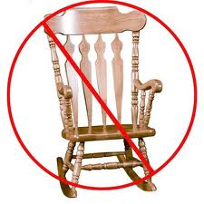
It’s not your mother’s retirement
Living longer
Working longer
Have more options than ever
Reinvent retirement!

Slide 8
Transforming retirement
ACT I Development | ACT II Productivity | ACT III Development Productivity Leisure | ACT IV Leisure

Slide 9
5 Emotional Stages
Imagination (6-15 years before)
Hesitation (up to 3 to 5 years before)
Anticipation (0-2 years prior)
Realization (retirement day and the year following)
Reorientation (2-15 years after retirement)
Reconciliation (16 years +)
Chat: What stage are you in?

Slide 10
About Retirement
Retirement is a career transition
Can be voluntary or involuntary
Stage of life
Includes biological aging
Requires economic support for an unknown time
Changes your level of engagement
Shaped by earlier life stages
Retirement well-being includes prosperity, health, and happiness
Nelson and Boles

Slide 11
Transition
What are some of the life transitions you’ve already been through?
Use chat to tell us
H/O #1 HELP WITH MANAGING

Slide 12
Stages
Relinquish
Recess
Redefine
Re-engage

Slide 13
Elements of an ideal retirement

Slide 14
Understanding yourself
Values
www.my.LifeValuesInventory.org
Strengths
www.VIACHARACTER.ORG
Personality Style
Fulfillment

Slide 15
What do you really value?
How do you sort out those things that are truly important-that make you tick – from those things that you learned to consider important only because you got approval and rewards for them?
Handout 3: Personal Turn-Ons and Turn-Offs

Slide 16
Sources of fulfillment: values
Collaboration
Recognition
Earning Income
Professional affiliation
Creative expression
Environments
Time structure
Influence
Purpose
Travel
Mental challenge
Friendship
Helping others
Spirituality
Community
Self-development
Physical exercise
Social connection
Family
Individual accomplishment

Slide 17
Sources of Fulfillment
What are the sources of fulfillment?
Are they coming mostly from work?
If so, what will you seek in the future?
Activity style plays a role
Cooperative pursuits?
Helping others?
Independent accomplishment?
Self development?
Combination?

Slide 18
Personality Style
Social: Contemplative -- Outgoing
Stress: Responsive - Resilient
Activity: Independent – Interdependent
Information: Practical - Visionary
Outlook: Cautious - Optimistic
Decision: Analytic – Empathetic
Planning: Structured – Flexible

Slide 19
activities
What activities do you see yourself doing when you finish full time work?
Use chat to tell us.

Slide 20
3 Categories of Activities

Slide 21
Relationships
No automatic relationship generator
Trust and reciprocity
Bonding and bridging

Slide 22
3 levels of relationships

Slide 23
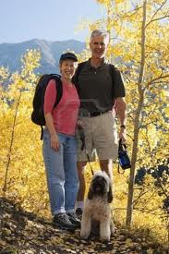
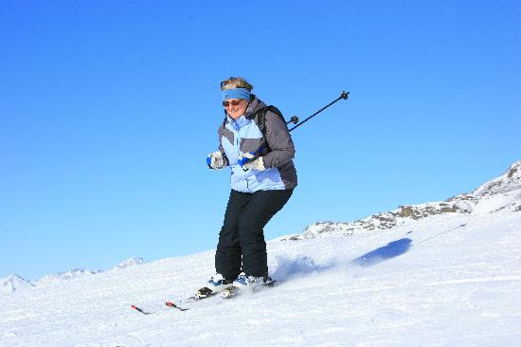
PLACE
Where would you like to live after you retire? Use chat to tell us.

Slide 24
Where to live?
S – sense of place
A – aging in place
L - livable community
E – essential region

Slide 25
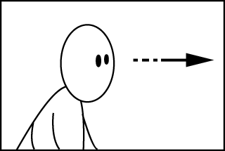
Anticipating Retirement
What can you do now?
If you haven’t already…
Nurture close relationships
Find a passion outside of your job
Give of yourself
Build social networks
Build deeper relationships
Meaningful/engaging/pleasant
Marriage S/O – on steroids: space and time

Slide 26
Anticipating retirement
Take classes to investigate new interests
Develop new skills for post-retirement work
Think about:
Who will I be once I stop working?
What will my mental, emotional and physical health be?
What losses will be there in my life?

Slide 27
Options
Work – sabbatical, reduced, alternative job, job share, telecommuting
Temp, freelance, or consultant role
Phased retirement/ bridge job
Downshifting
Encore career
Retooling – another profession, starting a business, education
My turn! (vol work, help kids, enjoying being free of commitments, practice being inner-directed)

Slide 28
chat:
Earlier we asked you What comes to mind when you think about your retirement? Let’s check in again: What comes to mind now when you think about your retirement?

Slide 29
Plan: Handout – Draft Plan
Health/exercise
Meaningful activity/passion
Relationship with mate
Friendships: pleasant/engaging/meaningful
Family
Self development/spirituality
Home
Community
Other
Recess
Continue/Expand/Test Drive

Slide 30
Action plan
What is the one step you will take in the next month to move you along the ACT III path?
In the next 6 months?
Use the chat to share an answer to the first question.

Slide 31
handouts
How to Manage Your Transition
Social Relationships and Activities: Pleasant, Engaging, Meaningful
Personal Turn-Ons and Turn-Offs
Drafting a Plan
Resources

Slide 32
Questions?

Slide 33
Thank you!
Paula M. Singer, Ph.D.
pmsinger@singergrp.com
Gail L. Griffith
gail-griffith@comcast.net

