Slide 1
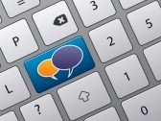
Building Digital Communities through Blogs and Social Networking
Digital Citizens
Notes:
Greeting/ Introductions
Housekeeping: Send your questions as we go along
“As digital library systems, applications, and projects proliferate, we expect a growing industry to emerge. In many ways, digital libraries propel the state of the art in information technology by requiring seamless integration of diverse approaches to collecting, organizing, storing, accessing, and applying knowledge.” That statement was reported
In a Communications of the ACM (Association for Computing Machinery) news report by university computer and library sciences professors Edward Fox and Gary Marchionini.
A decade later, this remains true today as well. With the combination of social media and traditional websites, libraries are embracing the new era of digital communities and are reshaping their relationships with their patrons. Building a digital community around your brand or library focus is a great way to create ambassadors and keep patrons coming back to your site. A digital community, simply put is a group of people coming together with similar goals and interests on the line. Community can come in many forms, you may want to develop it around something as direct and traditional as a regular book review or you may want to embrace social networking or mobile apps in creative ways.
Libraries around the world are making progressive strides by integrating new technologies into their marketing and information sharing. As we learned during my last InfoPeople webinar, Using Smart Phones as a Marketing and Programming Tool, libraries are already sharing eBook and audio collections, instructions via podcasts, virtual tours of libraries, mapping local history, networking with colleagues, social sharing of what you are reading, incorporating Quick Response Codes, and location based check ins. WOW - The future is really here already! Many of these exciting ideas can be easily incorporated into today’s topic of Building Digital Communities through Blogs and Social Networking.

Slide 2
Building Digital Communities through Blogs and Social Networking
Embracing Today’s Technology
Blogging vs Social Networking
Building A Brand
Creating A Social Media Guide
Effective Library Tools
Getting Started
Patric@MediaArtsCenter.org
Notes:
Today’s webinar will explore
Embracing Today’s Technology
Blogging vs Social Networking
Building A Brand
Creating A Social Media Guide
Effective Library Tools
Getting Started
This is an introductory webinar so I’ll try to cover a lot of ground. Please make sure that you include your e-mail when you fill out today’s webinar info as I always follow up my webinars with useful information that comes out of our Q&A session. If you missed out on submitting that info, then feel free to contact me so I can pass along additional information to you.

Slide 3
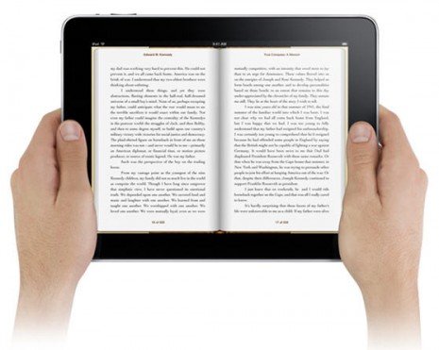
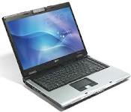
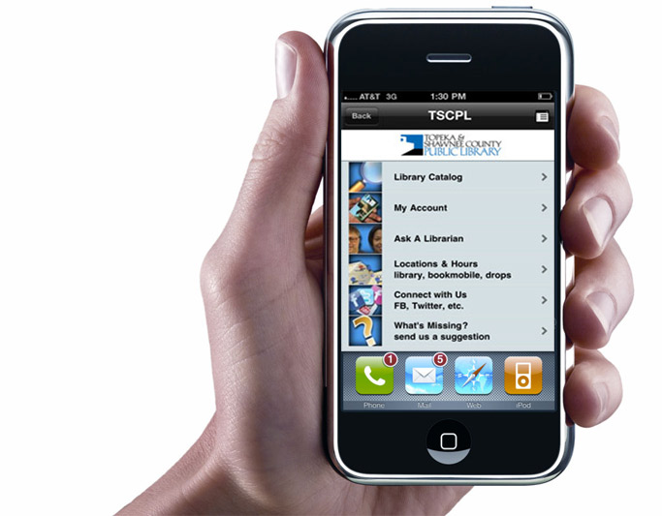
Building Digital Communities through Blogs and Social Networking
1.4 Billion Personal Computers
2 Billon Internet Users
5 Billion Mobile Phones
GREAT RESOURCE: Pew Internet Report
THE SOCIAL SIDE OF THE INTERNET
http://www.pewinternet.org/~/media/Files/Reports/2011/PIP_Social_Side_of_the_Internet.pdf
Notes:
If you’re asking yourself why does it matter whether or not you embracing today’s technology at the library, you need to look at what’s happening in the world today. We live in the computer age and we are living lives connected well beyond the confines of our own neighborhood.
According to the April 2011 report from Booze and Company, there were 100 million personal computers in 1990 and 1.4 billion in 2010.
The number of mobile phone users increased from 10 million to more than 5 billion over the same period,
and the number of Internet users surged from 3 million to 2 billion.
Not only are we attached to technology but our behaviors are changing because of it. Around the globe, people are coming to expect constant immersion in the digital world—to be able to fulfill their need for communication, information, and entertainment anywhere, at any time. What is more, they are not just consuming content but also creating it.

Slide 4
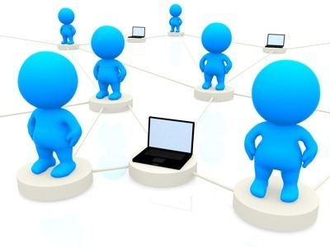
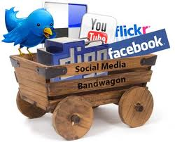
Building Digital Communities through Blogs and Social Networking
Notes:
Building an interactive online community – Know your target audience
Before we look into the nature of blogs and social networks, its important that we start with some basics. In order to build a the structure for our new digital community, we should ask ourselves who is our target audience and what are their needs?
A related question that we can consider is why do communities form around physical libraries and can we incorporate that into our online presence?
What do users wants? What do users need? What do we do when these two things differ? When we do this on the reference desk, it’s a reference interview. When we do it with collections, that’s how we build interest in the collection. On a larger scale, it’s assessment.
What’s the value that we offer to our patrons? What do they really need? Outcome-based assessment leads to effective marketing.
I assume that most patrons engage with your library because of the collections and the reference help. They form around physical collections because of interest, ownership, and investment. Interest leads to ownership which leads to investment. So build your digital community with this in mind.
You will be most successful if you ‘get out of your library.’ Think outside the box. Reach out to your local community that you are not reaching as well as your patrons. You may even consider joining MEETUP.COM which provides a great way for you to engage your community and see what people in your area are interested in.
Other characteristics of your intended audience may also play a role, age for example. If your audience is teens (digital natives), this is going to be a lot different than if your focus is on elders (digital immigrants). Each audience has different wants and needs as well as a different way of communicating. So you may want to tailor your activities on what will best reach the community you want to develop.
As with any worthwhile project, you will benefit by doing the legwork. As you can imagine, there is nothing more disappointing than putting in the effort to start something and then wait for people to find you. Identify patrons and colleagues you already have a relationship with to help you get things started. Utilize this group to give you feedback on what works and inform you on what they would invest their time and attention too.

Slide 5
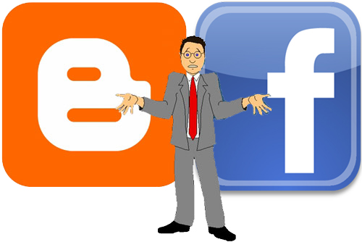
Blogs vs Social Networks
Notes:
Survey: What are you doing online? (Multiple choice question)
Twitter
Facebook
Flickr (or other Photo Sharing)
Posterous (autoposting, email Content)
YouTube (you create a video channel, build community)
LinkedIn
MeasuredVoice (or Hootsuite)-scheduling of tweets
Yelp!
Livestream
Wordpress, Blogger or other Blog service
Googledocs and now Google plus
Discover the difference between blogging and social networking
You may get a variety of answers if you ask what is a blog but I define it as basically an online journal. The activity of updating a blog is “blogging” and someone who keeps a blog is a “blogger.”‘
Social Networks, meanwhile, are online places that bring together like-minded people to share ideas, activities, events, and interests within their individual networks.
Last week, I was talking with Frank Luna, our marketing expert at Media Arts, about today’s webinar and he offered his input that also makes good sense. He looks at blogs as a place to showcase that you are an authority on a particular subject; meanwhile he uses social networks to build his ‘web presence’ and brand.
His definition allows for us to think of Blogging as a homebase that all of our marketing points back to. On this blog, content is king. Information provides a powerful tool towards building an audience. You might create themed blogs posts like author of the week, things you didn’t know about John Steinbeck, 10 steps to writing your own book, or a list of the libraries top 10 books for 2011. The blog can be informative and authoritative while still being interesting and fun.
Meanwhile, the social networking is here and now. Thoughts, comments and conversations that move rapidly against the backdrop of our brand – the personality we share online. You might create informative statements like The latest Rick Riordan book just came in and will be on the shelves this afternoon; add quick events by sharing an event like a Book Discussion: "A Still Moment," by Eudora Welty; or ask a question like What's your favorite Library story or service? The best social networking strategies start conversations.
With so many similar interactive features, its harder to tell Blogs and Social Networking apart but for me, it often comes down to word count and intent. Blogs typically can be any length (though the most effective are 250 words) and share in-depth information while social networks, like Facebook, often limit you to 120 characters and are interactive. Not a perfect definition which doesn’t apply to photo or video streams like Flickr or YouTube but it works in most cases.

Slide 6
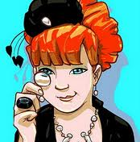
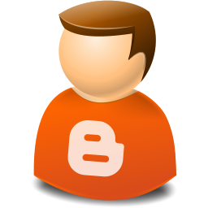
BLOGGING
THE DARING LIBRARIAN (Technology)
www.thedaringlibrarian.com
THE HANDHELD LIBRARIAN (Mobile Tech) www.handheldlib.blogspot.com
SOCIAL NETWORKING LIBRARIAN
www.socialnetworkinglibrarian.com
THE WEBFOOTED BOOKLADY
(Full Featured Blog)
www.bookminder.blogspot.com
Notes:
Blogs are the natural for librarians. These are an extension of what we already do: identify, organize, and make information accessible in libraries. They are a simple and efficient way for librarians to stay informed and for libraries to disseminate information in a timely manner.
Just type in Great Library Blogs into your search engine and you’ll find a variety of blogs touting ‘The Best Library Blogs’ – If you’re just starting out, read some of these blogs to get an idea of how you can be an effective communicator. Four of my favs are right here for you to look into later.
Michael Stephens of Saint Joseph County (IN) Public Library believes that “Blogging is one of the most effective things a medium or small library can do to reach a lot a people without spending a lot. I urge all libraries to do this!” Like a political manifesto, that library built a mission statement for its library blog, which states “Our blog is good, it’s going to be worth your while to visit it, and we create it ourselves.”
Blogging is nothing new. In 2003 there were already 57 established library weblogs and the numbers have only risen dramatically the past 8 years. Despite the increasing popularity of blogs, few libraries have taken advantage of what they offer. Adding a blog to libraries is free and easy. Librarians can collect and make information accessible to patrons and researchers – and if they want, invite them in on the discussion. Blogs can be updated easily, frequently and continuously, making them an appealing alternative to static newsletters.
You may receive both personal and business benefits from blogging. Some of the personal benefits include:
Refines your writing skills
Increases you knowledge base
Make you a better researcher
It establishes you as an authority
Connects you with other librarian bloggers
It Motivates you
Meanwhile the library also benefits:
Real-time Discussion
Allows for others to backlink and to share your words
Boosts traffic
Low cost marketing
Immediate self publishing
Establishes your brand

Slide 7
BLOGGING
Write to be helpful.
Be brief.
Tell a story.
Connect others, if appropriate.
Share. Often.
Don’t overthink it.
Be thoughtful.
Don’t be mean
Publish often enough to build a relationship.
10 Be mindful of your audience’s time.
Notes:
Blogger Chris Brogan offered these 10 tips to better blogging - so tiny, you can fit it on a 3×5 card and post them by your workstation.
Many people who build their first website are afraid to make it "live" until it is perfect. Art is never perfect so put your critical mind to the side and get messy.
Let’s Review these basic tips

Slide 8
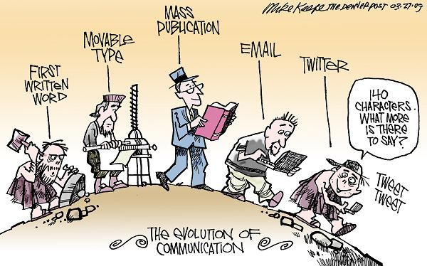
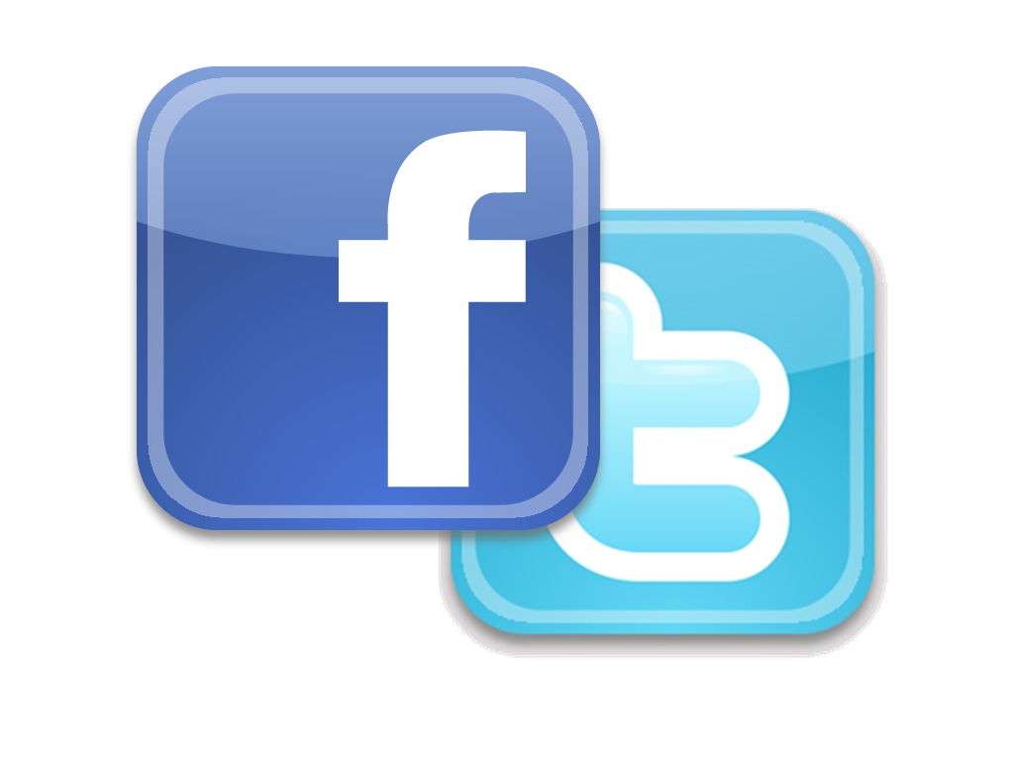
SOCIAL NETWORKING
Notes:
While I share a brief history of blogging and social networks, let’s do a quick Social Networking exercise. I want you to pitch your community why they should read your blog or attend a specific event at the library in 120 characters.
Normally, I’d have you tweet your response but since we are all currently in the webinar together lets use the tools at hand. Go ahead and simply post it to our chat board. 140 characters = about two lines in Chat
But before you make a posting online, re-read it. Think before your post…you want to be succinct, family friendly, and even humorous or thought provoking. Please check your spelling. Check the readability. Check the syntax. You are broadcasting newspaper headlines, so you have 140 characters to make mistakes. You have a space of 140 characters to show sloppiness or to show quality. It never hurts to have a partner in the process – even all good writers look for readers and editors to help shape their thoughts and words before going to press.
While we do this exercise in CHAT make sure you use Q&A for any questions. Keep the two separate otherwise your questions may get lost in the dialogue we are creating.
Okay, so go ahead and start typing in the CHAT section.
While you do that, here’s my brief history lesson:
In 1971, the first text was sent computer to computer. Online Bulletin Boards, Websites, and Social Networking sites like GeoCities followed suit. But it took nearly 20 years before AOL was on the scene offering instant messaging. Friendster and MySpace entered along after the Dot Com bubble burst but the real revolution took place when Facebook and Twitter launched in 2004 and 2006 respectively.
Today, social media offers us a large variety of services, software, apps, and plug-ins that give us the power to engage with each other by expressing our individual style in real time.With the advancement of mobile technologies, we are able to do everything that we used to do at our desk while we are on the go.
Not only is it not surprising that libraries are finding creative uses for social media but its becoming more and more necessary in order to remain relevant in this fast moving digital age. With each passing day, more and more apps are becoming available including those designed for library websites and by library database vendors that can assist. If you are ready to dip your toes into the m-library movement, I highly suggest the m-library wiki at
www.libsuccess.org/index.php?title=M-Libraries Which truly showcases an endless number of active m-libraries across the globe to vendors like Boopsie , publishers including Encyclopedia Britannica and Project Gutenberg.
Certainly, the speed of technology shows no signs of slowing.

Slide 9
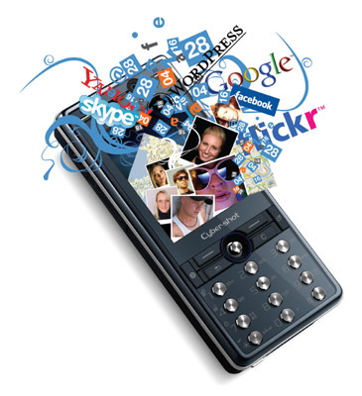
SOCIAL NETWORKING
Notes:
Okay this was fun!
As you read the posts, I’d like you to consider that the use of language, even in in small amounts, can provide personality and/or create an desire to learn more. That’s what we need to strive for because posts can easily be lost in the fury of postings. I like to switch things up by moving between being all business, sharing a fun thought to express my personality, linking to photos or videos and commenting or re-tweeting other’s posts. Most of us are looking for a refreshing point of view, a sense of honesty and compassion.
Identify personality
Identify teasers
Identify ‘open interest’
Great job, everyone!
Refine how you utilize social networks
A lot of libraries have started building presence using social networks by creating profiles. But you have to ask yourself is being there enough? What’s your real goal of setting up a library profile?
A nice photo, your address & hours, website URL and a few offhand comments probably aren’t going to win you many friends.
The goal should be how can I be useful to my patrons where they are? I challenge you to think about that question as it relates to you, your work and the library patrons you serve. How can I be useful to my patrons where they are?

Slide 10
SOCIAL NETWORKING
Be responsive to user comments
Ask for feedback
Have a plan
Cross promote
Be succinct
Start conversations – Don’t Broadcast
Seek friends and follow others
Limit the amount of messages per day
Notes:
Common sense once again shows up in these 8 tips to improve your social networking skills.
Create an extension of the library with links to the catalog, chat reference pages, research guides, calendar of events, etc. And now that we are going mobile with all kinds of devices from smart phones to tablets, its becoming just as interesting and easy to add video and photo collections.
Let’s review
I really like the cross promoting tip. Helping your community is great and supporting other organizations who share similar ideologies and goals can be an amazing way to build relationships with other organizations and broaden your message through shared contacts.
Searching for awesome library’s using social networking is much more difficult than searching for the top blogs. Your search results will come up with lots of useful information and tools to help you along your way. These days, it seems everyone is using social networks to some extent. I suggest that you consider friending or following other local libraries on Facebook and Twitter. This will give you some ideas on how they manage their community and may provide inspiration, collaboration and professional contacts to network with. I’d also include befriending or following national organizations like ALA or IMLS as well as leaders in the field of your specialty, for example if you are working the teen space, you may want to keep tabs on what’s happening with YouMedia at the Chicago Public Library. As you interact and read what others are doing, it can assist you in defining how you want to reach out to your community.
And for fun, if you want to keep your fingers on the pulse, I recommend liking New York Public Library, which seems to be really focused on exploiting new technologies on all platforms – the features on their facebook page will make you swoon and if you get the chance to download their historical reference app The Boundless Library or

Slide 11
Building Digital Communities through Blogs and Social Networking
Notes:
Whether you decide to blog, use social networks or both, its important to keep things fresh and offer your community a way to interact with you that keeps them engaged. Some suggestions you may consider come from actual library activities including these inspired ideas
TUESDAY TRIVIA with prizes for the first correct answer
BROADCASTING LIVE EVENTS like authors and children’s readers
PHOTO CONTEST for National Library Week
REFERENCE HIGHLIGHTS featuring good questions that have come to the ref desk
CHECK IN with Foresquare
TWEET when checking out with Symphony
FIRST READ highlights new books as they become available at the library
SHORT VIDEOS highlighting events at the library or library tour
GET FEEDBACK from the community
Neil Perkin of Only Dead Fish presents some sound general advice for digital communities that I’d like to share with you.
The first is “The community should have a purpose” – Its probably not difficult to identify your community but as Facebook Founder Mark Zuckerberg put it ““Communities already exist. Instead, think about how you can help that community do what it wants to do”
Secondly, put community at the heart of what you do. - “A business without engaging and nurturing its community is like a village, a town, or a city without a population” said author, Alan Moore.
Thirdly, don’t broadcast at your community - People are interested in what you have to say but it is a conversation, so don’t over do it with messages. Instead, interact and don’t only create content about your company or your brand, but try creating content about your community as well – the people , the stories. Don’t forget, your community are creating lots of value through their interaction, so shouldn’t you think about what value you are adding and how you can add more?
I’ve posted Neil’s complete 10 Key Principles Behind Digital Community with this webinar so you can deepen your thoughts on what makes for great common sense.

Slide 12
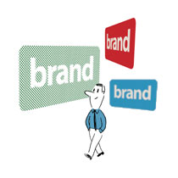
YOUR BRAND
GREAT RESOURCE: ALA Report CREATING YOUR LIBRARY BRAND
http://www.alastore.ala.org/pdf/9780838909621_excerpt.pdf
Notes:
Hands Up: Has your library established its online brand?
Hands Up: Has your library developed a social media guide?
What is your brand
Is your brand …what is your business personality … Is the brand hip, fast, and modern? Or is it traditional, unwavering and classic?
BRANDING is the latest marketing concept being applied to people and businesses online beyond the corporate world. In many ways, branding is similar to a non-profit’s mission statement. It’s distilling the library’s story down to one sentence and then using it as a guideline for your use of language, images and style in all of your marketing efforts. Heck, I’ve even see the branding concept on reality shows like America’s Next Top Model All-Stars where each contestant is given one word as a personal brand to incorporate into everything they do.
I’ve included ALA’s Library Branding PDF link on this slide for you to visit later and review. They suggest that your story can be about the details of the library (great customer service, a large collection, a beautiful building), or it can be about the needs that the library could fill in the lives of its patrons. The story might be that the library is a place where a community connects and comes together. It might be the intellectual center of a small town. It could be the tool that parents use to give their kids a head start in life. It could be the center of campus life for a college or a place where a student can feel part of a com- munity at a large university. Any one of these stories would be compelling to people thinking of using the library. They are powerful definitions of what makes the library relevant and important in its community.
Personally, when I think of branding, my mind wanders to the series of personal computer TV commercials that had an actual person represent WINDOWS and APPLE computers. In that series of ads, Apple was positioning itself as young and trendy against its competitor Windows which was old fashioned and out of date. You brand should be broken down into bite-sized concepts that are easily identified and represented by the use of language, color and design.
Create a social media guide
I’m sure that like Media Arts, where I work, you’ll find that other co-workers are also online. It can become confusing when everyone is doing their own thing.
A growing movement among libraries has been taken from our business counterparts. The Social Media Guide … a brief guide to how everyone should present the library brand. A good guide will not infringe upon individual personalities but should underscore your libraries overall brand.
For Media Arts, our Social Media Guide was born out of our original Marketing Guidelines, which included information as basic as what font type, font size, and colors everyone should use when creating websites or printed materials so that we had a consistent style. As our online presence grew, our guidelines began to address a variety of items, including some of the following:
Never respond negatively to public comments regardless of what has been said
Always refer to the organization as Media Arts, not MACSD or The Center
Review your posting before submitting to see if the message creates an action or response from our patrons
Reply to conversations in a timely manner [at a minimum review at the start and end of your shift]
Forbes Magazine presented a basic set of corporate guidelines for creating a social media guide that you may want to incorporate into your own.
Lead by example. Rules aren't enough. Leaders should model the behavior they would like to see their employees take.
Listen before you talk
Say who you are
Show your personality
Respond to ideas not to people
Know your facts and cite your sources
If you respond to a problem than own in
For librarians, you have the added opportunity to join ALA Connect Social Media Working Group
The group will support the following types of issues surrounding staff use of new media.
Provide best practices for the full spectrum of ALA situations (smaller units vs. bigger units, etc.);
Identify staff "ambassadors" who can advise other ALA staff members how to use specific channels (eg, Facebook, Twitter, podcasting, etc.);
Identify potential training topics based on staff needs and recommend best formats for that training, as well as potential trainers;
Help build screencasts to explain the tools available to staff;
Start an open resource center for staff where they can find all of these materials and discuss topics related to new media;
Create sandboxes where staff can "get their feet wet"
And the group will brainstorm ways we can better mesh our various channels together.

Slide 13
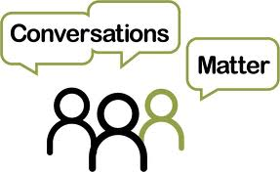
Effective Library Tools
MANAGING EVERYTHING:
Eye-Fi
Smartphone Texting
TinyURL
Media Dashboards
Measured Voice
Threadsy
Hoot Sute
WordPress
MobileStories.Org
Notes:
Managing Everything
Many libraries already have a variety of social networks set up and in use. At my organization, we have accounts with YouTube, Blip TV, Flickr, Facebook, Twitter and Posterous to name a few. With so many responsibilities, you may ask yourself how do you manage all that.
Five tools that libraries are using to keep on top of everything include
1. Eye-fi – This company offers memory cards for camera that once set up automatically upload photos and videos to your computer or favorite website when ever its near a wireless connection. You can take photo at library events, on and off site, and when you are in the range of your wireless, it will send the images automatically to your photo account like Flickr. I try to use a camera like that and take nor more than 5 good shots at each event. Using that technique, you can quickly build a great virtual photo album to use for marketing and social networking.
2. Smartphone texting – Most of the online social networks allow you to post via your phone, often you don’t even need a smart phone but can use the text feature of your regular cell phone. When I’m away from my computer is when I’m most inspired to share something that comes to mind. What happens when you are in the lobby and in walks a local celebrity? If you set up the social network as a contact, you could text your post, a photo or a video from your phone instantly – telling everyone what is happening, while it is actually happening. To find our how to get your text or e-mail link you’ll need to look within your social networking account.
For example: To set up a free @facebook.com address, go to your Messages view and click the "Claim your Facebook email" link.
Your email address will match your public username, for example:
Profile: facebook.com/username
Email: username@facebook.com
3. Don’t you hate those long, complicated URLS? TinyURL is a free service to make posting long URLs easier. It takes those horribly long URLs and creates a user friendly short URL which will make it memorable and easy for your community to cut and past. It also reduces the amount of characters you use on social networking for the link allowing you to maximize your interesting post.
An example, Turn this URL: http://mylibrary.com/readingroom/lib/ref=123&m+ATV… into something as sweet as http://tinyurl.com/libraryblog
4. Scheduled postings via Media Dashboard – I like MEASURED VOICE - measuredvoice.com, which allows you to schedule your Facebook & Twitter messages – great for event promotions
On a regular basis, I simply go to the dashboard and set up my events for the month. This provides me with a foundation of basic posts that will inform everyone of all the important events coming up and I don’t have to worry about missing that promotion should I become entangled with other priorities.
Dashboards are the latest crop of social media tools aims to clamp down the social media gusher by letting you update, monitor, manage and maintain several communication outlets at once. They can even manage passwords for all the accounts so you only have to log in to the dashboard once and be able to interact with your many social networking sites.
Two other dashboard that are very popular include –
Threadsy - no fees and no downloads/ one clean dashboard across the big names in social media platforms
HOOT SUITE – hootsuite.com $6 a month / Hootsuite is wide and deep with products and features that you can even update multiple social media platforms (Twitter, Facebook and more) from a computer or iPhone, Android or BlackBerry device
5. Wordpress as a home base. In October’s webinar, I discussed the in depth features of wordpress in the smart phone case study but I’ll plug it again because it provides the one place that everyone can go to and see at a glance what’s happening with all of our social networking. By choosing an easy to read template, you can not only highlight your blog but also use plug in’s so that all of the latest postings on your social networks also appear. Check out the library program wordpress site http://www.mobilestories.org/ to get an idea of how all of this information is brought together.

Slide 14
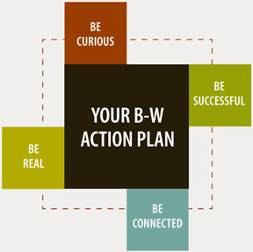
How To Get Started Next Steps
Your
Action
Plan
Notes:
I hope this has given you loads of ideas to incorporate into your blogs and social networks.
Before we wrap, I’ll give you a homework assignment. Take a moment to explore New York Public Library - http://www.nypl.org. They have fully embraced new technologies as tools to create community. If you visit their website, navigate to the EXPLORE section of their website and visit their blog page. If you are on facebook, befriend them and explore the long list of features they have incorporated into their FB page, they really know how to engage their community and get the most out of the social networking tools. Even though its outside of the perimeters of this webinar, I recommend you read up on their overnight scavenger hunt “Find the Future,” which took place earlier this year [http://mashable.com/2011/04/01/new-york-public-library-scavenger-hunt/] and their adoption of mobile apps [http://www.nytimes.com/2011/06/26/nyregion/new-apps-from-the-new-york-public-library.html].
It’s a big, well funded library but certainly one that is worth discovering through blogs, social networks, websites and apps. You never know when you’ll come up with the inspiration for something that propels your interest and captures the imagination of your community.
And then when you are ready, create your own social media action plan:
Meet with your staff/ colleagues
Establish a brand consistent with your library
Create a Social Media Guide
Create a plan that included specific activities and timeframes

Slide 15
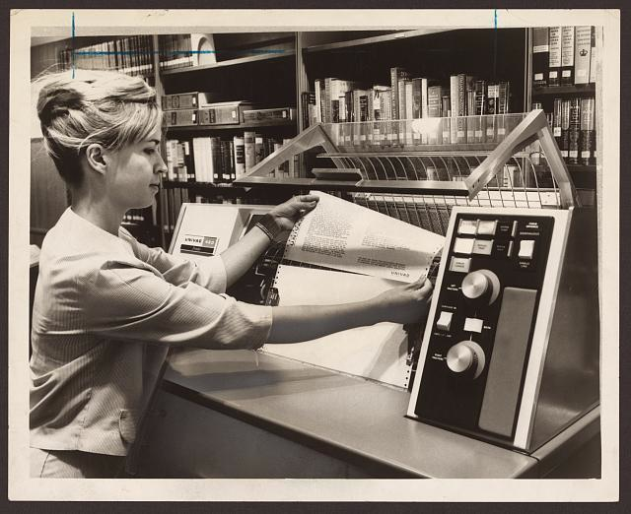
Questions & Answers
Notes:
Share Responses
Receive online resources that can assist you with next steps
Handouts
A copy of this PowerPoint Presentation
10 Key Principles Behind Digital Community (pdf)
A Short History of Social Media (Infographic)
The Growth Of Social Media (Infographic)
Links:
Pew Media: Social Side of the Internet (Jan 2011 report)
ALA Branding (pdf)

Slide 16
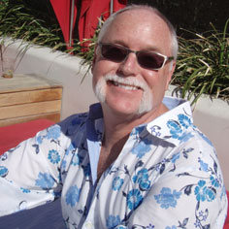
Building Digital Communities through Blogs and Social Networking
PATRIC STILLMAN
INNOVATIONS AND PROGRAMMING OFFICER
MEDIA ARTS CENTER SAN DIEGO
patric@mediaartscenter.org
Digital Citizens
Notes:
Thank you for participating.
This is the second of four webinars being lead by Media Arts Center San Diego.
The first webinar has been archived with InfoPeople – just look for the October webinar entitled
Using Smart Phones as a Marketing and Programming Tool
And I am please to ask you to join us next year
Wednesday, February 8, 2012:
Youth Media Activities in Your Community
Wednesday, March 28, 2012:
Outreach to Hispanic/Latino Populations

