Slide 1

What will happen when I’m gone: ensuring knowledge transfer to your successor
An
Webinar
Wednesday
December 13, 2011
12 noon—1:00 p.m. Pacific
Paula M. Singer, Ph.D.
pmsinger@singergrp.com
Gail L. Griffith
gail-griffith@comcast.net
Infopeople webinars are supported by the U.S. Institute of Museum and Library Services under the provisions of the Library Services and Technology Act, administered in California by the State Librarian.

Slide 2

Agenda
Why this topic?
Explicit information—formal knowledge
Implicit information—informal knowledge
How organizations capture and share knowledge
Ways that individuals share what they know—what can you do?

Slide 3
chat: Who’s Here?
Library Directors
Supervisors
Front-line Staff
Students
Other

Slide 4
Poll:
Choose all that apply
I’m planning to retire within 5 years
I work with someone who’s planning to retire soon
Our library has downsized and we’ve felt the loss of the knowledge people have taken with them

Slide 5

“If a person had a memory like the average organization, we would think he was very stupid, or suffering from a neurological disorder. Organizations routinely “forget” what they have done in the past and why they have done it.”-- Jeff Conklin

Slide 6

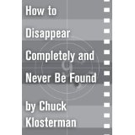

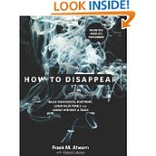


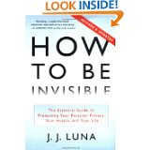


Slide 7
Poll:
How confident are you that your library will be able to capture the important pieces of organizational knowledge and memory you and your colleagues possess before it walks out the door with you?
  Not at all confident
  Somewhat confident
  Very confident

Slide 8
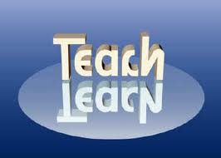
The age of the knowledge worker
“Knowledge work requires continuous learning on the part of the knowledge worker, but equally continuous teaching on the part of the knowledge worker.”—Peter Drucker

Slide 9


Easiest to share: explicit knowledge
Skills needed, especially for complex or unique tasks
The first thing you think of when training someone to do the job

Slide 10

Essential Program knowledge
Critical for the work, product, or organization to move forward?
Relevant for the future?
Unique—do few people possess the knowledge?

Slide 11


Tools for transfer
Preserve documents
Write manuals
Enhance tools you already use
  Calendar or tickler file
  Examples of critical reports with your work papers
What We Usually Do
Try This

Slide 12
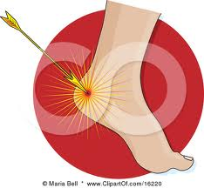
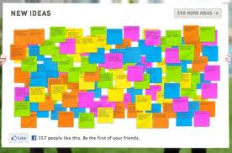
Things to think about
Where is the organization vulnerable when you leave?
  Example: Toledo-Lucas County’s collection snapshots for special collections
Leave room for new ideas from an incoming generation

Slide 13
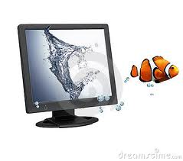
Chat:
Name one kind of explicit or task knowledge you would share with your successor. What would they need to know how to do that no one else would be able to tell them about in any detail

Slide 14
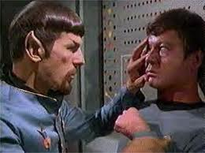
Harder to share: Implicit or tacit knowledge
Informal organizational knowledge that lends context
  Experience, stories, impressions, creative solutions
  Relationships that help get work done
    Inside the organization
    Out in the community

Slide 15

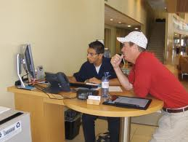

Some Effective ways to share
Collaboration
Shadowing
Storytelling

Slide 16

chat
Name one kind of implicit or contextual knowledge that your successor would find useful.

Slide 17

Best practices of organizations
Performance reviews
Mentoring programs
Teams with a balance of experienced and newer staff
Wiki or intranet to document procedures and policies
Staff meetings used for problem-solving
Exit interviews

Slide 18

More best practices
Identify Subject Matter Experts and develop an individualized plan for knowledge transfer
  Who do others go to in a crisis?
  Who has a long-term corporate memory?
  Who is doing a one-of-a-kind job?
  Who has a unique set of skills and knowledge?
  Who carries the ball on major projects?
Contract with key departing employees to come back and coach their successors
  Montgomery County (MD) Government Knowledge Transfer Contracts

Slide 19
Using technology as a tool
Shell Oil’s ROCK project (Retention of Critical Knowledge)
  Make and index video interviews with retiring employees
Vancouver (BC) Public Library
  Video interview with retiring City Librarian Paul Whitney on Facilitating Change

Slide 20
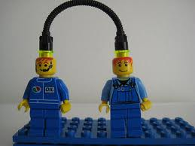
Chat
What is already going on in your organization that supports the transfer of knowledge?

Slide 21
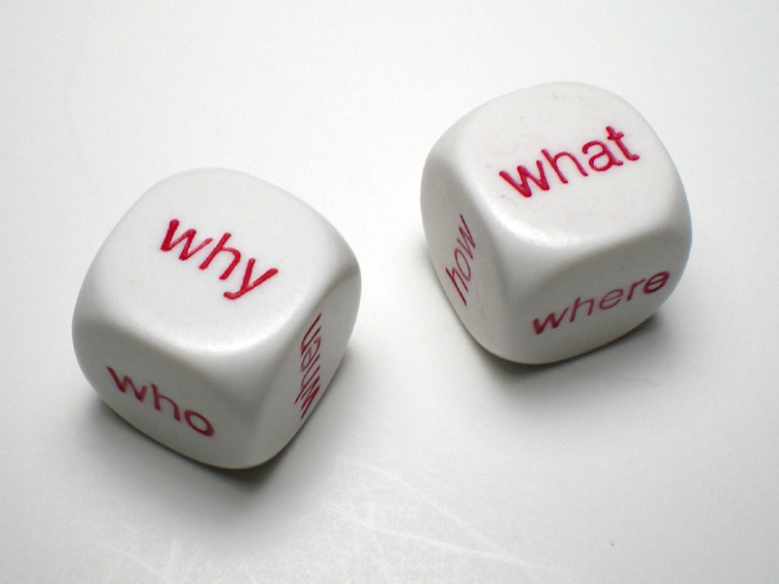
What can one person do?
Recognize that leadership change is an opportunity to revitalize the organization
Focus on information that informs future decisions
Develop your plan:
  And what will the consequence be of not sharing?

Slide 22
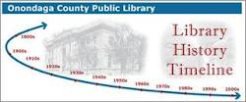
Include others, not just your successor
Introduce staff to your key community contacts
Tell stories about organizational values that include the people in the room, and get them to share their stories
Timeline with library milestones, with everyone’s hire date and plenty of space for the successor

Slide 23

Chat
What is the most powerful next step you can take to ensure that what you know, stays?
Handout: Developing Your Plan
  Include your most powerful next step, and other ideas you heard

Slide 24

Questions?

Slide 25
Handouts
Developing Your Plan
Resource List

Slide 26
Thank you!
Paula M. Singer, Ph.D.
  pmsinger@singergrp.com
Gail L. Griffith
  gail-griffith@comcast.net

