Slide 1
Social Media, Libraries, and the Law
Thursday, March 17, 2011
Time: 12:00pm to 1:00pm
Speaker: Mary Minow

Slide 2
Agenda
Terms of Service: Flickr, Facebook, Twitter
Creating content
Protecting Library from User Content
Special Issues with Children
Social Media Policies

Slide 3
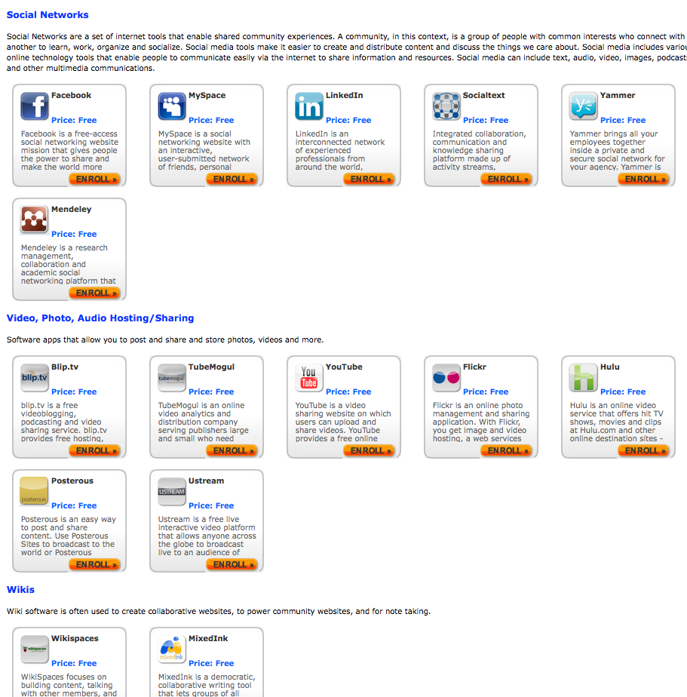
Terms of Service Flickr, Facebook, Twitter etc
APPS.GOV
Federal government negotiated
terms of service
amendments
Note: Twitter terms acceptable to U.S. General Services Administration
https://www.apps.gov/
https://forum.webcontent.gov/?page=TOS_agreements

Slide 4
Federal Model Terms of Service
No ads
No indemnification
Change governing law
Termination only for breach
Allow agency spiders
Modify user content – limited to format/display
No endorsement of products
etc.
http://go.usa.gov/liM

Slide 5
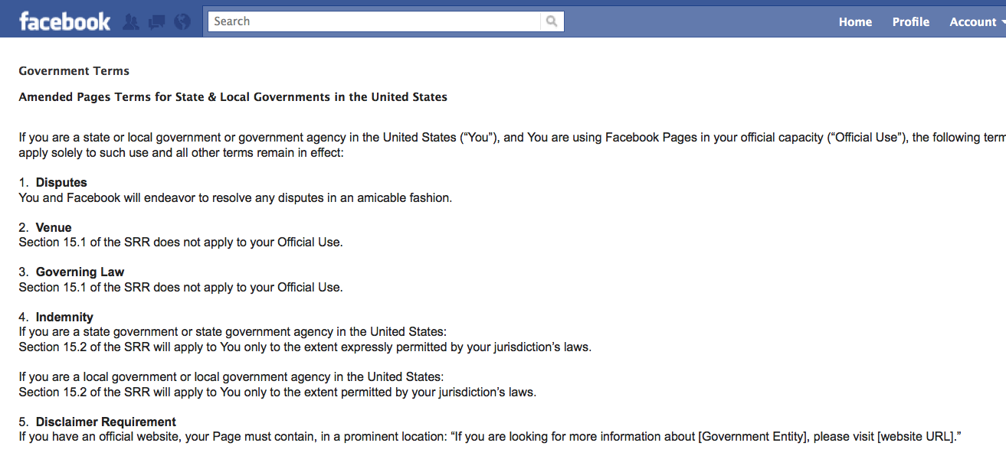
State and Local Governments FACEBOOK
New!
Jan. 2011 – National Association of Attorneys General and National Association of State Chief Information Officers negotiate Facebook agreement
http://www.naag.org/attorneys-general-negotiate-facebook-agreement-for-state-government-use.php
https://www.facebook.com/terms_pages_gov.php

Slide 6
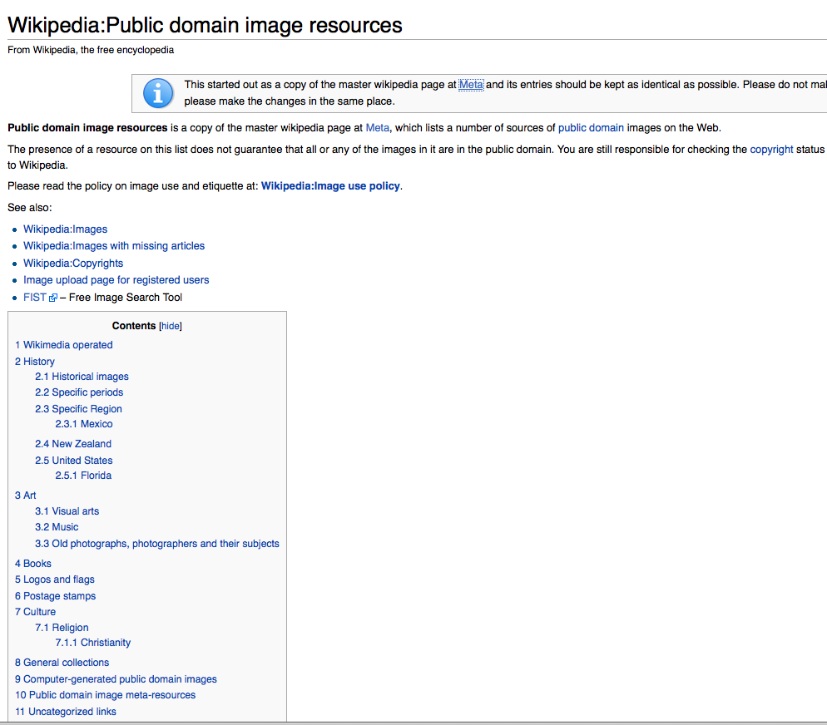
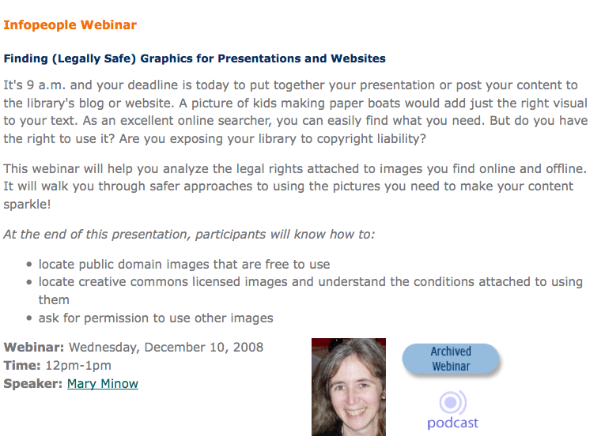
Creating Content
IMAGES
http://www.infopeople.org/training/webcasts/webcast_data/321/index.html
https://secure.wikimedia.org/wikipedia/en/wiki/Wikipedia:Public_domain_image_resources

Slide 7
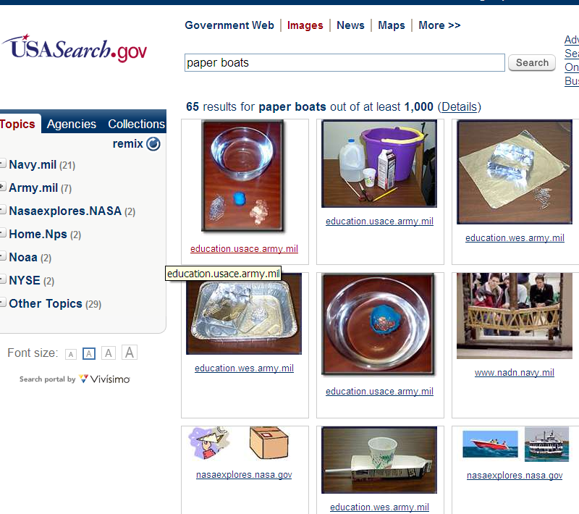
1. Finding Public Domain Images
Finding Public Domain Images
Facts
Recipes
Ideas
Dedicated works
Government works (U.S.)
Expired works

Slide 8
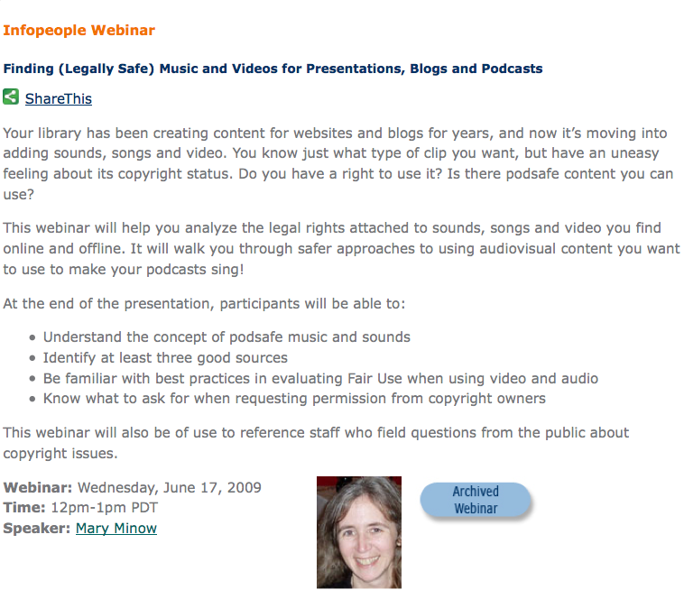
Music, Videos
http://search.creativecommons.org/
http://infopeople.org/rural/training/webcasts/webcast_data/321/index.html

Slide 9
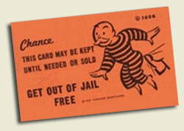
Protecting Library from User Content
Defamation, False Information, Negligence
… You’re not responsible
Matchmaker.com immune when user posted false profile for Star Trek actress – stalking
Carafano v. Metrosplash.com, Inc., 339 F.3d 1119 (9th Cir. 2003)
Sect. 230 broad protection – from false information, negligence, sexually explicit content, discrimination BUT NOT COPYRIGHT
No provider or user of an interactive computer service shall be treated as the publisher or speaker of any information provided by another information content provider. 47 USC§ 230(c)

Slide 10
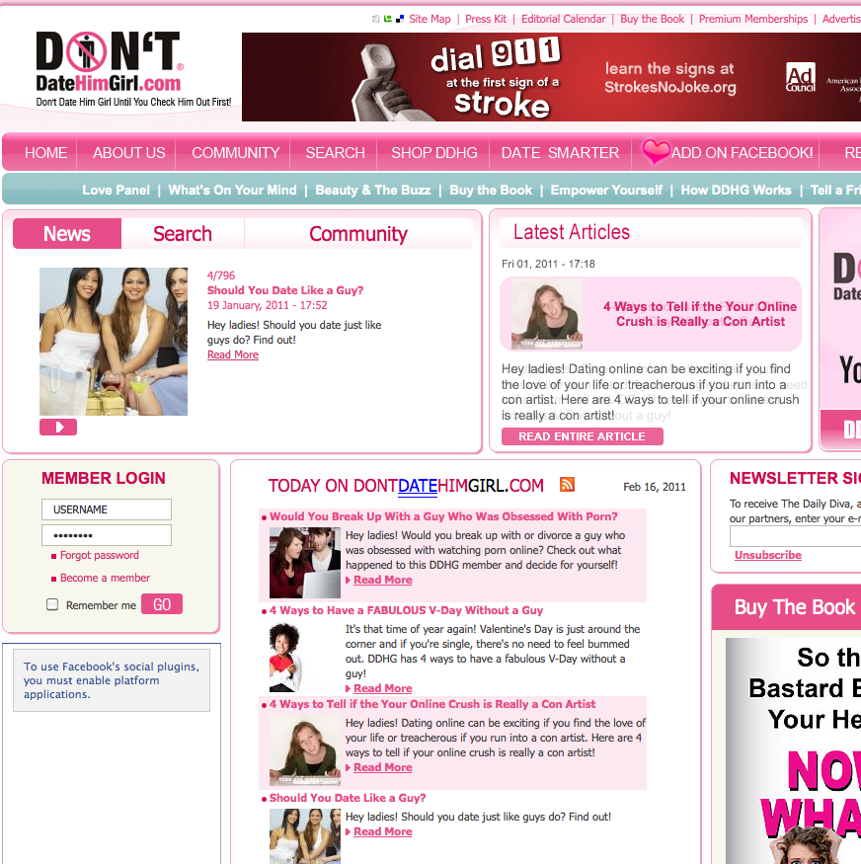
Today’s legal environment
gives us DontDateHimGirl.com

Slide 11
Ever-so-slight caution: Roommates case
Internet roommate locator service
Required users to use pull-down menus:
age, gender, sexual orientation, children
No immunity as co-producer of content search system based on illegal criteria
Yes immunity for free text "Additional Comments” - even gross discrimination
DON’T ASK FOR ILLEGAL INFORMATION
Fair Housing Council of San Fernando Valley v. Roommates.com, 521 F.3d 1127 (9th Cir. 2008)

Slide 12
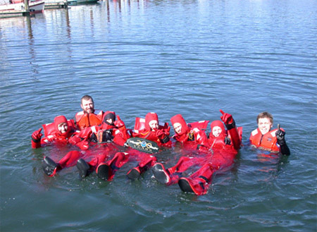
What about users that infringe copyright?
IMPORTANT!!
e.g. user posts someone else’s article …
SAFE HARBOR
Must register agent with Copyright Office
Must inform users of policy, agent contact info
May then follow take-down procedures
No direct financial benefit
www.noaaworld.noaa.gov/postcards/postcard3_w200th.jpg
17 USC § 512

Slide 13
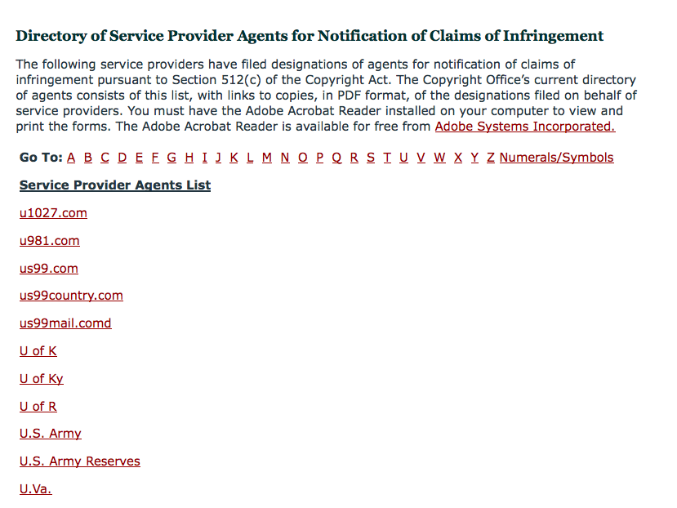
Look up your Institution
Is your library or parent organization registered?
http://www.copyright.gov/onlinesp/

Slide 14
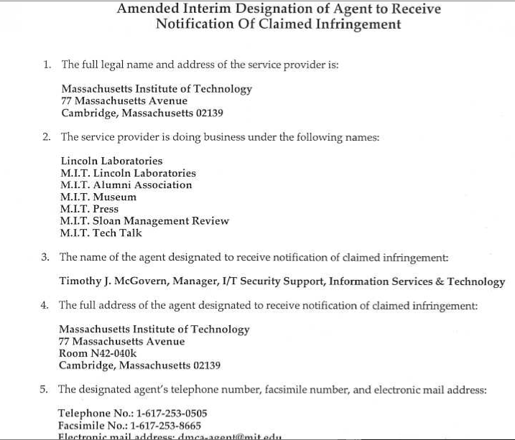
Example: MIT Museum Copyright Agent on file with Copyright Office
Remember to amend if your designated copyright designee changes
www.copyright.gov/onlinesp/agents/m/mit.pdf

Slide 15
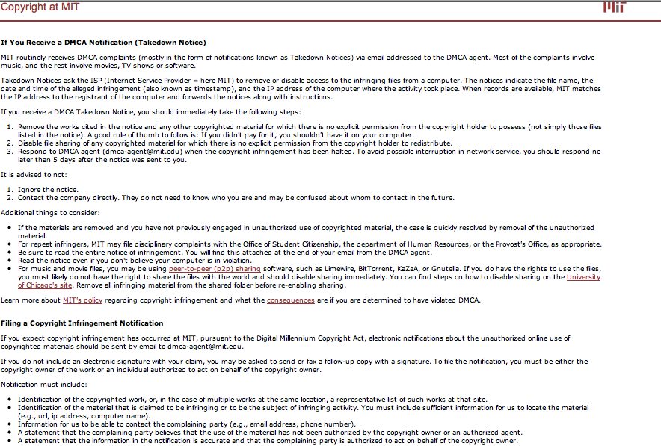
Example: MIT Copyright Policy
http://web.mit.edu/copyright/dmca-notices.html

Slide 16
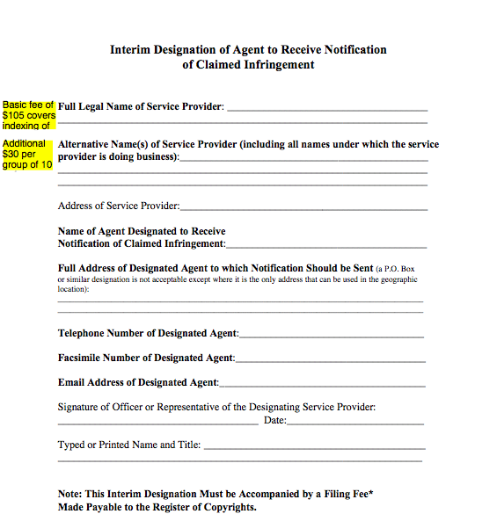
ONE PAGE FORM: FILL IT OUT. SEND IT IN.
Register Copyright Agent with Copyright Office
DMCA:
Digital
Millennium
Copyright
Act
www.copyright.gov/onlinesp

Slide 17
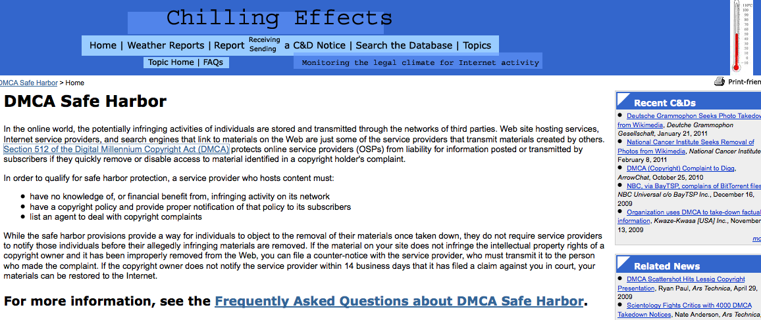
Sample Takedown Notices
http://www.chillingeffects.org/dmca512

Slide 18
Elements of notification
Written communication to designated agent
Physical or e-signature of copyright holder
Identify work(s) sufficiently for removal
Contact info for complaining party
Good-faith belief that use is unauthorized
Penalty of perjury
17 USC § 512(c)(3)

Slide 19
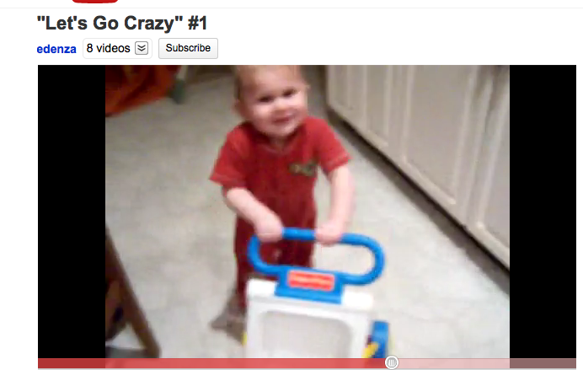
What about Fair Use?
Lenz v. Universal Music Corp.
Takedown notice sender must consider Fair use
Lenz v. Universal Music Corp, 572 F. Supp. 2d 1150 (N.D. Cal. 2008);
updates at http://dockets.justia.com/docket/california/candce/5:2007cv03783/196424
Video at www.youtube.com/watch?v=N1KfJHFWlhQ

Slide 20
Best Practice:
Follow takedown procedures for any content
Register once. Update if agent changes.
Use established procedure, even if not user generated.
Consider friendly notice and crowd-sourcing:
"Do you have information about a collection item? Please let us know! And let us know if you believe that you hold rights to an item on our website.”
… link to DMCA agent info
CAUTION: Takedown policy can mitigate risk and demonstrate good faith. Not a substitute for seeking permissions.

Slide 21
Special Issues with Children
Federal law requires parental consent for children under 13 for online comments
at commercial websites
Children's Online Privacy Protection Act (COPPA)

Slide 22
Children's Online Privacy Protection Act (COPPA)
Commercial services
Notice to parents about information practices
Verifiable parental consent before collecting
Parents must have access to child’s info
Confidentiality, security and integrity of child’s personal info
… link to privacy policy on any page where info is collected
Federal Trade Commission (FTC)
www.ftc.gov/bcp/conline/edcams/kidzprivacy

Slide 23
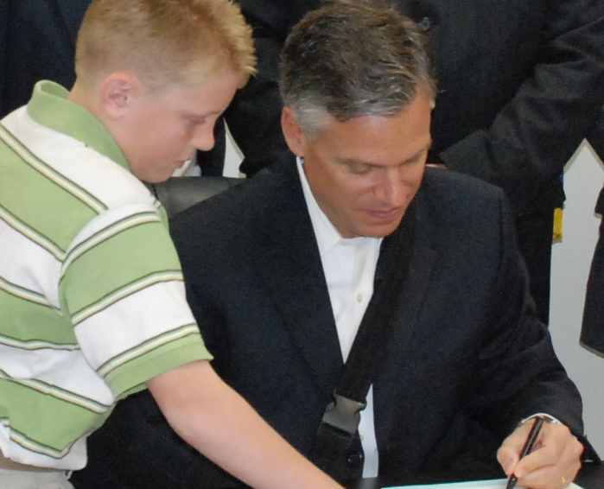
Verifiable Parental Consent
FTC rules
Parent signs and emails/faxes in
Credit card
Use toll-free number
Public key technology
www.ftc.gov/privacy/coppafaqs.shtm

Slide 24
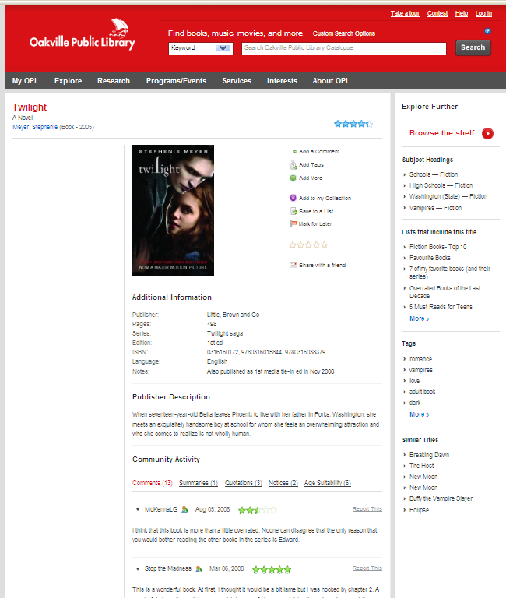
Children Without Consent
Noncommercial sites may choose to comply with COPPA.
Competing Principle: don’t restrict user participation based on age
FTC
Okay to use ratings, drop down choices
but
No free text, no messaging
http://opl.bibliocommons.com

Slide 25
California State Library
Children are not eligible to use services that require submission of personal information and we require that minors (under the age of 18) do not submit any personal information to us. This includes submitting personal information to the State as part of a user profile or personalization profile. If you are a minor, you can use these services only if used together with your parents or guardians. If you are a minor you should seek guidance from your parents. If the state decides to begin collecting personal information from children, it will notify parents that it is being requested, disclose the reasons for collecting it, and disclose our intended use for it. The state will seek parental consent before collecting any personally identifiable information. If it does collect it, parents may request information on the type of data being collected, view their child's information and, if they choose, prohibit the state from making further use of their child's information. The state will not provide personal information about children to third parties.

Slide 26
Social Media Policies
.. and Free Speech
Define purpose of the space
Teen reading club
Children’s poetry group
Ask for civility (but don’t enforce)
Remove OFF TOPIC
Cialis
Personal attacks that are off topic
Bury offensive posts

Slide 27
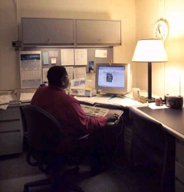
Limited Public Forum Analysis
purpose
Nonpublic
Forum
Limited
Public Forum
Limited
Public Forum
Limited
Public Forum
Public Forum
Cultural
Notices
office
Nonprofit
Flyers
Public
meeting
room
street
The broader the space’s purpose, the harder it is to take down content.

Slide 28
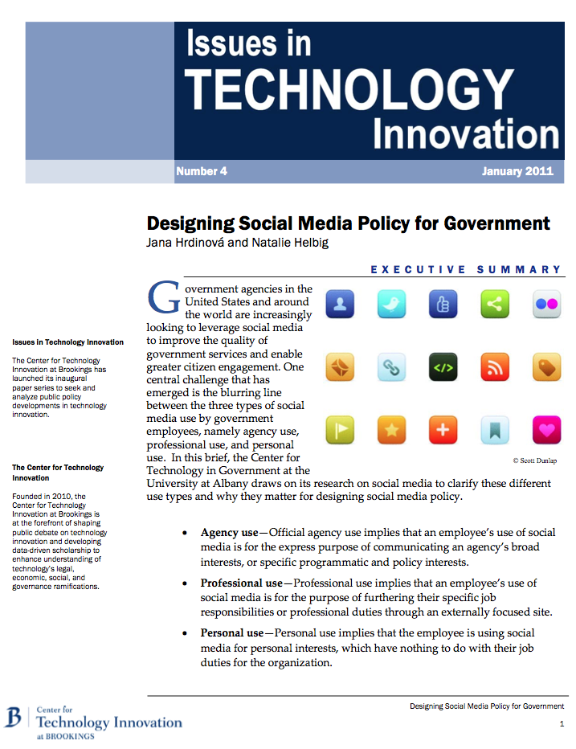
Social Media Policy Elements
Degree of employee access
Account management
Acceptable Use for employees (time, purpose)
Expectations/Consequences of violations
Agency content
Legal issues
Security
Users
http://www.brookings.edu/papers/2011/01_social_media_policy.aspx

Slide 29
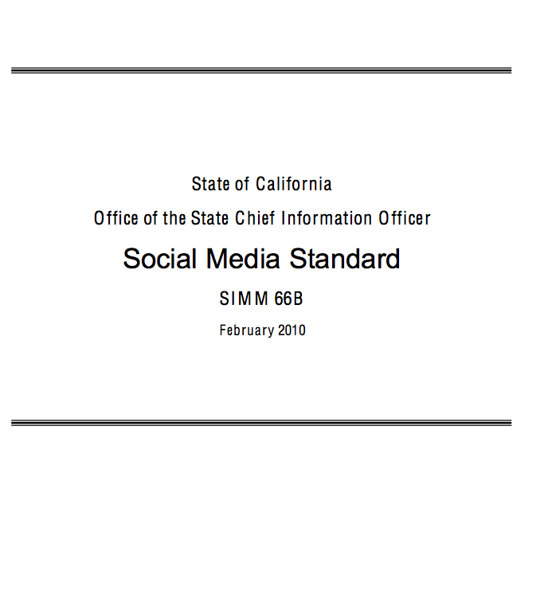
California – Policy Issues
Management
productivity, bandwidth, reputation, security
IT
authorized users
control file exchange, links
Users
no confidential info
speaker authorization
no masquerading
no work passwords
http://www.cio.ca.gov/Government/IT_Policy/pdf/SIMM_66B.pdf

Slide 30
Summary
Terms of Service: Flickr, Facebook, Twitter
Creating content
Protecting Library from User Content
Special Issues with Children
Social Media Policies

Slide 31
From the Infopeople Archive
Laura Solomon, MCIW, MLS
Library Services Manager, OPLIN
laura@designforthelittleguy.com
February 23, 2011
http://www.infopeople.org/training/webcasts/webcast_data/441/index.html

Slide 32
Thanks for listening!
Mary Minow, J.D., A.M.L.S. LibraryLaw.com

