Slide 1

The Hopeful Workplace
Presented by
George Needham and Joan Frye Williams
An Infopeople Webinar
January 17, 2012
Infopeople webinars are supported by the U.S. Institute of Museum and Library Services under the provisions of the Library Services and Technology Act, administered in California by the State Librarian.

Slide 2
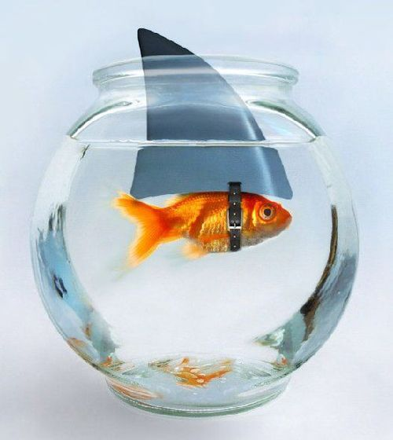
This is not hope

Slide 3
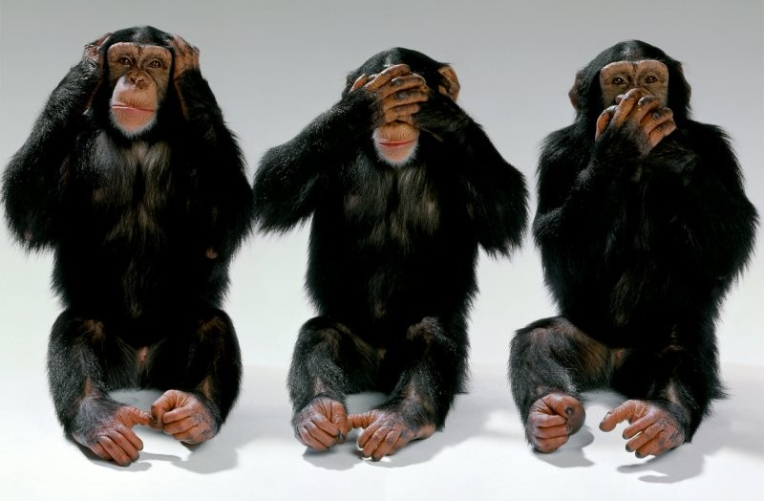
Neither is this

Slide 4

Nor this…

Slide 5

Not this, either!

Slide 6
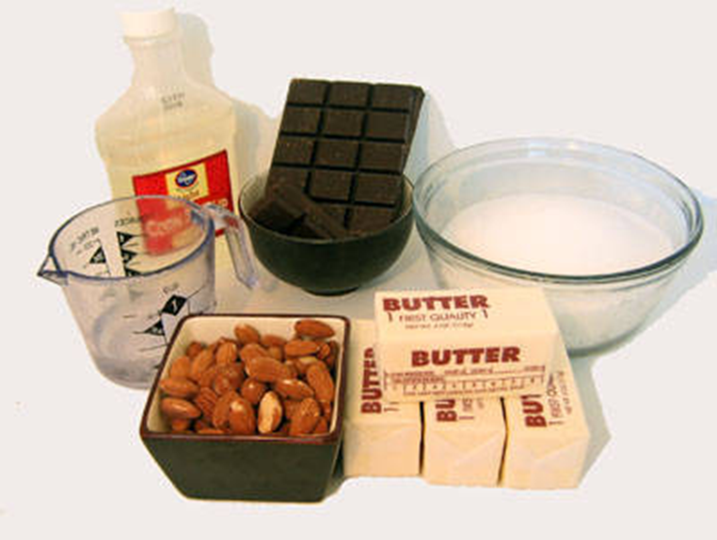
Ingredients
Meaningful goals
The will to get there
The way to get there
Some level of control
Reasonable expectation of success
Connection to others

Slide 7

Meaningful goals

Slide 8
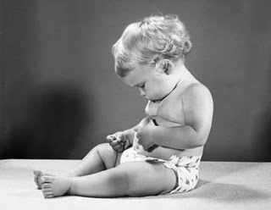
Look beyond the library

Slide 9

Clarity

Slide 10
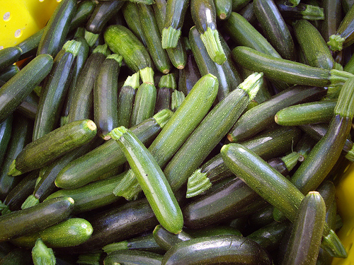
Prepare for success

Slide 11

The will to get there

Slide 12
“Here’s what’s in it for you…”

Slide 13
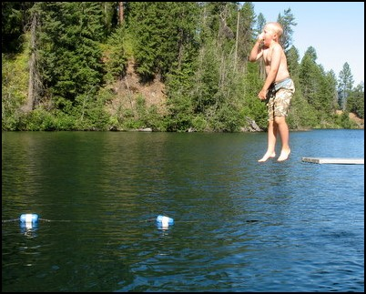
Dare to commit

Slide 14

Consensus
The process was fair
I understood the decision criteria
There was an opportunity for my voice to be heard
Even if the direction isn’t exactly what I would have chosen, I will support it with positive communications and actions

Slide 15

The way to get there

Slide 16

Appreciative inquiry
What do we have to work with?
What are we
really good at?
What is uniquely
ours?

Slide 17
Yes, and…

Slide 18
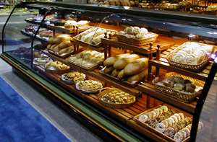
Focus on results

Slide 19
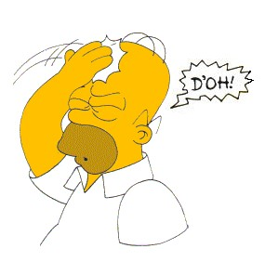
Learn from mistakes

Slide 20

Stealth, guile, and disobedience

Slide 21
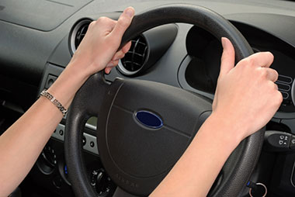
Some level of control

Slide 22
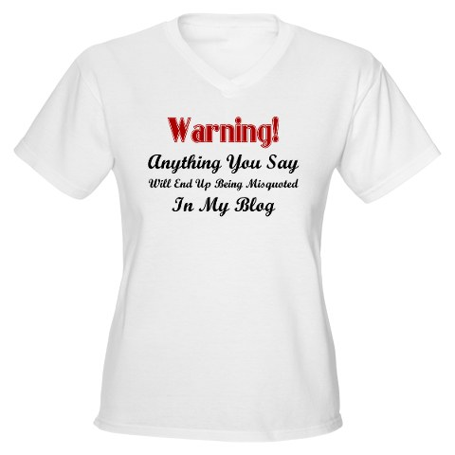

Slide 23
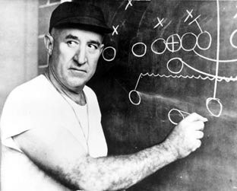
Clear role expectations

Slide 24

Open communications

Slide 25

Authority to seek alternate routes

Slide 26

Recognition

Slide 27

Reasonable expectation of success

Slide 28

Analogies and examples

Slide 29
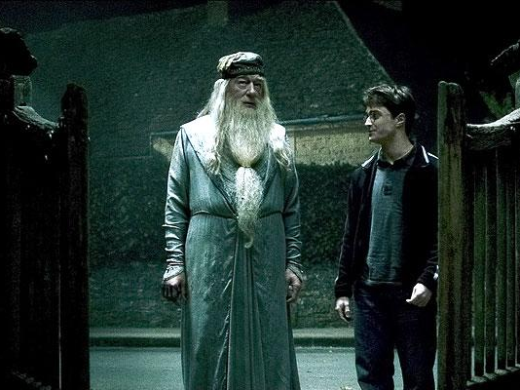
Support from successful role models

Slide 30
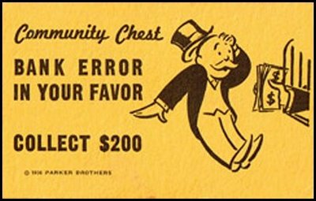
Equal time for the upside surprises

Slide 31
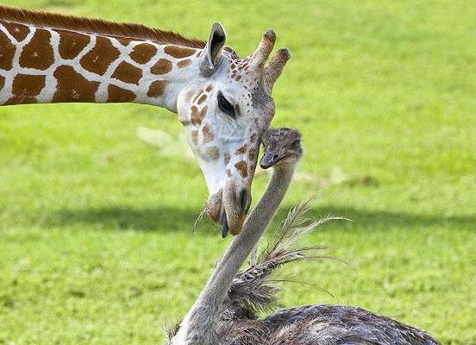
Connection to others

Slide 32
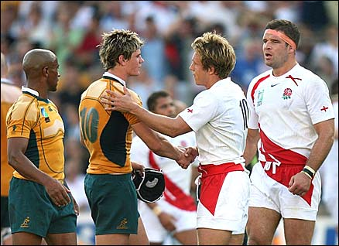
Civility

Slide 33
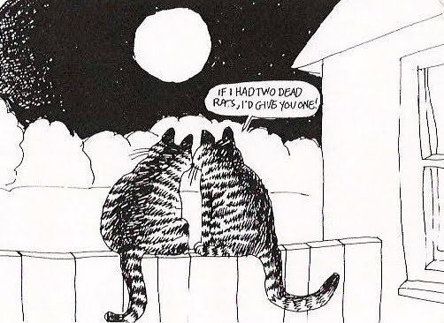
Generosity

Slide 34
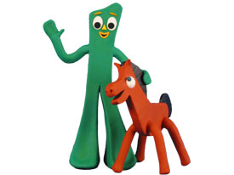
Flexibility

Slide 35
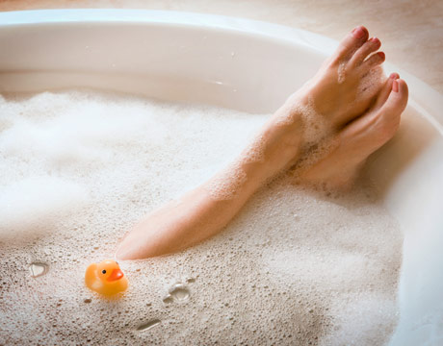
Self care

Slide 36
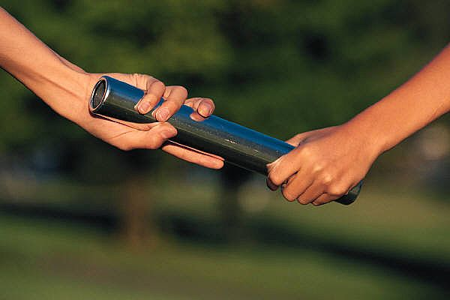
Teamwork

Slide 37
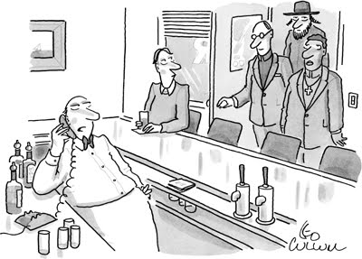
Laughter

Slide 38

Gratitude

Slide 39
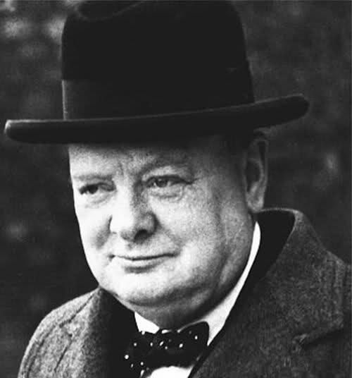
“If you’re going through hell, keep going.”
--Winston Churchill

Slide 40
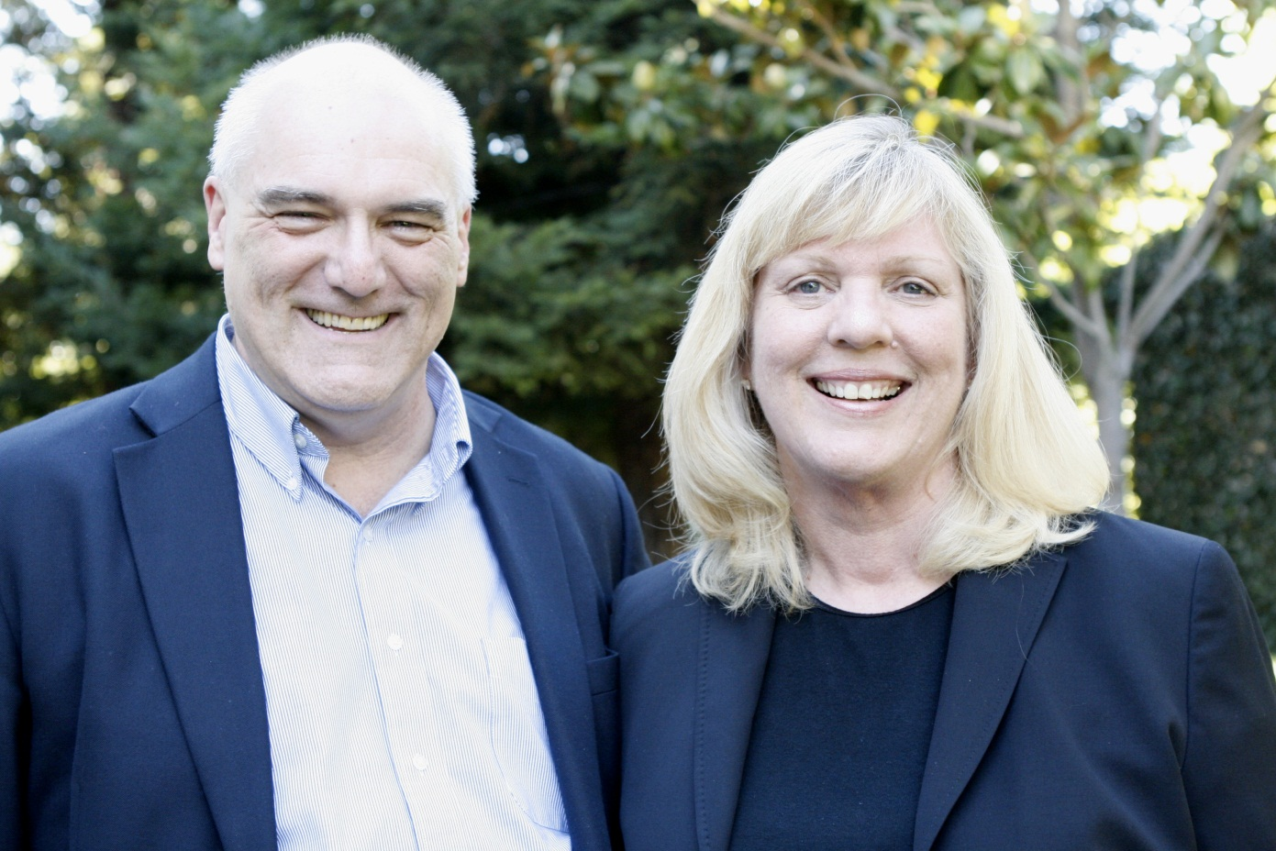
Let’s continue the conversation
http://www.georgeandjoan.com
hello@georgeandjoan.com

