Slide 1
Caregiver Resources
An Infopeople Webinar
January 19, 2011
Presented by Kelli Ham
Infopeople webinars are supported by the U.S. Institute of Museum and Library Services under the provisions of the Library Services and Technology Act, administered in California by the State Librarian.

Slide 2
Objectives
Understand the spectrum of caregiving topics, from daily tasks to the issues and challenges facing people who are in caregiver situations
Be aware of caregiver resources for specific conditions, such as Alzheimer’s disease
Be able to find resources regarding financial issues and housing decisions
Be able to provide support resources for the health and wellbeing of the caregiver

Slide 3
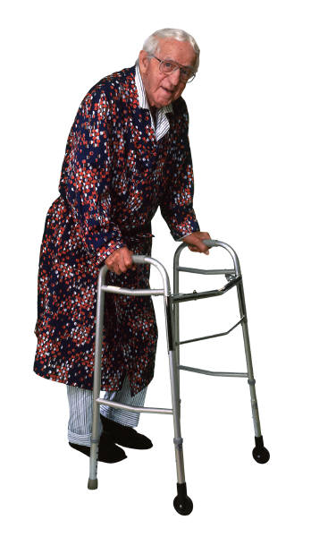
Overview
People are living longer with chronic or debilitating conditions
Adults often find themselves in caregiver roles for parents or spouse, a child or disabled person
Most people are unprepared and untrained for this role
Providing care for a loved one can take a tremendous toll on the caregiver, in terms of emotional health, physical health, and financial status.

Slide 4
Statistics: Numbers and Health
More than 65 million people, 29% of the U.S. population, provide care for a chronically ill, disabled or aged family member or friend during any given year and spend an average of 20 hours per week providing care for their loved one.
Nearly three quarters (72%) of family caregivers report not going to the doctor as often as they should and 55% say they skip doctor appointments for themselves. 63% of caregivers report having worse eating habits than non-caregivers and 58% indicate worse exercise habits than before caregiving responsibilities.
Evercare Study of Caregivers in Decline: A Close-Up Look at Health Risks of Caring for a Loved One, National Alliance for Caregiving and Evercare, 2006

Slide 5
Statistics: Work and Finances
Among employed caregivers (73%), two-thirds have gone in late, left early, or taken time off during the day to deal with caregiving issues (66%). One in five took a leave of absence.
Caregiving in the United States, National Alliance for Caregiving in collaboration with AARP, November 2009
47% of working caregivers indicate an increase in caregiving expenses has caused them to use up ALL or MOST of their savings.
Evercare Survey of the Economic Downturn and Its Impact on Family Caregiving, National Alliance for Caregiving and Evercare, March 2009

Slide 6
Your Thoughts
For those of you who have been a caregiver or know about caregiving from another perspective, please use the chat box and write in a word or phrase that comes to your mind when thinking about the experience.
You may submit more than one entry. After we get a number of entries, we will discuss the common themes.

Slide 7
Range of Emotions is Normal
Common emotions are both positive and negative
Guilt, anger, sadness, feelings of helplessness
Also feelings of gladness from being there for loved one, comfort, opportunity to spend quality time
Feeling of usefulness, worth, being helpful

Slide 8
Mental and Physical Effects
Enormous stress
Clinical depression
Physical injuries, such as back strain
Lowered immune system
Sleep disorders
Health issues from not exercising, poor nutrition, skipping routine checkups and tests

Slide 9
When the Caregiver Comes to the Library
As librarians know, people with health questions can be upset about a scary diagnosis, angry or fearful. The caregiver is facing these and other issues – worry, own health issues, and under stress.
Learn as much as possible about the caregiver’s individual situation.
Offer resources specific to situation and also refer to general resources that will provide help as the situation progresses.

Slide 10
The Good News
While it won’t fix problems, having access to information and knowledge about services can go a long way towards helping the caregiver!
What follows –
The big picture – legal and ethical issues, starting the conversation
Resources about caregiving tasks – what needs to be done on a day by day basis such as learning how to lift or bathe a person, managing meds, or even choosing a nursing home
Resources to help care for the caregiver

Slide 11
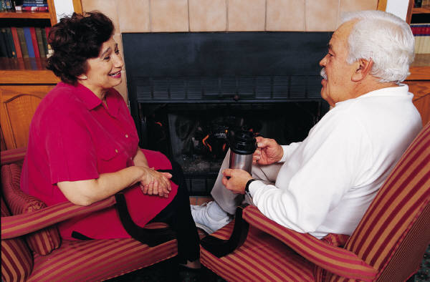
Starting the Conversation
Talking with parents or a loved one about sensitive issues can be difficult, but extremely important. Here is a resource to help get started:
FACE THE FACTS: Must-Have Conversations About Aging
http://www.n4a.org/pdf/Conversations_on_Aging.pdf
Notes:
Begin conversations early when possible; learn what is important to the parent. So much easier if they can let their wishes be known before it’s too late
Things can change slowly, then overnight something major happens
Nicely formatted PDF from the Eldercare.gov website here:
http://www.eldercare.gov/ELDERCARE.NET/Public/Resources/Factsheets/Face_the_Facts.aspx

Slide 12
The Bigger Picture
The best case scenario is when the person who needs care has already made decisions and provided instructions about their care, or is willing to take that step.

Slide 13
Resources for Legal Issues
Family Caregiver Alliance
Good place to start for information about advance directives, living wills, and legal issues such as LGBT caregiving situations.
http://www.caregiver.org
AGS Foundation for Health in Aging
Well-organized and easy to use, explaining all of the issues related to choices for life sustaining treatment and much more.
http://www.healthinaging.org/agingintheknow/chapters_ch_trial.asp?ch=4
Caring Connections
Information about Advance Directives and links to download state-specific forms
http://www.caringinfo.org/i4a/pages/index.cfm?pageid=3289
Notes:
Caring Connections is a program of the National Hospice and Palliative Care Organization

Slide 14
End-of-Life Issues
End of Life: Helping With Comfort and Care
This 68-page guide discusses key issues at the end of life. Topics include finding hospice care, what happens at the time of death, managing grief, and preparing advance directives along with resources for more information. Free; also available as a PDF.
http://www.nia.nih.gov/health/publication/end-life-helping-comfort-and-care

Slide 15
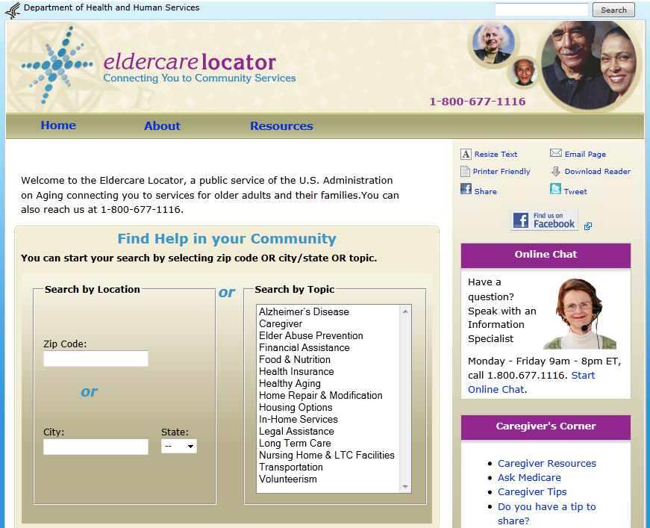
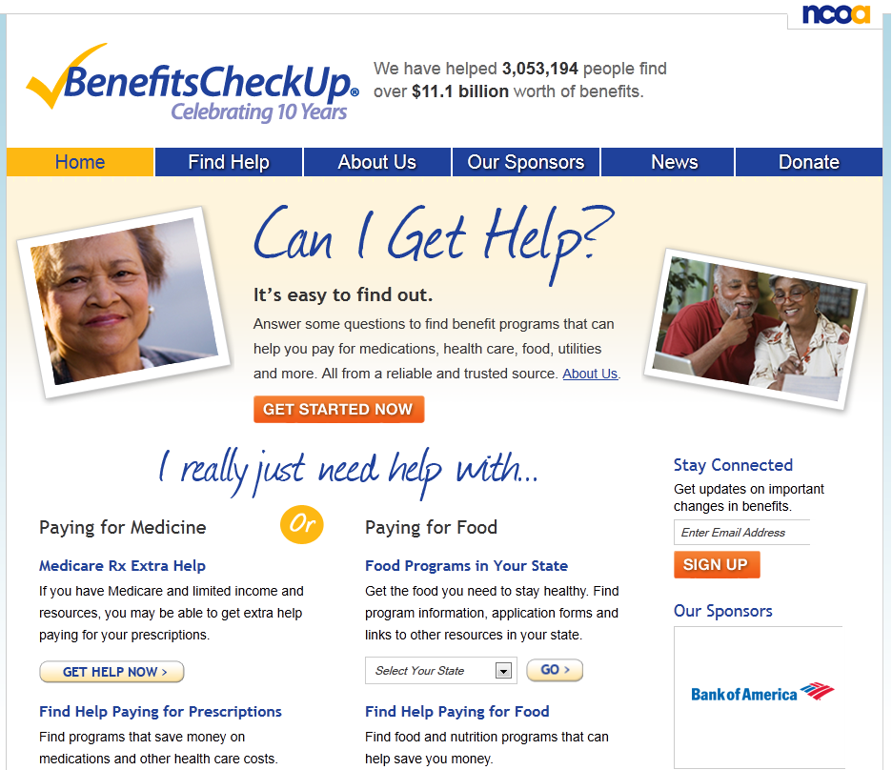
Locating Services and Benefits
Eldercare.gov
The Eldercare Locator from the U.S. Administration on Aging is a directory of services for older adults.
BenefitsCheckup.org
A directory of benefit programs that can help pay for medications, health care, food, utilities and other necessities.

Slide 16
Medicare and Medicaid Information
Medicare.gov is the primary source of information for all Medicare questions, including choosing a nursing home. The 4-minute video on the Caregivers website is worth watching:
http://medicare.gov/caregivers/
Medicaid.gov has basic information about Medicaid. For state-specific information, click on the map to drill down to information on Medicaid programs in each state.

Slide 17
Understanding Insurance
Health Insurance Counseling and Advocacy Program (HICAP)
HICAP is a federal program that assists people with information on Medicare, Medicare supplement insurance, managed care, long-term care planning and health insurance, and other health insurance concerns.
California: http://www.aging.ca.gov/programs/hicap_contacts.asp
In other states: Directory of State Health Insurance Counseling and Assistance Plans
http://www.payingforseniorcare.com/longtermcare/resources/state_health_insurance_programs.html

Slide 18
Daily Caregiving: Wide Range of Activities
Running errands
Grocery shopping
Preparing meals
Housekeeping and yard work
Bill paying
Driving to appointments
Help with getting dressed
Brushing teeth and combing hair
Assisting with getting in and out of chairs or bed
Help in using the toilet
Bathing
Feeding

Slide 19
Day to Day Activities
Hands-on Skills for Caregivers
Five techniques to help caregivers take care of a loved one’s physical needs. http://www.caregiver.org/caregiver/jsp/content_node.jsp?nodeid=787
Dental Care Every Day: A Caregiver's Guide
Illustrated, step-by-step guide for providing daily dental care such as brushing and flossing.
http://www.nidcr.nih.gov/OralHealth/Topics/DevelopmentalDisabilities/DentalCareEveryDay.htm

Slide 20
Day to Day Activities - Continued
Lifting Techniques for Home Caregivers
Illustrations and instruction for proper lifting and moving techniques to prevent injury to the caregiver
http://orthoinfo.aaos.org/topic.cfm?topic=A00096
Rehabilitation Tip Sheets
Step-by-step instructions and photo illustration for wheelchair positioning, assisted pressure relief, lifting and transfers, and swallowing strategies.
http://www.spinalcord.uab.edu/show.asp?durki=90249
Activities of Daily Living: Tips for the Family Caregiver
Helpful information about ADL assessments to determine needed levels of care, plus useful tips for the caregiver http://www.seniornavigator.org/virginianavigator/DetailSN.aspx?contentId=51&.f=1

Slide 21
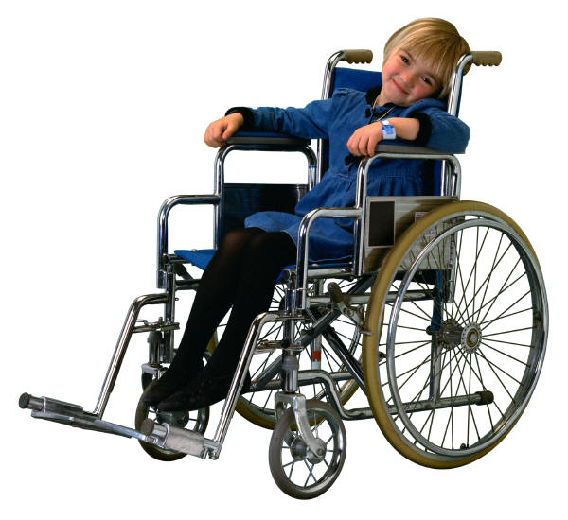
Special Situations for Caregivers
Disease or Condition
Alzheimer’s Disease
Cancer
Many others
Care Recipient
Special needs child
Elderly parent
Injured veteran
Long Distance Caregiving

Slide 22
Some Basics for Special Situations
Caregivers need to know the basics of the condition(s) their loved one is facing (diabetes, COPD, heart failure) in order to help provide appropriate care.
Knowledge of quality health information sites such as MedlinePlus.gov can be very useful.
Hospital social workers are very knowledgeable about resources through the hospital or community.
Check with the patient’s healthcare institution to see if there is any specialized training for caregivers.

Slide 23
Alzheimer’s Disease
Caring for a Person with Alzheimer's
Disease: Your Easy-to-Use Guide
This comprehensive, 136-page handbook from the National Institute on Aging offers easy-to-understand information and advice for at-home caregivers of people with Alzheimer’s disease. It addresses all aspects of care, from bathing and eating to visiting the doctor and getting respite care.
http://www.nia.nih.gov/alzheimers/publication/caring-person-alzheimers-disease

Slide 24
ALS (Lou Gehrig’s Disease)
Muscular Dystrophy Association ALS Caregiver’s Guide
Comprehensive 200 page guide from the Muscular Dystrophy Association
Covers emotional and financial concerns, everyday care tasks and finding help
Addresses topics such as nutrition, breathing, communication, finances, insurance accessibility and much more
Can be ordered online; each section is also available as a separate PDF
http://www.als-mda.org/publications/alscare/

Slide 25
Caregiving from Afar
So Far Away: Twenty Questions and Answers About Long-Distance Caregiving
Using a question-and-answer format, this beautifully illustrated, 44-page booklet offers information about caregiving from afar. It explores topics such as complex family relationships, legal issues, housing options, and advance directives.

Slide 26
Taking Care of the Caregiver
Caregivers often are the type of people who don’t ask for help themselves; they are problem solvers, doers, and very capable people. They often find it hard to ask for help, or accept help. Support comes in many forms:
Print and online resources
Online support groups
Mental health/social workers
Respite
Directories of services
Personal support networks, friends, family

Slide 27
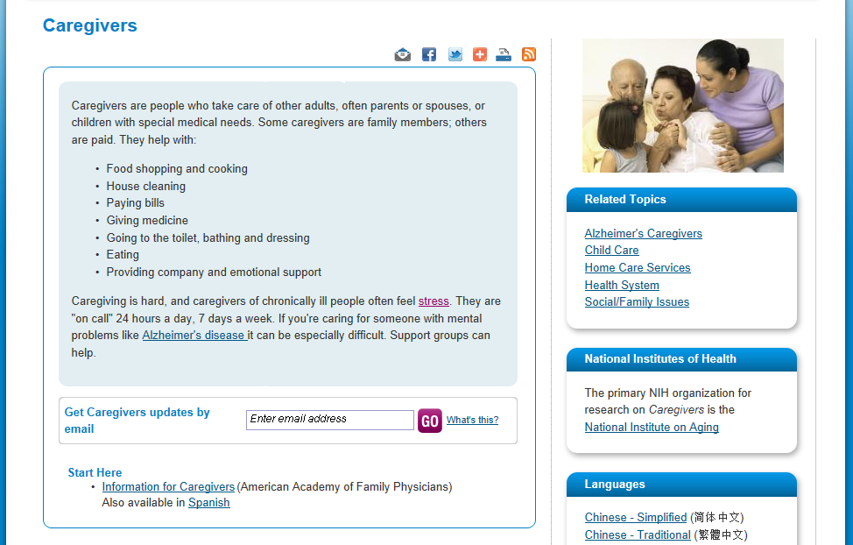
MedlinePlus.gov Caregiver Health Topic

Slide 28
Examples of MedlinePlus Resources
Coping
Caregiving and Depression(Family Caregiver Alliance), Also in Spanish
Caring for the Caregiver(National Cancer Institute), Also in Spanish
Respite Care(Administration on Aging)
Taking Care of You: Self-Care for Family Caregivers(Family Caregiver Alliance)
Specific Conditions
ALS Caregiver's Guide(Muscular Dystrophy Association)
Cancer: End-of-Life Issues for the Caregiver(American Academy of Family Physicians), Spanish
Caring for Adults with Cognitive and Memory Impairments(Family Caregiver Alliance), Spanish
Caring for Someone with AIDS at Home(Centers for Disease Control and Prevention), Spanish
Caring for Someone with Developmental Disabilities(Administration on Aging) - PDF
Caring for the Elderly: Dealing with Resistance(Mayo Foundation for Medical Education and Research)
Families with Special Needs: Caregiving Tips(Centers for Disease Control and Prevention)
Family Caregivers in Cancer (PDQ)(National Cancer Institute)

Slide 29
MedlinePlus Resources – Continued…
Related Issues
Adult Day Care(Administration on Aging)
Assistive Technology(Family Caregiver Alliance)
Caregiving and Sibling Relationships: Challenges and Opportunities(Family Caregiver Alliance)
Community Care Options(Family Caregiver Alliance), Also available in Spanish
Emergency Readiness for Older Adults and Caregivers(Administration on Aging) - PDF
Guidelines for Better Communication(Family Caregiver Alliance)
Hands-On Skills for Caregivers(Family Caregiver Alliance)
Holding a Family Meeting(Family Caregiver Alliance)
Information Caregivers Can Use on: Speaking with a Friend or Family Member's Doctor During an Office Visit(Centers for Medicare & Medicaid Services) - PDF
Information for Caregivers(American Health Information Management Association)
LGBT Caregiving: Frequently Asked Questions(Family Caregiver Alliance)
Lifting Techniques for Home Caregivers(American Academy of Orthopaedic Surgeons)

Slide 30
Basics of Caring for Yourself
Educate yourself about the disease or medical condition
Become part of the healthcare team
Consult with other experts if necessary (legal, financial)
Tap your social resources
Take time for relaxation and exercise
Use community resources
Maintain your sense of humor
Set realistic goals
Explore religious beliefs and spiritual values
http://www.aoa.gov/AoAroot/Press_Room/Products_Materials/fact/pdf/Taking_Care_Yourself.pdf

Slide 31
A Few More Things
Creating and maintaining an organized filing system reduces stress
Person handling the affairs of another will need power of attorney to speak to doctor, bank, insurers, even the cable company.

Slide 32
Make Time
Caregivers need to make time for the others in their life; it’s vital for everyone

Slide 33
Resources for the Caregiver
Nicely designed page for caregivers of people with heart disease, but information applies to caregivers in all situations. http://www.heart.org/HEARTORG/Caregiver/Caregiver_UCM_001103_SubHomePage.jsp
Wonderful resources, including a set of Journal pages for the caregiver.
Notes:
Journal pages:
http://www.heart.org/HEARTORG/Caregiver/Rights/JournalPages/Journal-Pages_UCM_301751_Article.jsp#.TxY8XV1pD9o

Slide 34
Finding Support Groups
Local resources – hospital social worker, community organizations
Area Agency on Aging
Online resources for specific conditions – often have support group directories
Online support groups

Slide 35
Seek Out Local and State Services
Area Agency on Aging
California divided into 33 PSAs (Planning and Service Areas)
http://www.c4a.info/index.php?option=com_content&view=article&id=4&Itemid=4
California Caregiver Resource Centers
11 non-profit centers throughout state
http://www.californiacrc.org/californiacrc/jsp/home.jsp
The National Family Caregiver Support Program
Provides information about caregiver programs and services, counseling, training services and respite
http://www.nei.nih.gov/nehep/about/partnership/nehep_partnership_organizations.pdf

Slide 36
Building a Small Collection
The National Institutes of Health
Free and low-cost publications for consumers
Examples:
National Diabetes Information Clearinghouse
http://diabetes.niddk.nih.gov/
National Cancer Institute
“What You Need to Know About” series
http://www.cancer.gov/cancertopics/wyntk
Building & Running a Small Resource Center: a toolkit
Published by the Alzheimer’s Association, the guide includes information useful to any organization interested in building and running a small resource center.
http://www.alz.org/library/downloads/BuildingSmallResourceCenter2.10.pdf
Notes:
Start with MedlinePlus for your topic; visit the NIH Institute and look for publications.
Other resources from librarians at the Alzheimer’s Association:
http://www.alz.org/library/index.asp
Resource lists
http://www.alz.org/library/lists.asp

Slide 37
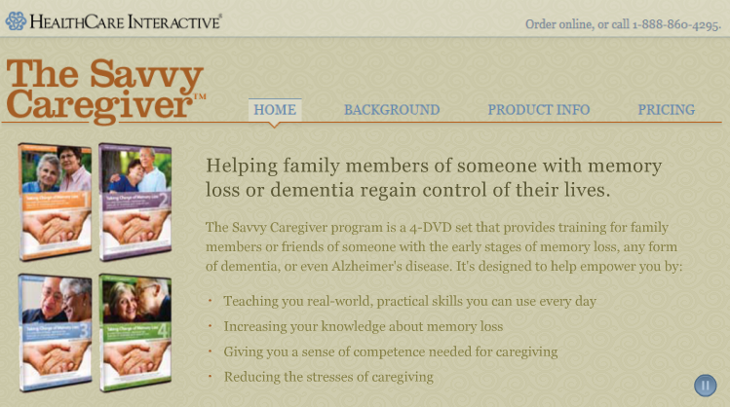
Caregiver DVDs
The Savvy Caregiver program is a training program for caregivers of persons with memory loss or dementia.
http://www.memorylossdvd.com/

Slide 38
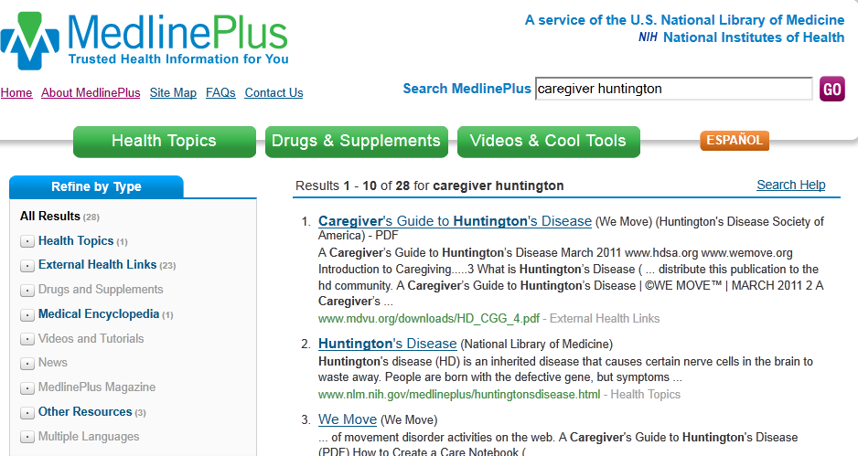
Tip: Quick Path to Information
Remember to use MedlinePlus for quick checks on caregiver information for just about any topic

Slide 39
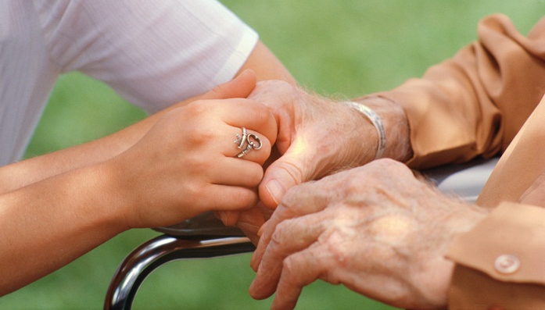
This Affects All of Us
Caregiving is probably affecting library staff members at any given time. Identify resources in your own institution:
Flexible spending accounts for dependent care
Family leave time
community resources http://www.thefamilycaregiver.org/who_are_family_caregivers/care_giving_statstics.cfm
Notes:
As we wrap up, let’s think about this issue and how it affects each of us individually and within our institutions

Slide 40
Thank You!
Kelli Ham
kkham@library.ucla.edu
http://nnlm.gov/psr/
1-800-338-7657
This project has been funded in whole or in part with Federal funds from the Department of Health and Human Services, National Institutes of Health, National Library of Medicine, under Contract No. HHS-N-276-2011-00009-C with the UCLA Louise M. Darling Biomedical Library.

