Slide 1

Improvisation at Work!
An Webinar
Infopeople webinars are supported by the U.S. Institute of Museum and Library Services under the provisions of the Library Services and Technology Act, administered in California by the State Librarian.
Communicating and Innovating in Your Library

Slide 2
What We’ll Cover Today
What do we mean by improvisation
Why improvisation is useful in the library now
Four Skills of Improvisation
  Be Present
  Yes, And…
  Take risks, mistakes are gifts
  Support your partner

Slide 3
Make a list of words that relate to the word
“library”

Slide 4
Make a list of words that are unrelated

Slide 5
Did you have more on the first list of words that relate to “library”
Please use the Yes/No feedback button

Slide 6
What words do you think of when you hear the word Improvisation?
Please type in the chat window

Slide 7
Myths of Improvisation
Unprepared
Frightening
Irresponsible
Has to be funny
I can never do that

Slide 8
Improvisation Through the Eyes of an Improviser
Practice
Connection
See offers
Listen
Awareness
Shared Leadership
Positivity
Flexibility
Adaptability
Story
Trust
Rapport
Teambuilding
Support
Building
Collaboration

Slide 9
Library Work Then and Now
No longer only about:
  Cataloging and organizing
  Answering questions from a limited set of materials
  Finding the right book
  People in the building
Library work now is about:
  Connecting people with resources
  Empowering
  Engaging community
  Directing people to the bathrooms ;)

Slide 10
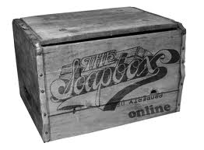
Work is About Communicating With People

Slide 11
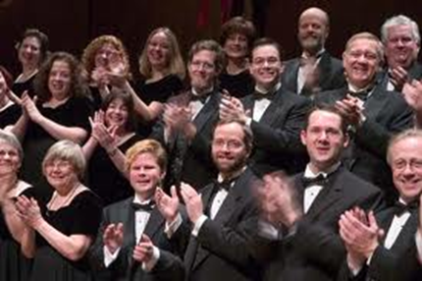

Slide 12
What Skills Do We Need to Thrive Survive?

Slide 13
What Skills Do We Need to Thrive Survive?
Collaborate
Authentic Respectful Communication
Shared Purpose
Active Listening
Flexibility/Comfort with Ambiguity
Focus on Positive Solutions
Let Go of Outcomes/Reframe Failure as Opportunity
Confidence

Slide 14
Four Skills of Improvisation
Be present
Yes, And…
Take risks, mistakes are gifts
Support your partner

Slide 15

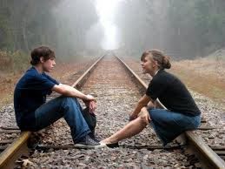

Slide 16


Slide 17
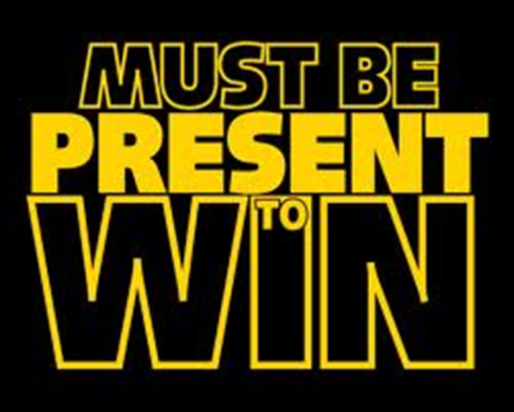
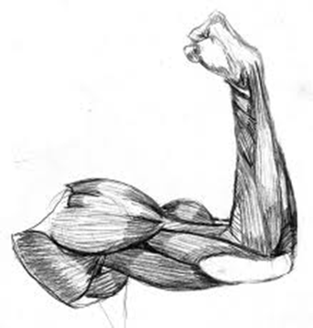
Practice building the muscle of being present:
  in meetings
  with challenging customers
  with colleagues in conversation.
Practice self awareness to:
  know when you’re NOT being present
  notice the tendency to judge and react
  have a choice about how to respond

Slide 18
See Red

Slide 19
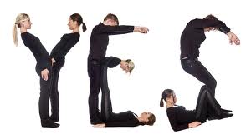
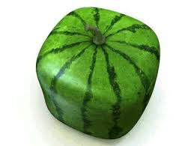
, AND …

Slide 20
Libraries should reduce their book collections and allocate more space to community gathering spaces

Slide 21

Build up the muscle of finding what’s right!
We too often shut down or block progress
  Yes, But = Blocking
  Yes, And = Building

Slide 22
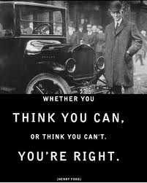
Take Risks, Mistakes are Gifts

Slide 23
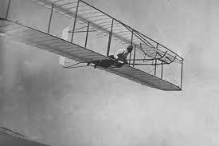
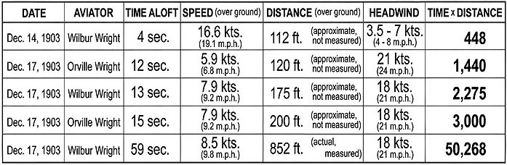
Learning to Fly

Slide 24
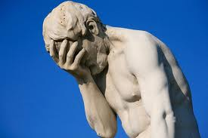

Slide 25
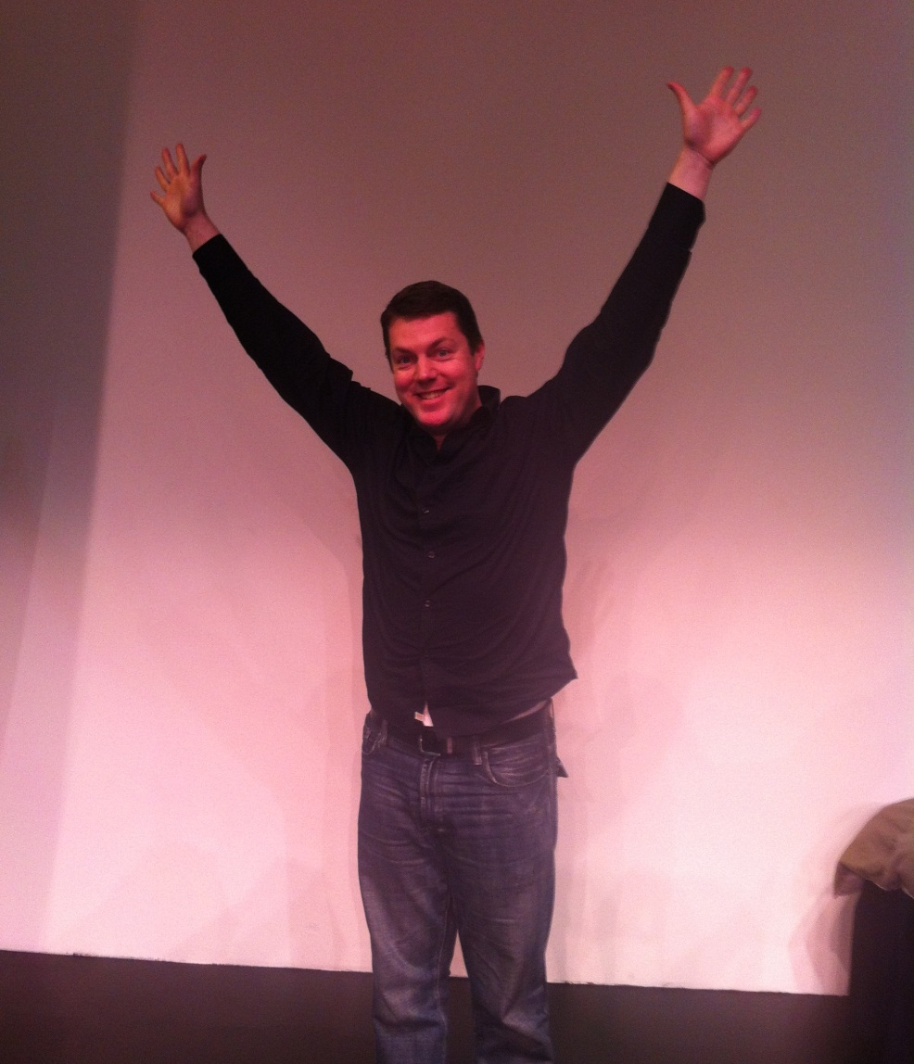
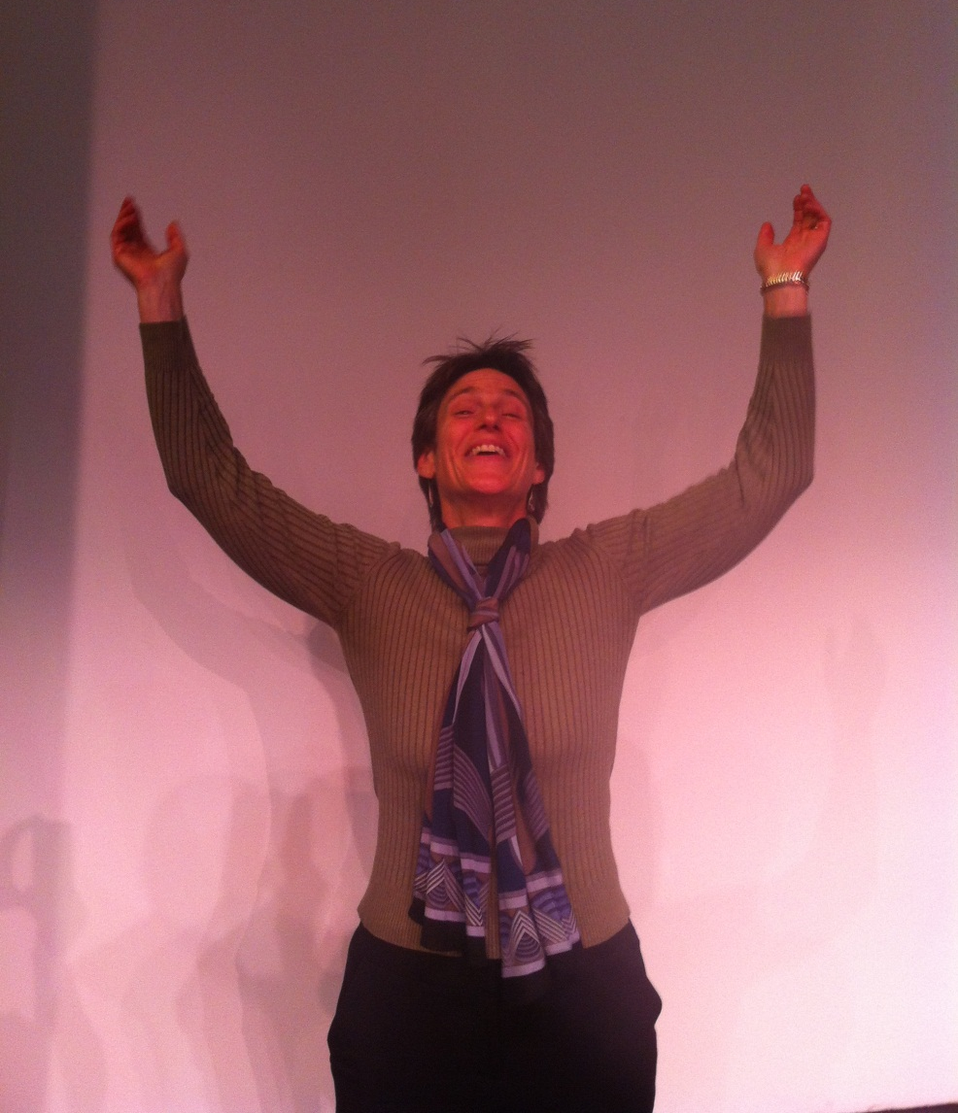
I blew it
I made a mistake

Slide 27
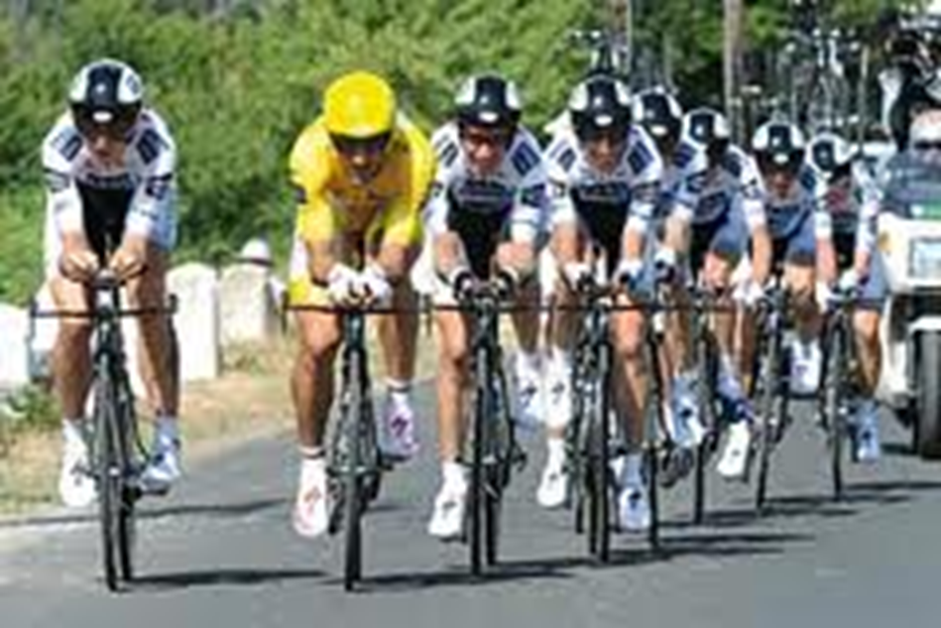
Support Your Partner

Slide 28


Slide 29
What’s Good About This?
More people are
reading on
digital devices

Slide 30
Practice Makes Perfect
Wrong Name

Slide 31
Summary of Today’s Skills
Be Present - let go of your personal bias, create connections and see opportunities.
Yes, And… - to show willingness to listen and build
Take risks – share ideas, worry less, experiment more
Support your partner – you don’t have to do it alone!

Slide 32

Nov/Dec 2011 Public Libraries: PLA president says
  We found our organization opening up after a communications training session that taught the “yes, and…” principle. (p. 5)
  What would happen if your organizational culture was one of “yes”? (p. 5)
http://www.publiclibrariesonline.org/magazines/from-the-president/grab-your-partner

Slide 33
Infopeople Workshop on Skills of Improvisation - Coming in Spring for California libraries
Open registration all-day workshops like in the old days.
  Come alone, with a buddy or with an existing team
Contract for the workshop for your
  Management team
  Staff day
  Any groups that need to work together for the good of the library.

Slide 34

Q and A

Slide 35
Thank You!
Cheryl Gould
cheryl.gould@gmail.com
Chris Sams
chris@improv.org

