Slide 1

It’s Who You Know:
Finding, Making,
and Keeping Connections for
Successful Community Partnerships
Infopeople webinars are supported by the U.S. Institute of Museum and Library Services under the provisions of the Library Services and Technology Act, administered in California by the State Librarian.
Erica Cuyugan
Sarah Bleyl
Carissa Purnell

Slide 2


California
Libraries…
(all bad)
“California Governor Jerry Brown announced Tuesday a mid-year, $16 million cut to state library funding, which essentially eliminates all remaining state funding for the California Library Services Act (CLSA), theCalifornia Library Literacy and English
Acquisition Service, and the Public Library
Foundation (PLF). Last year the programs received $30.4 million”
(Library Journal December 14, 2011. “With Mid-Year Cut, California Reduces State Funding for Libraries to Zero “)

Slide 3
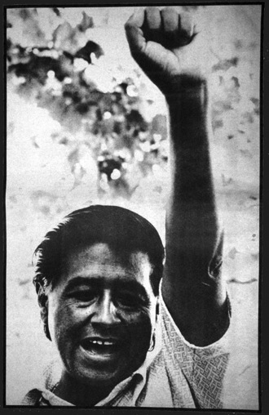
Why Community?
“Once social change begins, it cannot be reversed. You cannot uneducate
the person who has learned to
read. You cannot humiliate the
person who feels pride. You
cannot oppress the people who
are not afraid anymore. We have
seen the future, and the future
is ours.”
Cesar Chavez

Slide 4
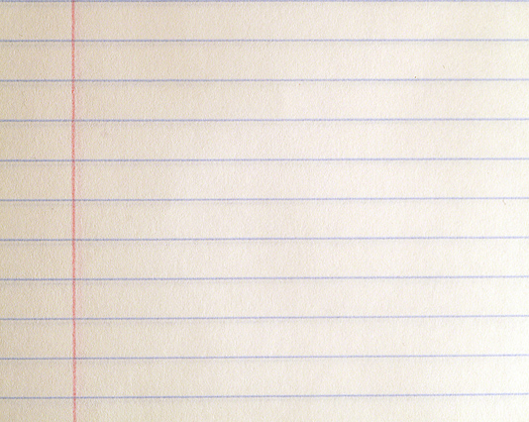
AGENDA
The Basics
Levels of Partnerships
Connections
How’s It Going?
Thinking Outside the Box
Questions

Slide 5
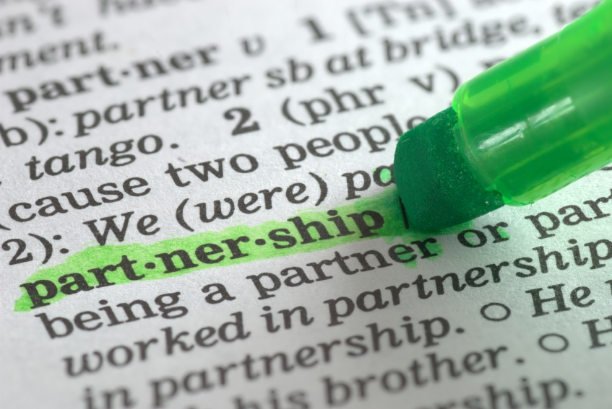
What does “Partnership” mean?

Slide 6
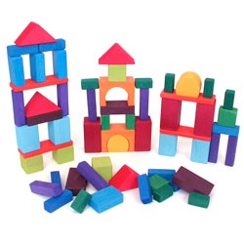
the basics
  WHAT is our definition of partnership?
  WHY are partnerships beneficial?
  KNOW your community FIRST.

Slide 7
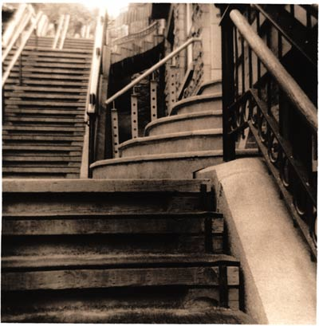
All partnerships are
NOT the same

Slide 8
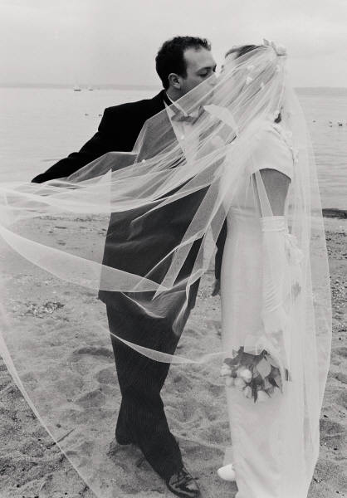
Different stages of partnership
Glance
Date
Engagement
Marriage
(Thank you George and Joan)

Slide 9

Short term vs.
LONG TERM

Slide 10

CONNECTIONS
Who Do You Know?

Slide 11

Who’s In Your Community?
Arts, Sports & Leisure
Local Businesses (Restaurants, Dance
Studios, Galleries, Retail Stores)
Media (Print, Online, Radio, Television)
Cultural Organizations
Museums
Parks & Recreation Department
Local Sports Teams
Education
Community Colleges
UC’s and CSU’s
Test Prep Companies
Health
County Health Departments
Health Clinics
Fitness or Nutrition Specialists
Farmers’ Markets
Youth
PTA’s
School Districts (Teachers, Librarians,
Counselors)
Boys and Girls Club
Afterschool programs
Teen/Youth Centers
Legal
County Probation
Juvenile Detention Facilities
Law Enforcement
Other Potential Partners
Nonprofits
Faith-based Organizations
Public Transportation Departments
Local Government
Banks and Financial Institutions
Chamber of Commerce

Slide 12
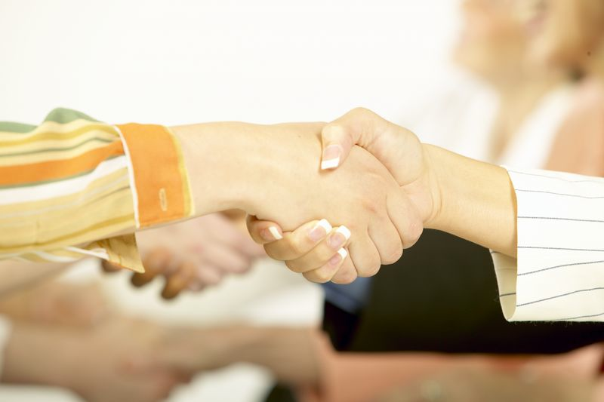
Types of Contacts
In Your Network
“Friend of a Friend”
New Contact

Slide 13
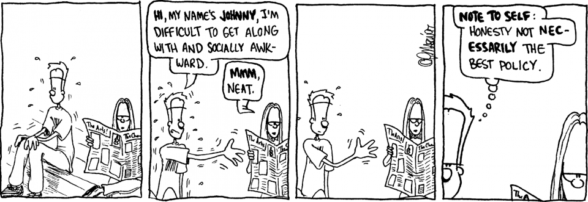
The Approach
Source: portermason.com

Slide 14
Maintain Your Connections
  Expectations
    Responsibilities
      Communication
        Periodic Check-In

Slide 15

How’s It Going?
  What’s working and what isn’t?
  What needs improvement?
  Has the partnership run its course?

Slide 16
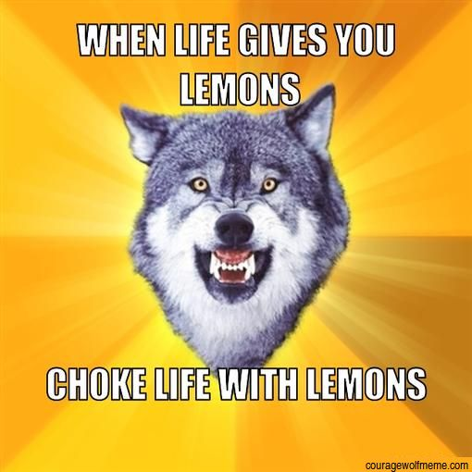
Nothing is perfect…work with it…
Whether or not you may know
it there is a political implication
to everything you do as a
public servant…
KNOW your councilmembers,
district lines, where local
agencies receive funding, know
what partnerships currently
exist, do your research…
Otherwise… you’ll get lemons…

Slide 17

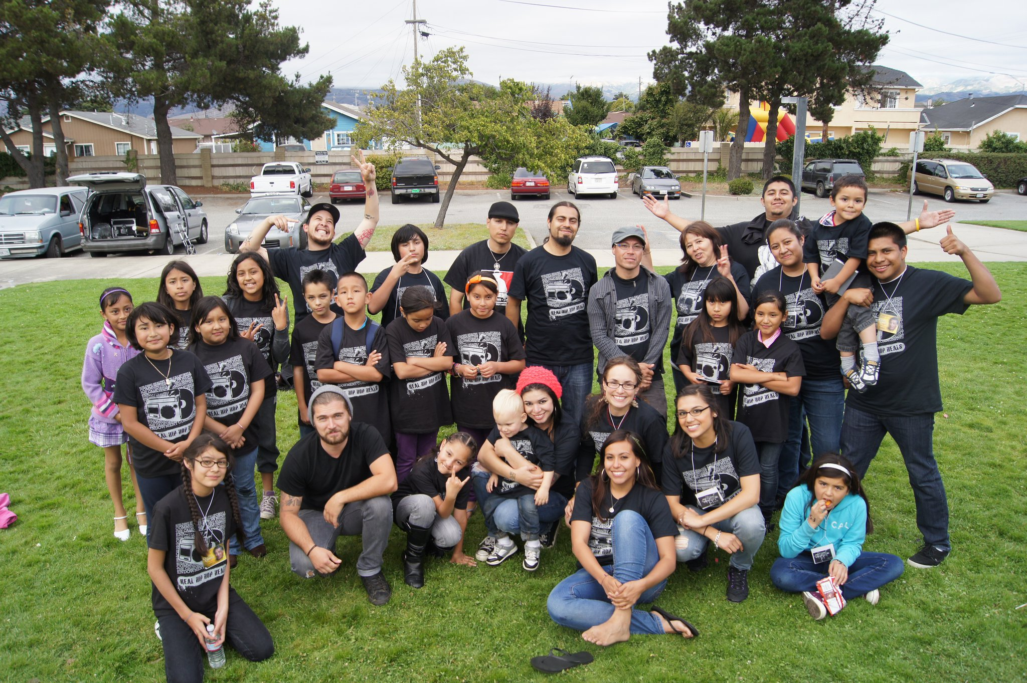
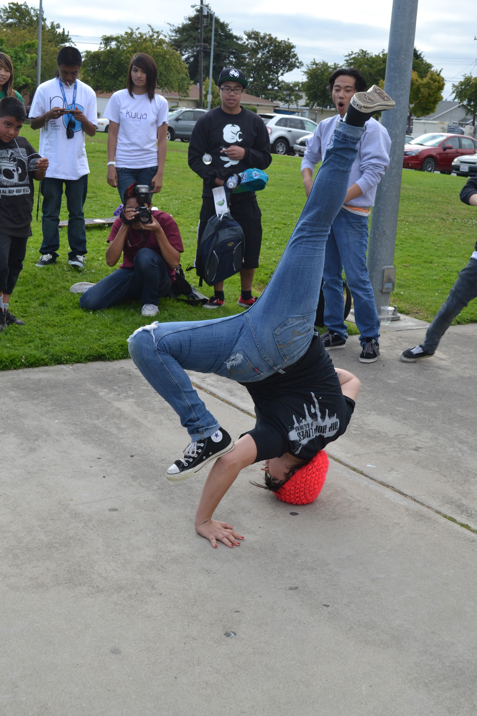

Taking lead from the "cool" crowd...NYPL
Reality Check: We all don't have millions of dollars...
New York Public Library hosted JayZ and Cornel West to discuss his new book titled, Decoded. This inspired youth in Salinas to do design their own hip hop driven program with the book as the catalyst using digital media to bring JayZ into our library.
http://www.youtube.com/watch?v=7bH2xg5XMPs
http://www.flickr.com/photos/aliterarymarvel/sets/72157627481157032/

Slide 18
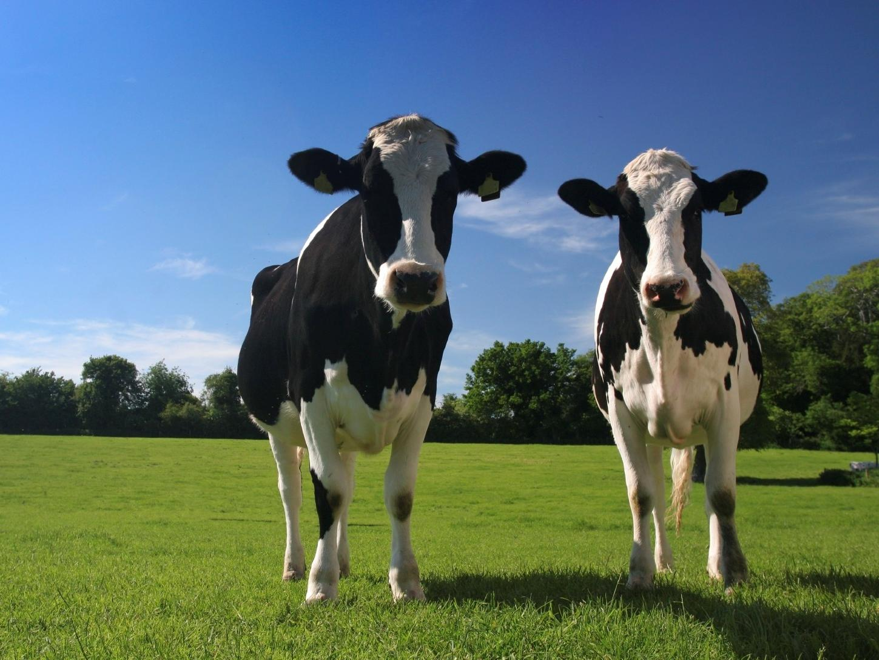
Keeping it Old School…teaching everything
Including milking a cow…
Children milk cow in library
“A dozen or so children practiced milking a cow at the Luther Callaway Public Library in Chiefland on Friday (July 15) as part of a program presented by Dana Langford of Levy County Soil and Water Conservation….”
(http://hardisonink.com/review.php?page=1311206986.html)

Slide 19

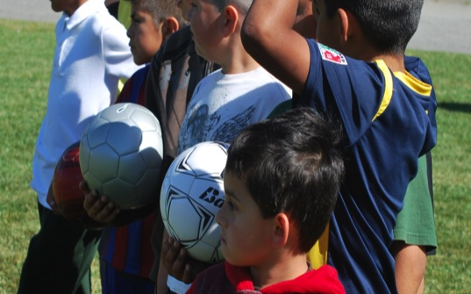



Breaking Tradition: Soccer @ the Library!
California State University Monterey Bay has provided over 100 college student volunteers for library programming. One including free bilingual soccer clinics that have served an upwards of 1,000 youth and spawned a community wide clinic beginning January 2012.
PRESS COVERAGE:
Good Monday Morning: Salinas man scores with free soccer camp for kids. May 30, 2011
La Biblioteca César Chávez Ofrece Gratis Clínica de Fútbol Para Niños. El Sol. September 24, 2011.

Slide 20
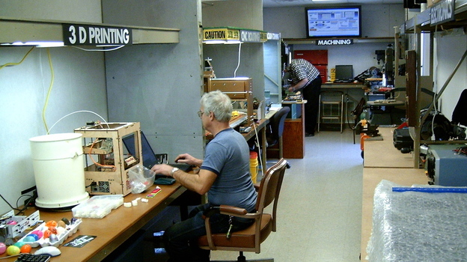
unique connections
HACKER SPACE!
The Allen County Public Library, which serves the city of Fort Wayne, Ind., has a modest hackerspace inside a trailer in its parking lot. Library director Jeff Krull says hosting it is consistent with the library's mission. "We see the library as not being in the book business, but being in the learning business and the exploration business and the expand-your-mind business," he says. "We feel this is really in that spirit, that we provide a resource to the community that individuals would not be able to have access to on their own." (www.npr.org)

Slide 21
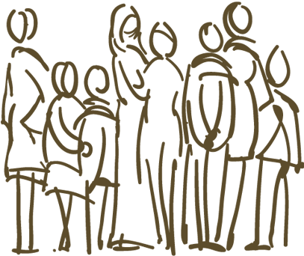
Your “Community” as a Partner
While organizations often bring to the table resources and expertise, community resident themselves bring a lived experience no group can replicate…recognize the talents within your own communities.
Check Out KQED’s Mindshift article, “The Public Library as an Incubator for the Arts” that highlights the potential of local community level arts based programming.
http://mindshift.kqed.org/2012/01/the-public-library-as-an-incubator-for-the-arts/

Slide 22

Expand Your Network
Attend Community or
School Functions
Sponsor a Booth at Local Festivals
Join a Task Force or Committee
Take a Walk or Pick Up the Phone
Learn to ask “Why Not?"
What are some other ways to expand your network?

Slide 23


questions

Slide 24
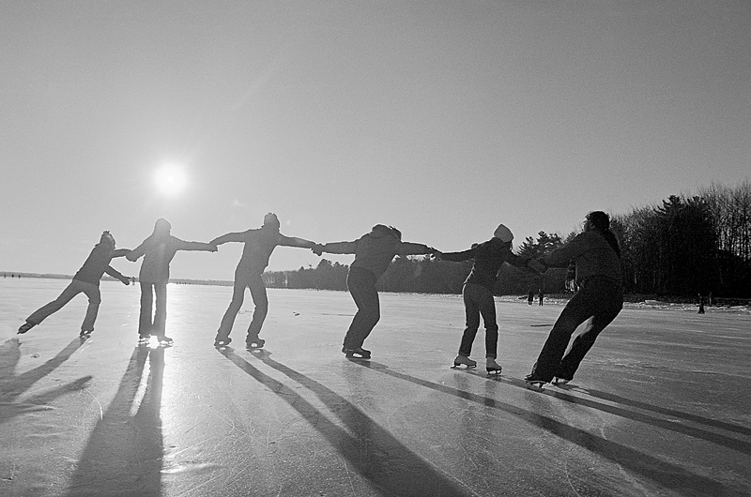
Coming together is a beginning. Keeping together is progress. Working together is success. -Henry Ford
Sarah Bleyl, Kern County Library
sarah.bleyl@kerncountylibrary.org
Erica Cuyugan, Santa Monica Public Library
erica.cuyugan@smgov.net
Carissa Purnell, Salinas Public Library
carissapurnell@gmail.com
THANKS FOR TUNING IN!

