Slide 1
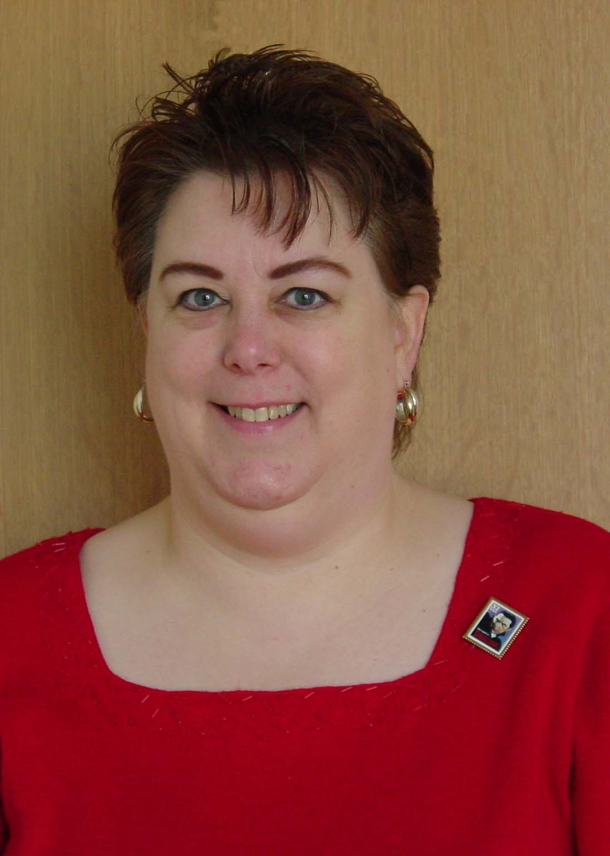
Children’s Literature Update 2012 An Webinar
Thursday, Feb. 2, 2012
12:00 noon to 1:00 p.m.
Presenter: Penny Peck
Pikly@aol.com
Infopeople webinars are supported by the U.S. Institute of Museum and Library Services under the provisions of the Library Services and Technology Act, administered in California by the State Librarian.

Slide 2
Agenda
Recent Book Awards
New Picture Books and Easy Readers
New Transitional Fiction, Nonfiction, Poetry
Tween Genre Fiction
Graphic Novels, Books adapted into Movies

Slide 3
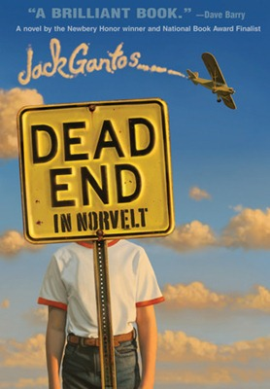
Newbery Medal Winner

Slide 4
Newbery Honor Books

Slide 5
Caldecott Medal Winner

Slide 6
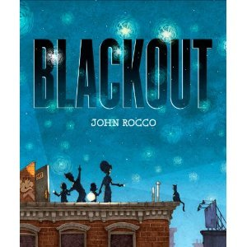
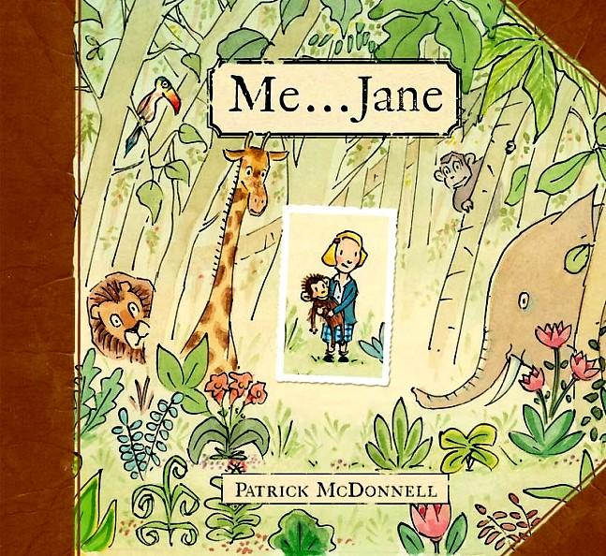
Caldecott Honor Books

Slide 7
Pura Belpre Award Winners
Author
Illustrator

Slide 8
Pura Belpre Honor Books

Slide 9
Sibert Medal for Informational
Winner

Slide 10
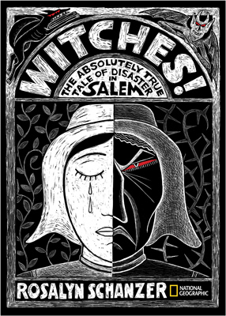
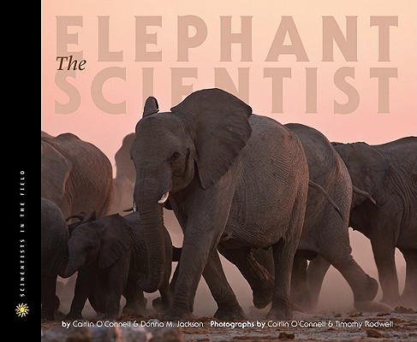
Sibert Honor Books

Slide 11
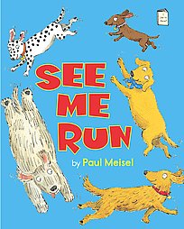
Geisel Award: Beginning Reader
Winner
Honor Books

Slide 12
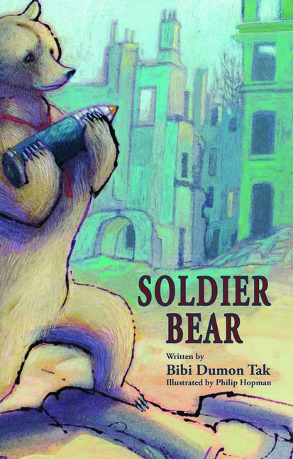
Batchelder Award
Winner
Honor Books

Slide 13
Schneider Family Award
Co-Winners

Slide 14
Coretta Scott King Awards
Author
Illustrator

Slide 15
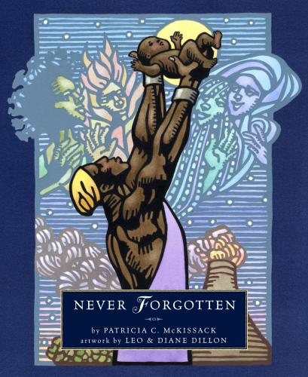
CSK Honor Books
Author
Illustrator

Slide 16
Any Questions or Surprises?

Slide 17
New Board Books

Slide 18
New Picture Books

Slide 19
More New Picture Books

Slide 20
New Easy Readers

Slide 21
Simon and Schuster’s “Ready to Read” books: pages.simonandschuster.com/readytoread
Any favorites I missed you would like to mention?

Slide 22
Transitional Fiction
Easy Chapter Books
Bridge or Moving Up Books
2nd and 3rd grades
Series fiction
Sometimes with ink drawings once or twice in each chapter

Slide 23
New Transitional Books

Slide 24
More New Transitional Fiction

Slide 25
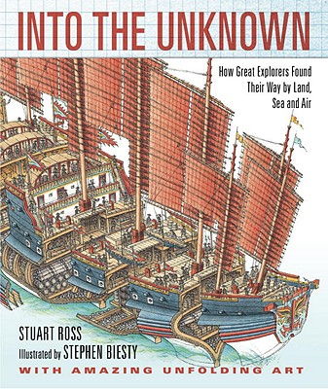
New Nonfiction

Slide 26
More New Nonfiction

Slide 27
New Poetry

Slide 28
Any favorites I missed you would like to mention?

Slide 29
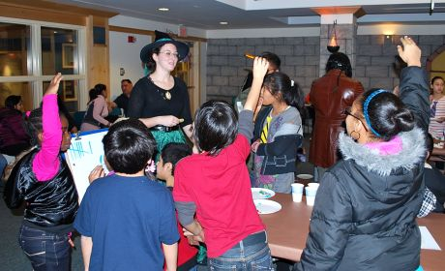
Tween Genre Fiction
Genres include:
Fantasy
Historical Fiction
Sports novel
Humorous novel
Science Fiction
Mystery
Adventure
For grades 4 – 8
Ages 9-12
Independent, confident readers

Slide 30
Fantasy

Slide 31
More New Fantasy

Slide 32
Historical Fiction

Slide 33
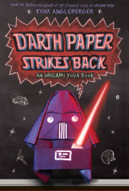
Humor

Slide 34
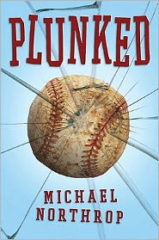
Adventure and Sports
Adventure
Sports

Slide 35
Mystery

Slide 36
Science Fiction and Realistic
Science Fiction
Realistic - Contemporary

Slide 37
Any new favorites I missed?

Slide 38
Books for Reluctant Readers
Nonfiction and poetry (mentioned earlier)
Graphic Novels
Books that have been adapted into feature films
Series fiction, especially books adapted from TV series
Popular authors such as Rick Riordan or Jeff Kinney

Slide 39
Graphic Novels

Slide 40
Graphic Novels Website
No Flying No Tights Kids Section
noflyingnotights.com/?cat=11
describes graphic novels for Kids

Slide 41
Books turned into Films
“Harry Potter and the Deathly Hallows Part II” by J.K. Rowling
“Legends of the Guardians: The Owls of Ga’Hoole” by Kathryn Lasky
“Chronicles of Narnia: Voyage of the Dawn Treader” by C.S. Lewis
“Ramona and Beezus” based on Beezus and Ramona by Beverly Cleary
“I am Number Four” based on the book by Pittacus Lore
“Mr. Popper’s Penguins” based on the book by Richard and Florence Atwater
“Incarceron” – based on the book by Catherine Fisher
“Hugo” – based on The Invention of Hugo Cabret by Brian Selznick
“War Horse” – based on Michael Morpurgo’s book
“Hunger Games,” coming out March 23, 2012, based on the book by Suzanne Collins.

Slide 42
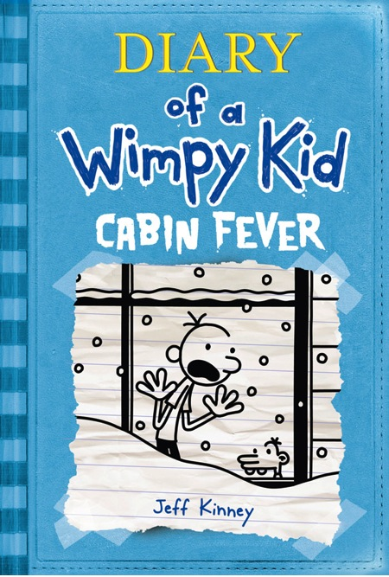
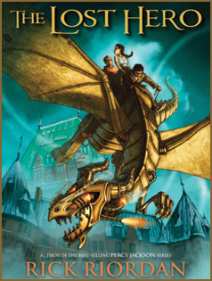
Popular Authors and Series

Slide 43
Finding Read-Alikes
“What book did you read recently that you liked?” – then find something similar
A book in the same genre
A book by that author or from that series
Try the following websites for Read-Alikes

Slide 44
Book Adventure
www.bookadventure.com/book_finder.aspx

Slide 45
ACL Read-alikes
www.bayviews.org/readalikes.html

Slide 46
Useful Websites (see handout)
ALA/ALSC Book Awards:
www.ala.org/alsc/awardsgrants/bookmedia
Bestseller’s Lists:
www.publishersweekly.com/pw/bestsellers/childrens-fiction.html

Slide 47
Time for questions?

Slide 48
Thank You!
Penny Peck
Pikly@aol.com

