Slide 1
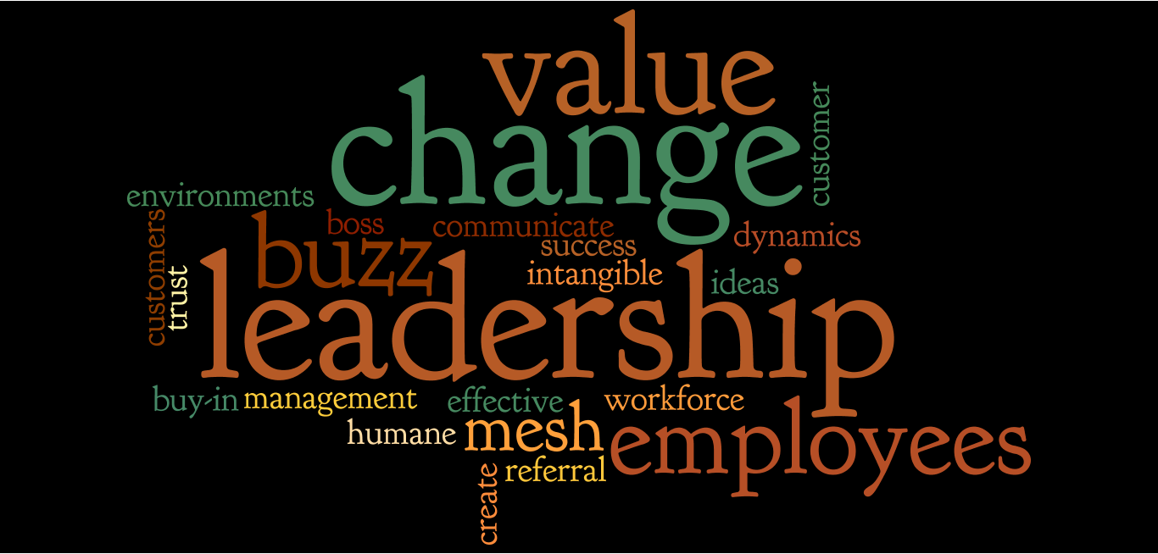
Libraries, We Mean Business:
Best Ideas from LJ’s Best Business Books of the Year
February 16, 2012
Presented by: Chris Brown, Lisa Dale, Deborah Lipoma
Infopeople webinars are supported by the U.S. Institute of Museum and Library Services under the provisions of the Library Services and Technology Act, administered in California by the State Librarian.

Slide 2






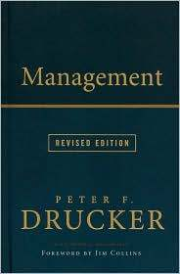

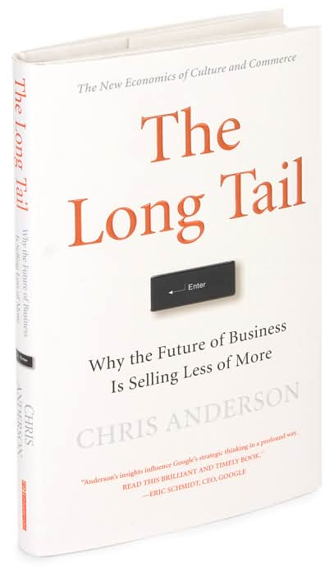
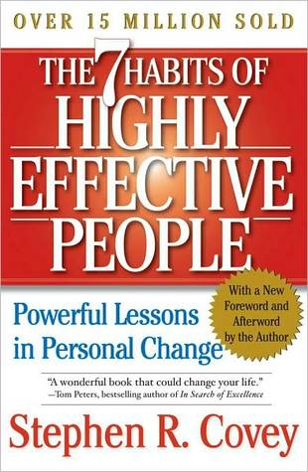












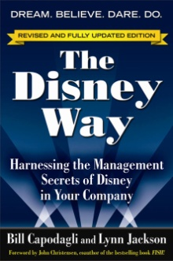



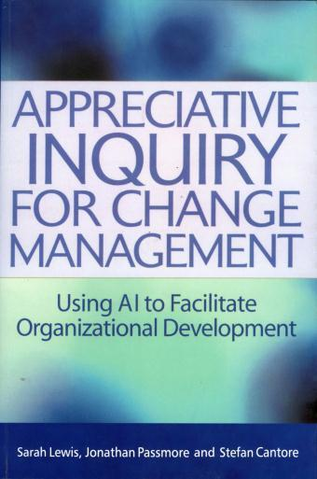

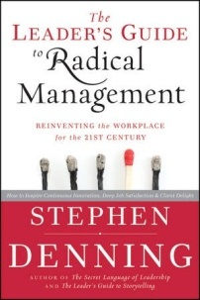



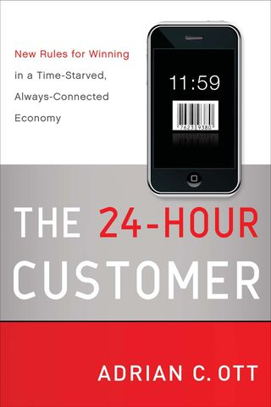

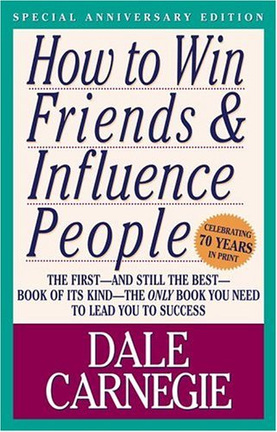

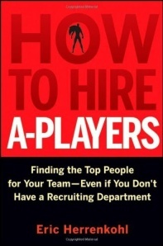
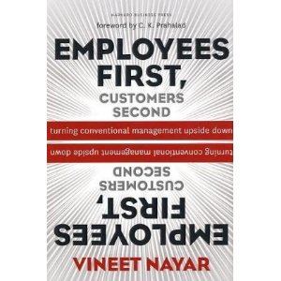



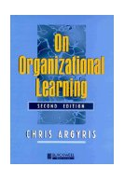



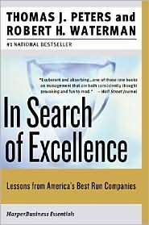


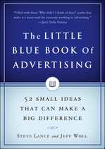


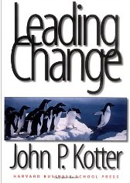
How Do You Keep Up?

Slide 3

Library Journal’s
Best Business Books
Management & Leadership
Organizational Dynamics
Marketing
Success
http://www.libraryjournal.com/lj/collectiondevelopmentspecialty2/888437-483/lj_best_business_books_2010.html.csp

Slide 4



Management & Leadership

Slide 5
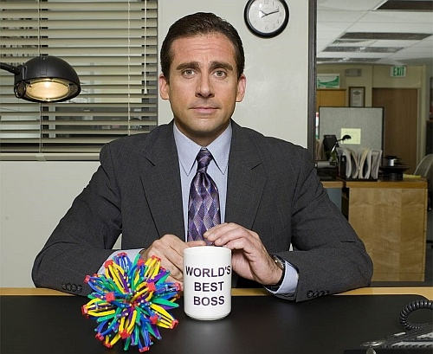
Good Boss, Bad Boss
by Robert Sutton
How to Be the Best…
How to Learn from the Worst

Slide 6

Create effective and humane workplaces

Slide 7

Strive to be wise
Listen, really listen
Observe and question
Seek balance between courage and humility

Slide 8
Employees First, Customers Second:
Turning Conventional Management Upside Down
By Vineet Nayar

Slide 9

The Value Zone
The Inverted Pyramid

Slide 10

Inverting the Organizational Pyramid
U + I
Smart Service Desk
Performance Review
Directions Meetings

Slide 11
The Intangibles of Leadership:
The Ten Qualities of Superior Executive Performance
By Richard A. Davis

Slide 12

Wisdom
Fortitude
Integrity
Presence
Will
Self-Insight
Executive Maturity
Fallibility
Social Judgment
Self-Efficacy

Slide 13
Marketing

Slide 14
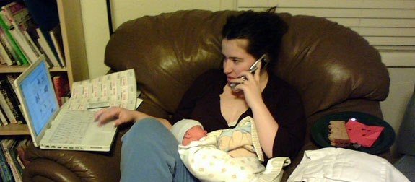
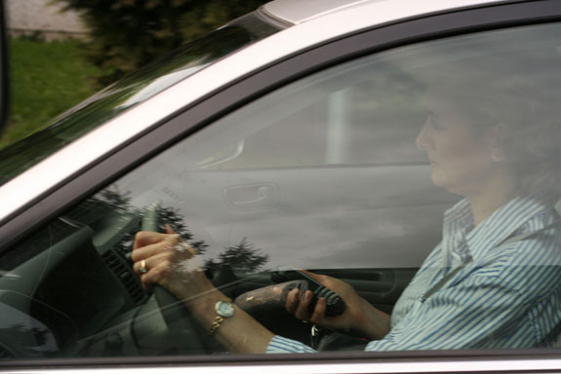

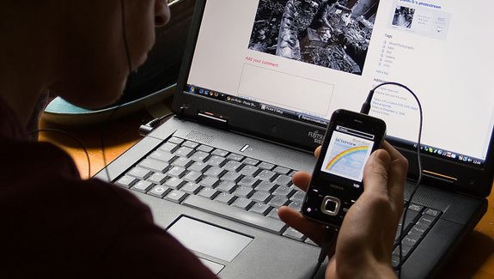
The wired brain…

Slide 15


Slide 16

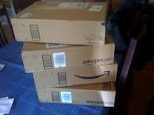


28 minutes each day

Slide 17

Increase dwell time

Slide 18

Find your users’ triggers

Slide 19


Reduce time and effort to access
QR codes make the library mobile!
  - QR codes on buses link to audiobooks
  - QR codes link to recommended reads

Slide 20


Referral Engine
by John Jantsch

Slide 21

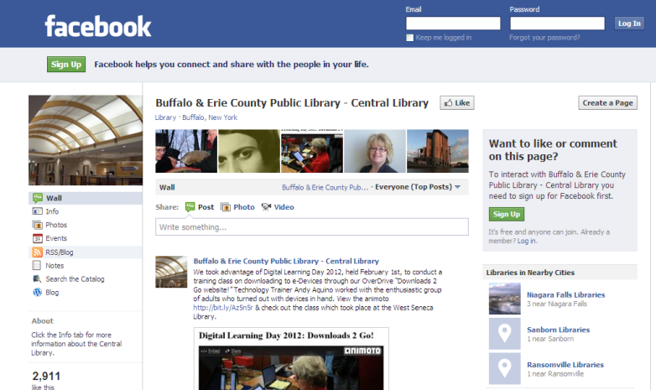
Create Convergence

Slide 22
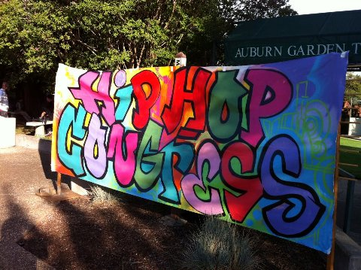
Strategic Relationships
Add value
Generate referrals
• Introduce new users

Slide 23


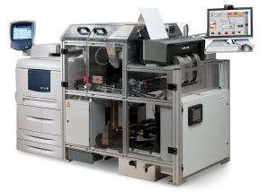
Throw a Party

Slide 24



Organizational Dynamics

Slide 25
Profit at the Bottom of the Ladder:
Creating Value by Investing in Your Workforce
By Jody Heymann and Magda Barrera

Slide 27
Blueprint for Effective Change
Provide Incentives
Support Employee Health
Train
Communicate Openly

Slide 28
What’s a mesh business?
And why would a library care?
Stuff that can be shared ALOT
Web networks to track usage
and customers
Delivery of service relevant
Offers mainly communicated by
word of mouth

Slide 29


the mesh in libraries
Relevant delivery through an online library
Collected data benefits museum partners
Software shareable across numerous ILSs
Over 13,000 museum and cultural visits!

Slide 30

Switch
by Chip and Dan Heath

Slide 31

Two Essentials of Change Leadership
Influence environment
Influence heart and mind

Slide 32
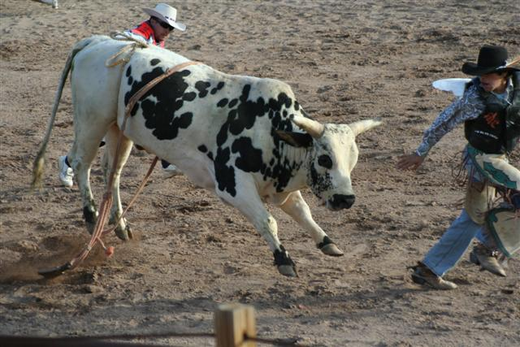
Direct the Rider

Slide 33
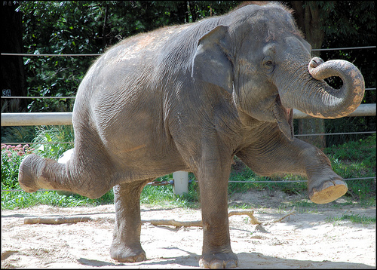
Motivate the Elephant

Slide 34

Shape the Path

Slide 35

Success

Slide 36
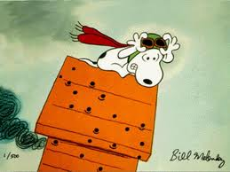
Good ideas shot down?
Create buy-in!
http://oakblue.wordpress.com/2011/04/21/the-red-baron/

Slide 37
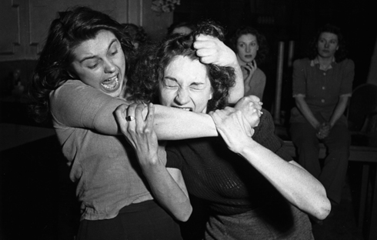
Let the attackers in!

Slide 38
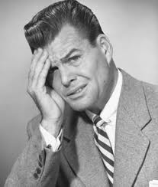
Sure we can look at your data, again…

Slide 39
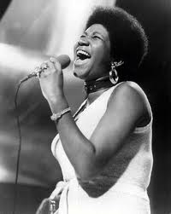
R-E-S-P-E-C-T
http://lyricsdog.eu/lyrics/525322

Slide 40
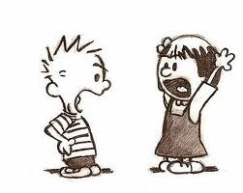
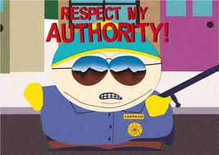
Focus on the majority
FAIL
http://www.whitec0de.com/20-logical-ways-to-win-an-argument/

Slide 41
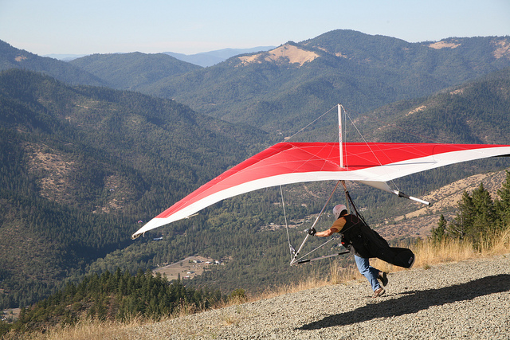
Are you prepared?

Slide 42
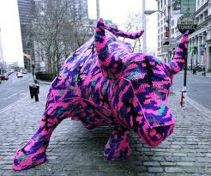
Wrap Up

Slide 43


Slide 44

Questions?
Questions?

Slide 45

Chris Brown, Contra Costa Public Library
cbrown@ccclib.org
Lisa Dale, Placer County Library
ldale@placer.ca.gov
Deborah Lipoma, Santa Cruz Public Library
lipomad@santacruzpl.org

