Slide 1

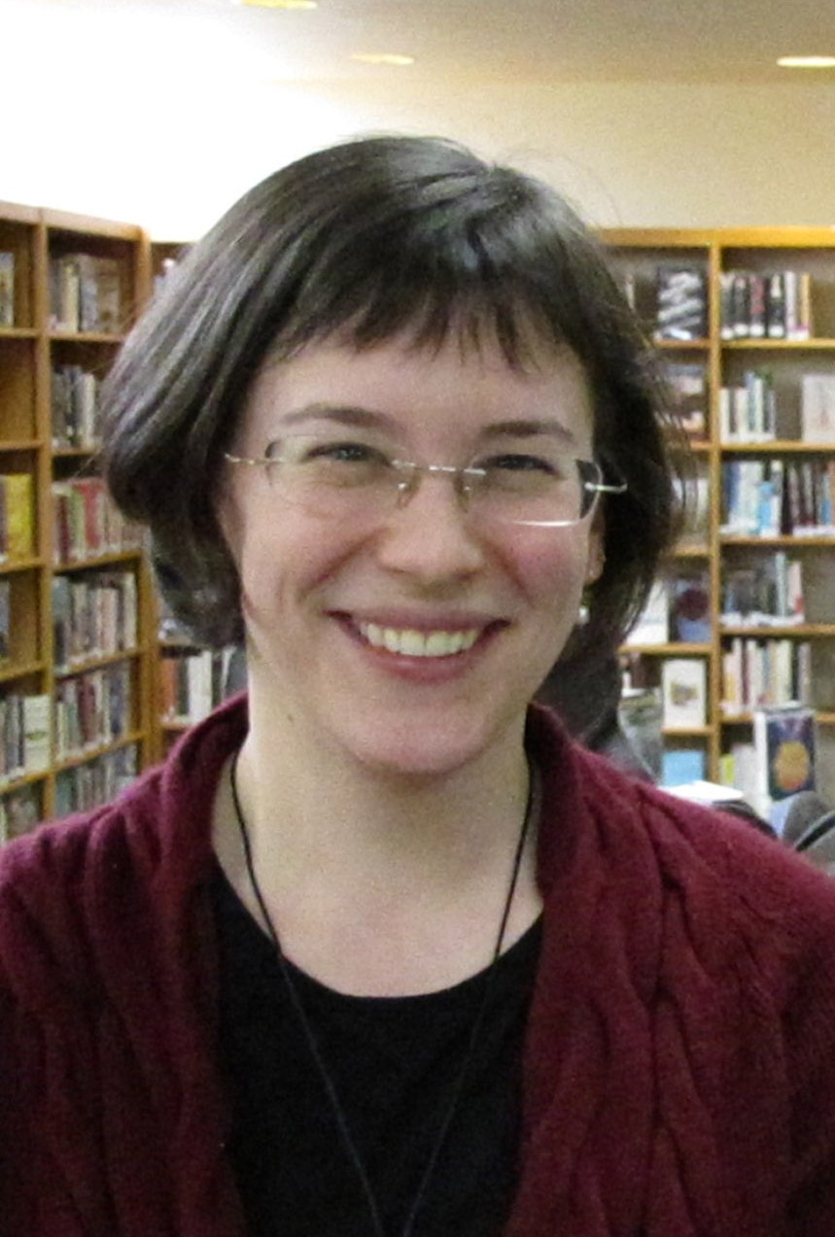
Being Customer Focused
New and Emerging Trends in Customer Service
An Webinar
March 21, 2012
12:00 noon to 1:00 p.m.
Presenter: Gretel Stock-Kupperman
gretelsk@gmail.com
Infopeople webinars are supported by the U.S. Institute of Museum and Library Services under the provisions of the Library Services and Technology Act, administered in California by the State Librarian.

Slide 2
Who are you?
Type into chat your location and role in the library

Slide 3
Agenda
Trends in libraries and customer service
Why the Customer Focused Library?
Shifting our focus
Strategies for success

Slide 4
Trends impacting library “permanence”
Libraries
Ebooks, Apps, Content Change
Funding Issues and Perceptions
Technology Divide
Retail Expectations
Service Expectations

Slide 5
Trends in customer service
Homogenization of retail experience and service expectations
Focus on community, quality, and social responsibility.
Emotional investment in organizations
Custom content/custom connection.

Slide 6
The Customer Focused Library
  Type one or two words in the chat box: how do you define customer-focused?

Slide 7
What is the Customer Focused Library?
The Customer Focused Library consciously steps outside of embedded assumptions and observes patron behavior to discover needs and opportunities.
“Don’t try to change people’s behavior – identify and design for it.” – Anne Marie Luthro, VP Sales and Marketing, Envirosell

Slide 8
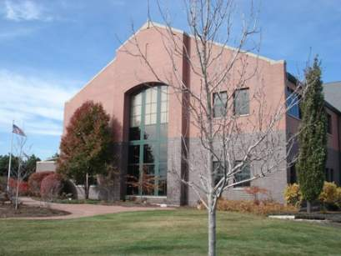
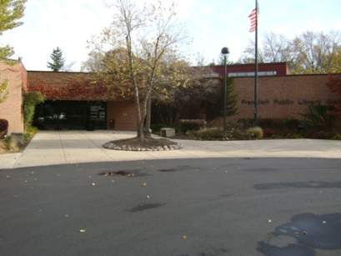
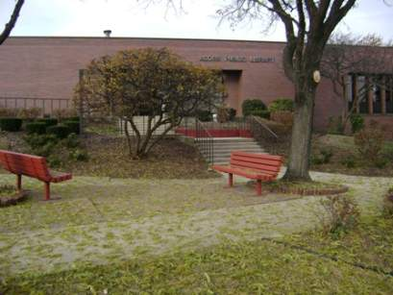
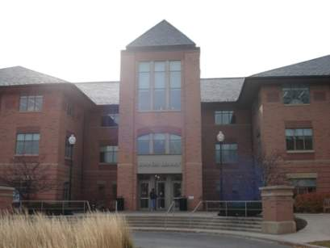
Customer Focused Library Illinois
Indian Prairie
Tuesday, November 13, 2007- Hours 12-8
Wednesday, November 14, 2007- Hours 9-5
Frankfort
Tuesday, November 13, 2007- Hours 12-8
Wednesday, November 14, 2007- Hours 9-5
Acorn
Thursday, November 15, 2007- Hours 12-8
Friday, November 16, 2007- Hours 9-5
North Park
Thursday, November 15, 2007- Hours 12-8
Friday, November 16, 2007- Hours 9-5

Slide 9
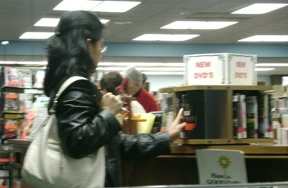
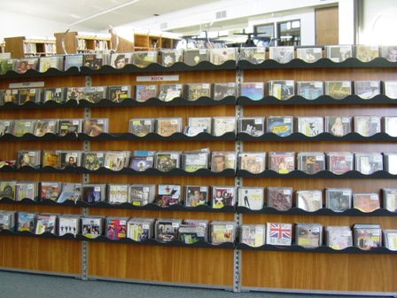
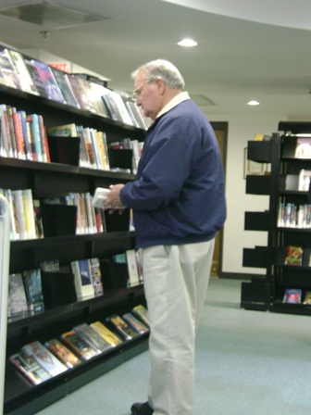
Key Findings

Slide 10
Key Findings
The Percentage of Patrons in Each Age Group Who Visit Each Section Type
The Future
The Past

Slide 11
Key Findings
Children Teenagers
College-Age Adults Seniors Library Staff
Source: Observation
Envirosell Draft Report for the Metropolitan Library System

Slide 12
Best Practices
Market Resources Effectively
Orient Yourself to Patron Convenience
Use Space Creatively
Use Signs Effectively

Slide 13
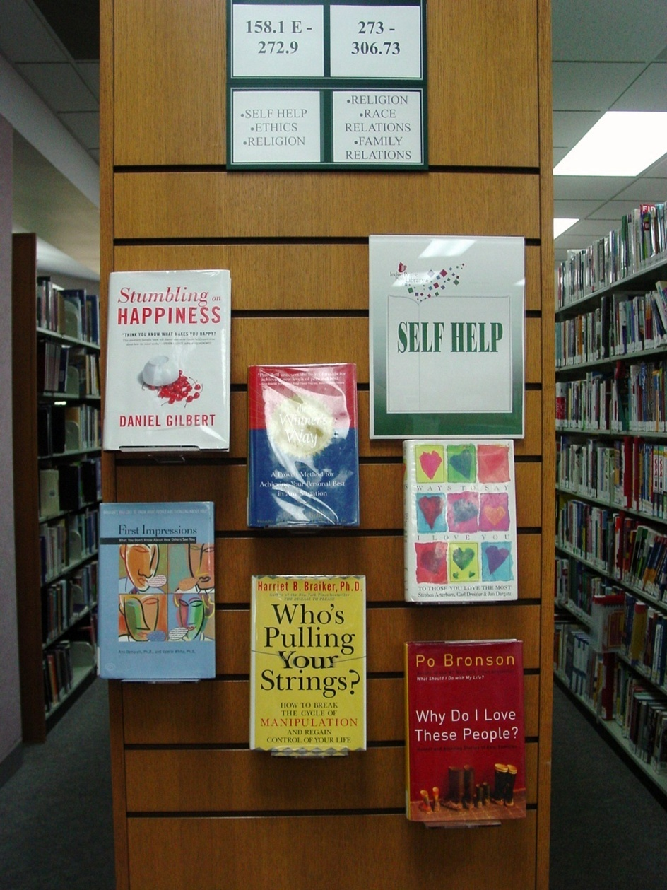
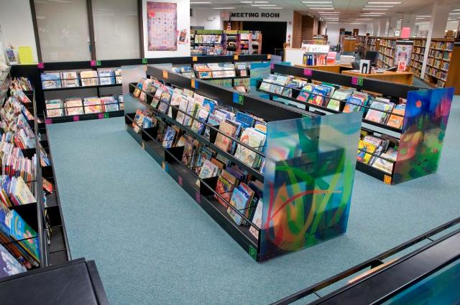
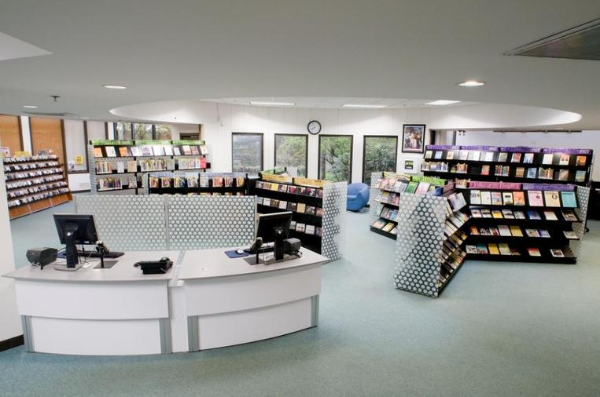
Applications and Successes

Slide 14
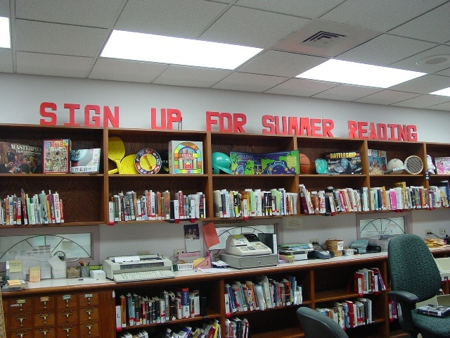
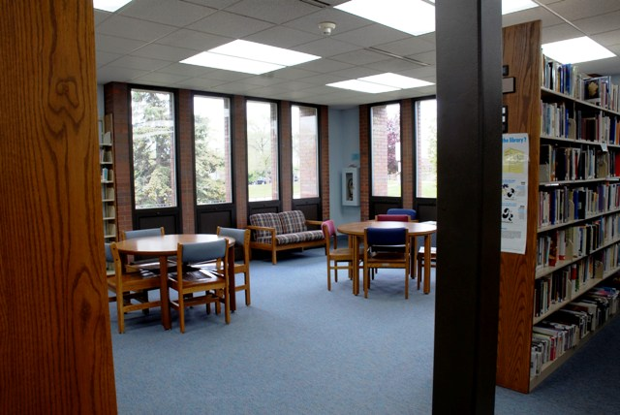
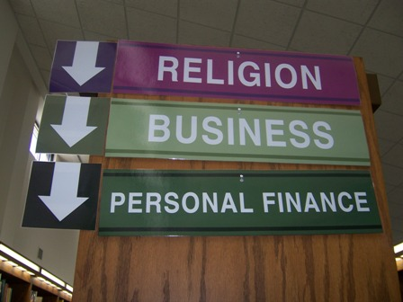
Applications and Successes

Slide 15
Why the Customer Focused Library?
Expectations of individuals for service
Responding to a shifting environment
How do we know what our patrons want?
  Actions speak louder than words…

Slide 16
Questions to be customer focused

Slide 17
Do you really know your customers?
Under-standing
Collectable Data
Observable Data
Opinion and Feedback

Slide 18
Do you have customer-aware leaders?
Can you:
  Try without fear?
  Ask probing questions?
  Raise patron concerns?
Do they:
  Listen
  Respond
  Assess
  Challenge status quo
  Involve staff

Slide 19

Are your processes customer friendly?
Is your first desk service focused?
How often do you say no?
How many steps does it take for someone to get what they need?

Slide 20
Have you got the means to deliver?
Design
Deliver
Measure
Assess
Reflect

Slide 21
What barriers do you have?
Type a few words in chat: describe a barrier to being customer focused in your library.

Slide 22
Customer Focused Trends and Successes

Slide 23
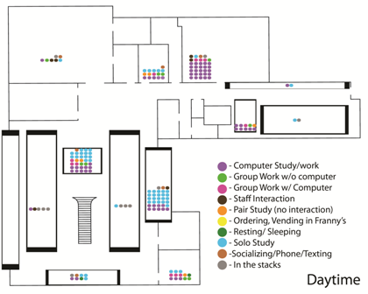
    Space Use analysis and changes

Slide 24
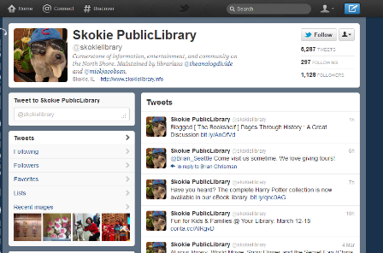
Twitter and Facebook: listening and engagement
https://twitter.com/#!/skokielibrary

Slide 25
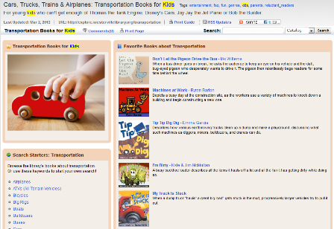
Library Guides/Online Tools
http://explore.westervillelibrary.org/

Slide 26
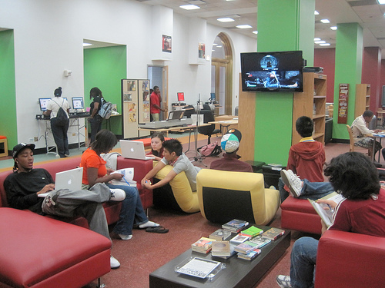
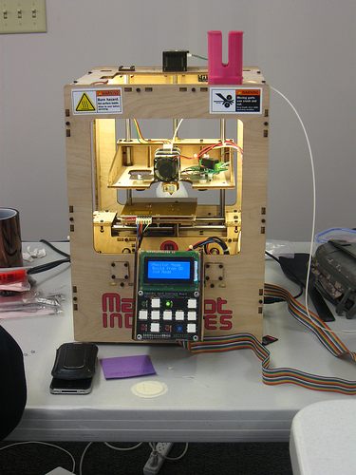
Media Creation &
Entrepreneur Centers
http://youmediachicago.org/2-about-us/pages/2-about-us
http://www.fayettevillefreelibrary.org/about-us/services/fablab

Slide 27
Discover your customers needs
What is one strategy or tool you could implement today to learn about your customer’s needs? Type your answer in chat.

Slide 28
Key strategies for customer focus
  Organize around Customer Focus
    Listen, Measure, Reach Out
    Respond
    Assess
    Challenge status quo
    Involve staff
    Identify and Design for Customer Behavior

Slide 29
Being Customer Focused is:
Being where your patrons are
Being what your patrons need
Consistently revisiting and revising

Slide 30
Resources
Customer Focused Library on Webjunction
  http://www.webjunction.org/home/articles/content/8052613
Webjunction’s feature on “Focusing on the Customer”
  http://il.webjunction.org/interpersonal/-/articles/content/135802482
Handout on webinar site

Slide 31
Questions?

Slide 32
Thank you!
Gretel Stock-Kupperman
gretelsk@gmail.com

Slide 33

Infopeople webinars are supported by the U.S. Institute of Museum and Library Services under the provisions of the Library Services and Technology Act, administered in California by the State Librarian. This material is licensed under a Creative Commons 3.0 Share & Share-Alike license. Use of this material should credit the author and funding source.

