Slide 1
Outreach to Hispanic / Latino Populations
Tu Biblioteca!

Slide 2
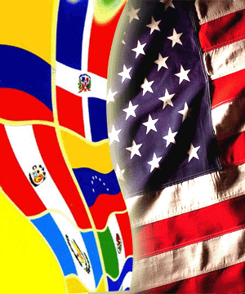
Outreach to Hispanic / Latino Populations
Webinar Objectives:
Learn the facts about this growing population
Look at how libraries are meeting the challenges to reach this community
Discover how to create participatory programming & services
Review what program/service elements have proven successful at other libraries
Determine a course of action to assist your library in expanding your effectiveness
Receive online resources that can assist you with next steps
Tu Biblioteca!

Slide 3
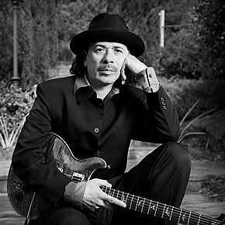
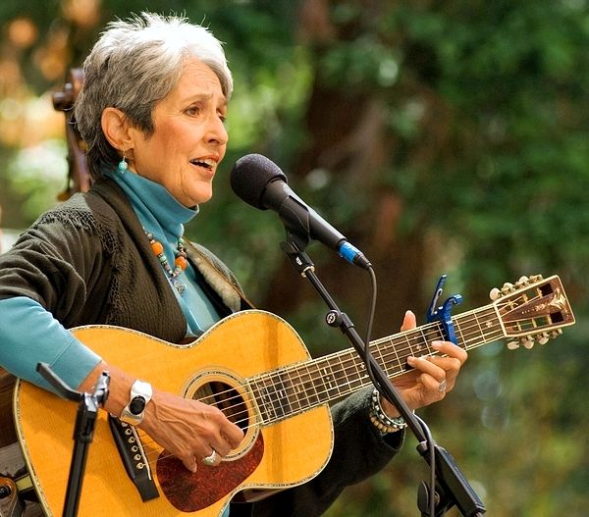
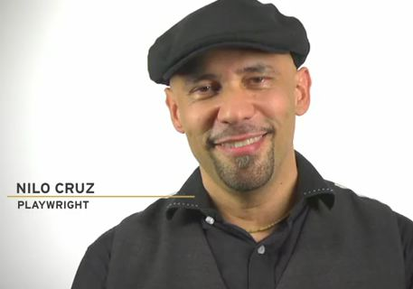
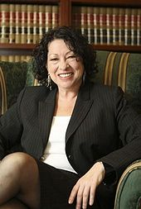
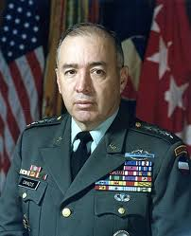
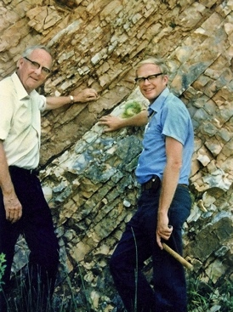
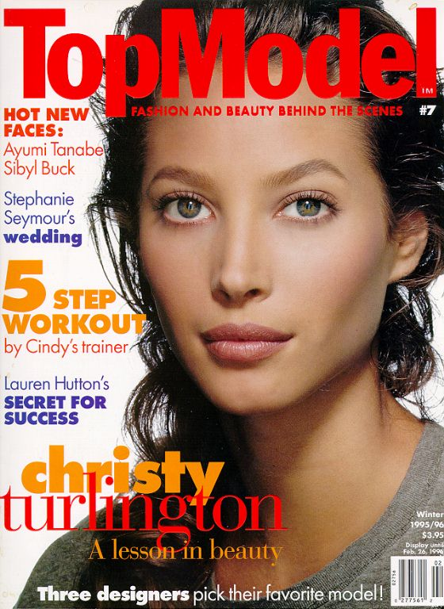
WHO MAKES UP THE
HISPANIC/LATINO COMMUNITY?

Slide 4
WHO MAKES UP THE
HISPANIC/LATINO COMMUNITY?

Slide 5
WHO MAKES UP THE
HISPANIC/LATINO COMMUNITY?

Slide 6
WHO MAKES UP THE
HISPANIC/LATINO COMMUNITY?
¿Hispanic or Latino?

Slide 7
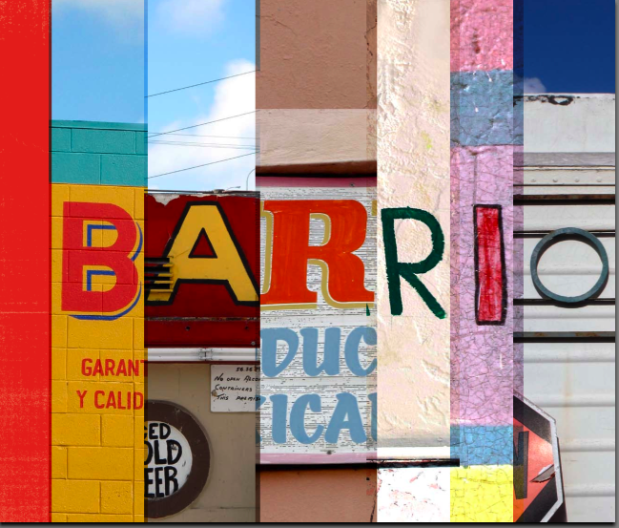
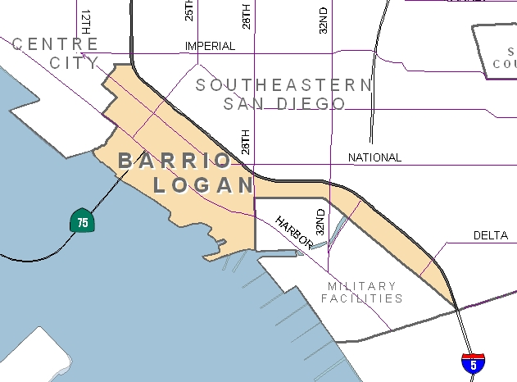
CASE STUDIES:
BARRIO LOGAN AND ADELANTE!

Slide 8
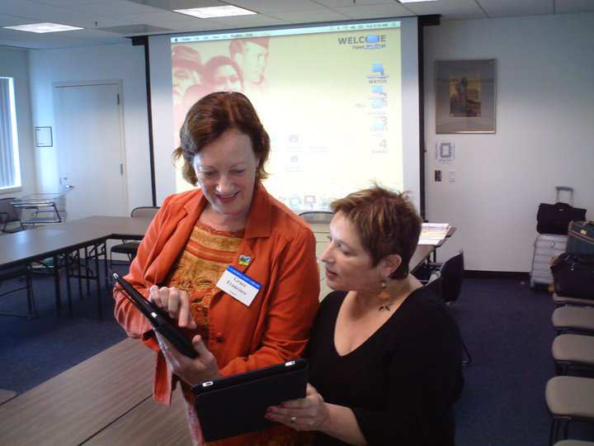
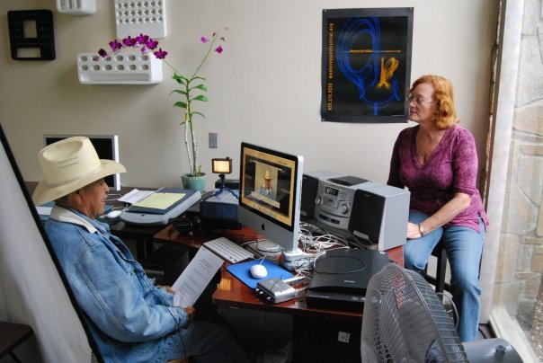
CASE STUDIES:
BARRIO LOGAN AND ADELANTE!
www.DigitalStoryStation.com
California of the Past: Salinas Stories
Media Arts Center’s Services to Create Your Own Digital Story Station
InfoPeople Webinars
Introduction to Digital Storytelling: Everyone Has a Story to Tell
Introduction to Digital Storytelling Communities: How to Engage the Public

Slide 9
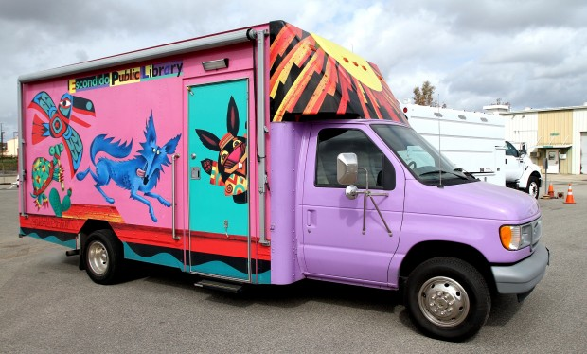
CASE STUDIES:
BARRIO LOGAN AND ADELANTE!
Identify community leaders
Invite to library and introduce initiative
Create needs assessment
Recruit bilingual volunteers
Retool services & marketing
Go into the community

Slide 10
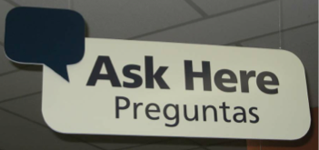
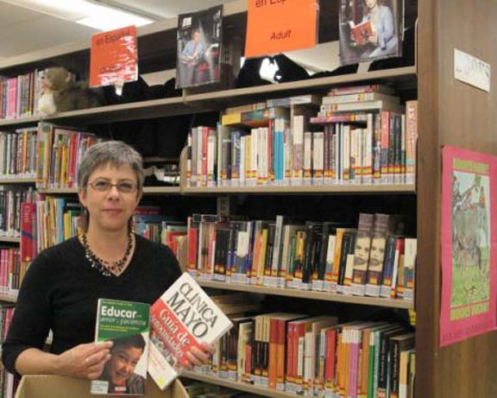
CASE STUDIES:
BARRIO LOGAN AND ADELANTE!

Slide 11
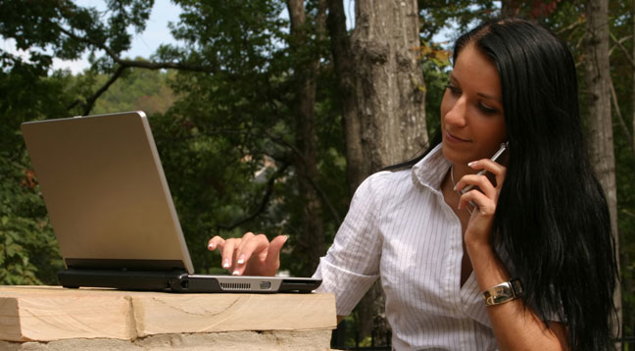
MARKETING AND PUBLIC RELATIONS

Slide 12
RESOURCES:
SUCCESSFUL PROGRAMMING & SERVICES
Spanish Language Outreach also known as SLO
S.A.L.S.A.
Spanish Award-winning Literature Seminar for All

Slide 13
TAKING ACTION
Advisors
– Identifying key advisors
Community Leaders
– Contacting local community leaders
In-kind Media Partnerships
– Building a partnership

Slide 14
QUESTIONS & ANSWERS
Preguntas y respuestas

Slide 15
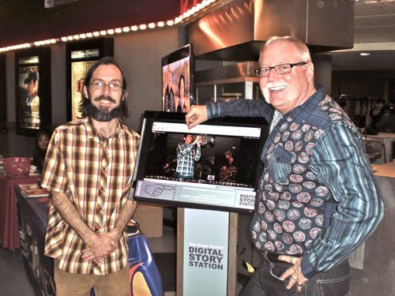
Outreach to Hispanic / Latino Populations
ETHAN
VAN THILLO
PATRIC STILLMAN
FOUNDER &
EXECUTIVE DIRECTOR
MEDIA ARTS CENTER SAN DIEGO
ethan@mediaartscenter.org
INNOVATIONS AND PROGRAMMING OFFICER
MEDIA ARTS CENTER SAN DIEGO
patric@mediaartscenter.org
Tu Biblioteca!

Slide 16
Infopeople webinars are supported by the U.S. Institute of Museum and Library Services under the provisions of the Library Services and Technology Act, administered in California by the State Librarian. This material is licensed under a Creative Commons 3.0 Share & Share-Alike license. Use of this material should credit the author and funding source.

