Slide 1
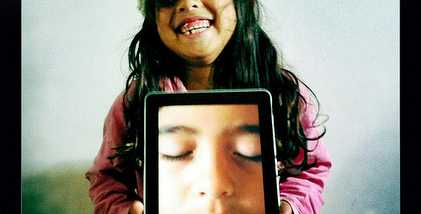
Leveraging Technology to Support Early Literacy
Photo by Lance Shields
An Infopeople Webinar
Presented by Kelly Stade
Tuesday, April 24, 2012

Slide 2
Learning Objectives
Today you will learn:
How technology can be used to enhance early literacy learning
The library’s role in early literacy technology
The availability and use of early literacy technology
How to remain current

Slide 3
QUESTION
What messages have you heard about technology for young children? (Please type your answers into the Chat box.)

Slide 4
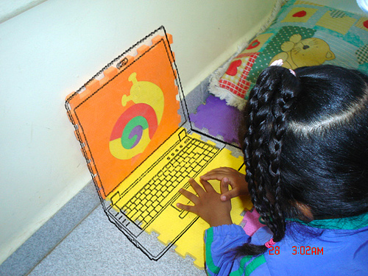
Technology and Early Literacy Skill Development
Background: early research on technology for young children.
NAEYC vs. American Academy of Pediatrics
Parent opinions
Photo by Ana Fukase

Slide 5
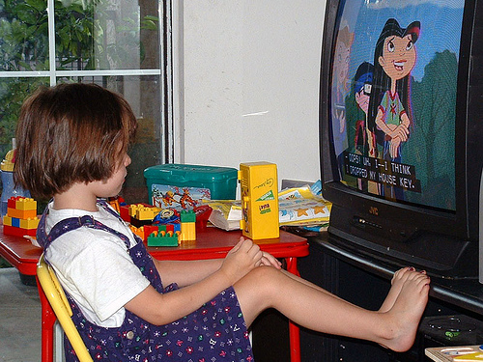
Technology and Early Literacy Skill Development
Not all technology is created equal.
  Beneficial technology should be hands on, engaging, empowering, playful and put the child in control.
Skill Development
Using technology as a tool to promote early literacy
Photo by Oddharmonic

Slide 6
Question
How many of the following experiences are likely to occur when a child watches a DVD about colors? Plays a painting game on the computer?
  Child engages in decision making.
  Child directs the experience (length of interaction, pace, etc.)
  Child engages in cause and effect interactions.
  Child expresses personal creativity.
  Child follows instructions.
  Child engages in open ended play.

Slide 7
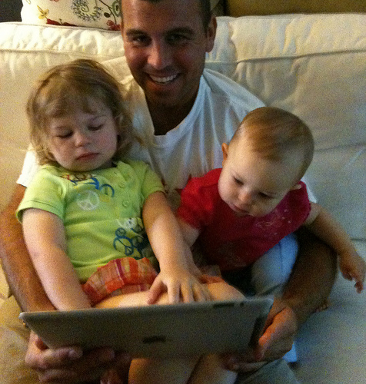
Helping Children Achieve Success
Parent Involvement
Role of Library
Age Appropriateness
Photo by Wayan Vota

Slide 8
Technology Availability
Tablet Computers and Portable Devices
Early Literacy Computer Stations
Literacy Rich Websites
eBooks
Other
Question Part I: In what ways do children play? Type your responses into the Chat box.

Slide 9
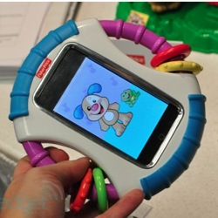
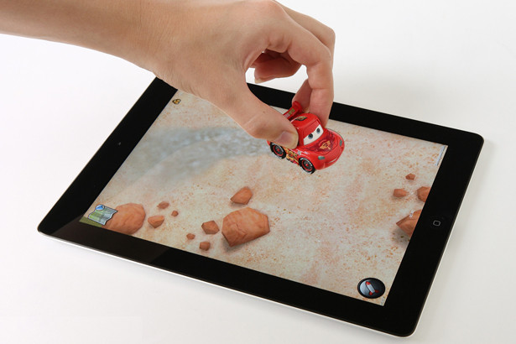
Tablet Computers and Portable Devices
Benefits
How to Rate
Examples of Use
  Disney Virtual Play Mat

Slide 10
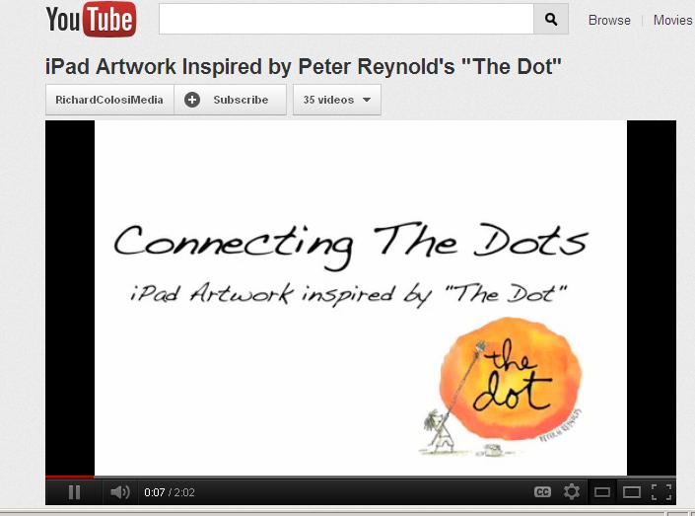
Tablet Computers and Portable Devices
Examples of use cont.
  The Dot with the iPad
  http://www.youtube.com/watch?v=CseZabRV-Mwth the iPad

Slide 11
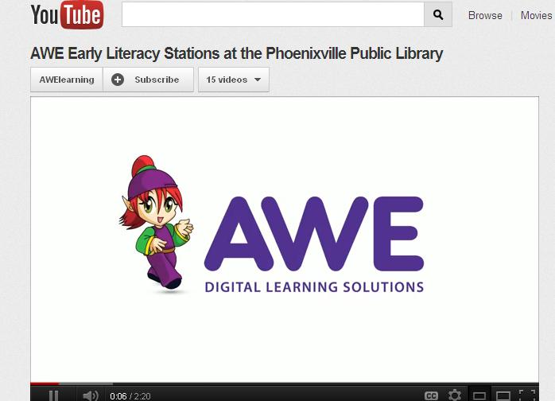
Early Literacy Computer Stations
AWE
Benefits
How to Rate
Examples of Use
  AWE Demonstration
  http://www.youtube.com/watch?v=ByYlKUeKme8

Slide 12

Early Literacy Rich Websites
Benefits
How to rate
Examples
  www.buildyourwildself.com
  www.monsterexchange.org
  www.walphabet.com
  www.smories.com
  www.fungooms.com

Slide 13



eBooks
Benefits
How to Rate
Examples

Slide 14
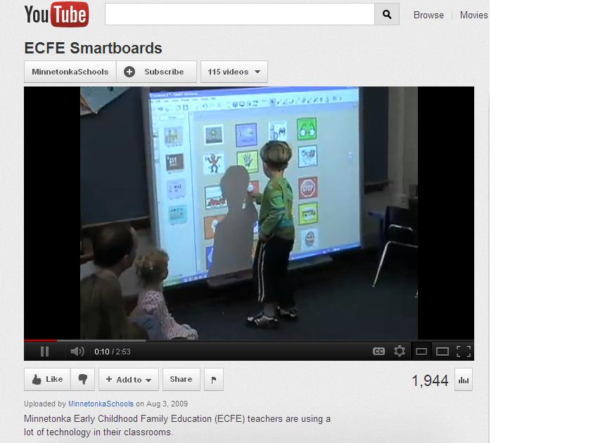
Other
Documentation Cameras
White Boards
http://www.youtube.com/watch?v=RmhdKQ3m9d4
Question Part II: What types of play can occur using technology? Type your answers into the Chat box.

Slide 15
Early Literacy Technology and
Every Child Ready to Read @ Your Library
Baby Karaoke http://raisingchildren.net.au/baby_karaoke/baby_karaoke_landing.html
Drawing
Puzzles

Slide 16
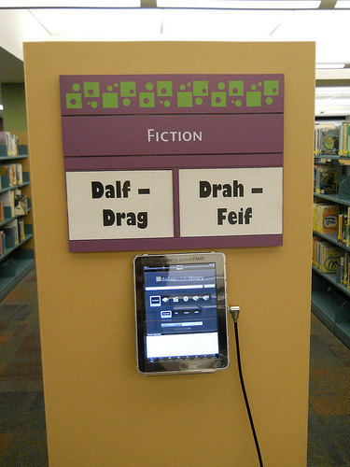
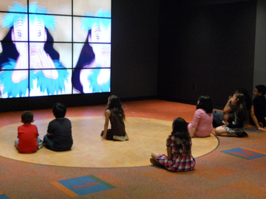
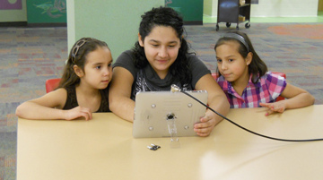
Incorporating Early Literacy Technology at Your Library
Environments
Programming
Circulation
Photos by Dallas Public Library

Slide 17
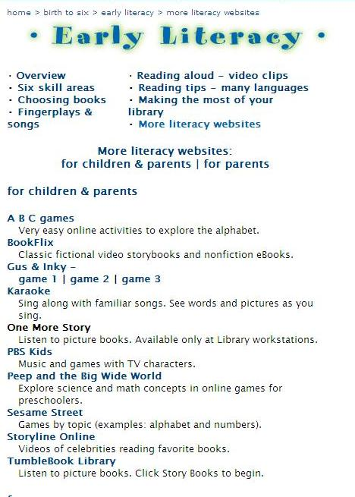
Incorporating Early Literacy Technology at Your Library
Website

Slide 18
Question
Which of the following ways does your library connect families to appropriate technology experiences?
  Devices in the library
  Signage encouraging caregivers to share technology experiences with children
  Recommended web sites for children on library web site
  Recommended apps on library web site
  Special technology based programming for parents
  eBooks in Storytime
  Circulate technology devices for children
  Tell us about it!

Slide 19
Technology is in Place, Now What?
Importance of Remaining Current
Blogs, Resources, and More
http://playsciencelab.com/
http://www.ecetech.net
http://www.brueckei.org/Raised-Digital/
http://www.wired.com/geekdad/
http://mashable.com/
http://www.commonsensemedia.org
http://www.teccenter.erikson.edu
http://gws.ala.org/

Slide 20
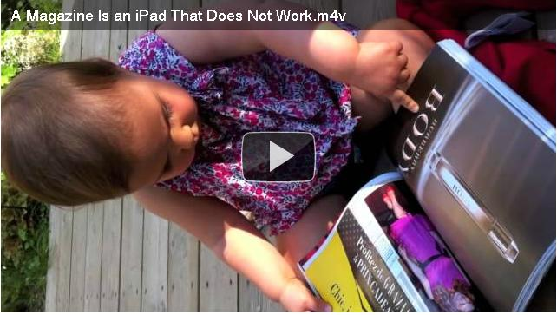
Conclusion
Growing up with Technology
Mashable Video of the Day
http://mashable.com/2011/10/13/baby-magazine-ipad/

Slide 21
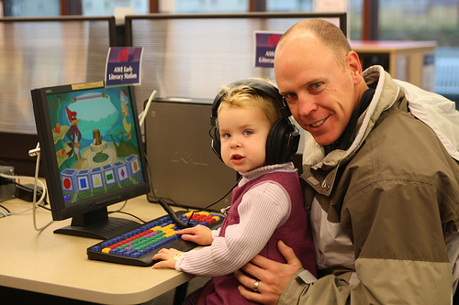
Questions
Photo by London Public Library

Slide 22

Thank You!
Kelly Stade
kcstade@gmail.com

Slide 23

Infopeople webinars are supported by the U.S. Institute of Museum and Library Services under the provisions of the Library Services and Technology Act, administered in California by the State Librarian. This material is licensed under a Creative Commons 3.0 Share & Share-Alike license. Use of this material should credit the author and funding source.

