Slide 1
Tell Me Something I Don’t Know: Meaningful Community Engagement
An Infopeople Webinar
Joan Frye Williams and George Needham
Tuesday, June 12, 2012

Slide 2
Community focus is essential

Slide 3
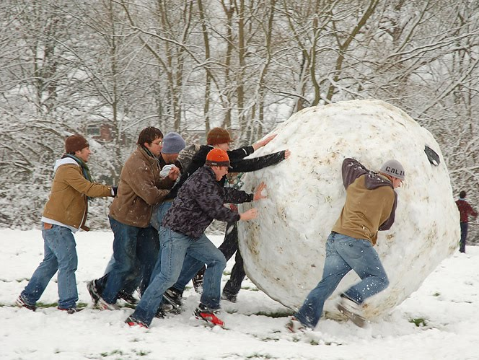
It’s everybody’s responsibility

Slide 4
Can’t afford to guess

Slide 5
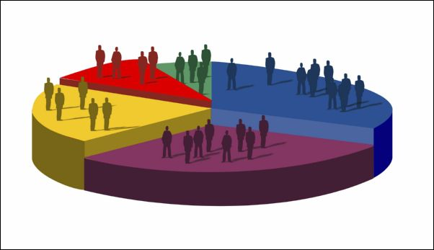
Demographics are not enough

Slide 6
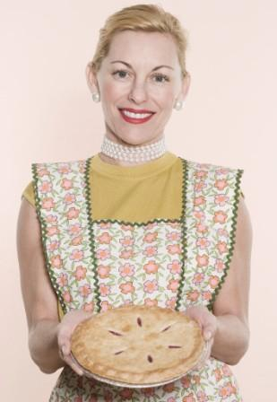
Neither are satisfaction surveys

Slide 7
Who speaks for your community?

Slide 8
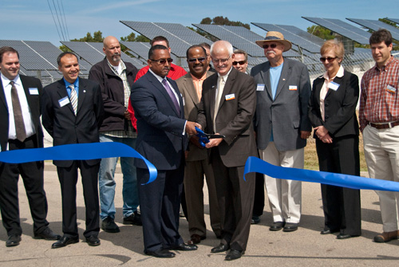
What does your community value?

Slide 9
How to ask the right questions

Slide 10
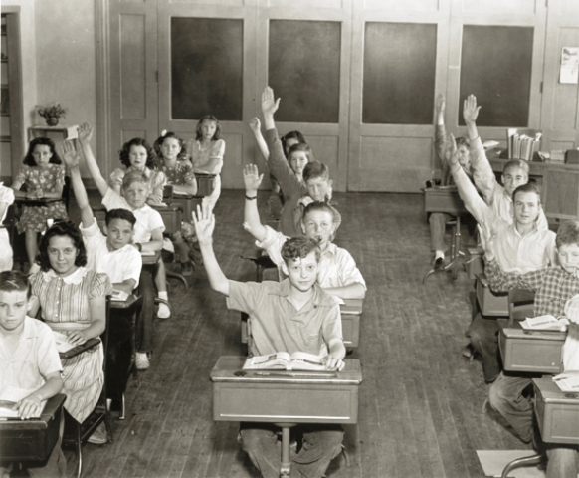
What they know about

Slide 11
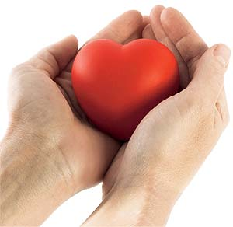
What they care about

Slide 12
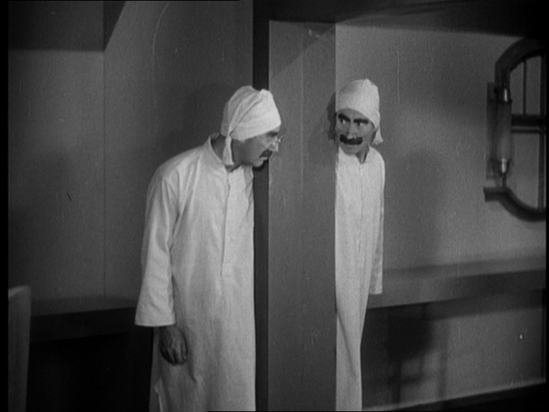
How they see themselves

Slide 13
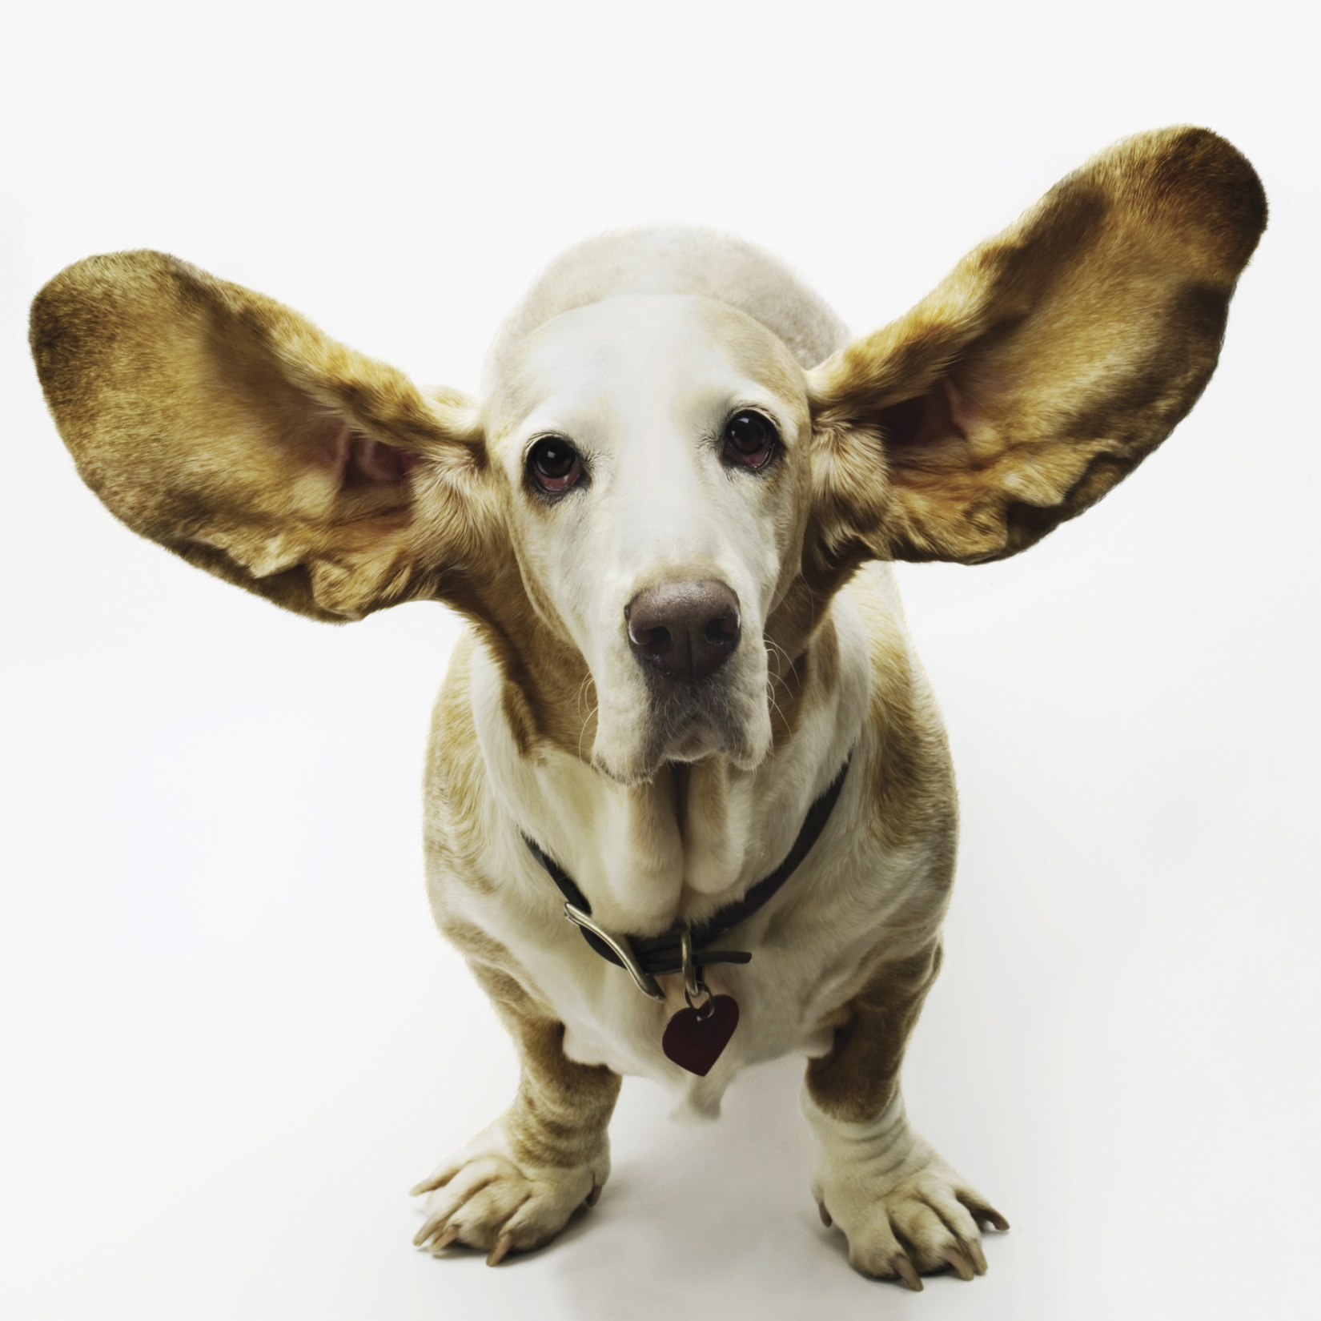
Listen, don’t explain

Slide 14
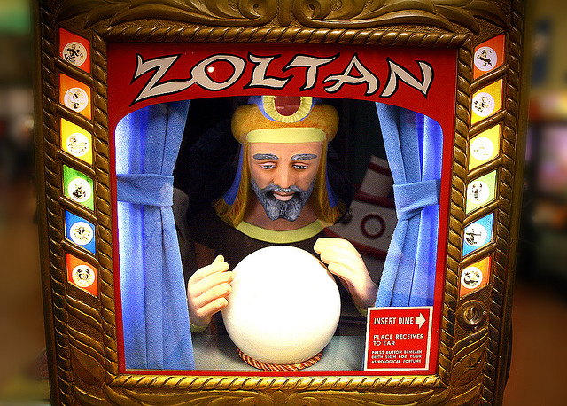
How to talk about the future

Slide 15
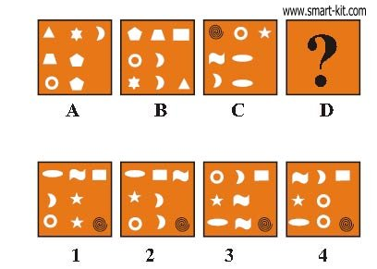
Analogies

Slide 16
Experiences

Slide 17
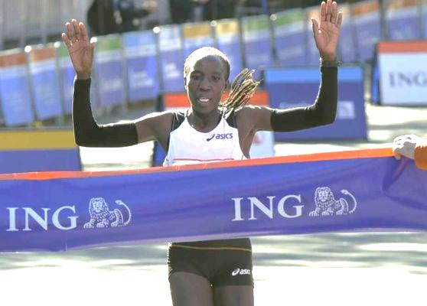
Outcomes

Slide 18
How to avoid wasting time

Slide 19
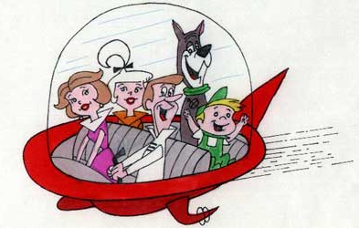
No library predictions

Slide 20
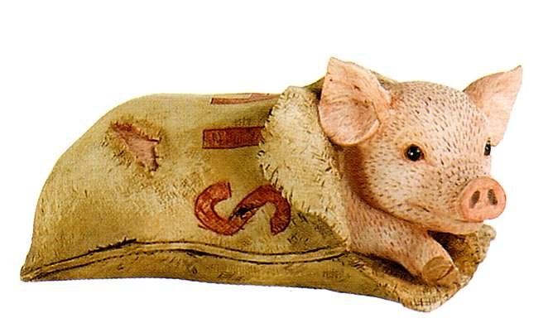
No commitments to non-existent services

Slide 21
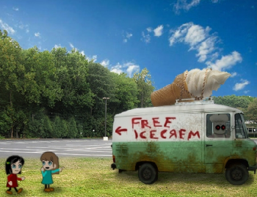
No free ice cream

Slide 22
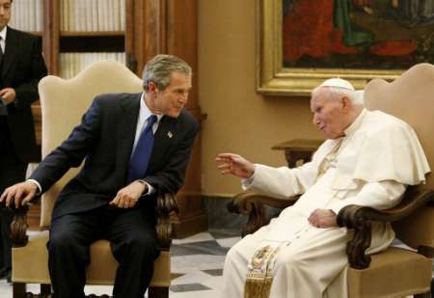
How to connect effectively

Slide 23
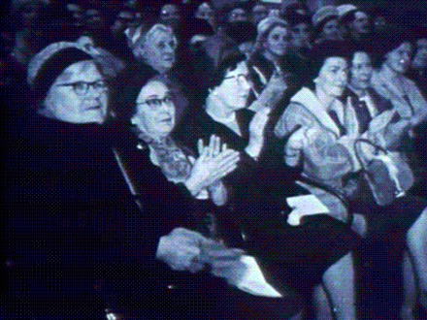
Effective community meetings

Slide 24
Effective social media

Slide 25
Effective interviews

Slide 26
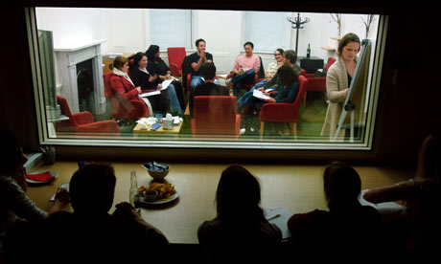
Effective focus groups

Slide 27
Effective surveys

Slide 28
Thank them for their service

Slide 29
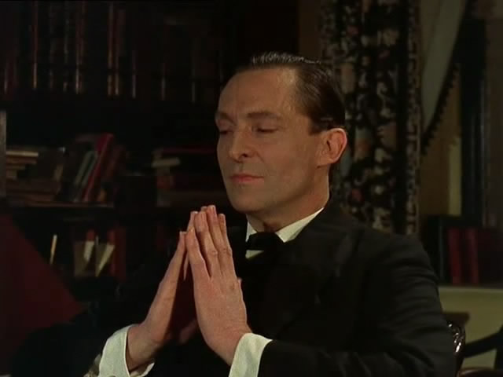
How to make sense of the input

Slide 30
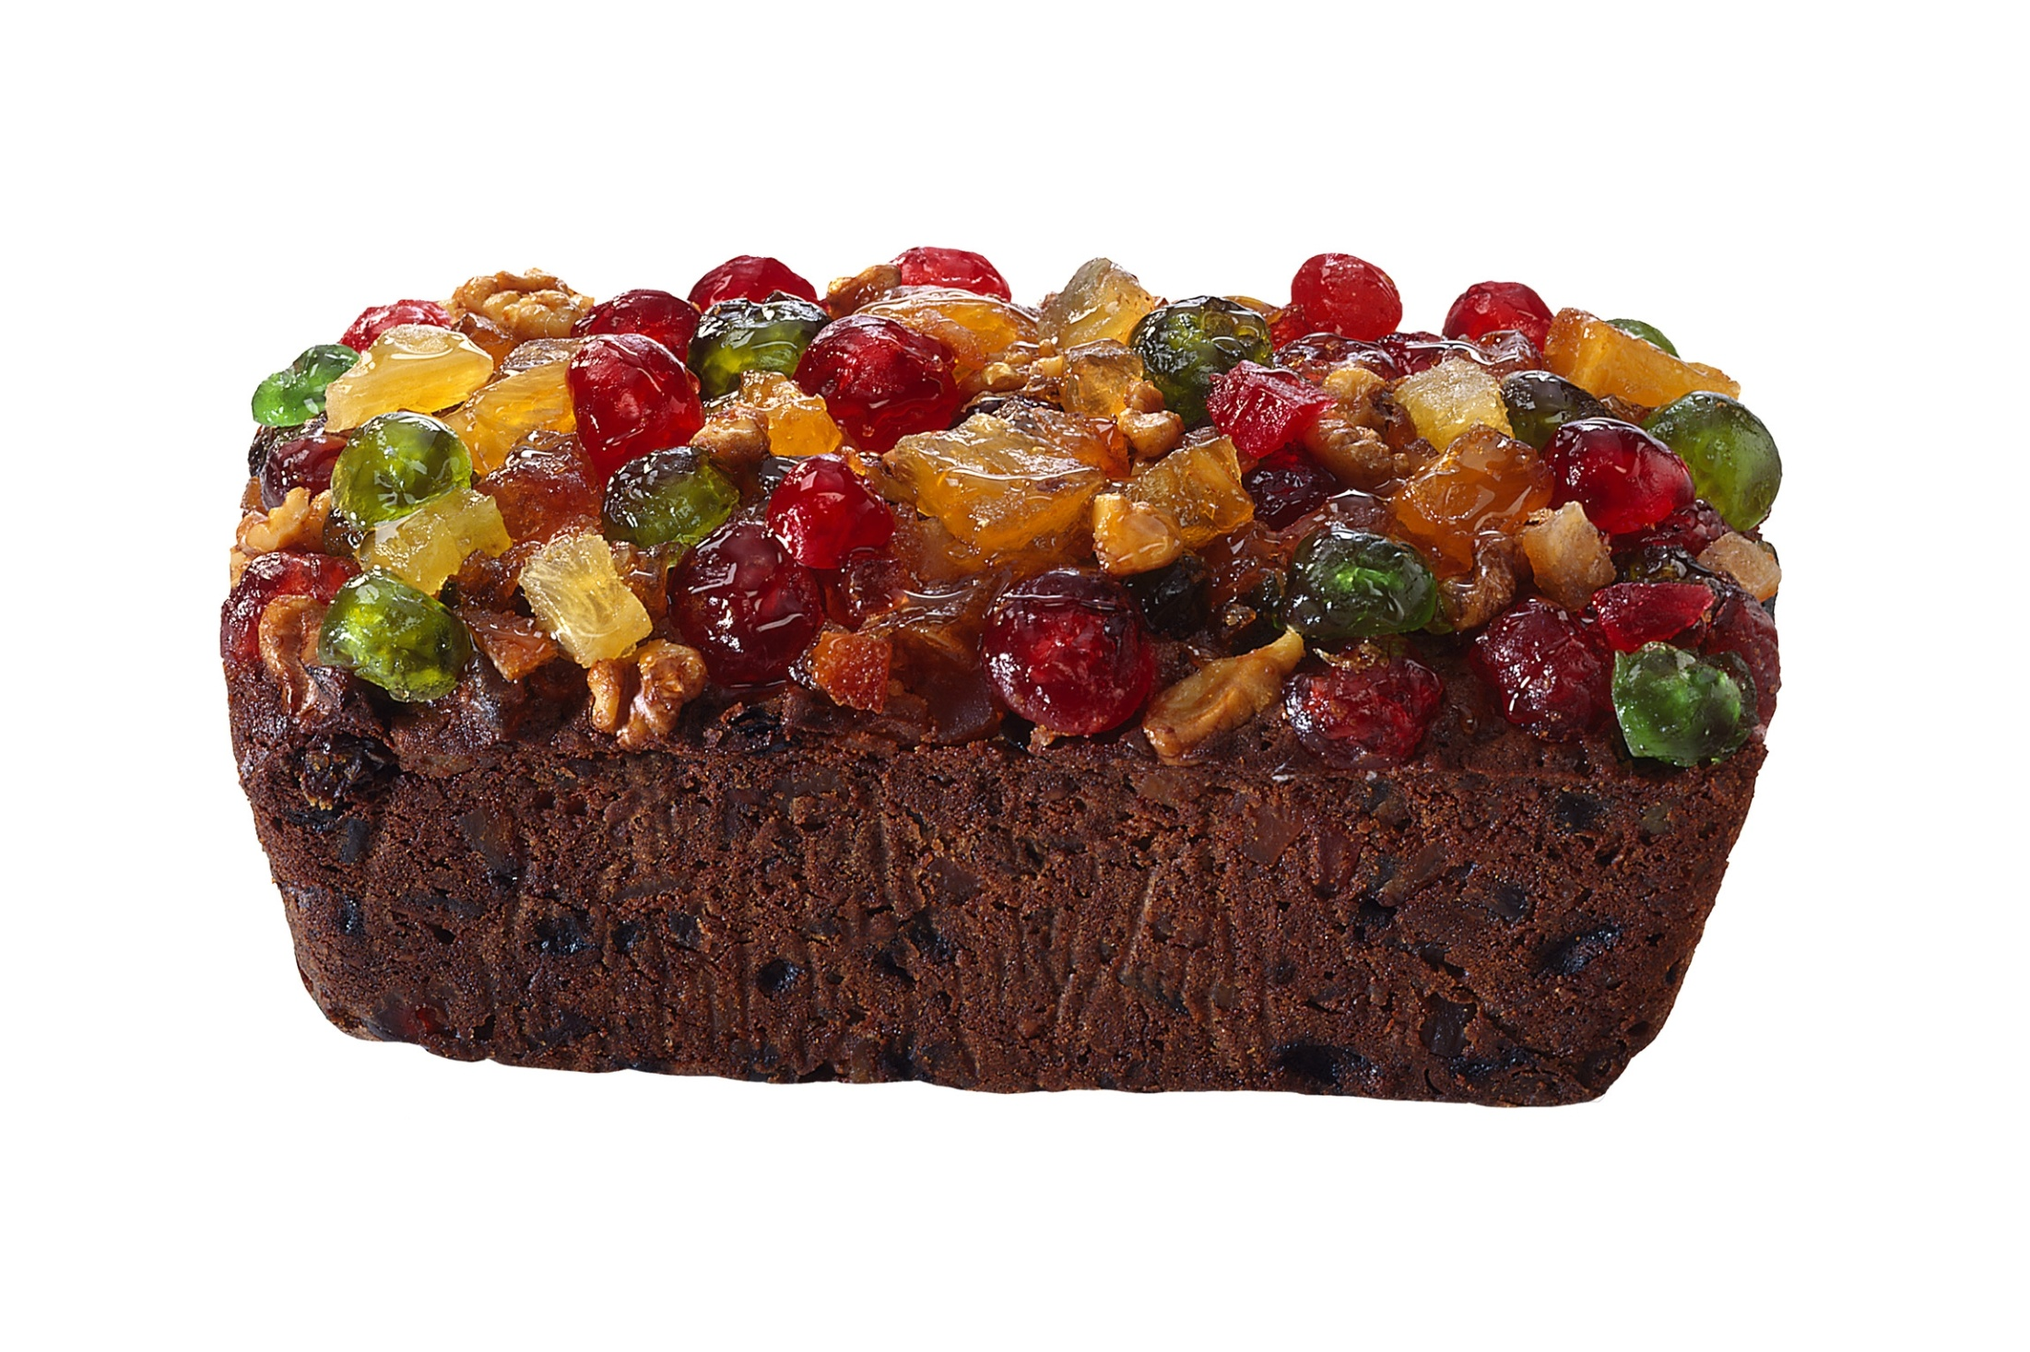
All input is not created equal

Slide 31
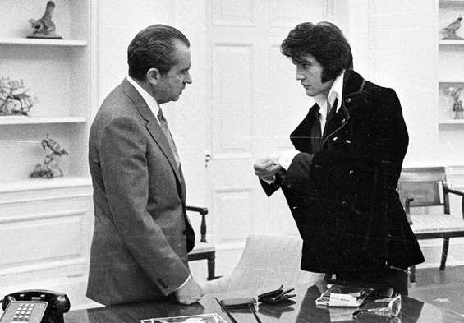
What people have in common

Slide 32
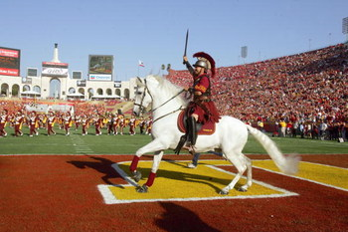
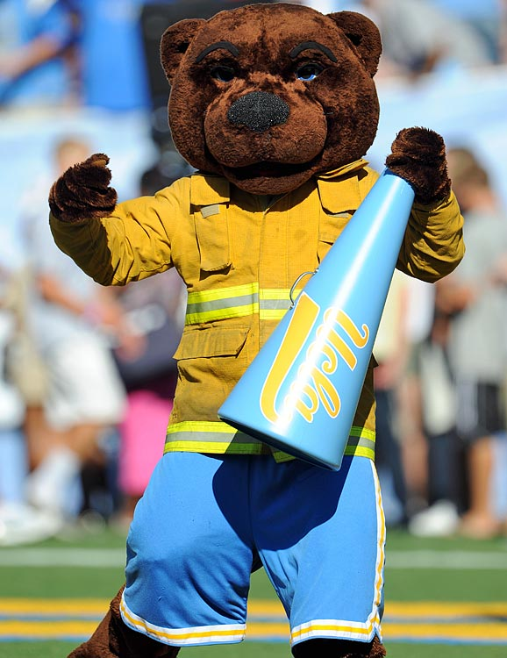
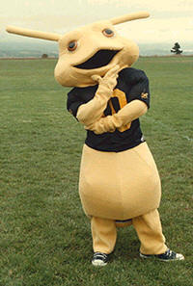
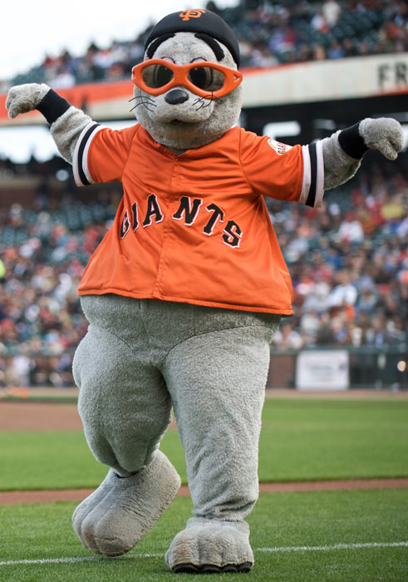
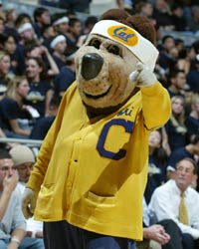
What generates the most enthusiasm

Slide 33
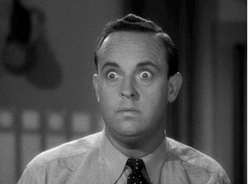
What surprises you

Slide 34
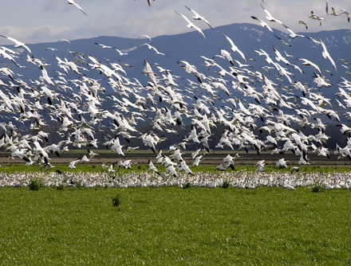
What comes up most often

Slide 35
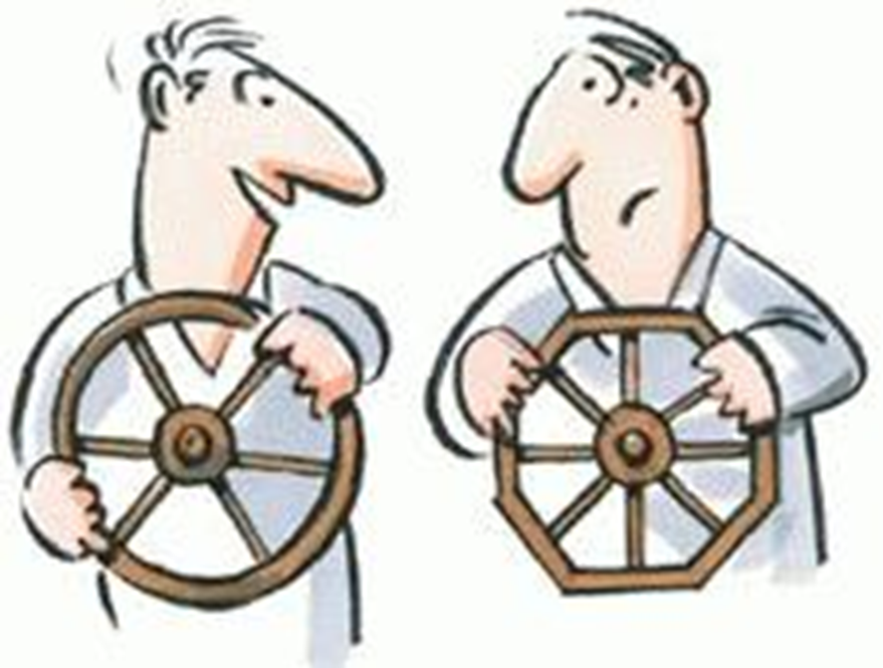
Learning from the inaccuracies

Slide 36
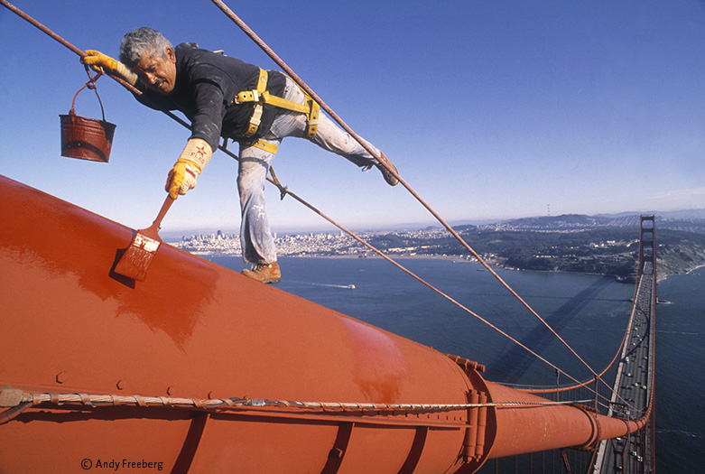
…and repeat

Slide 37
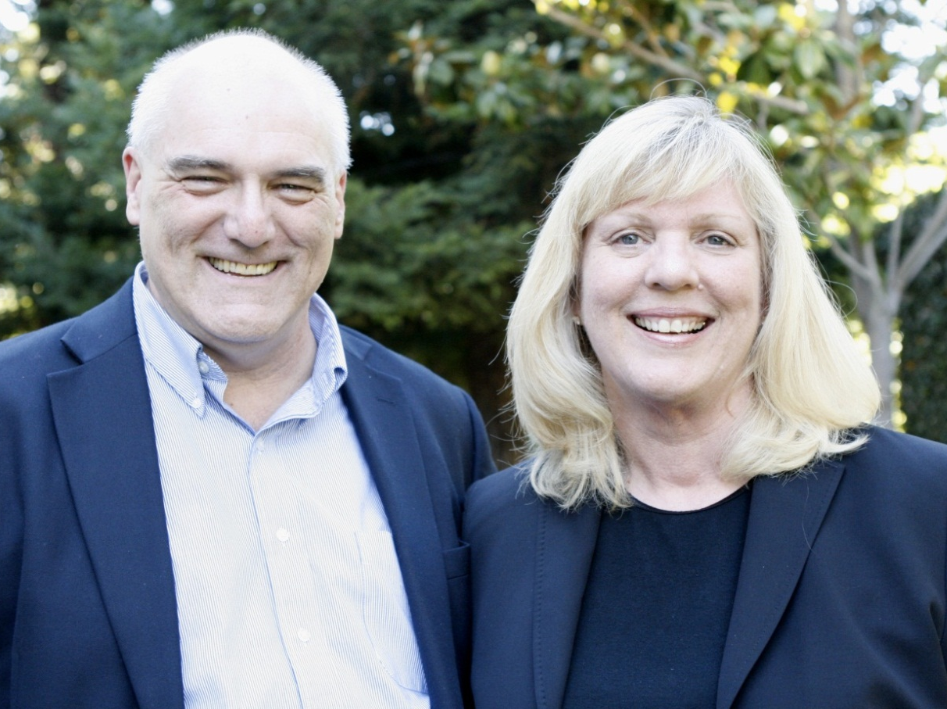
Let’s continue the conversation!
http://georgeandjoan.com
hello@georgeandjoan.com
Photo by Chuck O’Shea

Slide 38
Infopeople webinars are supported by the U.S. Institute of Museum and Library Services under the provisions of the Library Services and Technology Act, administered in California by the State Librarian. This material is licensed under a Creative Commons 3.0 Share & Share-Alike license. Use of this material should credit the author and funding source.

