Slide 1
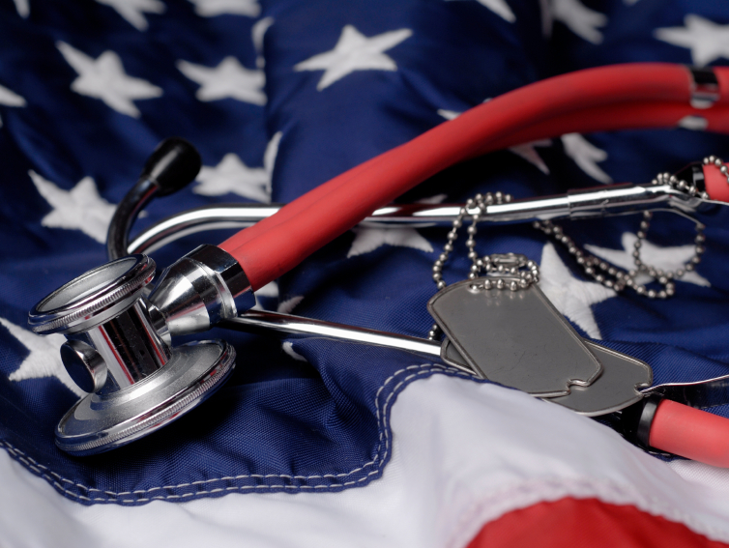
Operation Health:
Resources for Veterans and Their Families
An Infopeople Webinar
Presented by Kelli Ham
June 13, 2012

Slide 2
Today’s Topics
Defining the users
Statistics
Injuries and Conditions
Unique issues for veteran subgroups
Health resources
Finding services

Slide 3

User Snapshot
Who are these library users?
  Veterans
  Military families
  Caregivers of veterans
  Active duty service members

Slide 4

A Few Statistics

Slide 5
Injuries and Conditions
Different conflicts, different outcomes
  Exposures: environmental, substances
  Physical injuries
  Mental health issues
  Social issues

Slide 6
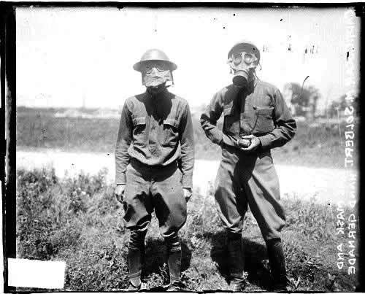
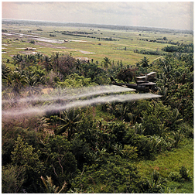
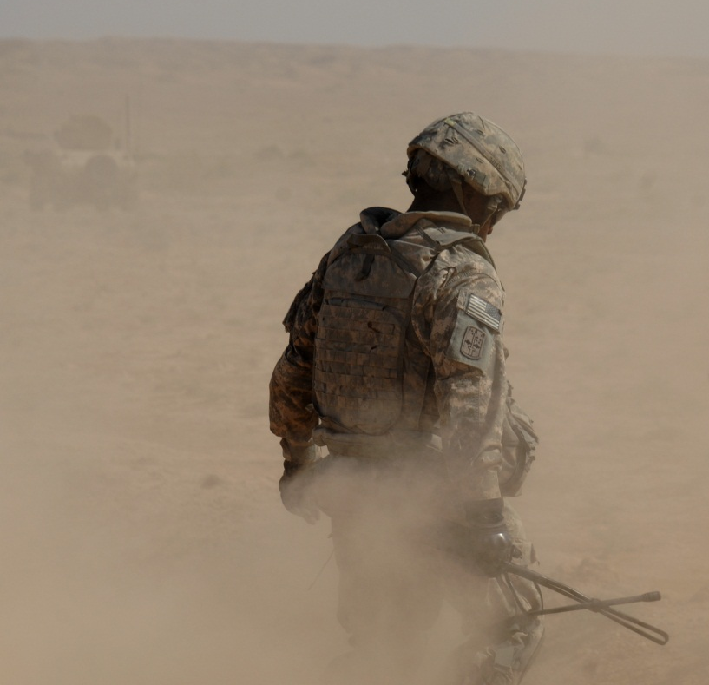
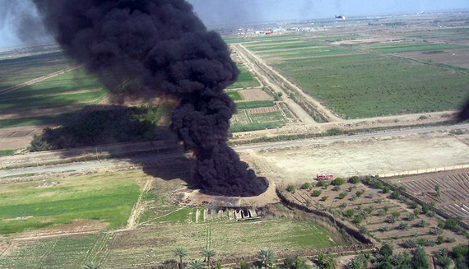
Military Exposures
http://www.publichealth.va.gov/exposures/

Slide 7
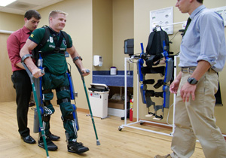
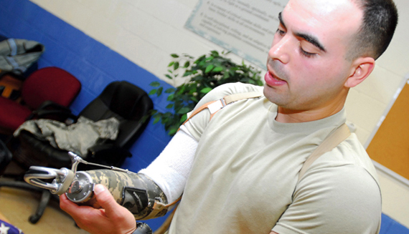
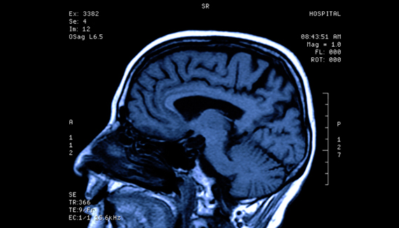
Physical Injuries

Slide 8
Traumatic Brain Injury
“…TBI has become the “signature injury” of current warfare”.
Sharon Shively and Daniel Perl
Journal of Head Trauma Rehabilitation,
Vol 27, No. 3, pp 234-239

Slide 9
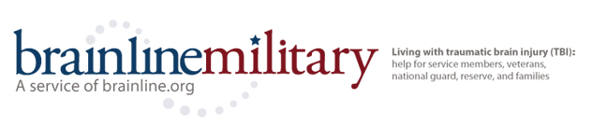
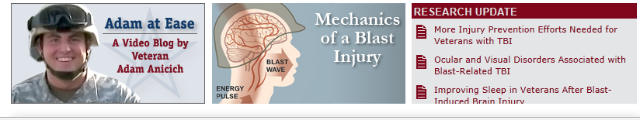
Brainline Military
http://www.brainlinemilitary.org/

Slide 10
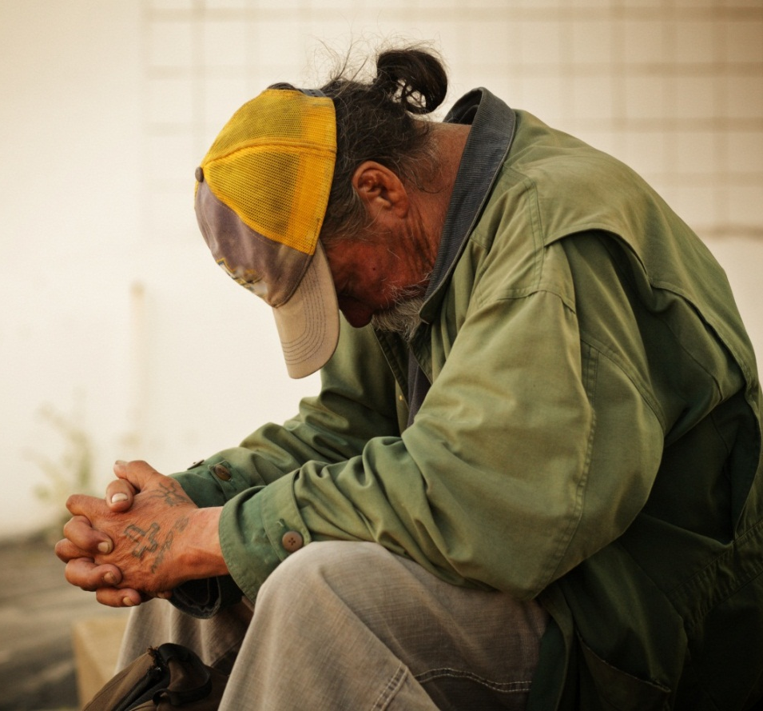
Mental Health Issues
PTSD
Depression
Sleep disorders
Anger
Suicide
http://www.mentalhealth.va.gov/

Slide 11
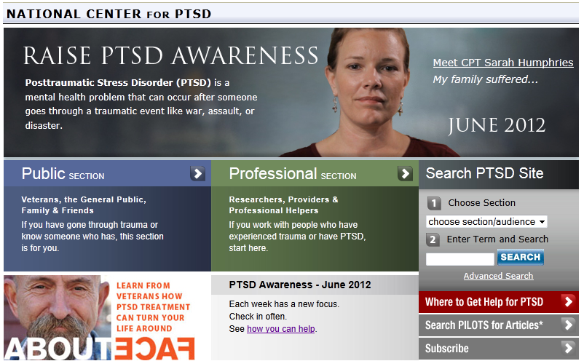
National Center for PTSD
http://www.ptsd.va.gov/

Slide 12

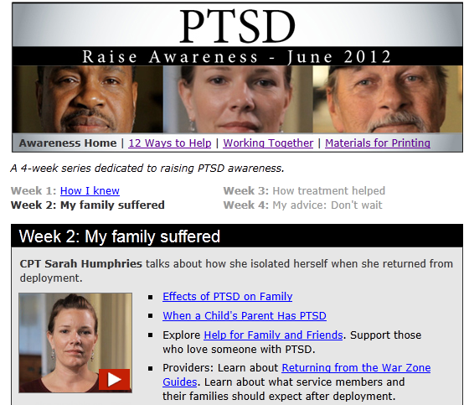
June is PTSD Awareness Month

Slide 13
Navigating the VA.gov Site:
Mini Practice
We’ll take about two minutes for this exercise. Go to http://va.gov/
Click on Veterans Services
Note the topics under Health and Well-Being
Click on Mental Health and scan the page; go back later explore more
In the Chat box: Reactions? Anything notable?

Slide 14
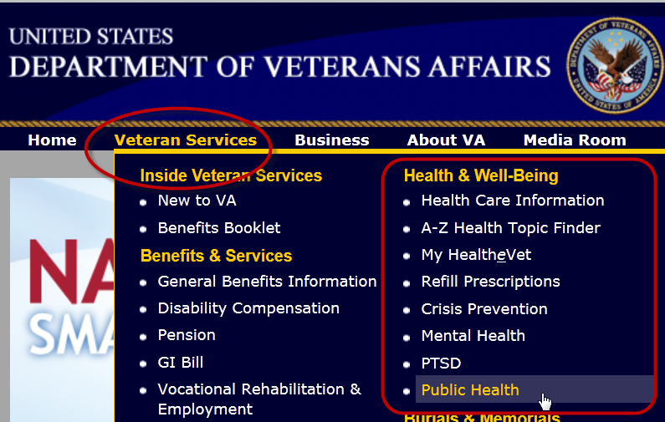
Navigating the VA.gov Site

Slide 15
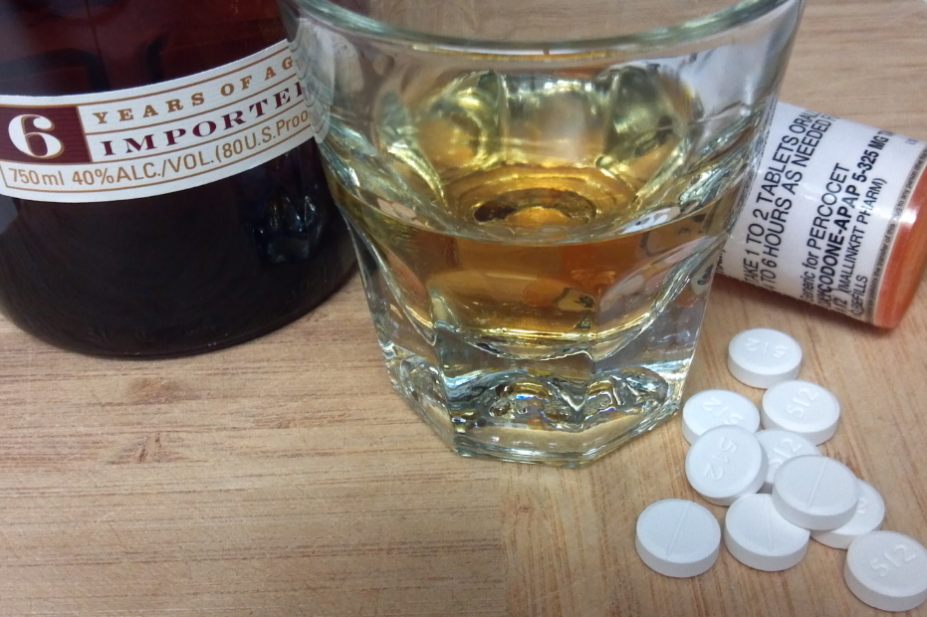
Substance Abuse
http://www.drugabuse.gov/patients-families
http://www.easyread.drugabuse.gov/

Slide 16

Homelessness
http://www.nchv.org/veterans.cfm

Slide 17
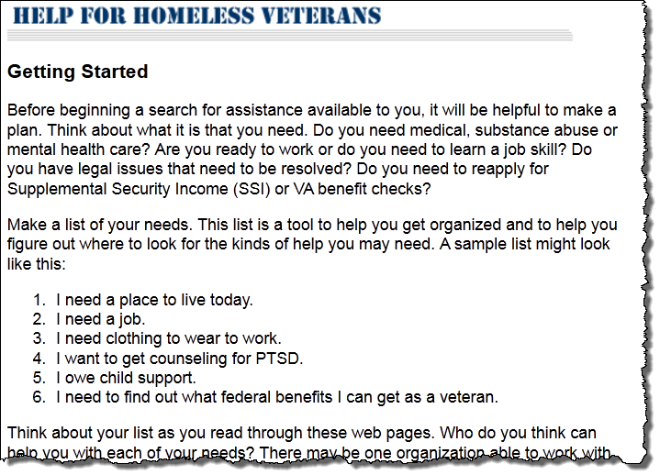
Helpful Tools from NCHV

Slide 18
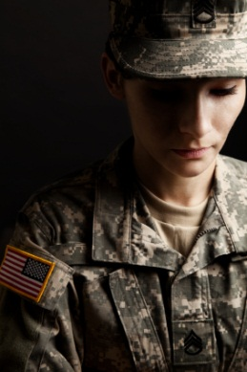
Special Issues for Women Veterans
Family Issues
Military Sexual Trauma
Homelessness
Suicide
http://www.mentalhealth.va.gov/
http://www.womenshealth.va.gov/

Slide 19
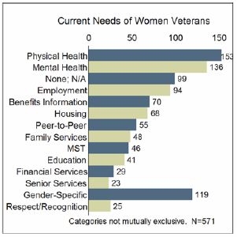
California’s Women Veterans
California has both the greatest number – more than 167,000 – and the greatest proportion of female veterans in the country (9.5 percent).
California’s Women Veterans
Response to the 2011 Survey: Preliminary Report
http://www.library.ca.gov/crb/12/FINAL_REPORT.pdf

Slide 20
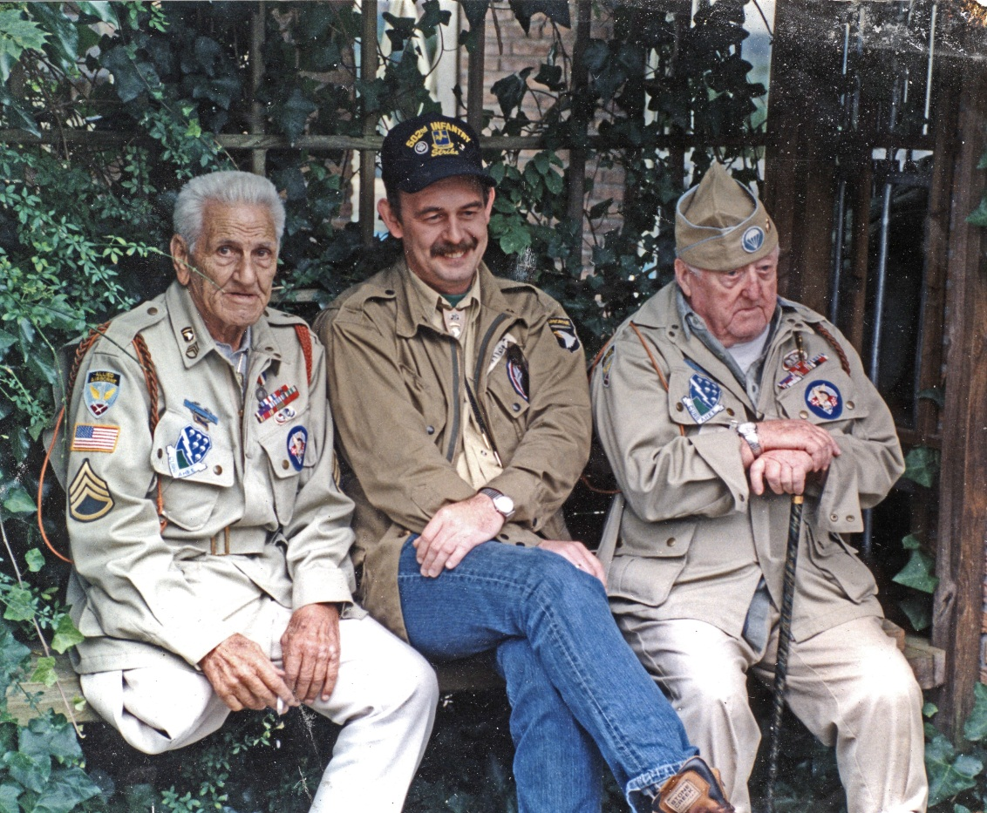
Older Vets

Slide 21
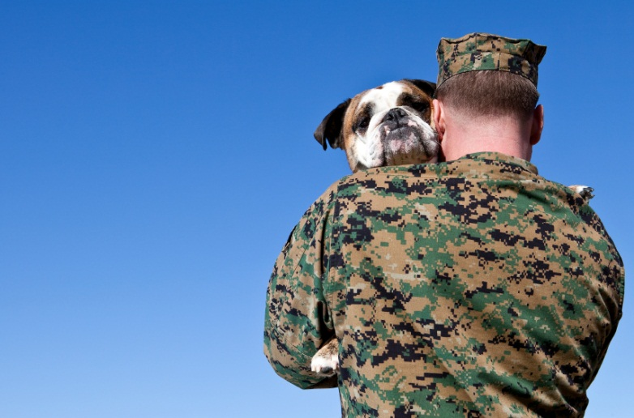
Support Services

Slide 22
Make the Connection
MakeTheConnection.net is a one-stop resource where Veterans and their families and friends can explore information about physical and mental health symptoms, challenging life events, and mental health conditions.
Highly recommended for any vet, family member or friend seeking support and information
http://maketheconnection.net/

Slide 23
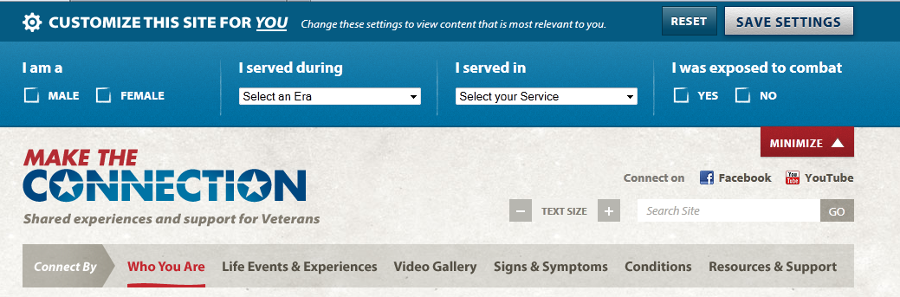
Make the Connection
Customizable
Allows user to drill down to relevant info

Slide 24
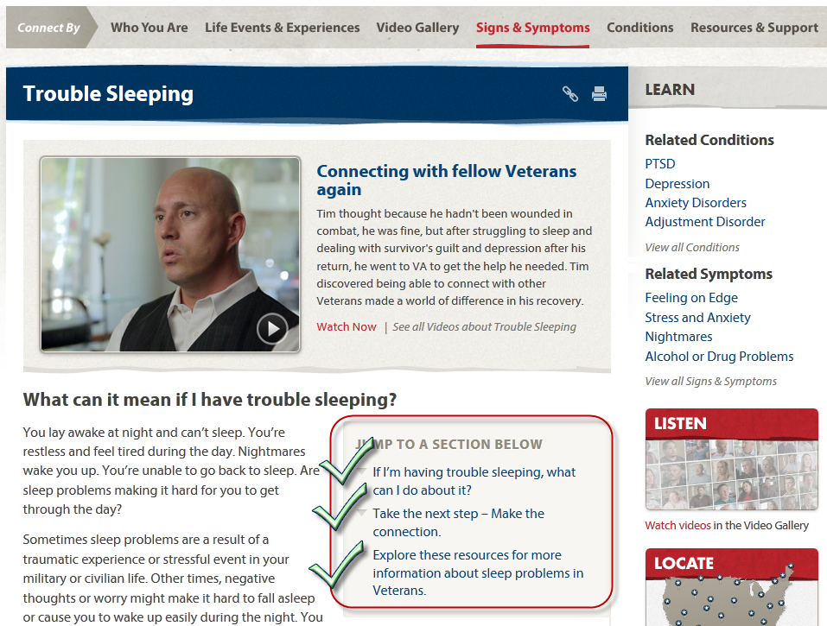
Make the Connection:
Signs and Symptoms

Slide 25
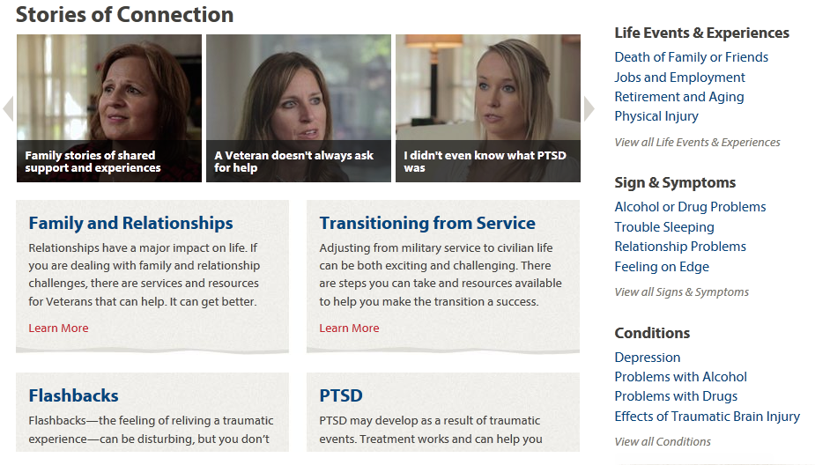
Military Families and Friends
http://maketheconnection.net/family-friends

Slide 26

Hotlines Worth Noting
Veterans Crisis Line 1.800.273.TALK (8255)
National Call Center for Homeless Veterans 1.877.4AID.VET (424.3838)
VA Caregiver Support Line 1.855.260.3274
Wounded Warrior Resource Center 1.800.342.9647

Slide 27
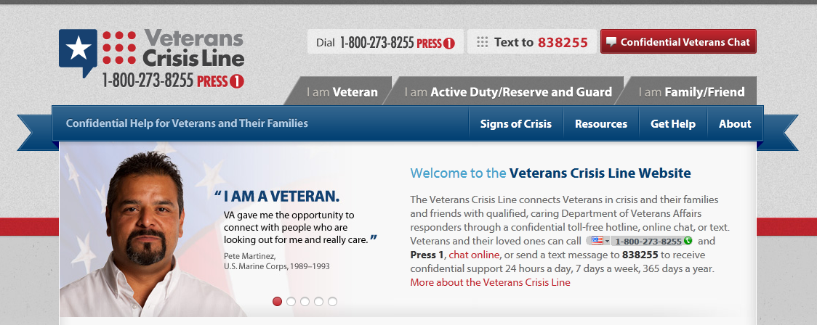
Veterans Crisis Line

Slide 28
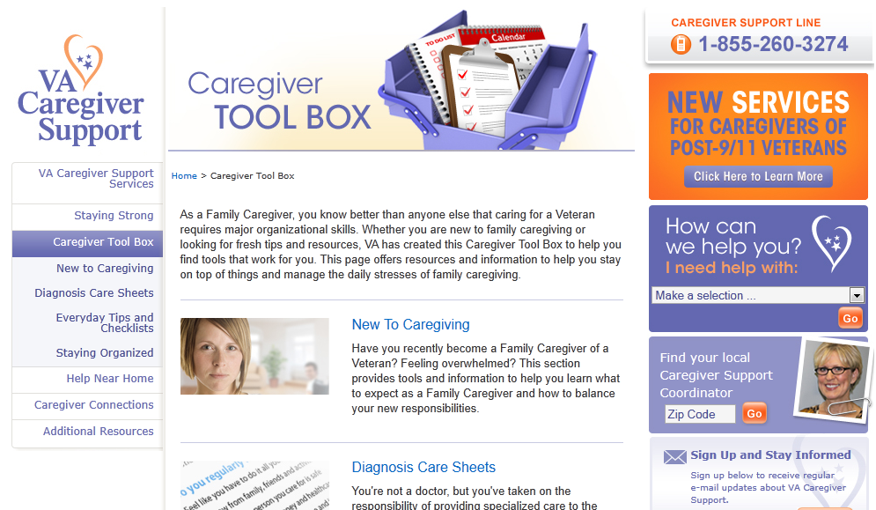
Support For Caregivers
http://www.caregiver.va.gov/

Slide 29
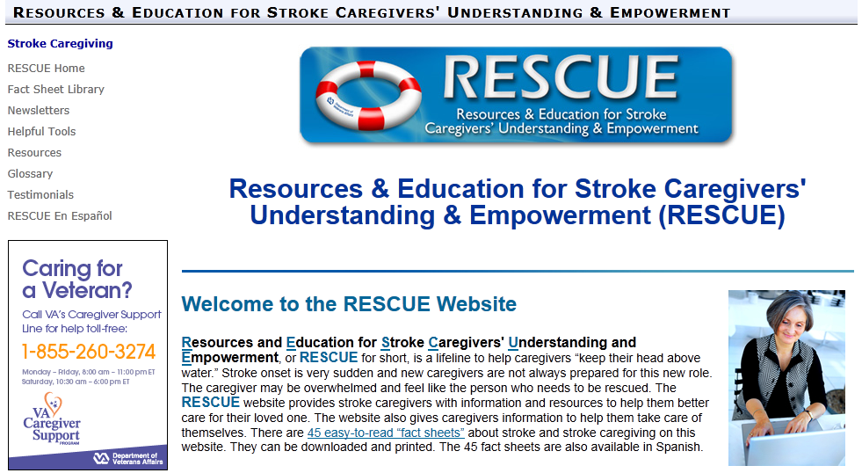
For Stroke Caregivers
http://www.rorc.research.va.gov/rescue/

Slide 30

Online Health Resources
So many excellent sites; where to start?
http://medlineplus.gov

Slide 31
Mini Practice
We’ll take about 3 minutes here.
Go to http://MedlinePlus.gov
Search for the key word veterans, then limit your results to Health Topics only
Scroll the results; click on any one of the Health Topics of interest
In the Chat box, add any comments!

Slide 32
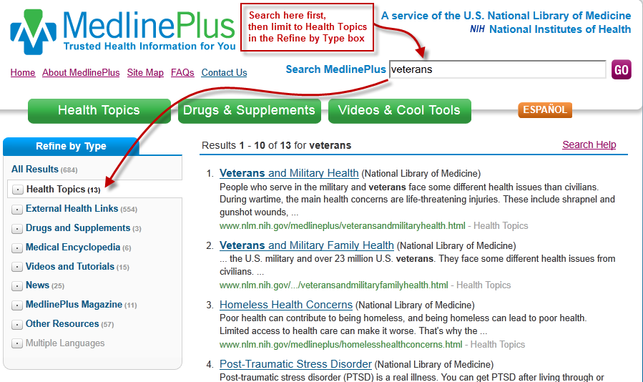
Searching MedlinePlus

Slide 33
Vets in the Digital Age
Mobile Apps
PTSD Coach
T2 Mood Tracker
Breath2Relax and Tactical Breather

Slide 34
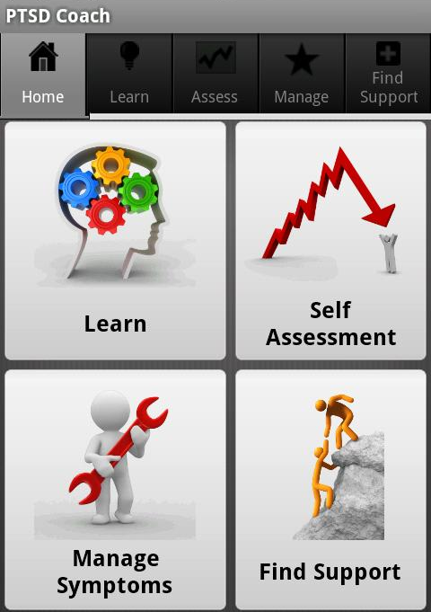
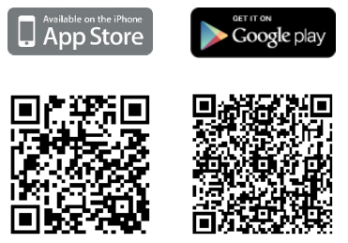
Mobile Apps and Sites
PTSD Coach
Easy-to-use
http://t2health.org/apps

Slide 35

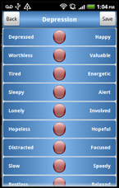
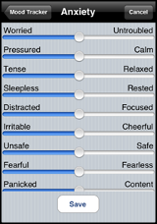
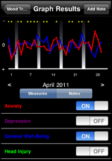
T2 Mood Tracker
http://t2health.org/apps/t2-mood-tracker

Slide 36
Online Support Groups
After Deployment
http://www.afterdeployment.org/
National Alliance on Mental Illness (NAMI) http://bit.ly/VetSupport
Veterans Forum
Homeless Forum
Living with Posttraumatic Stress Disorder

Slide 37
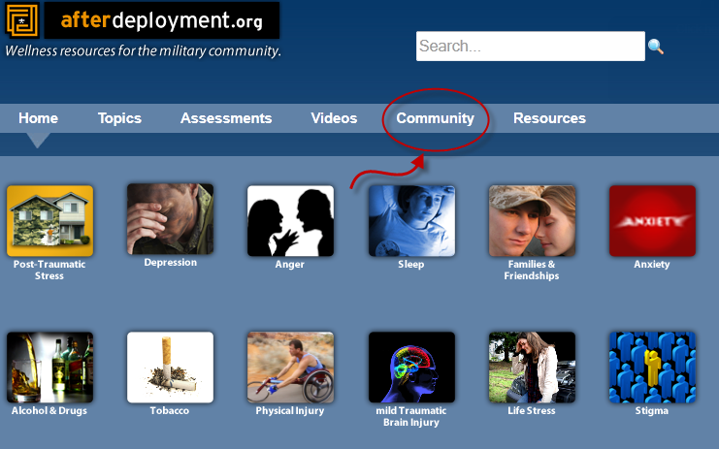
Support in Online Community

Slide 38
Military Kids Connect
MKC is an online community of military children (ages 6-17 years old) is a safe site that provides access to age-appropriate resources to support children from pre-deployment, through a parent's or caregiver's return.
https://www.militarykidsconnect.org/

Slide 39
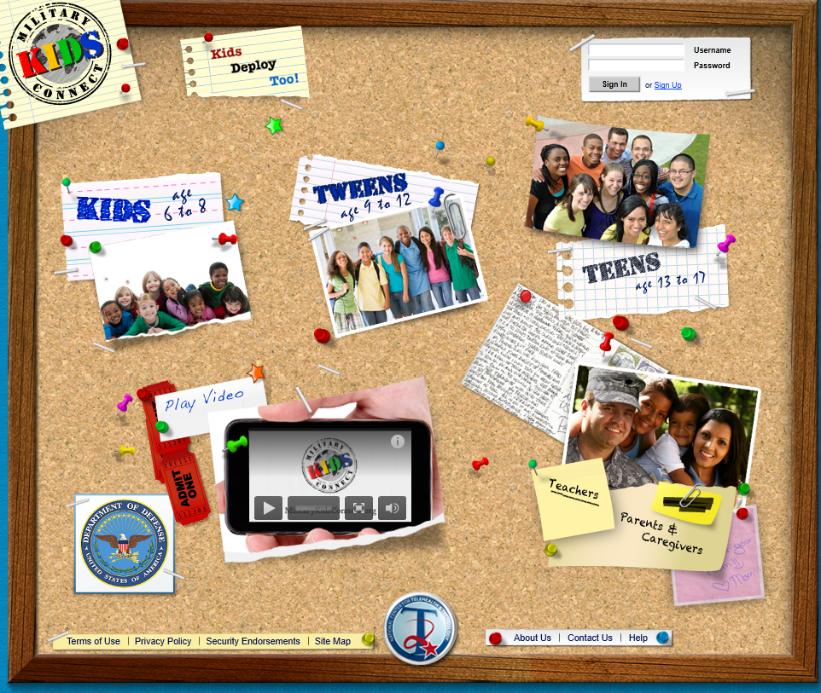
Military Kids Connect
Home Page

Slide 40
The VA Health System
Complex!
Where to turn first?
Helps to know how it’s organized

Slide 41
Snapshot of the System – Services and Facilities
Veterans Administration
Veterans Health Administration
Veterans Integrated Service Networks
State Veterans Services
County offices
Vet Centers
Veterans Service Organizations (VSOs)
MyHealtheVet

Slide 42
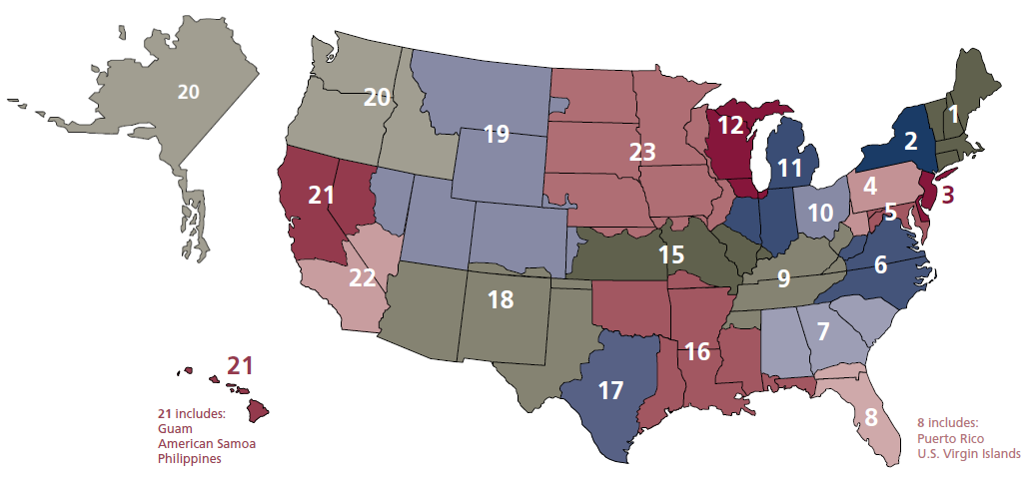
Veterans Integrated Service Networks (VISNs)

Slide 43
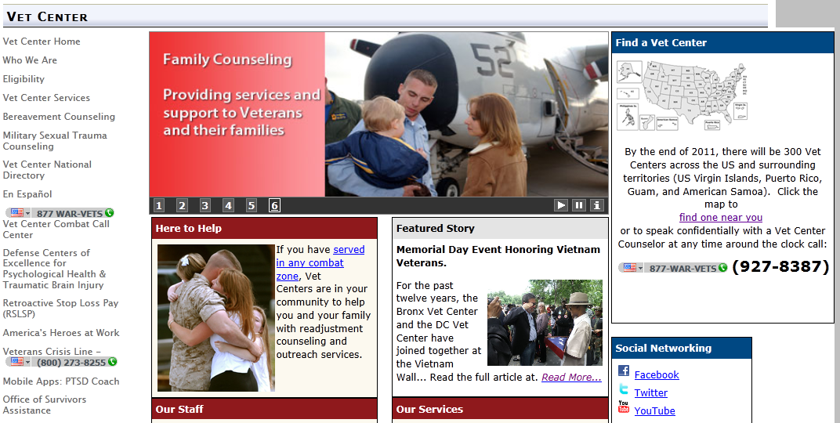
Vet Centers
http://www2.va.gov/directory/guide/vetcenter_flsh.asp

Slide 44
State and Local Resources
State Departments of Veteran Affairs
  Essential resource for veterans
  Each state has one
  Additional benefits vary from state to state
  http://www.va.gov/statedva.htm
County Veteran Service Organizations
  www.cacvso.org
Search for all facilities based on your criteria: http://www2.va.gov/directory/guide/rpt_fac_list.cfmhic regions

Slide 45
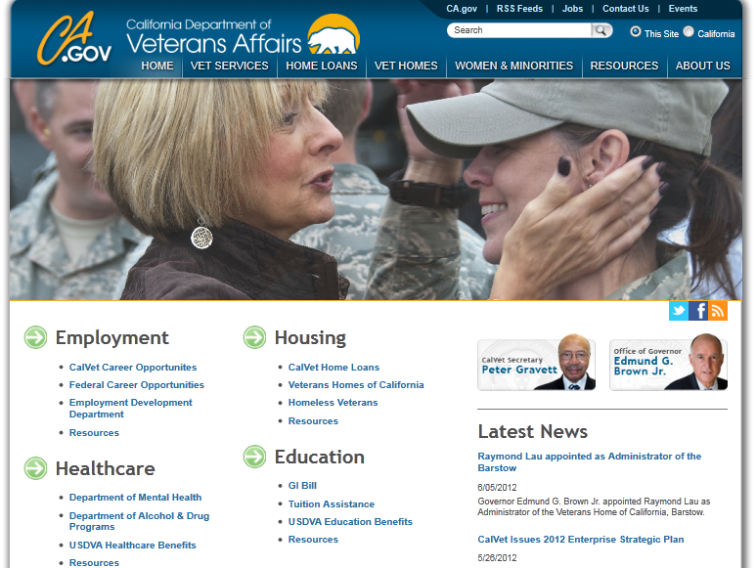
CalVet: the California Department of Veteran Affairs
http://www.calvet.ca.gov/

Slide 46
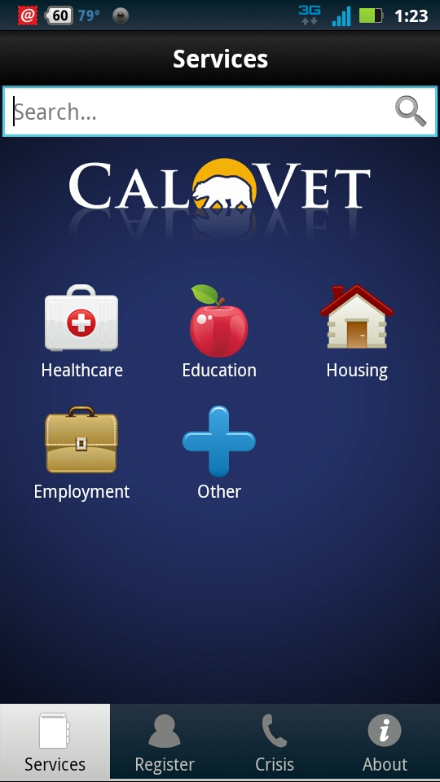
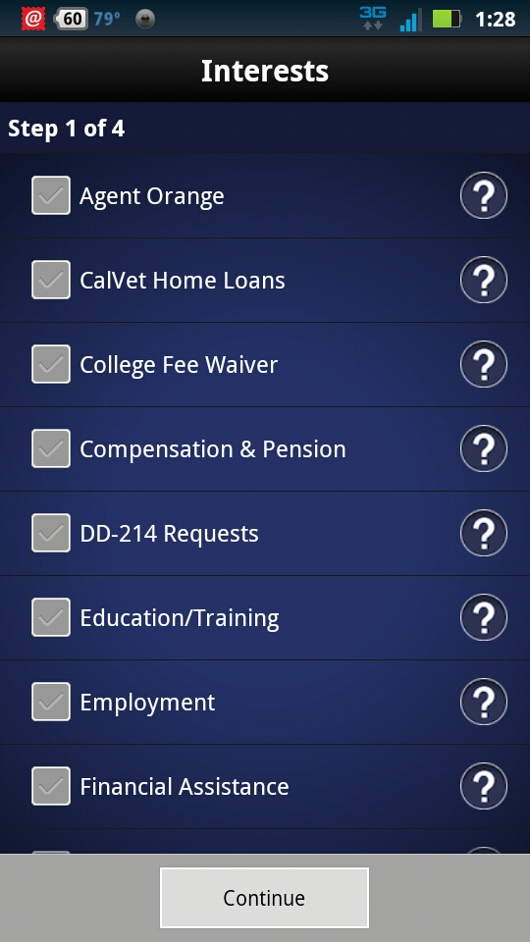
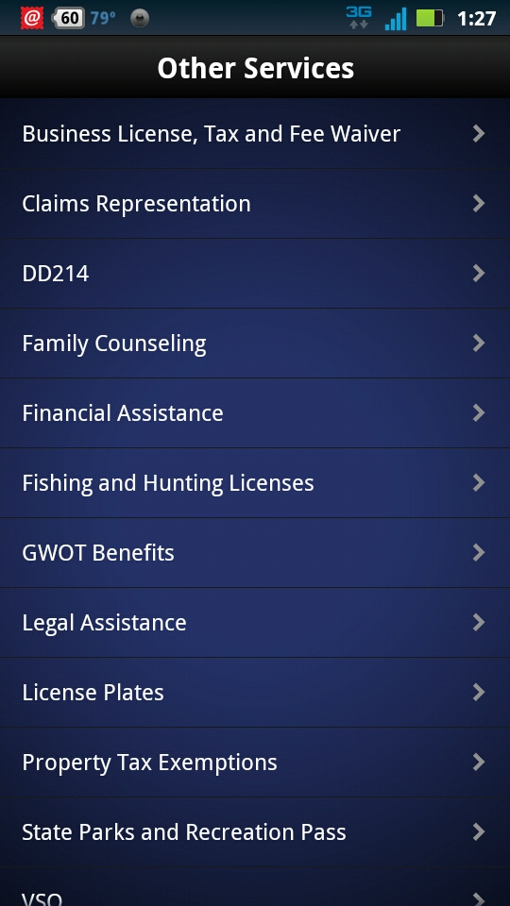
CalVet App

Slide 47
CA Dept. of Veteran Affairs and the CA State Library
Pilot outreach project to veterans and their families
Three geographic areas identified
  Shasta Public Libraries
  Fresno County Library
  San Diego County Library
Veteran ‘resource stations’ in each library
  Print resources, designated laptop for veterans’ use, trained volunteers and more!

Slide 48
MyHealtheVet
My HealtheVet is a Personal Health Record and information portal for vets and their caregivers
Refill VA prescription medicines
Access links to Federal and VA benefits
Take on-line courses to improve physical and mental health
Create personal health records
Track changes in health
http://www.myhealth.va.gov

Slide 49

More Ways to Find
Services and Benefits
National Resource Directory
Connecting wounded warriors, service members, veterans, their families, and caregivers with those who support them

Slide 50
VALNET – VA Libraries
Librarians are able to help vets (and public librarians) find health information
Located at some VA hospitals
Check out the consumer resources (some more up-to-date than others)
http://www.va.gov/VALNET/Consumer_Health.asp

Slide 51
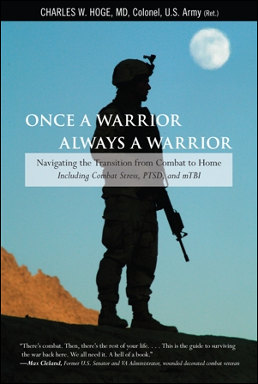


A Few Recommended Titles

Slide 52



A Few More

Slide 53
Finding Organizations:
Mini Practice
Using DIRLINE: Directory of Health Organizations
http://dirline.nlm.nih.gov/index.html
Try a few searches with simple key words:
  spinal
  veteran
Now try this: (be sure to capitalize OR)
  amputees OR amputation

Slide 54
Final Words
Barely scratched the surface
Be cautious of websites targeted to veterans; many try take advantage of the vulnerabilities faced by this population
Learn about your own state and county resources; often the personalized services help the veteran reintegrate more easily

Slide 55


Thank You!
Kelli Ham, MLIS
NN/LM Pacific Southwest Region
kkham@library.ucla.edu
http://nnlm.gov/psr/
1-800-338-7657
This project has been funded in whole or in part with Federal funds from the Department of Health and Human Services, National Institutes of Health, National Library of Medicine, under Contract No. HHS-N-276-2011-00009-C with the UCLA Louise M. Darling Biomedical Library.

Slide 56

Infopeople webinars are supported by the U.S. Institute of Museum and Library Services under the provisions of the Library Services and Technology Act, administered in California by the State Librarian. This material is licensed under a Creative Commons 3.0 Share & Share-Alike license. Use of this material should credit the author and funding source.

