Slide 1
Hack Your Career: Dream Job FTW!
Jesse Lanz and Nicole Pasini
Wednesday, July 18, 2012

Slide 2
FTW = FOR THE WIN
Notes:
Nicole: Before we get started, I just want to make sure you all know this -- when we say FTW, we use it to mean "for the win", as it's often used in internet gamer parlance. UrbanDictionary.com will give you a variety of other definitions that we're not ascribing to this webinar... my favorite of which is "Free Taco Wednesdays". I wish we could give you free tacos with this webinar. But alas...

Slide 3
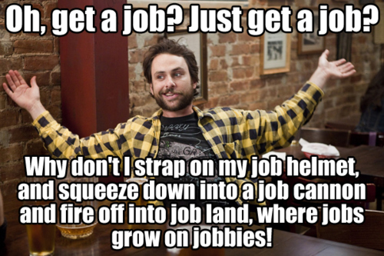
source: http://weknowmemes.com/wp-content/uploads/2011/10/oh-get-a-job-charlie-day.jpg, Always Sunny in Philadelphia
Notes:
JESSE: Looking for a job can seem incredibly daunting. If you're unemployed, you feel an incredible amount of pressure to find a job. If you're currently employed and looking for a new job, the prospect of a major life change can be pretty scary. Wherever you're at in your life, searching, applying and interviewing for jobs is a lot of work -- it can be time consuming, emotionally draining, stressful and demoralizing.
NICOLE: We want to acknowledge that the job search process is not easy, especially now in this economy. We want to give you some tools that will help you better communicate your particular skills and talents while navigating the job search process. We believe that there is a great job out there for you -- a job that will tap into your amazing skills, a job that you'll find professionally satisfying, a job that will challenge you to become the awesome librarian you have the potential to be. We challenge you to have the audacity to not just look for a job, but for your dream job. You have to go to work every day anyway, right?
So, Why should you listen to us?

Slide 4
Jesse Lanz
Community Library Manager
Diamond Bar Library
County of Los Angeles Public Library
JLanz@library.lacounty.gov
Nicole Pasini
Branch Manager
Woodside and Portola Valley Libraries
San Mateo County Library
pasini@smcl.org
Notes:
Nicole: I currently work as the Branch Manager for the Woodside and Portola Valley branches of the San Mateo County Library. For about 3 years, I worked as the Training and Staff Development Manager. I coordinated staff recruitments, organized trainings and worked on a wide variety of other projects related to training, development, HR and staffing. Prior to that, I worked on collections and services for teens and children for San Mateo County Library and Phoenix Public Library. Prior to working in libraries, I was the Executive Director of a literacy tutoring program in Phoenix.
Jesse Lanz...
We've also polled a lot of managers and library directors in California and beyond for their input on what they're looking for in an applicant.
Nicole: Questions:

Slide 5
source: http://www.someecards.com/graduation-cards/allow-me-to-take-some-pressure-off-your-job-search
Notes:
Nicole: Oh, and have you heard? The economy is *still* horrible.
Jesse: As you may have been informed by NYT, NPR and WSJ -- the economic recovery is slow. Government tends to be on the tail end of any economic recovery. We don't need to cite depressing unemployment statistics or talk about the financial straits many libraries find themselves in. You already know all that.
For this reason, now more than ever, it's important to be smart and strategic about how you present yourself in a job interview. It's critical that you communicate clearly why you're the best possible candidate for your dream job.

Slide 6
SOMETHING HOPEFUL
source: http://calmingmanatee.com/img/manatee1.jpg
Notes:
Nicole: Take a deep breath first and relax. Stay positive throughout your job hunt and remember what Calming Manatee says: Everything Will Be OK

Slide 7
objectives
Identify the three questions they need to answer before beginning the job search process.
Understand the three major ways that civil service hiring processes differ from hiring processes in the private and nonprofit sectors.
Identify 10 steps that go into successful resumes, applications and interviews, from the perspective of hiring managers.
Notes:
Jesse: We’re going to talk about figuring out what you want to do; the civil service process; and how to develop successful resumes, applications and interviews.
So this is what we're going to talk about today. We want to help you...

Slide 8
sections
Where Are You Going? Where Have You Been?
The Civil Service Process
Pre-Application Work
Resumes and Applications
Interviews

Slide 9
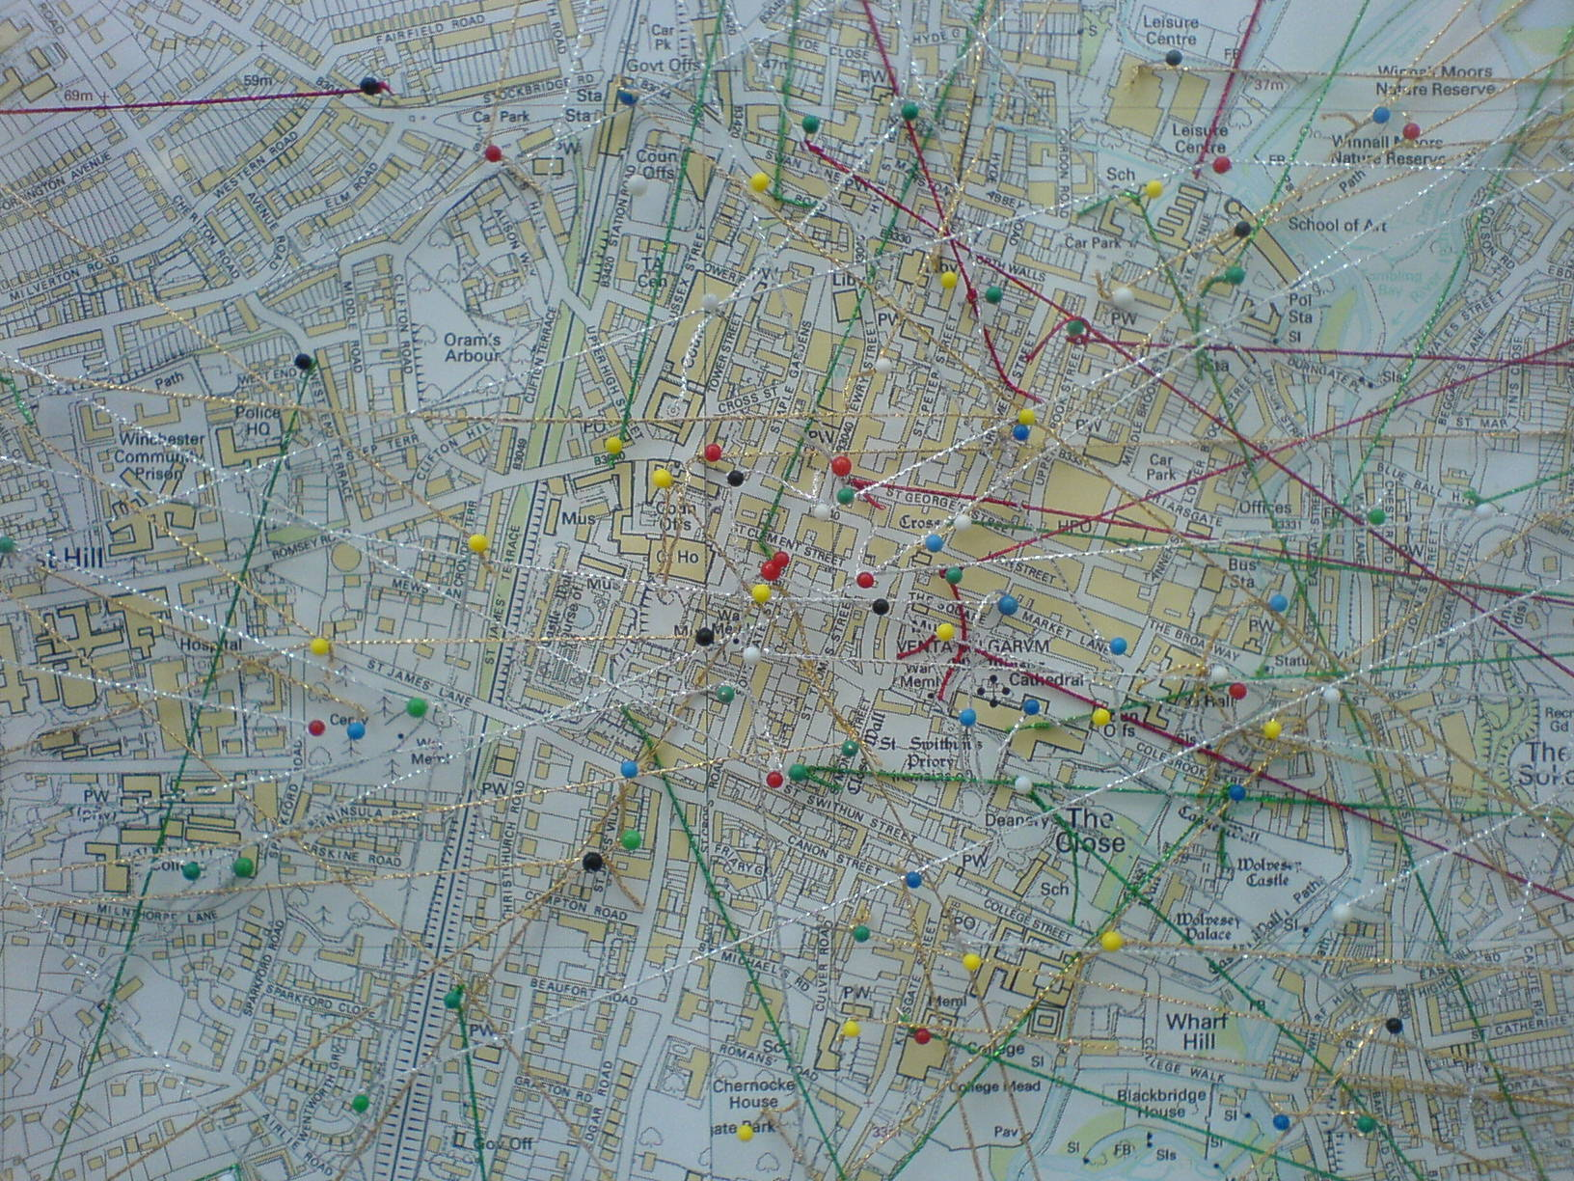
Where are you going?
Where have you been?
source: http://www.flickr.com/photos/zabdiel/3028620509
Notes:
Nicole: So we want to know, where you’re at in your career – TELL THEM WHAT TO DO
INTERACTIVE QUESTIONS
Where are you at in your career? (Multiple choice)
Student
Unemployed
Employed and looking around vaguely
Employed and looking around seriously
I have my dream job already; I just love webinars!
CHAT: If you have a career goal right now, what is it? Short term or long term – put it in the chat.

Slide 10
WAIT….
WHERE AM I GOING???
source: http://www.flickr.com/photos/scottiet812/4436396357/
Notes:
Jesse: Are you not really sure where you want to go next? I've definitely been in the position where I knew I wanted to do something new, but I just didn't know what that was yet.... To help you develop some long-term career goals, think about...
What you enjoy doing?
What do you see others doing that interests you?
Can you “test-drive” new areas of responsibility in your current position?
Can you try out new areas of librarianship as a volunteer?
Can you do informational interviews with people who have jobs your interested in?
Can you connect with mentors who will help you figure out what path you want to take?

Slide 11
to prepare for what's next?
Notes:
Nicole:
We want to ask you -- If you know what you want to do next, if you can identify what kind of work would make up your dream job, what should you do know to prepare yourself to get that job? I'm talking about things separate from your formal job search; the experiences and work you want to have that will make you an excellent candidate for your dream job.
INTERACTIVE ELEMENT:
So, in the chat box -- What do you think good strategies are to prepare yourself? What are you doing right now to get ready for your dream job? What strategies can recommend to other participants.

Slide 12
source: http://www.escapingthe9to5.com/wp-content/uploads/2010/02/Picture-25.png
Notes:
Jesse: In getting ready for your next step, you of course want to be good at your current job, whatever it is. Take it to the next level and ask for responsibilities in your current job that will give you experience that relates to your goals. Are there opportunities to take on new projects or initiatives in your current job (wherever it is) that will give you good experience and help you strengthen your skills?
For example, do you want to be a children's librarian, but don't have storytime experience? Can you get storytime training at work? Can you lead or assist at storytimes, or expand your library's storytime by doing outreach storytimes? Don't work at a library? Can you volunteer to lead or assist a storytime at your local library?
Nicole: If I was going to be hiring for a children's librarian, I'm going to look very favorably on a candidate who, for example, worked as an aide and lead storytimes. That tells me he or she is a person who is willing to take on new challenges that might fall into the "other responsibilities as required" part of their job description. It also shows me that they're enthusiastic about the work.
Already have a lot on your plate at work? So does everybody else. Challenge yourself to stretch a bit further -- Do like the Courage Wolf: bite off more than you can chew, then chew it.
I'm pretty sure I stole courage wolf from another Eureka Webinar.

Slide 13
Notes:
Jesse: These are some qualities that hiring managers who answered our questionaire brought up multiple times as highly desirable. Are these qualities that you have right now? Where do you excel and where could you use some work? What can you do at work now to embody these different traits?
Most managers didn't say, "I really want someone who has experience with our ILS," or "They have to know how to use every database we have." Having hard skills is of course important. Hiring managers are looking at your experience of course, but they're also looking at your attitude.
Nicole: One of my coworkers, PC Sweeney, says:
"I am looking for someone who is excited about the profession and has a personality. I can teach you the skills to be a good librarian, but I can’t teach you the personality."

Slide 14
Notes:
Jesse Managers ultimately want someone who is going to support the work they're trying to accomplish in the library. You want to work with people who will support you -- why wouldn't a manager want the same thing? Being supportive of change doesn't mean passively accepting everything management wants you to do. It means offering your input in a productive, timely fashion, and then, when a final decision is made, getting on board with it (whether you think it's a genius choice or a misguided one).
Nicole Is there an opportunity in your work for you to constructively support change right now? Supporting change is a skill just like public speaking or HTML coding; it's something you can learn and practice.

Slide 15
You Are Not Joan Jett.
source: http://www.flickr.com/photos/no-alternative/5252958850/
Notes:
Nicole: Which brings me to reputation -- You are not Joan Jett -- You need to care about your reputation.
Your reputation at your current job is critical to you landing a future job. Your reputation is probably going to follow you, whether you're changing departments, libraries, or careers, so you need to build a name for yourself at work that you feel proud of.
Jesse: What do you want to be known for at work? Being innovative? A team-player? A hard worker? Every day you need to be reinforcing this image of yourself through your behavior and work.

Slide 16
source: http://www.flickr.com/photos/shankbone/4488830140/
Notes:
Nicole: A big part of your reputation is based on your interpersonal skills. We need to work to maintain positive relationships with all of our coworkers -- ALL of them. Even the ones you don't like. That means no fights, pillow-based or otherwise. Work to resolve conflict productively and on your own as much as possible. If you have to involve your boss, be prepared to own up to how you've contributed to the problem and constructively work towards a solution.
Jesse: If I'm thinking about hiring someone, in addition to calling their references, I will also ask around -- if I can find current or past co-workers or supervisors, people you've worked with on a professional committee, etc. I'm going to try to talk to people you *didn't* list as references, and I think a lot of managers will "shake the tree" to see who else they can chat with about you. To the greatest extent possible, you want *most* people to have good things to say about you.

Slide 17
Notes:
Nicole: We also need to think about our online reputations. Prospective employers will (if they're smart) research you online as extensively as possible. When I research a job applicant, I want to 1) get a sense of the person's personality, 2) see if there are articles, etc. that corroborate or expand upon what they've told me, and 3) see if this person is smart enough not to have ridiculous stuff connected to them on the internet.
What you need to figure out is whether your online presence supportive of, neutral to, or detrimental to your job search. Do you need to address a problem? Can you advertise an asset (such as articles about your work)?
Jesse:
o Google yourself. What comes up first? Is information correct? How does it make you look? It can be helpful to set up a Google alert for your name, so that when there are new search results about you, you know immediately.
o Consider your social network reputation. Use professional sites like linkedin to make your resume public, but also think about your personal social network presence. We've all heard stories about people whose negative or unprofessional social network profiles have come back to bite them. Does your facebook page present the image you want to present? How do your facebook/twitter/linkedin profiles look to people you aren't friends with?

Slide 18
Can you give me
a good reference?
source: http://www.flickr.com/photos/psexypsychic/
Notes:
Nicole: You *have* to ask first! I've contacted references who didn't know the call was coming, and who didn't feel comfortable giving a reference for that person.
Jesse: If you're applying for a new job in your current organization, don't list the hiring manager as a reference -- they will want to check in with people, even if they know you well. A current or past manager/supervisor is the best reference, followed by coworkers and professional contacts. Personal friends are low on the list, followed by family. Listing a reference whose relationship is "friend" or "aunt" does not look good.
Nicole: I had a professor in college who told me to ask, “Can you give me a *good* reference?” Be specific! And, once you have people who will enthusiastically endorse you and your work, let them know when you're looking for a job and that you'll be listing them as references on a number of applications.

Slide 19
Ask a Mentor for Help!
"Find someone who you trust who might be willing to mentor you in the job search progress. ...
- A Library Director
Notes:
Nicole: Check in with mentors about what they recommend -- what can you specifically do to make yourself a better candidate? What weaknesses and strengths do they see in you, your skill set, your experience? How's your resume? What aren't you doing in your job search that you could be doing?
A mentor can be someone who...
You know well.
A friend connects you with.
You cold call.
You communicate with regularly.
You only ask for advice from once.
Librarians can be extremely generous -- we like to give people information! Don't be afraid to reach out to someone you don't know well to ask for advice.
Nicole: I had a mentor who did practice interviews with me, edited my resume, and gave me advice on what areas I needed more experience in. She was EXTREMELY helpful to me in understanding what I needed to do to get a job.
A good friend of mine who wanted to become a law librarian contacted the local head of a law library to ask her some questions about the profession generally; the librarian invited her to a law librarian association meeting and was forthcoming with advice about job searches, the profession, and what she needed to do to meet her goal. Don't be afraid to contact someone experienced you don't know well -- The worst they can say is "no".

Slide 20
The Civil Service Process
source: http://www.loc.gov/pictures/item/95508819/
Notes:
Jesse: Now we're going to talk about the civil service process that most states, cities and counties, including their public and state libraries, use for recruiting and hiring in some form or another.
INTERACTIVE ELEMENT:
RAISE YOUR HAND IF YOU HAVE SOME EXPERIENCE WITH APPLYING AND INTERVIEWING IN A CIVIL SERVICE ENVIRONMENT
NOW, RAISE YOUR HAND IF YOU FOUND IT DIFFICULT, IRRITATING, OR SLOW.
Nicole:
OK, that's good. Let's talk a little about the background of Civil Service hiring, so that we have an understanding of its purpose, besides just making for socially awkward interviews.
Up to the early 1800s, America was in The Spoils Era of government employment -- whoever’s in power cleans house and puts in their own people. We're looking at rampant cronyism and nepotism in government; there's also a lot of problems created when so many staff are replaced so regularly and quickly -- the institutional knowledge just gets lost, right?
In the 1870s, Ulysses Grant begins implementing reform.
Other presidents continued the effort, and the Civil Service Act of 1883 made it so that merit, as basis for hiring, was guaranteed by law.
SO, the whole point of the civil service process is to ensure fairness, competitiveness, and transparency in hiring.
SOURCE: http://www.opm.gov/about_opm/tr/history.asp, Office of Public Management

Slide 21
Major Differences
major differences
Civil Service vs. Private Sector
Open & competitive vs. ?
Highly formal vs. ?
Usually slow vs. ?
Notes:
Jesse/Nicole
Civil Service
Open and competitive
Highly formalized, rule-based and transparent hiring process
Usually slow
Private Sector
Open and competitive... unless it's not.
Process may or may not be formal or transparent.
Speed depends on company.

Slide 22
understanding the process
source: http://www.co.sanmateo.ca.us/portal/site/HR
Notes:
Nicole: Process – the best way to understand an individual library’s hiring process is to READ EVERYTHING. We’re including a handout on the civil service process, but individual counties, cities and states will have specific processes that you’ll want to know about when you’re serious about a position.
Jesse: Read everything if you want to know what steps there will be in the hiring process. Every jurisdiction will have some amount of information available about their hiring processes online. Is there a closing date for this job, or is it a continuous recruitment? Will there be any testing or just interviews? Have they set the dates for these already?
Nicole: Read ALL the application instructions – Some jurisdictions will want a resume and cover letter; some will ask you to fill out a work history form and answer essay questions. You want to give them whatever they ask for. Don’t write “see cover letter” or “see resume” if you’re asked to input work history and answer essay questions.
Jesse: Contact the organization's HR with questions -- there will probably be someone assigned to the recruitment.

Slide 23
source: http://www.flickr.com/photos/finsthwait/295045370/
Notes:
Nicole: There are three Other things to keep in mind about the civil service process. First of all, interviews will feel different. The ideal experience for a job interview would be like sitting down with Terry Gross, right? She'd put you at ease, make you comfortable, ask probing questions. Terry would help you portray your best self.

Slide 24
source: http://www.flickr.com/photos/usfbps/4597078894/
Notes:
Jesse: Instead, you'll probably get this guy.

Slide 25
source: http://www.flickr.com/photos/usfbps/4597078894/
Notes:
Nicole: Actually it will be more like this. A wall of three people who have been interviewing applicants since 8AM, and they're wondering what's happening back at the branch, and the guy who interviewed before you just went on and on and on and they're just ready for lunch. It's not going to be encouraging.
Jesse: I've encountered many, many people who find the panel interview that most public libraries do to be difficult to do well in. It's not an engaging back and forth. Often panelists are taking notes while you're speaking -- this is to help them score, and keep all the interviews straight, but they might not be making eye-contact with you. They'll be asking a scripted set of questions, and they probably won't answer many of your questions.
Nicole: I've also talked to applicants who went through a panel interview and decided they didn't like that particular library system because the people seemed cold and off-putting. This point in the process is not the time to judge the library itself; highly formal interviews are just a part of what the civil service code in most jurisdictions requires.
Jesse: So, YOU have to bring your energy and enthusiasm with you! You have to prepare because you're not going to get much help once you get in there. I've been blown away by job applicants who came not only prepared, but also showed us their enthusiasm and passion for libraries. It's totally possible, and We will talk later about how to accomplish this.

Slide 26
source: http://www.flickr.com/photos/videocrab/280787884/
Notes:
Nicole: Scoring is the other piece of the civil service process you should keep in mind. Every step of the process you are scored -- your application and your interview. That means following directions and playing by the rules, just like when you play Pac-Man.
Jesse: Every portion of the hiring process -- from your resume up through the interview- needs to be polished and professional in order for you to do well.

Slide 27
Analyze This
Supervisory Librarian Job Announcement
Notes:
Nicole: OK, so let's go through a job announcement and analyze it together. I picked a recent job announcement for a supervisory librarian, but I've removed the specifics from what we're going to see here.
Jesse: Why should we do this instead of just jumping into the application? You *must* have a good understanding of the job in order to create an application that convinces a hiring manager that you are the best possible applicant. Ask yourself:
What skills, abilities and knowledge are they looking for?
What would the "ideal candidate" look like?
Am I that candidate?
What does the announcement tell you about the library system?

Slide 28
Typical Tasks
Hires, trains, supervises, evaluates and terminates subordinate personnel;
Creates employee work schedules;
Attends professional workshops and meetings;
Participates and assists in making system policy decisions for program area;
Gathers and conducts analysis of data for various internal library reports.
Plans, develops, organizes, conducts, publicizes and evaluates appropriate programs;
Familiarizes and trains library patrons in the use of library facilities and materials; assists patrons on selection of appropriate material;
Evaluates and reviews Library literature;
Manages collections based upon community needs using established procedures;
Promotes reading and performs reader's advisory services;
Answers difficult reference questions;
Collaborates with local educational and community agencies on projects and presentations;
Recommends materials to be purchased and purges old materials based on established criteria;
Manages a community library in the absence of the Community Librarian to resolve routine operating problems;
Organizes the physical interior for assigned section of the library; coordinates library displays;
Speaks to community groups;
Plans and develops programs for assigned section;
Assists in the preparation of the annual budget for the County Library; allocates and monitors spending for programs;
Oversees all aspects of a program such as , technical innovation, outreach, training, and staff development;
Coordinates the Integrated Library System (ILS) with circulation and information system staff and develops procedures for use in all outlets;
Analyzes and resolves automation problems with technical information system staff;
Performs other related duties as required.
Notes:
Nicole: What we see in the first part of the announcement is an overwhelmingly long list of tasks -- and this is only one section! My eyes are already glazing over. One important thing that applicants forget to do is READ THE ENTIRE JOB DESCRIPTION!
Jesse: So I will start by going to go at the job announcement methodically -- I'm going to first tick off what tasks I have a lot of experience with; then I'll evaluate what tasks I have some transferrable, related experience in, and then finally, I'll go through and tick off what tasks would be totally new to me.

Slide 29
Typical Tasks
Hires, trains, supervises, evaluates and terminates subordinate personnel;
Creates employee work schedules;
Attends professional workshops and meetings;
Participates and assists in making system policy decisions for program area;
Gathers and conducts analysis of data for various internal library reports.
Plans, develops, organizes, conducts, publicizes and evaluates appropriate programs;
Familiarizes and trains library patrons in the use of library facilities and materials; assists patrons on selection of appropriate material;
Evaluates and reviews Library literature;
Manages collections based upon community needs using established procedures;
Promotes reading and performs reader's advisory services;
Answers difficult reference questions;
Collaborates with local educational and community agencies on projects and presentations;
Recommends materials to be purchased and purges old materials based on established criteria;
Manages a community library in the absence of the Community Librarian to resolve routine operating problems;
Organizes the physical interior for assigned section of the library; coordinates library displays;
Speaks to community groups;
Plans and develops programs for assigned section;
Assists in the preparation of the annual budget for the County Library; allocates and monitors spending for programs;
Oversees all aspects of a program such as , technical innovation, outreach, training, and staff development;
Coordinates the Integrated Library System (ILS) with circulation and information system staff and develops procedures for use in all outlets;
Analyzes and resolves automation problems with technical information system staff;
Performs other related duties as required.
Notes:
Jesse: As I do this evaluating what I have a lot or a little experience in, I'm also going to look for themes or groups of tasks -- what tasks are all of a piece? So, I'm going to go through and highlight the stuff that I think falls under standard librarian work, all of which I have a fair amount of experience with. Let's say I've done a million programs and I'm really strong in my ref/readers' advisory skills. I want to make sure I really emphasize my skills and experiences in this area in my application/resume/cover letter.
Nicole: There are also a number of collections duties listed here -- weeding and selection, etc. -- so I can think about my collections experience holistically as well. Let's say I hadn't done much selection of materials, but I'd done a lot of weeding and replacement lists. This tells me that when I answer written questions or write my cover letter, I'll want to focus on my strengths in this area, while expressing my interest in getting more experience in selection, also mentioning any education I've had in the area.

Slide 30
Typical Tasks
Hires, trains, supervises, evaluates and terminates subordinate personnel;
Creates employee work schedules;
Attends professional workshops and meetings;
Participates and assists in making system policy decisions for program area;
Gathers and conducts analysis of data for various internal library reports.
Plans, develops, organizes, conducts, publicizes and evaluates appropriate programs;
Familiarizes and trains library patrons in the use of library facilities and materials; assists patrons on selection of appropriate material;
Evaluates and reviews Library literature;
Manages collections based upon community needs using established procedures;
Promotes reading and performs reader's advisory services;
Answers difficult reference questions;
Collaborates with local educational and community agencies on projects and presentations;
Recommends materials to be purchased and purges old materials based on established criteria;
Manages a community library in the absence of the Community Librarian to resolve routine operating problems;
Organizes the physical interior for assigned section of the library; coordinates library displays;
Speaks to community groups;
Plans and develops programs for assigned section;
Assists in the preparation of the annual budget for the County Library; allocates and monitors spending for programs;
Oversees all aspects of a program such as , technical innovation, outreach, training, and staff development;
Coordinates the Integrated Library System (ILS) with circulation and information system staff and develops procedures for use in all outlets;
Analyzes and resolves automation problems with technical information system staff;
Performs other related duties as required.
Notes:
Nicole: So that's all the standard librarian work I've pulled out of the description, and I can see that there are two areas I'm a rock star in and one area I'm pretty solid in.

Slide 31
Typical Tasks
Hires, trains, supervises, evaluates and terminates subordinate personnel;
Creates employee work schedules;
Attends professional workshops and meetings;
Participates and assists in making system policy decisions for program area;
Gathers and conducts analysis of data for various internal library reports.
Plans, develops, organizes, conducts, publicizes and evaluates appropriate programs;
Familiarizes and trains library patrons in the use of library facilities and materials; assists patrons on selection of appropriate material;
Evaluates and reviews Library literature;
Manages collections based upon community needs using established procedures;
Promotes reading and performs reader's advisory services;
Answers difficult reference questions;
Collaborates with local educational and community agencies on projects and presentations;
Recommends materials to be purchased and purges old materials based on established criteria;
Manages a community library in the absence of the Community Librarian to resolve routine operating problems;
Organizes the physical interior for assigned section of the library; coordinates library displays;
Speaks to community groups;
Plans and develops programs for assigned section;
Assists in the preparation of the annual budget for the County Library; allocates and monitors spending for programs;
Oversees all aspects of a program such as , technical innovation, outreach, training, and staff development;
Coordinates the Integrated Library System (ILS) with circulation and information system staff and develops procedures for use in all outlets;
Analyzes and resolves automation problems with technical information system staff;
Performs other related duties as required.
Notes:
Jesse: OK, so, now I'm looking at the area maybe I have a little less experience with -- As I go through the list of tasks, I can see that they want a librarian who can supervise and let's say I haven't formally supervised anyone before, but as I look more closely it's clear they also want someone to manage a program area, and I think that I do have some direct experience in that area.

Slide 32
Typical Tasks
Hires, trains, supervises, evaluates and terminates subordinate personnel;
Creates employee work schedules;
Attends professional workshops and meetings;
Participates and assists in making system policy decisions for program area;
Gathers and conducts analysis of data for various internal library reports.
Plans, develops, organizes, conducts, publicizes and evaluates appropriate programs;
Familiarizes and trains library patrons in the use of library facilities and materials; assists patrons on selection of appropriate material;
Evaluates and reviews Library literature;
Manages collections based upon community needs using established procedures;
Promotes reading and performs reader's advisory services;
Answers difficult reference questions;
Collaborates with local educational and community agencies on projects and presentations;
Recommends materials to be purchased and purges old materials based on established criteria;
Manages a community library in the absence of the Community Librarian to resolve routine operating problems;
Organizes the physical interior for assigned section of the library; coordinates library displays;
Speaks to community groups;
Plans and develops programs for assigned section;
Assists in the preparation of the annual budget for the County Library; allocates and monitors spending for programs;
Oversees all aspects of a program such as , technical innovation, outreach, training, and staff development;
Coordinates the Integrated Library System (ILS) with circulation and information system staff and develops procedures for use in all outlets;
Analyzes and resolves automation problems with technical information system staff;
Performs other related duties as required.
Notes:
Nicole: So now I want to think about my experience as how it relates to these areas. Let's say I manage teen programming in my current library; sometimes I delegate tasks to other staff and work with other staff on teen services -- that's makes me feel pretty confident that I could lead a program area. Supervision isn't something I have direct experience with, so I start thinking about what experience I have that's transferrable -- maybe I've managed volunteers or interns; maybe I was the lead barista at Starbucks in college; maybe I lead a committee or work group; maybe I've taken some supervisory prep courses. In my application, I'm going to emphasize how interested I am in growing in this area, while touching on my nascent experience.
Jesse: It's also good to go through and look for key words that come up multiple times or that just jump out at me -- Analyze, plan, diverse communities, principles of management, etc. Can I pull these into my application somehow? What does the language of the job announcement tell me about the organization?

Slide 33
Research the Library
source: http://www.flickr.com/photos/kavo1/526353251/
source: http://www.flickr.com/photos/shannonpatrick17/2394235624/
source: http://www.flickr.com/photos/blacktulip/395220505/
http://www.flickr.com/photos/wsl-libdev/3615593368/
Notes:
Jesse
INTERACTIVE
Let's talk about getting a feel for a library -- I want everyone to type into the chat what they've done that's helped them get a good feel for a library or other organization where you were trying to get a job. How have you done your research? What's been helpful?
Nicole
Great answers! You've said everything I've wanted to say!
While you're researching, keep these questions in mind:Is this the kind of library that you want to work for? What *don't* they have that I can bring to the table?
You Need To
Visit the website
What does their catalog look like?
Use chat/online reference
What events are coming up?
What services do they offer?
Mission/Vision/Strategic Plan and Goals -- Tie your experience to their goals!
Jesse Visit the library
What's the building like?
What's the customer service like?
Collections? Computers? Automation?
Call and ask a question
Nicole Ask colleagues about the library
Do you know anyone who works for the system? In the area? What kind of a reputation does the library have?
Search for news stories about the library
What's their social networking presence like?
What's going on with the library?
Do you see stories about events? Services? Funding?

Slide 34
"If you haven’t done any research, you are going to be written off. You are a librarian."
- Retired Library Director
Notes:
Jesse: This right here is why you need to research the library in advance! One director said that if an applicant said that they hadn’t visited the library before, for him, the interview is over. They didn’t prepare, and that’s reflects a characteristic he doesn’t want on his staff.

Slide 35
why?
Source: http://www.flickr.com/photos/videolux/2389320345/
Notes:
Nicole Just about any job you want will require you to submit some paperwork, and we’re going to focus on two here… the application and the resume.
Jesse: You may be asking yourself, why all this paperwork? Or more to the point, why do I need to worry about the resume and the application– they’ve got the same information on them, right? As we discussed earlier, the civil service process is likely to require you to fill out an application form, which may or may not be scored as a part of your “exam.” It’s also very likely that you will be able to upload your resume, which may or may not be considered as part of your score. Either way, you need to make sure that everything you submit represents you in the best possible way. Consider this the very first assignment of your new job!
http://www.flickr.com/photos/videolux/2389320345/

Slide 36
Source: http://www.flickr.com/photos/sybrenstuvel/2468506922/
Notes:
Nicole
INTERACTIVE:
Okay, quick survey: raise your hand if filling out job applications makes you feel like this guy. Yep, me too. So here’s a few pointers to get you through it…
http://www.flickr.com/photos/sybrenstuvel/2468506922/

Slide 37
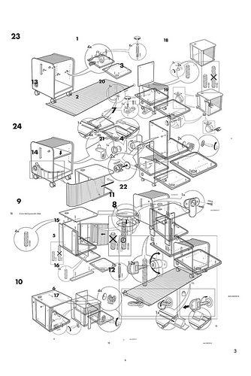
the application
Follow instructions
Source:
http://www.flickr.com/photos/jackbetty/4427395256/
Notes:
Jesse: It seems obvious that you should always follow instructions, but in the civil service environment it's vital. You can be docked points or even eliminated for any information that is missing or inaccurate. If at all possible, have a friend look over the application for you, just to make sure you haven't missed or misunderstood anything.

Slide 38
the application
Grammar counts!
Source:http://www.flickr.com/photos/dickdotcom/818445088/
Notes:
Nicole: Keep in mind that your application is essentially a sample of business writing that you're submitting to a potential employer. Be sure to check your grammar, and make sure that all your t's are crossed, i's dotted, and your apostrophes appropriately either there or not!

Slide 39
the application
So does spelling!
Source: http://www.flickr.com/photos/pswansen/216995731/
Notes:
Jesse
Also, keep in mind that spell check will catch some errors, but not all...

Slide 40
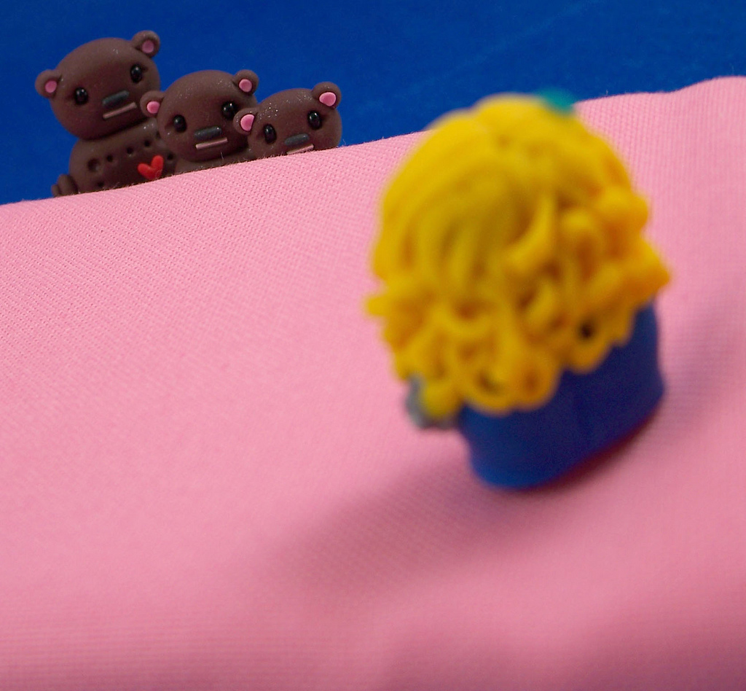
the application
Source: http://www.flickr.com/photos/ittybittiesforyou/3539781784/in/photostream
Notes:
Nicole:
If there are essay or short answer questions, or you’re asked for a cover letter, you really need to hit the sweet spot with the length and amount of detail you provide. Think Goldilocks: Not too long, not too short, just right. You want to be succinct, while also communicating your experience and skills clearly.

Slide 41
the resume
Source: http://www.flickr.com/photos/videolux/2389320345/
Notes:
Jesse: Some libraries will ask for a resume, some won’t, but will give you the option to upload one. Whether they’re asking for a resume or application, you want one drafted so that you can input it into an application.

Slide 42
a resume…
is:
a summary
the highlights
a first impression
is not:
an autobiography
a confessional
a comprehensive list of everything you’ve done in every job, ever
Notes:
Jesse: Let’s backtrack for just a moment here and define what the purpose of a resume is… A resume is a summary or the highlights of your education and experience. Its purpose is to get you an interview. The interview is your opportunity to explain in more detail about your experiences and accomplishments. For the resume, it's okay to be specific, but you really don't want every last detail... if you do the resume right, you'll get to explain the details in person later...

Slide 43
length
http://www.flickr.com/photos/bionicteaching/3212235059/
Notes:
Jesse: How long should your resume be? Most good resume books (and you’ll find some in our bibliography) recommend a one page resume. You will also find some books that recommend a 2-pager, but if you do go with a two page resume make sure that you’re using that second page to the fullest. If just a few lines are trickling on to that second page, then really you’ve got a one page resume that’s in need of some editing. Also, the length of your resume may also correlate to where you are in your career. If you're applying for a library director position and have 10+ years experience in libraries, you've probably earned that extra page. If your resume is more than 2 pages, you probably need to rethink and rework it.
Nicole After all, it is supposed to be the highlights and summary that will win you an interview– that’s where you’ll have an opportunity to give more details about how your experience is relevant to the job you’re applying for. While you might think that a longer resume will better enumerate the many ways you are qualified for a position, this can easily backfire. For one thing, hiring managers are BUSY, so they will appreciate a clear and concise summary of your merits. And in an extreme case, a very long resume could communicate that you are some sort of ego maniac… or, perhaps even worse for someone applying for librarian work, that you’ve never looked at any resume book, ever. If you think this can’t happen, we had one colleague report that he received a 78 page resume! This is not the first step to getting your dream job! Remember: Goldilocks!
http://www.flickr.com/photos/bionicteaching/3212235059/

Slide 44
appearance
DO use a legible font
Notes:
Jesse: Next, let’s talk for a minute about the overall look of the resume. The overall visual impression should be neat, clear, and organized. As far as the font or typeface goes, it needs to be legible and professional. Type can be very evocative for some people, so it’s best to avoid anything overly flowery, whimsical, or retro. I would recommend erring on the side of neutral when it comes to fonts. If you’re really curious about what the typeface on your resume might really be communicating, a great book is Just My Type: A Book About Fonts, by Simon Garfield. And while we’re speaking about fonts, make sure that you use a size that’s legible. No cheating on turning your two-page resume into a one-page resume by making the font tiny!

Slide 45
appearance
DO include white space
(but not this much)
Notes:
Nicole
White space is not just for margins! A resume should not look like a solid block of text. As you scan the page, your eyes should be drawn to the major sections of the resume.

Slide 46
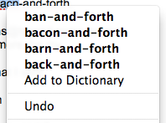
appearance
DO proofread
(and have someone else proofread too)
Source: http://www.flickr.com/photos/b-may/6170176616/
Notes:
Jesse
It’s absolutely essential to proofread. Just one silly error could be the difference between getting your dream job and not. Having someone else proofread your resume is really helpful -- a second set of eyes will often catch what you've become blind to after reworking a resume fifteen hundred times. Spell check is great, but it’s not perfect.

Slide 47
appearance
DON’T assume abbreviations are universal
CLM? ARA? RYSC? ROM? RA? LA? ALA? APRC? RASC? CDS? CRC? ILS? SAM? AIRC? BRC? FOL? CHIPS? AVMS? CBE? NIC? SIR? NFMS? EXCOM? DSR? SMS? AUP? MMT? ADCON?
Notes:
Nicole
INTERACTIVE
Okay… show of hands… how many of you can identify what all of these stand for?
Right, me either, so don’t put them in your resume or application without defining them first.

Slide 48
Presented storytimes Holding storytime
Led team Team leader
Designed web page In charge of web design
Implemented guidelines Worked on guidelines
Provided customer service Customer service
These are consistent & parallel These aren’t
Notes:
Jesse
You need to be consistent on your resume. Here are two sets of phrases that you might find on a person’s resume. The phrases on the left all begin with action verbs and they’re all in the same verb tense. The phrases on the right mean exactly the same thing, but some start with verbs and others nouns. The verbs are in different tenses. Even though it means the same thing, it doesn’t read as well. One of my favorite career guides Can I Wear My Nose Ring to the Interview? Compares resumes to sonnets or haiku. Each word should be carefully chosen for maximum effect.
Nicole: By the way, the phrases on the left are good because they are all consistent with each other, but what would make them even more effective would be to add quantities. Anything that you can quantify in your resume, do it. So, in the example above it would be more effective to say “Presented storytimes to 75 children weekly,” “led team of 20,” “designed web page viewed 10,000 times,” “implemented guidelines that increased circulation by 20%”, or “provided customer service in a library with 250,000 annual visits.” Again, it’s good to pull in key words from the job announcement as applicable.

Slide 49
grammar & punctuation
DON’T worry about using complete sentences
Notes:
Jesse: Resumes are typically made up of phrases. It's not necessary to use complete sentences. It's also usual to leave out articles "a," "an," and "the."

Slide 50
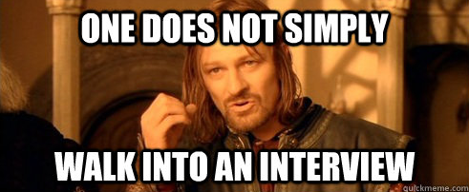
source: http://www.quickmeme.com/meme/3pmgye/
Notes:
Nicole: Now let’s talk about the interview, which can sometimes feel pretty intimidating, almost like a trip to Mordor.

Slide 51
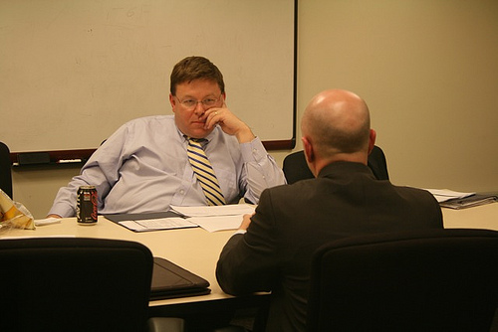
the interview
Source: http://www.flickr.com/photos/usfbps/4597078894/
Notes:
Jess: Because we’re back to these guys! Assuming that you’ve done your homework, spruced up (or totally revamped) your resume, hopefully you’ll end up with an interview. Nervous? Well, that’s perfectly normal. You’ve got a lot riding on this after all– including your dream job– so we’ve got a few tips to help you out.

Slide 52
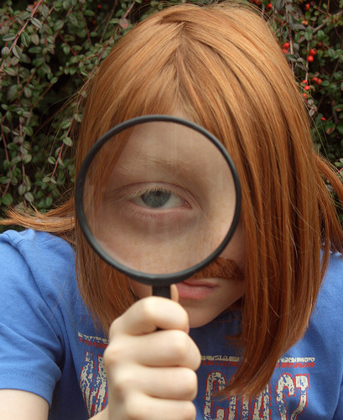
review!
Source: http://www.flickr.com/photos/quack-quack/2157564985/
Notes:
Nicole; So now you really need to put all the homework you’ve done on your dream library to work. Just a few minutes ago we saw how important the hiring managers we surveyed felt it was to demonstrate that you’ve adequately researched the job and the library. Your interviewers will certainly notice that you’ve taken the time to do your homework. Make sure you review your research.

Slide 53
practice, practice, practice
Formulate questions you think you may be asked
Notes:
Jesse:
While you'll never know for certain what questions you'll be asked in an interview, you can probably make an educated guess about the things you'll be asked, based on the job announcement. If the job announcement lists a lot of customer service duties, be prepared to discuss your customer service experieince. Being confident that you have answers in mind for these questions will give you a huge head start in terms of preparing for the interview.

Slide 54
practice, practice, practice
What questions have you been asked at interviews?
Notes:
Nicole:
INTERACTIVE
So, I’d like everyone to think about the interviews they’ve been on. What kids of questions have you been asked? Answer in the chat…

Slide 55
practice, practice, practice
Here are some topics that the experts we surveyed frequently ask about:
Great customer service experiences
Differences in philosophy/values with management/administration
Electronic resources and their challenges to customers
Change
Notes:
Jesse: Those are some really good questions. We asked the same question to our experts, and we found that there were some definite similarities in the questions that they tend to ask on interviews. Customer service was a popular question topic, and our experts often asked interviewees to describe good customer service experiences they had, even outside of the library setting. Our experts also asked job candidates how they might handle a disagreement or difference in philosophy with their supervisor or administrator. They asked questions about the place of technology in the library, and especially about the customer service issues that arise when customers have difficulty with newer technologies. And finally, they asked a variety of questions that all tried to get candidates to talk about how they handle or approach change.

Slide 56
practice, practice, practice
Prepare for the dreaded questions…
Notes:
Nicole: There are some intimidating questions you just know you’re going to get at some point, so be prepared for them.

Slide 57
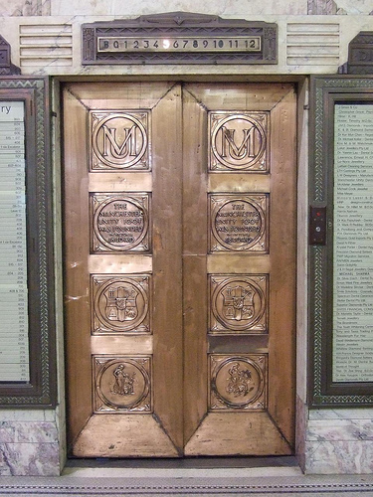
practice, practice, practice
1. Tell us something about yourself.
Source: http://www.flickr.com/photos/timriley/2630062931/
Notes:
Jesse:
The first question will often be some combination of the vague and gigantic: "Tell us about yourself" or "Describe how your education and experience have prepared you for this position".... You want to respond with, "Um, can I get a prompt here? Do you people want to narrow it down?" However, you should be expecting this question because almost every interview opens with a "warm up" question like this. You should have a little elevator speech prepared for yourself -- draft and practice a 1-3 minute overview of what makes you a great candidate for the job. In a way, it's a freebie and a chance to summarize your many sparkling accomplishments and fabulous qualities.

Slide 58
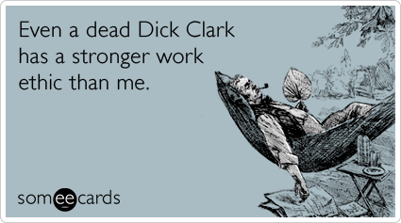
practice, practice, practice
2. What are your weaknesses?
Source:http://www.someecards.com/workplace-cards/dick-clark-die-workplace-work-funny-ecard
Notes:
NIcole: Why is this question so hard? Well, first of all, it’s hard because you’re in the interview for your dream job, and you only want to talk about your strengths! It’s also really tempting to blurt out something trite or disingenuous… like “I work too hard,” “I’m a perfectionist,” or, heaven forbid, “I don’t have any weaknesses.” The best bet here is to be honest… but use an example of a weakness that you are already working on overcoming. For example, for me, I’m not a naturally organized person. It’s definitely a weakness, and when I was younger it was a significant problem for me. But it’s a weakness I’m aware of, and so I have been working on it for quite some time, and I have a lot of systems in place to keep myself organized. It doesn’t come naturally and it’s a bit of a slog for me, but I’m always working on it.
Jesse: By the way, the ecard above was intentionally chosen to illustrate another point… if you use humor in an interview, use extreme caution. While your great sense of humor might be well-received, you might also come across as unprofessional, or even worse offend someone. The only truly safe topic for humor in an interview is to make fun of yourself.

Slide 59
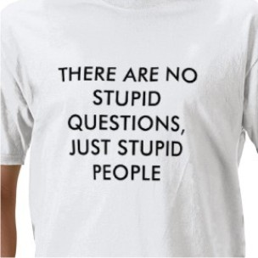
practice, practice, practice
3. So, what questions do you have for us?
Source: http://www.flickr.com/photos/busyprinting/4228084870/
Notes:
Nicole: We’re librarians and we are used to answering questions, and while this t-shirt may be a little harsh, I think we’re all aware that some questions are better than others. Often the very last question you’re asked in an interview is if you have any questions for the interviewer. It’s possible that in a civil service exam-type interview, you *won’t get this opportunity, or what you say at this point may not even be scored, but nevertheless your response is going to be the last thing you say before the interview concludes, so you want it to be memorable. In a second interview, smart, probing questions will show your interest in the position, demonstrate you’ve spent some time thinking about the position and the organization, and that you’ve got some professional knowledge.
Jesse: So, what are good questions to ask? A good question will demonstrate that you’ve done your homework. It will show that you’re curious to learn more about the position and the organization. A not-so-good question will show that you’ve not taken the time to do your homework. It’s okay to ask questions about the interviewers experiences at the library or ask them questions about their thoughts on the organization. (Interviewers, like just about everyone else, like to talk about themselves!) You should also not ask a question that is very, very specific, or something that your interviewer could have no way of knowing. Stumping your interviewer with a really tough question might prove that you’re smart, but it could also make the interviewer feel icky or resentful. This is probably not how you want them to feel while they’re considering hiring you!
Nicole: If you’re worried about this part of the interview, think of a few good questions you’d like to ask in advance and jot them down. Referring to your notes before asking a question will only show that you’ve thought ahead and prepared.

Slide 60
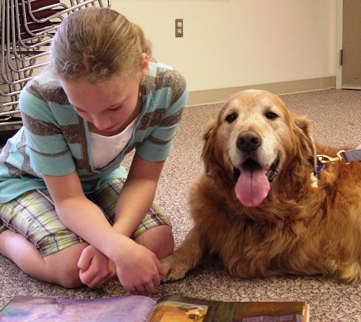
practice, practice, practice
Get comfortable telling stories about yourself
Source: http://www.flickr.com/photos/fcpl/3498006166/
Notes:
Jesse: For some of us, talking about ourselves isn’t easy, but this is something you’ll have to get over if you want to get your dream job! It’s a good idea to think about 4 to 5 stories you can tell about yourself that demonstrate the qualities that your future employer is likely to want. Practice these stories. Tell them to yourself in the mirror, or to your dog if you need to. Just get used to telling them!

Slide 61
practice, practice, practice
How does this story present me as a candidate for this position?
Notes:
Nicole: If the answer to this isn’t clear, or if it isn’t favorable, rethink and tweak your stories until you’ve got stories that do demonstrate that you are the right candidate for the job.

Slide 62
practice, practice, practice
Have a friend quiz you…
and/or…
videorecord yourself
Notes:
Jesse: Now that you’ve thought about all of the questions you may be asked, as well as some that you’d like to ask yourself, have a friend ask you these questions. A good friend will give you some honest feedback about your answers! If you want to be really sure how you’re coming across, video yourself answering the questions. Now, this is not for the faint-of-heart. You may be surprised at how often you say “um”, that you raise your voice at the end of every phrase so your answers sound more like questions, or even notice that you have some sort of distracting habit like touching your face or playing with your earrings while you talk -- Umm, Nicole.
Nicole: Yes, its true I do that -- as I was informed by my wife while she was quizzing me on interview questions! But knowing is half the battle! But once you have this information, you can work to be more self-aware about how you’re coming across during the interview, and make sure that your communication style isn’t getting in the way of the substance of your answers.

Slide 63
in the interview…
Take your time
(but if there’s a time limit be aware of it!)
Source: http://www.flickr.com/photos/tonivc/2283676770/
Notes:
Jesse: Now it’s the day of your interview. Here’s a few tips to help you through the main event. First of all, it’s normal to want to jump into every question the moment you are asked it, but there’s nothing wrong with taking a moment to pause and reflect before you start responding.

Slide 64
in the interview…
Source: http://www.flickr.com/photos/ittybittiesforyou/3539781784/in/photostream
Notes:
Nicole: As you answer each question, you want to make sure you answer fully. On the other hand, interviews will quickly become bored or impatient if you’re rambling. Since you’ve done your research and practiced, you’ll be able to clearly and concisely answer each question. (And telling great and to-the-point stories about yourself while you do!) Remember, you don’t need to give every single detail of your experience, but you want to leave your interviewers with an accurate picture of your merits. Again, Goldilocks!
Jesse: A good framework for getting your stories concise is STAR -- situation or task, action, result -- pull a specific situation and describe it in 2-3 sentences; describe the action you took, keeping the action on what you actually did; describe the result, i.e., how successful your actions were, what you learned, etc., again, keeping it brief.

Slide 65
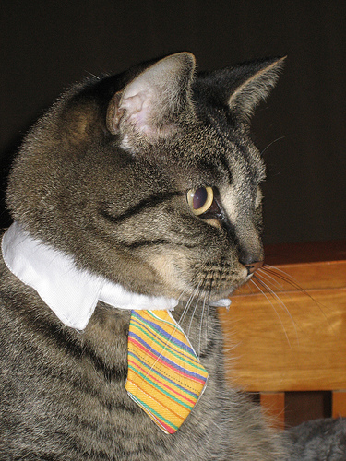
in the interview…
Dress for success
Source: http://www.flickr.com/photos/jgd3/2155660009/
Notes:
Jesse: You wouldn’t think we would have to remind professional librarians of this, but several of the hiring managers we surveyed noted that it’s very important for job candidates to look the part.

Slide 66
in the interview…
Shake each panel member’s hand at the beginning and end of the interview
Source: http://www.flickr.com/photos/mytudut/5188623575/
Notes:
Nicole: This also might seem like an obvious tip, but if you’ve never taken part in a civil service panel interview before you might get thrown off. Remember, shake hands with each member of the panel at the beginning of the interview as you introduce yourself, and then again at the end. As you’re leaving, make sure that you thank the panel for their time. It never, ever hurts to say “thank you”!

Slide 67
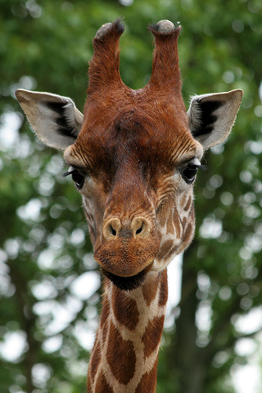
in the interview…
Make eye contact (but remember it’s not a staring contest)
Source: http://www.flickr.com/photos/hawksanddoves/496757353/
Notes:
Jesse: Throughout the course of the interview, you’ll want to be sure that you make eye contact with each of the members of the interview panel. If the panel members are taking turns asking the questions, it’s okay to direct your answer more to the person that asked the question. You want to avoid only making eye contact with one of your interviewers. When you’re shaking hands, make sure that you make eye contact then, too.
Nicole: Please note: You also don’t want to confuse eye contact with staring. It’s okay to look away occasionally! Also, keep in mind that your interviewers are going to want to look at you. You want to give them an opportunity to observe you without making them feel awkward by staring back.

Slide 68
nervous?
Of course you are!
Notes:
Jesse: It’s perfectly normal to be nervous for interviews! We aren’t going to tell you that you shouldn’t be. In fact, being nervous is just a sign that you want to do well. Take a few deep breaths… this really helps!

Slide 69
still nervous?
These guys probably are too!
Source: http://www.flickr.com/photos/usfbps/4597078894/
Notes:
Nicole: If you’re still nervous, it’s good to keep in mind that the people sitting across the table are also nervous! Hiring and training a new employee represents a huge investment in time and resources. The people interviewing you are making this decision based on a few pieces of paper and a short conversation with you… they should be nervous.

Slide 70
just remember…
Notes:
Jesse: Everyone on the interview panel wants you to make it abundantly clear that you are the best possible candidate for their position! They want you to make their job of hiring a new staff member an easy, clear-cut decision.

Slide 71
source: http://www.flickr.com/photos/hystericalmark/2484549521/sizes/l/in/photostream/
Notes:
Nicole: ...And if you don't get the job, and you're feeling really discouraged, I want you to imagine that this guy got the job. When I don’t get a job I’ve applied for, and was really excited about, I just imagine that the most amazing, awesome, super heroic person possible got the job. Obviously, right?

Slide 72
questions?
Source: http://www.unshelved.com/2007-9-27
Notes:
Jesse: Questions, type in chat.

Slide 73
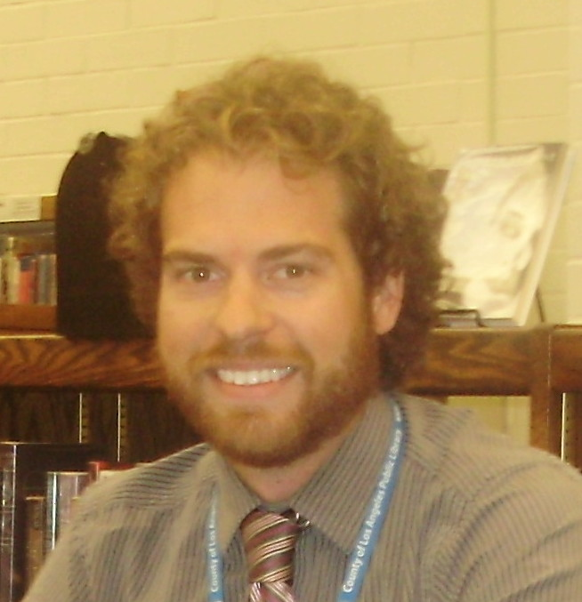
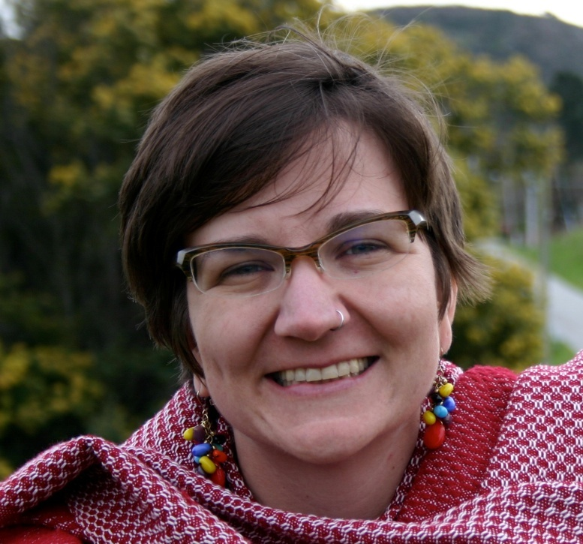
thanks!
Jesse Lanz
Community Library Manager
Diamond Bar Library
County of Los Angeles Public Library
JLanz@library.lacounty.gov
Nicole Pasini
Branch Manager
Woodside and Portola Valley Libraries
San Mateo County Library
pasini@smcl.org
Notes:
Thank YOU!

Slide 74
Infopeople webinars are supported by the U.S. Institute of Museum and Library Services under the provisions of the Library Services and Technology Act, administered in California by the State Librarian. This material is licensed under a Creative Commons 3.0 Share & Share-Alike license. Use of this material should credit the author and funding source.

