Slide 1

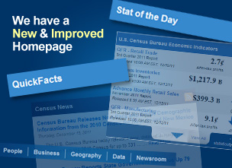

Census Data Immersion
From A Novice to A Skilled Data Miner
U.S. Census Bureau
census.gov
Infopeople Webinar
August 7, 2012
1

Slide 2
Content
Homepage
  Shortcuts to data
American FactFinder: data access tool
  Demographic programs: what you need to know
    2010 Census
    Population Estimates
    American Community Survey (ACS)
Support
  Census website
  External resources

Slide 3
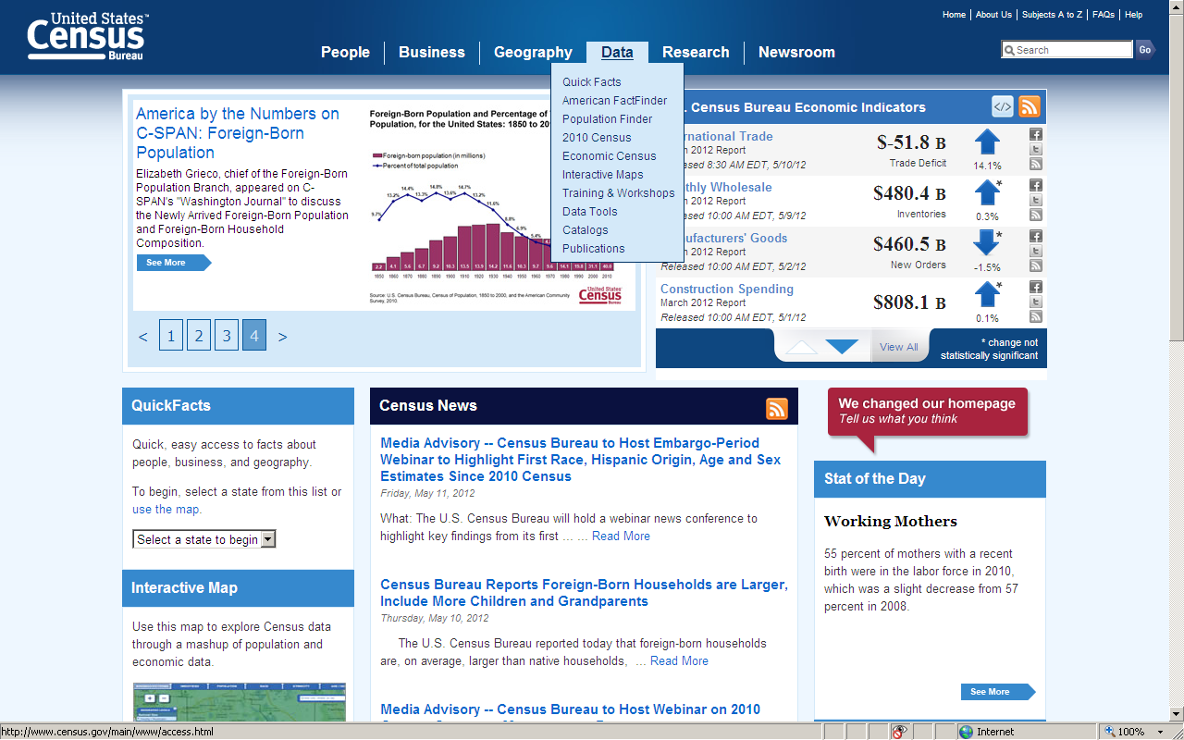
New
Homepage: census.gov
American FactFinder is the entry point for Census Bureau
demographic and economic data

Slide 4
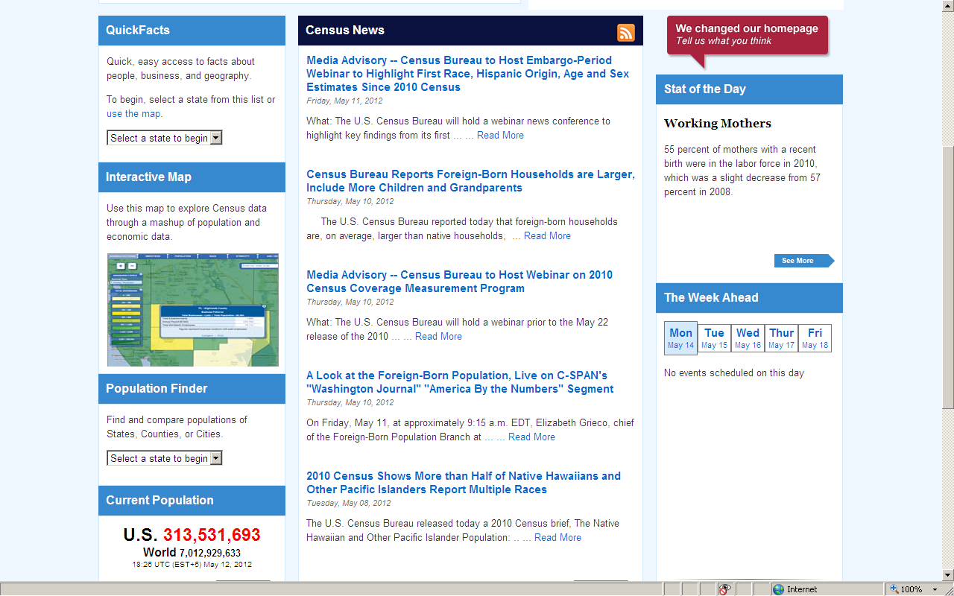
Simple Data Searches
Linked from Homepage
QuickFacts
Interactive Map
Population Finder

Slide 5
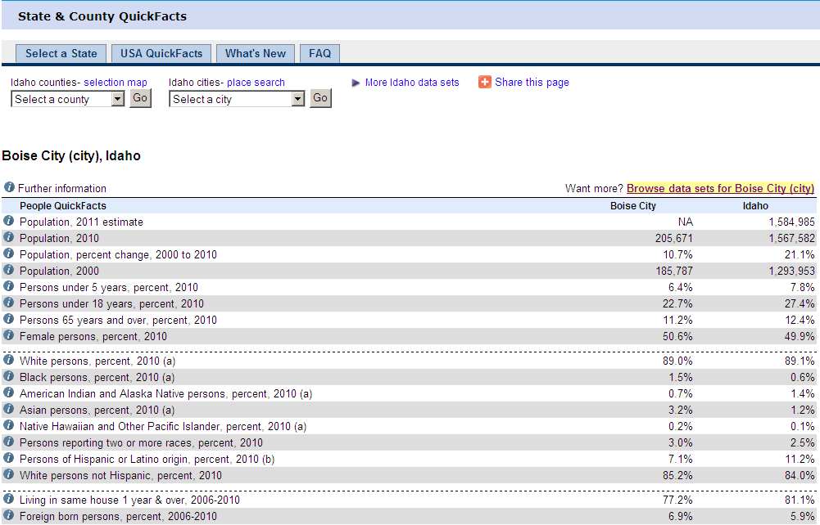
1. Quick Facts
Easy access to the
2010 Census
Demographic Profile
and to the four
ACS Data Profiles
Must meet population threshold of 5,000 residents for inclusion in QuickFacts

Slide 6
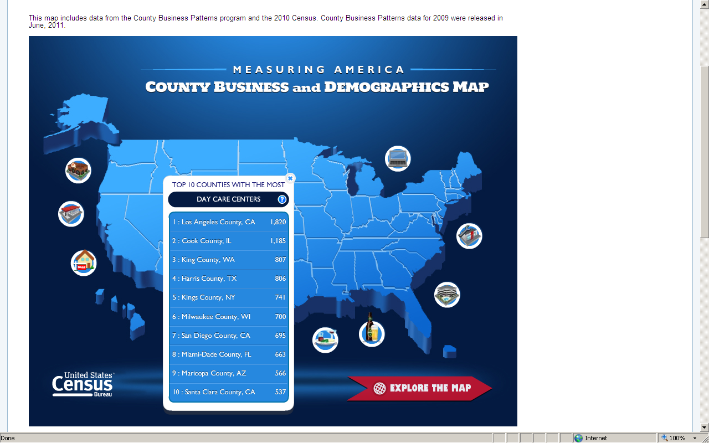
New
2. Interactive Map
Explore Census data through a mashup of population and economic data
Icons display 10 top-ranked U.S. counties or states in various types of business
Click arrow

Slide 7
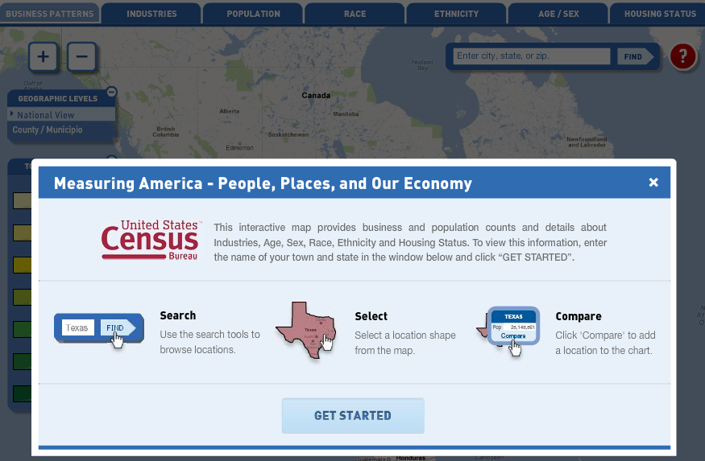
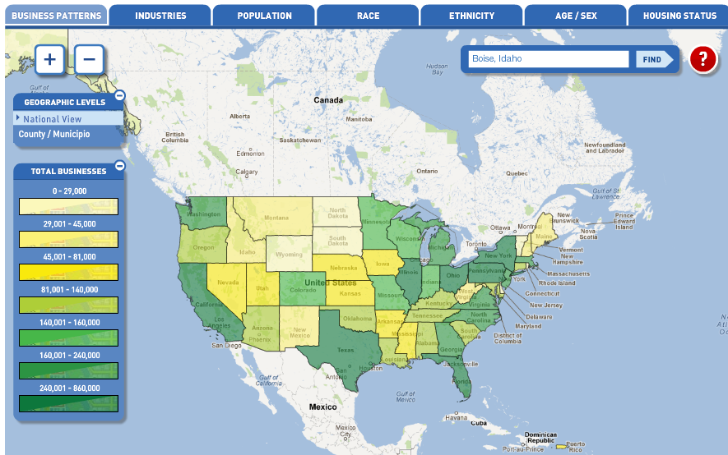

Slide 8
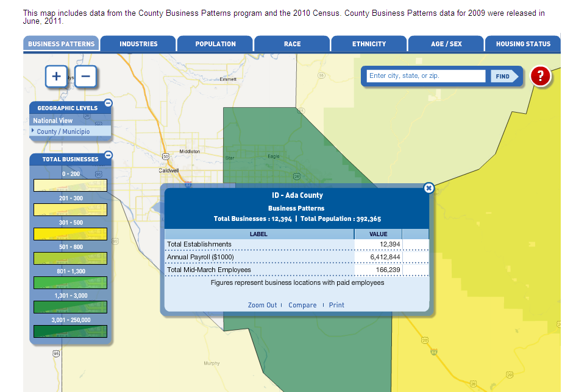

Slide 9
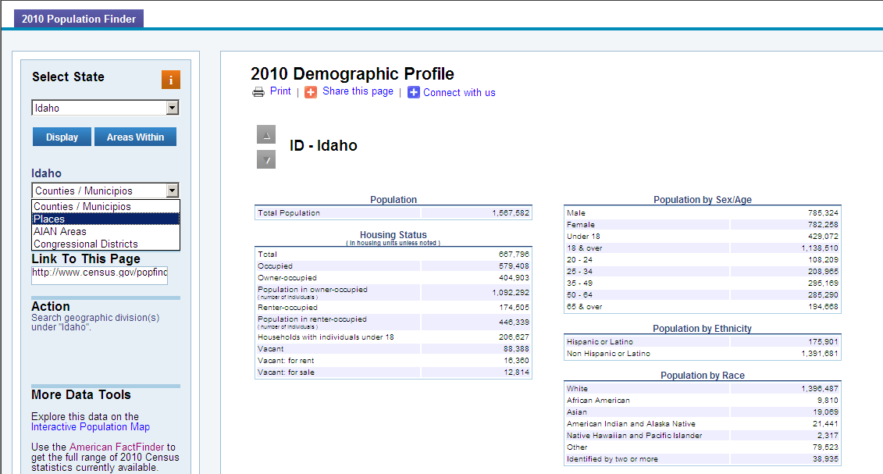
Displays information from the
2010 Census Demographic Profile (100% count)
3. Population Finder
(Select state on homepage)
Re-select state here
Click on Areas Within to see the four geographic types available
Select Places (cities)
Select Search (hidden) . . .

Slide 10
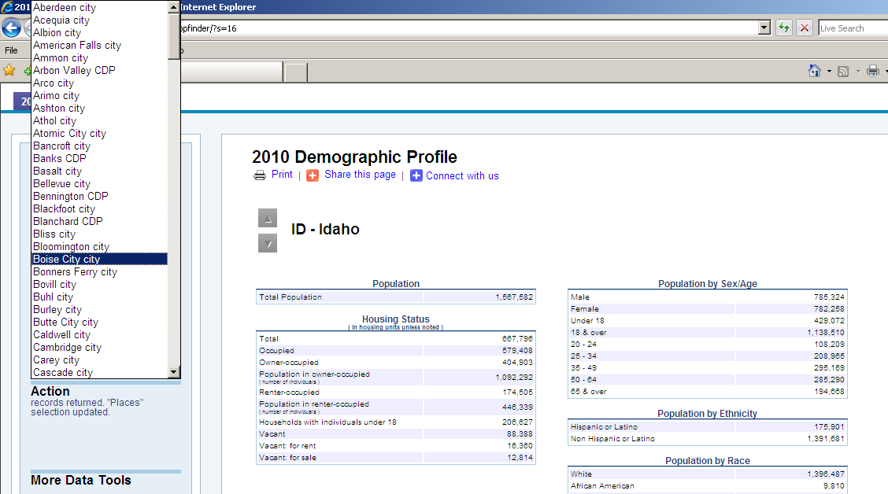
Refining Your Search
Make selection from
alphabetical listing of
geographies for the state

Slide 11
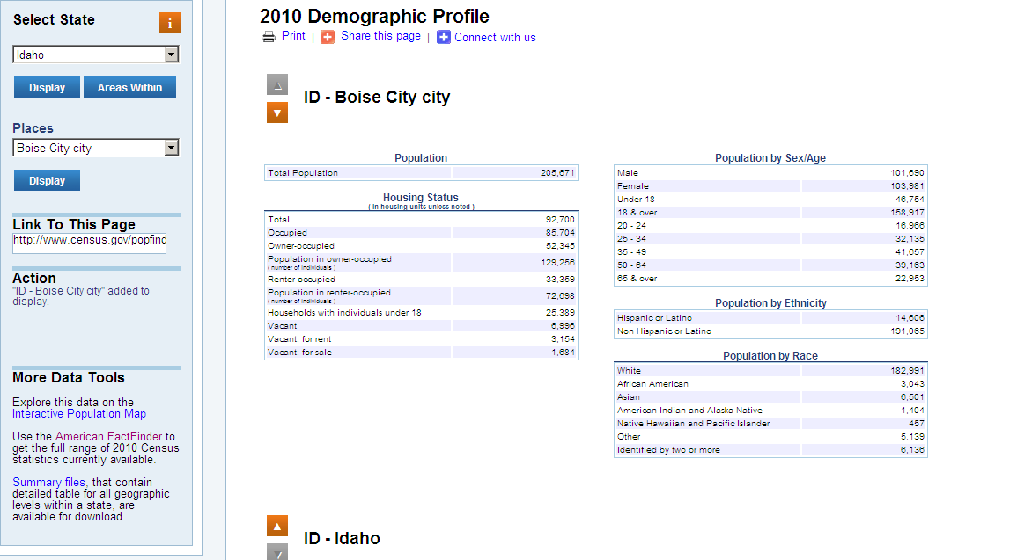
Displays selected city (or other selected geography) on top of page and retains the selected state at the bottom

Slide 12
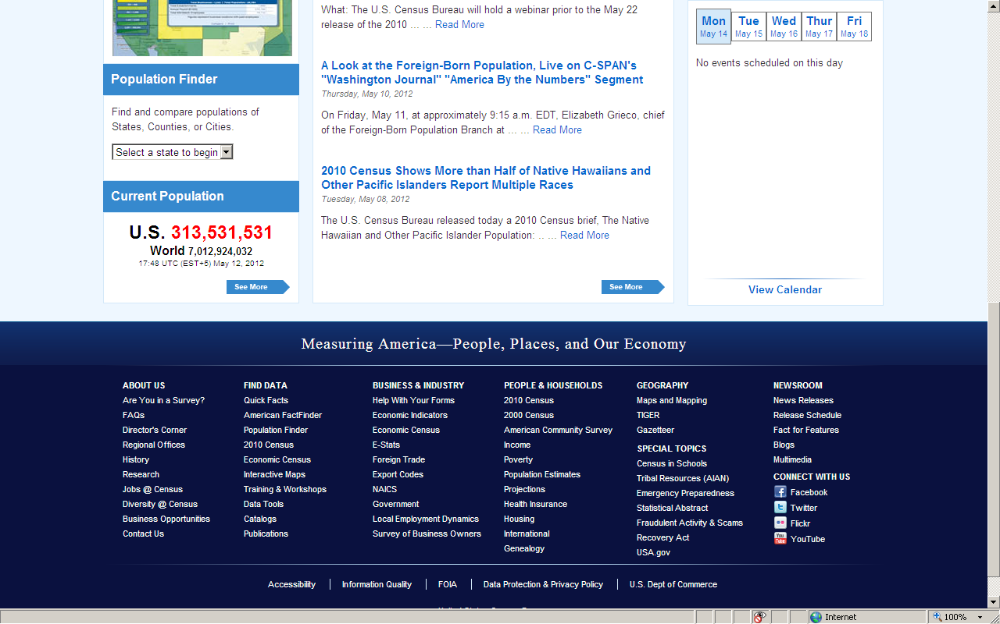
“Megafooter”
Links to program pages and special interest pages

Slide 13
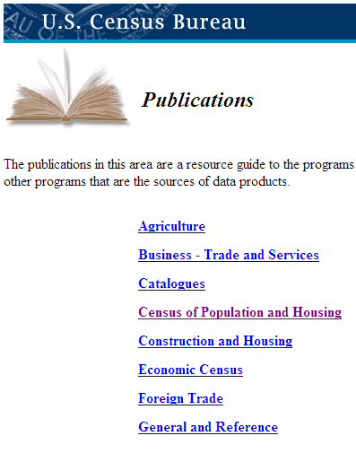
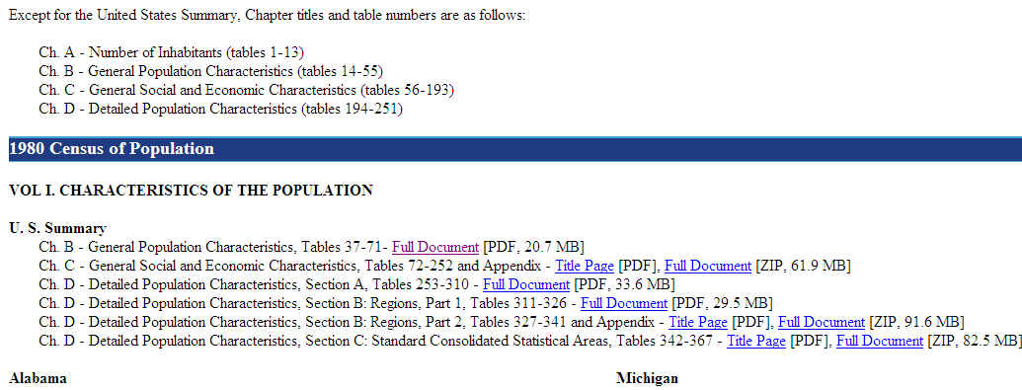

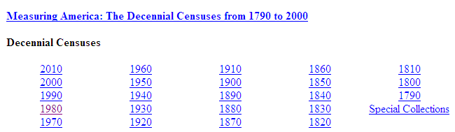
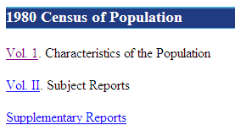
Publications:
Drill down to access census tables back to 1790

Slide 14
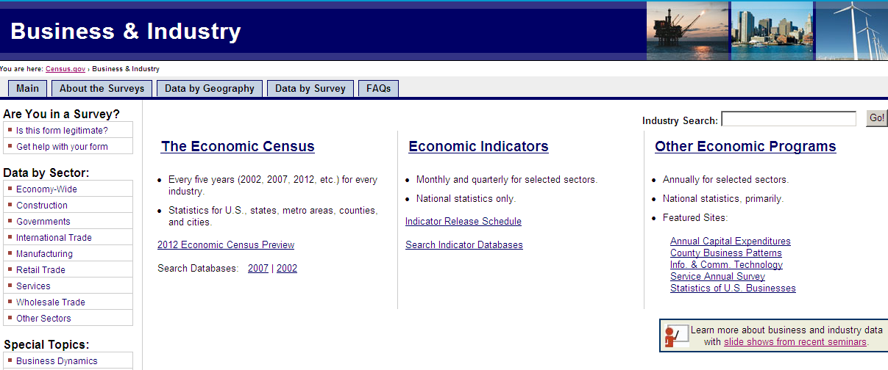
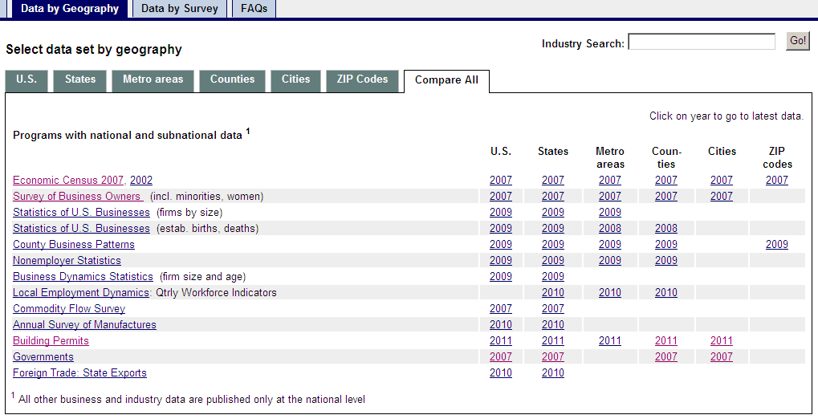

Slide 15
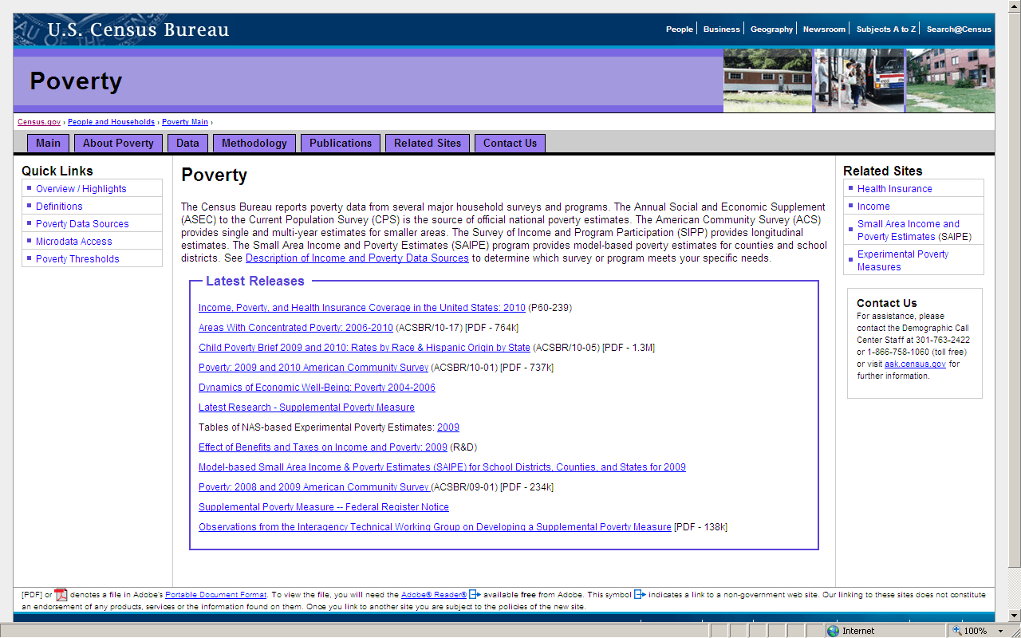
Poverty
What is “poverty?”
How is it measured?
Which survey should I use?
SAIPE provides poverty
estimates of children by
school district

Slide 16
American FactFinder
Three Simple Things You Need to Know
Before Embarking on Your Search
What is Census geography?
What’s the difference between race and ethnicity?
Which demographic program should I use?

Slide 17
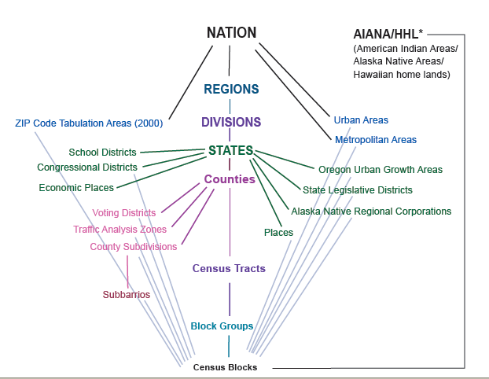
Census Geography Hierarchy
(with 2010 Statistical Area Criteria)
Revised 05-13-12
Central axis describes a nesting relationship
Cities and towns -- incorporated
Census Designated Places (CDPs):
- - Unincorporated; no size threshold
- - Separate and distinct from city/town
- - Redefined each census
600 to 3,000 population
240 to 1,200 housing units
Blocks are not defined by population
and are the smallest geographic level at which data are ever released (Decennial Census, not the ACS)
1,200 to 8,000 population (optimum 4,000)
480 to 3,200 housing units

Slide 18
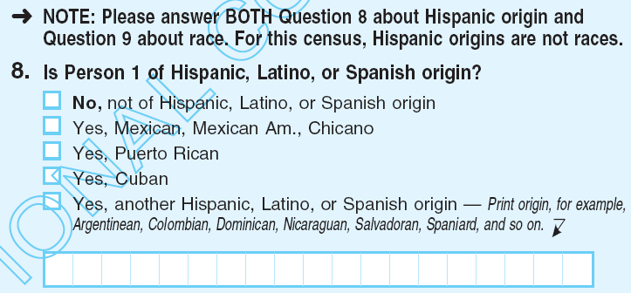
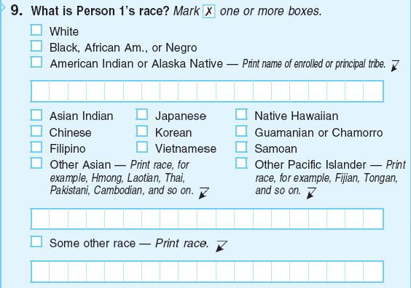
2010 Census Ethnicity Question
2010 Census Race
Question

Slide 19
2010 Census
Questionnaire Topics
(Name)
Sex
Age
Date of birth
Ethnicity
Race
Relationship of people within household
Rent / own house (tenure)
(Coverage questions)

Slide 20
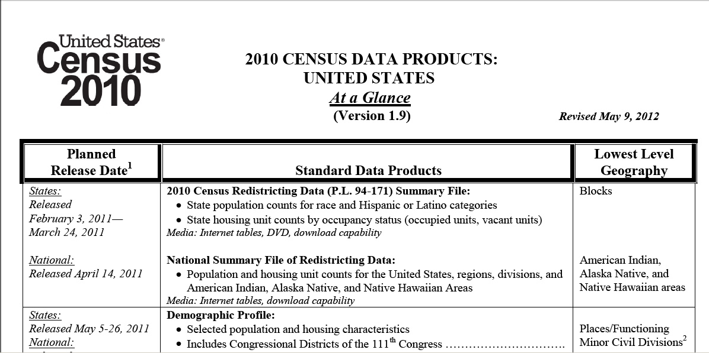
2010 Census
Data Release Schedule

Slide 21
Population Estimates
Intercensal Year Releases
Population counts
  Nation - - age, sex, race, and Hispanic origin
  States - - age, sex, race, and Hispanic origin
  Counties - - age, sex, race, and Hispanic origin
  Incorporated places - - total population only
Housing unit counts
  States
  Counties

Slide 22
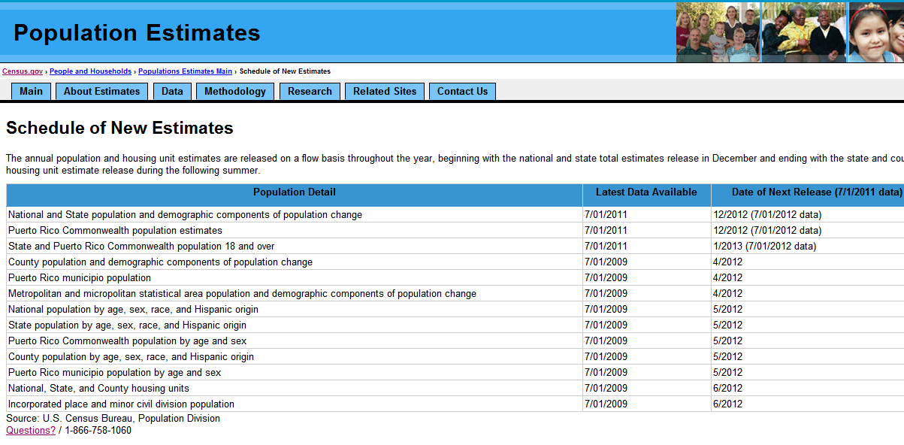
Population Estimates
Release Schedule

Slide 23
American Community Survey (ACS)
Content
Four types of characteristics
  Social
  Economic
  Housing
  Demographic
Characteristics, not population counts

Slide 24
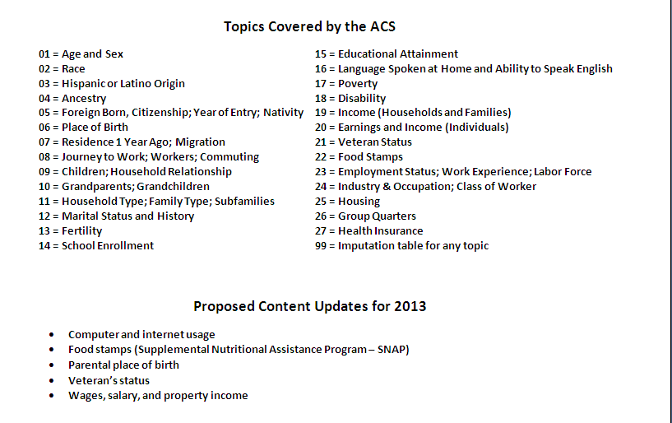

Slide 25
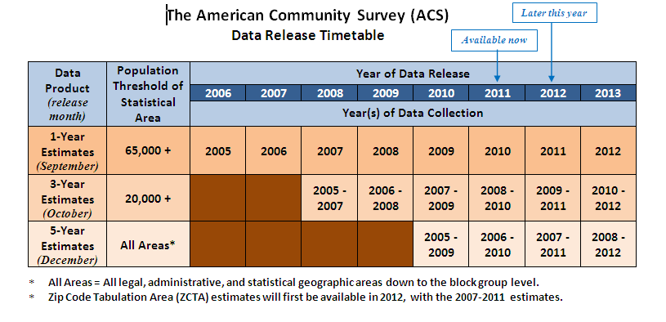

Slide 26
Support

Slide 27
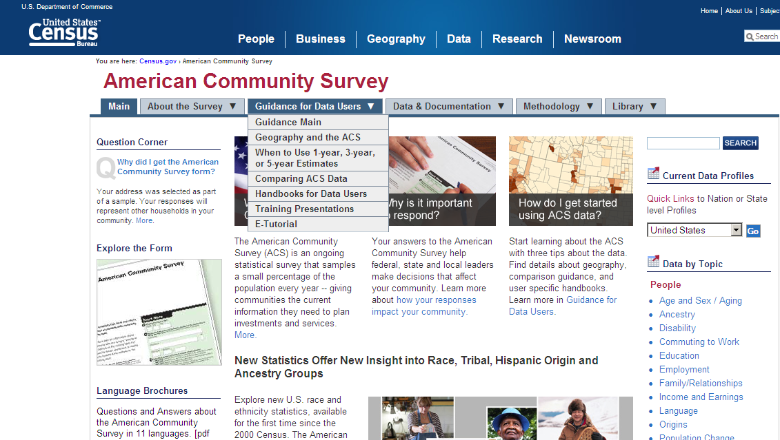
ACS Compass Products
Help for data users on a
variety of subjects

Slide 28
Intended Audiences
ACS Compass Handbooks
  General Data Users
  Businesses
  High School Teachers
  Congress
  Federal Agencies
  Media
  PUMS Users
  Researchers
  Rural Areas
  State and Local Governments
  American Indian and Alaska Native Populations
  Puerto Rico Community Survey

Slide 29
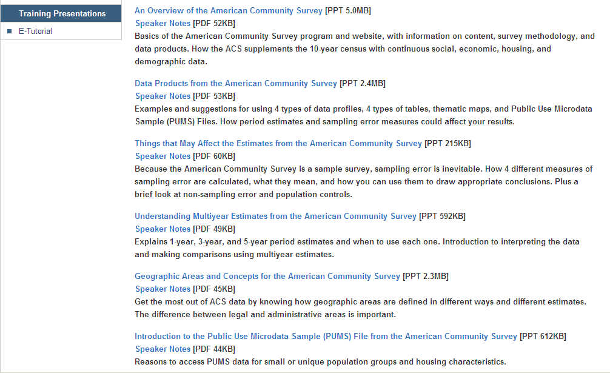
ACS Training Presentations with Speaker Notes

Slide 30
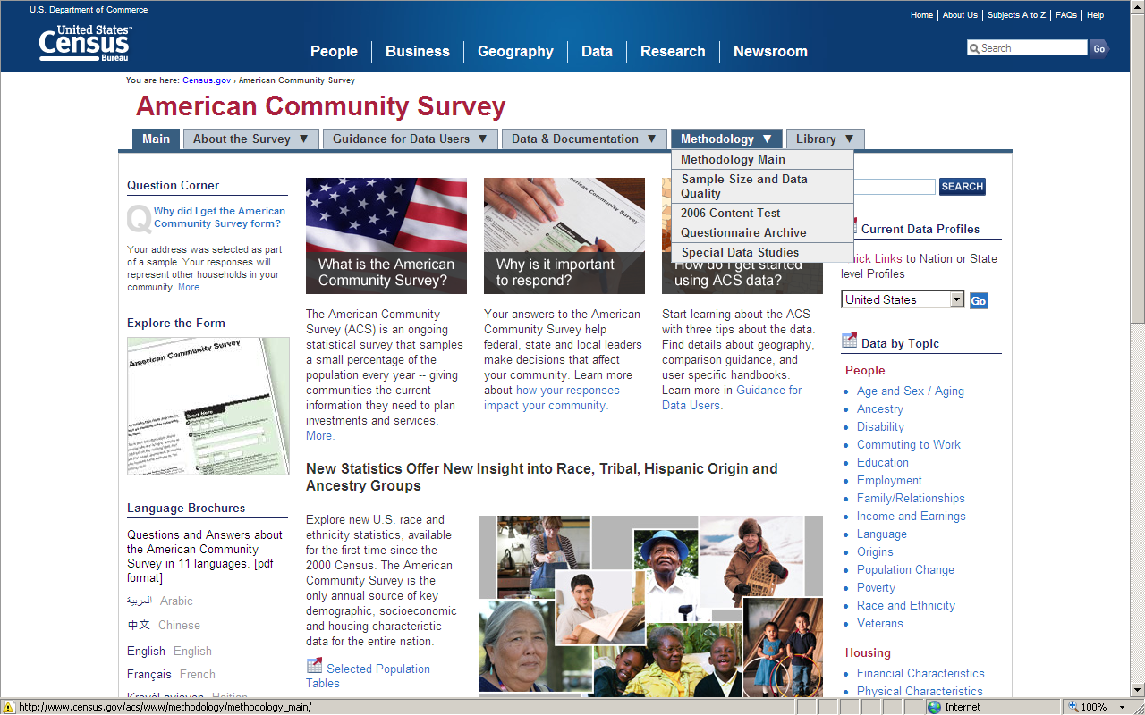
ACS Questionnaires

Slide 31
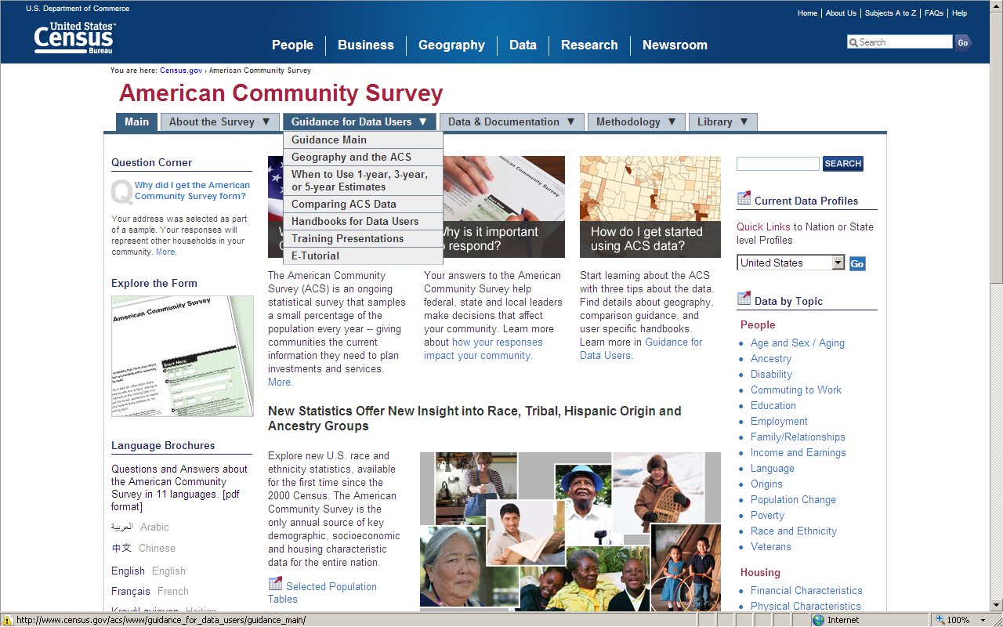
Comparing ACS Estimates

Slide 32
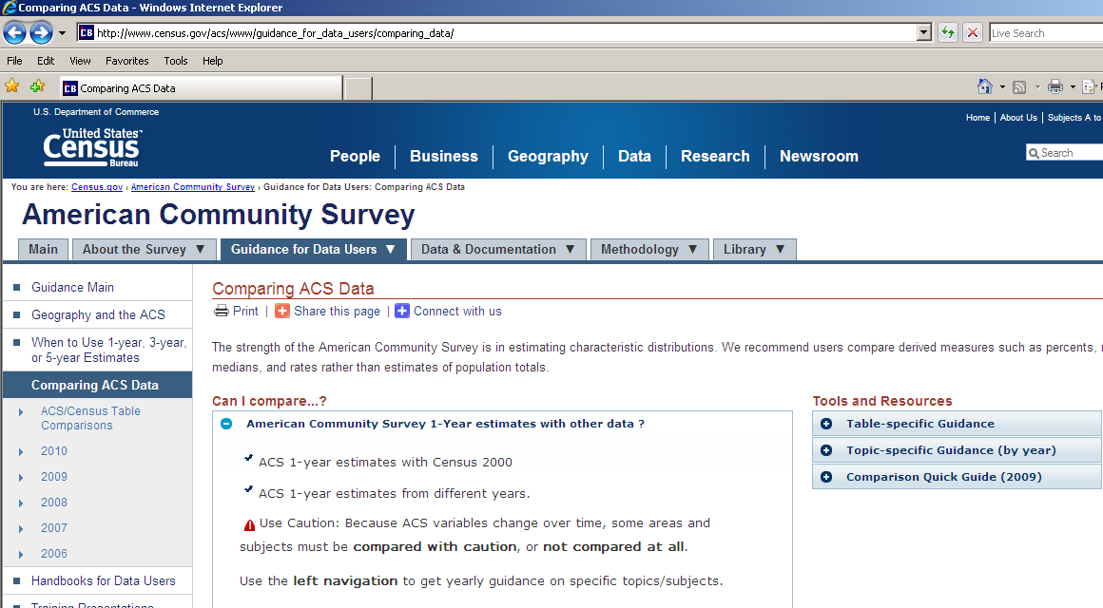
Comparing ACS Estimates

Slide 33
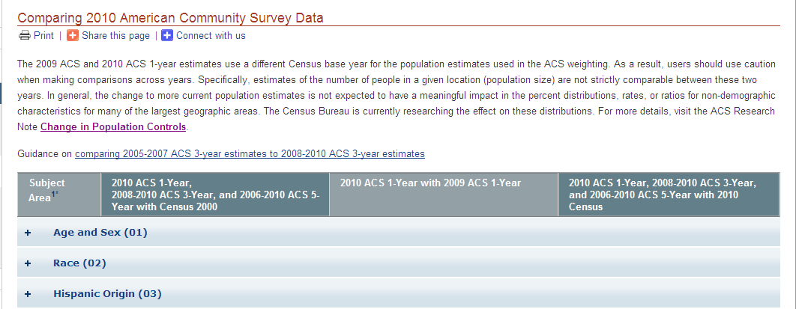
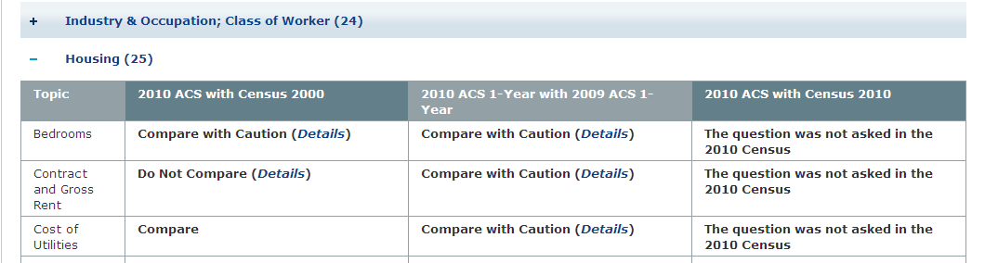
Comparing ACS Estimates:
Three Possible Outcomes
1
2
3

Slide 34
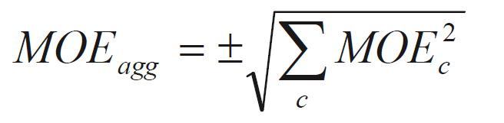
Aggregating ACS Estimates
How to Calculate the New MOE
Geography | Estimate | Margin of Error
Tract 1 | 5,264 | +/- 1,624
Tract 2 | 6,508 | +/- 1,395
Tract 3 | 4,364 | +/- 1,026
Tract 4 | 6,865 | +/- 1,909
TOTAL | 23,001 | +/- 5,954
Apply the formula:
New Estimate = 23,001 Equal to the sum of the estimates
New MOE = +/- 3,046 Less than the sum of the MOEs
The estimates in this example are fictitious.
Note the ACS easy calculator next slide.

Slide 35
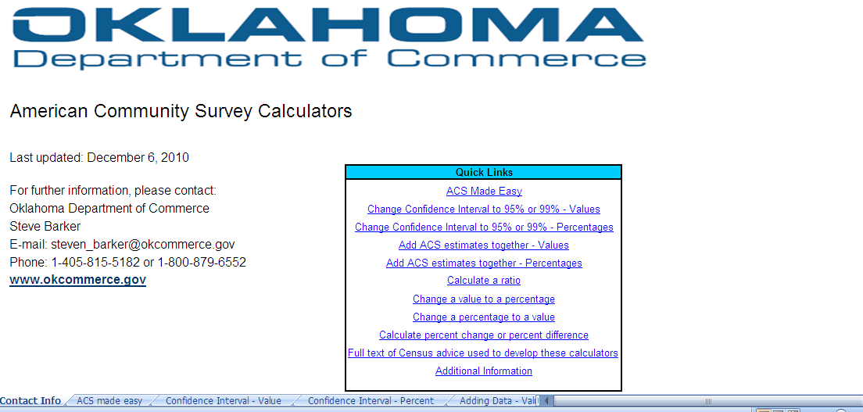
Oklahoma Department of Commerce
ACS Calculator (the easy way!)
www.okcommerce.gov/data-and-research/demographics-and-population-data/

Slide 36
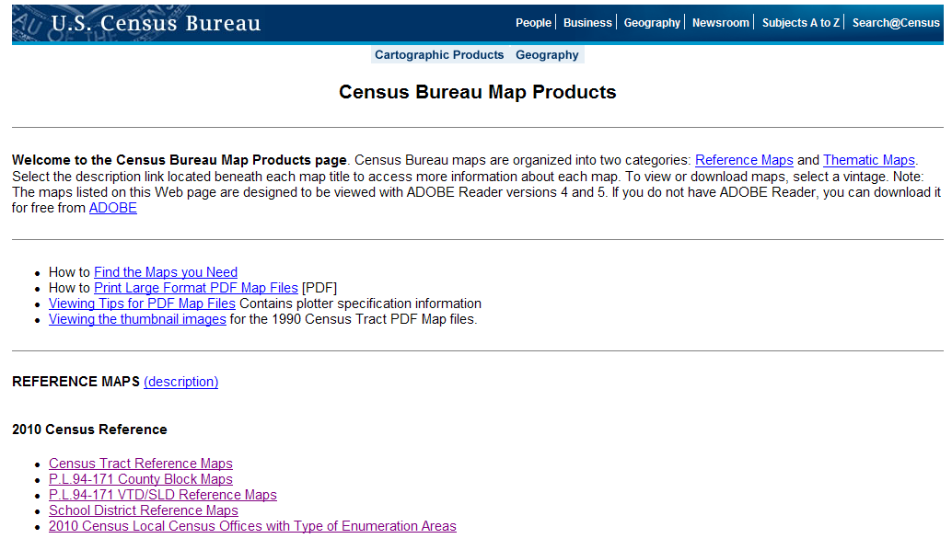
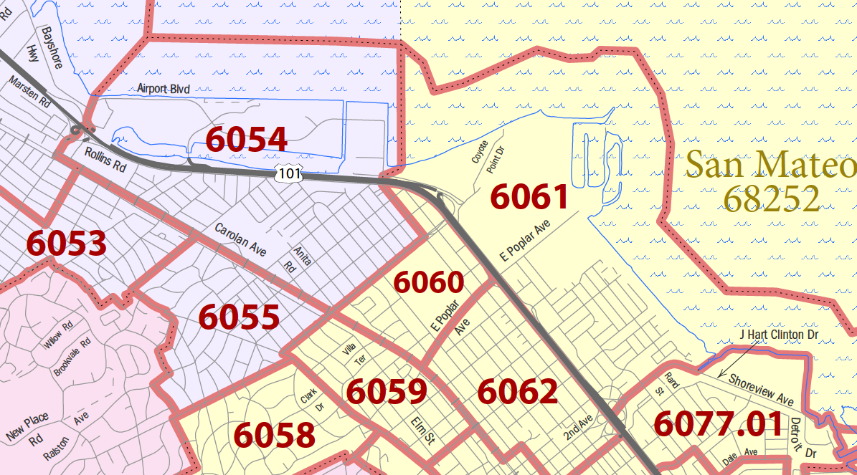
2010 Reference Maps
Census Tracts
County / Blocks
  Home page > Geography > Maps and Mapping Resources > Map Products (this page) > (select type of map) > (select state) > (select county) > open 000.pdf (index map) and zoom in to determine map sheet (or inset) > back out > select map sheet (or inset)

Slide 37
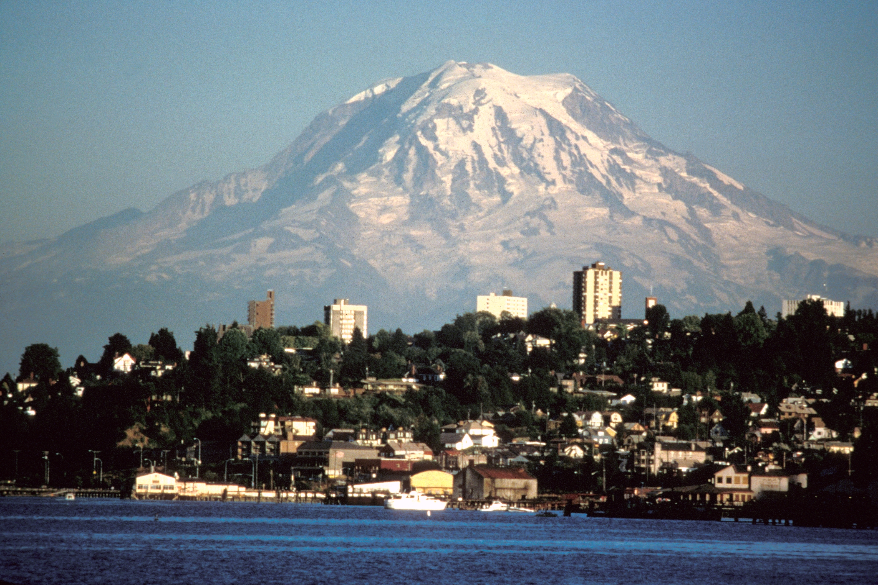
Thank you!
Workshop Information
and
Data Questions
Linda Clark
Data Dissemination Specialist
Pacific Northwest and Alaska
Los Angeles Region
U.S. Census Bureau
Linda Clark
Data Dissemination Specialist
Pacific Northwest & Alaska
U.S. Census Bureau
Los Angeles Region
linda.clark@census.gov
Mobile: 206-446-8794
Los Angeles Regional Office
818-267-1725 or
888-806-6389 (toll-free )

