Slide 1
Organizational Storytelling for Librarians
Infopeople Webinar
August 15, 2012
Kate Marek

Slide 2
Organizational Narrative /Organizational Storytelling
Notes:
Brief introduction to the concept of organizational storytelling and how I got interested in the topic. I have always loved using stories to teach, but I originally thought specifically about using fiction to illustrate key points – such as using the book Fahrenheit 451 to talk about censorship and intellectual freedom. In much of the business and academic literature, this term “narrative” is often used interchangeably with the term “story,” so I had seen various articles about “organizational narrative.” Then I also began to see the term “organizational storytelling.” So my interest in using stories to teach had kind of put these things on my radar.
Let me just say as well that the stereotypical 20th century approach to business, and then the enthusiasm in the late 20th century / early 21st century for technology, focused respectively on mechanization and then the wonders of electronic communication. However, there emerged a counter-narrative, if you will, that focused on the value of building human relationships in the workplace.

Slide 3
Organizational Narrative /Organizational Storytelling
Have you heard of this concept before?
Notes:
Brief introduction to the concept of organizational storytelling and how I got interested in the topic. I have always loved using stories to teach, but I originally thought specifically about using fiction to illustrate key points – such as using the book Fahrenheit 451 to talk about censorship and intellectual freedom. In much of the business and academic literature, this term “narrative” is often used interchangeably with the term “story,” so I had seen various articles about “organizational narrative.” Then I also began to see the term “organizational storytelling.” So my interest in using stories to teach had kind of put these things on my radar.
Let me just say as well that the stereotypical 20th century approach to business, and then the enthusiasm in the late 20th century / early 21st century for technology, focused respectively on mechanization and then the wonders of electronic communication. However, there emerged a counter-narrative, if you will, that focused on the value of building human relationships in the workplace.

Slide 4
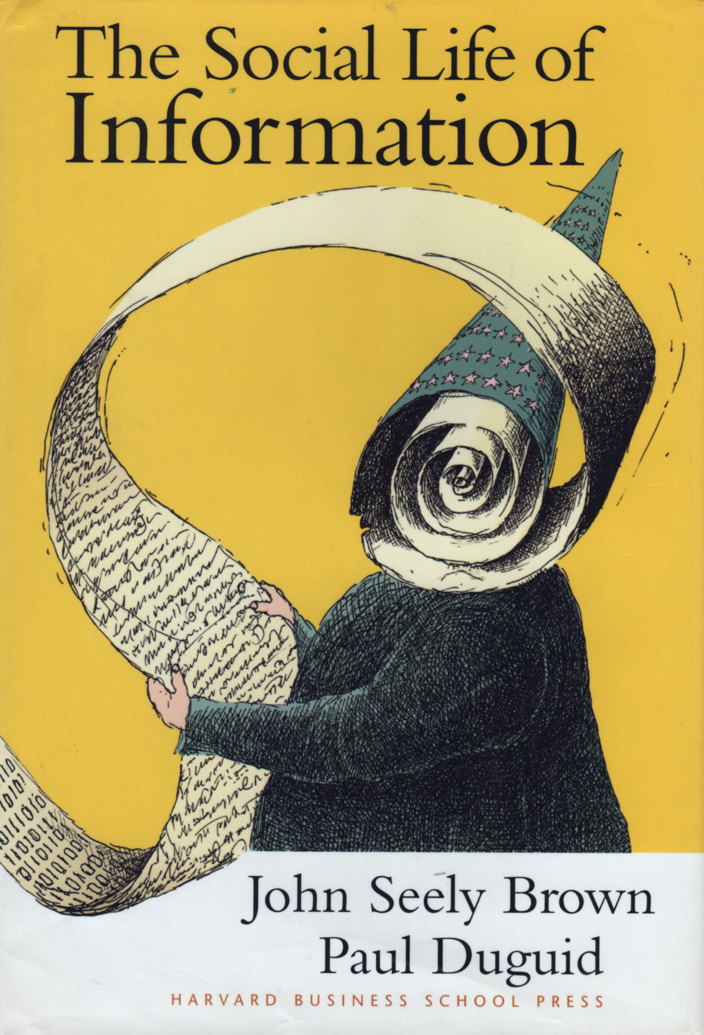
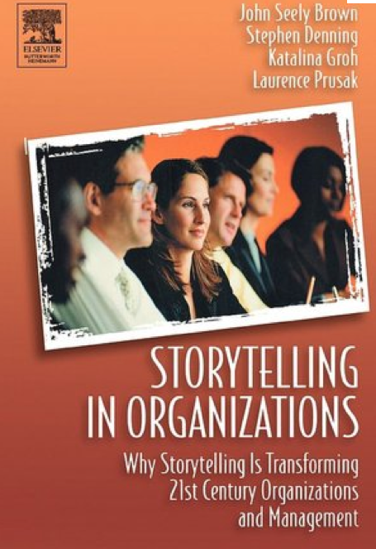
Notes:
With that in mind, I’ll point out a couple of books to you that were published between 1999 and 2004 that solidified my interest in organizational narrative and then organizational storytelling.
-- Social Life: “knowledge management’ - some great examples in the book about capturing knowledge and expertise of an organization’s workers simply by encouraging them to talk to one another.
-- Storytelling in Organizations took that a step further through the authors’ specific essays of their experiences sharing stories and listening to stories within an organization.

Slide 5
Sharing Stories
Knowledge Management
Leadership: Sharing Vision; Advocacy; Making connections with people through sharing ideas and values
Organizational narrative
Building community
Using stories to teach
Notes:
So in that process I began to see some key, exciting areas where the life-stories and work-life stories could be captured in various ways to improve organizations and relationships.
Knowledge management: what are the “knowledge stories,” if you will, of the staff members? How can we encourage them to share their work through conversation and reflection?
Leadership
Organizational narrative: What is the story of the organization?
Building community: Collecting and sharing stories within the organization and among our customers to strengthen community ties.
Using stories to teach: tied to all of the above

Slide 6


Slide 7
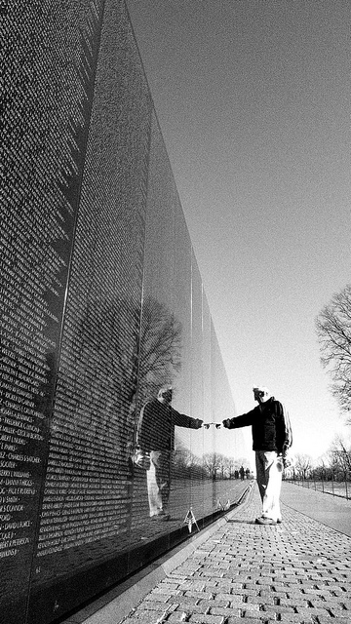
http://www.flickr.com/photos/gregvmusic/4537079902/
Notes:
Another thing we should acknowledge about stories is that they touch people’s hearts. We hear so much today about “confirmation bias” -- that people read things and interpret them in a way that confirms their bias.

Slide 8
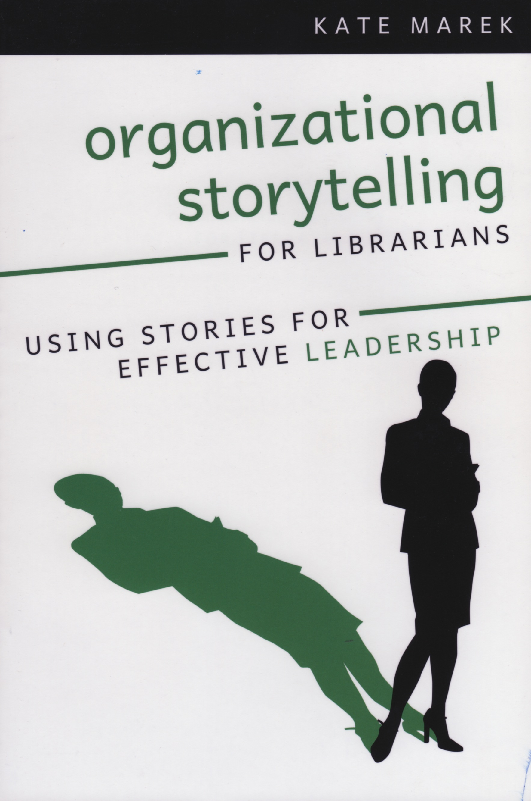
Organizational Storytelling for Librarians
Communicating vision and values
Using stories to navigate change
Using stories to build community
Library Advocacy
Telling stories through buildings
Developing the skill set
Notes:
So in that process I began to see some key, exciting areas where the life-stories and work-life stories could be captured in various ways to improve organizations and relationships.
Knowledge management: what are the “knowledge stories,” if you will, of the staff members? How can we encourage them to share their work through conversation and reflection?
Leadership
Organizational narrative: What is the story of the organization?
Building community: Collecting and sharing stories within the organization and among our customers to strengthen community ties.
Using stories to teach: tied to all of the above

Slide 9
Leadership
Notes:
Let me just briefly talk about using stories in leadership.

Slide 10
Leadership
Communicating
Listening
Sharing

Slide 11
Stories for Leadership
“Who I Am”
“Why I Am Here”
The Vision story

Slide 12
Six Stories You Need to Know How to Tell (Simmons)
“Who I am” stories
“Why I am here” stories
“The Vision”
Teaching stories
Values-in-action stories
“I Know what you are thinking” stories

Slide 13
Facilitating Change

Slide 14
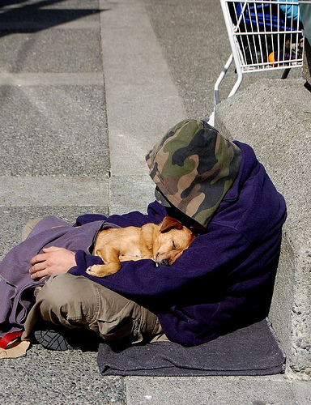
Syowoe Photostream, http://www.flickr.com/photos/mavor/2391657339/ Creative Commons License
Notes:
Touch people’s hearts before their minds - don’t try to convince through logic until you’ve got their minds opened.

Slide 15
Building Community
Notes:
Peter Block: Community: The Structure of Belonging. “What can we create together?”

Slide 16
Building Community
Internal:
  Within the organization
External:
Among the service community
Notes:
Peter Block: Community: The Structure of Belonging. “What can we create together?”

Slide 17
The Organization
Notes:
What about also using the organization’s story to communicate vision and values?

Slide 18
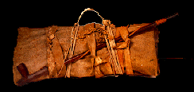
The Sacred Bundle
http://www.kshs.org/p/sacred-pawnee-bundle/10118
Notes:
Peg Neuhauser, in her book Corporate Legends and Lore: The Power of Storytelling as a Management Tool, tells about the Pawnee Indian concept of the sacred bundle; a physical collection of artifacts that represented key moments or events in the life of the tribe. These artifacts served as reminders of both successes and failures – they told the story of the organization.
Sacred bundles were a powerful part of Pawnee ceremonies linked to planting and harvesting. They contained tools necessary to those ceremonies, and the rituals and ceremonies associated with them were passed from generation to generation along with the bundles. Bundles were owned by women and inherited through the female line, but could be used by men only. To open or use a bundle without the proper ritual and ceremony invited disaster.
Bundle contents changed from ritual to ritual. The Society's bundle is a collection of precious objects wrapped in an ocher-stained bison hide. On the outside of the bundle are tied several ceremonial objects: a long pipe, arrow fragments, a meat fork tipped with a raccoon bone, and small American flags. X-ray analysis indicates that inside are stuffed bird bundles, hawk bells, counting sticks, and glass beads sewn on a leather strip.

Slide 19
The Sacred Bundle
What are 4-5 key events in your library’s history?
Who are your library’s heroes?
What key values or characteristics of your library are highlighted in your stories?
What physical artifacts might you include in your sacred bundle?
What crisis events or stories are in your sacred bundle?
Notes:
The artifacts that you choose for your sacred bundle serve to tell the story that you want to tell.

Slide 20
The Service Community
Notes:
What about also using the organization’s story to communicate vision and values?

Slide 21
Building Community
Cultural memory
What can we create together?

Slide 22
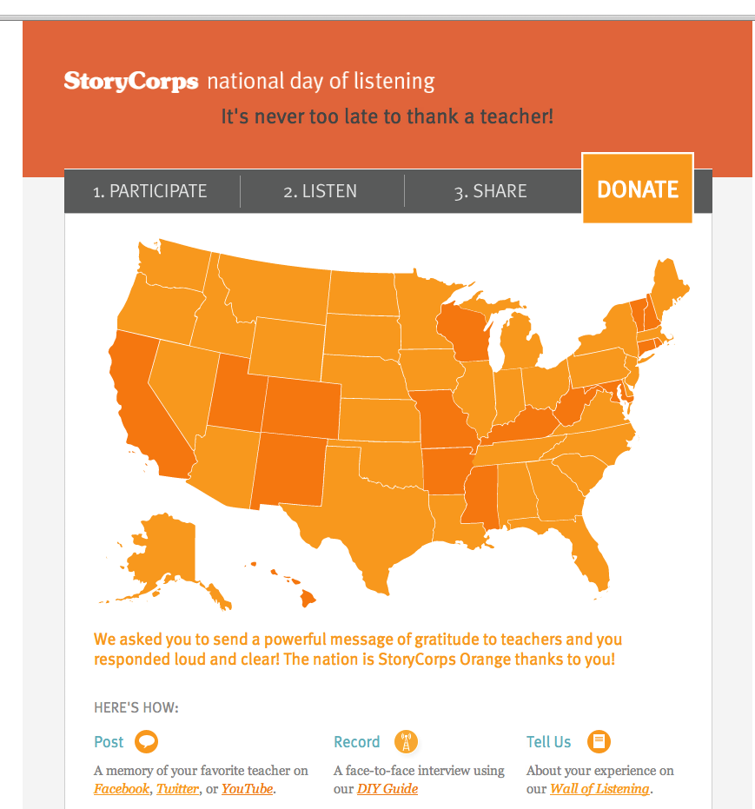
http://nationaldayoflistening.org/

Slide 23
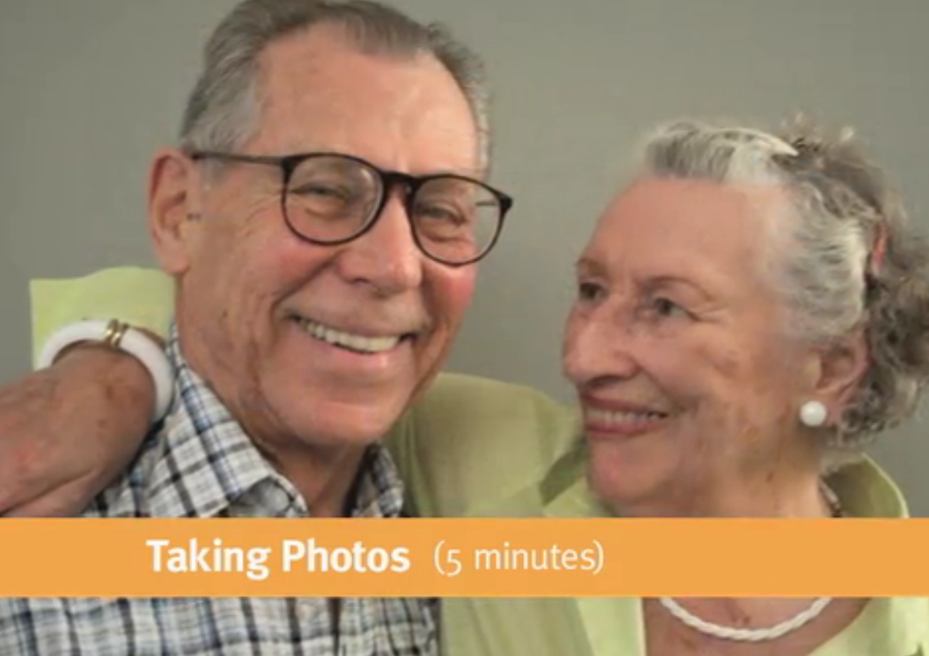
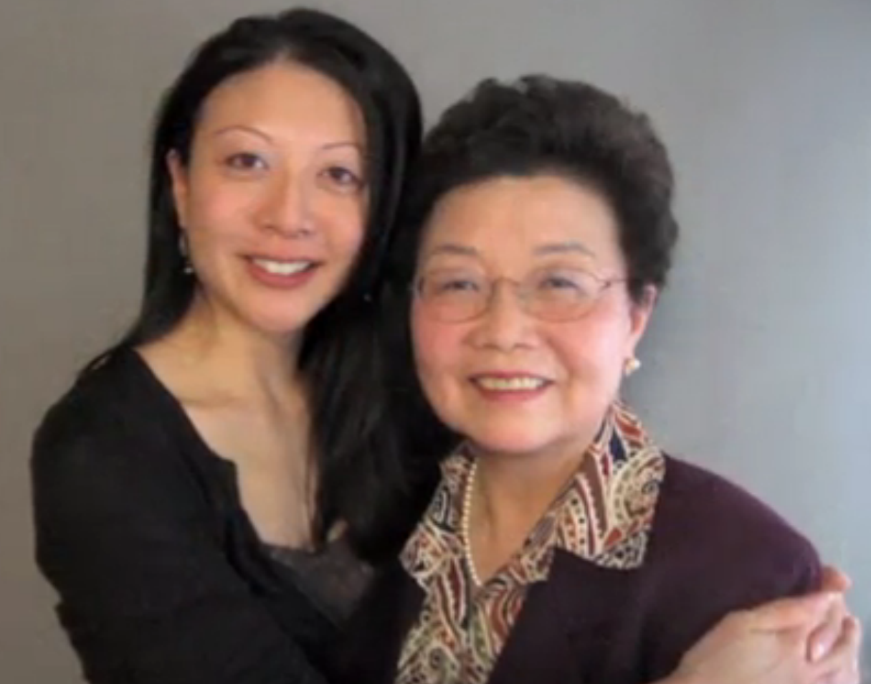
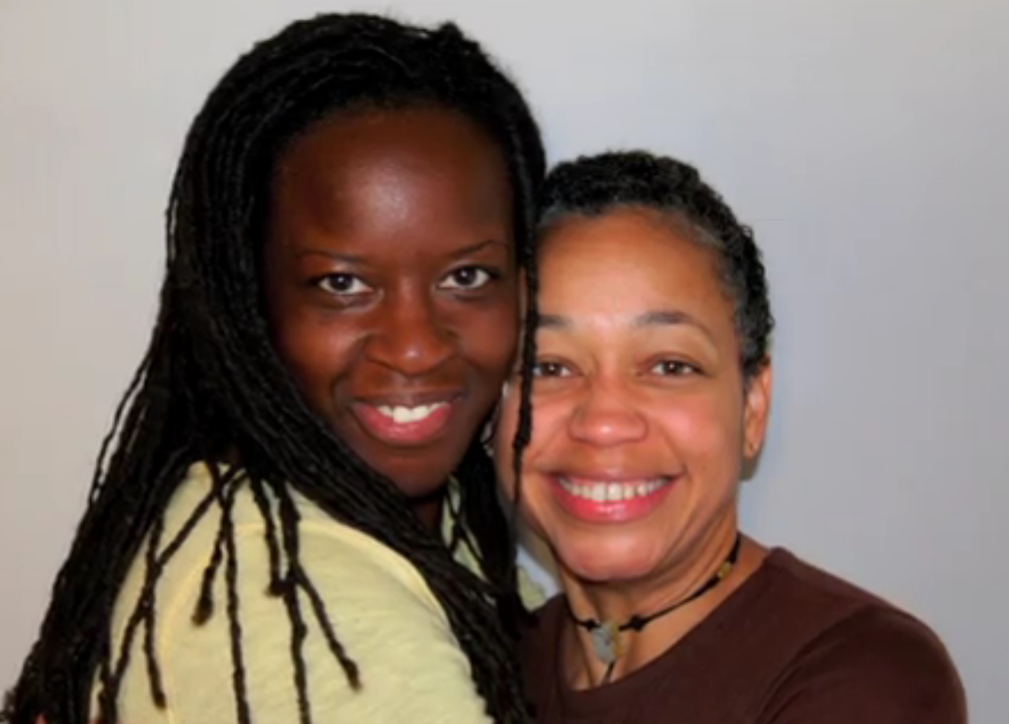
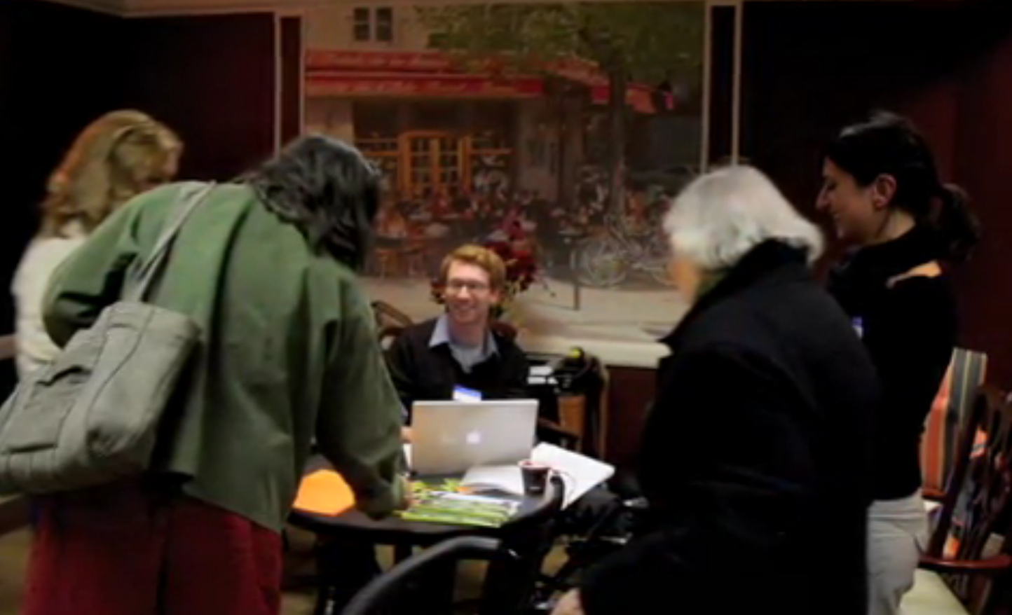
Story Corps Door-To-Door service; http://storycorps.org/your-community/

Slide 24
Advocacy
Notes:
Let me just briefly talk about using stories in leadership.

Slide 25
How good is the library? (Counting collections and visitors)
vs
How much good does the library do?

Slide 26
Colorado’s BHAG
Sustained library advocacy
  Building stories around four key messages:
    Libraries change lives
    Libraries build community
    Libraries mean business
    Libraries are a smart investment
See http://bhagcolorado.blogspot.com/2011/09/whats-next-library-advocacy.html

Slide 27
Stories for Advocacy
Stories of your customers
  Get permission if you get too specific
  Be accurate!

Slide 28
Waynn Pearson
Telling Stories Through Buildings

Slide 29
The Skill Set

Slide 30
“Beware the well-told story…”
Stephen Denning

Slide 31
Developing the Skill Set
Be authentic
Be accurate, but think in terms of a painting rather than a photograph
Be yourself
Consider your audience and consider your goals
Be brief; Be careful of TMI !
Be consistent and on point
Listen
Practice

Slide 32
Images, Memories, Taking Notes, Listening

Slide 33
Try It!
Take a moment to think of a “Who I am” and/or a “Why I am here” story.
Take a moment to think of events and items that should go into your library’s “sacred bundle.”
Consider ways to gather and share stories from within your community.
Think of a story from your community that you could share with decision makers to advocate for support or funding.

Slide 34
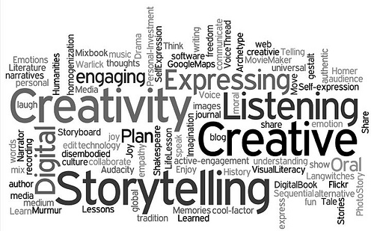

Thank you!

Slide 35
Survey and Certificate of Attendance
Please take a minute and fill out our webinar survey. You will find in at:
https://survey.qualtrics.com/SE/?SID=SV_0jrjcQFpfJ1Srn7
Thank you!

Slide 36
Infopeople webinars are supported by the U.S. Institute of Museum and Library Services under the provisions of the Library Services and Technology Act, administered in California by the State Librarian. This material is licensed under a Creative Commons 3.0 Share & Share-Alike license. Use of this material should credit the author and funding source.

