Slide 1
Waynn Pearson
Telling Stories Through Buildings

Slide 2
Hello…that’s me on the left!
Notes:
Hello…I am Waynn Pearson. Great to have you with us today. I want to tank Kate for inviting me to be part of this webinar.

Slide 3
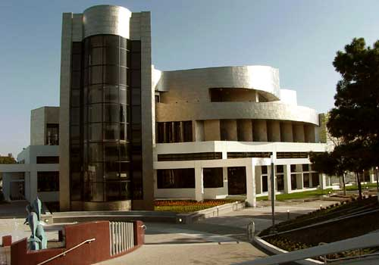
Night time is very cool
Notes:
Now…let’s “experience it!” The Cerritos Library that is.

Slide 4
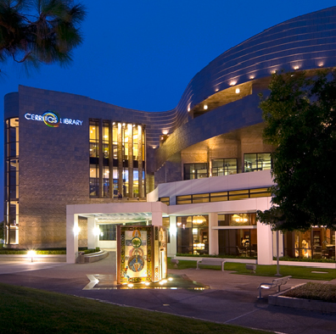
That is an Artists Book by … in the foreground
Notes:
I am talking today about using compelling story telling as we did in creating the Cerritos Library in California…the first EXPERIENCE LIBRARY.

Slide 5
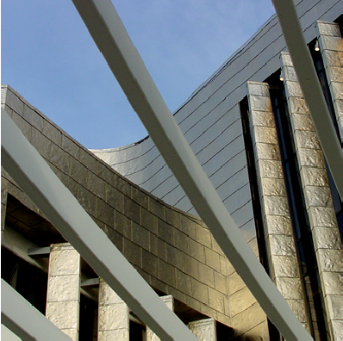
Zeitgeist is Story Telling
Notes:
At the end of the 20th Century I spoke at the California Millennium Conference. I suggested then that the Zeitgeist…the spirit of the age…in this case the future of libraries…would be experiences and convergence.
Today in the second decade of the 21st Century I can safely say that the Zeitgeist is experiences…and experiences are what stories are all about!

Slide 6
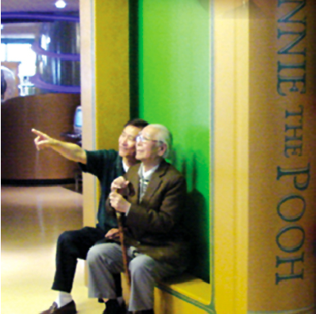
In Cerritos we used
Story telling in order to
Get out of the box…
Notes:
At Cerritos We needed to meet the challenge of building a library for the new millennium… of the future… so we “threw away the box and started with a blank piece of paper and created storylines” We used stories as a tool to conceptualize, design and build our new library.

Slide 7
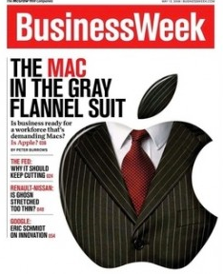
A good librarian always starts by reading…
to learn!
Notes:
My research brought about subscribing to Business Week and the Wall Street Journal…I read about corporate America and the trends they were following in presenting services, products and customer experiences.

Slide 8
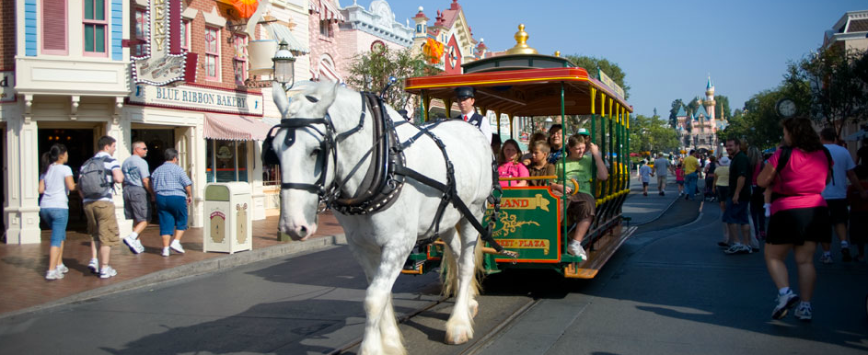
Disneyland’s Main Street
Notes:
We looked at entertainment venues especially Disneyland. Their use of story telling simply was the benchmark for our effort.

Slide 9
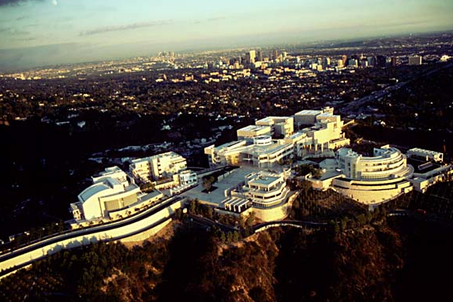
Getty Center
Notes:
We visited museums and universities… In 1997 museums were really changing their image with new forms of providing learning experiences.

Slide 10
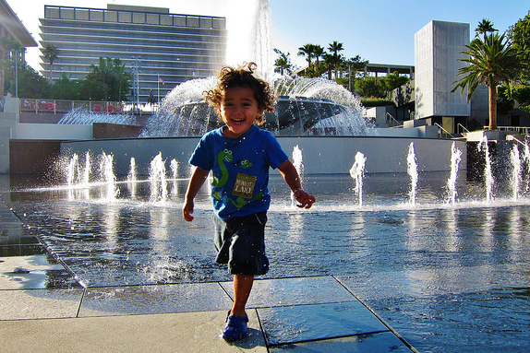
Public spaces with fun stuff!
Notes:
We had fun visiting OPEN public spaces where people could gather…we would watch people use a particular space. We learned lessons that we used in designing “The Library as Place” which played a very important part in making Cerritos Library a learning Destination and a learning organization.

Slide 11
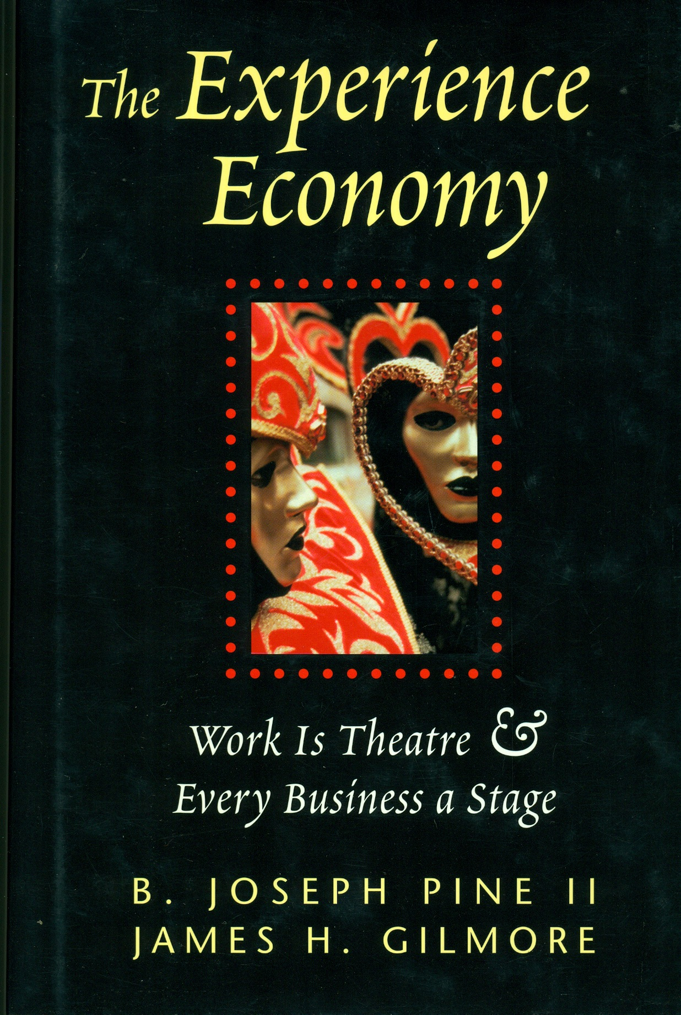
On stage…places ready…Curtain up!
Notes:
…along the way we found Joe and Jim, Pine and Gilmore. They wrote this wonderfully insightful book about how Story telling can create experiences and play a roll in building stronger relationships with guests…staff and your product. At this point, we decided that our product was going to be users experiences instead of traditional books and information.

Slide 12
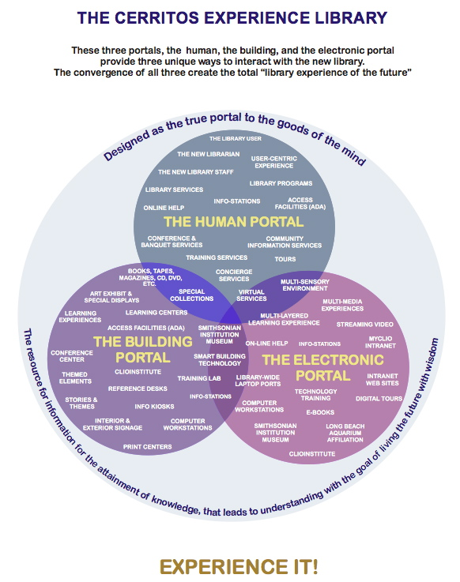
Notes:
…in Cerritos we infused everything with story telling. This Mind Map…shows the portals we designed around. We wanted to see relationships between the users, the tools and the building…in a clear way.

Slide 13
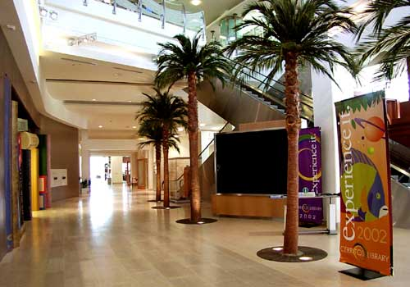
Main Street
Notes:
I am focusing today on the building itself. We decided early on to use Theming…through out the new library. This decision set the tone for the architecture and provided for the idea of being “on stage”…we the staff complimented the building as stage by being performers. The physical building, the electronic technology and the human touch had a comfortable place to provide library services.

Slide 14
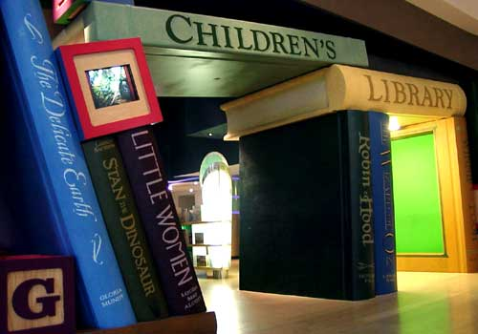
Children’s Portal
Notes:
The building itself is designed as a series of themed spaces that collectively carry out several meta-storylines. The Children’s Library has one storyline…Save the Planet.

Slide 15
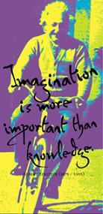
First Meta-storyline…a quote from
Albert Einstein
Notes:
We discovered that organizational story telling…not in the usual form of “narrative knowledge”…but instead in the form of “narrative imagination” is a great way of connecting to your audience…engaging your community. Maybe most important we found that story telling connected us to those so called…non-users.
Our first Meta-storyline came from this famous image of a strange little, wild haired guy riding a bicycle…Imagination is more important than knowledge.

Slide 16
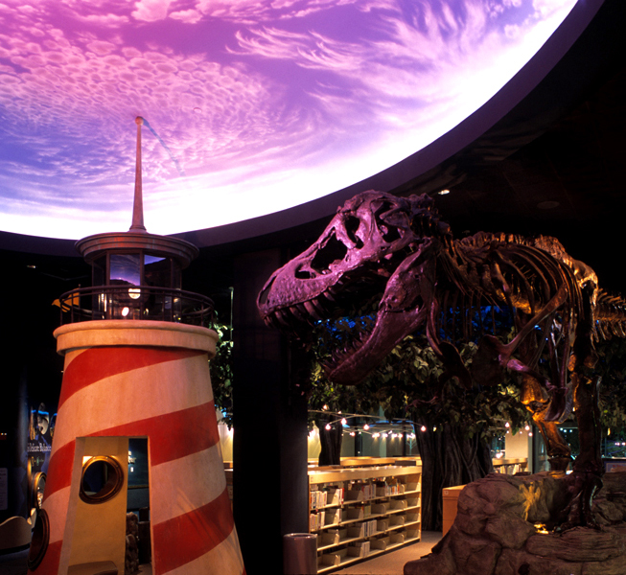
Ray Bradbury’s World!
Notes:
Compelling storylines come from imagination…or as our friend Ray would say he never saw a blank piece of paper! Storylines create a spark for learning…it triggers peoples imaginations in a memorable way… it transforms their thinking about what a library is….about what a library can be.

Slide 17
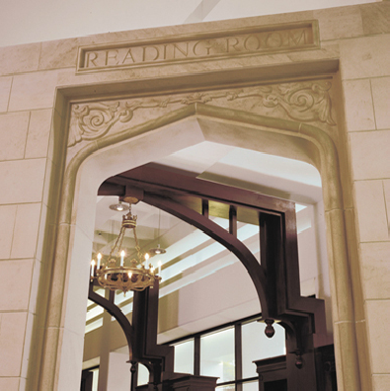
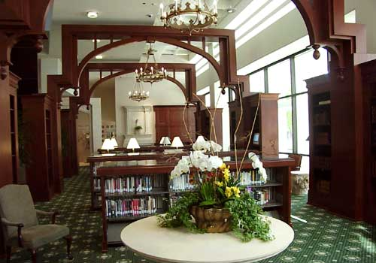
The library of your dreams
…Gothic in its storyline…leather bound
Classics to boot!
Notes:
Yet another meta-story was that the library is a “Club Med for the mind” It is designed to engage users in the many pleasures of learning. In Cerritos the library offers a wide variety of learning spaces that respond to different needs and learning styles.

Slide 18
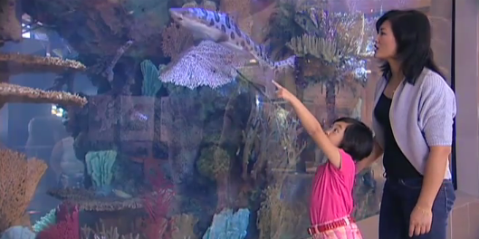
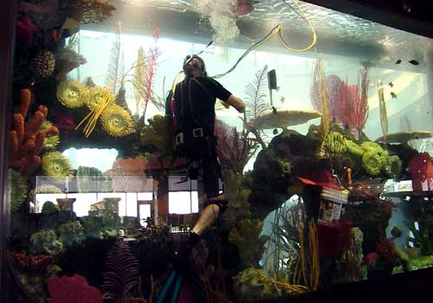
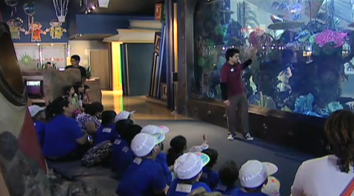
Mother and daughter learning together
Skip answering kids questions
Notes:
Big time learning can be a! Mom and daughter…one on one. Or Skip in our 15,000 gal aquarium answering kids questions and telling them all about the reef and the fish. There are 7 cameras in the tank also that provide for learning…we discovered that kids react better at times to smaller scale images. We worked at getting the most out of every designed learning experience…people through out the library while working at computers can click on a drop down window and watch the fish swimming around.

Slide 19
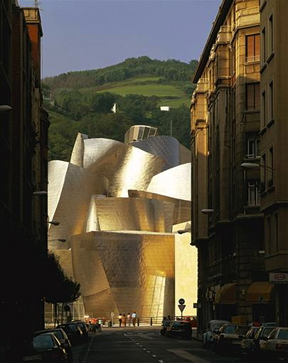
“Honoring the Past
and
Imagining the Future”
Notes:
Our mega-storyline…which infuses all library spaces, is “Honoring the Past and Imagining the Future.” This came from an image that gave me the idea for how to tell people what is meant by the word…the future. I was reading the New York Times one Sunday morning…and boom this image jumps out at me…it was the Guggenheim Museum in Bilbao, Spain. The Cerritos Library’s titanium skin came from this image…I had to have it!
An ancient city, an ancient street and lo and behold at the end of the street was this very futuristic building with curving lines and intersecting planes. The ticket…make that the “E” Ticket became simply escorting people in our new library on a “eye candy” JOURNEY through time.

Slide 20
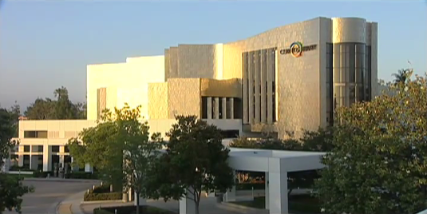
Voilà…
The Library of the Future…Cerritos Millennium Library
March 16, 2002
Notes:
…and now you have it.

Slide 21
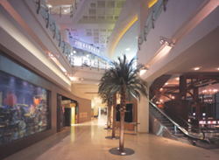
Main Street…a gathering place…shops and services
Notes:
Because of my experience of building the Cerritos Library I was asked to talk and in some cases put my thoughts together on how we did it…build a library of the future. So a few years ago I wrote an Epilogue for “Last one out turn off the the lights” a book by Cleyle and Mgillis. It has become a popular handbook for how to build a library model for the future.
These are my 10 suggestions for doing it…as they say. Create gathering places…Main Street is a good example.

Slide 22
Craftsman…20th Century
Notes:
Design for users…express the users desires…. learn from their needs and how they want to do things…

Slide 23
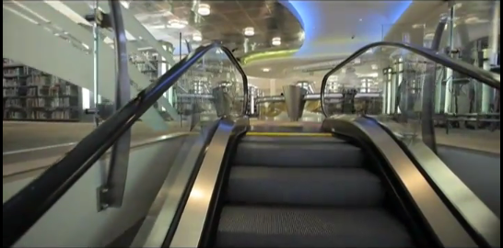
Arriving in the 21st Century
Notes:
Do not limit yourself to providing information…libraries are so much more. We ran away from the idea that a library is an INFORMATION PLACE…that was not acceptable for a library of the future…we need to adapt to a new zeitgeist.

Slide 24
An Information Desk
that is a
“Time Machine”
Notes:
Get out from behind the desk…even if it a beautifully designed a time machine. Design meets and greets through out the library. We provided our staff with headsets and two way radios so they could answer peoples questions in the stacks…study carrels.

Slide 25
The sizzle of the 21st Century computer bay!
Notes:
Look outside the library for ideas…OUTSIDE in was our mantra. I believe story telling is all about gaining a foothold in the world of information, knowledge, understanding and…yes, wisdom.

Slide 26
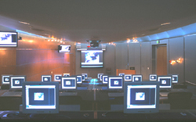
Notes:
Communicate with more than words…use images , provide planned emotions. We put flowers in the restrooms…

Slide 27
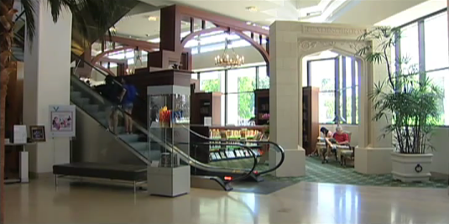
Notes:
Develop a storyline…to get through a period of change, it helps to have a clear sense of what you want the library to accomplish. A good storyline can organize the flow of people and ideas…in our case a potent blend of history and innovation.

Slide 28
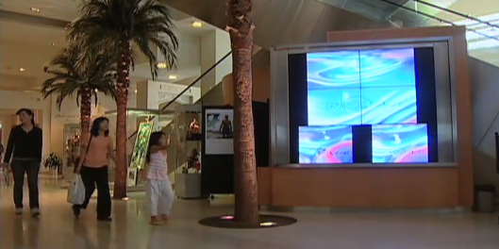
Notes:
Romance your users…People want to feel good. At Cerritos we build a library that would provide for just that in the morning guests are welcomed outside the library with movie clips…Oh what a beautiful morning plays on a large outdoor monitor, along with clip from Rocky showing him getting up and running the streets of Philadelphia….with that energizing soundtrack blaring away.
At night the video wall on Main Street announces the closing of the library with similar emotional movie clips…the last scene from Casablanca plays. The most popular clip is from Sound of Music…So long, farewell, Auf wiedersehen. Our guests have taken to singing along and dancing. People leave the library feeling good!

Slide 29
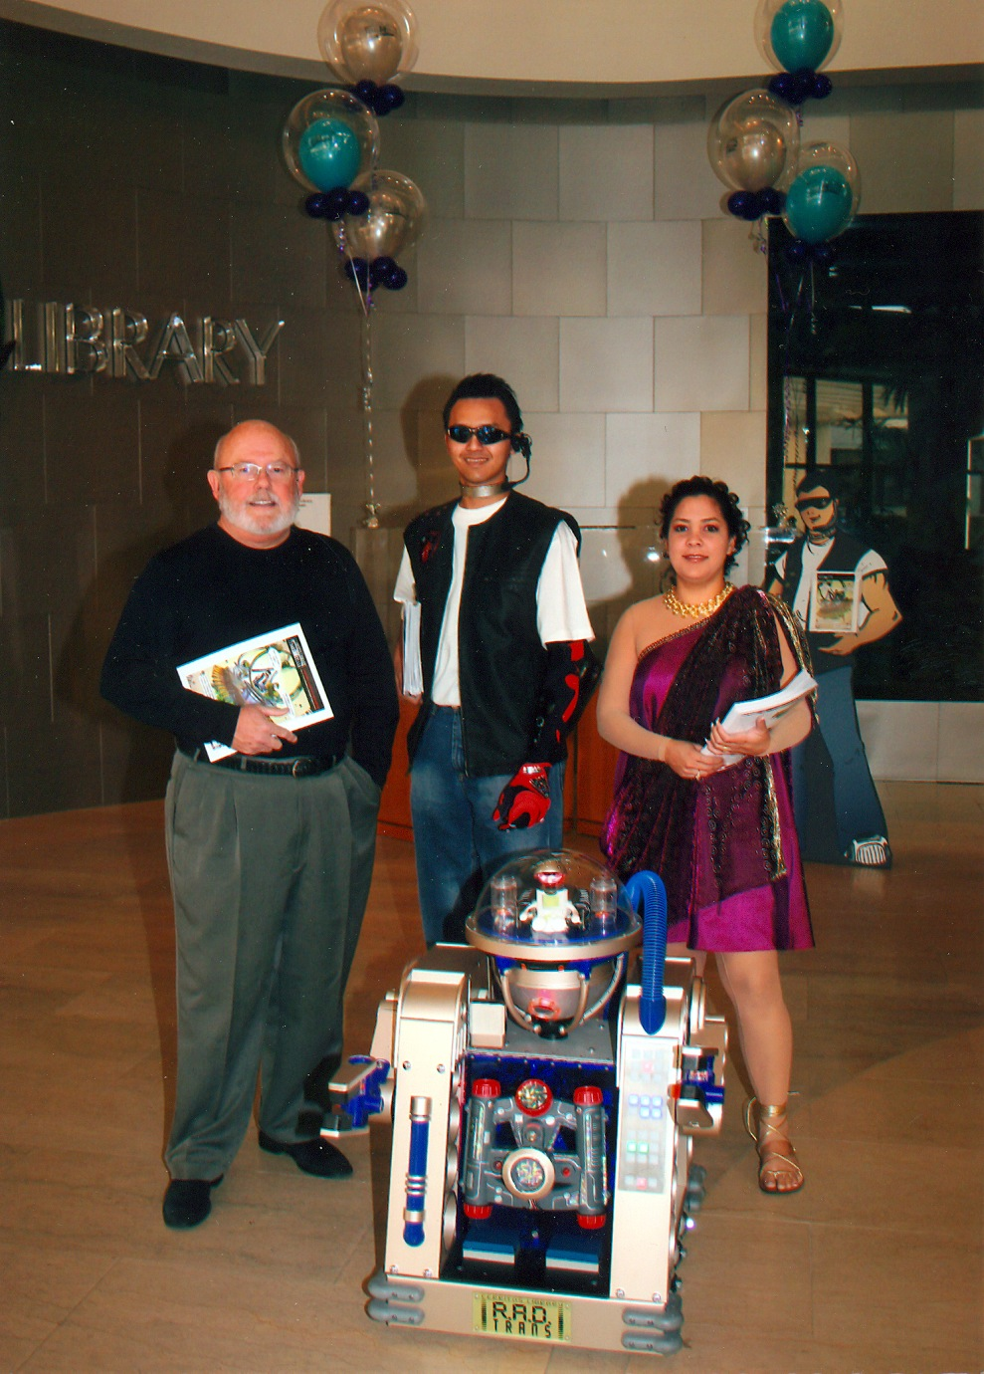
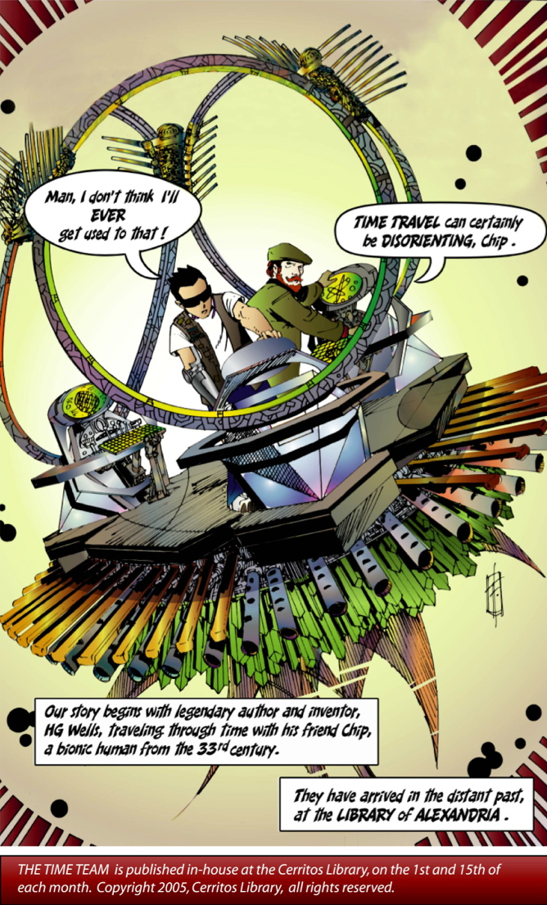
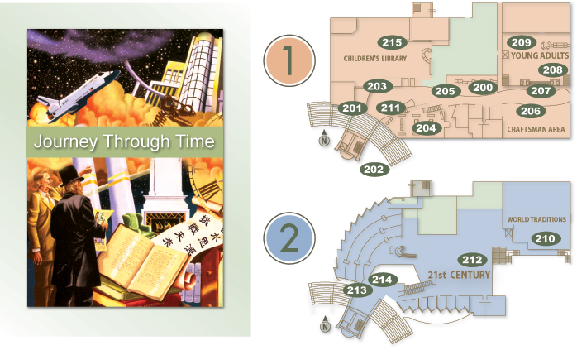
Notes:
Make it fun…we created a comic strip…we created “walk-abouts” that resembled the cartoon characters.
We developed a self-guided audio tour of the library that is hosted by H.G. Wells and Jules Verne… with sound effects to boot.

Slide 30
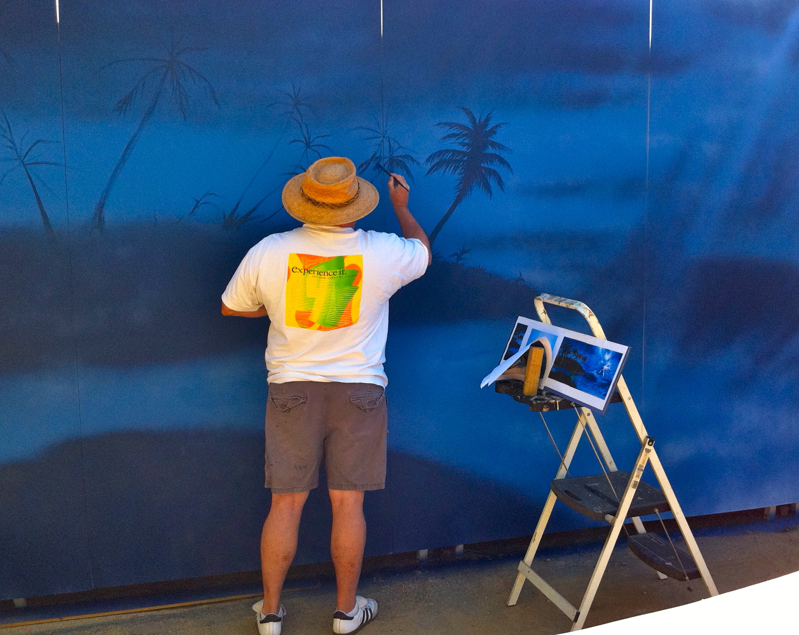
Yep! This is me in retirement…
Notes:
I can really paint Coconut Palm Trees. Thanks for listening.

