Slide 1

Telling Your Story: Five Secrets for Successful Career Growth and Advancement
An Infopeople Webinar
October 10, 2012
Deb Hunt, Information Edge
David Grossman, Mill Valley Public Library
Infopeople webinars are supported by the U.S. Institute of Museum and Library Services under the provisions of the Library Services and Technology Act, administered in California by the State Librarian. This material is licensed under a Creative Commons 3.0 Share & Share-Alike license. Use of this material should credit the author and funding source.

Slide 2

Agenda
The importance of successful interactions
The five secrets of successful interactions
Case study
Developing your own talking points for success
A sampling of job opportunities

Slide 3

Successful Interactions

Slide 4

The Five Secrets of Successful Interactions
Storytelling
Elevator pitch
Listening
Getting buy-in
Getting to yes

Slide 5
Why Telling Your Story is So Important
First impressions can mean everything
Limited time to make a pitch
Importance of conveying your value
It is really a sales pitch for you or your work
Concise storytelling is a hallmark of successful people
People remember stories
Your story is your unique brand

Slide 6
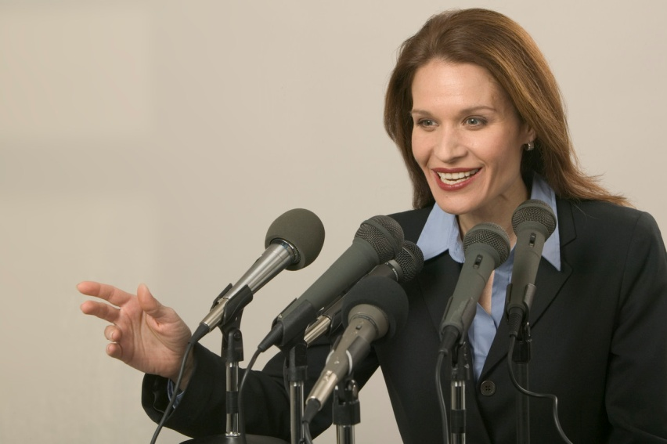
Storytelling
Engage and excite the involvement of listeners
Develop information center/library stories to support the work you do
Testimonials

Slide 7
Elevator Pitch
30 seconds
Know it by heart
Say it with passion
Be prepared to expand on it, and don’t count on it as your only tool
Fantastic Formulas for Composing Elevator Speeches http://bit.ly/fN8q0v

Slide 8
Listening
“Listening to what customers, competitors and experts are saying can be a much more productive social networking tactic than promoting your library through
blogs, tweets and the like.”
“Listening: The Fast Track
to Social Networking?” by Bill French. Information Outlook, April/May 2010, p. 15.

Slide 9
Getting Buy-In
Stay informed of topics and trends
of interest to senior executives
Become an expert on these topics
and always be ready to share
valuable information
Be visible/seen/heard from regularly
Be the link to outside and inside expertise

Slide 10

Getting to Yes
With decision makers (employers/clients, etc.)
Demonstrate your value (how you can positively affect the bottom line)
Consistently obtain buy-in
See the world through their eyes (not yours)
Adapt to reality (don’t try to change the world)

Slide 11
Case Study: Successful Interactions
Leigh Montgomery’s Talking Points
Situation/ Interaction | Leigh’s Talking Points
Leigh’s Story | I was recruited for a position in the MONITOR’s library after I finished…
Leigh’s 30 second elevator pitch | Librarians/Info Pros should have several of elevator pitches, depending on the…
What Leigh listens for | This is an interesting and complex question. As an information professional in a…
How Leigh gets buy-in | I set quarterly goals and I'm asked to suggest three to five goals to accomplish…
How Leigh gets to “Yes” | “Yes" these days is more like: not "No." I do get this with most things and not others…

Slide 12
Leigh Montgomery’s Story
Overview:
Summarizes where Leigh has been in her career
Enumerates what jobs/tasks Leigh has performed
Emphasizes Leigh’s skills
Highlights Leigh’s accomplishments
Details what value Leigh can offer any organization
Provides a good idea of what Leigh brings to any situation

Slide 13
Leigh Montgomery’s Story
Specifics:
Possesses extensive research skills
Writes and communicates well
Possesses teaching skill and experience
High achiever
Quick learner
Goes outside comfort zone

Slide 14
Leigh Montgomery’s Story
Specifics: (Continued)
Versatile
Self starter
Embraces change
Positive attitude
Active in professional organizations
An “experience” collector

Slide 15
Leigh Montgomery’s Elevator Pitch
Has several elevator pitches depending on audience/situation
Prefers elevator “pitch” over “speech” because it is a sales job
Sees elevator pitch as “elevating” your profile or self
Should be casual/conversational to start conversation
Uses elevator pitch during meeting introductions
Often begins elevator pitch with a question

Slide 16
What Leigh Montgomery Listens For
Looks for common aspirations in digital and quality journalism
Listens for patterns in how management uses the information and learns what’s important to them
Listening carefully tells Leigh what is OK and not OK to do
Leigh listens for subtle but important phrases
Listens for books and articles admired or endorsed by management

Slide 17
How Leigh Montgomery Gets Buy-In
Leigh sets quarterly goals aligned with her manager’s goals
Leigh looks for opportunities to motivate her, apply her abilities and support company objectives
Leigh communicates what she’s done and quantifies her achievements
Leigh tries to provide examples where a librarian has made a difference
Leigh always maintains revenue streams as a goal

Slide 18
How Leigh Montgomery Gets to “Yes”
Leigh says, these days, “yes” is more like “not no”
Holds quarterly meetings with management to review results of the previous quarter
Quantifies everything = management’s preference
Leigh and manager review best performing items, what she is proudest of, where she’s applied technology innovatively and new clients and changes to the electronic portfolio
She’s always able to articulate what something is and why they are paying “$X” for it
Leigh’s objective is for clear and descriptive communication

Slide 19
Successful Interactions:
Your Talking Points
Situation/ Interaction | Your Talking Points
Your Story
Your 30 second elevator pitch
What you listen for
How you get buy-in
How you get to “Yes”

Slide 20
Audience Poll: What will be your favorite talking points?
(choose all that apply)
Storytelling
Elevator pitch
Listening
Getting buy-in
Getting to yes

Slide 21
A Sampling of Job Titles for Recent Grads and Our Colleagues
Business Development Manager at Geneca
Human Factors Engineer, Intel Corp.
Information Architect
Information Specialist, National Center for Patient Safety
Knowledge Manager, Freedom from Hunger
Library Partnerships Manager, Google Book Search
Metrics Manager, Global Consumer Design, Whirlpool
Project Manager, The SoftAd Group
User Experience Researcher, Microsoft Corp.
User-Interface Designer, Lockheed Martin
Web Production Assistant, Adobe Systems

Slide 22
A Sampling of Job Titles and Sources You May Not Have Considered
Museum Curator
Library Research Consultant
Sharepoint Power User
Web Applications Developer
Publications Director
Document Logistics Manager
http://www.jobsfed.com/
http://jobsearch.monster.com/
http://www.net-temps.com/
http://job-hunt.indeed.com/
http://www.jobcentral.org/
http://careers.peopleclick.com/

Slide 23
Audience Poll: Which job titles are most appealing to you?
(choose all that apply)
Museum Curator
Library Research Consultant
Sharepoint Power User
Web Applications Developer
Publications Director
Document Logistics Manager

Slide 24
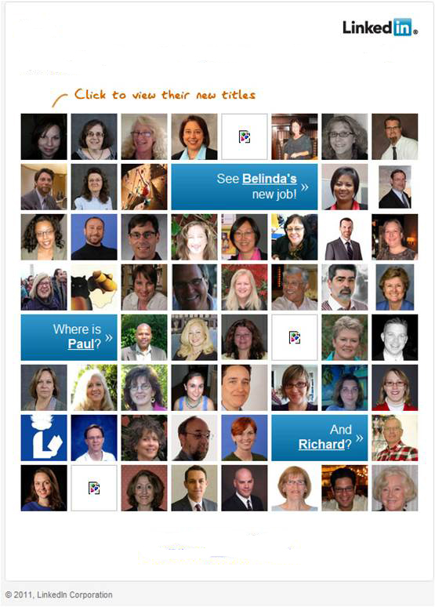
Look who’s recently changed jobs!

Slide 25
Summary of What We’ve Learned in this Series
There are no excuses
33 critical skills for career advancement
Six ways to acquire new skills
New ways to overcome adversity
How to develop a dynamite resume
The value of networking
How to become a front runner
Invest in yourself
Five secrets of successful interactions
How to develop your talking points
Notes:
Deb will introduce this slide.

Slide 26
Audience Poll: What is your most important takeaway from these webinars?
(choose all that apply)
There are no excuses
The importance of having the right skills
Strategies for acquiring new skills
Value of networking
Need to invest in yourself
Tips for developing a dynamite resume
How to become a Front Runner
Case studies of successful librarians/info pros
Secrets of successful interactions
Great follow up resources

Slide 27
Homework Assignment:
Readings and Exercises
Investigate two or three areas/associations for career changing/job opportunities
“How Do You Prove Your Worth” Jill Strand. Information Outlook. Dec 2011. Vol. 15, Iss. 8; pp. 28-29.
“10 Questions: Julie Takata.” Stuart Hales. Information Outlook. Dec 2010. Vol. 14, Iss. 8; pp. 17-21. [case study]
“Information Pro as Storyteller For Staff, Patrons, Management.” Debbie Schachter. Information Outlook, Feb 2008. Vol. 12, Iss. 2; pp. 28-29.
Coping with Continual Motion http://bit.ly/edd6Cf

Slide 28

Questions?

Slide 29
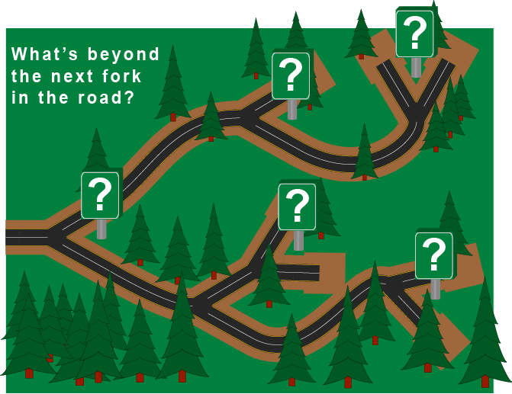
What’s Next?
Stay in touch! Please join our Career Sustainability Group on LinkedIn http://linkd.in/pqkjzp
Deb and David also provide:
  Workshops/seminars
  Customized career coaching, resume writing, mentoring
Contact Us: Join our mailing list to more learn about our upcoming workshops, coaching services, publications and discussion groups. dhunt@information-edge.com / dgrossman@cityofmillvalley.org

Slide 30

Infopeople webinars are supported by the U.S. Institute of Museum and Library Services under the provisions of the Library Services and Technology Act, administered in California by the State Librarian. This material is licensed under a Creative Commons 3.0 Share & Share-Alike license. Use of this material should credit the author and funding source.

