Slide 1

Basic Graphic Design
for Library Staff:
Quick and Easy Solutions
Wednesday, December 12, 2012
12 Noon Pacific
Presented by
Stanley K. Strauss
Infopeople webinars are supported by the U.S. Institute of Museum and Library Services under the provisions of the Library Services and Technology Act, administered in California by the State Librarian. This material is licensed under a Creative Commons 3.0 Share & Share-Alike license. Use of this material should credit the author and funding source.
Notes:
Title slide

Slide 2
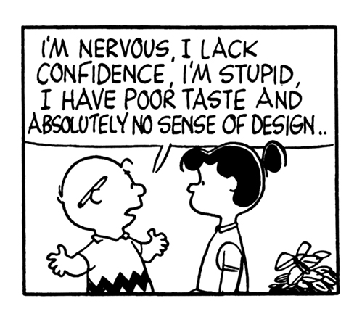

Slide 3
Today’s Agenda
Working with:
Shapes
Text
Images and Color
The Web
Customer Service
Setting Up Shop
Q & A

Slide 4
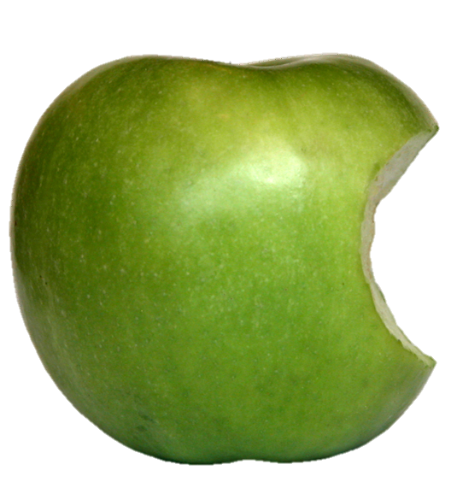
A Minor Disclaimer
Apple-centric
PC compatible
Everything you need
Notes:
No Apple version of MS Publisher.

Slide 5
It is
Placing objects on a page.
Communicating visually and verbally.
Problem solving.
Art.
It is not
Writing text.
Editing text.
Creating images.
Busy work.
Notes:
IS: Great Graphic Designers are also great artists.
IS NOT: Typing an Out of Order sign in inch high letters is not graphic design.

Slide 6
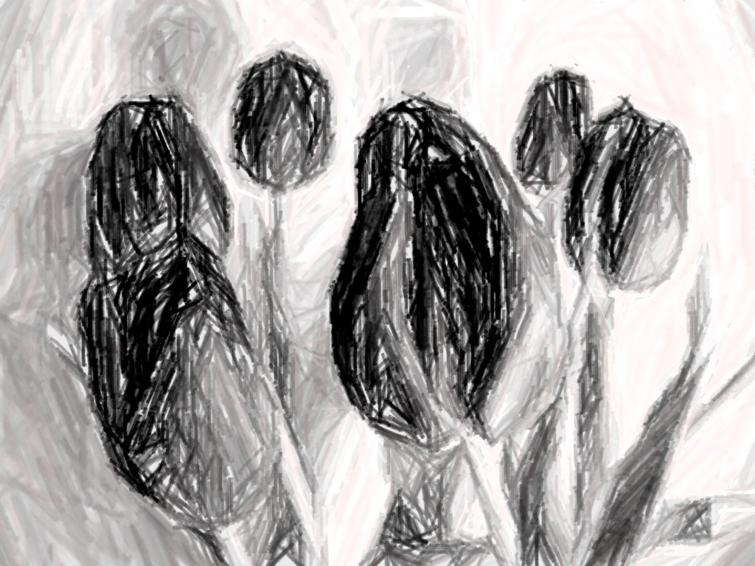
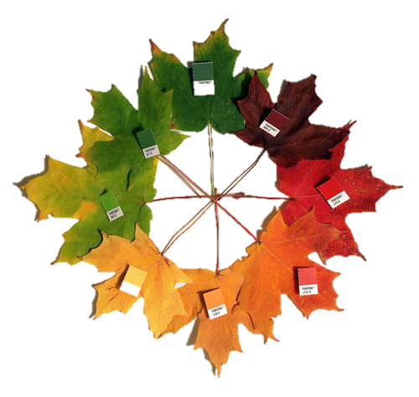
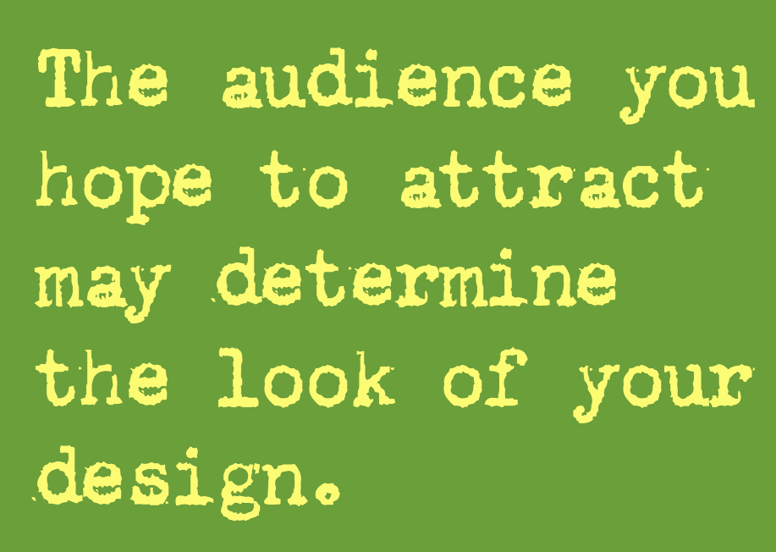
Three Basic Elements
Text
Images
With eager eyes and strained attention, Mr Haredale saw him chained, and locked and barred up in his cell. Nay, when he had left the jail, and stood in the free street, without, he felt the iron plates upon the doors, with his hands, and drew them over the stone wall, to assure himself that it was real; and to exult in its being so strong, and rough, and cold. It was not until he turned his back upon the jail, and glanced along the empty streets, so lifeless and quiet in the bright morning, that he felt the weight upon his heart; that he knew he was tortured by anxiety for those he had left at home; and that home itself was but another bead in the long rosary of his regrets.
Shapes
Customer Service

Slide 7

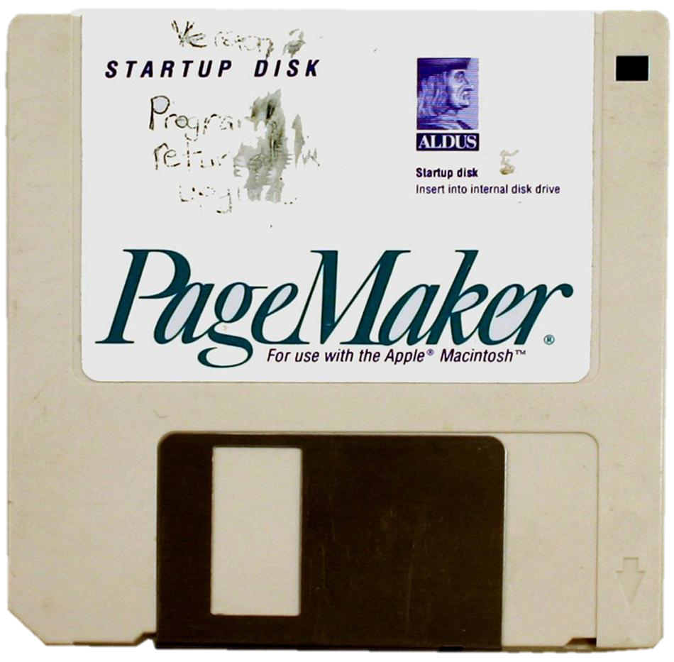
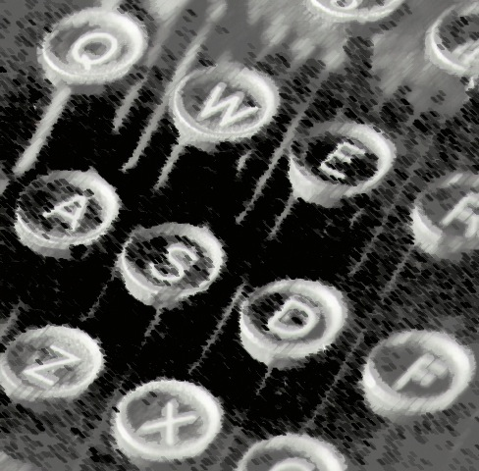
In the beginning…
Notes:
Mention Varityper.

Slide 8
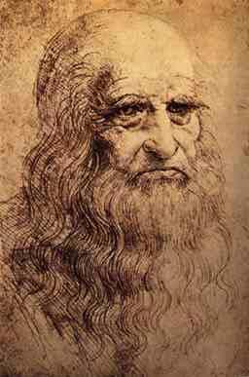
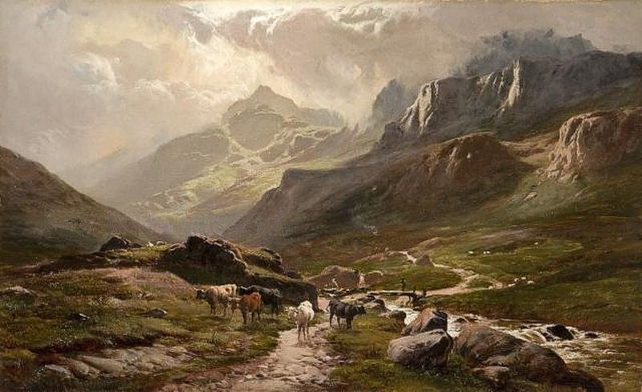
Shapes and Layout
Landscape
Portrait
Notes:
What is a shape? It can be an image, a paragraph of text, a column of numbers.

Slide 9
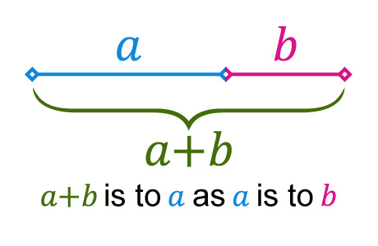
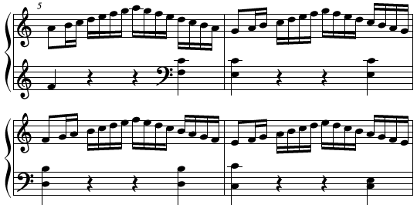
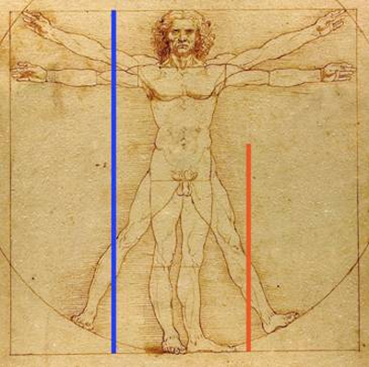
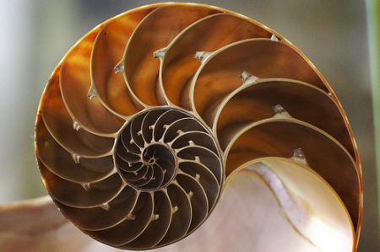
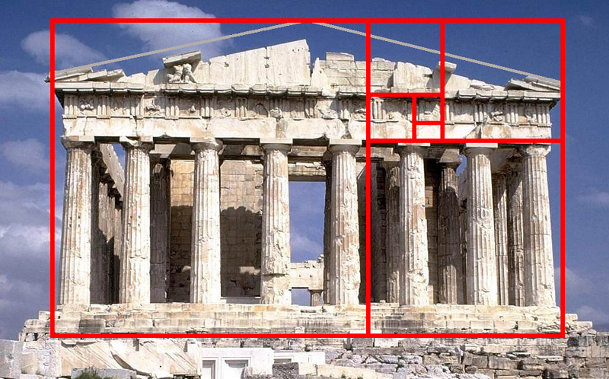
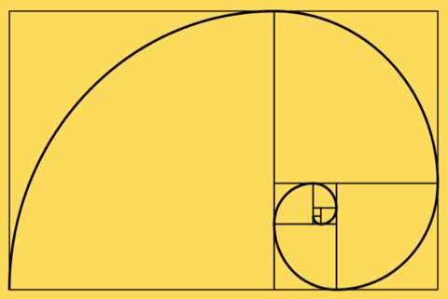
The Golden Ratio
Notes:
Organic, grounded in nature, the way we see things to organize our world.

Slide 10
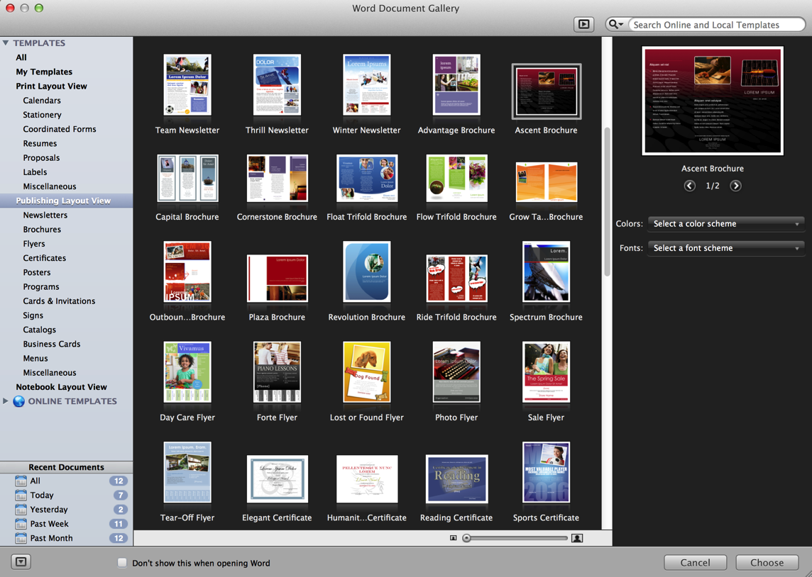
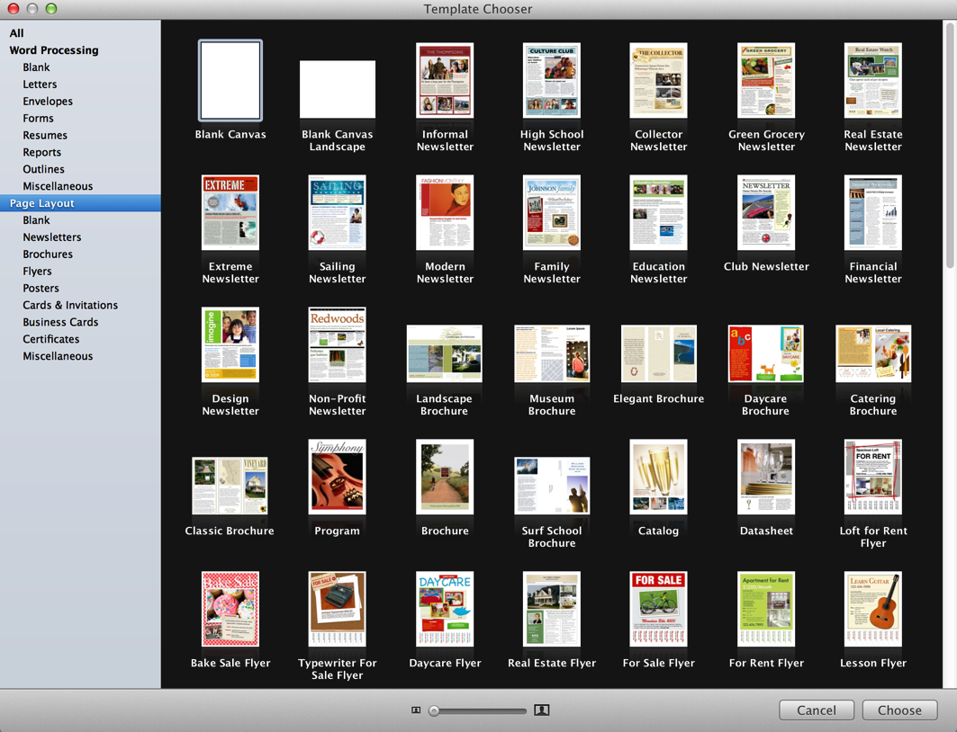
Using Templates
Microsoft Word 2011
Pages 2009
Notes:
Positive: Gives a head start, creates its own organizational space
Negatives: Confined to someone else’s view

Slide 11
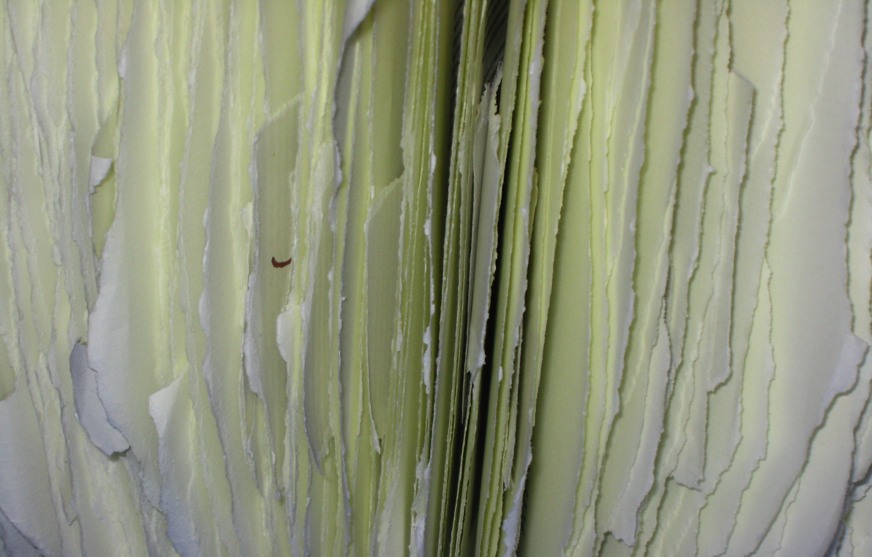

Your own photo.
Professional backgrounds
http://backgrounds.mysitemyway.com/

Slide 12
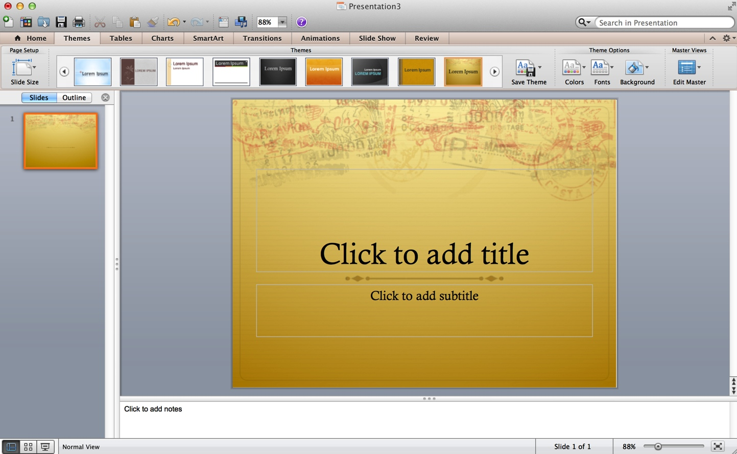
PowerPoint Templates
PowerPoint 2011

Slide 13


Slide 14
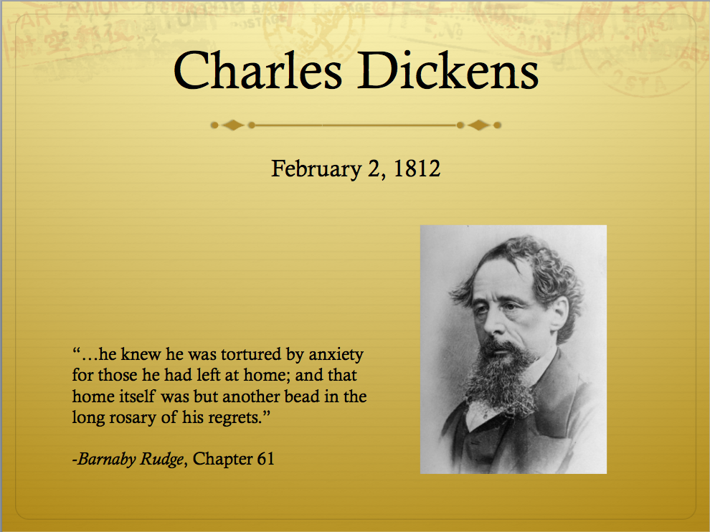

Slide 15
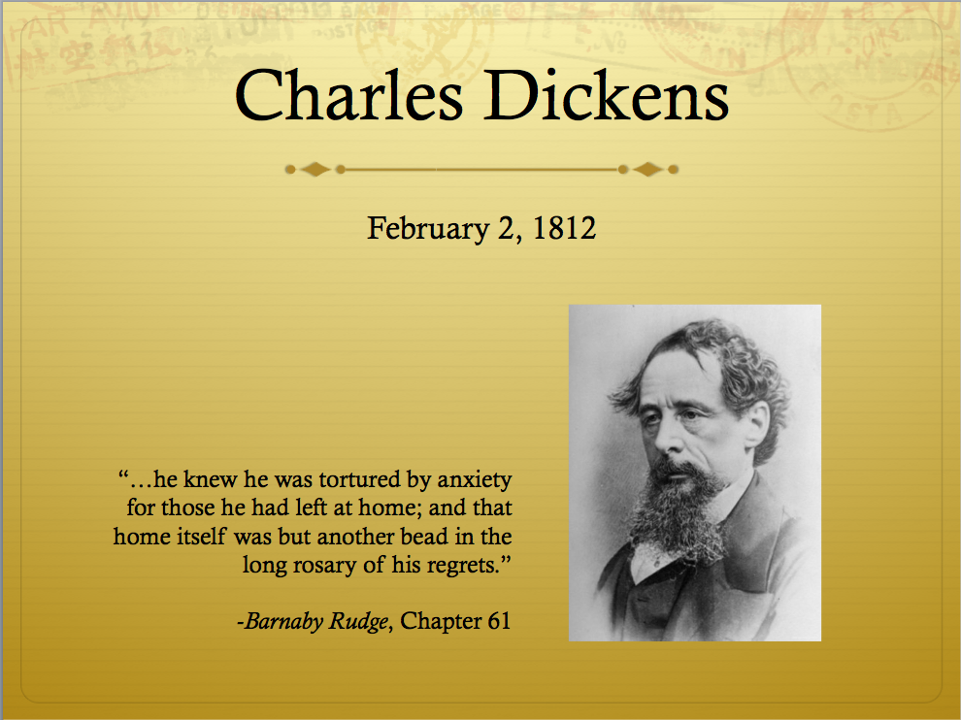

Slide 16
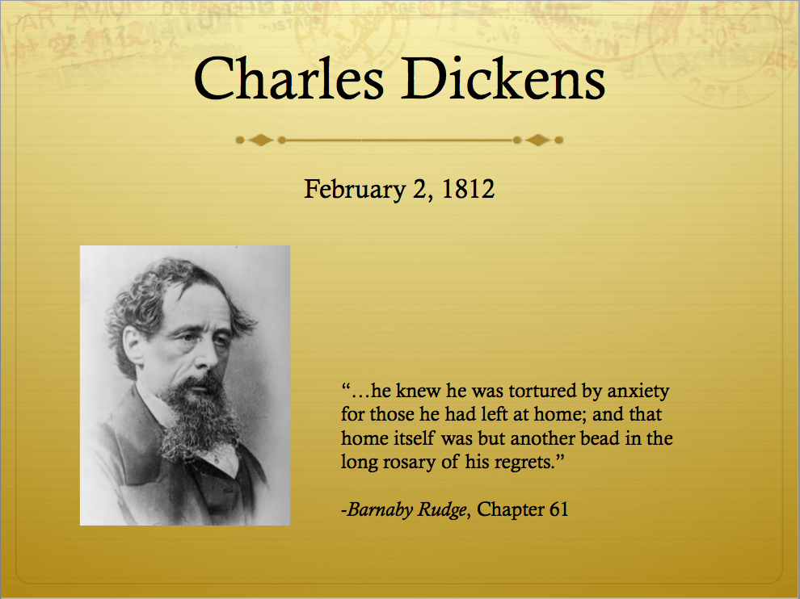

Slide 17
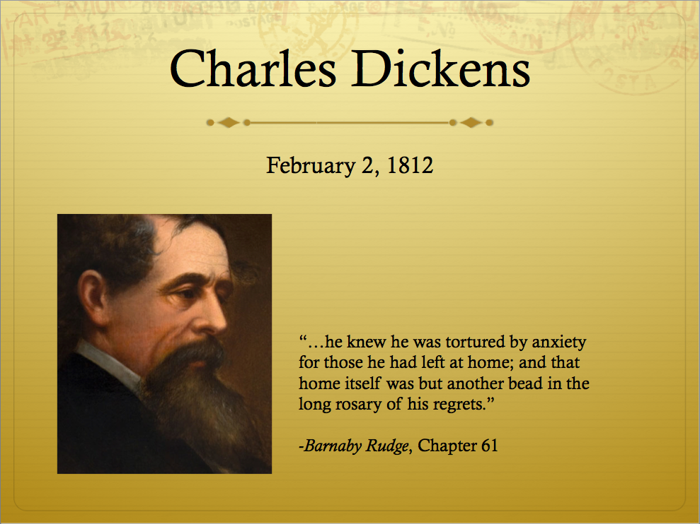

Slide 18
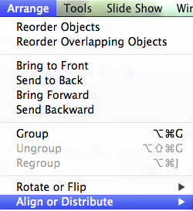
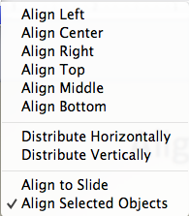
Aligning Shapes
Top
Distribute

Slide 19

The 7 Pesky Must-Haves
Day of the Week
Date
Time
Address
Phone Number
Contact Name
Logo
Fee
Ages
Registration
QR Code
Other

Slide 20
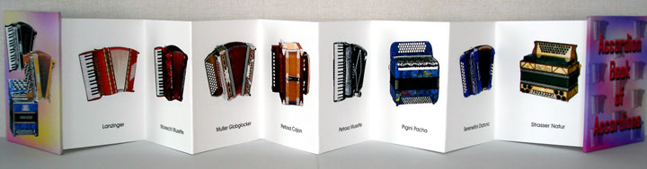
Image
Title
Making Accordion Books: Folding and Unfolding
Day
Date
Time
Address
Website
Additional Information
Logo
Notes:
These are the various areas.

Slide 21
Before
After

Slide 22
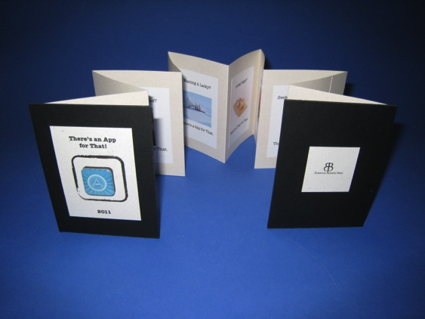
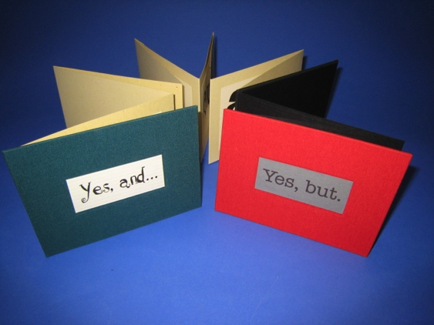
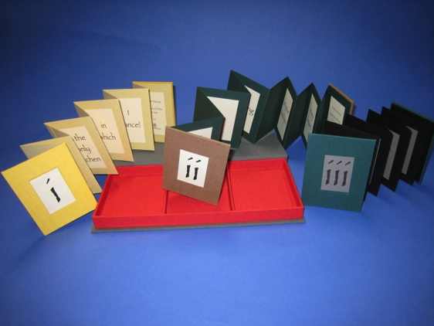
Making Accordion Books: Folding and Unfolding
a bookmaking workshop
Wednesday, December 12, 2012
7pm – 9pm
MyTown Public Library
1111 Main Street
MyTown, CA 90101
http://mytownlibrary.org
This program is free.
For ages 18 and up.
To pre-registration and for more information,
please call Stanley at 555-1212.
MyTown Library
Discovering New Worlds
Notes:
Here’s a simple flyer. Now let’s deconstruct it. That blank space in the center is called “white space.”

Slide 23
g
Accordion
Making
Books:
Folding and Unfolding
a bookmaking workshop
Wednesday, December 12, 2012
7pm – 9pm
MyTown Public Library
1111 Main Street
MyTown, CA 90101
http://mytownlibrary.org
This program is free.
For ages 18 and up.
To pre-registration and for more information,
please call Stanley at 555-1212.
MyTown Library
Discovering New Worlds
Notes:
Here’s a simple flyer. Now let’s deconstruct it.

Slide 24
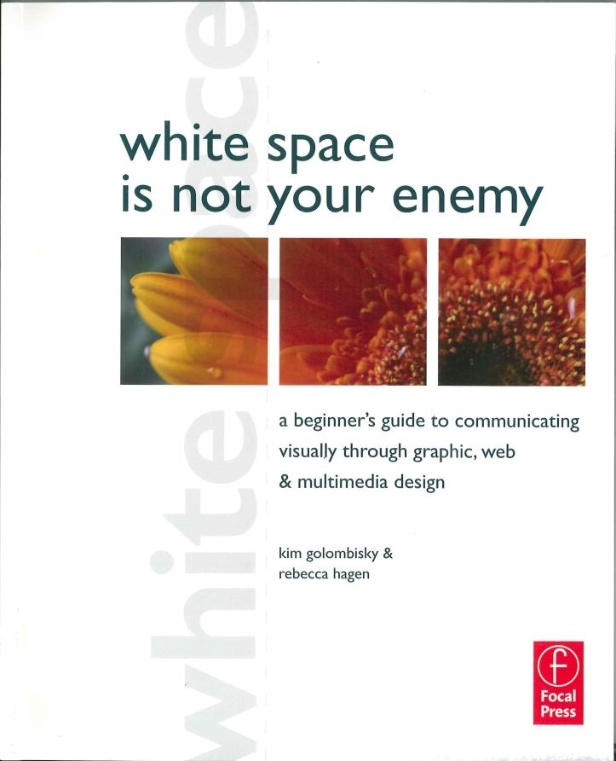
White space is
unused space
used with a purpose.
It can be any color.

Slide 25

I move things around until
they look right.
Milton Glaser
Glaser, Milton. Milton Glaser: Graphic Design.
New York. Overlook Press. 1983.

Slide 26
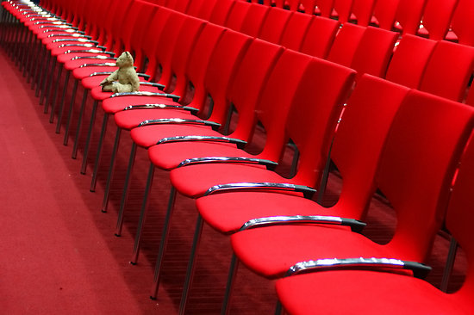
Working with Text
Text
Images
With eager eyes and strained attention, Mr Haredale saw him chained, and locked and barred up in his cell. Nay, when he had left the jail, and stood in the free street, without, he felt the iron plates upon the doors, with his hands, and drew them over the stone wall, to assure himself that it was real; and to exult in its being so strong, and rough, and cold. It was not until he turned his back upon the jail, and glanced along the empty streets, so lifeless and quiet in the bright morning, that he felt the weight upon his heart; that he knew he was tortured by anxiety for those he had left at home; and that home itself was but another bead in the long rosary of his regrets.
Shape
Customer Service

Slide 27
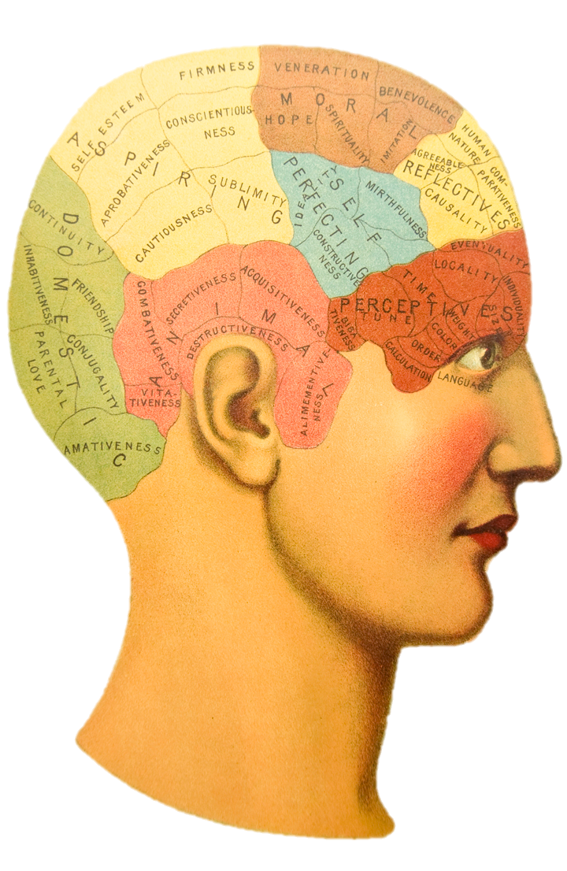
I have a theory about the human mind. A brain is a lot like a computer. It will only take so many facts, and then it will go on overload and blow up.
Erma Bombeck
Notes:
Most interesting and complicated human organ
Changing at break-neck speed with the easy availability of PCs, and mobile devices

Slide 28
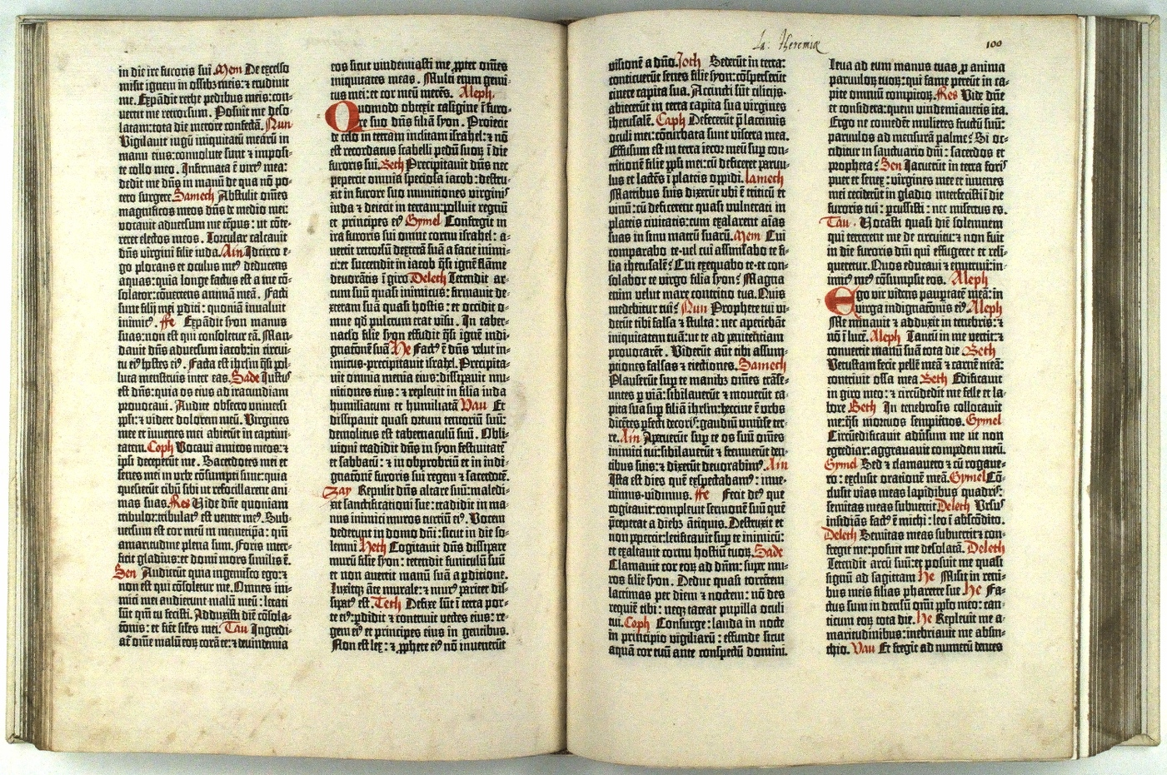
The Original Layout Scheme

Slide 29
Text Alignment
Left
Center
Justify
Right
With eager eyes and strained attention, Mr Haredale saw him chained, and locked and barred up in his cell. Nay, when he had left the jail, and stood in the free street, without, he felt the iron plates upon the doors, with his hands, and drew them over the stone wall, to assure himself that it was real; and to exult in its being so strong, and rough, and cold. It was not until he turned his back upon the jail, and glanced along the empty streets, so lifeless and quiet in the bright morning, that he felt the weight upon his heart; that he knew he was tortured by anxiety for those he had left at home; and that home itself was but another bead in the long rosary of his regrets.
With eager eyes and strained attention, Mr Haredale saw him chained, and locked and barred up in his cell. Nay, when he had left the jail, and stood in the free street, without, he felt the iron plates upon the doors, with his hands, and drew them over the stone wall, to assure himself that it was real; and to exult in its being so strong, and rough, and cold. It was not until he turned his back upon the jail, and glanced along the empty streets, so lifeless and quiet in the bright morning, that he felt the weight upon his heart; that he knew he was tortured by anxiety for those he had left at home; and that home itself was but another bead in the long rosary of his regrets.
With eager eyes and strained attention, Mr Haredale saw him chained, and locked and barred up in his cell. Nay, when he had left the jail, and stood in the free street, without, he felt the iron plates upon the doors, with his hands, and drew them over the stone wall, to assure himself that it was real; and to exult in its being so strong, and rough, and cold. It was not until he turned his back upon the jail, and glanced along the empty streets, so lifeless and quiet in the bright morning, that he felt the weight upon his heart; that he knew he was tortured by anxiety for those he had left at home; and that home itself was but another bead in the long rosary of his regrets.
With eager eyes and strained attention, Mr Haredale saw him chained, and locked and barred up in his cell. Nay, when he had left the jail, and stood in the free street, without, he felt the iron plates upon the doors, with his hands, and drew them over the stone wall, to assure himself that it was real; and to exult in its being so strong, and rough, and cold. It was not until he turned his back upon the jail, and glanced along the empty streets, so lifeless and quiet in the bright morning, that he felt the weight upon his heart; that he knew he was tortured by anxiety for those he had left at home; and that home itself was but another bead in the long rosary of his regrets.

Slide 30
Font Styles
Plain
Bold
Italic
Underline
With eager eyes and strained attention, Mr Haredale saw him chained, and locked and barred up in his cell. Nay, when he had left the jail, and stood in the free street, without, he felt the iron plates upon the doors, with his hands, and drew them over the stone wall, to assure himself that it was real; and to exult in its being so strong, and rough, and cold. It was not until he turned his back upon the jail, and glanced along the empty streets, so lifeless and quiet in the bright morning, that he felt the weight upon his heart; that he knew he was tortured by anxiety for those he had left at home; and that home itself was but another bead in the long rosary of his regrets.
With eager eyes and strained attention, Mr Haredale saw him chained, and locked and barred up in his cell. Nay, when he had left the jail, and stood in the free street, without, he felt the iron plates upon the doors, with his hands, and drew them over the stone wall, to assure himself that it was real; and to exult in its being so strong, and rough, and cold. It was not until he turned his back upon the jail, and glanced along the empty streets, so lifeless and quiet in the bright morning, that he felt the weight upon his heart; that he knew he was tortured by anxiety for those he had left at home; and that home itself was but another bead in the long rosary of his regrets.
With eager eyes and strained attention, Mr Haredale saw him chained, and locked and barred up in his cell. Nay, when he had left the jail, and stood in the free street, without, he felt the iron plates upon the doors, with his hands, and drew them over the stone wall, to assure himself that it was real; and to exult in its being so strong, and rough, and cold. It was not until he turned his back upon the jail, and glanced along the empty streets, so lifeless and quiet in the bright morning, that he felt the weight upon his heart; that he knew he was tortured by anxiety for those he had left at home; and that home itself was but another bead in the long rosary of his regrets.
With eager eyes and strained attention, Mr Haredale saw him chained, and locked and barred up in his cell. Nay, when he had left the jail, and stood in the free street, without, he felt the iron plates upon the doors, with his hands, and drew them over the stone wall, to assure himself that it was real; and to exult in its being so strong, and rough, and cold. It was not until he turned his back upon the jail, and glanced along the empty streets, so lifeless and quiet in the bright morning, that he felt the weight upon his heart; that he knew he was tortured by anxiety for those he had left at home; and that home itself was but another bead in the long rosary of his regrets.

Slide 31
Using lots of fonts…
and lots of sizes…
makes it look as if…
we don’t know…
what we’re doing.

Slide 32
Making Accordion Books: Folding and Unfolding
a bookmaking workshop
Wednesday, December 12, 2012
7pm – 9pm
MyTown Public Library
1111 Main Street
MyTown, CA 90101
http://mytownlibrary.org
This program is free.
For ages 18 and up.
To pre-registration and for more information,
please call Stanley at 555-1212.
MyTown Library
Discovering New Worlds
Notes:
Here’s a simple flyer. Now let’s deconstruct it.

Slide 33
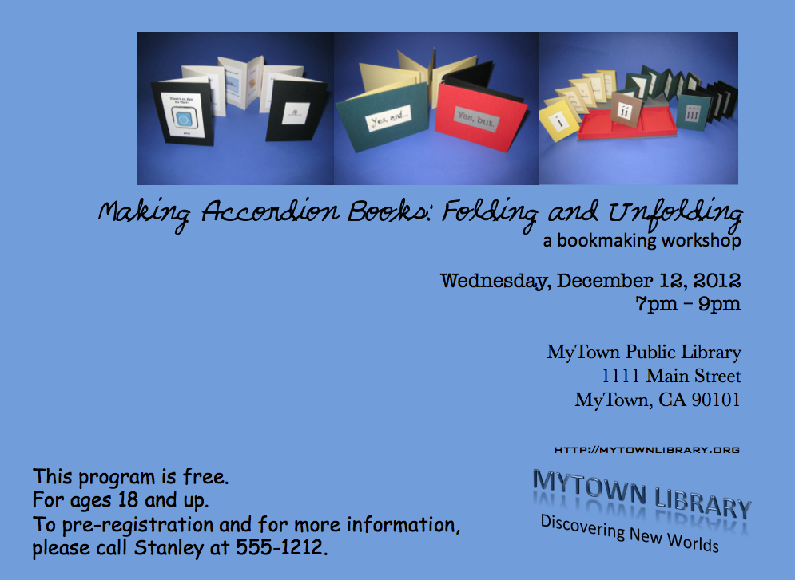

Slide 34
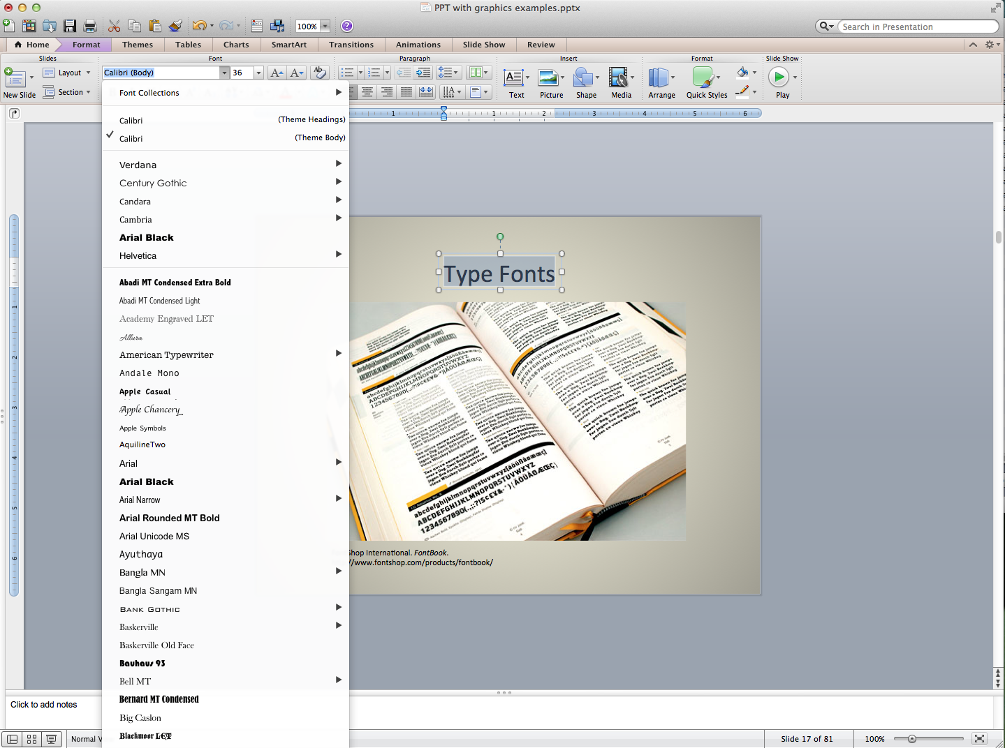

Slide 35
Legibility
Readability
With eager eyes and strained attention, Mr Haredale saw him chained, and locked and barred up in his cell. Nay, when he had left the jail, and stood in the free street, without, he felt the iron plates upon the doors, with his hands, and drew them over the stone wall, to assure himself that it was real; and to exult in its being so strong, and rough, and cold. It was not until he turned his back upon the jail, and glanced along the empty streets, so lifeless and quiet in the bright morning, that he felt the weight upon his heart; that he knew he was tortured by anxiety for those he had left at home; and that home itself was but another bead in the long rosary of his regrets.
With eager eyes and strained attention, Mr Haredale saw him chained, and locked and barred up in his cell. Nay, when he had left the jail, and stood in the free street, without, he felt the iron plates upon the doors, with his hands, and drew them over the stone wall, to assure himself that it was real; and to exult in its being so strong, and rough, and cold. It was not until he turned his back upon the jail, and glanced along the empty streets, so lifeless and quiet in the bright morning, that he felt the weight upon his heart; that he knew he was tortured by anxiety for those he had left at home; and that home itself was but another bead in the long rosary of his regrets.

Slide 36
Monospaced font
Proportional font
With eager eyes and strained attention, Mr Haredale saw him chained, and locked and barred up in his cell. Nay, when he had left the jail, and stood in the free street, without, he felt the iron plates upon the doors, with his hands, and drew them over the stone wall, to assure himself that it was real; and to exult in its being so strong, and rough, and cold. It was not until he turned his back upon the jail, and glanced along the empty streets, so lifeless and quiet in the bright morning, that he felt the weight upon his heart; that he knew he was tortured by anxiety for those he had left at home; and that home itself was but another bead in the long rosary of his regrets.
With eager eyes and strained attention, Mr Haredale saw him chained, and locked and barred up in his cell. Nay, when he had left the jail, and stood in the free street, without, he felt the iron plates upon the doors, with his hands, and drew them over the stone wall, to assure himself that it was real; and to exult in its being so strong, and rough, and cold. It was not until he turned his back upon the jail, and glanced along the empty streets, so lifeless and quiet in the bright morning, that he felt the weight upon his heart; that he knew he was tortured by anxiety for those he had left at home; and that home itself was but another bead in the long rosary of his regrets.
Each letter contains the same amount of space in the text. - 12 pt. Courier)
Each letter occupies only the space it needs in the text. – 12 pt. Calibri.

Slide 37
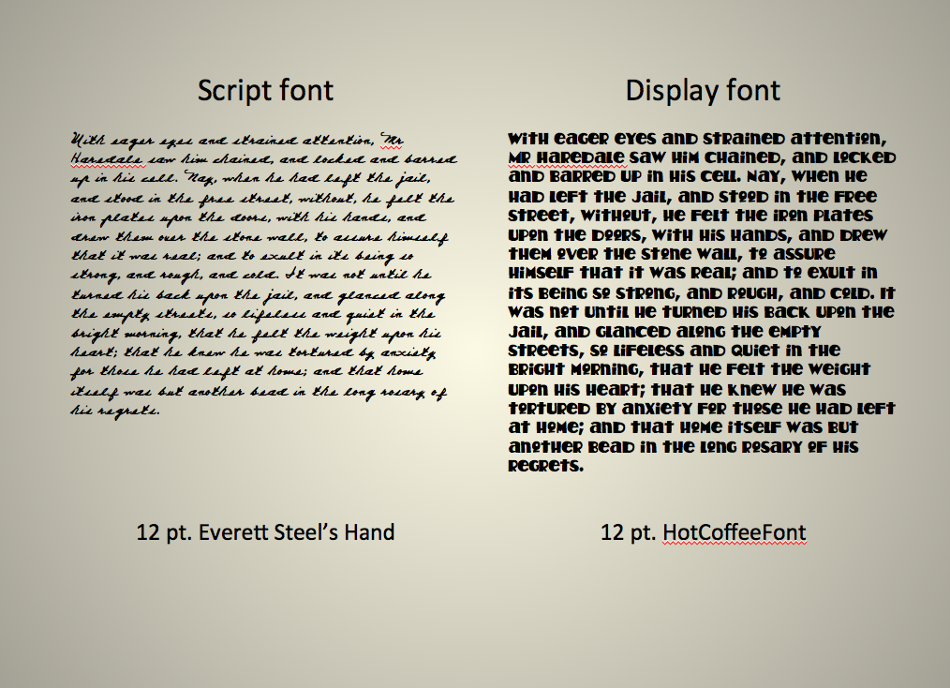

Slide 38
READING ALL CAPS IS MORE DIFFICULT
than Reading in Title Case.
“…HE KNEW HE WAS TORTURED
BY ANXIETY FOR THOSE HE HAD
LEFT AT HOME; AND THAT
HOME ITSELF WAS BUT
ANOTHER BEAD IN THE LONG ROSARY OF HIS REGRETS.”
-BARNABY RUDGE, CHAPTER 61
“…he knew he was tortured by
anxiety for those he had left at
home; and that home itself was
but another bead in the long
rosary of his regrets.”
-Barnaby Rudge, Chapter 61

Slide 39
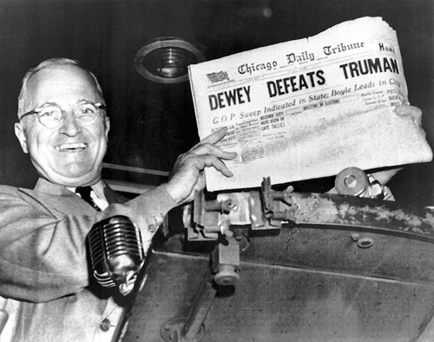
Headlines are an exception.
Notes:
That’s why headlines are in ALL CAPS. But size does matter.

Slide 40
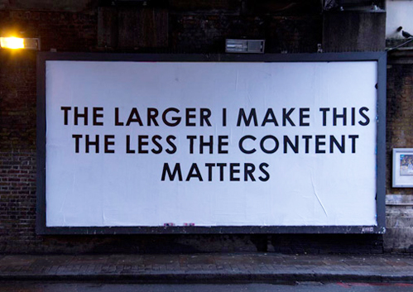

Slide 41
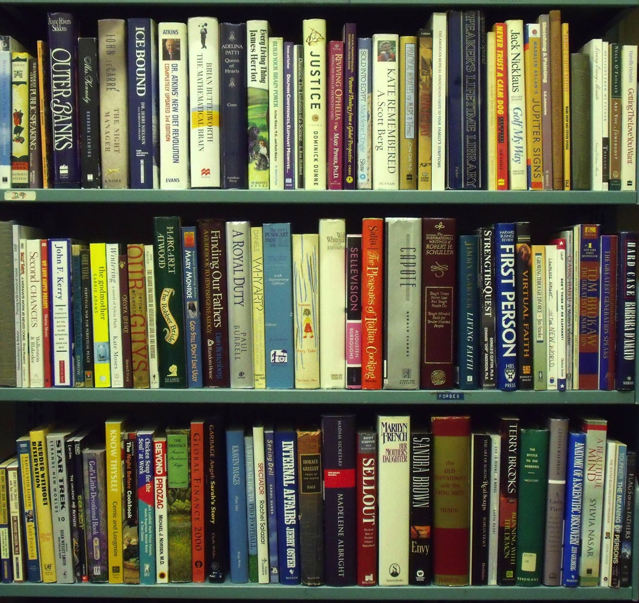
Reading
Vertically
is
more
difficult
than reading Horizontally.
VERTICAL READING
Notes:
That’s why so many people browsing the stacks get cricks in the necks!

Slide 42
Reading white text on a black background is harder than
“…he knew he was tortured by anxiety for those he had left at home; and that home itself was but another bead in the long rosary of his regrets.”
-Barnaby Rudge, Chapter 61
Reading black text on a white background
“…he knew he was tortured by anxiety for those he had left at home; and that home itself was but another bead in
the long rosary of his regrets.”
-Barnaby Rudge, Chapter 61

Slide 43

The almost perfect example.

Slide 44
What We See
After reading the
the sentence, you are
now aware that the
the human brain
often does not
inform you that the
the word ‘the’ has
been repeated twice
every time.

Slide 45
What’s Really There
After reading the
the sentence, you are
now aware that the
the human brain
often does not
inform you that the
the word ‘the’ has
been repeated twice
every time.
After reading the
the sentence, you are
now aware that the
the human brain
often does not
inform you that the
the word ‘the’ has
been repeated twice
every time.

Slide 50
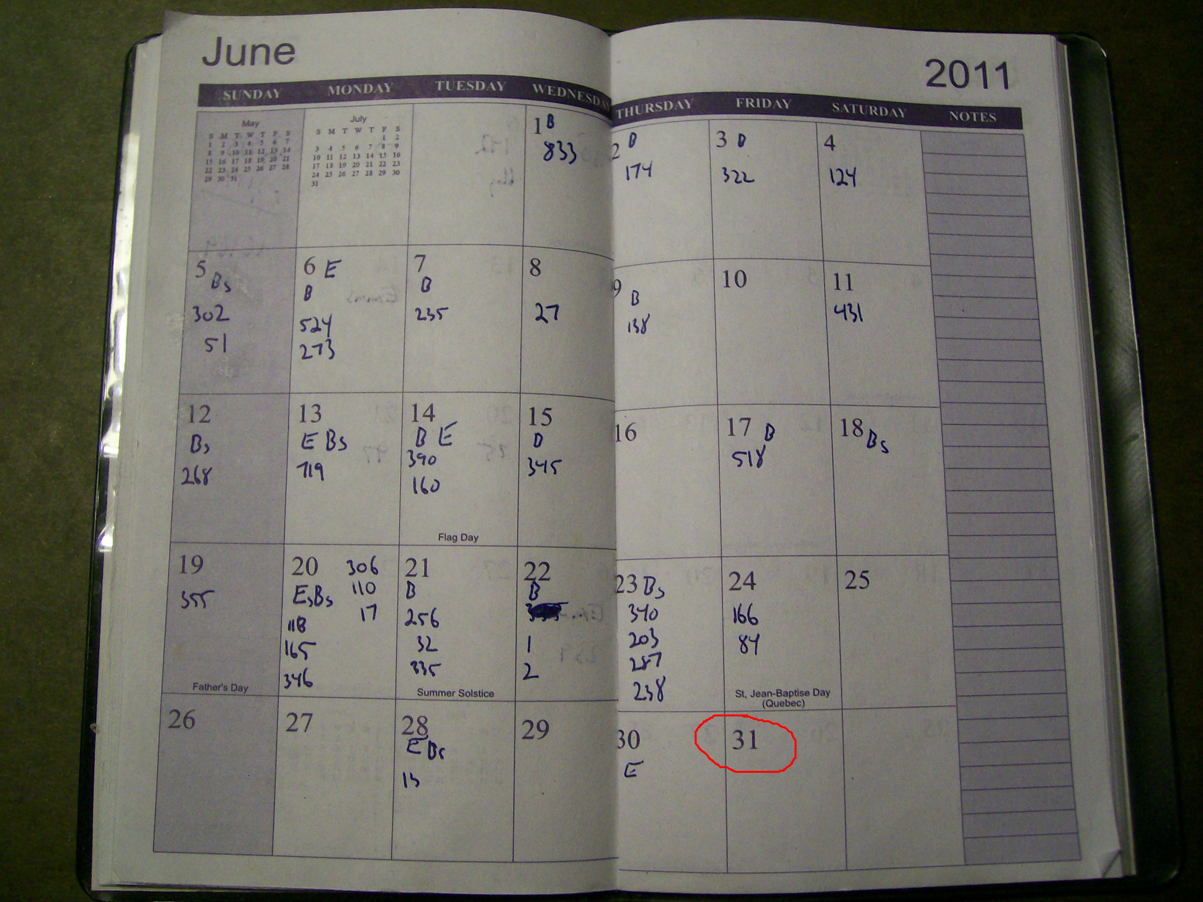
Proofreading
Content:
  Does it make sense?
  Is the data correct?
Correction:
  Grammar
  Spelling
  Punctuation
They feel bad about that.
There, their, they’re
Let’s eat Grandma (or)
Let’s eat, Grandma.
Notes:
In an ideal world, graphic design does not include proofreading. Few of us work in and ideal world…

Slide 51
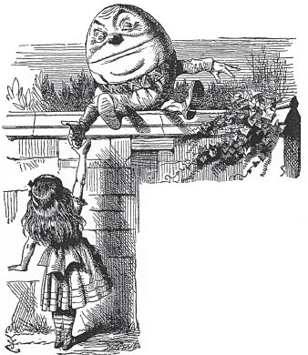
“When I use a word,”
Humpty Dumpty said in
rather a scornful tone. “It
means just what I choose it
to mean –
neither more or less.”
Lewis Carroll. Through the Looking Glass, Chapter VI.

Slide 52
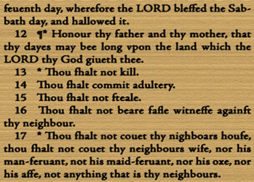
Proofreading: A Very Old Mistake
(a missing word)
From a 1631 Bible published by Robert Barker and Martin Lucas, the royal printers in London

Slide 53

Proofreading: An Embarrassing Mistake
(a missing letter)
“When I was only three,
and still named Belle
Miriam Silverman, I sang my first aria in pubic.”
Opening sentence:
Bubbles: a self-portrait by Beverly Sills.
First edition. New York: Bobbs-Merrill. 1976.

Slide 54
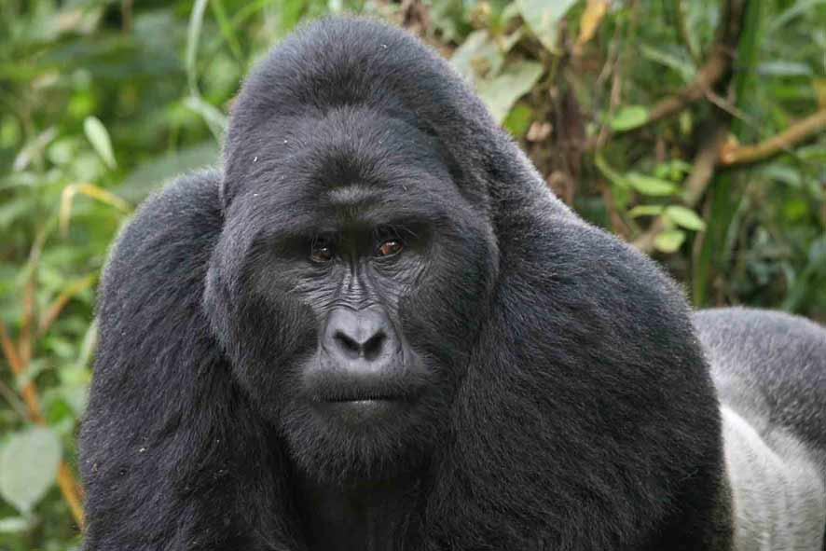
Proofreading: A Silly Mistake
(an unintended word)
“Gorilla warriors have been kidnapping children as young as five years old
and training them to become rebel soldiers.”
Spellchecking Is Not Proofreading

Slide 55


Read
Read Again
Read Backwards

Slide 56
Working with Images
Text
With eager eyes and strained attention, Mr Haredale saw him chained, and locked and barred up in his cell. Nay, when he had left the jail, and stood in the free street, without, he felt the iron plates upon the doors, with his hands, and drew them over the stone wall, to assure himself that it was real; and to exult in its being so strong, and rough, and cold. It was not until he turned his back upon the jail, and glanced along the empty streets, so lifeless and quiet in the bright morning, that he felt the weight upon his heart; that he knew he was tortured by anxiety for those he had left at home; and that home itself was but another bead in the long rosary of his regrets.
Images
Shapes
Customer Service

Slide 57
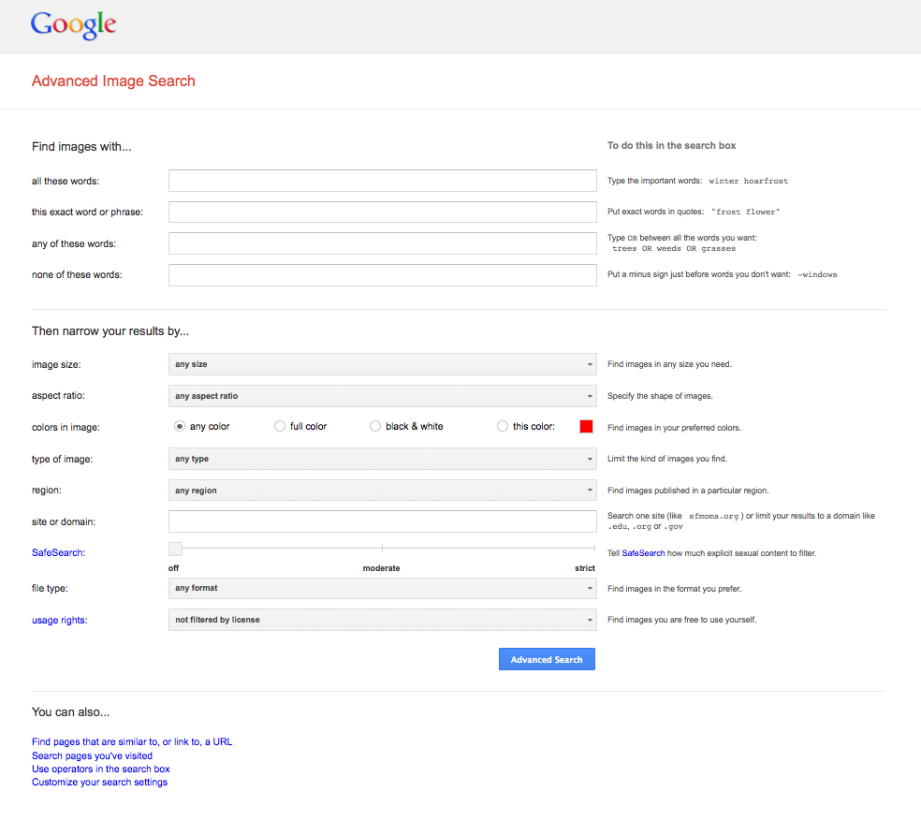
http://www.google.com/advanced_image_search

Slide 58
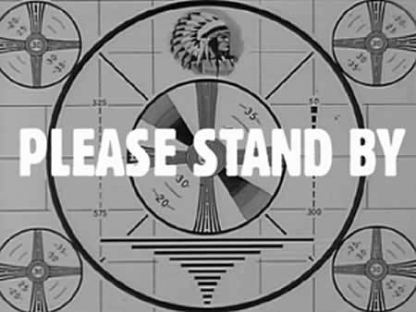
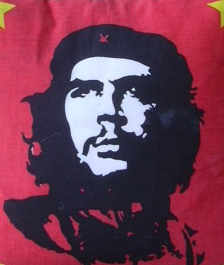
Searches and Results
Google Image Search
Key Word: ebooks
Color: black and white
Usage Rights: free to use or share
Google Image Search
Key Word: ebooks
Color: blue
Usage Rights: free to use or share

Slide 59
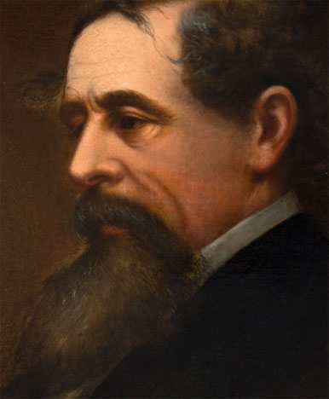
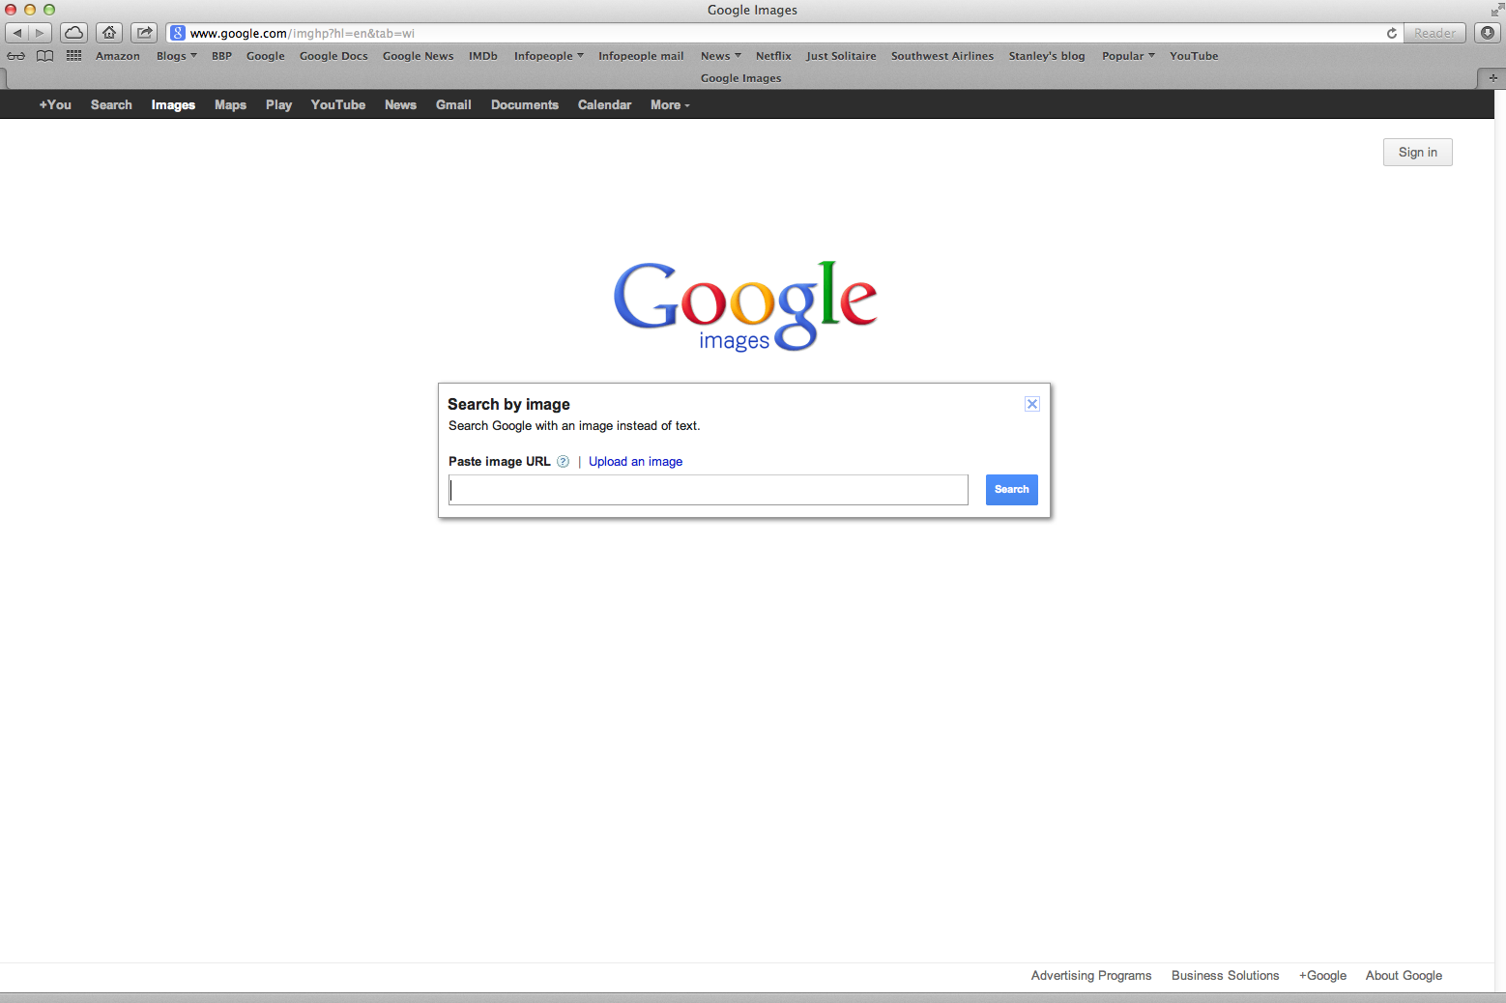
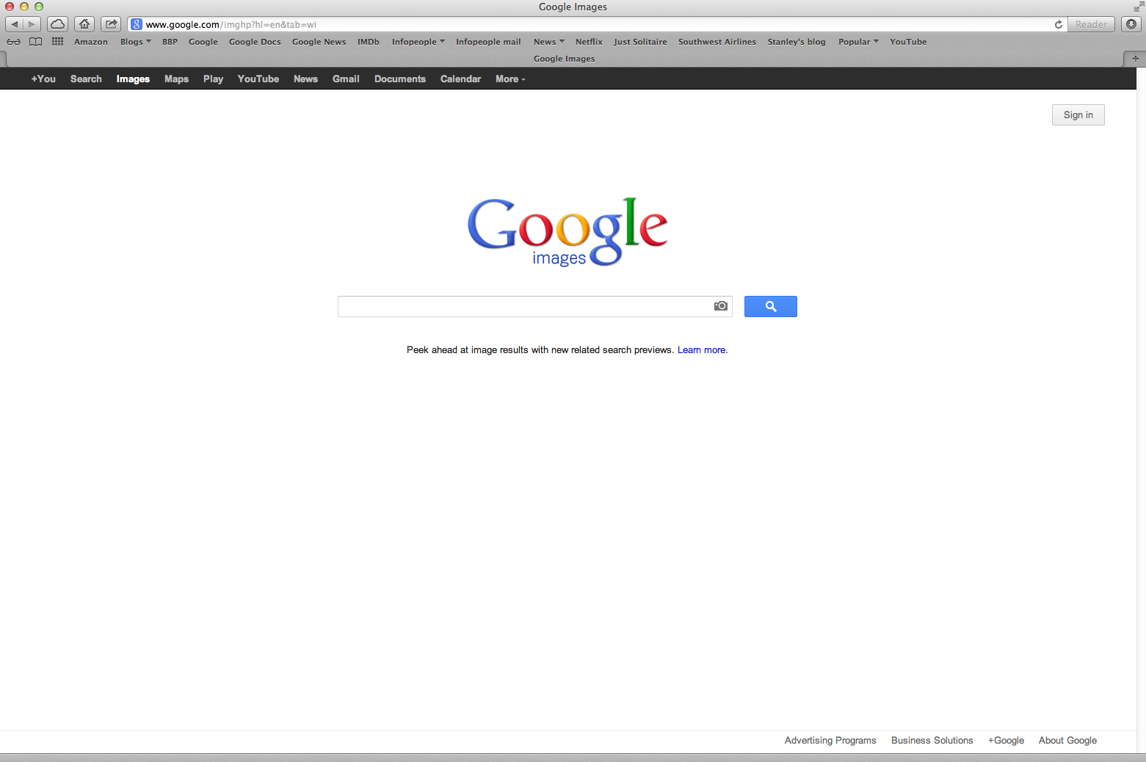
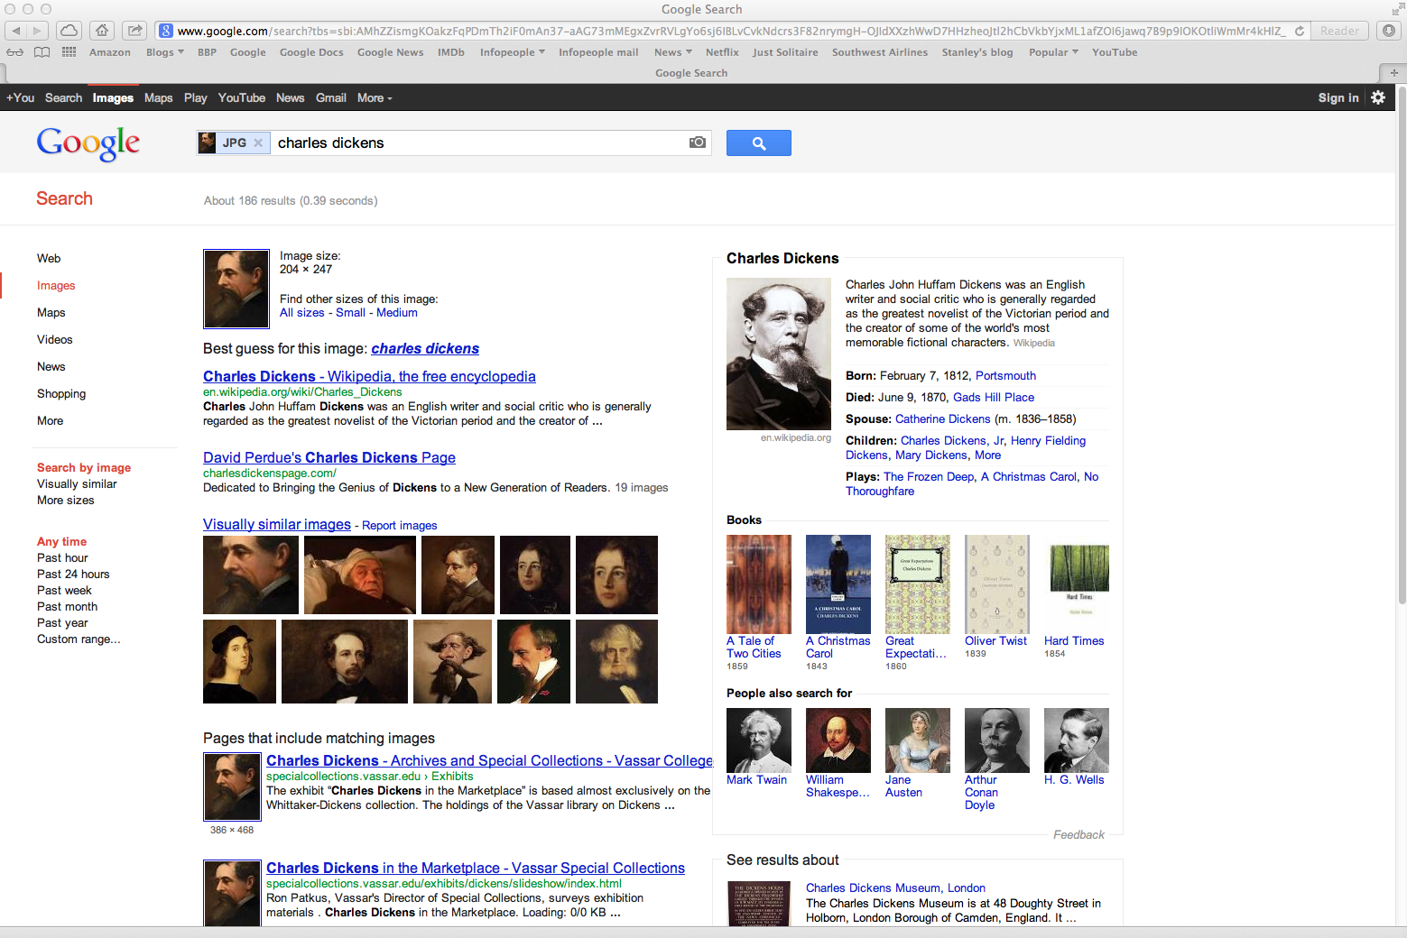
Google Image Search

Slide 60





Image File Formats

Slide 61




Slide 62



Editing Images
In Keynote
In PPT
http://en.wikipedia.org/wiki/File:Autumn_leaves_%28pantone%29_crop.jpg

Slide 63
Editing Images
A Bit about Color

Slide 64




Slide 65

Working with the Web
http://personalpages.manchester.ac.uk/staff/m.dodge/cybergeography/atlas/eick_arctran.gif

Slide 66

Click…Click…Click…Gone.

Slide 67



Slide 68


Slide 69
Before
After

Slide 70



Slide 72

Writing for the Web
(A.K.A.
“Trying to get people to give a darn”)
Laura Solomon
Library Services Manager
OPLIN
laura@oplin.org
An Infopeople Webinar
Thursday, August 9, 2012
http://infopeople.org/training/writing-web

Slide 73


QR Codes
http://www.qrstuff.com/
http://www.mobile-barcodes.com/qr-code-generator/

Slide 74

Upcoming Webinars of Interest
QR Codes
Thursday, January 17, 2013 at 12 Noon Pacific
Tom Peters and Guest
Mobile Website Design
Thursday, March 14, 2013 at 12 Noon Pacific
Tom Peters and Guest

Slide 75
Working with Customer Service
Text
Images
With eager eyes and strained attention, Mr Haredale saw him chained, and locked and barred up in his cell. Nay, when he had left the jail, and stood in the free street, without, he felt the iron plates upon the doors, with his hands, and drew them over the stone wall, to assure himself that it was real; and to exult in its being so strong, and rough, and cold. It was not until he turned his back upon the jail, and glanced along the empty streets, so lifeless and quiet in the bright morning, that he felt the weight upon his heart; that he knew he was tortured by anxiety for those he had left at home; and that home itself was but another bead in the long rosary of his regrets.
Shapes
Audience

Slide 76



Who Is Your Target?
What Are They Seeing?

Slide 77


Slide 78


Slide 79




1.
2.
3.
4.
5.

Slide 81
Before
After

Slide 83
Before
After

Slide 84


Slide 85
Something’s Not Working Right
We apologize for the inconvenience.
We’re working on a solution.
If you need assistance,
please ask any staff member.
Thanks for your patience.
Oh, no…
Date
Logo
Notes:
Oh, no… is in HolyCow font.

Slide 86
Before
After

Slide 87


http://www.flickr.com/photos/travelinlibrarian/

Slide 88




Slide 89

Crocker Art Museum
Sacramento, CA
Notes:
Image used is for non-English speaking visitors.

Slide 90

Take the Tour
Notes:
First time visitors see everything; regular visitors ignore most things.

Slide 91


Setting Up Shop

Slide 92

Where to Store Your Files
- On your intranet
- In your desk files
https://maps.google.com/
Notes:
So everyone can access them, particularly when you’re not there.
Because…just in case..

Slide 93


A: In the dark.
Q: Where were you when the lights went out?

Slide 94









VolunteerMatch.org
Where volunteering begins
Online Resources
Notes:
Some are free, other are one-time cost or month fee. Consider VolunteerMatch if all else fails. Have a volunteer create templates for you. Contact Carla Lehn at the California State Library for more information on the program here in CA.

Slide 95

The 7 Pesky Must-Haves
Day of the Week
Date
Time
Address
Phone Number
Contact Name
Logo
Fee
Ages
Registration
QR Code
Other

Slide 96
Three Basic Elements
Text
Images
With eager eyes and strained attention, Mr Haredale saw him chained, and locked and barred up in his cell. Nay, when he had left the jail, and stood in the free street, without, he felt the iron plates upon the doors, with his hands, and drew them over the stone wall, to assure himself that it was real; and to exult in its being so strong, and rough, and cold. It was not until he turned his back upon the jail, and glanced along the empty streets, so lifeless and quiet in the bright morning, that he felt the weight upon his heart; that he knew he was tortured by anxiety for those he had left at home; and that home itself was but another bead in the long rosary of his regrets.
Shapes
Customer Service

Slide 97



Slide 98


Questions?

Slide 99

Thanks!
stanley@infopeople.org
stanley@burningbridgespress.com
909-626-3539

Slide 100
Infopeople webinars are supported by the U.S. Institute of Museum and Library Services under the provisions of the Library Services and Technology Act, administered in California by the State Librarian. This material is licensed under a Creative Commons 3.0 Share & Share-Alike license. Use of this material should credit the author and funding source.

