Slide 1

Family Law Basics
For Public Libraries
An INFOPEOPLE Webinar
Janine Liebert
Librarian, Programs & Partnerships
LA Law Library
jliebert@lalawlibrary.org
Thursday, January 10, 2013
12 Noon
Ana M. Storey
Managing Attorney
Legal Aid Foundation of Los Angeles
Astorey@lafla.org

Slide 2
Agenda
Receive a general overview of family law matters and the divorce process
Become familiar with key terminology in family law matters
Tour the California Court’s self-help center’s sections on divorce and family law
Learn about additional print and online resources addressing divorce and family law issues

Slide 3
Matters Family Law Courts Decide
Ending a marriage (divorce) and domestic partnerships
Establishing parentage
Custody and visitation with minor children
Division of property and debts during divorce
Protections from actions by other party
Child and spousal support

Slide 4
Getting a Divorce in California

Slide 5
Key Terms and Forms
Forms to Start a Family Law Case
Summons
Petition
Response
Filing a Form
Filing Fees
Fee Waiver
Service of Process
Court Rules for Filing
Procedure for Divorce
Uncontested or Contested
Default
Judgment
Self-Represented Litigant
Self-Help Center
Where to File a Case
Jurisdiction
Venue
Parties
Petitioner
Respondent
Types of Divorce
Dissolution of Marriage
Annulment
Legal Separation

Slide 6
Divorce Basics
Divorce officially called a dissolution of
marriage
Three types: Divorce, annulment or legal separation
A court has to have the authority to hear and decide a family law case
California’s residency requirements
  Six months in California
  Three months in the County (Venue)
    Otherwise file a legal separation

Slide 7
Grounds for Divorce in California
Grounds for Divorce in California
  “Irreconcilable Differences”
  “Incurable Insanity”
California is a “no-fault” state
  Spouse does not have to give permission

Slide 8
Procedure for Divorce
Petition filed
Possible responses to the petition by the respondent
Order to Show Cause hearing
Disclose financial information
Notes:
1. Petition filed and personally served on respondent
2. Respondent has 30 days to file a Response
No Response Filed (Default)
Response Filed (Contested)
Divorce by settlement agreement
3. Order to Show Cause Hearing
Temporary child custody, support and restraining orders
4.

Slide 9
Procedure for Divorce
Three ways to complete the divorce case
Granting the divorce
  “6 months plus 1 day” rule
  Separating related issues from divorce issues
Receive a judgment signed by the court

Slide 10
Spousal Support Basics
Applies to spouses and registered domestic partners alike
Mutual duty of support while together
Temporary and permanent support
  Discretionary as to amount, duration and retention of jurisdiction

Slide 11
Online Resources:
California Courts Online
Self-Help Center

Slide 12
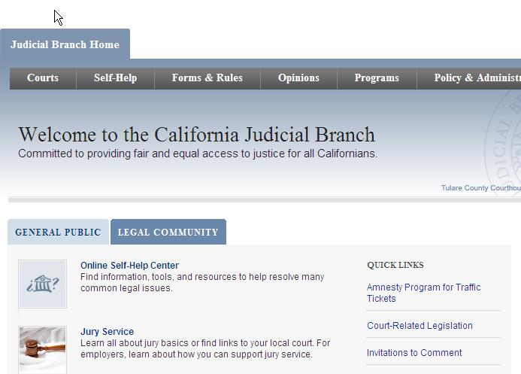
California Courts – Online Self-Help Center http://www.courts.ca.gov/

Slide 13
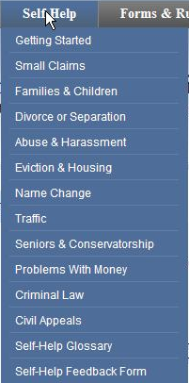
California Courts – Online Self-Help Center http://www.courts.ca.gov/selfhelp.htm
For each case type, provides basic information about applicable law
Outlines steps in court process
Forms presented within informational context
Instructions for completing each form

Slide 14
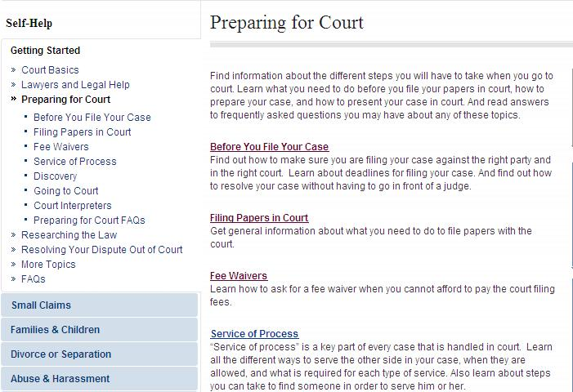
“Getting Started”
California Courts Online Self-Help Center http://www.courts.ca.gov/1002.htm

Slide 15
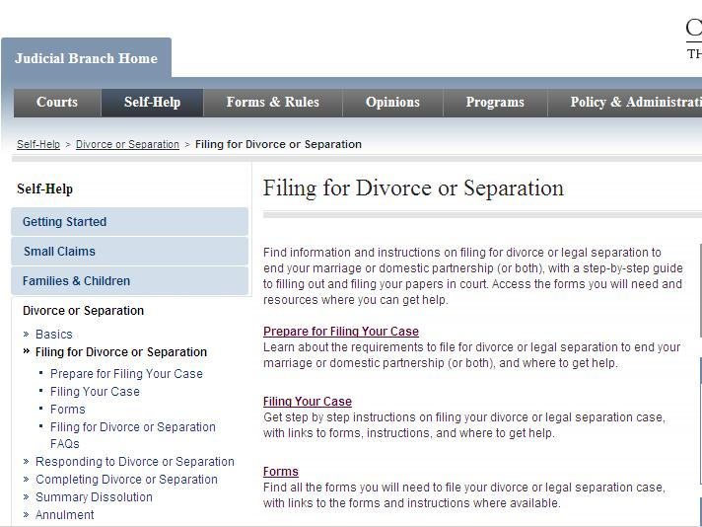
“Filing for Divorce or Separation”
California Courts Online Self-Help Center http://www.courts.ca.gov/1225.htm

Slide 16
Custody, Support and Paternity

Slide 17
Key Terms and Forms
California Family Code (CFC)
Custody
Joint Legal Custody
Sole Legal Custody
Joint Physical Custody
Sole Physical Custody
Family Law Facilitator
Visitation
Minor Child
Guardian ad litem
Paternity/Parentage
“Other Parent”
Procedure
Court Hearing
Court Orders
Mediation
Wishes of the Child - Testimony
Forms
Order to Show Cause w/Declaration
Income & Expense Declaration
Declaration under the Uniform Child Custody Jurisdiction and Enforcement Act (UCCJEA)
Volunteer Declaration of Paternity

Slide 18
When are Custody Decisions Made?
Marital and domestic partnership litigation
Exclusive custody
Domestic Violence Prevention Act (DVPA)
LA County’s Child Support Services Department (CSSD)
Grandparent visitation

Slide 19
General Custody Guidelines
Frequent and continuing contact with both parents
Best Interests of the child
Factors considered in determining child’s best interest
History of abuse
Denial of custody or visitation

Slide 20
Court Hearing on Custody/Visitation
Role of mediation
  Agreement in mediation
  No agreement in mediation
Evaluation
Minor’s counsel
Wishes of the child - testimony
Order to Show Cause (OSC) hearing

Slide 21
Child Support Basics
Both parents have a duty to support their minor children
Statewide uniform child support guidelines
  Equation based on both parents’ income
  Computer programs to calculate support
  Add-ons for healthcare, education and child care expenses

Slide 22
Parentage/Paternity
What it means to establish paternity
Why establish paternity
Ways to establish paternity
  Volunteer Declaration of Paternity
Disputing paternity

Slide 23
Online Resources:
California Courts Online
Self-Help Center

Slide 24
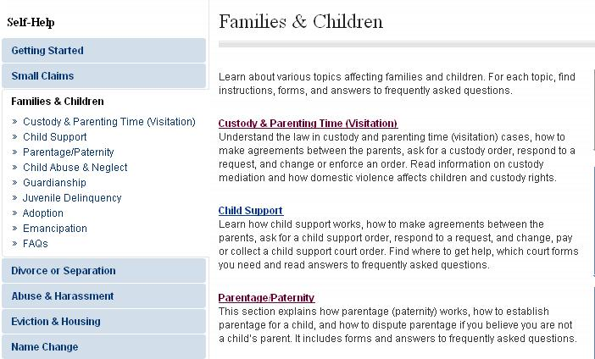
“Families & Children”
California Courts Online
Self-Help Center http://www.courts.ca.gov/selfhelp-family.htm

Slide 25
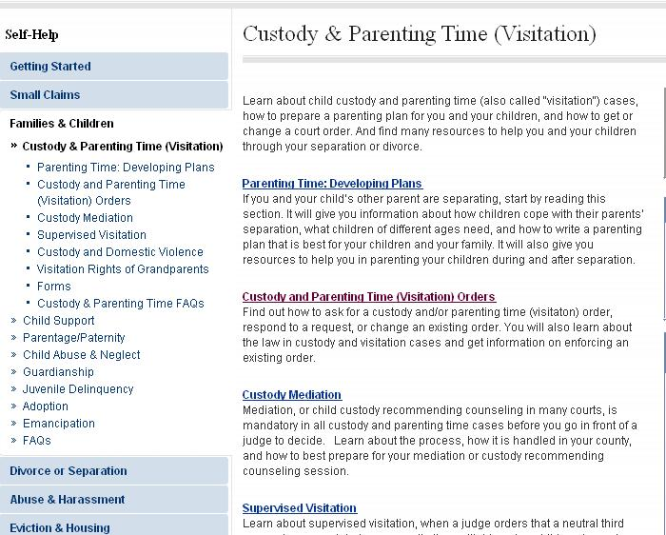
Custody & Parenting Time (Visitation) http://www.courts.ca.gov/selfhelp-custody.htm

Slide 26
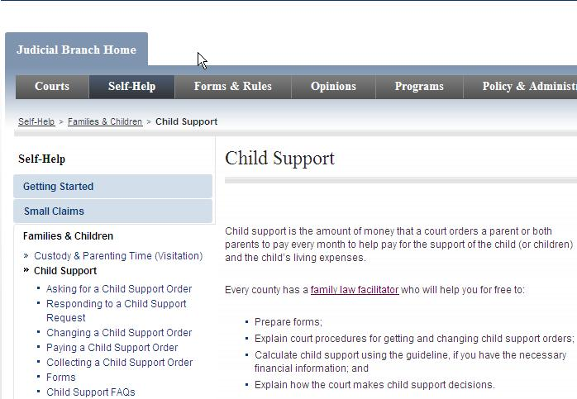
Child Support
California Courts Online Self-Help Center http://www.courts.ca.gov/selfhelp-support.htm

Slide 27
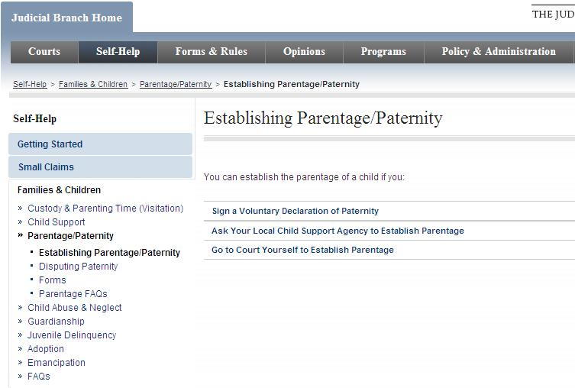
Establishing Paternity http://www.courts.ca.gov/1201.htm

Slide 28
Domestic Violence

Slide 29
Key Terms
Restraining Orders
Temporary Restraining Order (TRO)
Standard Restraining Order (ATRO)
Domestic Violence Prevention Act (DVPA)
DVPA Orders
California Evidence Code
Types of Evidence
Acts of the parties
Witness testimony
Records, documents,
exhibits, objects, recordings, etc.

Slide 30
Domestic Violence
Domestic Violence Prevention Act (DVPA) Allows an abuse survivor to apply for:
  Protection from further abuse
  Custody and support over children
  Control of property (including pets) and kick out orders; and
  Payment of debts, restitution and attorney fees and costs to prevailing party
Requires an intimate relationship
  Minors over 12 don’t need a “Guardian ad Litem” (GAL)

Slide 31
Domestic Violence
(Restraining Orders)
Evidence to prove domestic violence
Temporary restraining order (TRO)
Permanent domestic violence restraining order
Notes:
Preponderance of Evidence to Prove Domestic Violence
Support Person
No fee for filing for a domestic violence restraining order

Slide 32
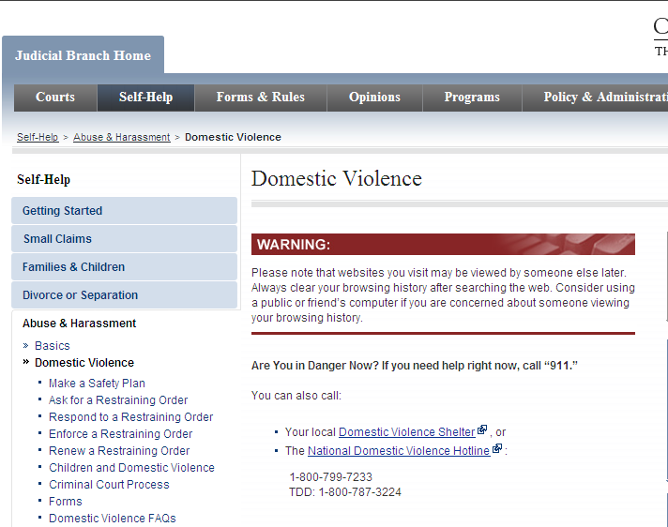
Domestic Violence Restraining Orders http://courts.ca.gov/selfhelp-domesticviolence.htm

Slide 33
Self-Represented Litigants
Types of cases where lawyers are needed
Legal advice versus legal information
Courts=neutrality versus lawyers=advocates
Preparing for court
Notes:
Courts = neutrality versus lawyers = advocates

Slide 34
Online Resources and Facilitating Referrals

Slide 35
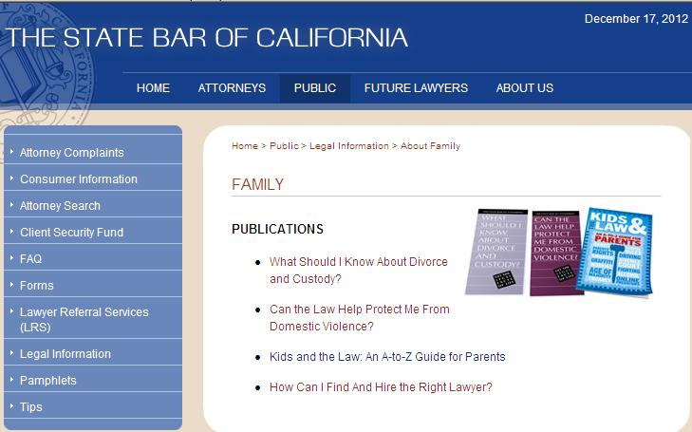
Online Resources –
California State Bar http://www.calbar.ca.gov/Public/LegalInformation/AboutFamily.aspx

Slide 36
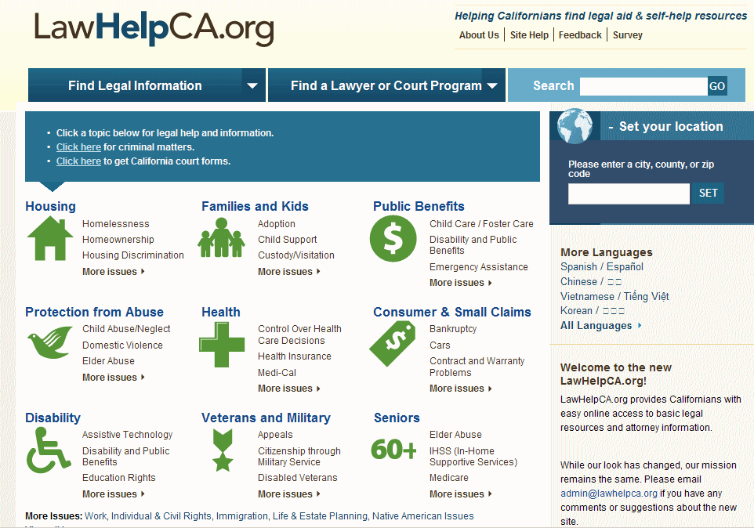
Law HelpCA.org
www.lawhelpca.org

Slide 37
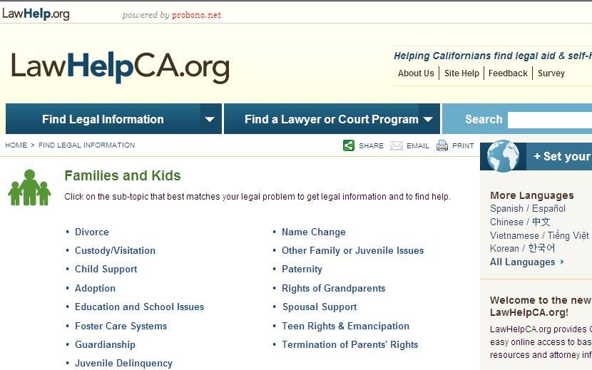
LawHelpCA.org – Families and Kids
www.lawhelpca.org
Notes:
Click on the subtopic that best matches your specific question.

Slide 38
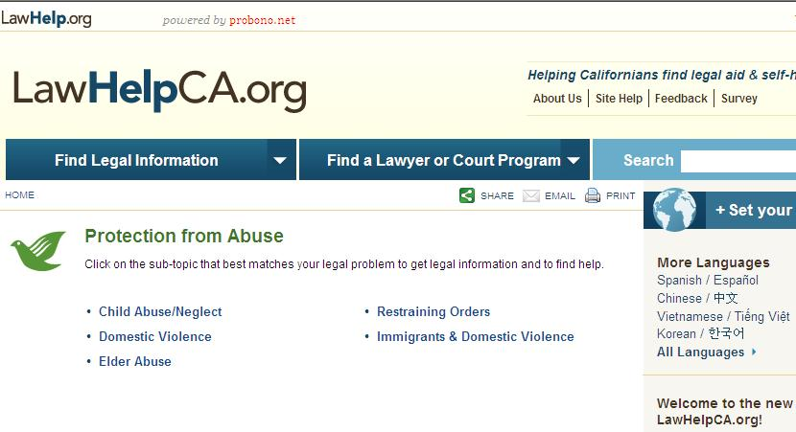
LawHelpCA.org – Protection from Abuse
www.lawhelpca.org

Slide 39
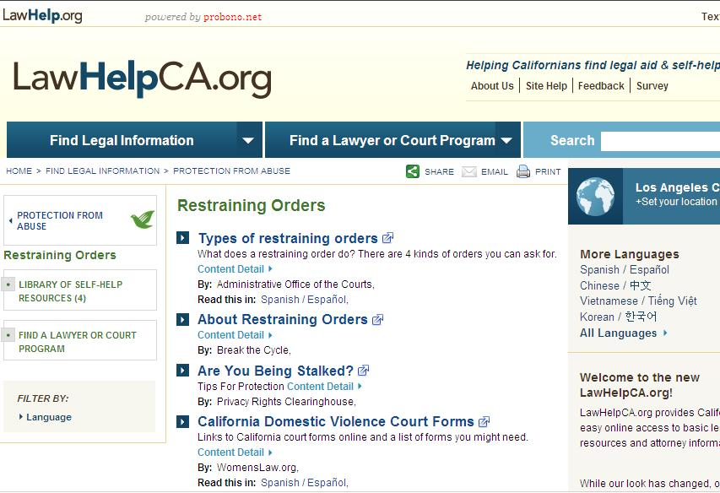
LawHelpCA.org
www.lawhelpca.org
Notes:
Use the tabs on the left to find referrals or self-help resources connected to your legal question.

Slide 40
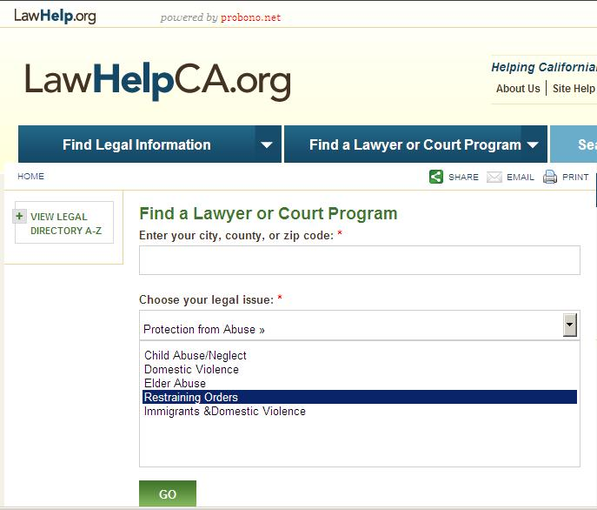
LawHelpCA.org
www.lawhelpca.org

Slide 41
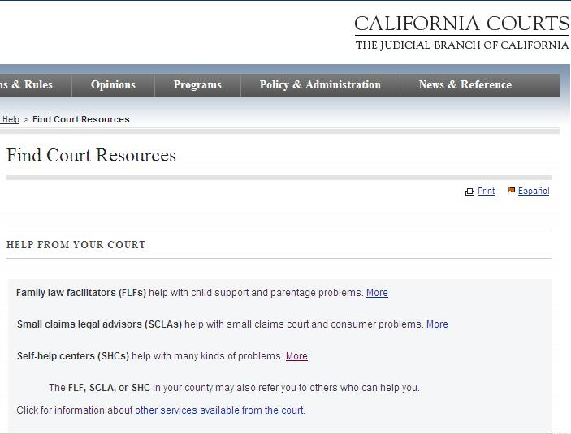
California Courts’ Self-Help Programs http://www.courts.ca.gov/selfhelp-courtresources.htm

Slide 42
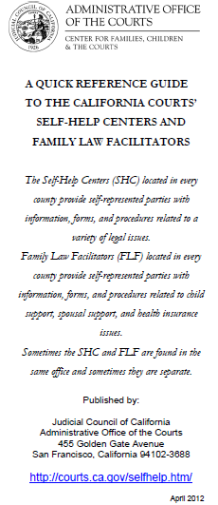
Locating Family Law Facilitators and Self-Help Centers in California
California Courts’
Self-Help Centers and Family Law Facilitators Reference Guide
http://courts.ca.gov/documents/Public_Locations_Directory_4-9-12.pdf
Downloadable brochure provides locations for family law facilitators and self-help centers located in every county in California

Slide 43
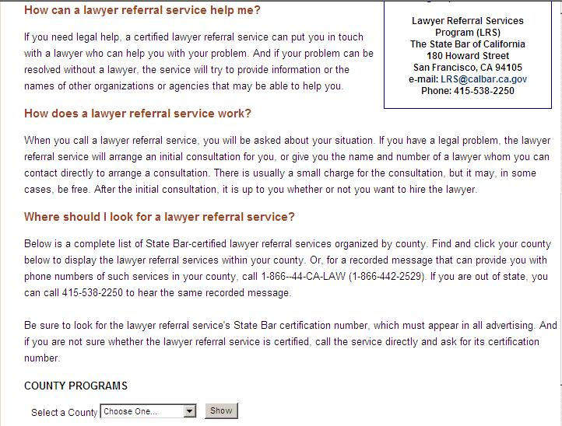
State Bar of California – Lawyer Referral Services http://www.calbar.ca.gov/lrs

Slide 44
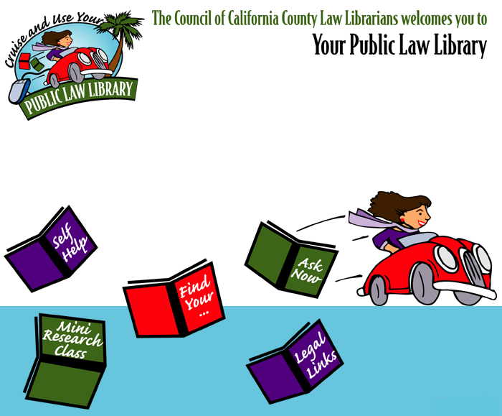
Locating Law Libraries in CA
Council of California County Law Librarians http://www.publiclawlibrary.org

Slide 45


Slide 46
Thank You!
Janine Liebert
Librarian, Programs & Partnerships
LA Law Library
jliebert@lalawlibrary.org
Ana M. Storey
Managing Attorney
Legal Aid Foundation of Los Angeles
Astorey@lafla.org

Slide 47

Infopeople webinars are supported by the U.S. Institute of Museum and Library Services under the provisions of the Library Services and Technology Act, administered in California by the State Librarian. This material is licensed under a Creative Commons 3.0 Share & Share-Alike license. Use of this material should credit the author and funding source.

