Slide 1

Finding Legal Forms:
Getting Started in Public Libraries
An Webinar
Thursday, February 7, 2013
12 Noon
Janine Liebert
Librarian, Programs & Partnerships
LA Law Library
jliebert@lalawlibrary.org

Slide 2
Workshop Objectives
Be able to understand the two types of legal forms – “pre-made” and “self-created"
Have a basic understanding of the free forms that court websites have and what they don’t have
Be introduced to the Forms section on Courts.ca.gov, the California Courts website and the different ways to access those forms
Learn about form resources – both in print and electronic – publicly available at county public law libraries

Slide 3
Categories of Forms
Transactional Forms:
Generally of a business or transactional nature. If filed, with an agency or office, not in a court. Pre-printed or self- created.
Pleading and Practice:
Filed in Court proceedings. Filed in proper court. Pre-printed or self-created.

Slide 4
How to Find Forms
Sources for forms
  Court and agency websites
  Form books
  Commercial library databases
Tip: If you need a form you are going to file with a specific court or agency, start at the court’s/agency’s official website. Many courts and agencies have standardized forms for this purpose.

Slide 5
Preprinted California Court Forms
California Courts have provided preprinted fill-in forms for many commonly used court papers
Commonly called “Judicial Council Forms”
Fully comply with all format requirements
Either mandatory or optional
Available in print and on California Courts website
Many available in non-English versions

Slide 6
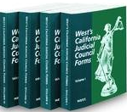
Print Resources –
Available at County Law Libraries
Printed Judicial Council Forms are available from court clerks and in:
West’s California Judicial Council Forms
Four volume set, softcover
Full-sized perforated forms
Regular index and spine index

Slide 7
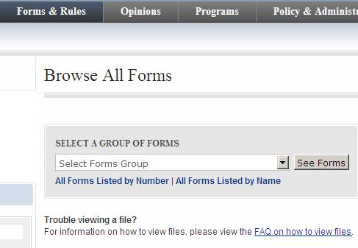
How to Find a Judicial Council Form http://www.courts.ca.gov/forms.htm
Forms listed by number
Forms listed by name
Fillable PDF’s
Downloadable

Slide 8
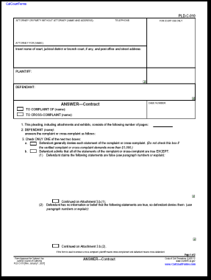
Using Judicial Council Forms http://www.courts.ca.gov/forms.htm
Mandatory or optional indicated in the lower left hand corner
Form number in upper right corner of first page
Form name in bottom center
Bottom right corner, laws that relate to what form is about

Slide 9
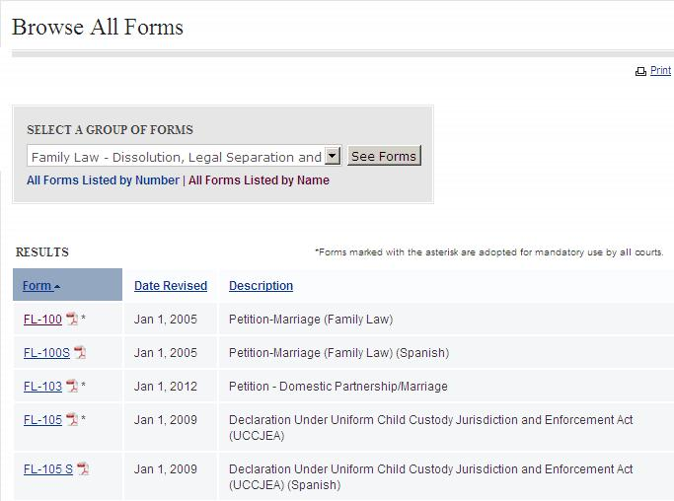
“Mandatory” Judicial Council Forms

Slide 10
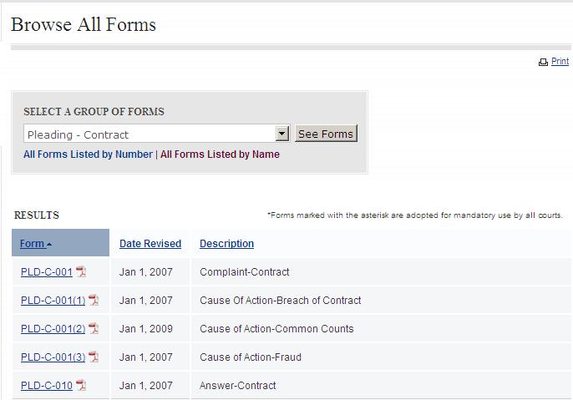
“Optional” Judicial Council Forms

Slide 11
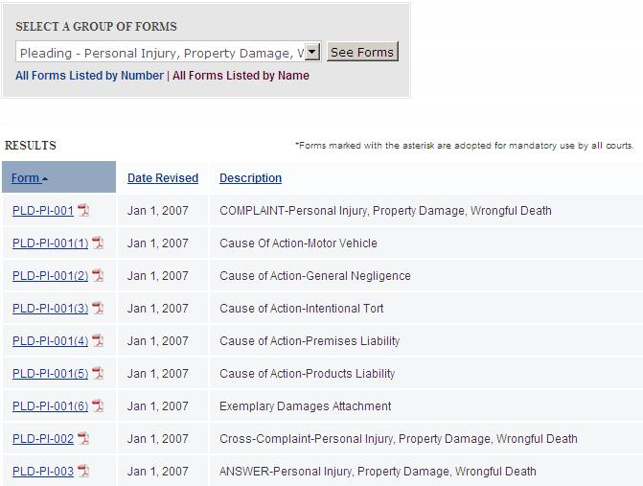
“Optional” Judicial Council Forms

Slide 12
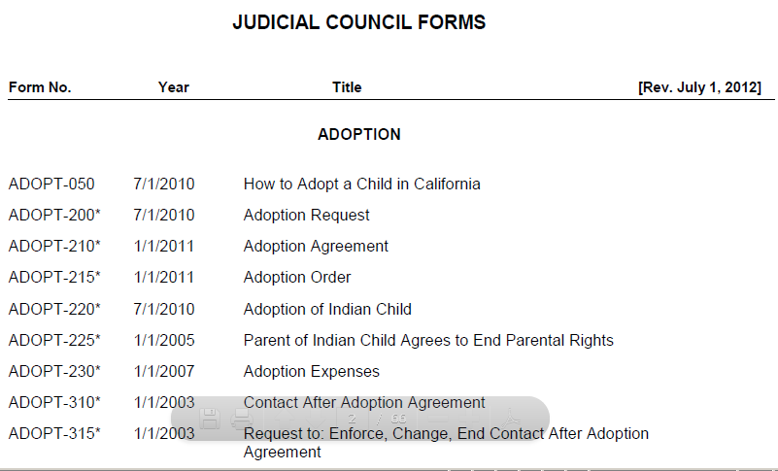
Judicial Council Legal Forms List http://www.courts.ca.gov/documents/appendix_a.pdf

Slide 13
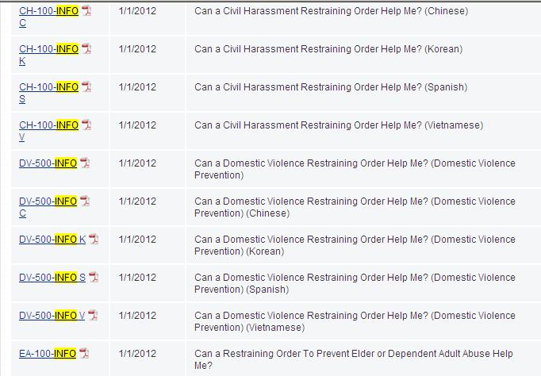
Using Judicial Council Forms

Slide 14
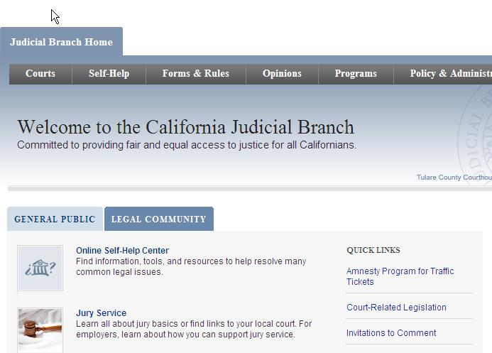
California Courts – Self-Help http://www.courts.ca.gov/

Slide 15
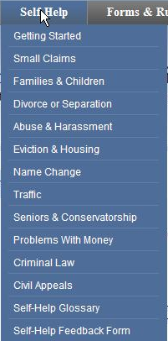
California Courts – Integrated Forms by Topic http://www.courts.ca.gov/
For each case type, provides basic information about applicable law
Outlines steps in court process
Forms presented within informational context
Instructions for completing each form

Slide 16
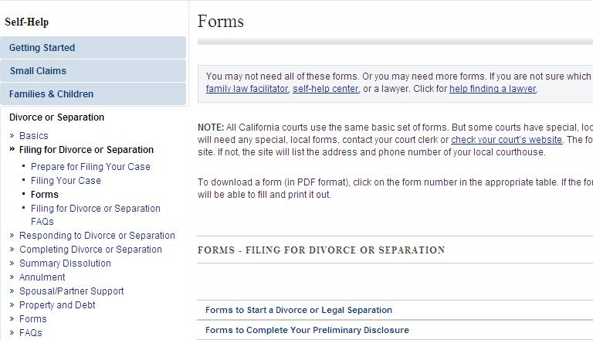
Example of Integrated Information/Forms http://www.courts.ca.gov/1230.htm

Slide 17
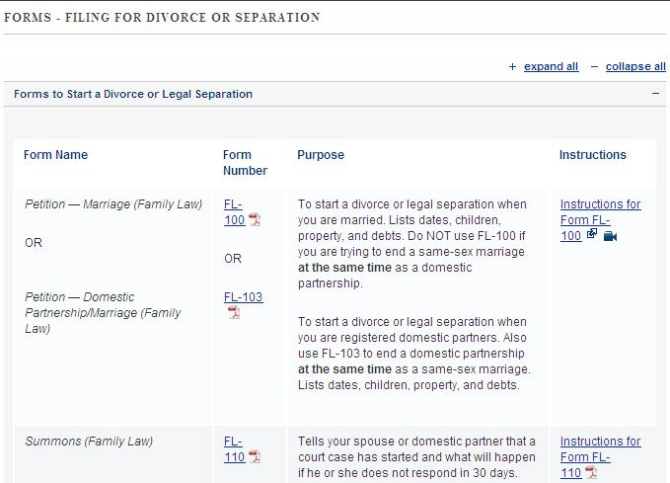
Example of Integrated Information/Forms http://www.courts.ca.gov/1229.htm

Slide 18
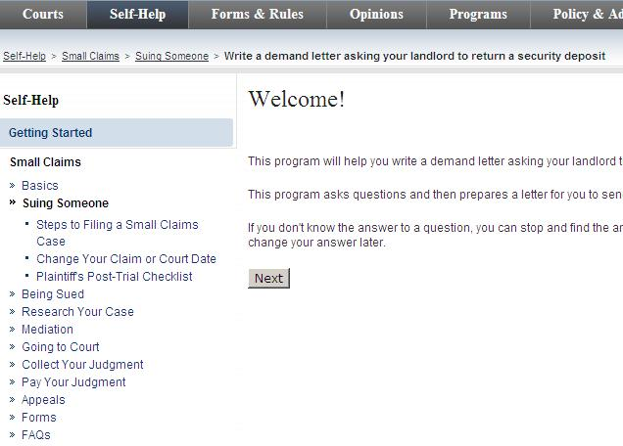
Example of Integrated Information/Forms http://www.courts.ca.gov/1230.htm

Slide 19
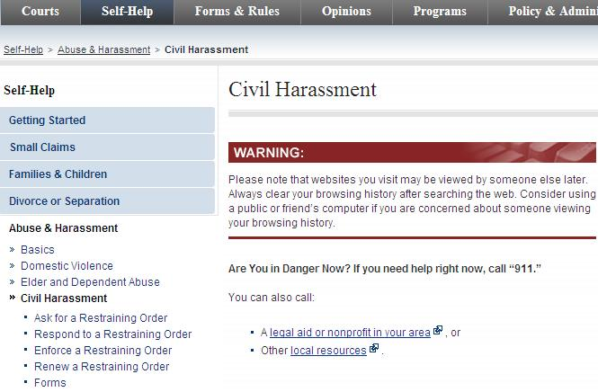
Example of Integrated Information/Forms http://www.courts.ca.gov/1230.htm

Slide 20
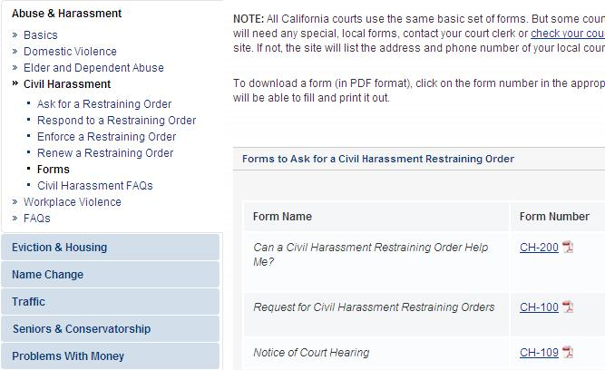
Example of Integrated Information/Forms http://www.courts.ca.gov/1230.htm

Slide 21
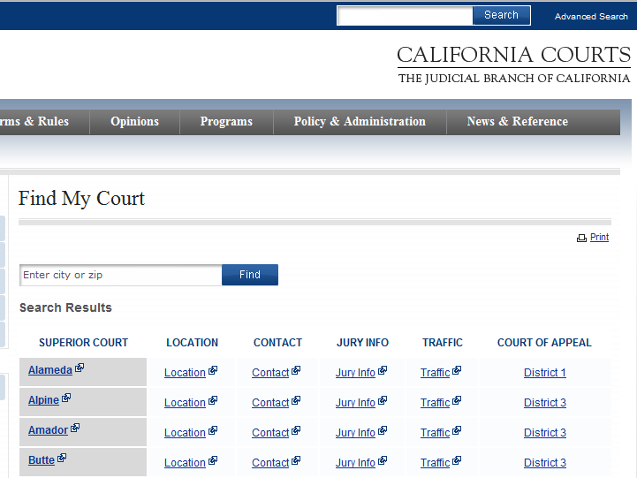
How to find a Local Court Form http://www.courts.ca.gov/find-my-court.htm

Slide 22
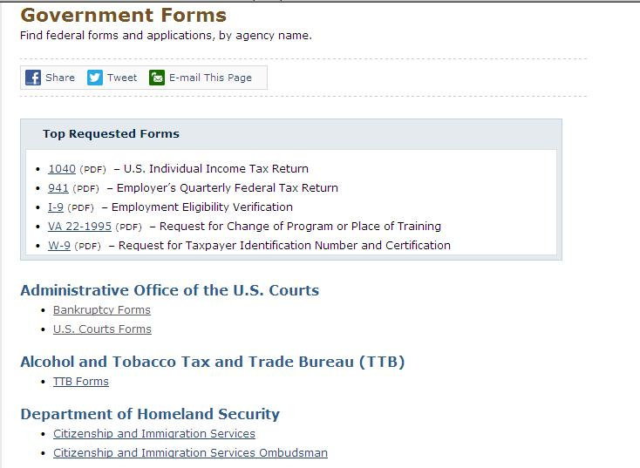
How to Find a U.S. Court Form http://www.usa.gov/Topics/Reference-Shelf/forms.shtml

Slide 23
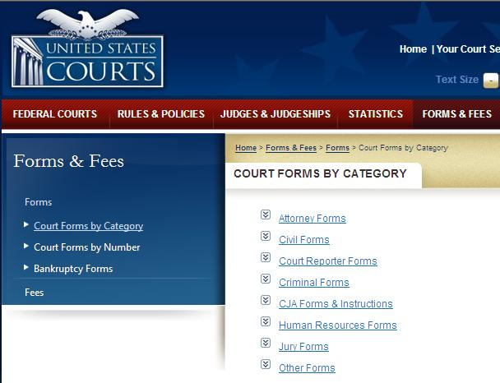
U.S. Court Forms by Category http://www.uscourts.gov/FormsAndFees/Forms/CourtFormsByCategory.aspx

Slide 24
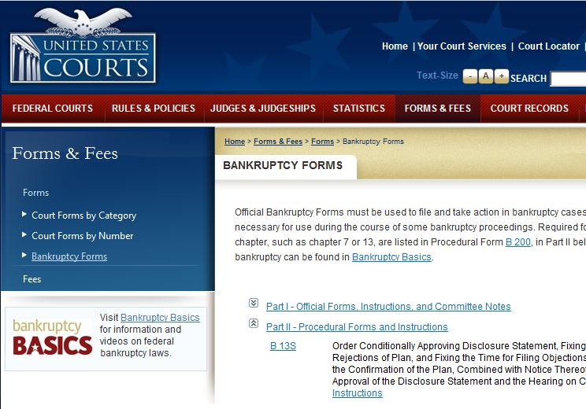
United States Courts
Bankruptcy Forms http://www.uscourts.gov/FormsAndFees/Forms/BankruptcyForms.aspx

Slide 25
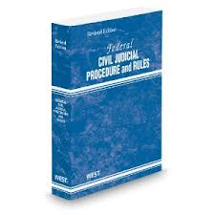
Print Resources –
Available at County Law Libraries
Official U.S. court forms available in print in:
Federal Rules Appendix of Forms
One volume, softcover
Unannotated

Slide 26
Form Packets on U.S. District Court Websites
There are also form packets developed specifically for those without lawyers – known as a pro se litigant
Available on California District Court websites
Commonly available for:
  General and civil rights
  Social security appeals

Slide 27
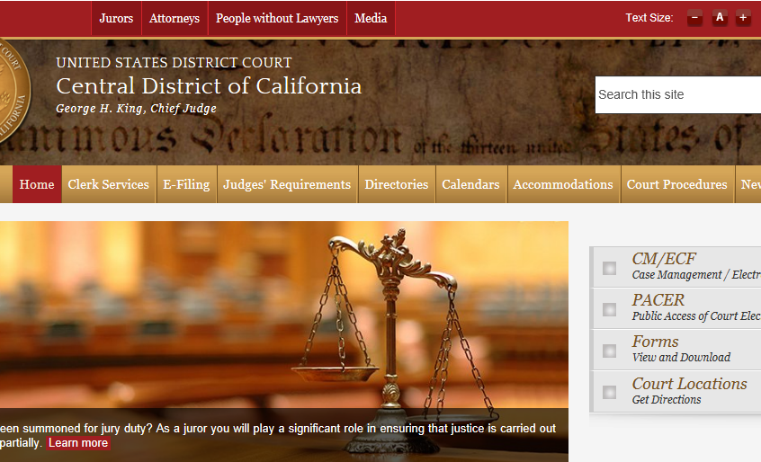
United States District Court
Central District of California Website http://www.cacd.uscourts.gov/

Slide 28
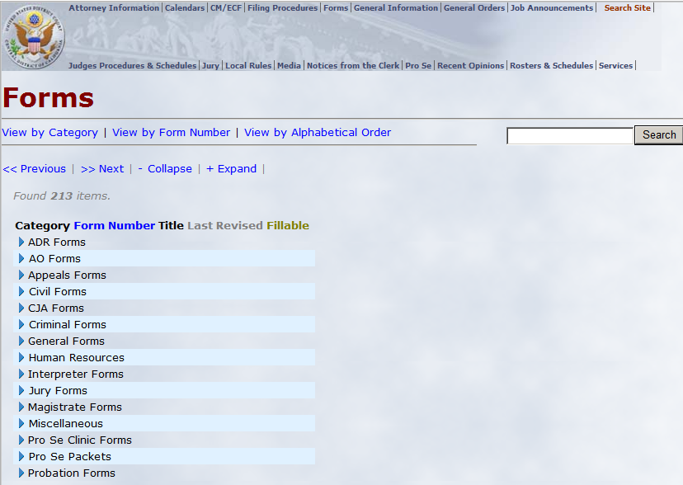
Central District of California Court Forms http://court/cacd.uscourts.gov/CACD/Forms.nsf/Forms

Slide 29
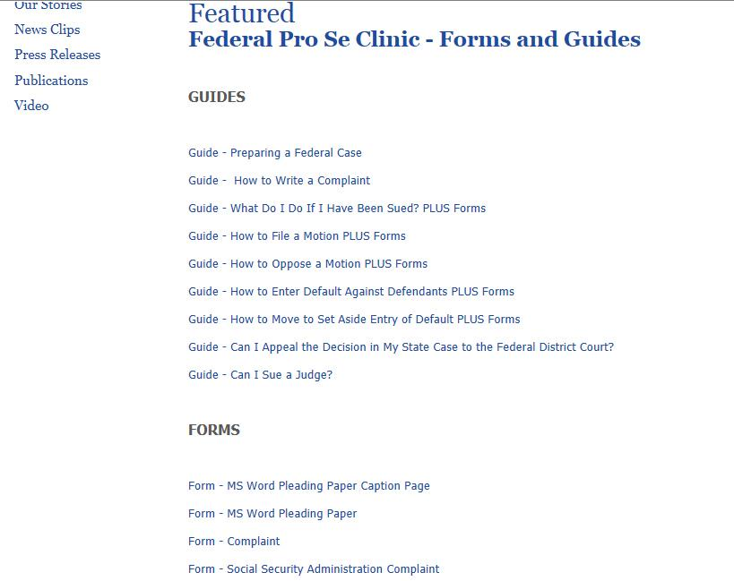
http://www.publiccounsel.org/featured?id=0003

Slide 30
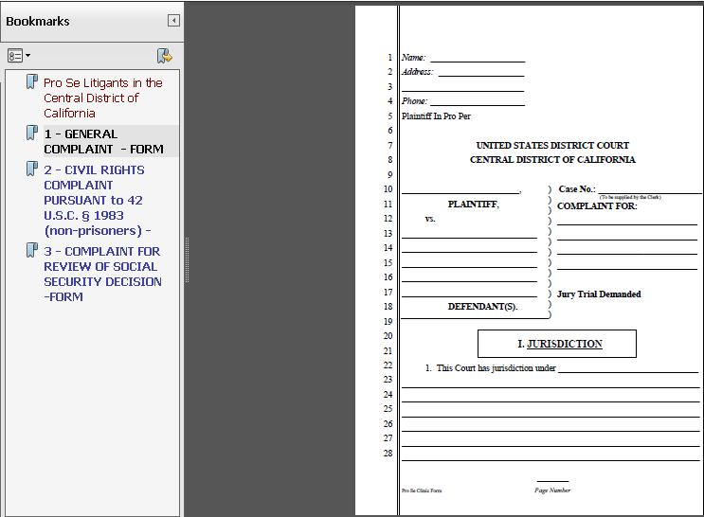

Slide 31
Creating a Form
If there is not a pre-printed form for your action, then you must create a unique form. There are library resources that will help you and give sample language.
  Motion to Set Aside a Judgment
  Motion for Stay of Execution
  Motion for Change of Venue
  Petition for Writ of Mandate
  Motion to Disqualify Judge

Slide 32
Drafting a Pleading
For state courts, must be created per California Rules of Court 2.100 – 2.119 in legal format on pleading paper
Format of a California complaint in California Forms of Pleading and Practice, ch. 123 – Complaints
To create pleading, use Microsoft Word (versions 2003 and earlier) Pleading Wizard

Slide 33
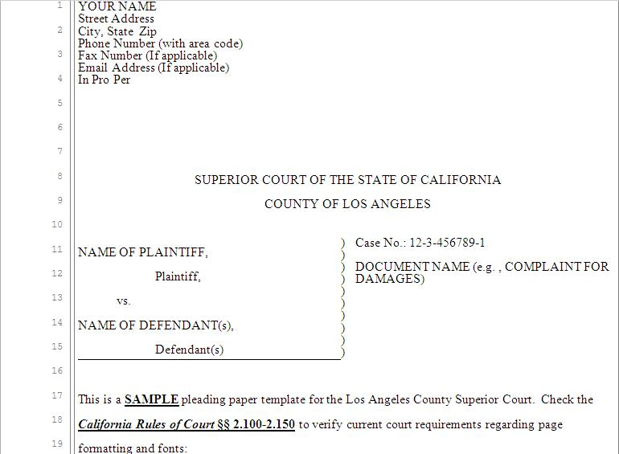

Slide 34
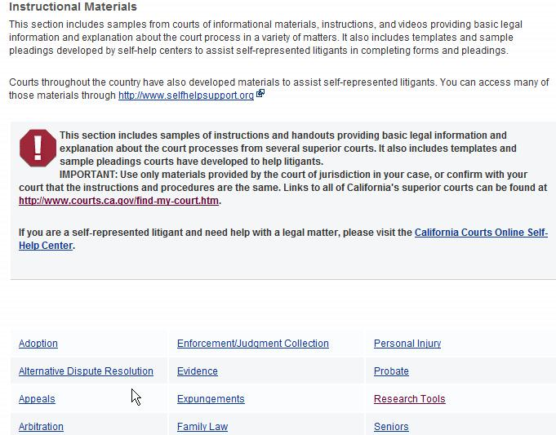
Sample Pleadings Developed by California Superior Courts http://courts.ca.gov/partners/55.htm

Slide 35
Form Books
Contain both sample forms and explanations about how to use the forms
Can be categorized:
  General
  Jurisdictional (e.g., state-specific, federal)
  Subject-specific
Available on Lexis, Westlaw, CEB OnLaw and EBSCO database, Legal Information Reference Center
Tip: Sample forms are just that -- samples.

Slide 36
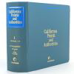
Popular California Form Books
California Forms of Pleading and Practice:
Also available on Lexis
Sample forms for complaints, answers and motions
California Points and Authorities:
Also available on Lexis
Memorandums of points and authorities in support of
of motions
California Legal Forms: Transaction Guide:
Also available on Lexis
Transactional rather than court pleading forms
Non-litigation business and personal transactions

Slide 37
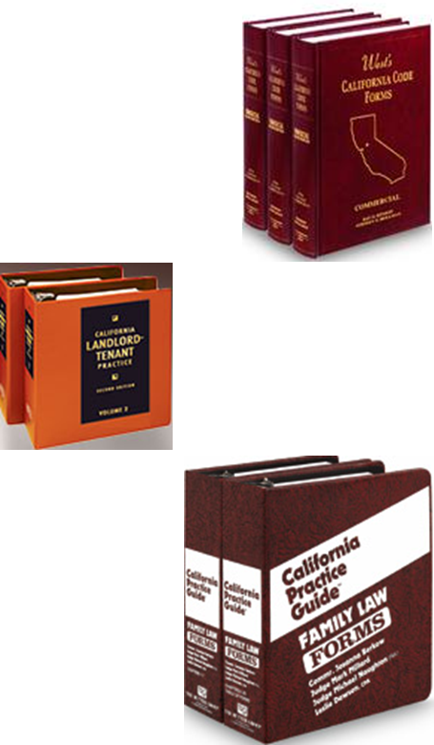
Popular California Form Books
West’s California Code Forms:
Also available on Westlaw
CEB (California Continuing Education of the Bar) publications:
Also available on CEB OnLaw
Rutter California Practice Guides:
Also available on Westlaw

Slide 38
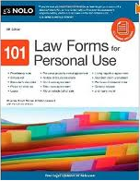
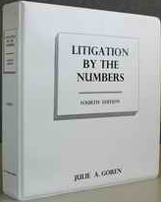
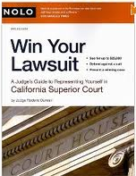
Self-Help Form Books
101 Law Forms for Personal Use (Nolo):
SHC KF170 .054
Litigation by the Numbers (Lawdable Press):
SHC KFC 995.A65 G67 2003
Win Your Lawsuit (Nolo):
SHC KFC968 .W56

Slide 39


Commercial Databases at County Law Libraries (in-library use only)
Lexis:
California Forms of Pleading and Practice, California Points and Authorities and California Legal Forms: Transaction Guide
WestlawNext:
Rutter California Practice Guides
CEB OnLaw:
California Continuing Education of the Bar publications

Slide 40
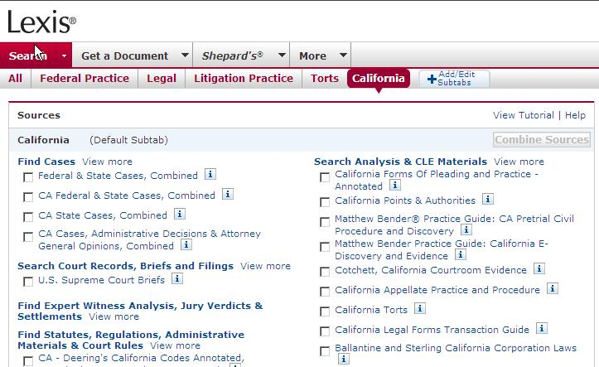
Lexis

Slide 41
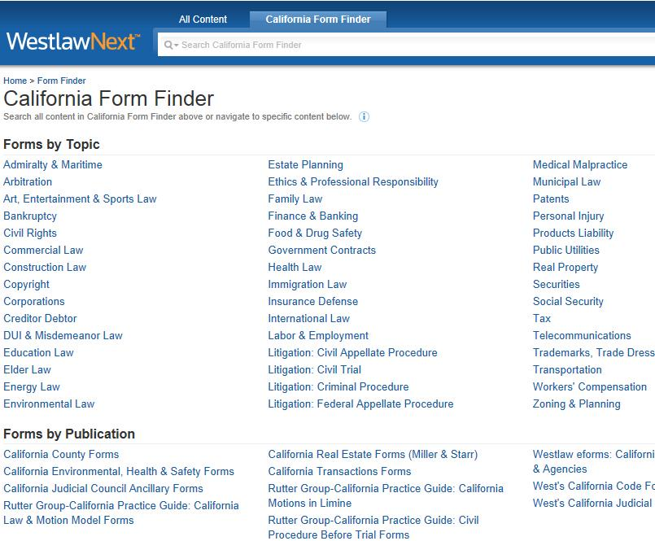

Slide 42
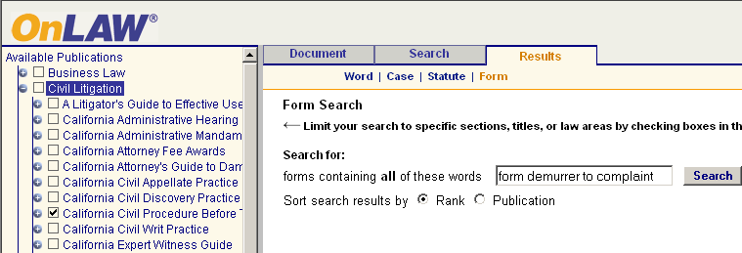
CEB OnLaw

Slide 43

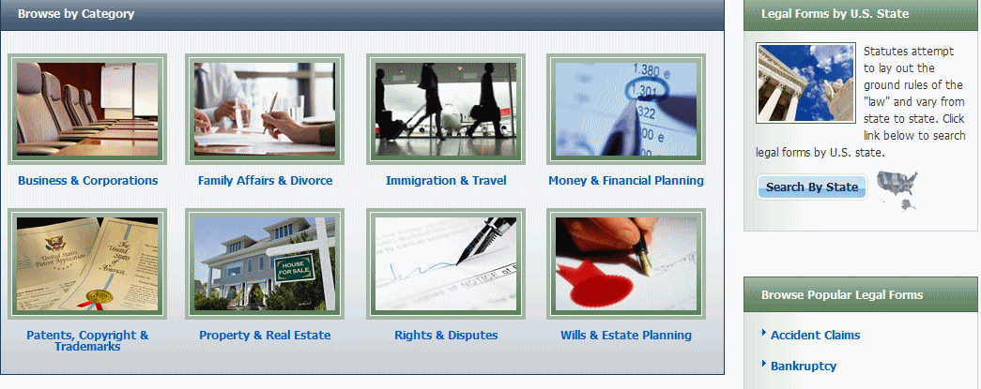
Forms – Legal Information Reference Center (EBSCO Host)
California consortium hosts full access (remotely) by county
Example: LA Law Library http://www.lalawlibrary.org/research/onsite/default.aspx
Login: CA / LA

Slide 44
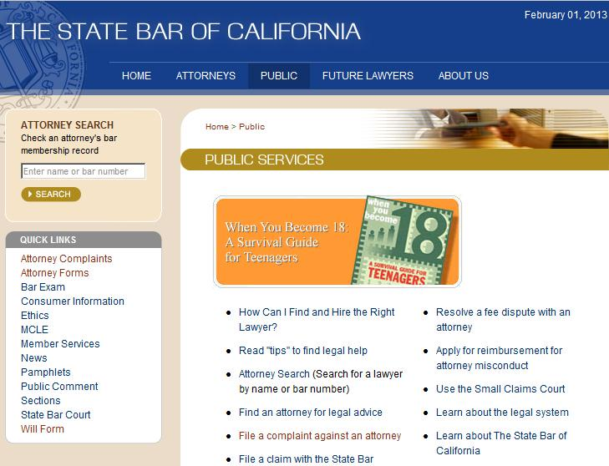
Statutory Will Form – California State Bar http://www.calbar.ca.gov/Public.aspx

Slide 45
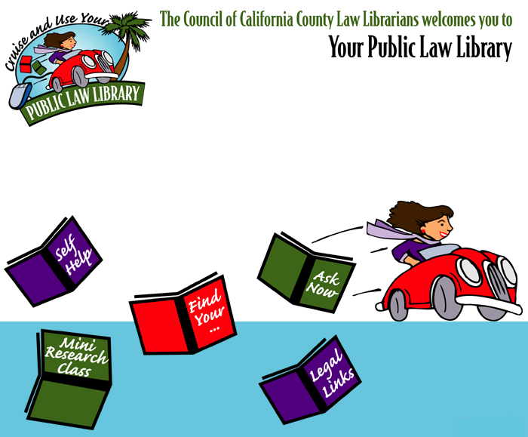
Locating Law Libraries in CA
Council of California County Law Librarians http://www.publiclawlibrary.org
Notes:
This is a website for locating law libraries in California.
Homepage for the Council of California County Law Librarians (CCCLL)
Red Circle: click on the “Find Your..” link:
List of contact info for all county law libraries in California.
Many counties have websites.
Particularly helpful if someone needs help outside of LA County.
The website also provides:
Ask Now – chat reference with a law librarian.
Self-Help provides links to websites that are helpful for people who are representing themselves in court.
Legal Links provides links to legal materials – state and federal: cases, statutes, links to locating your representative.
Mini Research Class may be interesting to you if you want to learn more about legal research.

Slide 46


Slide 47
Thank You!
Janine Liebert
Librarian, Programs & Partnerships
LA Law Library
jliebert@lalawlibrary.org

Slide 48
Infopeople webinars are supported by the U.S. Institute of Museum and Library Services under the provisions of the Library Services and Technology Act, administered in California by the State Librarian. This material is licensed under a Creative Commons 3.0 Share & Share-Alike license. Use of this material should credit the author and funding source.

