Slide 1
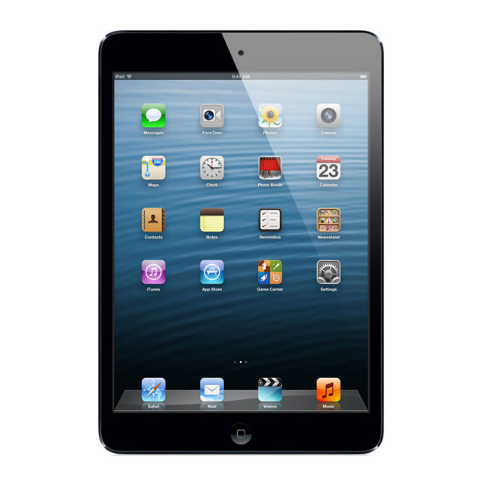
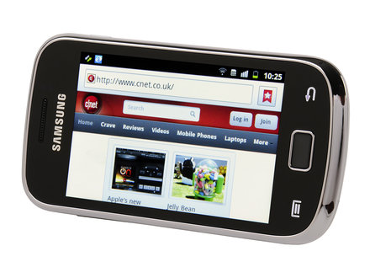
Mobile Web
Thursday, March 14, 2013
an Infopeople webinar
presented by
Chad Mairn
Design
Image sources: apple.com & samsung.com

Slide 2
Today’s Agenda
Know 3 innovative library mobile website designs.
Understand how HTML, CSS, and JavaScript work together to build mobile websites.
Know what a mobile framework is and why they are used.
Know 3 existing mobile services/apps that can be included in library-created mobile websites.
Know the best practices in mobile Web development.
Have a step-by-step guide for implementing a mobile website.

Slide 3
Quick Poll

Slide 4
Some Mobile Examples

Slide 5
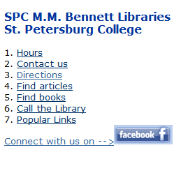
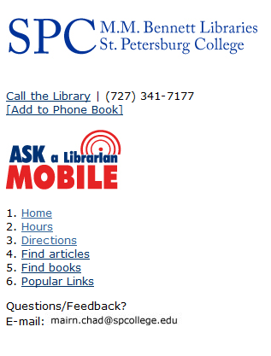
A simple mobile-optimized Website can work on all devices!
<p><a class="call" href="tel:17273417177" accesskey="0">Call the Library</a> | (727) 341-7177<br />
<a href="wtai://wp/ap;+17273417177; SPC%20Library">[Add to Phone Book]</a><br />

Slide 6
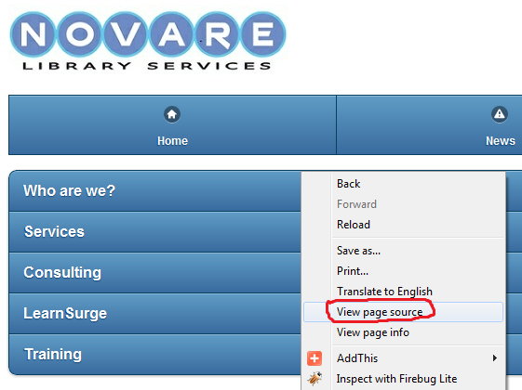
Learn and borrow from sites you like.
http://m.novarelibrary.com/

Slide 7
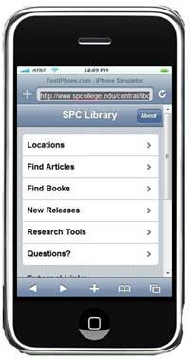
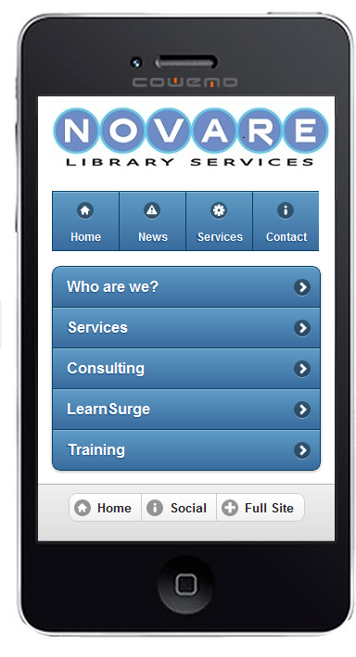
Or you can build something using HTML, CSS, and JavaScript that acts like a native app!
Built using jQTouch
Built using jQuery Mobile

Slide 8
jQuery Mobile is …
a unified, HTML5-based user interface system
for all popular mobile device platforms.
Source: http://jquerymobile.com/

Slide 9
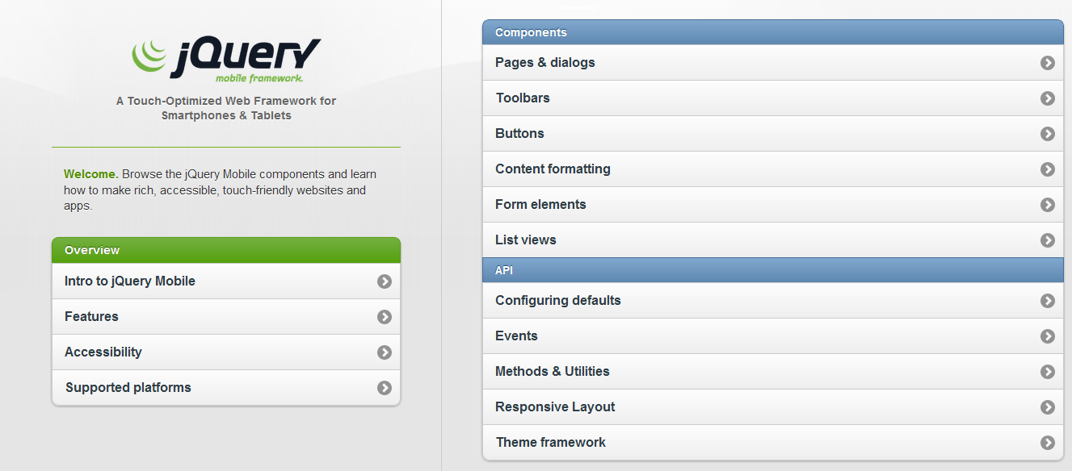
jQuery Mobile is well-documented and
there are great demos to get you started

Slide 10
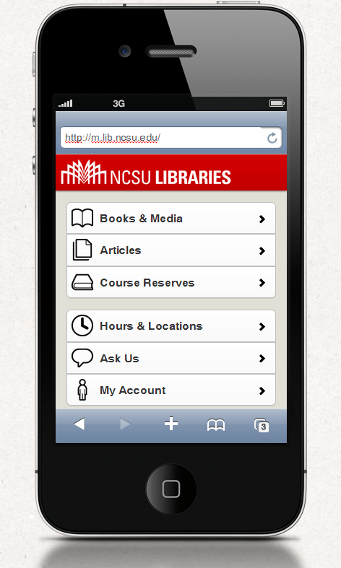

Slide 11
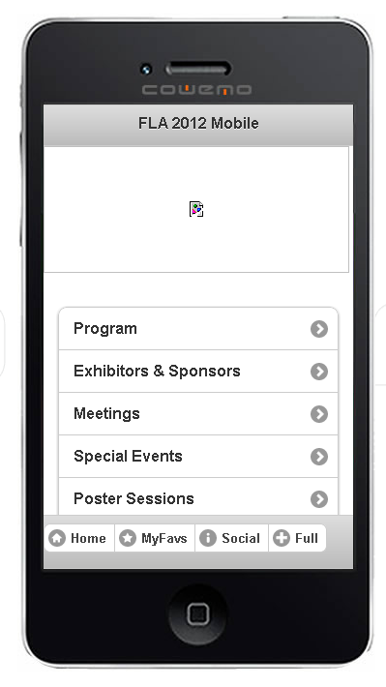
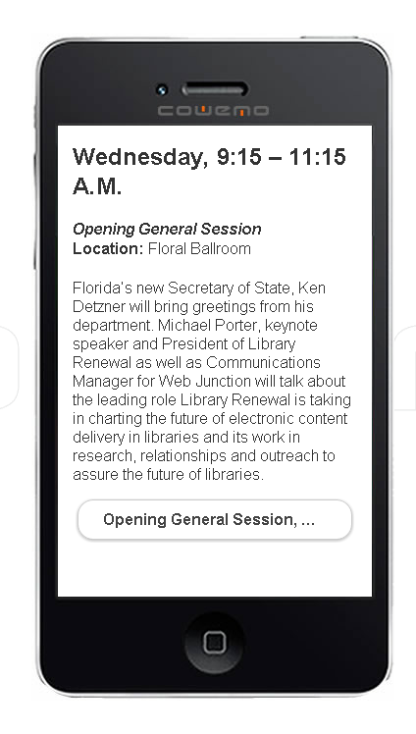

Advanced Example (Web SQL Database stores data within user’s browser. No cookies!) HTML5 has offline storage capabilities!
Favorites List
Favorites Found: 4
Conference Committee, Friday, 8-9am, Azalea A
Building the Next Generation of E-Govt, Thurs. 1-2pm, Jasmine
Opening General Session, Wed. 9:15-11:15am, Floral Ballroom
http://novarelibrary.com/FLAmobile/
Note: this URL is not a best practice. More later.

Slide 12

http://www.w3.org/TR/webdatabase/
Although Web SQL Database worked on this Web app, the W3C recommends these storage-related specifications: Web Storage and Indexed Database API.

Slide 13
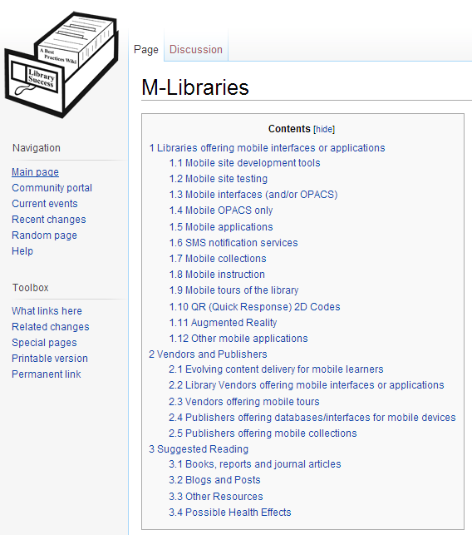
www.libsuccess.org

Slide 14
What is HTML, CSS, and JavaScript and how do they all fit together?

Slide 15



HyperText Markup Language (HTML) is the skeleton.
Cascading Style Sheets (CSS) are the skin, clothes, cologne etc.
JavaScript is the personality. The character. The pizazz!
Source: http://goo.gl/kWzET

Slide 16
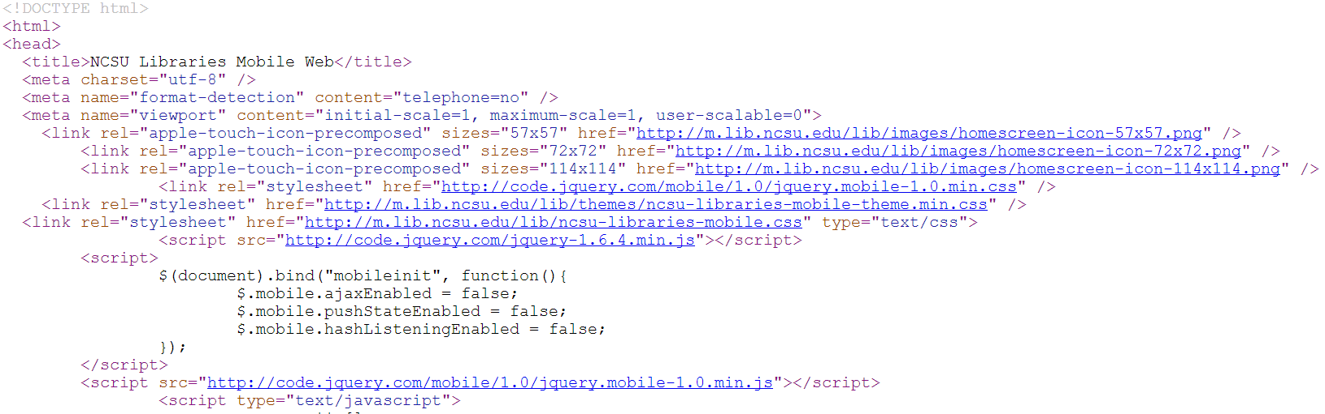

Slide 17
Native Apps vs. Web/Browser Apps
Issues | Native apps | Web apps
Internet access | Not required | Required, except for apps written in HTML5 (offline capabilities)
Shareable content (Twitter etc.) | Only if it is built in to the app | Web links can be shared. Social API’s allow 1-click posting
Access to hardware sensors | Yes: camera, gyroscope, microphone, compass, accelerometer, GPS | Access thru browser is limited. Geolocation works!
Development | Build app for target platform (Android, iOS [Objective-C] etc.) | Write/publish once using standard Web technologies, view it anywhere with URL. Speedy debugging and development.
Distribution | Most app stores require approval. | No hassles.
Source: http://goo.gl/zSeDU

Slide 18

A framework resembles scaffolding. It is a temporary platform used as a supportive guide to help build something. Mobile frameworks work similarly in that they provide libraries etc. that allow
one to build something quickly.

Slide 19
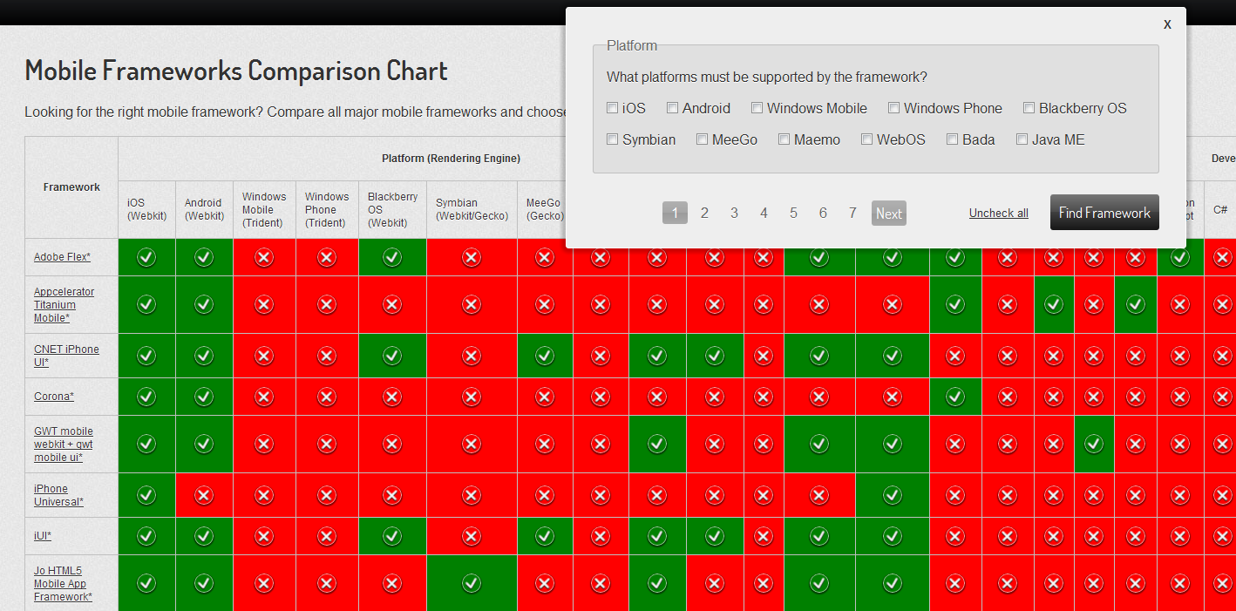
Source: http://http://goo.gl/y8CFb

Slide 20
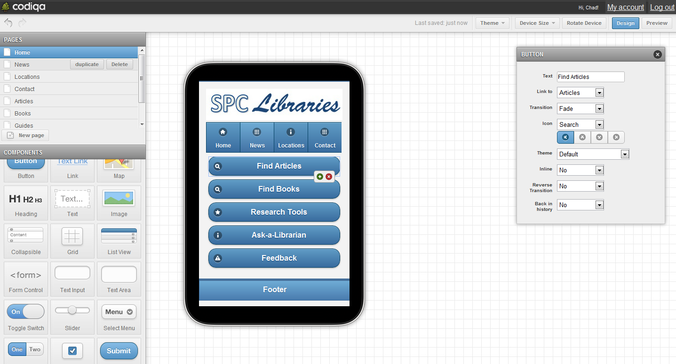
Rapid Prototyping for jQuery Mobile
Try it at http://codiqa.com/

Slide 21
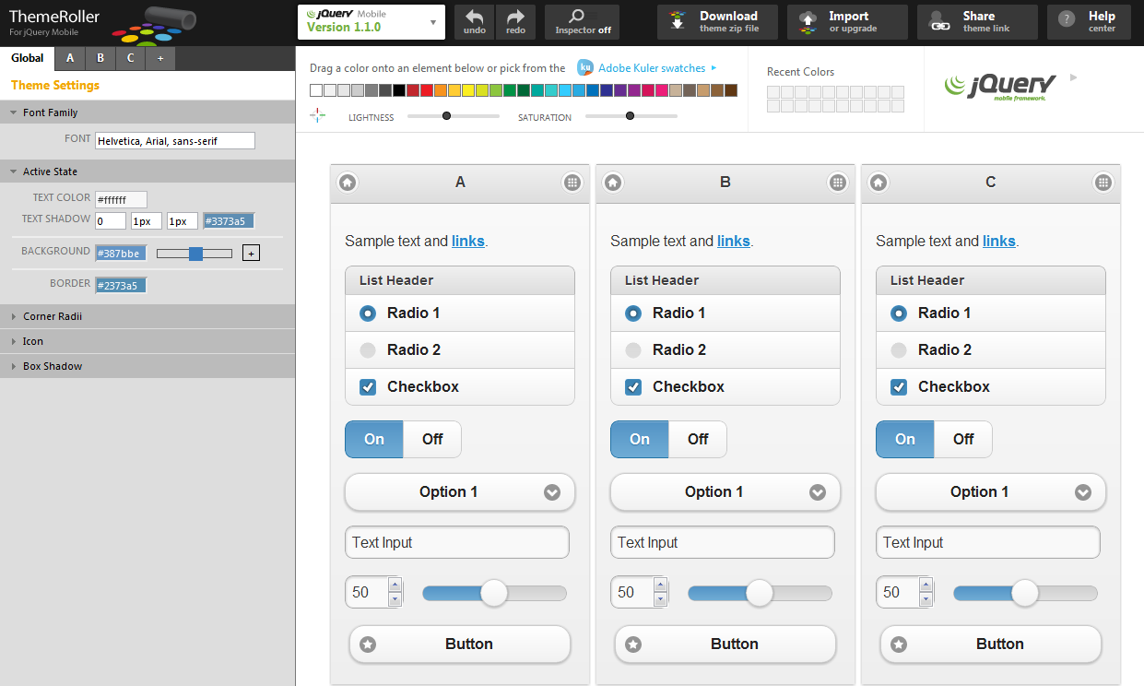
Try it at http://jquerymobile.com/themeroller/

Slide 22

Codiqa Demo

Slide 23
3rd Party Apps/Services

Slide 24
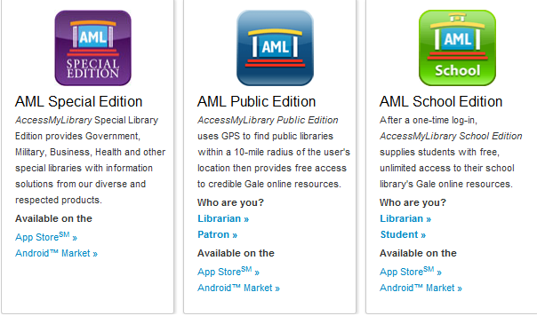
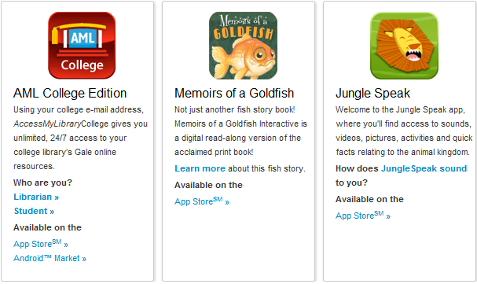
http://www.gale.cengage.com/apps/

Slide 25
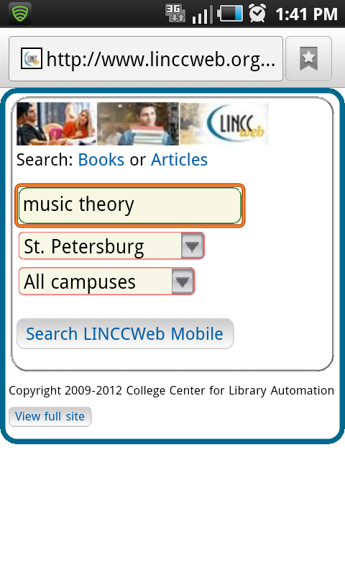
Mobile OPACs

Slide 26
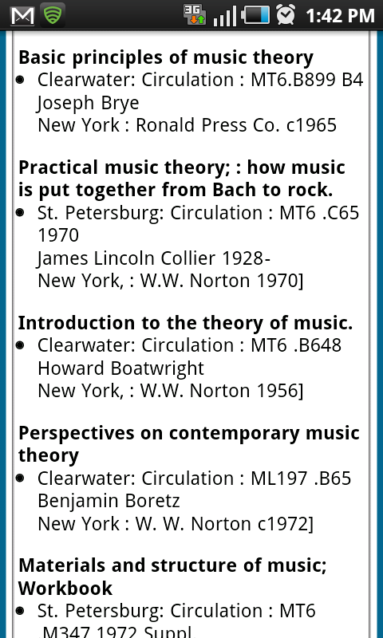

Slide 27
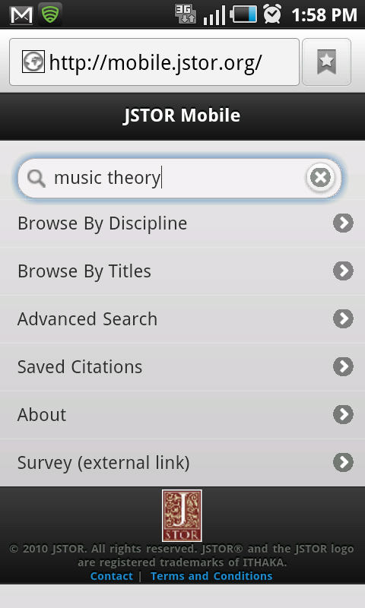
Mobile Databases

Slide 28
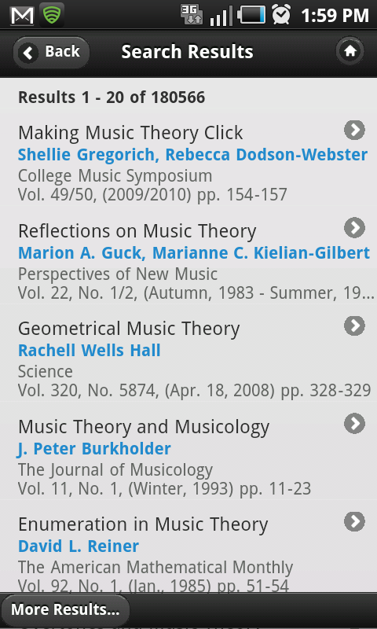

Slide 29
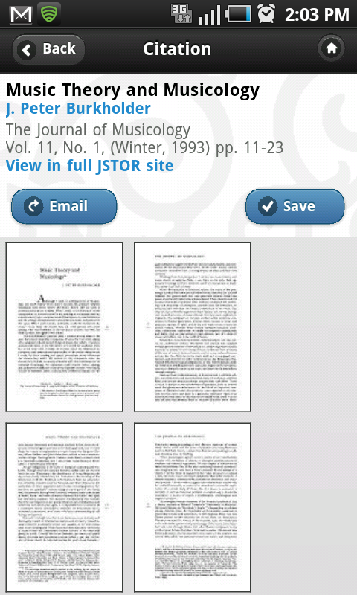

Slide 30


Powered by:

Slide 31












Some e-reading Apps

Slide 32
QR Codes etc.

Slide 33
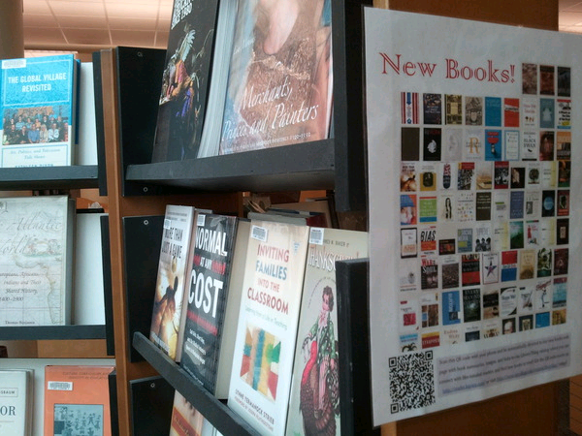
QR (Quick Response) codes can help guide mobile users in
your physical spaces come visit your digital library spaces.

Slide 34
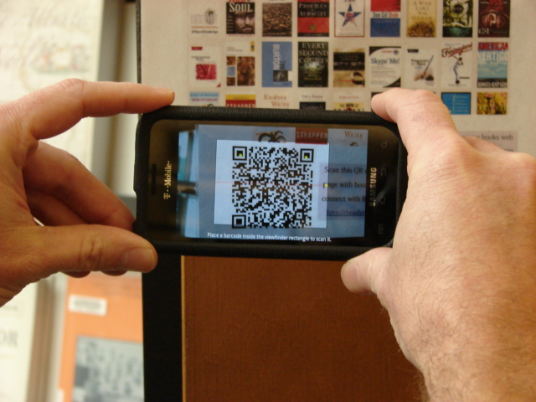
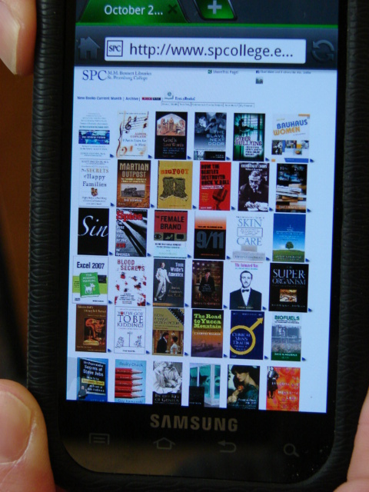

Slide 35
Check with your vendors to see if they have apps and/or mobile- optimized resources.
If they don’t, put some pressure on them to build something quickly!

Slide 36
Getting Started!

Slide 37
“Fundamentally, ‘mobile’ refers to the user, not the device or application.”
Barbara Ballard Designing the Mobile User Experience

Slide 38
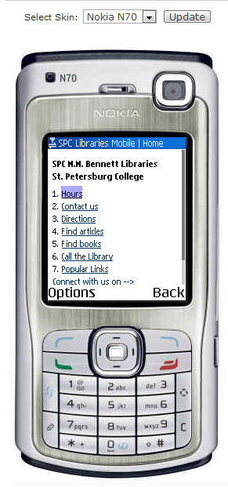
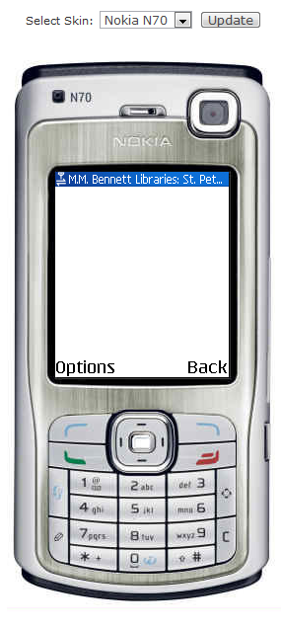
Take an emulated look at your desktop site.
Mobile Site
Desktop Site

Slide 39
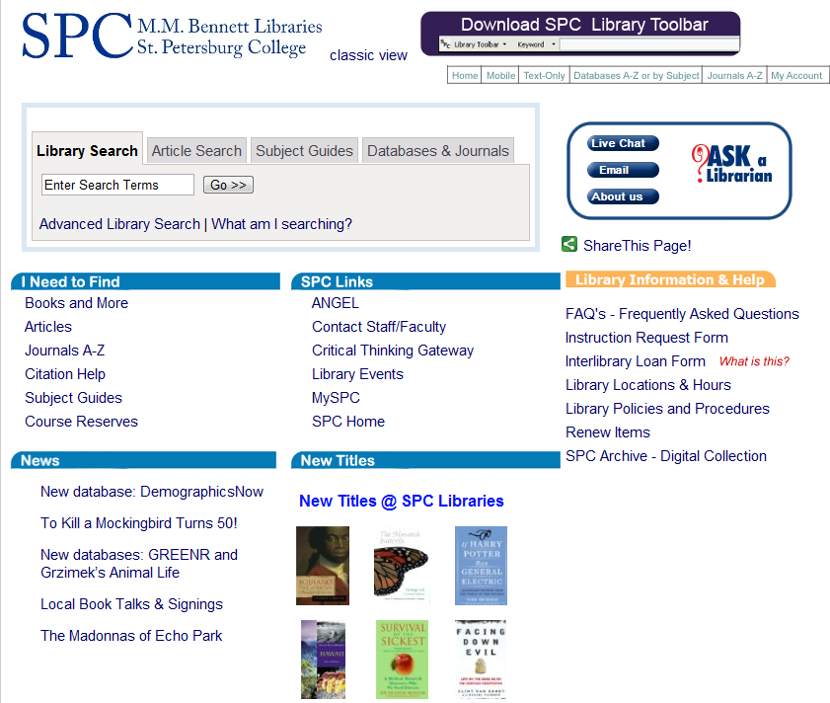
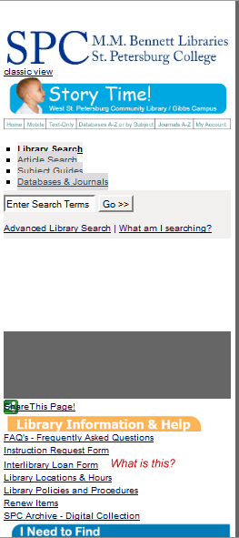
Small Screen Rendering (260 px) using the
Web Developer add-on in Firefox
Desktop
Small Screen

Slide 40
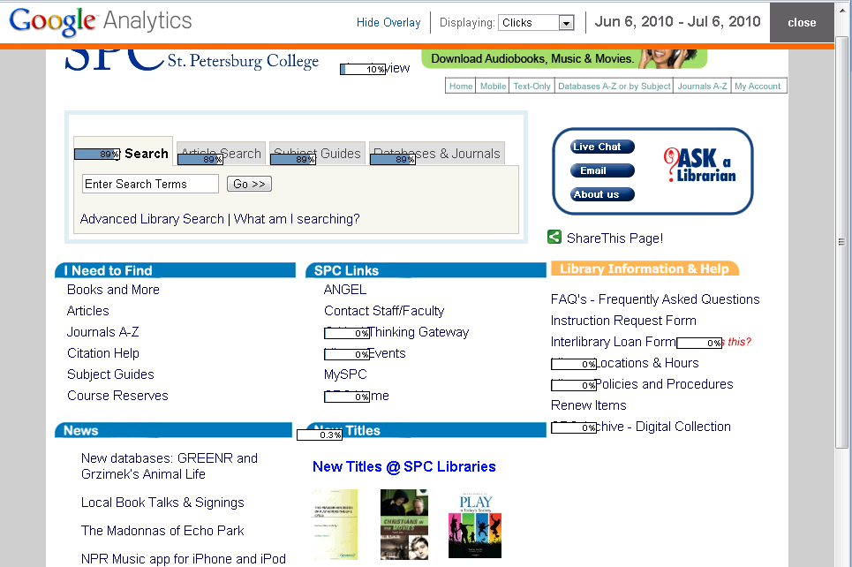
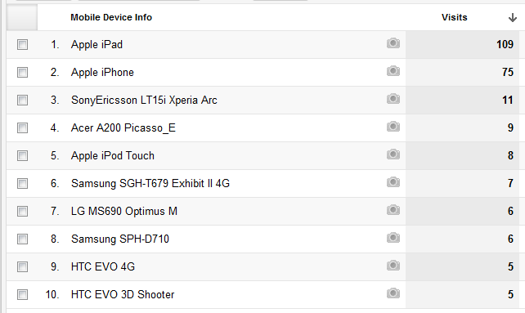
In-page Analytics
Note: you can determine how your user’s are accessing your Web site (e.g., mobile devices, carriers, browsers , OS’s, screen resolution etc.)

Slide 41
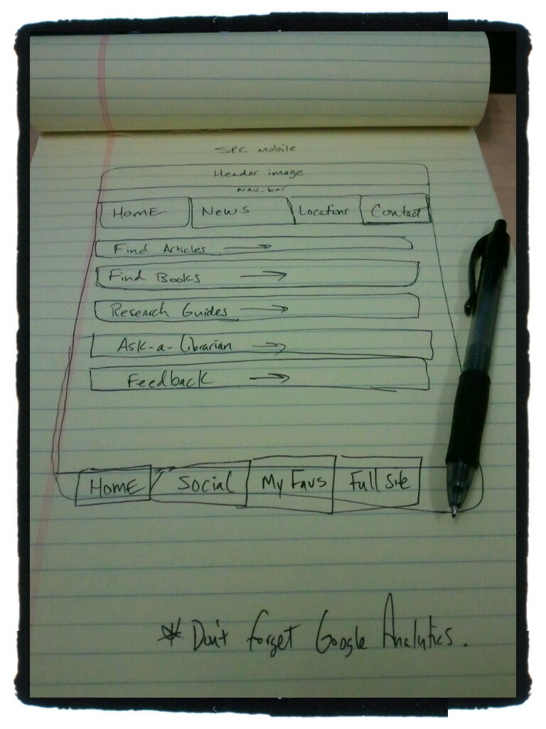
Sketch ideas

Slide 42
Some Best Practices
  Follow the "m" convention (m.novarelibrary.com OR lifeonterra.com/m/)
  Keep categories (directories) short. Remember that you are creating a page that people touch without much typing
  Limit image and markup sizes
  Limit HTML pages to 25KB to allow for caching
  "Minify" your scripts and CSS (JSLint, CleanCSS)
  Link to Full Site
  Sniff for User Agent – Detection (allow the user to decide where to go)
  One Column Layout with some whitespace
  Mobile refers to the user!

Slide 43
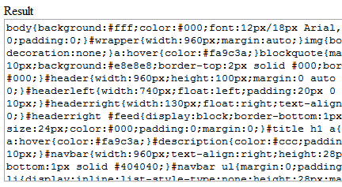
Minified CSS Code

Slide 44
Redirecting Mobile Users
1.
<script type="text/javascript">
<!--
if (screen.width <= 699) {
document.location = "YOUR-MOBILE-SITE.com";
}
//-->
</script>
2.
<span><script type="text/javascript">
<!--
if ((navigator.userAgent.match(/iPhone/i)) || (navigator.userAgent.match(/iPod/i))) {
location.replace("<a href="http://YOUR-MOBILE-SITE.com">http://YOUR-MOBILE-SITE.com</a>");
}
-->
</script>
</span>
Note: http://www.user-agents.org has an extensive list.
3.
<link rel="stylesheet" href="screen.css" media="screen"/>
<link rel="stylesheet" href="handheld.css" media="handheld"/>
4.
<? if (
stristr($ua, "Windows CE") or
stristr($ua, "Mobile") ) {
$DEVICE_TYPE="MOBILE";
}
if (isset($DEVICE_TYPE) and $DEVICE_TYPE=="MOBILE") {
$location='YOUR-MOBILE-SITE.com/index.php';
header ('Location: '.$location);
exit;
}
?>
Using WordPress? http://wordpress.org/extend/plugins/wordpress-mobile-pack/
Source: http://goo.gl/Amfj2

Slide 45









Other mobile development tools/frameworks

Slide 46
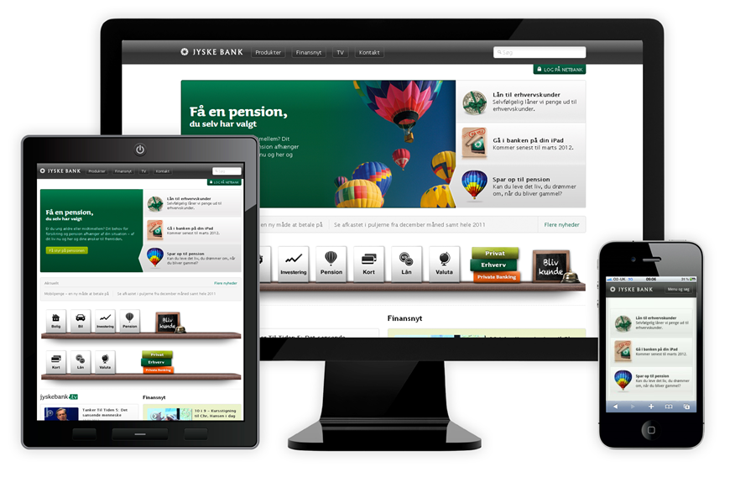
The Future of Mobile Web App/Site Development? Responsive Web Design?

Slide 47
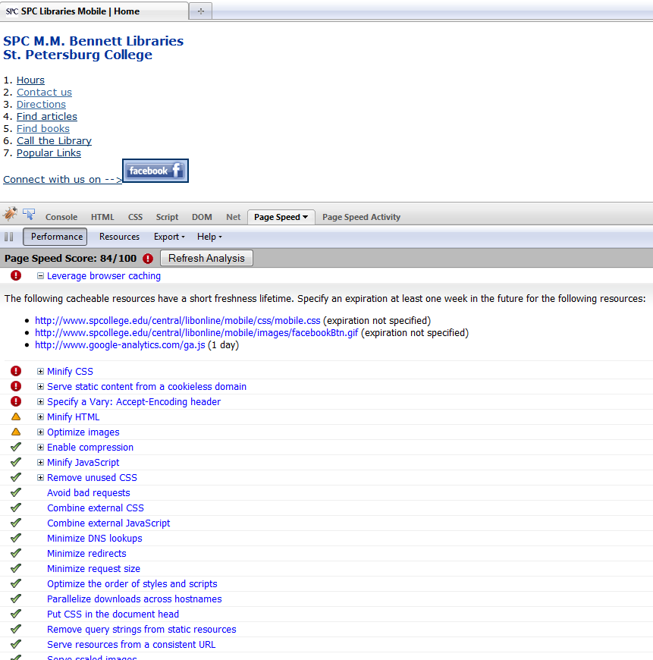

Testing and validation
Test Page Speed in Firebug
http://getfirebug.com/

Slide 48
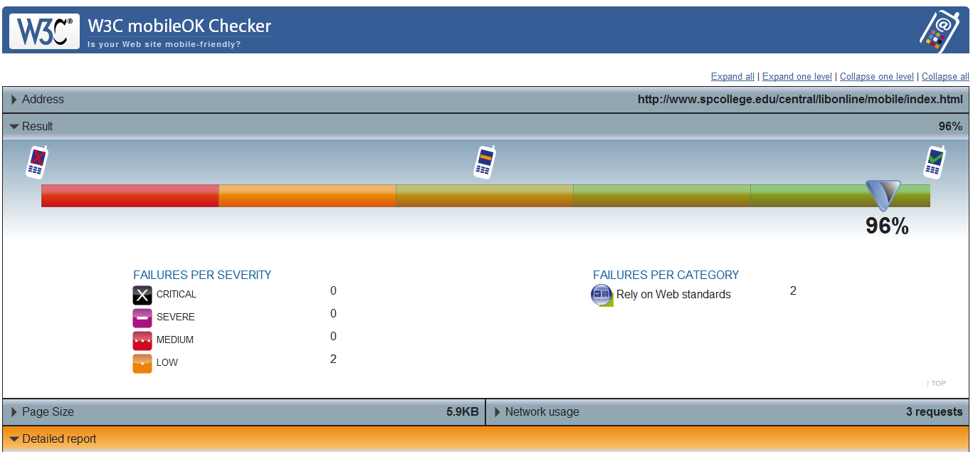
W3C mobileOK Checker http://validator.w3.org/mobile/

Slide 49
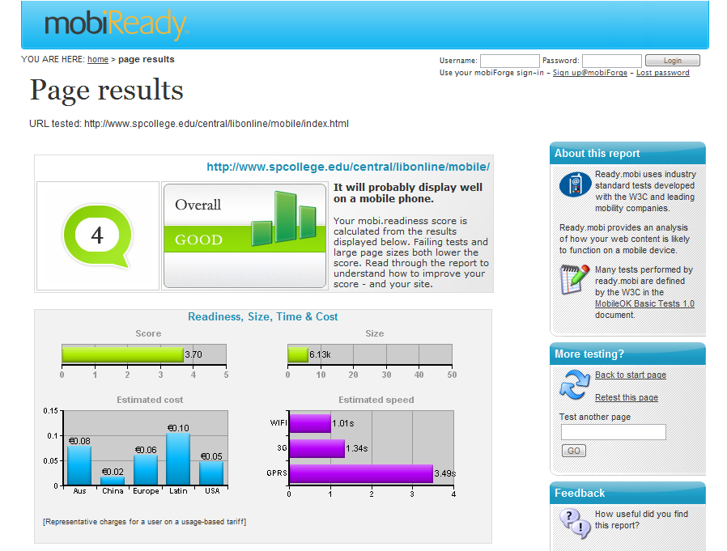
http://ready.mobi

Slide 50
Editors and Tools
You can use a simple text editor (e.g., Notepad) or a more sophisticated application (e.g., Dreamweaver).
Adobe Device Central is part of Adobe’s CS.
iUI: http://code.google.com/p/iui/ for iPhone.
MIT Mobile Web Open Source Project http://sourceforge.net/projects/mitmobileweb/
Device detection? http://detectmobilebrowsers.mobi/
To see your browser's HTTP Headers. Works on mobile browsers. http://rabin.mobi/http
Web Developer Toolbar in Firefox: Select Miscellaneous >>> Small Screen Rendering (260 px) >>> the layout will be reformatted to simulate rendering by a mobile browser.

Slide 51
Emulators/Simulators:
Cowemo Mobile Emulator: http://www.mobilephoneemulator.com/
dotMobi Emulator - http://mtld.mobi/emulator.php
Opera Mini Simulator - http://www.opera.com/mobile/demo/
Mimic - emulates European and Japanese models: N400i and N505i. http://pukupi.com/post/2059
Android Emulator - http://developer.android.com/guide/developing/tools/emulator.html
BlackBerry Device Simulators - https://www.blackberry.com/Downloads/entry.do?code=060AD92489947D410D897474079C1477
iPhone Dev Center: http://developer.apple.com/iphone/
Palm Pre - http://developer.palm.com/
Windows Mobile - http://msdn.microsoft.com/en-us/windowsmobile/default.aspx
JAVA ME - Java Platform Micro Edition was termed J2ME. It is considered one of the most ubiquitous application platform for mobile devices.
http://java.sun.com/javame/reference/apis.jsp

Slide 52



http://www.slideshare.net/chadmairn
Real-time notebook powered by
at: http://goo.gl/NZAeG
@cmairn

Slide 53


Virtual Petting Zoo
anymeeting.com/chadmairn
Want to hangout?
gplus.to/chadmairn

Slide 54

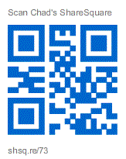
Want to Hangout?
gplus.to/chadmairn

Slide 55
Infopeople webinars are supported in part by the U.S. Institute of Museum and Library Services under the provisions of the Library Services and Technology Act, administered in California by the State Librarian. This material is licensed under a Creative Commons 3.0 Share & Share-Alike license. Use of this material should credit the author and funding source.

