Slide 1


Landlord/Tenant Law
For Public Librarians
Janine Liebert
Librarian, Programs & Partnerships
LA Law Library
jliebert@lalawlibrary.org
Thursday, March 21, 2013
12 Noon
Ronnette Ramos
Managing Attorney
Legal Aid Foundation of Los Angeles
Rramos@lafla.org

Slide 2
Agenda
Provide a general overview of landlord - tenant law matters and the eviction process
Become familiar with key terminology in landlord - tenant law matters
Tour the California Court’s self-help center’s sections on evictions and housing
Learn about additional print and online resources addressing landlord – tenant issues

Slide 3
Landlord-Tenant Overview
Rights and responsibilities of CA tenants and landlords
What is a UD?
  CA Laws
Eviction Process
  Timeline
  Types of Notices
  Pleadings and Responses
Most Commonly used UD Defenses
Foreclosure
Security Deposits

Slide 4
Tenant’s Legal Rights and Responsibilities
  Pay Rent
  Take reasonable care of the rental unit
  Repairs
  Limits on the Landlord’s right of entry
  Security deposit limits
  Time to return security deposit
    Itemized accounting

Slide 5
Tenant’s Legal Rights and Responsibilities
  Repair and deduct
  Withhold rents
  Sue for damages
  Right to warranty of habitability
  Protection against retaliatory eviction

Slide 6
Refund of Security Deposits
Allowable deductions:
  Unpaid rent
  Cleaning the rental unit when tenant moves out
  Repair of damages other than normal wear and tear
  If the lease allows for cost of restoring or replacing personal property (such as keys or furniture)
21 calendar days or less after tenant moves out
  Send tenant a full refund of security deposit OR
  Mail or personally deliver an itemized statement
If Landlord does not provide refund
  Tenant can call or request a refund
  Tenant can sue in small claims court

Slide 7
Landlord’s Responsibilities
Implied covenant of quiet enjoyment
Landlord must make the unit fit to live in, or habitable
Landlord must repair problems that make the rental unit unfit to live in or uninhabitable

Slide 8
What is an Unlawful Detainer?
  Statutory procedure defined under California Code of Civil Procedure §1161-1179a
  Lawsuit that a landlord must file and win before he or she can evict a tenant
  Also called an eviction lawsuit

Slide 9
Rent Control
Protections:
  Rent increases are limited on a yearly basis
  Greater Tenant Protections
  Cities with Rent Control
    Berkeley Beverly Hills East Palo Alto
    Glendale Hayward Maywood
    Los Angeles Oakland Palm Springs
    Richmond Ridgecrest San Diego
    San Francisco Santa Monica Thousand Oaks
    West Hollywood

Slide 10
Who are the Parties
Involved in an Unlawful
Detainer?

Slide 11
Plaintiffs in Unlawful Detainers
Management
Companies
Corporation
Plaintiff
Landlord
Non-Profits
Tenants

Slide 12
Defendants in Unlawful Detainers
Foreclosed Landlords
Managers/ Employees
Defendant
Tenants
Sub-tenants
Hotel Lodgers

Slide 14
Notices to Terminate a Tenancy
No Cause / Fault Notices
30/60/90-day notice to vacate
  Non-rent control properties
90-day notice
  Government subsidized housing
For Cause Evictions
Three-day notice to pay rent or quit
Three day notice to cure or quit
Three-day notice to quit

Slide 15
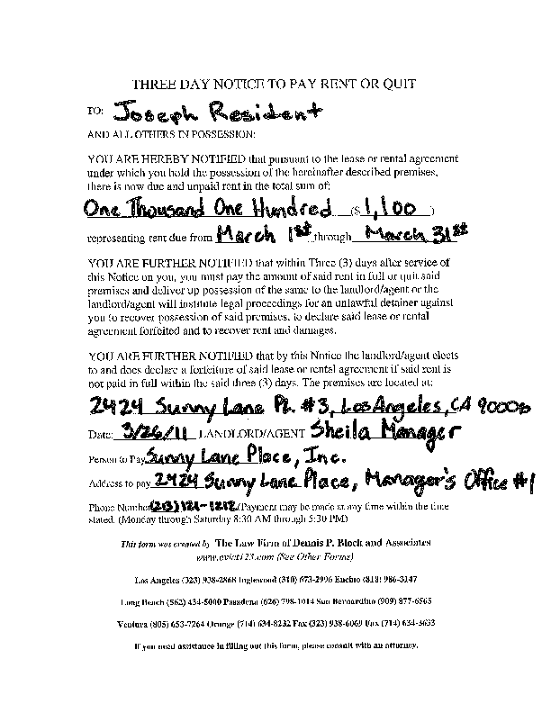
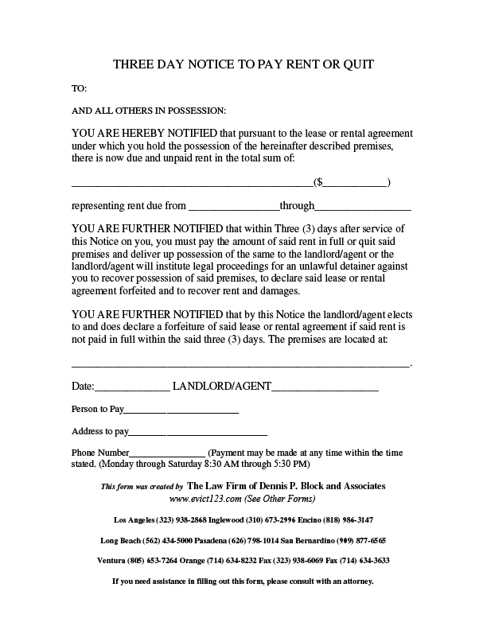
Step 1: Eviction Notice Stage
Notice must be WRITTEN
STRICT COMPLIANCE with CCP 1161 notice requirements
Time for compliance begins to run the day after notice is served

Slide 16
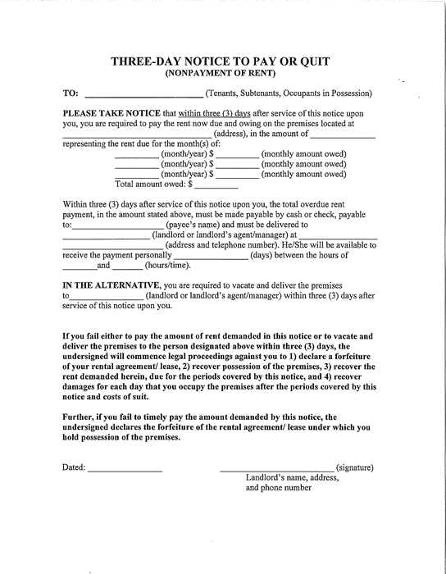
Three-Day Notice to Pay Rent or Quit
For when tenant is behind on the rent
Three days begins on the first day after service of the notice
If the third day falls on a Saturday, Sunday or legal holiday – the three-day period will not expire until the following Monday or non-holiday

Slide 17
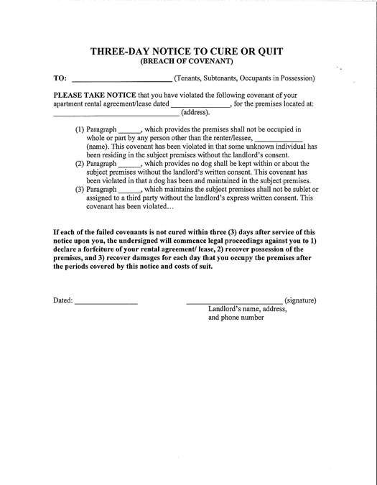
Three-Day Notice to Cure or Quit
For when tenant is violating terms of the lease or rental agreement, other than nonpayment of rent, and the problem can be fixed
Must specify violation
Written lease agreement must exist

Slide 18
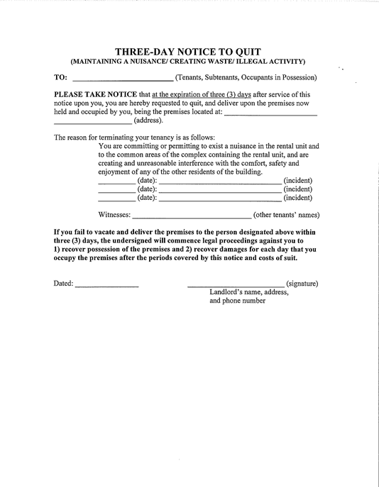
Three-Day Notice to Quit
For when tenant is violating terms of the lease or rental agreement, other than nonpayment of rent, and the problem cannot be fixed:
  committing “waste”
  creating a nuisance on the premises
  Illegal use

Slide 19
Tenant Defenses for Defective Notice
Pay or Quit Notice:
Rent is not due
Includes late fees
Demands more rent than tenant owes
Fails to state specific information pursuant to C.C.P. §1161(2)
Fails to state amount due
Perform or Quit Notice:
Fails to state how to cure alleged violation
No written lease
Not in the alternative and breach is “curable”
Applies to all:
Does not declare a forfeiture of the lease
Defective service of notice

Slide 20
Service of Notice
Notice may be served upon the Tenant in one of three ways:
  Personally
  Leaving a copy with a person of suitable age and sending a copy by mail
  Nail and mail

Slide 21
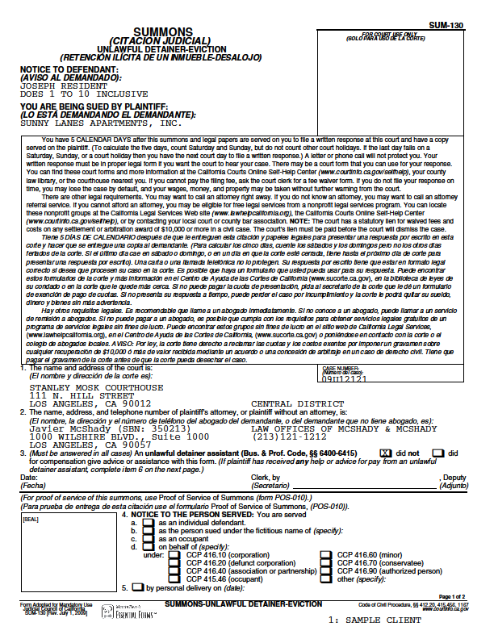
Step 2: The Unlawful Detainer
The court eviction process begins by filing a summons and complaint
Named Defendant(s) must be served a copy of the summons and complaint
The Court will mail out a Notice stating that UD lawsuit has been filed

Slide 22
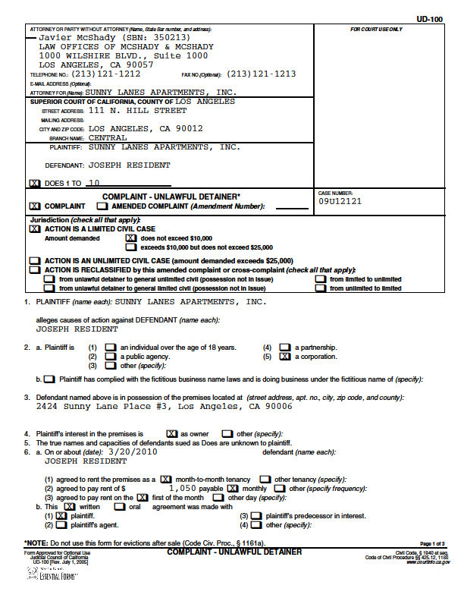
The Complaint:
States landlord’s basis for the eviction
Eviction Notice must be attached to the complaint, C.C.P. § 1166
Attorneys can use their own pleadings

Slide 23
Common Defective Complaint Defenses
Notice not attached
Lease not attached:
  Cases not based on failure to pay rent.
  Tenant named but incorrect address
Improper Plaintiff:
  Plaintiff must have some right of possession to the property either as the owner or agent of the owner

Slide 24
How to Respond to an Unlawful Detainer
Complaint

Slide 25
Responsive Pleadings
Answer
  General denial or deny each allegation in the complaint
  Technical and factual defenses
  If in doubt, raise the defense, otherwise it is waived
Pre-Judgment Claim of Right to Possession
  If tenant is in possession and not named on complaint
Demurrer
  Plaintiff failed to state a cause of action
  Complaint is unclear
Motion to Quash Service of the Summons
  Improper service of the summons and complaint

Slide 26
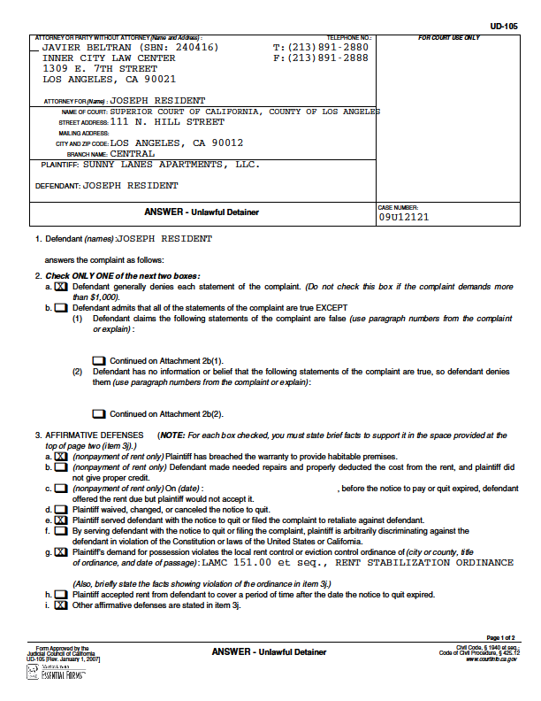

Step 3: Filing a Response
5 DAYS to file an answer
Fail to file an answer, a default judgment will be entered and tenant will have to vacate
Answering defendant must claim defense(s) to complaint’s allegations

Slide 27
Timeline for Trial
  Continue Discovery
Service of Complaint
  Request to Set Case for Trial
Date of Trial
5 days
1 or 2 weeks
1 week
2 weeks
File Responsive Pleadings
Start Discovery
  Notice of Trial
  (file jury demand & post fees)

Slide 28
Pre-Trial Considerations
Jury Trial Demand:
  Must be filed within 5 days of the Notice of Trial date (C.C.P. § 631(d)(4))
  Jury Fees: $150 at least 5 days before trial
Motion for Summary Judgment (C.C.P. § 437c):
  No triable issue of material fact
  Defendant must show Plaintiff does not have a cause of action
  Filed upon 5 days notice (C.C.P. § 1170.7) and opposition may be filed 1 day before or on hearing day.
Trial Date:
  Request to Set Case for Trial
Discovery:
  See Next Slide

Slide 29
Discovery and Unlawful Detainers
Civil Discovery Act C.C.P. § 2016 et seq.
Types of Discovery:
Written Interrogatories
  Form (UD-106)
  Special Interrogatories
Demand for Production of
Documents
Request for Admissions
Depositions
  Scheduled w/in 5 days of the Notice but no later than 5 days before Trial
Time Limitations:
Discovery completed 5 days before the date of Trial
Responses due w/in 5 days for personal service, 10 days for mailing
Motions to Compel may be filed at any time upon 5 days notice

Slide 30
Commonly Used Tenant Defenses
Waiver of Notice to Quit
  Generally: Affirmative defense if landlord accepts rent to cover a period of time after the termination date stated in the notice
Estoppel
  Generally: Tenant must have relied on the landlord’s conduct and was injured by it
Breach of the Warranty of Habitability
  What is a breach?
  Proof of a substantial breach
Retaliatory Eviction
Discrimination

Slide 31
After the Court’s Ruling
If tenant wins
  Tenant will not have to move and pay back rent
  Landlord may be ordered to pay court costs
If landlord wins
  Court issues Writ of Possession
  Service of Writ and posting of 5 day Notice to Vacate
  Sheriff will remove all occupants

Slide 32
Default Judgment if Tenant Fails to File Answer within Five Days
Default judgment entered in favor of landlord
Writ of possession
Service of writ and posting of five day Notice to Vacate
    To request additional time, tenant must file Stay of Execution with the court
Sheriff will remove all occupants
Setting aside default judgment requires proof of mistake, inadvertence, excusable neglect

Slide 33
Abandoned Personal Property Left
in a Rental Unit
California law has specific steps to follow to get possessions returned
  Civil code § 1951.3
  Identify and value the property left behind
  Send possible owners notice
If tenant does not respond to Notice
  Property worth less than $750 = Landlord
  Property worth more than $750 = auction
Notice of Right to Reclaim Personal Property

Slide 34
Protecting Tenants at Foreclosure Act
Applies to all residential properties foreclosed after 5/20/2009
Does not preempt local and state laws that offer additional protections
90-Day Notice required unless lease term not yet expired
Must be “bona fide” tenant.
Section 8 Tenants: new owner subject to lease and contract with PHA
Notes:
Other Post-Foreclosure Issues
Failure to notify tenant of change of ownership (Ca. Civ. Code §1111)
Plaintiff is not the owner of the premises
3/90 Day Notices
Failure to serve notice of termination of tenancy
Premature filing of complaint

Slide 35
Online Resources for
Locating Information,
Forms and Referrals

Slide 36
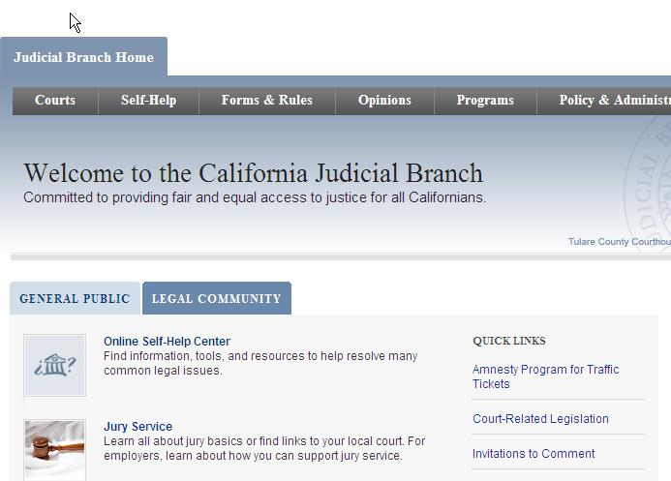
California Courts – Online Self-Help Center http://www.courts.ca.gov/
Notes:
This is a screenshot of the California Courts Online Self-Help Center. The website is maintained by staff attorneys within the California Courts and is intended to provide self-represented litigants with quick access to comprehensive information about many basic court procedures, resources, referrals to legal services programs, lawyer referral services, and other assistance. The Online Self-Help Center is searchable by key word or phrase but the website does not interpret the law or provide advice on individual cases.

Slide 37
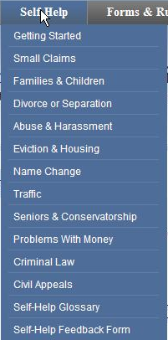
California Courts – Online Self-Help Center http://www.courts.ca.gov/selfhelp.htm
For each case type, provides basic information about applicable law
Outlines steps in court process
Forms presented within informational context
Instructions for completing each form
Notes:
This table represents the topics that are covered at the Court’s self help website. The topics provided here are those in which self-represented litigants are most likely to appear -- family law (including divorce, paternity, child support, child custody and visitation, adoption, and domestic violence matters), landlord-tenant, name change, traffic, seniors & conservatorship, problems with money, criminal law, civil appeals.
For each topic, the website provides basic information about the applicable law, outlines the steps in the court process required to obtain relief (e.g., filing, service of process, and obtaining a default judgment or conducting a contested hearing), and presents the forms along with step-by-step instructions for completion within the context of that information.

Slide 38
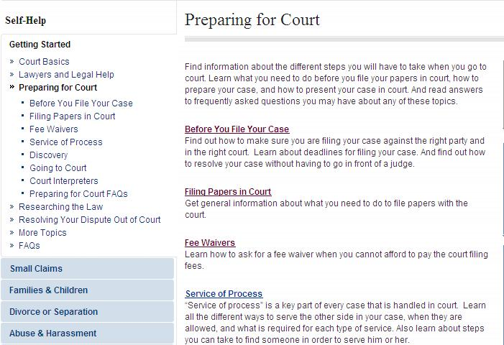
“Getting Started”
California Courts Online Self-Help Center http://www.courts.ca.gov/1002.htm
Notes:
This is a screenshot of the “Getting Started” section which is a detailed overview section on the court system, working with an attorney, how to represent yourself in court, getting legal help, using court forms, researching the law, and preparing for court. There is also a discussion of the risks of representing yourself and when it might be a good idea to get an attorney. The Preparing for Court sections provides an overview of what needs to happen before a case is filed in court and how to prepare (filing papers, fee waivers, service of process). The Going to Court section provides information on preparing and presenting evidence for court and tips for what you should and shouldn’t do when you go to court. There is also a section on How to do Legal Research
Sample questions that can be answered in the Preparing for Court section include:
Q: How can I get forms for use in my case?
Q: How do I file papers in court?
Q: What do I do if I get served with court forms?
Q: Where can I find how much court fees are?
Q: Where can I find the local rules for my court?

Slide 39
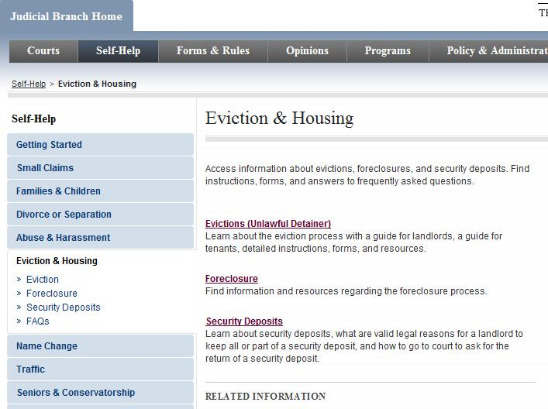
“Eviction and Housing”
California Courts Online Self-Help Center http://www.courts.ca.gov/selfhelp-housing.htm
Notes:
The section on eviction and housing covers…Sample questions that can be answered in this section include:

Slide 40
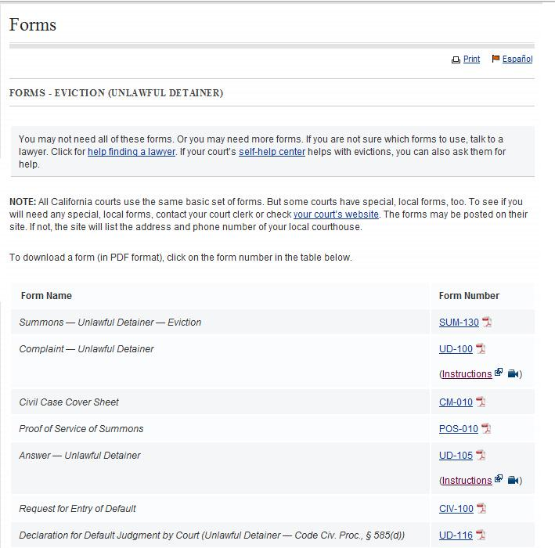
Notes:
The “Evictions (Unlawful Detainer)” section explains the Sample questions that can be answered on this section include:

Slide 41
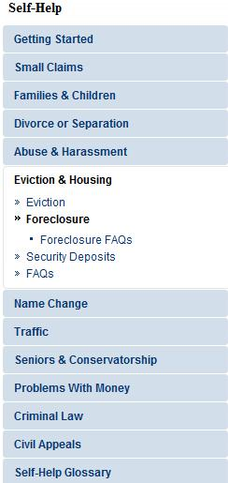
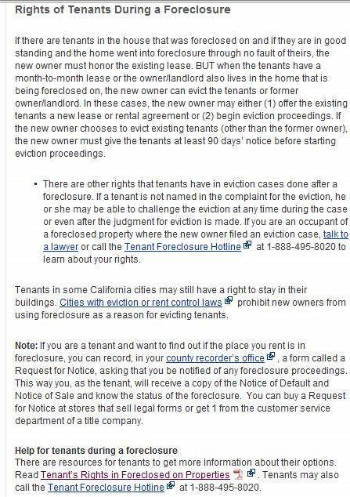
Foreclosures - http://www.courts.ca.gov/1048.htm

Slide 42
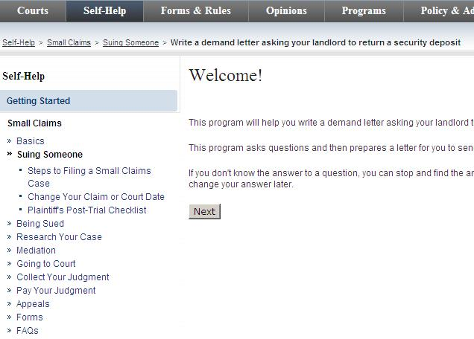
Security Deposits – Demand Letter http://www.courts.ca.gov/1230.htm

Slide 43
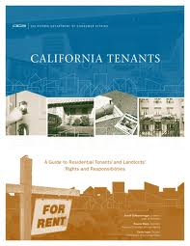
Landlord-Tenant Legal Guides
Dept. of Consumer Affairs Website http://www.dca.ca.gov/publications/legal_guides/index.shtml
California Tenants – A Guide to Residential Tenants’ and Landlords’ Rights and Responsibilities
How to Get Possessions Back You Have Left in a Rental Unit
Options for a Landlord: When a Tenant’s Personal Property Has Been Left in the Rental Unit
Landlords and Tenants Responsibilities
For Habitability and Repairs
Rent Increases: Basic Information for Tenants

Slide 44
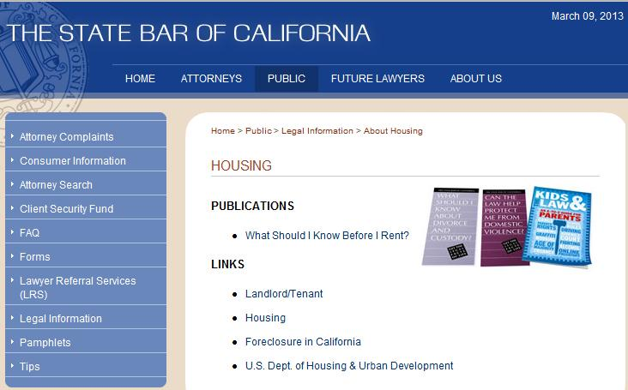
Online Resources – California State Bar http://www.calbar.ca.gov/Public/LegalInformation/AboutFamily.aspx
Notes:
The California State Bar publishes pamphlets on several family law topics including divorce and custody and domestic violence. They are available in print and on the California State Bar website.
Pamphlets available in English and Spanish.
Pamphlets are FAQ’s, between 10 and 20 questions, depending on the brochure.
Includes questions:
How do I file for divorce?
What is spousal support? Is it the same as alimony?
What choices does the judge have in granting custody or visitation rights?

Slide 45
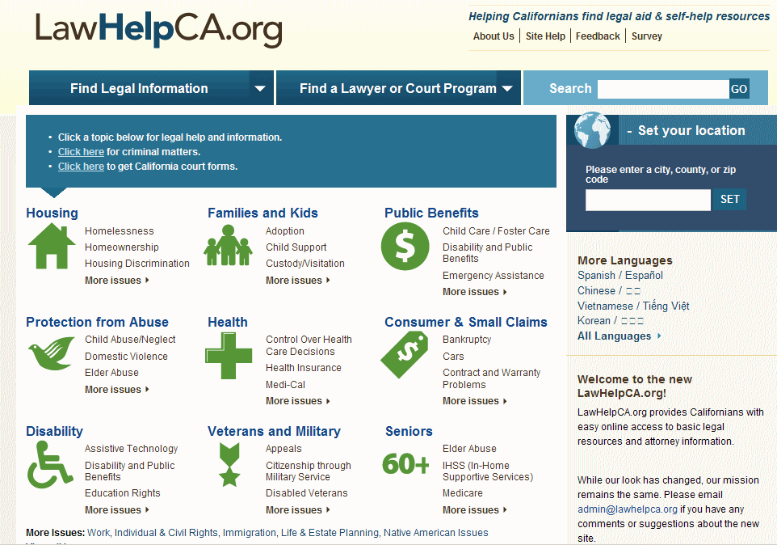
Law HelpCA.org
www.lawhelpca.org
Notes:
This is a screenshot of LawHelpCalifornia, which is a FREE website to help individuals find legal information and referrals in civil matters. There are many different family law topics available…all geared towards civil matters that low income people might encounter. Here I selected Housing. Result pages generate a list of subtopics that fall under Housing. The legal rights information is presented in plain language. The intended audience is the layperson – NOT attorneys.

Slide 46
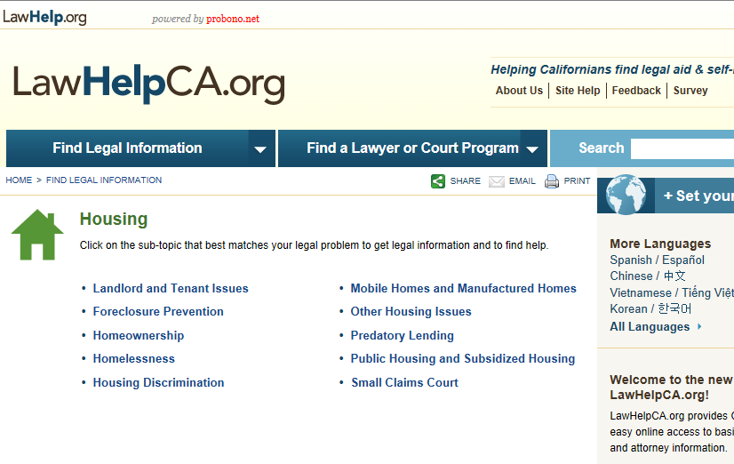
LawHelpCA.org – Housing
www.lawhelpca.org
Notes:
Here are the subtopics that fall under Housing.

Slide 47
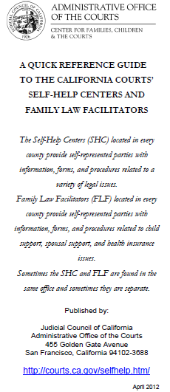
Locating Self-Help Centers in California
California Courts’
Self-Help Centers and Family Law Facilitators Reference Guide
http://courts.ca.gov/documents/Public_Locations_Directory_4-9-12.pdf
Downloadable brochure provides locations for family law facilitators and self-help centers located in every county in California
JL
Notes:
This is a downloadable brochure that provides locations for family law facilitators and self-help centers located in every county in California.

Slide 48

Locating Law Libraries in CA
Council of California County Law Librarians http://www.publiclawlibrary.org
JL
Notes:
This is a website for locating law libraries in California.
Homepage for the Council of California County Law Librarians (CCCLL)
Red Circle: click on the “Find Your..” link:
List of contact info for all county law libraries in California.
Many counties have websites.
Particularly helpful if someone needs help outside of LA County.
The website also provides:
Ask Now – chat reference with a law librarian.
Self-Help provides links to websites that are helpful for people who are representing themselves in court.
Legal Links provides links to legal materials – state and federal: cases, statutes, links to locating your representative.
Mini Research Class may be interesting to you if you want to learn more about legal research.

Slide 49

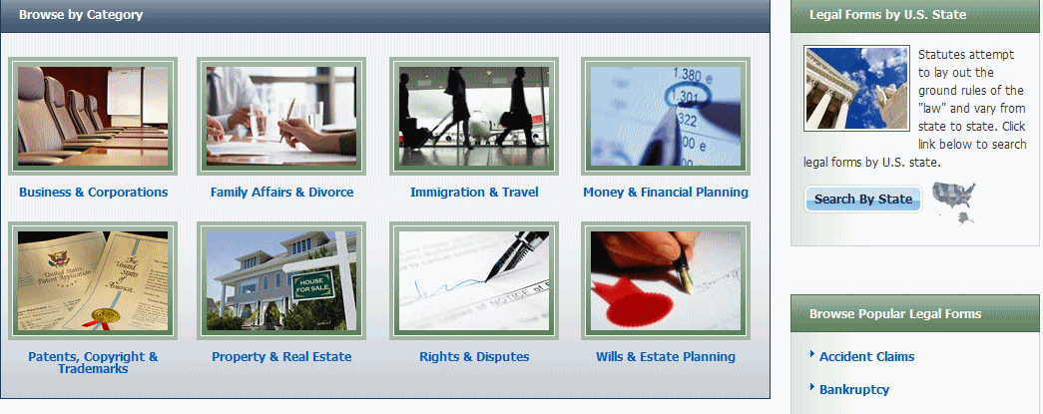
Nolo Books – Legal Information Reference Center (EBSCO Host)
California consortium hosts full access (remotely) by county
Example: LA Law Library http://www.lalawlibrary.org/research/onsite/default.aspx
Login: CA / LA

Slide 50
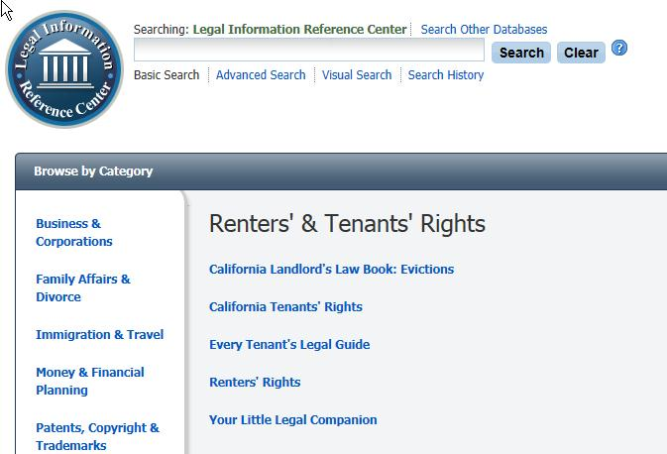
Nolo Books – Legal Information Reference Center (EBSCO Host)

Slide 51


Slide 52
Thank You!
Janine Liebert
Librarian, Programs & Partnerships
LA Law Library
jliebert@lalawlibrary.org
Ronnette Ramos
Managing Attorney
Legal Aid Foundation of Los Angeles
Rramos@lafla.org

Slide 53

Infopeople webinars are supported by the U.S. Institute of Museum and Library Services under the provisions of the Library Services and Technology Act, administered in California by the State Librarian. This material is licensed under a Creative Commons 3.0 Share & Share-Alike license. Use of this material should credit the author and funding source.

