Slide 1


Small Claims Court Legal Resources:
a Guide for Public Libraries
Thursday, April 18, 2013
12 Noon Pacific
Bill Tanner
Directing Attorney
Legal Aid Society of Orange County
Btanner@LEGAL-AID.com
Janine Liebert
Librarian, Programs & Partnerships
LA Law Library
jliebert@lalawlibrary.org

Slide 2
Agenda
Receive a general overview of the Small Claims process including going to court and collecting money
Become familiar with key terminology and court procedures used in Small Claims
Tour the California Court’s self-help center’s sections on small claims

Slide 3
Agenda
Have a basic understanding of the online resources to assist parties in completing Small Claims forms
Learn about the Small Claims advisory services available at local superior courts
Learn about additional print and online resources for locating small claims information and forms

Slide 4
Small Claims Overview
People represent themselves
Attorneys cannot represent litigants
  Except on Appeal

Slide 5
Parties Involved in Small Claims
Person who sues is the Plaintiff
  Any person, at least 18 years, or business
Person who is sued is the Defendant
  Any person or entity (business, corporate or government)
  Exceptions

Slide 6
Is Small Claims the Best Option
Does the claim justify the cost?
Is the person or business able to pay the money owed?
No more than two cases for over $2500 filed in the same calendar year
Must sue in right court and location
  Called Venue

Slide 7
Time Limits to File in Small Claims
Personal Injury – Two years from date of injury. If the injury isn’t immediately discovered, two years from the date it is discovered.
Oral Contract – Two years from the date the contract was broken
Property Damage – Three years from the date the property was damaged.
Written contract – Four years from the date the contract was broken
Malpractice - One year from the date of malpractice
Fraud – Three years from the date or of the date of discovery
Government Entity - Must file written claim with agency before filing lawsuit in court

Slide 8
How Much and How Often Can a Person Sue?
Claim must be for money
  $10,000 for “natural persons”
  $5,000 for corporations
Claims for $2,500 or more limited to two per year
Claims for less than $2,500 are unlimited

Slide 9
Examples of Cases Heard in Small Claims Court
Landlord/tenant issues
Car accidents
Claims against businesses and corporations
Bad checks
Breach of contract
Equitable relief in the form of
  Rescission
  Restitution
  Reformation
  Specific performance

Slide 10
How do I Sue in Small Claims Court?
Plaintiff’s Claim (Form SC-100) filed with the court
Clerk will select hearing date within 20 to 70 days from date claim filed
Copy of Plaintiff’s Claim served to the defendant
  Called service of process
Proof of Service (Form SC-104) must be filed with the clerk’s office at least 5 days before court date
Forms available at California Courts
website: www.courts.ca.gov/1017.htm

Slide 11
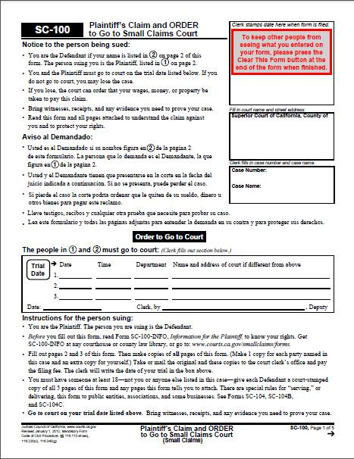
Plaintiff’s Claim (Form SC-100)

Slide 12
I’ve Been Sued… Now What?
Defendant can sue the Plaintiff back
Called countersuing
To countersue, defendant files the Defendant’s Claim (Form SC-120)
  Available at California Courts website: www.courts.ca.gov/1017.htm
May not be for more than $5,000 or $10,000 if the defendant is a natural person

Slide 13
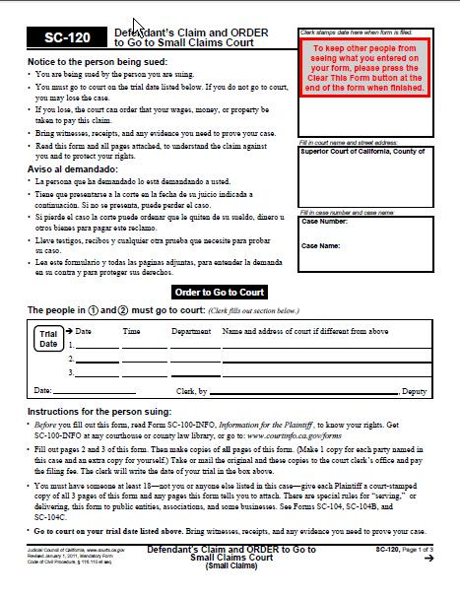
Defendant’s Claim (Form SC-120)

Slide 14
Filing Fees
A plaintiff (or a countersuing defendant) is charged a filing fee of:
$30 for a claim up to $1,500
$50 for a claim between $1,500-$5,000
$75 for a claim over $5,000
*Frequent filers (> 13 within a calendar year) pay $100 per claim
Plaintiff may apply for a fee waiver (FW-001)

Slide 15
Naming an Individual
Must sue using the defendant’s exact legal name
An individual
  First name, middle initial and last name
  Example: “Betty M. Hart”
A husband and wife
  Listed separately
Other Plaintiffs or Defendants (Form SC-100A) if case involves three or more Plaintiffs or Defendants

Slide 16
Naming a Business
Owner of a sole proprietorship doing business under a fictitious business name:
  “John P. Jones d.b.a John’s Shoe Store”
Partners on behalf of a partnership:
  “Betty M. Hart, individually and as a partner in Hart and Simons, a partnership”
  “Joan J. Simons, individually and as a partner in Hart and Simons, a partnership”
Obtaining a fictitious business name statement (d.b.a.)
  County Clerk’s office
  City Hall, Business License Division

Slide 17
Naming a Corporation
A corporation:
  “Beacham & Beacham, Inc.”
  Or “Abacast Corporation d.b.a. Maritime Company”
More information about a corporation
  www.ocsmallclaims.com
  Secretary of States’s Website: www.kepler.sos.ca.gov/list.html

Slide 18
Describing Claim for Money Damages
Money Judgments (provide dates and the basis for the amount of the claim)
“On 11/2/01 Maria Cortez stopped paying on a contract dated 7/9/01. The remaining balance to be paid is $438.22.”

Slide 19
Describing Claim for Money Damages
Conditional Judgments
  “Return of 1988 Toyota Corolla Vin# or $5,000”
Rescission
  “The phone service I ordered with Pacific Bell never worked. I would like to have this contract rescinded.”
  TIP: It is still a good idea to indicate a dollar amount on the claim. The judge may find that a monetary judgment is appropriate.

Slide 20
Where do I File my Case?
Sue where:
  The defendant resides or does business
  The defendant entered into the contract
  The contract was to be performed
  The real property is located
  The accident/injury occurred
If there is more than one proper venue, plaintiff may choose the one that is most convenient

Slide 21
How do I File my Papers with the Court?
Three ways to file:
  File in Person
  Mail
    Send self-addressed envelope so that the court may send the documents back – include original and a copy
  Some courts permit online filing of the initial claim
    www.icandocs.org (Orange County)
    www.lasuperiorcourt.org (Los Angeles County)
    www.saccourt.ca.gov/efiling/small-claims.aspx (Sacramento County)

Slide 22
How do I Tell the Defendant they
are being Sued?
Called “Service of Process”
Gives the date, time and place of the hearing
Who can serve the court papers?
How are the court papers served?
  Certified Mail through the clerk
  Sheriff
  Personal service
  Substituted service
When must the court papers be served?
  Personal service must be done at least 15 days before the court date. If the defendant lives outside the county, service must be done at least 20 days before the court date.
  Substituted service adds 10 days prior to court case.

Slide 23
Who must be served?
An individual – claim served to that person
A business – claim served to the owner or a person in charge
Corporation, Limited Liability Company, Limited Partnership
  Secretary of State’s Office has the name of the party (referred to as the Agent for Service or Process) who can be served
  Available online at www.kepler.sos.ca.gov/list.html
Mailing Address
5457 Florence Ave
Missoula, MT 59802
Agent for Service of Process
Bruce Covington
6125 Pine St.
Bell Gardens, CA 90201

Slide 24
Can a Claim be Served Outside California?
A claim must be served in California, except:
  When an auto accident happened in California, and the registered owner or driver lives out-of-state.
  A dispute involving real property in California, when the owner of that property lives out of state

Slide 25
Getting People, Papers and Things to Trial

Slide 26
Evidence
Parties have the right to offer evidence through witnesses
  Voluntarily
  Serve witness with court order to appear “subpoena” (Form SC-107)
Special rules apply for “consumer records”
  Party may subpoena records and papers using Form SC-107)

Slide 27
What Happens at the Hearing?
Hearing is informal
Who will hear the case?
Parties may settle before the trial
If the defendant was properly served but fails to appear, the plaintiff may be entitled to a default judgment
Plaintiff presents case first, then defendant
Judge will ask questions
Judge can render decision at the hearing or send it by mail

Slide 28
I Won my Case! How do I Collect the Money?
The money the court awards is the judgment
Judge can render judgment at the hearing or send it by mail
Party who wins the case and collects the money is called the judgment creditor
Party who loses the case and owes the money is called the judgment debtor
Judgment creditor must take steps to collect. The court will not do it.
Judgment creditor must wait 30 days from the date of mailing on the Notice of Entry of Judgment to begin collecting
Judge can make the judgment conditional

Slide 29
Can the Case be Appealed?
Only a losing defendant (or plaintiff who has lost a countersuit) may appeal
Must be filed no later than 30 days after the date of mailing on the Notice of Entry of Judgment
Appeal results in a new hearing or trial de novo
Filing fee is $75
Attorneys may represent the parties

Slide 30
Collection Methods
Three ways Sheriff can help:
  Garnish wages
  Levy bank account
  Till Tap/Keeper
Other collection methods
  Suspend Driver’s License
  Place a lien on property
  Third party

Slide 31
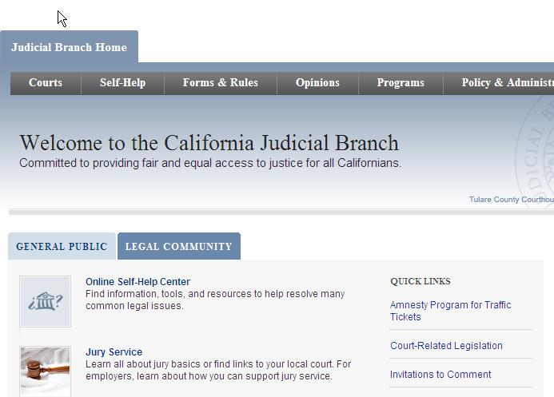
California Courts – Online Self-Help Center http://www.courts.ca.gov/

Slide 32
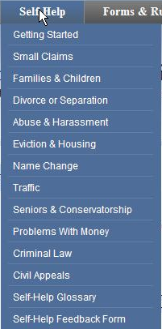
California Courts – Online Self-Help Center http://www.courts.ca.gov/selfhelp.htm
For each case type, provides basic information about applicable law
Outlines steps in court process
Forms presented within informational context
Instructions for completing each form

Slide 33
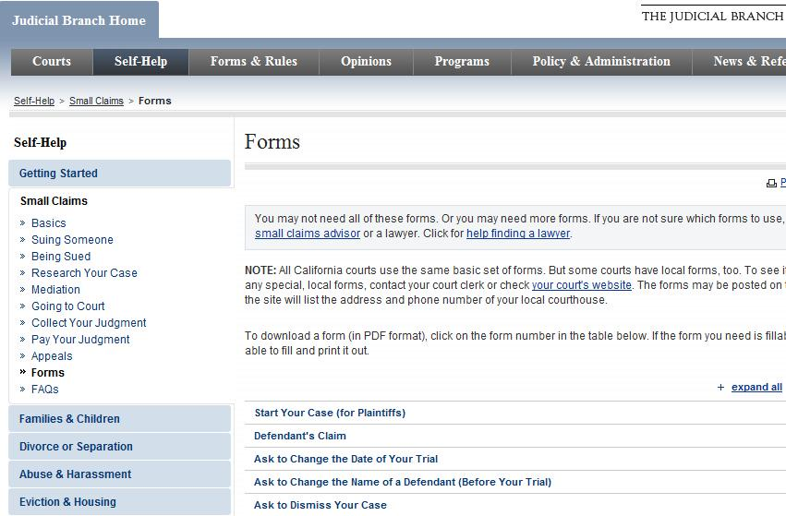
“Small Claims”
California Courts Online Self-Help Center http://www.courts.ca.gov/1002.htm

Slide 34
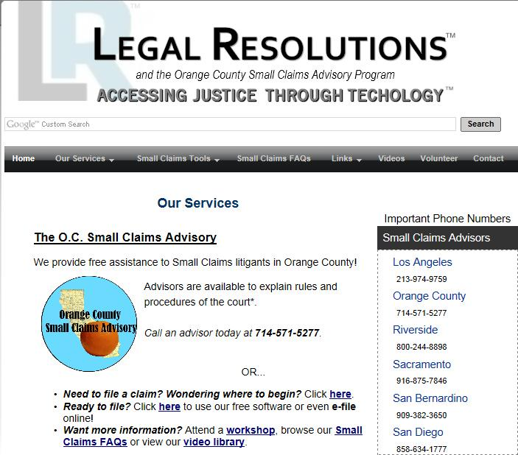
Small Claims Advisors http://www.courts.ca.gov/1002.htm

Slide 35
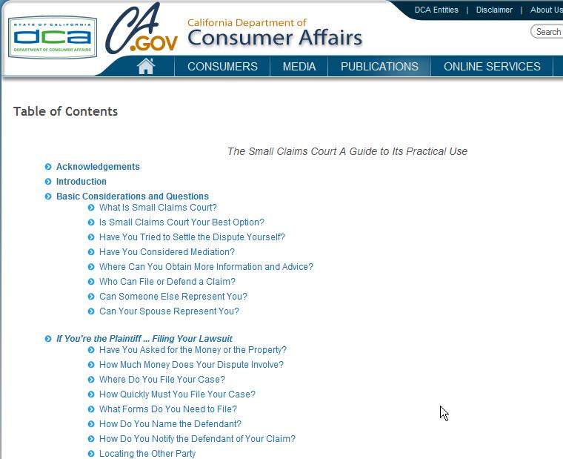
http://www.dca.ca.gov/publications/small_claims/index.shtml

Slide 36
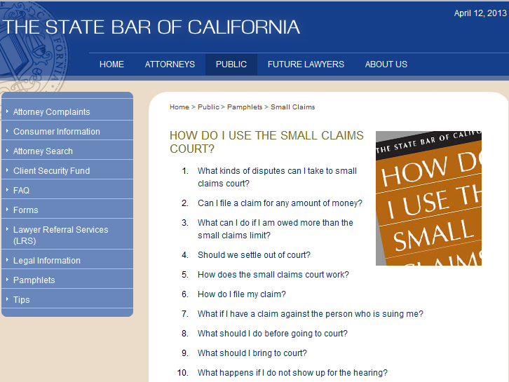
Online Resources –
California State Bar http://www.calbar.ca.gov/Public/LegalInformation/SmallClaims.aspx

Slide 37
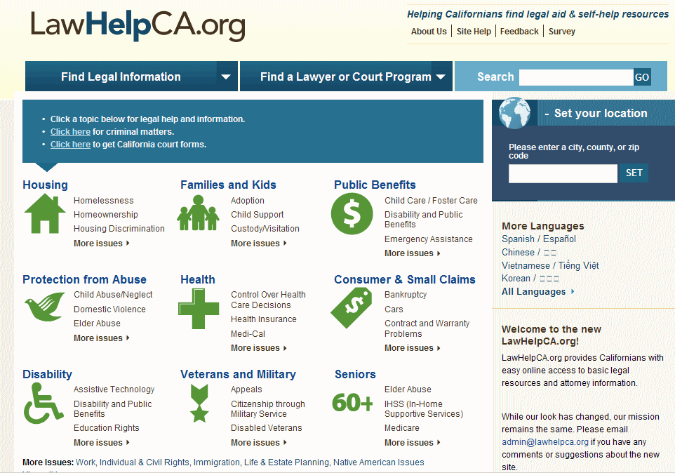
Law HelpCA.org
www.lawhelpca.org

Slide 38
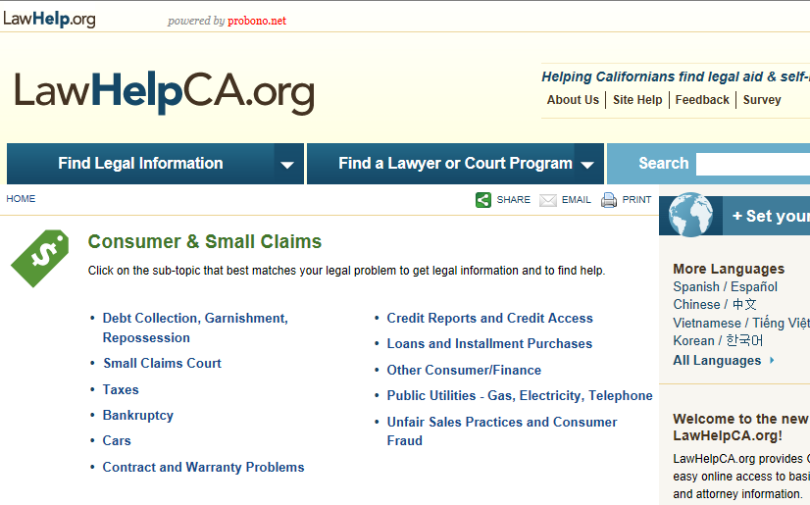
LawHelpCA.org – Consumer & Small Claims
www.lawhelpca.org

Slide 39

Locating Law Libraries in CA
Council of California County Law Librarians http://www.publiclawlibrary.org

Slide 40

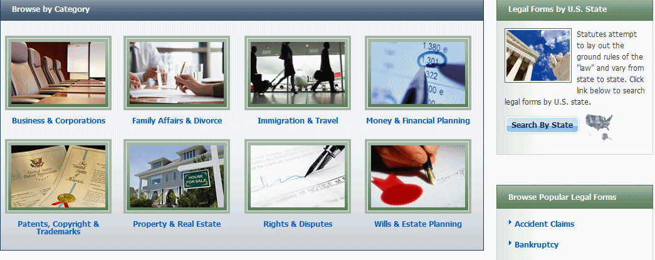
Nolo Books – Legal Information Reference Center (EBSCO Host)
California consortium hosts full access (remotely) by county
Example: LA Law Library http://www.lalawlibrary.org/research/onsite/default.aspx
Login: CA / LA

Slide 41
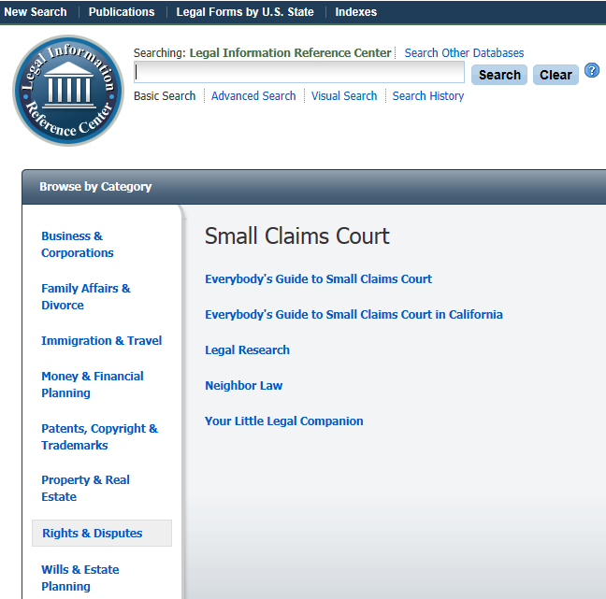

Slide 42


Slide 43
Thank You!
Janine Liebert
Librarian, Programs & Partnerships
LA Law Library
jliebert@lalawlibrary.org
Bill Tanner
Directing Attorney
Legal Aid Society of Orange County
Btanner@LEGAL-AID.com

Slide 44
Survey and Certificate of Attendance
Please take a minute and fill out our webinar survey. You will find in at:
https://survey.qualtrics.com/SE/?SID=SV_1XlRvtzGddXlwVv
Thank you!

Slide 45

Infopeople webinars are supported by the U.S. Institute of Museum and Library Services under the provisions of the Library Services and Technology Act, administered in California by the State Librarian. This material is licensed under a Creative Commons 3.0 Share & Share-Alike license. Use of this material should credit the author and funding source.

