Slide 1
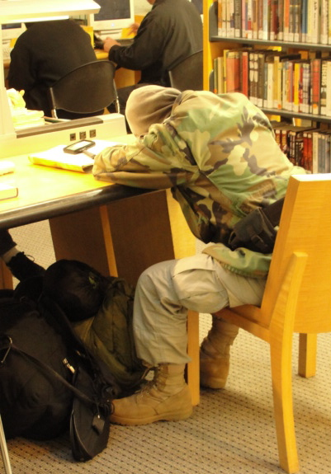

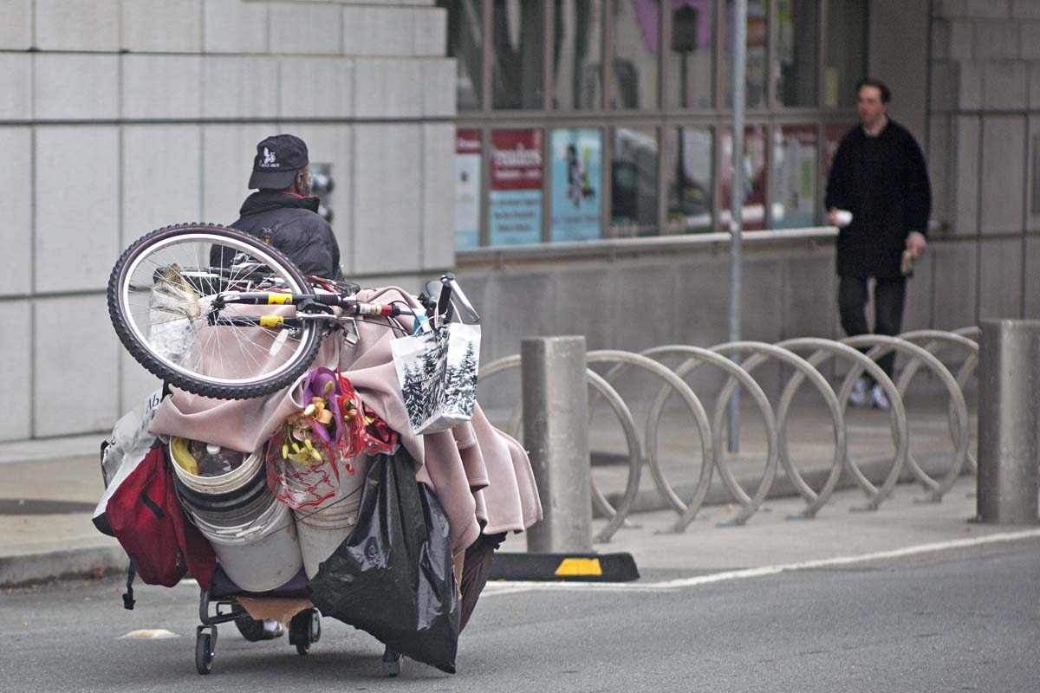
WHAT DO I DO NOW?:
Handling Challenging Situations with Mentally Ill and Homeless Library Users
Part One
Tuesday, May 14, 2013
Karen Strauss and Leah Esguerra

Slide 2
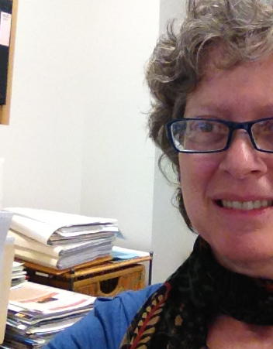
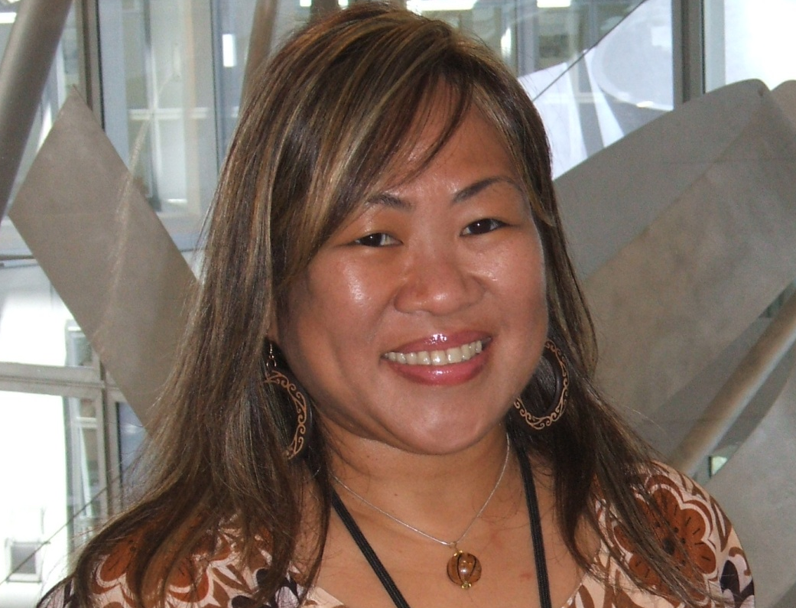
Who We Are
 Karen Strauss
Leah Esguerra 

Slide 3
Parts 1 and 2 Takeaways
      Partnerships
       Setting limits
       Real life

Slide 4
Homelessness in America
Assumptions and labels

Slide 5
Homelessness in America
People whose behavior is challenging to us might be
homeless or housed;
mentally ill or healthy.

Slide 6
Homelessness in America –
Trends 2011-2012
633,782 overall
20 homeless people per 10,000
29 states reported increases
38% unsheltered
2,325 fewer homeless people
6.8% fewer chronically-homeless individuals
National Alliance to End Homelessness: endhomelessness.org.
Source: 2011 and 2012 point-in-time counts as reported by jurisdictions
to the U.S. Department of Housing and Urban Development

Slide 7
Homelessness within Populations

Slide 8
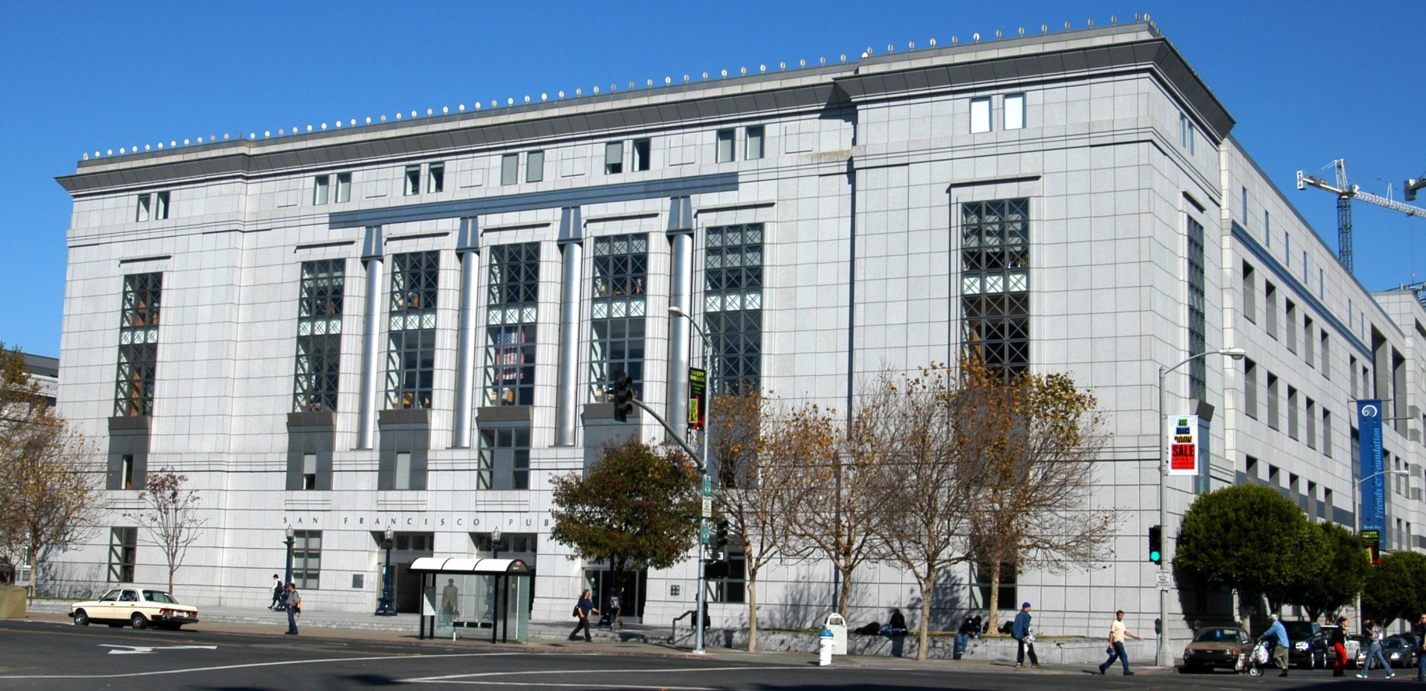
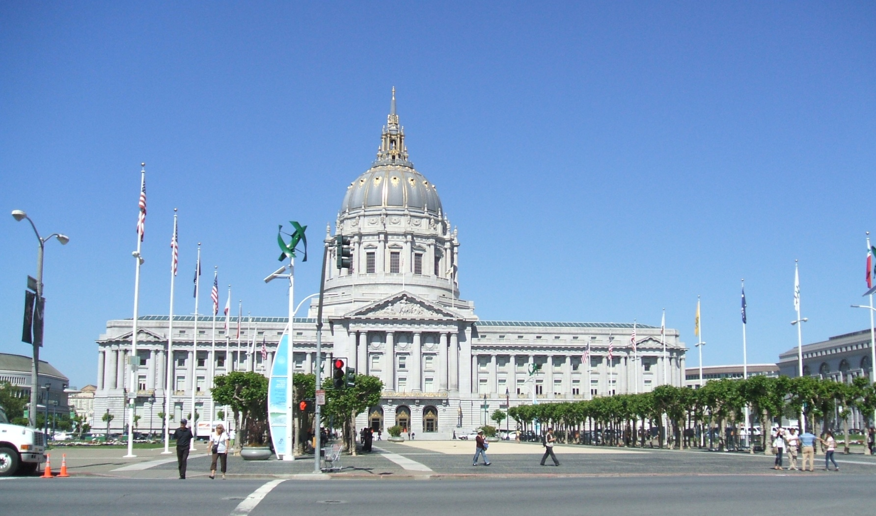

Slide 9
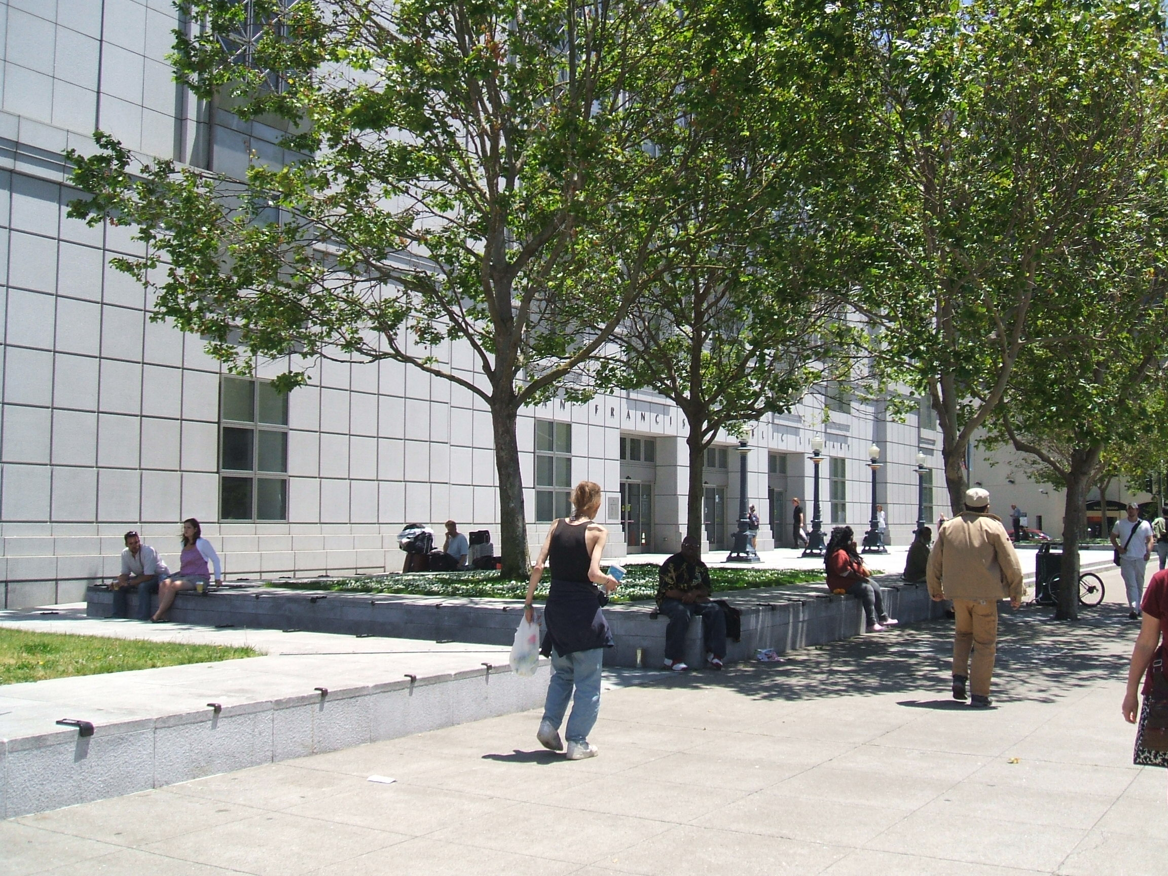

Slide 10
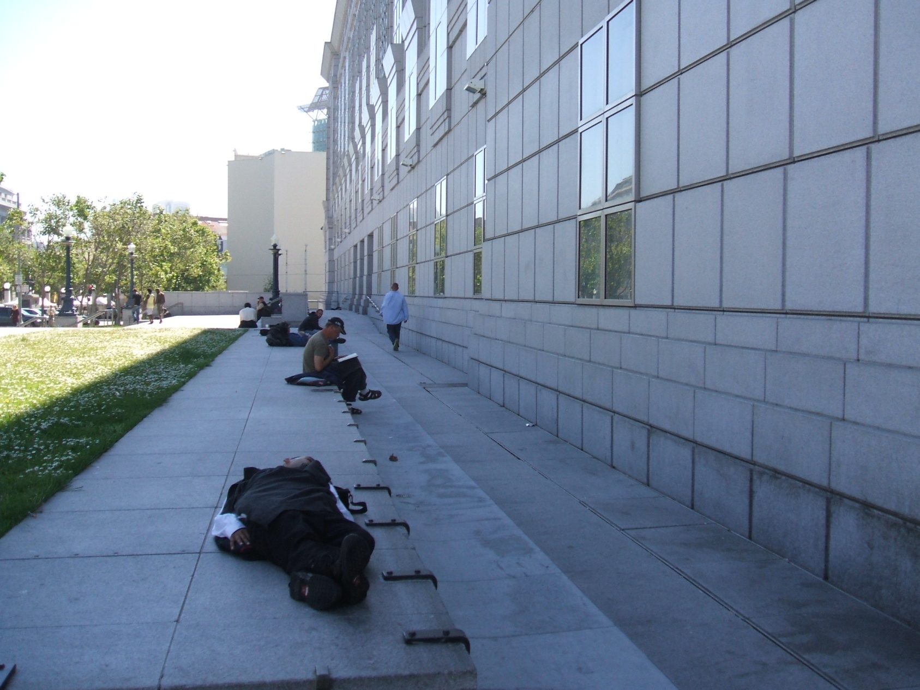
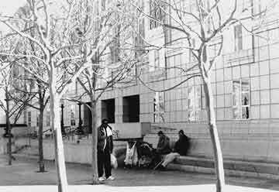

Slide 11
Homelessness in
San Francisco
THEN:
Barbary Coast  Great Depression 
Summer of Love 
AIDS and crack epidemics  Shelters
▪•▪ ▪•▪ ▪•▪ ▪•▪ ▪•▪ ▪•▪ ▪•▪ ▪•▪ ▪•▪ ▪•▪ ▪•▪ ▪•▪ ▪•▪ ▪•▪ ▪•▪ ▪•▪ ▪•▪ ▪•▪ ▪•▪ ▪•▪ ▪•▪ ▪•▪ ▪•▪ ▪•▪ ▪•▪
NOW:
Care-Not-Cash

Project Homeless Connect

Slide 12
Homelessness in
San Francisco
People who spend their days at the library...
have nowhere else to go during the day… have jobs… are housed… are homeless… just enjoy what we have to offer.

Slide 13
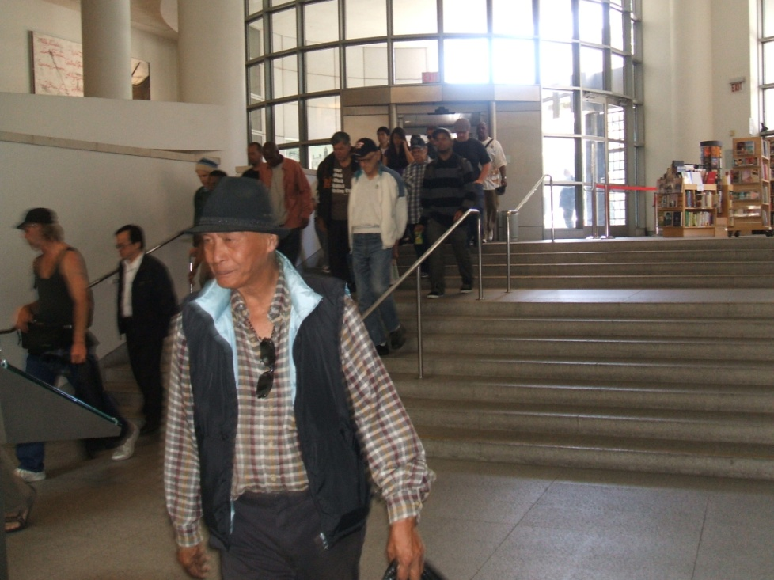
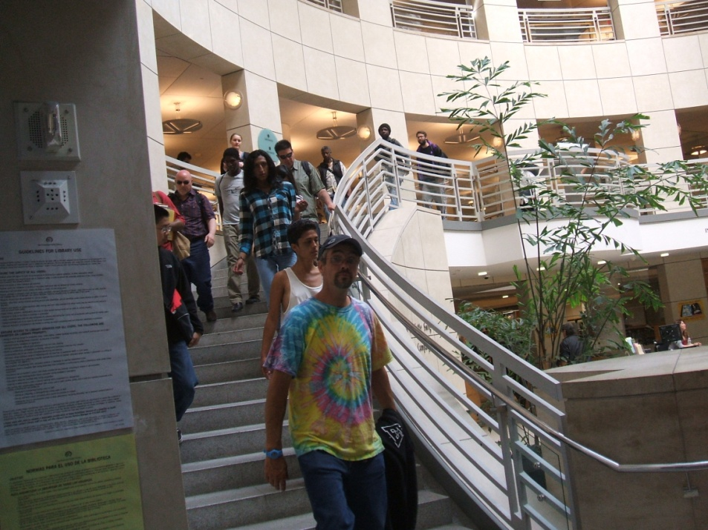
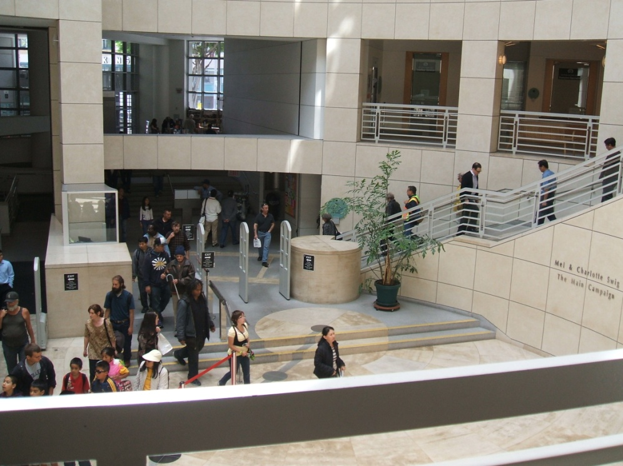

Slide 14
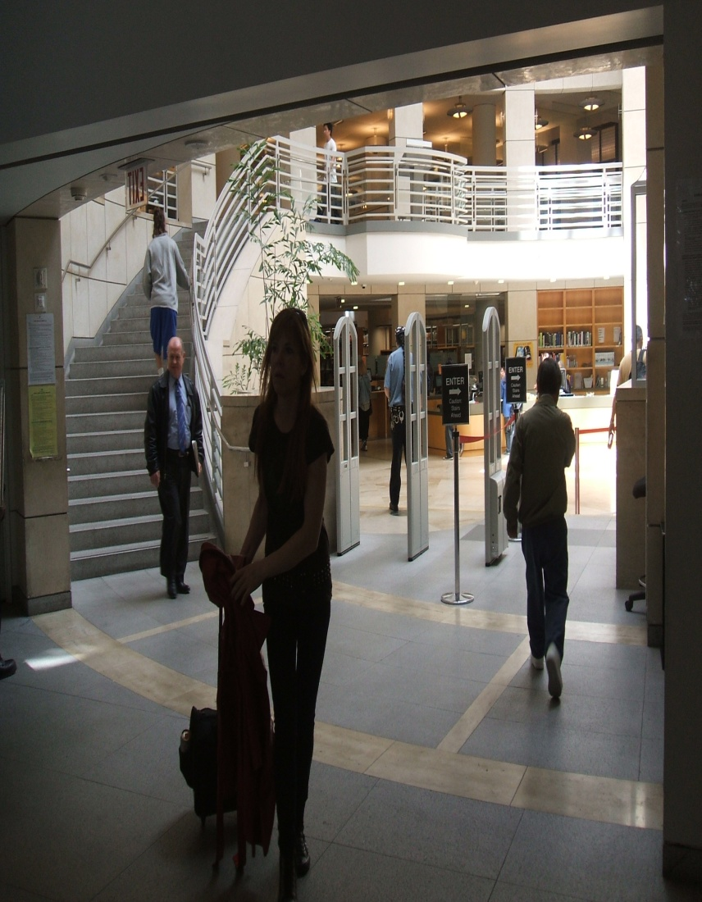
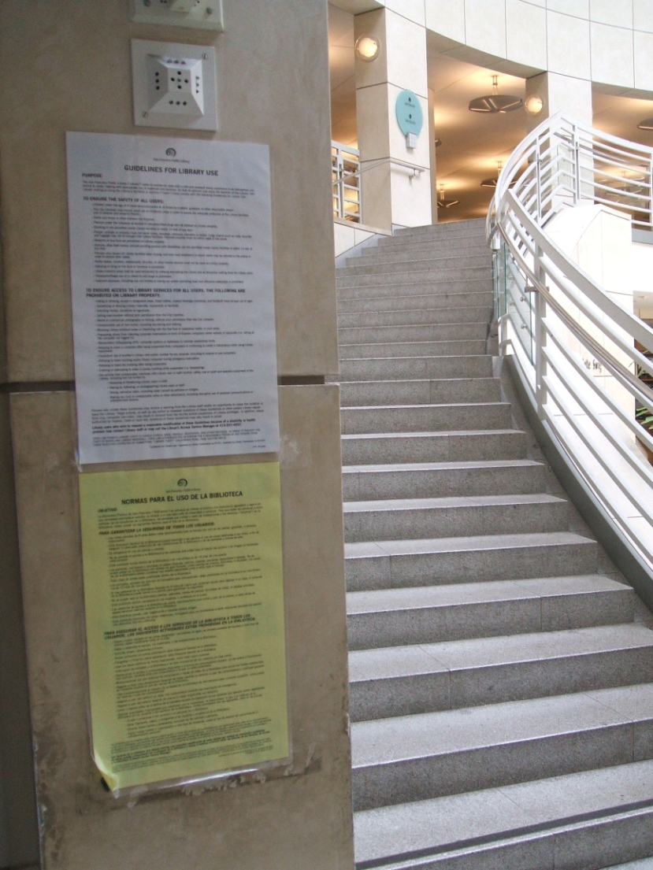

Slide 15
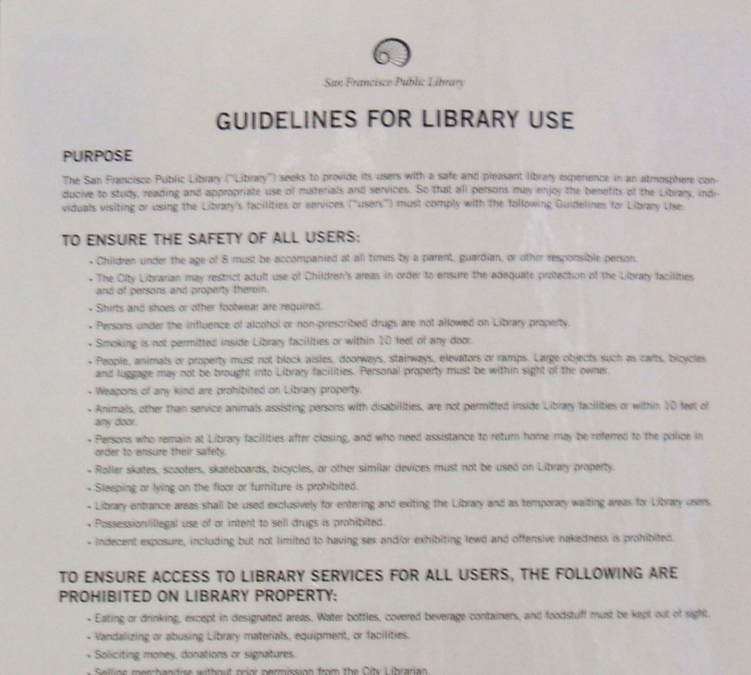
Patron
Behavior Guidelines

Slide 16
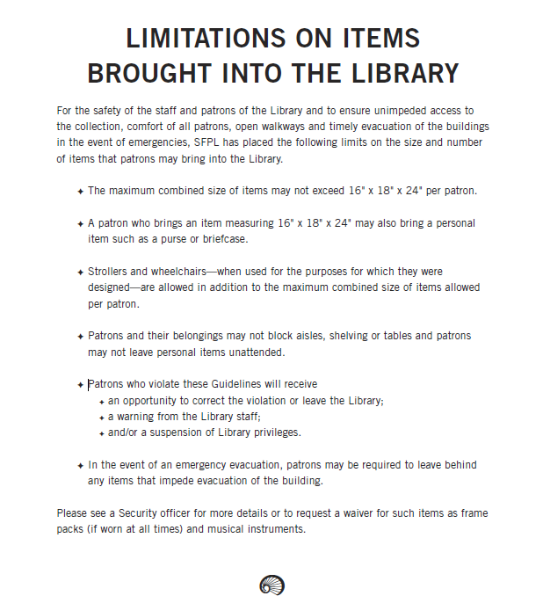
Patron
Baggage Limits

Slide 17
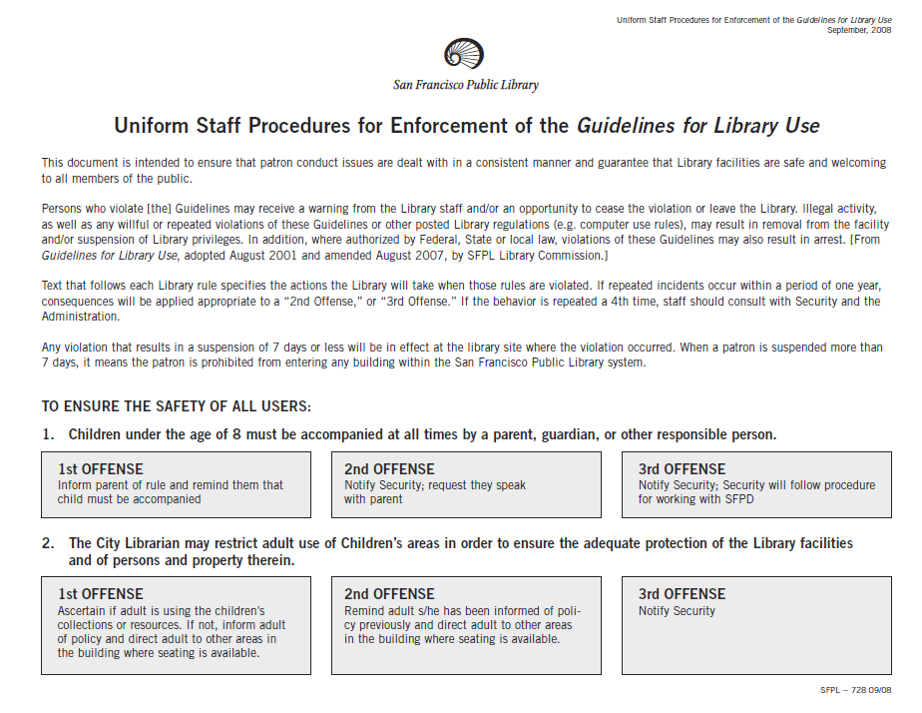
Consequences

Slide 18
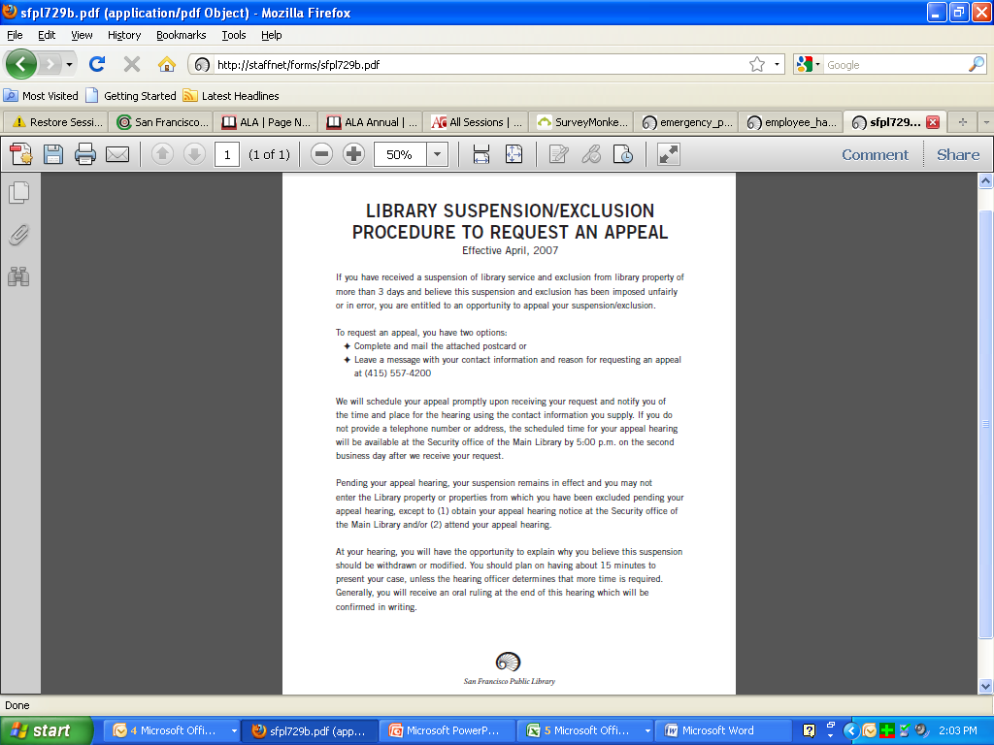
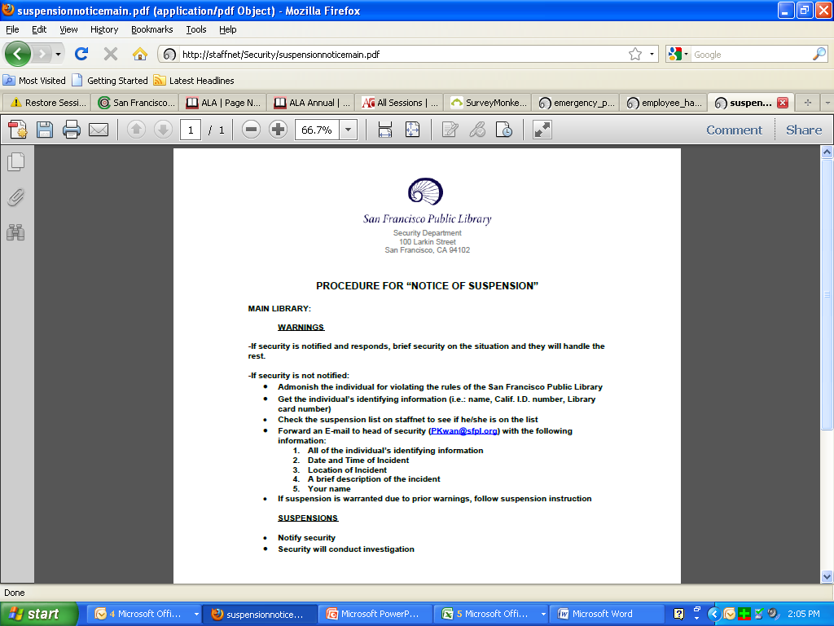
Appeals Process Following Suspension

Slide 19
What’s in
Your Library?

Slide 20
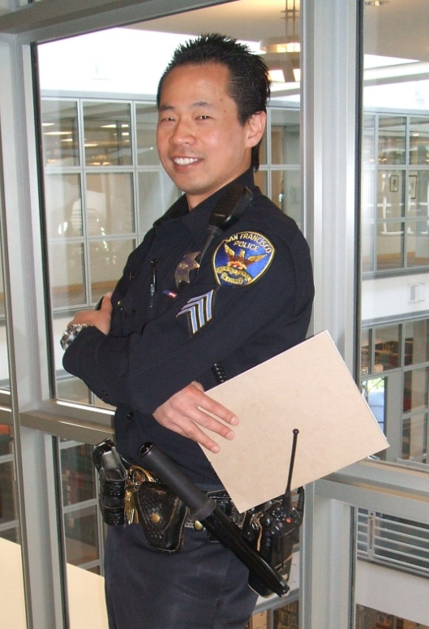
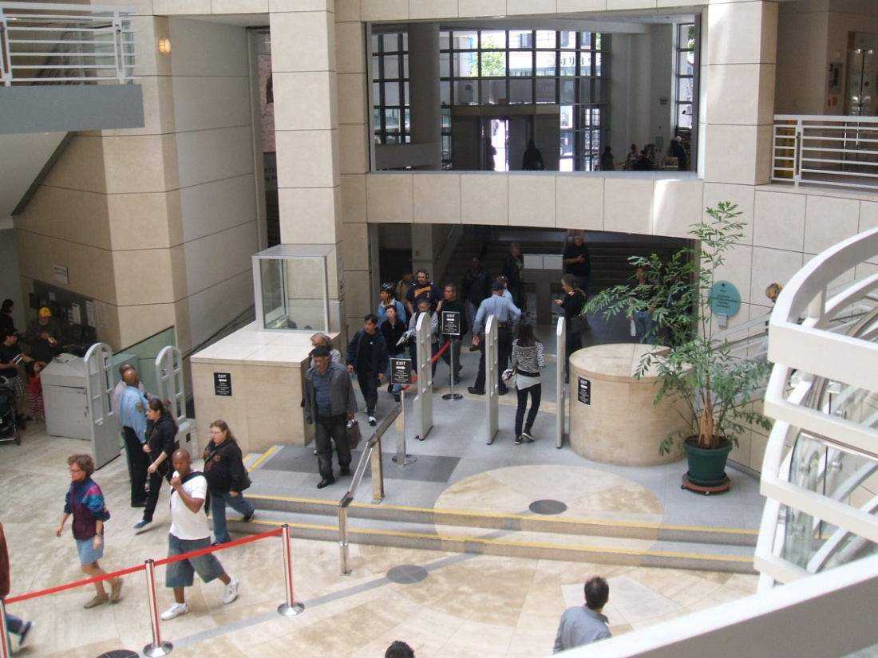

  San Francisco Police Department

Slide 21
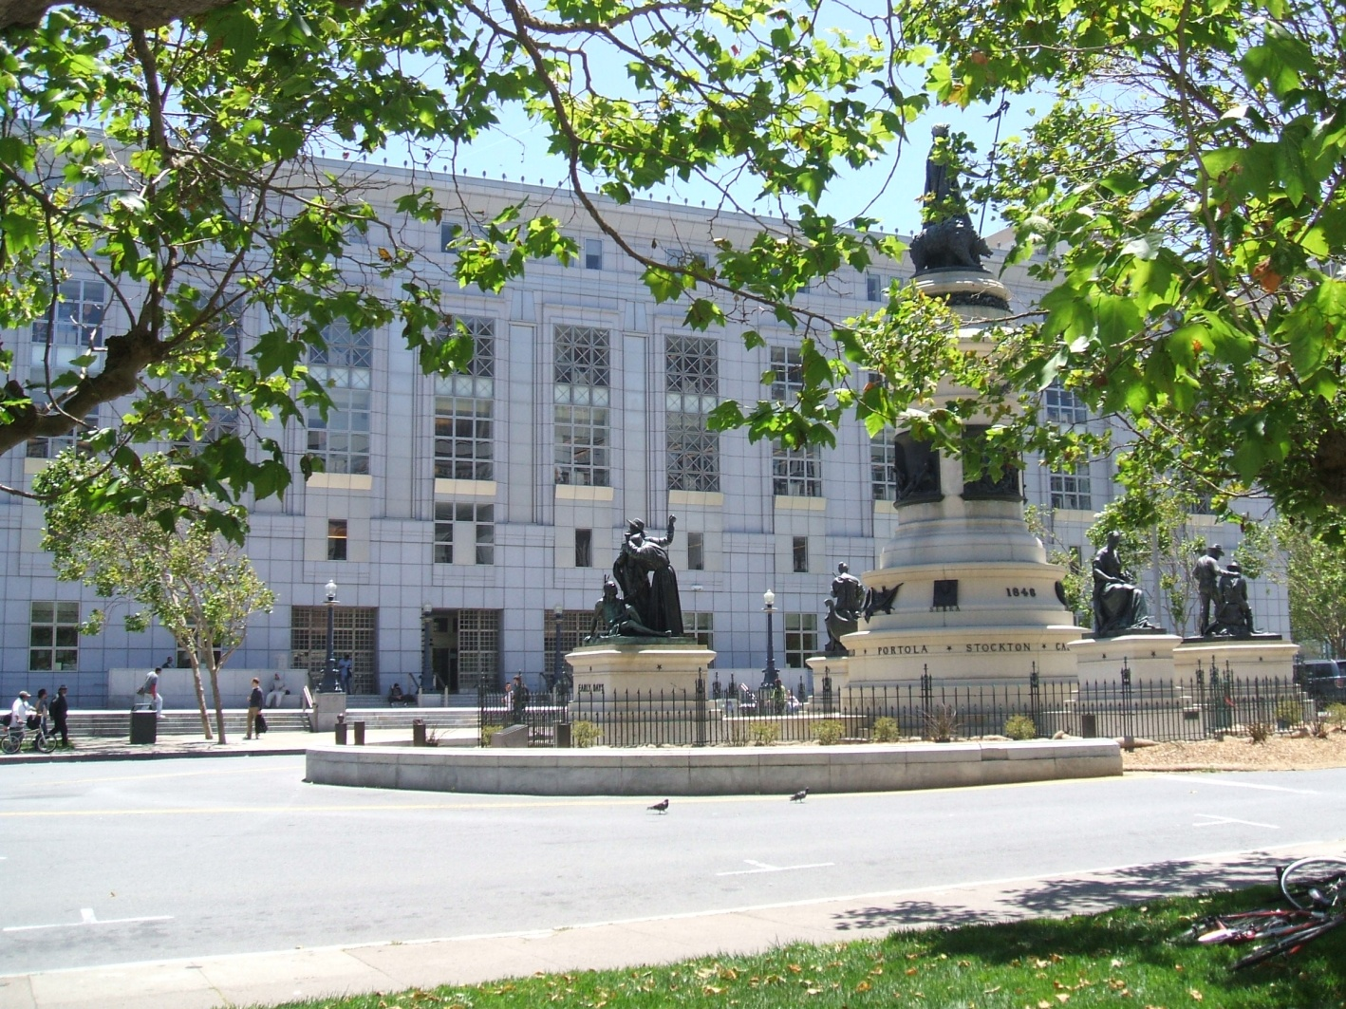

Department of Public Works

Slide 22
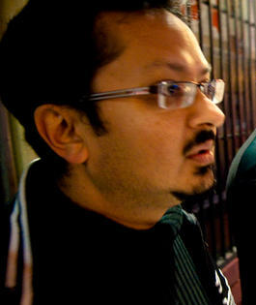
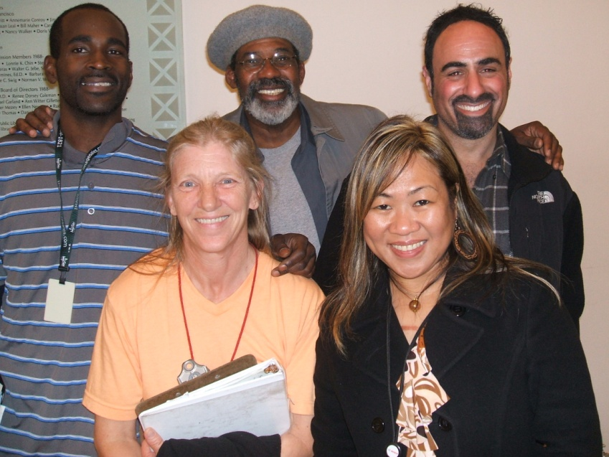
  Department of Public Health

Slide 23
Patrons Served YTD
365
13
12
19
20

Slide 24
Other DPH Services
Meetings & consultations with staff
Staff Training:
  ➲ History of homelessness
  ➲ Understanding mental illness
  ➲ Understanding substance abuse
  ➲ Anger management
  ➲ Limit-setting

Slide 25
Who’s doing what?

Slide 26
The Library’s Social Worker
Leah Esguerra , LMFT

Slide 27
LIMIT-SETTING WITH LIBRARY PATRONS

Slide 28
What is Limit-Setting?
Providing direction when patrons might be confused and disorganized in their thoughts, speech and/or behavior.
Providing guidance using a reasonable amount of time and attention, while also using a range of interventions that are respectful, welcoming and sometimes firm.

Slide 29
Why Set Limits?
  You’ll manage your time
  more effectively.

Slide 30
Why Set Limits?
  Inappropriate and hostile behavior won’t escalate and should even stop.

Slide 31
Why Set Limits?
You’ll be in control of otherwise-confused patrons and/or unmanageable situations.

Slide 32
Why Set Limits?
  Your mental, emotional and physical health will benefit –
  you will manage your own frustrations and anger
  instead of “losing it.”

Slide 33
How To Set Limits
Taking a risk is
essential
for effective limit-setting.

Slide 34
How To Set Limits
Evaluate
the situation

Slide 35
How To Set Limits
      Be clear
      Be RESPECTFUL
      Be Kind
      Be firm and tactful
      Be consistent

Slide 36
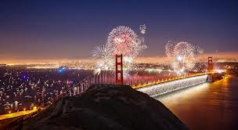
HELPFUL HINTS

Slide 37
HELPFUL HINTS
Respectful
disengagement

Slide 38
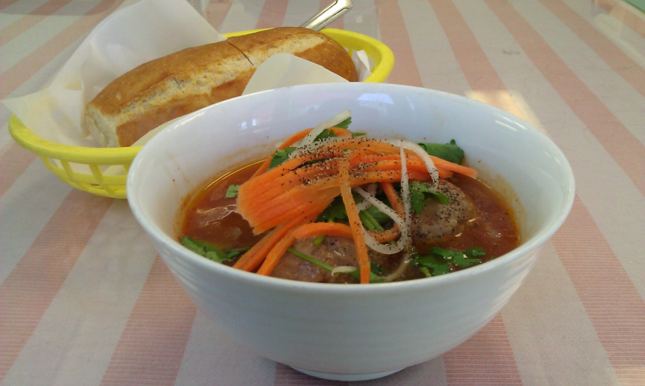
TAKING CARE OF OURSELVES

Slide 39
NEXT WEEK:
Helping Others as we Help Ourselves

Slide 40

Questions?

Slide 41

Thank you
Karen Strauss, Acting Chief of Main
kstrauss@sfpl.org
Leah Esguerra, Social Worker
lesguerra@sfpl.org

Slide 42
Infopeople webinars are supported in part by the U.S. Institute of Museum and Library Services under the provisions of the Library Services and Technology Act, administered in California by the State Librarian. This material is licensed under a Creative Commons 3.0 Share & Share-Alike license. Use of this material should credit the author and funding source.

