Slide 1
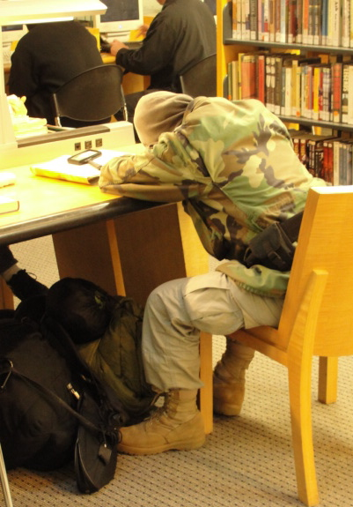
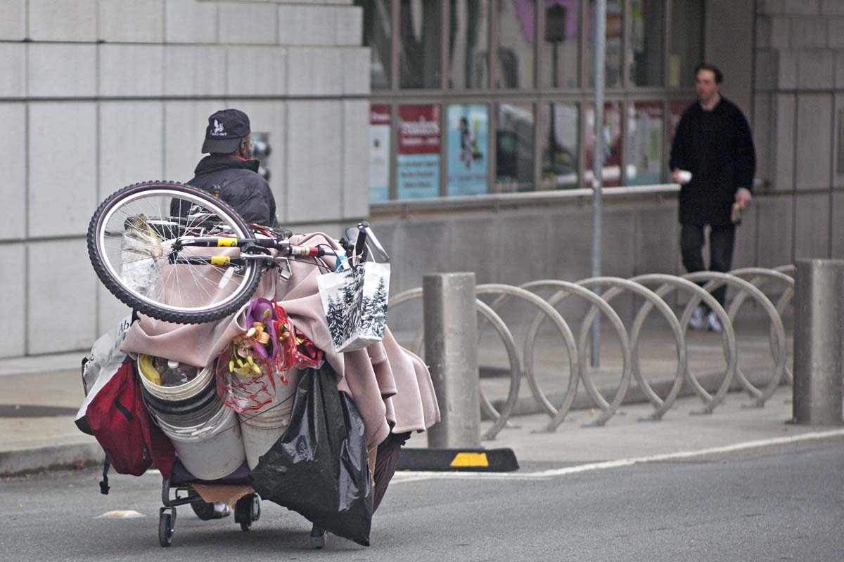
WHAT DO I DO NOW?:
Handling Challenging Situations with Mentally Ill and Homeless Library Users
Part Two
Tuesday, May 21, 2013
Karen Strauss, Leah Esguerra, Kathleen Smith

Slide 2
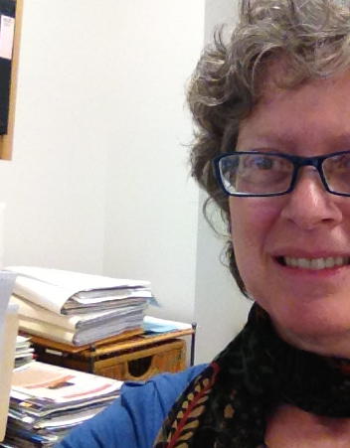
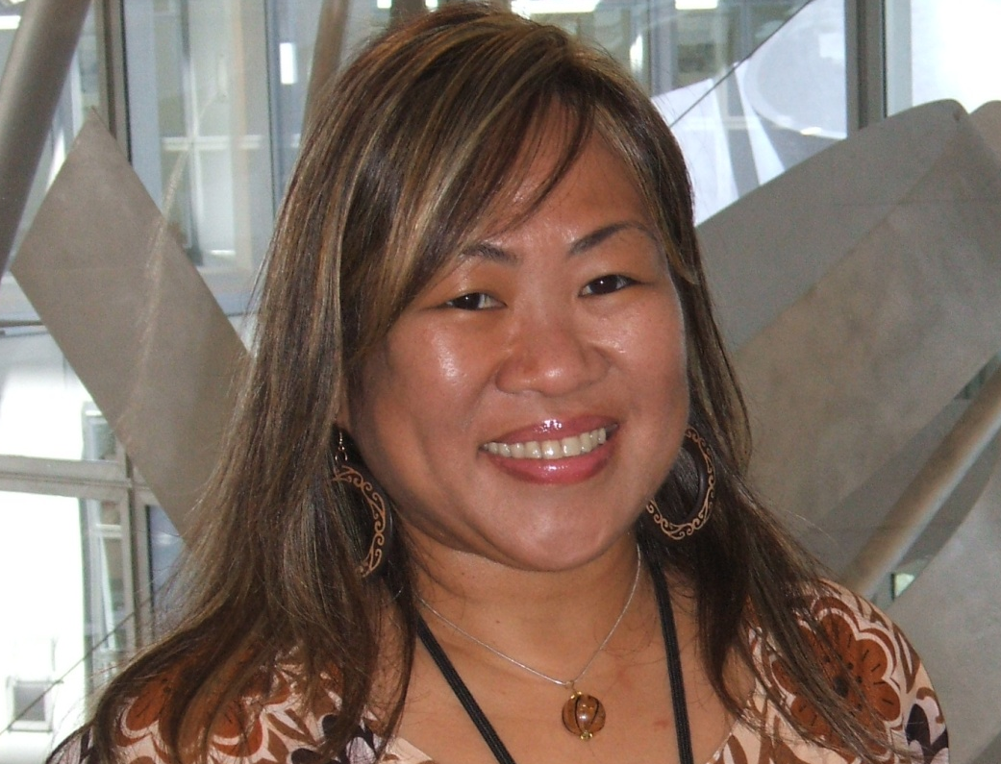
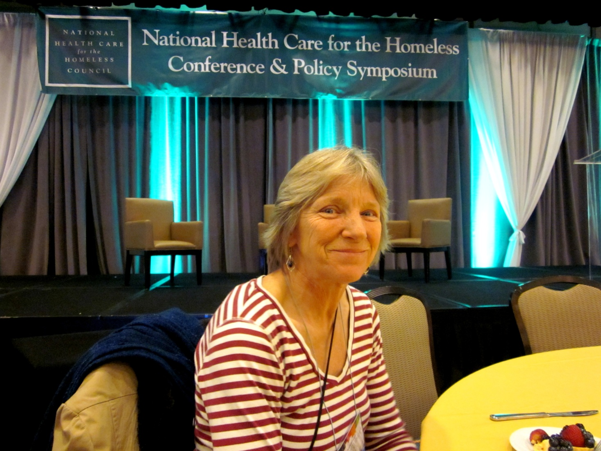
Who We Are
 Karen Strauss
Leah Esguerra
Kathleen Lee 

Slide 3
The Library’s Social Worker
Leah Esguerra
LMFT

Slide 4
What is Limit-Setting?
Providing direction when patrons might be confused and disorganized in their thoughts, speech and/or behavior.
Providing guidance using a reasonable amount of time and attention, while also using a range of interventions that are respectful, welcoming and sometimes firm.

Slide 5
Why Set Limits?
  Your mental, emotional and physical health will benefit --
  you will manage your own frustrations and anger
  instead of “losing it.”

Slide 6
How To Set Limits
      Be clear
      Be RESPECTFUL
      Be Kind
      Be firm and tactful
      Be consistent

Slide 7
Health and Safety
Associates
known at SFPL as
HaSAs

Slide 8
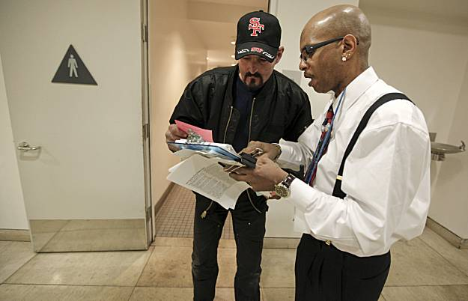
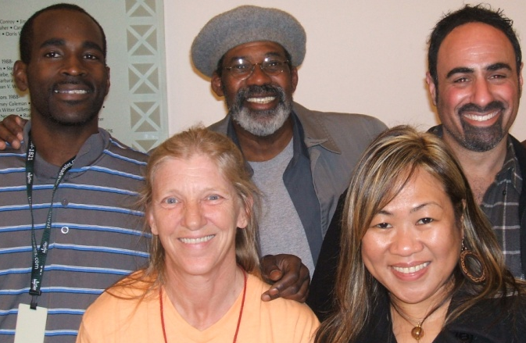
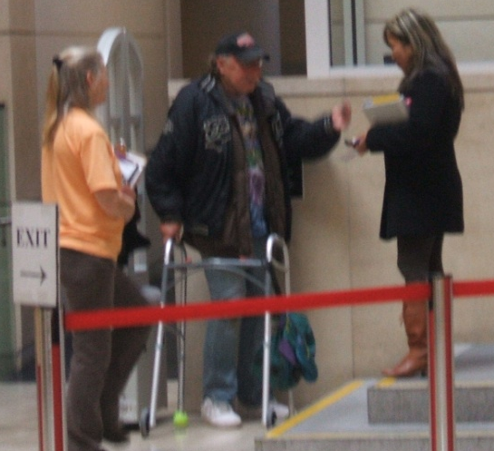

Slide 9


POLL #1

Slide 10

Philadelphia PL offers jobs to those who were homeless

Slide 11
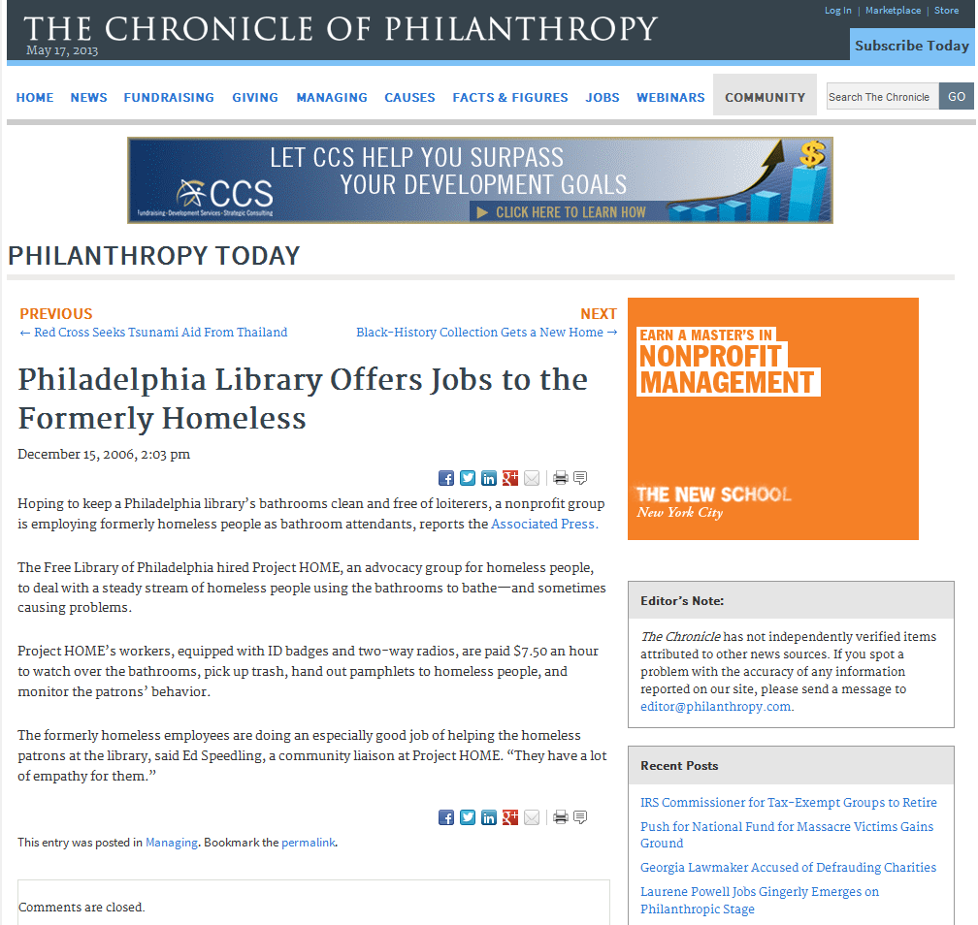

Slide 12
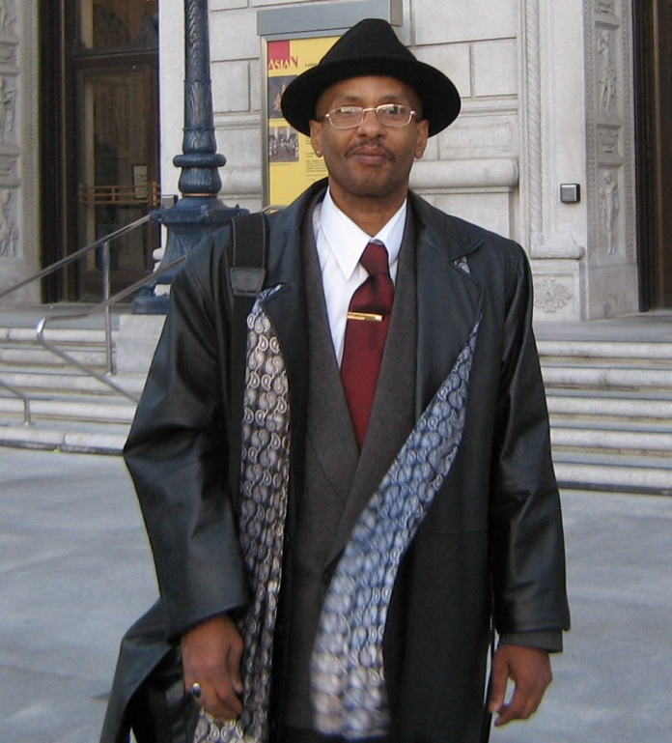
First Health and Safety Associate (hired 2009)
Melvin was invited by the mayor to attend the State of the City address in which he mentioned the HaSA program.

Slide 13
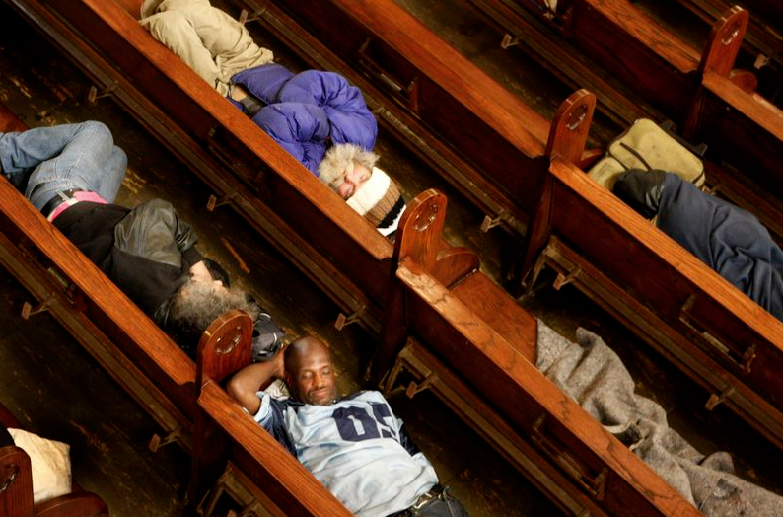
St. Boniface Church in San Francisco lets homeless people sleep in pews
PHOTO: Jeanette Antal
HaSAs are individuals who…

Slide 14
HaSAs are individuals who…
…have experienced homelessness and the issues often associated with homelessness.
…have first-hand experiences using the system to obtain public benefits, access shelters, free eats, mental health and/or substance abuse treatment.
…are current or former clients of the SF Homeless Outreach Team.
…have overcome homelessness and other issues.

Slide 15
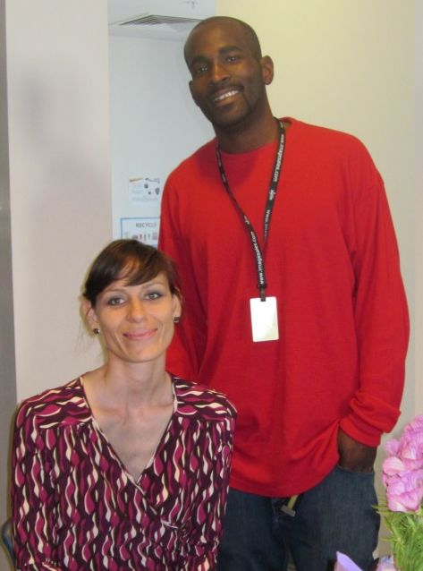
HaSAs are now helping others

Slide 16
Job Overview
Paid internship (up to 15 hours/week)
Six to 12 month duration
Morning, afternoon and evening (until closing) shifts
English-, Spanish- and Tagalog-speakers
Funding for 4 HaSAs simultaneously (1 female; 3 males)

Slide 17
Job Duties
Monitor the bathrooms for inappropriate activities.
Provide resources (free eats, showers, shelter, etc.).
Report illegal activities to Security staff.

Slide 18
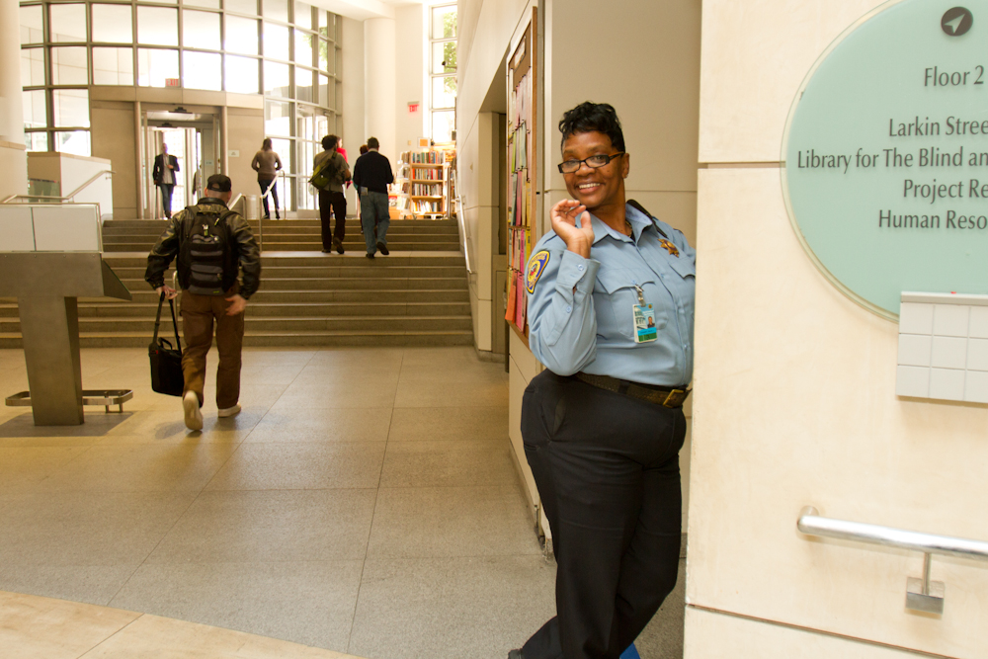
The Social Worker and HaSAs complement but do NOT take the place of Security staff.

Slide 19
Library Staff Call Security
…when staff feel unsafe addressing a violation of the Guidelines for Behavior (violence or potential violence).

Slide 20
Security calls the
Social Worker
…when a patron might benefit from social services (housing, mental health treatment, substance abuse treatment, etc.)

Slide 21
Security calls the
Social Worker
…when a patron is a danger to him/herself or others, after the situation has been stabilized

Slide 22
Library staff calls the
Social Worker
…when
in
doubt

Slide 23
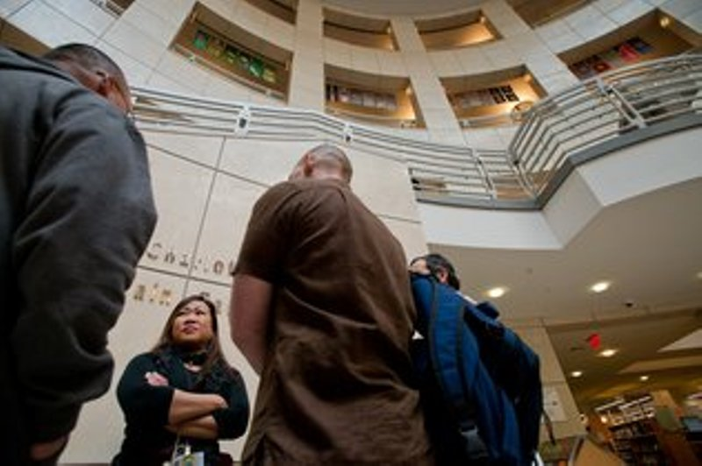
On-the-job Training
HaSAs receive feedback during daily meetings with the social worker, before and after their shifts. They learn how to do outreach, respect confidentiality, and recognize mental health issues.

Slide 24
HaSA Contributions to Patrons and Staff
Permanent housing for ca. 100 patron (since 2009)
Assistance to over 1,000 patrons
HaSAs wake up 2-16 patrons/day, each

Slide 25
HaSA Contributions to Patrons and Staff
HaSAs do outreach with 1-6 people/day
Find patrons inappropriately using bathrooms; report to Security
Alert Custodian if bathroom needs cleaning

Slide 26
HaSA Contributions to Patrons and Staff
Assist Library staff with patrons whose social services needs are non-library-related
Reduce inappropriate use of bathrooms
Reach some patrons more effectively than social worker, thanks to their first-hand experiences

Slide 27
From Homelessness to Work
Vocational Training Model –
former HaSAs are now employed as peer counselors and in the culinary field

Slide 28
Health and Safety Associates
Life experiences and knowledge = insider tips when helping those in need

Slide 29
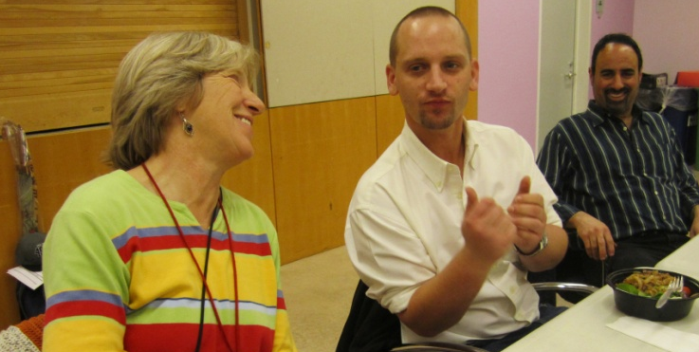
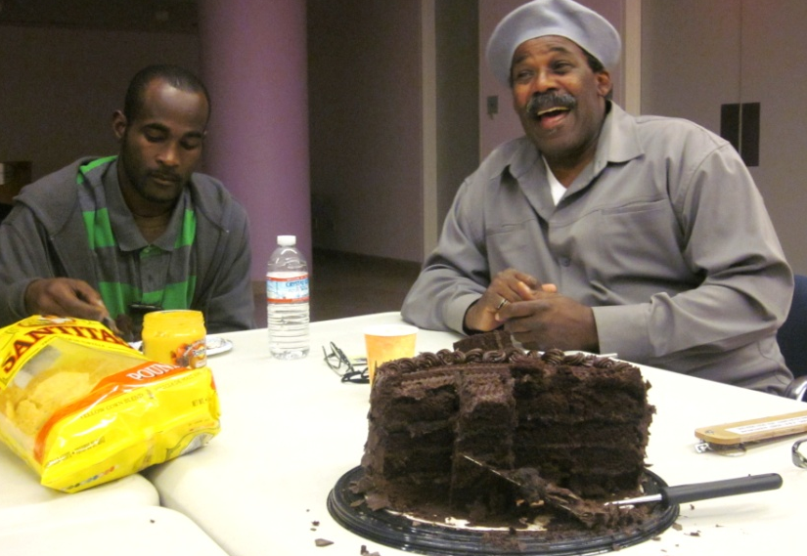
From Homelessness to Community

Slide 30
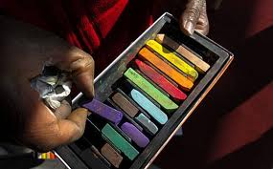
SOMETHING TO THINK ABOUT

Slide 31
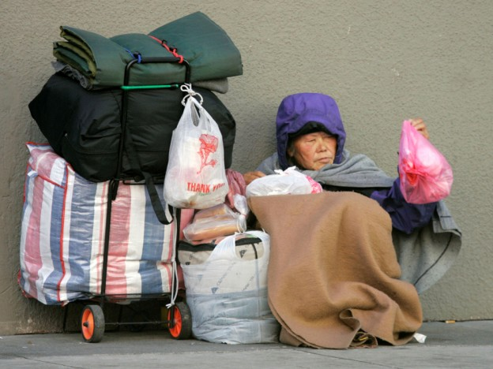
POLL #2

Slide 32
There are MANY faces of homelessness.

Slide 33
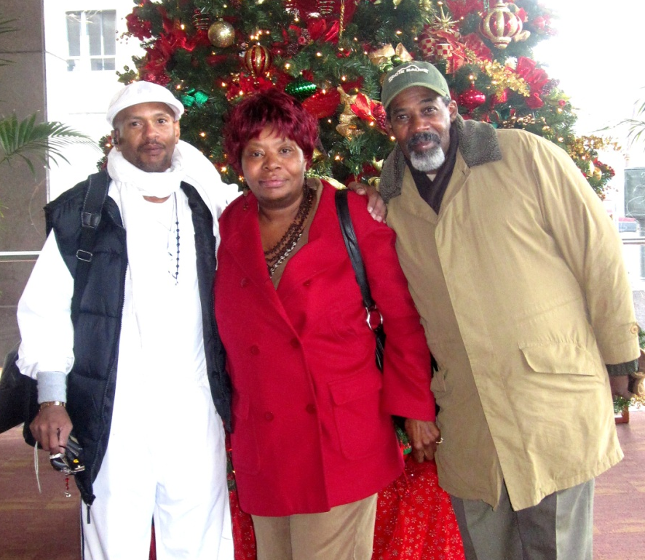

Slide 34


Slide 35
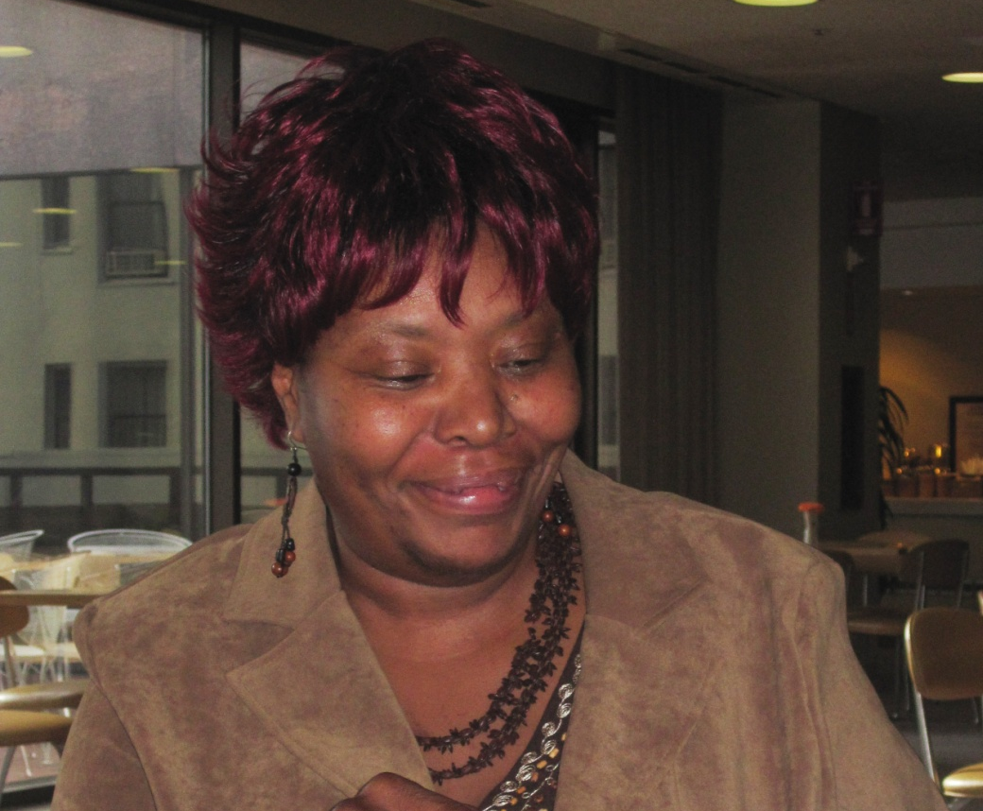

Slide 36
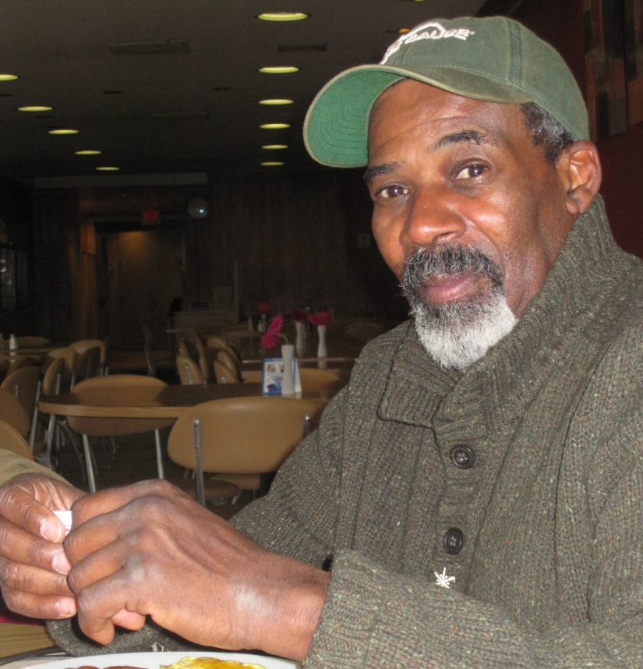
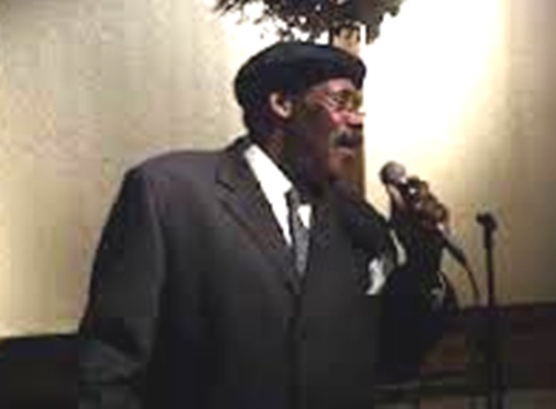

Slide 37

Guilty Verdict For Man Accused Of Homeless Shelter Stabbing
A jury found a 64-year-old man guilty of the stabbing death of another man at a homeless shelter in San Francisco’s South of Market neighborhood in February 2012.

Slide 38
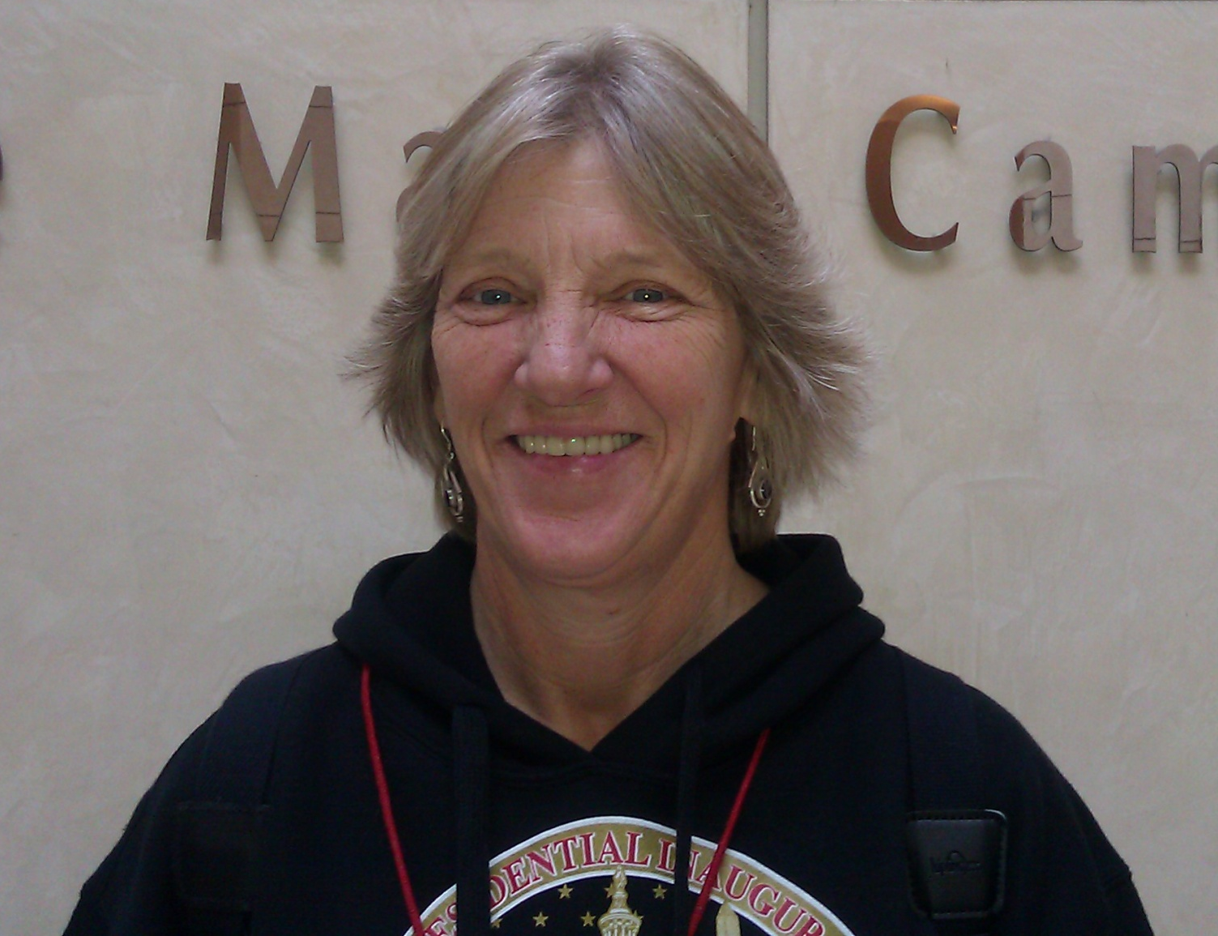
Kathleen’s Story

Slide 39
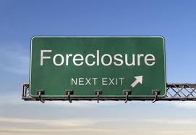

Slide 40
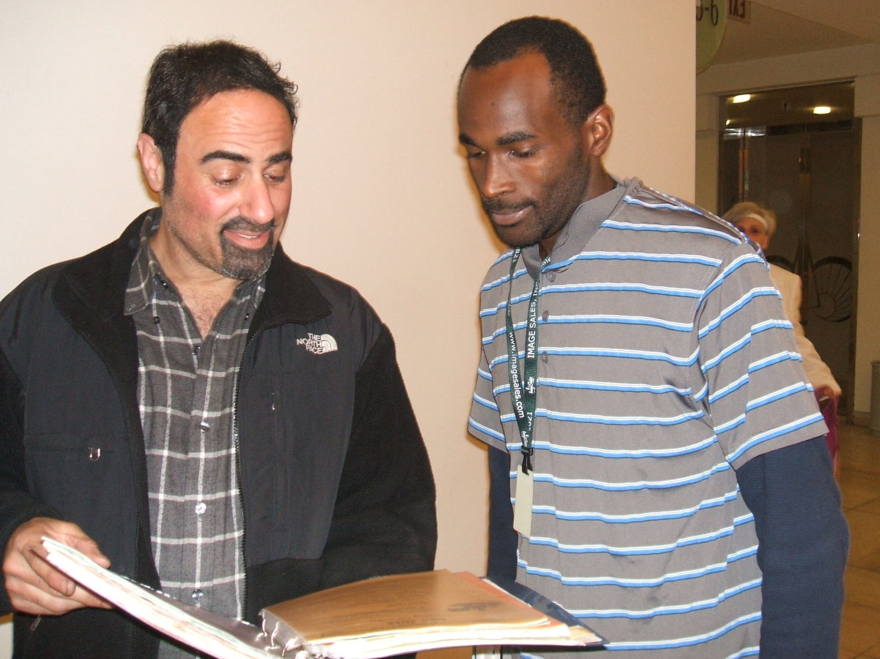
Timing is Everything

Slide 41
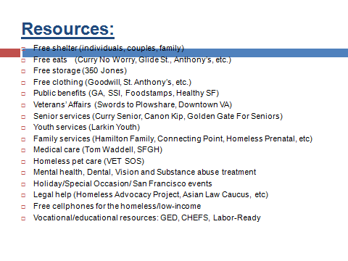

Slide 42
LAUNDRY & SHOWER RESOURCES
Mission Neighborhood Resource Center
165 Capp Street near 17th Street
869-7977
Monday through Friday 7:00am-11:30am
Tuesday & Wednesday 2:00pm-6:00pm
Men and women
MSC South
525 – 5th Street near Bryant
597-7960
Every day, 24 hours
Men and women
A Woman’s Place
1049 Howard Street near 6th Street
487-2140
Every day, 6:00am-7:00am, 8:00am-10:00am,
11:30am-3:00pm; 4:00pm-10:00pm
Women only
A Woman’s Place Drop-In
211 – 13th Street @ Mission
746-1945
Every day, 24 hours
Women only
LOW-COST LAUNDRIES
Bayview Hunters Point Multi-Service Center
2111 Jennings Street @ Van Dyke
671-1100
Every day, 7:00pm-12:00 midnight
Mission Neighborhood Resource Center
165 Capp Street near 17th
869-7977
Monday through Friday 7:00am-11:30am
Tuesday & Wednesday 2:00pm-6:00pm
FREE SHOWERS
Bayview Hunters Point Multi-Service Center
2111 Jennings Street @ Van Dyke
671-1100
Every day, 7:00pm-12:00 midnight
Men and women
Martin de Porres
225 Potrero Avenue @ 15th Street
552-0240
Tuesday & Thursday 9:00am
Men and women

Slide 43
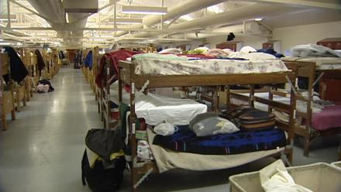
Shelter Counselor
Full-time shelter counselor at A Woman’s Place.

Slide 44
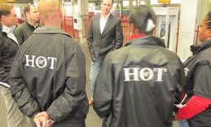
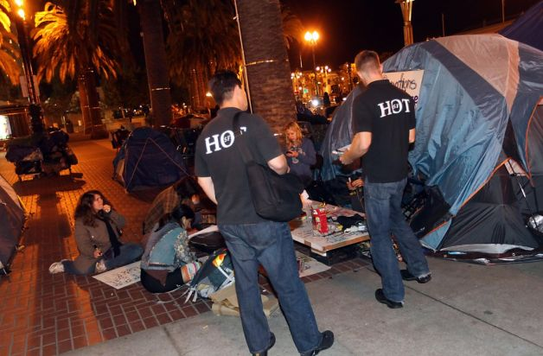
The Homeless Outreach Team (HOT)
Full-time street outreach worker.

Slide 45
Photo: Leah Esguerra
March 2013
Kathleen gave a presentation in Washington, DC, at the conference on National Health Care for the Homeless.

Slide 46
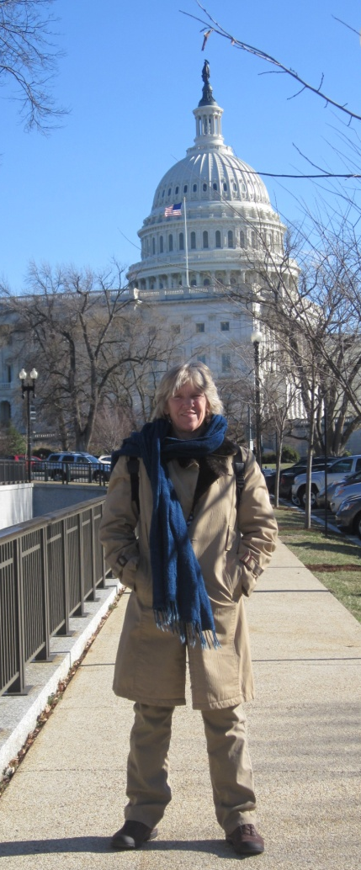
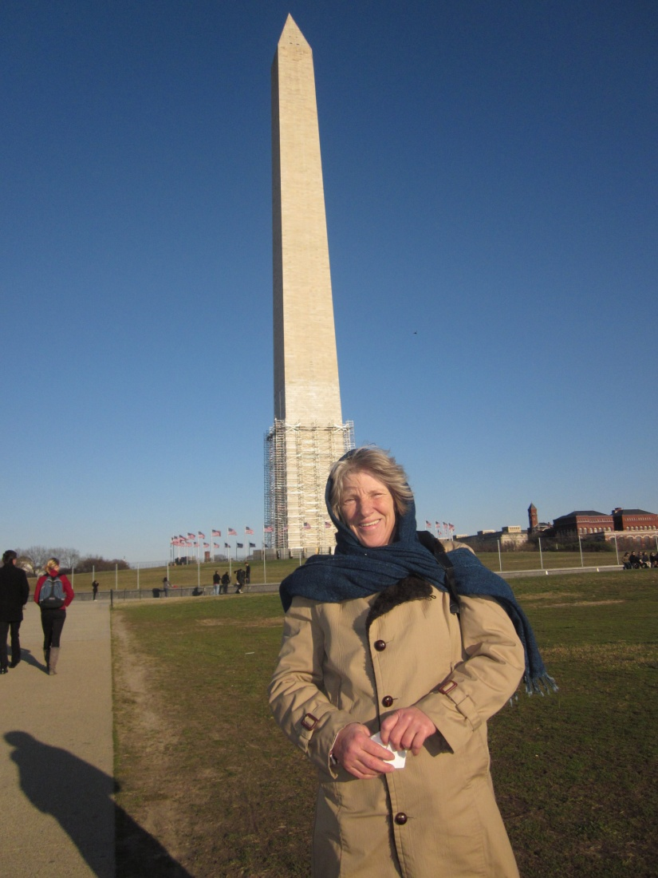
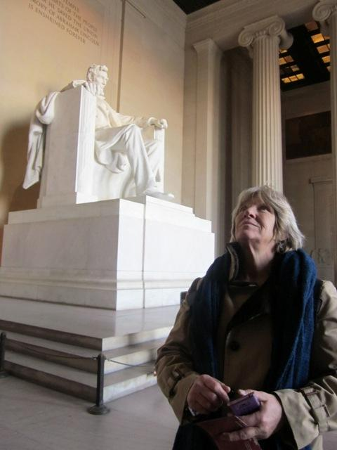
Kathleen in Washington, DC

Slide 47
How has your library served this population?

Slide 48
What new idea will you talk about?
What’s something you do that we should know about?

Slide 49
Parts 1 and 2 Takeaways
      Partnerships
       Setting limits
       Real life, real ideas

Slide 50
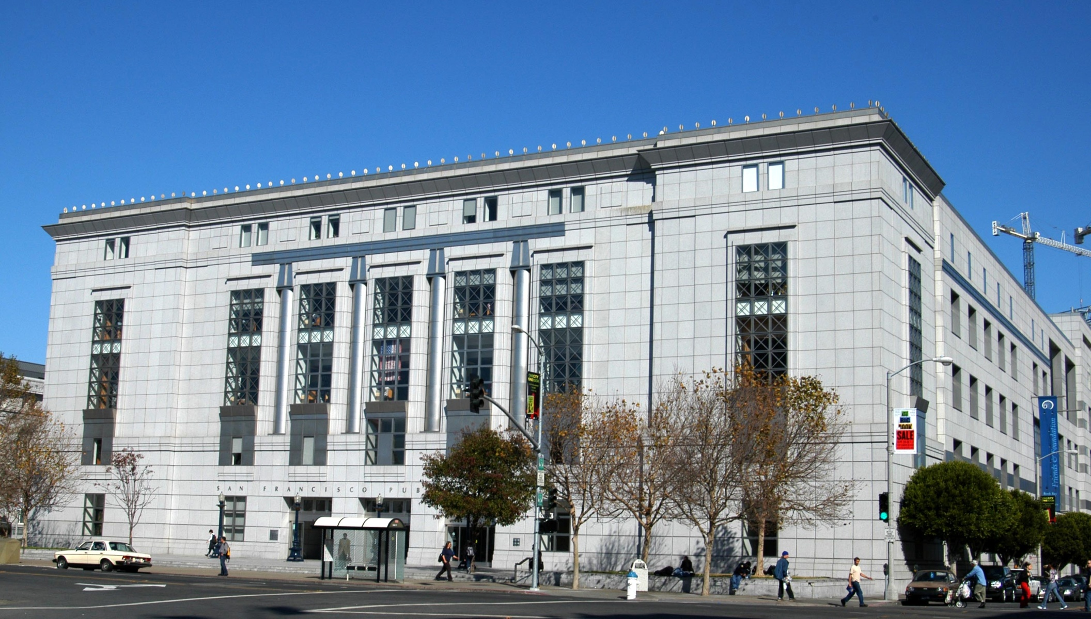
Leah Esguerra, Social Worker
lesguerra@sfpl.org
Karen Strauss, Acting Chief of Main
kstrauss@sfpl.org

Slide 51

Questions?

Slide 52
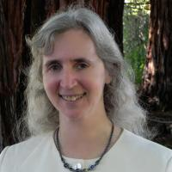
Libraries and the Homeless:
Legal Issues
Presented by Mary Minow
Tuesday, September 17, 2013 at 12 Noon Pacific

Slide 53
Infopeople webinars are supported in part by the U.S. Institute of Museum and Library Services under the provisions of the Library Services and Technology Act, administered in California by the State Librarian. This material is licensed under a Creative Commons 3.0 Share & Share-Alike license. Use of this material should credit the author and funding source.

