Slide 1
Libraries and Veterans
What every library should know about veterans in your community.
Thursday, May 23, 2013
12:00 noon to 1:00 p.m.
Presenter: Kristen Mulvihill
kjsmulvihill@gmail.com
Infopeople webinars are supported in part by the U.S. Institute of Museum and Library Services under the provisions of the Library Services and Technology Act, administered in California by the State Librarian. This material is licensed under a Creative Commons 3.0 Share & Share-Alike license. Use of this material should credit the author and funding source.
Notes:
(These notes represent what I plan to say, though I generally speak without reading from notes. Please contact me if you are reading the notes section of this presentation, and you require a transcription of what I actually say during the webinar.)
Hello, I'm Kristen Mulvihill, and I work as a consultant for the California State Library to look at ways in which we can connect with and assist veterans and military families in California. Although this webinar focuses on California libraries, most of the information can be applied toward your work in another location.
I was first asked to talk about veterans as a recipient of the Librarians for Diverse Communities Scholarship Program in southern California. I had a particular interest in veterans and disabilities and wanted to learn what my classmates knew about these issues when I presented a short presentation for a diversity workshop about three years ago. Since then, I have expanded my research to include all types of veteran issues, strategic planning and public libraries, and how to assist public library employees in their work at reference desks when assisting a veteran or a family member of a veteran.
I was in the army for four years, and I personally experienced some of the hardship that many veterans experience in transitioning from military to civilian life. I had a difficult time getting used to civilian life where my job wasn’t 24/7, and where my purpose wasn’t as exciting as defending the Constitution of the United States. I was also very proud of my ability to handle stress and solve problems. I never wanted to ask for assistance.
So, even now, I still remember how shocked I was, and relieved, the first time I learned that I could seek healthcare from a V.A. facility with or without health insurance, regardless of whether I had an official disability from my service in the military. For almost ten years, I was under the impression that I had to have some kind of disability status to receive any assistance at all.
My own lack of knowledge about resources that were available to me, and my interest in helping both veterans and the organizations that assist veterans, have inspired me to work on furthering the education of veteran issues among librarians today. I believe that libraries have an opportunity to help veterans, in terms of information management, as well as helping organizations that work with veterans, too. I look forward to learning from you about what you know as library professionals who work with veterans. I hope that we can work together to increase our knowledge and find ways to help libraries continue to be relevant in every community where veterans can benefit from the materials, programming, an services that a public library provides.

Slide 2
Agenda
Why talk about veterans and libraries?
What is a veteran?
Today’s challenges
Organizations
What every librarian should know
What libraries are doing now
What libraries can do next
Notes:
Today we'll be talking about what every librarian should know about veterans and the veteran community. Here’s an outline of what I hope to discuss with you:
We will be talking about why this topic is important, who is a veteran of the U.S. military and who might not fall into that category, some of the latest challenges faced by the men and women who work for the V.A. and other organizations that serve veterans as well as the challenges of the veterans themselves.
Most of the content of this webinar is basic information. This is an overview, a starting point in thinking about assisting veterans in your community or partnering with organizations that serve veterans.
Before I forget, we will be doing a few polls during the webinar, so that I can get to know you better. If you haven’t worked with the polls in Adobe Connect, that’s okay, we’ll walk you through it.

Slide 3
Why talk about veterans and libraries?
This is about what libraries already do:
  Learning about the community we serve,
  Connecting community with information,
  Building relationships.
“Aren’t veterans being helped by other organizations?”
“Why should libraries be responsible for helping veterans?”
Notes:
I have been asked on a couple of occasions why librarians should be thinking about the veteran community. It has been suggested to me on occasion that libraries serving the veteran community might be doing the work that other organizations ought to do, or that libraries should not be in the business of offering social services.
My goal in talking about working with veterans, however, is about connecting with the community that our libraries serve. Part of connecting with our communities is helping organizations who help people in our community. Libraries do not necessarily offer social services as much as they provide information about resources available to people who need them.
Even though there are many federally funded and state funded organizations serving veterans today, there is still a role for libraries to play, a role that we have been playing for a long time. Our role is to keep the public informed about the resources that are available to them – at the library or elsewhere. We distribute bus route information, we answer questions at the reference desk about telephone numbers, and we also try to stay connected with the community we serve. Working with veterans is all about these things.
I also like to think about veterans in terms of diversity. To me, military families and veterans represent a unique cultural group. Increasing our knowledge about their information-seeking behaviors, needs, and interests in using the library are a part of our job in serving the community. The library is also often described as a safe place for children and adults.
Part of our task, therefore, is to manage collections, programs, and services in such a way that our work corresponds to the needs and interests of our community. Veterans are a part of the community we serve. And partnering with organizations that serve veterans is one way to work more closely with the people in our community and stay relevant today.
Now, let’s learn a little about where you are coming from first….our first poll!

Slide 4
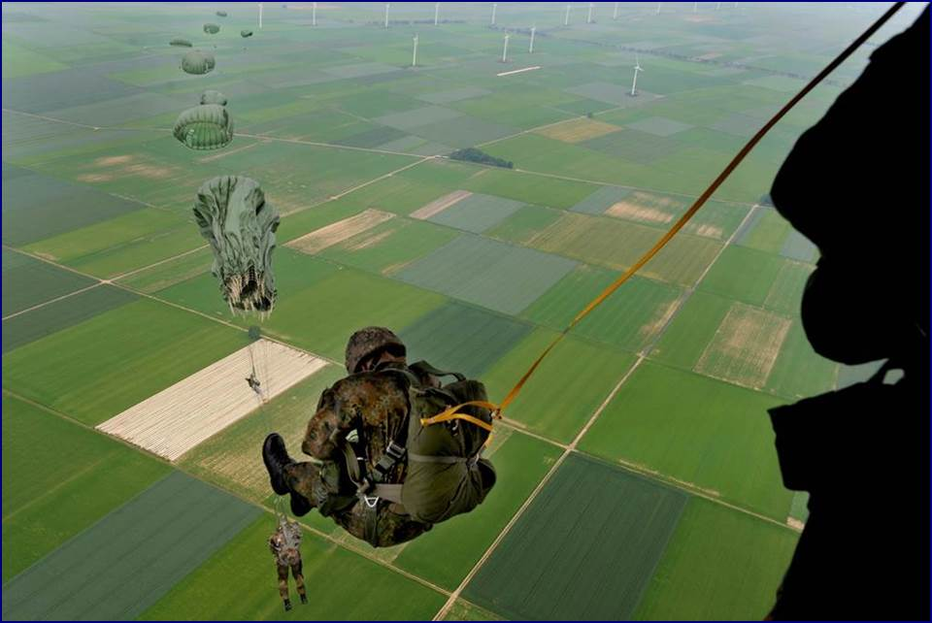
Poll #1
Are you a veteran or are you related to someone who is a veteran or in the military?
Also, please type your additional responses into the chat box.
Notes:
I am always surprised by how library professionals answer this question. Some of you might have someone in the military in your family, though you have never really talked to them about their experiences. Some of you might be very knowledgeable through your friends and family connections about military life or the veteran community. When you are done answering this question, please feel free to comment in the chat window about what you know, or comment about what you have always wanted to know about veterans. We’ll take a minute to discuss your comments before we proceed.

Slide 5
Who are our U.S. veterans?
Branches of military service and types of separation
Assumptions/biases
Unique cultural backgrounds
Recently separated or older veterans
Talking / not talking about the past
Veteran Community:
    Spouses and children
    Parents and caregivers
    Organizations
Notes:
For starters, I have to say that many U.S. veterans don’t even realize that they have the right to call themselves “veterans.” We get so caught up in the hierarchy in the military, and we are taught to be self-reliant as well, that when we leave the military we aren’t necessarily knowledgeable about the categories of veterans or the different ways we can ask for assistance. So, the first thing you should know is what a veteran is.
Contrary to what I believed when I left the army, a veteran is someone who has left the military after at least one to two years of service. Period. In some cases, veterans might have served for even less time. We don’t have to be a veteran of combat or a veteran of a foreign war to be called a veteran of the U.S. military.
Veterans are usually classified by the V.A. according to the type of discharge they received from the military. If you were in basic training for four weeks and left the military by going AWOL, you’re probably not honorably discharged. If you received an injury during your first few weeks of the military, however, you probably were medically discharged and you were honorably discharged.
Most veterans make a lot of assumptions about two things – if they were honorably or dishonorably discharged and if they did twenty years of service before retiring from the military. We are told a lot about the benefits of giving 20 years of service, and so we sometimes forget that we have access to benefits even if we served for only two years. If a veteran is concerned about the type of discharge he/she received, however, you should not make any assumptions as a librarian. Focus on helping the person learn where to go to learn the facts. We’ll talk about where to go in a minute.
Finally, I would like to mention that we have all types of veterans…make no assumptions about whether a person is a veteran based on their appearance or age. And in terms of how libraries assist everyone in a community, let’s not forget that there is a larger community of people who seek resources for veterans – their families and caregivers. I prefer, therefore, to talk about libraries serving the veteran community, which includes spouses, children, and caregivers.
One more thing we should consider when we think about who is a veteran is what I mentioned just recently -- Veterans represent a diversity group with unique cultural experiences from their time in the military. Many veterans and their families experience some isolation after leaving the military. They no longer have access to active-duty military resources and often relocate away from friends and coworkers. We’ll talk about this again some more when we talk about what libraries are doing for veterans these days.
- Two possibilities or something in between: Many veterans are seeking a community with veterans with similar experiences; while others seek a sense of community that will not remind them of their negative experiences in the military.
Most members of Congress are now concerned about veterans and mental illness and depression can be exacerbated by isolation. Finding a welcoming group within the community is part of the effort of many men and women to reduce isolation. Children of veterans whose parents are coping with the changes of leaving the military also cope with depression and anxiety and benefit from healthy social experiences.
The public library can provide a sense of community, schedule events for veterans seeking the company of other veterans, and coordinate other groups that are not entirely made up of veterans – the diversity of opportunities to interact socially with the community through a library are one of the greatest services available to all veterans.
Not to overgeneralize, but typical experiences of veterans who leave the military:
Loss of “family”
Loss of “purpose”
Loss of routine
Disabilities

Slide 6

Poll #2
What percentage of the nation’s veterans live in California?
Notes:
I will discuss some statistics at this point. These will be made available online after the webinar.
21.5M veterans in U.S. as of 2011
2009 Census reports 1.9M veterans in California (10% of national veteran population)
Almost 25% (24.6%) of California’s veterans are classified as disabled, per 2009 Census
Nationally, 33% of the male homeless population are U.S. veterans, per Census Veterans Day handout
Expenditures have more than doubled since 2000 from $47,086 (in the millions) in 2000 to $108,761 (in the millions) in 2010, according to a V.A. report
References for the statistics above will be listed on my blog/handout.
(Statistics will include Karen’s numbers of veterans by county. The link to references at the end of the webinar will include a link to a map and some charts online.)

Slide 7
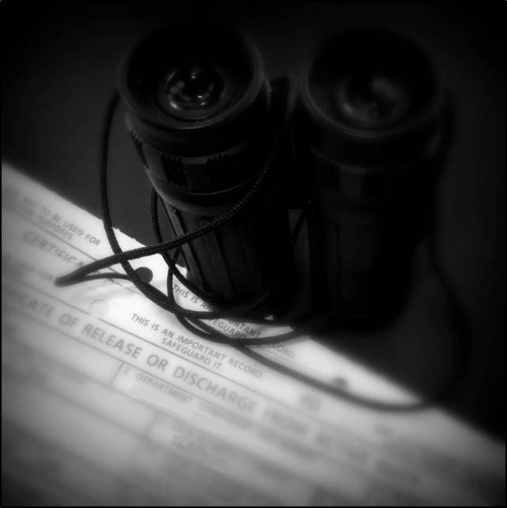
Today’s challenges for veterans and the veteran community
Intimidating paperwork
    Lost your DD-214?
Media misconceptions
Information overflow:
Resources are
abundant
but not necessarily
organized
New battlefield medicine yields more survivors
+
Veterans of previous wars are living longer
Notes:
Let’s talk about what’s happening right now in the world of the veteran community. (This is an outline of what I will discuss.) (FYI - Image on this slide is the top of a DD214 form.)
Discouraging paperwork: Getting started or reconnecting with organizations that serve veterans requires proof (DD-214 form) which many veterans lose soon after leaving the military.
Discouraging news in the media: When lengthy processing of disability claims and other types of negative news coverage about veterans receiving adequate care are portrayed in the news, this can discourage many veterans from initiating or re-initiating contact with organizations that are qualified and prepared to help them.
Distractions: Most veterans are like all of us – they are trying to hold down a job or find a job while managing health issues, family problems, and the challenges of everyday life. Seeking assistance takes too much time, and this task is all the more intimidating when veterans are dealing with technology fatigue and information overflow.
Multi-tasking: Recently separated veterans are usually managing a complicated relocation of their household and family, finding new schools, a new job for the veteran and his/her spouse, while facing uncertainty about the future.
Health issues: A majority of recently separated veterans have experienced combat and are coping with PTSD. Even those veterans who have not been in combat are coping with the loss of an extended family that they had while serving in the military, disorientation, and isolation. Other health issues include TBI. The reference list at the end of our presentation provides a link to an archived presentation about health resources for veterans and a link to the National Archives video that shows the process for ordering a copy of the DD 214.

Slide 8
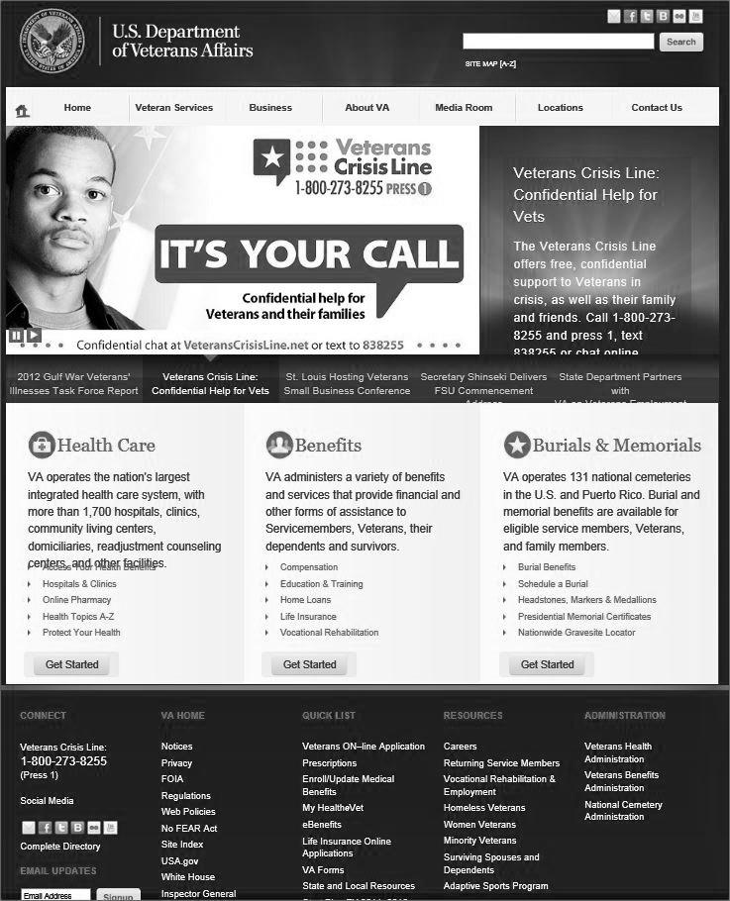
Organizations
Department of Veteran Affairs – V.A.
  Federal, State, County
  VBA vs. VHA
  Death and Burial Services
CVSO vs. VSO
National Archives
Notes:
The starting point for librarians who want to assist veterans is learning about the organizations that help them. By learning about the organizations that are in your community, not just the organizations that are always in the news, and by connecting with those organizations, librarians can assist veterans in several ways.
Federal, State, County: What each level does and how they work together.
More about the V.A. and some acronyms (VBA, VHA, etc.)
There is a department responsible for processing claims, a department responsible for healthcare, the department in charge of death and burial services, and so on.
In terms of the V.A., librarians need not memorize which department is which, but it is important to be aware that there is sometimes a disconnect between the departments, where veterans have to do a lot of back and forth to get help. The information about where to go is not only overwhelming to veterans, it is also overwhelming to the people who work for the V.A.
The solution? You might see if just one employee at your library can get accustomed to navigating the V.A. website, in case you want to help people quickly. The other solution is to create a contact list of frequently used numbers and names, as well as a list of acronyms that the veteran community frequently refer to.
In addition to the V.A., several types of organizations are working to help veterans: VFW, PVA, VVA, etc. Each community’s demographics are different, so the organizations that serve that community will be different. Seek more information by going to the National Resource Directory. (a) Some chartered by Congress, (b) Alternate funding and additional resources, (c) Assistance with claims with the V.A., (d) Programs and corporate funded programs, including grants that assist employees who are veterans.

Slide 9
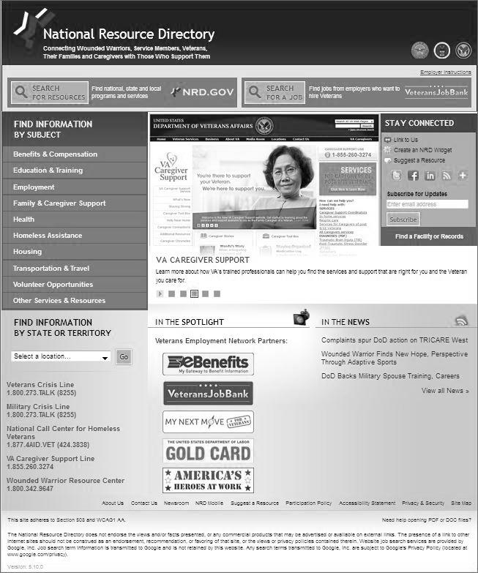
Alternate Access Points:
Other Organizations (VSOs)
Networks of knowledge, service, training
  Get to know them,
  Try to keep in touch,
  Collaborate.
Congressionally chartered organizations
One-on-one counseling
https://www.nrd.gov/
http://veterans.house.gov/citizens/resources
Notes:
We sometimes think of VSO’s as the “other V.A.,” because they can provide so much help to veterans who might have met with obstacles on their first attempt to seek assistance.
The second most important organization serving veterans, what some people might argue is even more important than the V.A., is the county veteran service office.
One acronym, “VSO,” might be used to refer to two different entities. One of these is the county veteran service officer, or local VSO. This is the person hired by the state department of veteran affairs to integrate as many veterans as possible into the V.A. system. The more people who are registered with the V.A. in any given state, the more funding that state receives for helping their veterans.
The local VSO, however, usually doesn’t focus on just signing people up at the V.A. His job is to be the alternate access point for the V.A.
Because of the complex bureaucracy of the V.A., many veterans might give up on seeking assistance if it weren’t for local VSOs who are eager to meet with veterans one on one to help them find the right place to go, get through obstacles in seeking assistance, and learning more about resources available to them beyond the V.A.
Libraries should have at least two goals in learning about VSOs:
Learn which ones are the most active and the most helpful to veterans in your community. All communities are different, so different VSOs are prominent in different communities. You want to know which ones are prominent, because you don’t want to recommend to a veteran that they visit an office that is no longer there. As with all reference desk issues, you want to efficiently and effectively refer the person to the right place.
Connect with these organizations in whatever way is possible for you. Some librarians only have enough time to make a phone call once a year. In other cases, where the veterans are greater in number, librarians meet regularly with VSOs to partner in scheduling events and outreach projects. Libraries can also collaborate with VSOs to seek grant funding for outreach and additional collection materials, as well as new programming or help with training volunteers an staff.

Slide 10
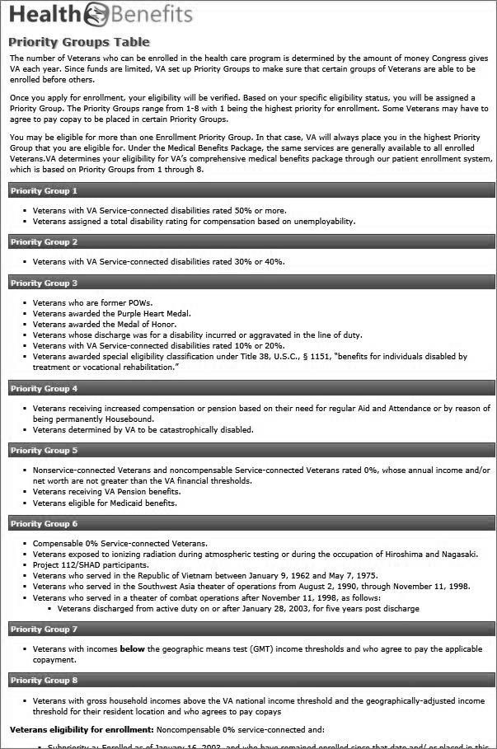
Poll #3
If I am a veteran and I make $50k per year and have health insurance, can I still seek healthcare at the V.A.?
(What are “Priority Groups”?)
https://www.va.gov/healthbenefits/assets/documents/publications/IB-10-441_enrollment_priority_groups.pdf
Notes:
At the very least, your library will want to have a cheat sheet at the main reference desk with the addresses and phone numbers of the V.A., the nearest veterans hospital and/or medical clinic, information about transportation to the V.A., and crisis lines. (And let’s not forget, to my knowledge, most V.A. facilities provide free shuttle transportation for veterans who are registered and need to get from one V.A. facility to another.)
One final note on acronyms – some library visitors who are veterans might assume you know what they are talking about when they use an acronym to describe a condition. Generally speaking, I would handle this situation in the same way that I would handle working with any library visitor who says something I don’t understand. It is worth noting that there are just a few acronyms worth learning, however, in case you ever need to work with someone who is not used to asking for help and might not want to explain. PTSD = Post traumatic stress disorder, TBI = Traumatic Brain Injury, MST = Military sexual trauma. You can learn more about these conditions by visiting a well-organized website: Make the Connection. I also have found some interesting materials about mental health issues through the NIMH and NIH websites. The California State Library has researched women veterans issues as well.

Slide 11
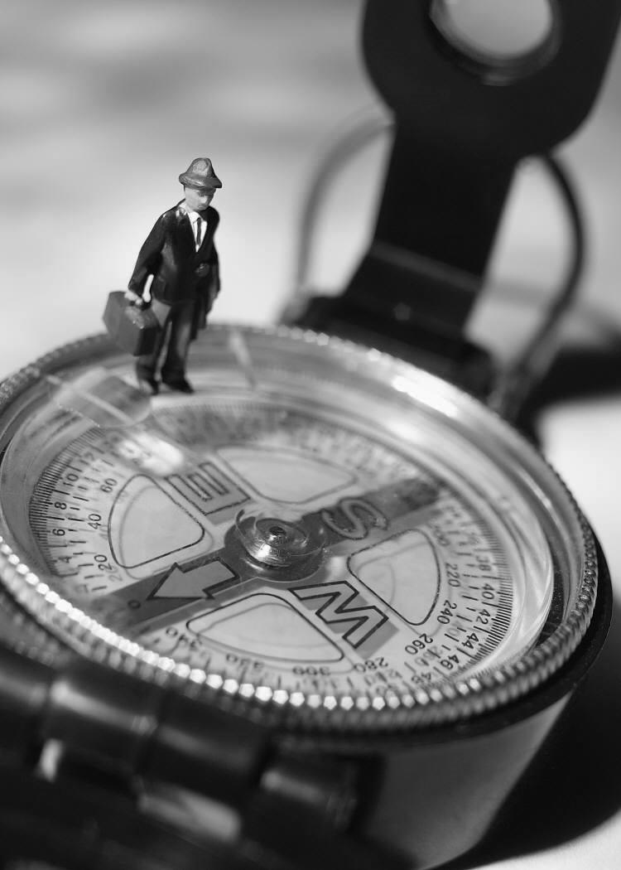
What every librarian should know
Crisis lines
    Cheat sheet
    Magnets, flyers, brochures
Who is your veteran community and your CVSO
V.A. & VSO locations
    Shuttle services
    Directions
Keep track of FAQS
Are there military families in your community?
Notes:
The most important thing to know is that, as librarians, you have the skills and knowledge to assist veterans and their families in locating the right resources.
Don’t worry about acronyms.
Focus on dialogue with individuals and organizations.
Be aware of aspects of information seeking behavior you may have studied in school – each person is different.
Remember that families and caregivers of veterans are also seeking information, resources, and community.
If you lack the resources to design a formal community analysis?
See if one already was done by a VSO or a military advisory council,
Learn from the county VSO,
Talk to the people who visit the library,
Re: those who do not visit the library yet – go where they are and talk to the organizations that serve them,
Keep track of what you are learning and share this with employees.
Think about what libraries already do well:
A welcoming place, a safe place
Information resources
Sense of community
Dialogue
Also think about the military families in your community – Blue Star Mothers of America and the military installations in your community are a place to start.

Slide 12
Poll #4
What do you think should be added to the list of “What every librarian should know” about serving veterans and the veteran community?
Please type your responses into the chat box.
Notes:
The answers will vary depending on the age groups and experiences of veterans in your community. This is a poll where I hope to see some of the diverse examples of where veterans go to seek a sense of community, and how libraries might be added to that list of places.

Slide 13
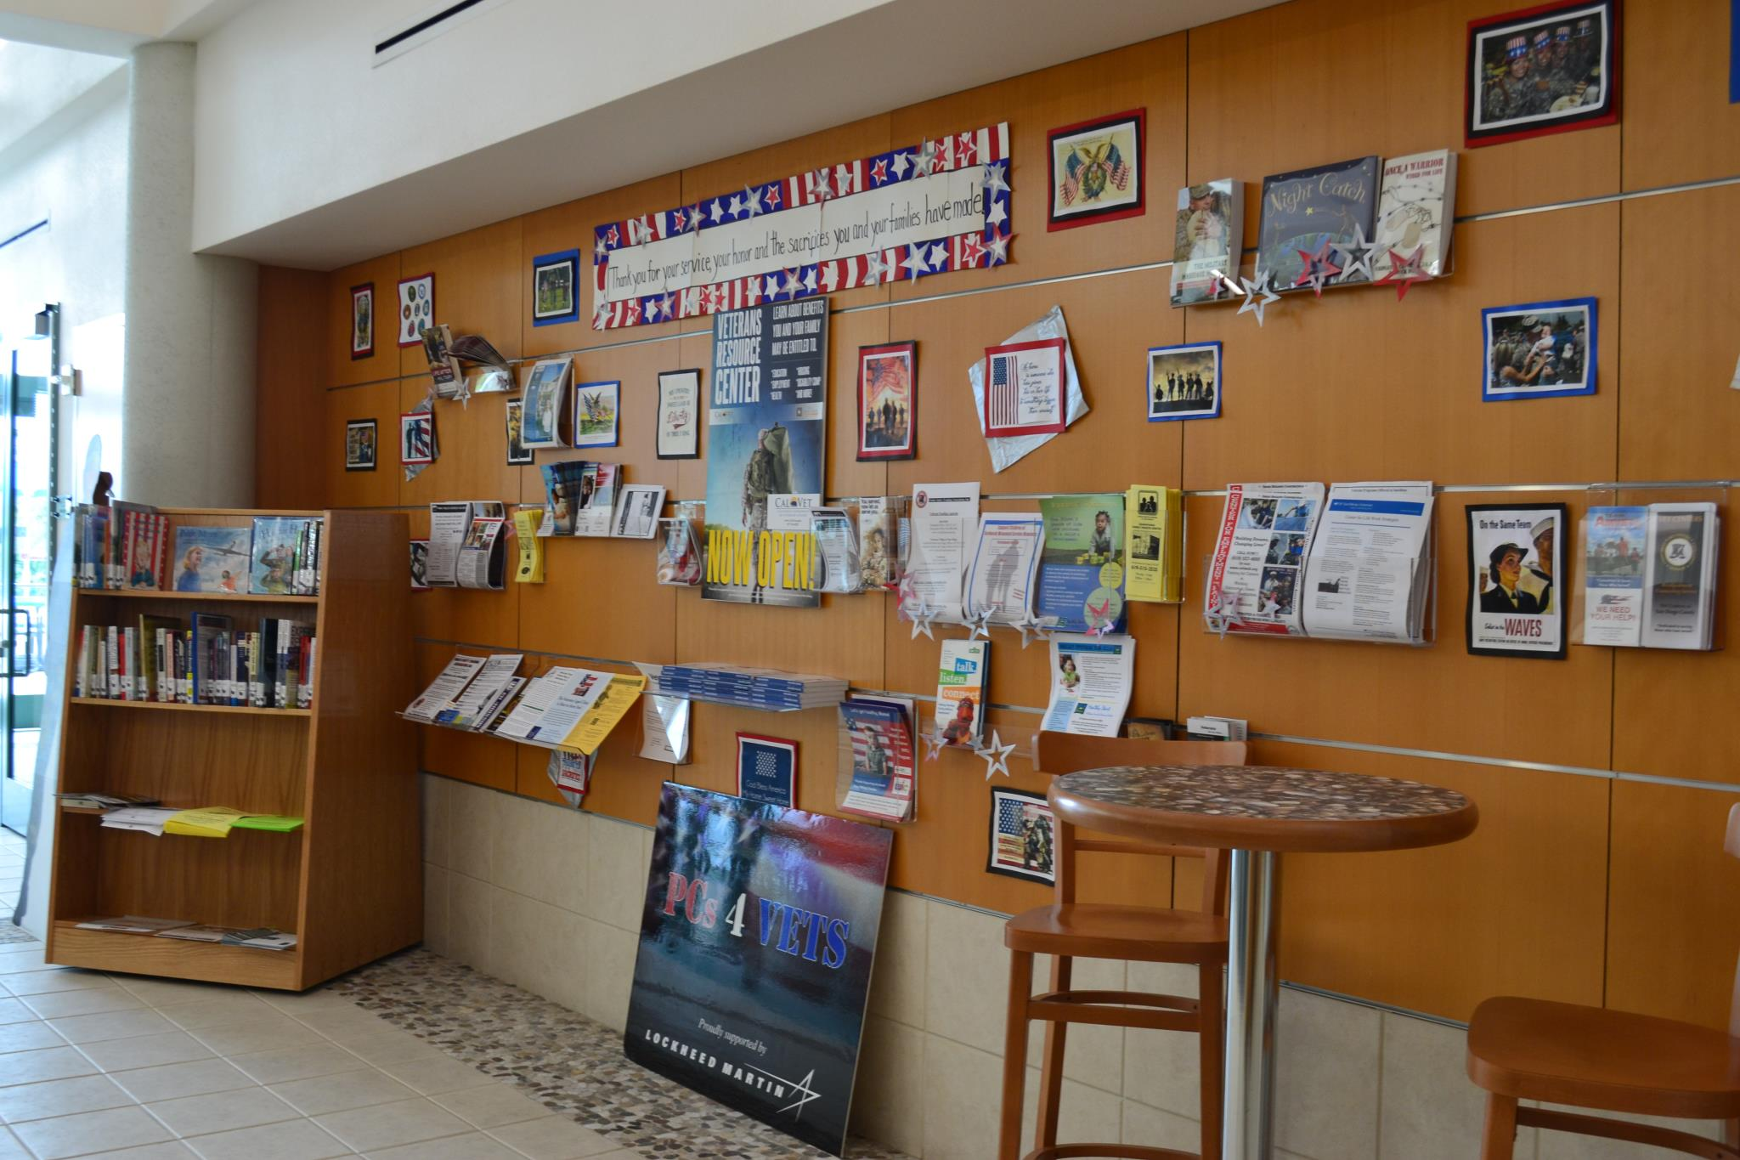
What are libraries doing now?
Online resources
Shasta Public Libraries
Programming
Kern County Library
Collections
San Diego Public Library
See also:
Escondido Public Library Veteran Services
Chula Vista Public Library Veterans Wing
California Center for the Book
Building relationships and collaborations
Notes:
Libraries are a safe place, a starting point, an alternate access point.
I’m thrilled to see so many libraries already doing many things for veterans. Escondido and Chula Vista, for example, started working with veterans in their communities through the public library many years ago. I think one of the greatest accomplishments of both cities is their willingness to connect with the organizations that serve veterans and find ways to share resources and outreach efforts with those organizations.
The California State Library started a Veterans Outreach Program recently, and three libraries were selected to assist the state library in designing different models for working with the veteran communities in their areas. Here are three examples of successes, though there are many more throughout the country:
INFORMATION ORGANIZATION: The best example I have found so far of a web page created by a library that provides online resources for veterans in the community is the Shasta County Library…
PROGRAMMING: One of my favorite examples of how libraries are already creating new programs that serve veterans is a writing workshop developed by the Kern County Library.
SHARED SPACE AND DIALOGUE: While all three libraries that received this grant have accomplished impressive programs where the libraries have engaged in dialogue with organizations and shared space and outreach efforts, the San Diego Public Library represents a good example of these efforts. The slat wall displays and the collection materials at the Point Loma Branch are a role model for libraries, particularly libraries with a military installation in town, where attention should be paid to military families, not just the veteran community…
…Will also mention Library Journal collection development article and webinar on veterans and health
Usually when I teach a sensitivity workshop about veterans, this is when I like to ask you what you think are some good ideas for what we can do. I might briefly cover the following, though this is a time when I will look for some comments and observations from webinar participants.
This used to be on an extra slide which I have deleted because it seems redundant.

Slide 14
Poll #5
What are your ideas for raising awareness or improving services, programming, and collections for veterans at your library?
Please type your responses into the chat box.
Remember our strengths as librarians:
Organizing information,
Helping people access information,
Providing a venue for people to meet each other,
Providing a sense of a safe place,
Helping people in the community and the organizations in the community connect with each other.
Notes:
The best formula for helping veterans, regardless of your lack of resources or your access to resources, is connecting with the organizations that serve veterans.
I might talk a little about the “third place” here, though my emphasis is on how libraries are the ideal venue for people to connect with one another. The majority of veterans I have talked to tell me that they learn more about resources from each other than from representatives of any organization. Even a book club that has no scope related to military history or veterans can be a social opportunity for veterans (or spouses, caregivers, or children of veterans) who seek to reduce isolation in their lives.
Remember that our strengths as librarians – organizing information, helping people access information, providing meeting space and events for a community to strengthen its ties – these are areas where the veteran community already benefit from and will continue to benefit from libraries today. If there is just one “next step” for you at your library, I would suggest that it be to increase your awareness of the veteran community where you work.
Since we will be running out of time, don’t forget to join the Linked In group for Librarians Serving Veterans to continue our discussion!

Slide 15
Q&A
Let’s review your questions!
More questions?
  Join the discussion on LinkedIn
References available at Librarians Serving Veterans on Wordpress
Notes:
While you fill out the evaluation on your screen, I’ll begin answering any questions you’ve submitted via chat.
I will mention that a lengthier list of resources will be available on a separate website.
THE FINAL BULLET OF THIS SLIDE WILL BE A HYPERLINK TO A SEPARATE DOCUMENT: THE HANDOUT WITH REFERENCES.
…I can store the information on a wordpress page or create a word document with the references, including some images of the grant-funded libraries. Do you prefer just one or both?

Slide 16
Thank You!
More information, more discussion, more connections:
Librarians Serving Veterans on LinkedIn
If you are unable to access LinkedIn, resources discussed today will be listed at the following URL:
http://librariansservingveterans.wordpress.com/references-and-resources/
Contact Kristen at mulvihill.librarian@gmail.com

Slide 17
Survey and Certificate of Attendance
Please take a minute and fill out our webinar survey. You will find in at:
https://survey.qualtrics.com/SE/?SID=SV_3DiSJuVftrXr0bP
Thank you!

Slide 18
Infopeople webinars are supported in part by the U.S. Institute of Museum and Library Services under the provisions of the Library Services and Technology Act, administered in California by the State Librarian. This material is licensed under a Creative Commons 3.0 Share & Share-Alike license. Use of this material should credit the author and funding source.

