Slide 1
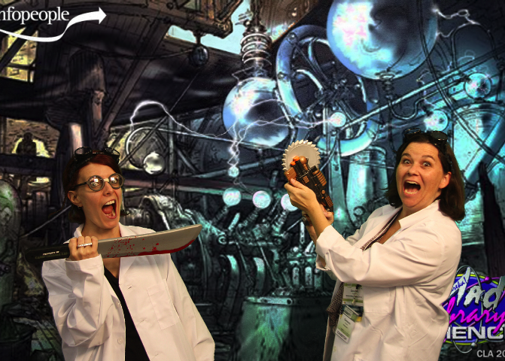
Early Literacy Programming in the Digital Age
Wednesday, July 24, 2013
Cen Campbell/Genesis Hansen

Slide 2
How many of you already use technology in your storytimes?

Slide 3
Show me the data
Research, Resources, and Recommendations:
NAEYC
AAP
Fred Rogers Center
Joan Ganz Cooney Center
Campaign for Grade Level Reading
Common Sense Media

Slide 4
Rules of thumb
Media = tools (not inherently good or evil)
Use technology in service to relationships and social and emotional development
Used appropriately, media can support learning and enhance cognitive and social abilities
Focus on active, engaged use rather than passive

Slide 5
This is how we roll now
Joint Media Engagement
Appvisory
Caregiver/Child Engagement
Child/Device Engagement
Librarian/Content Engagement
Where is the good stuff?
How do I use it?
Where do I find more?
Librarians do this now

Slide 6
Evaluation of Apps
Intended use
Support for early literacy skills
Interactivity
Placement & design of controls
Affordances
Customizability

Slide 7
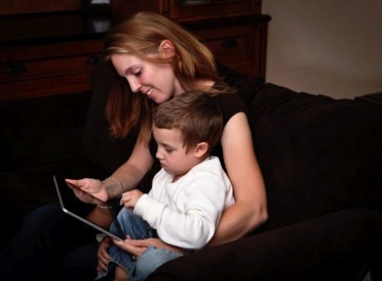
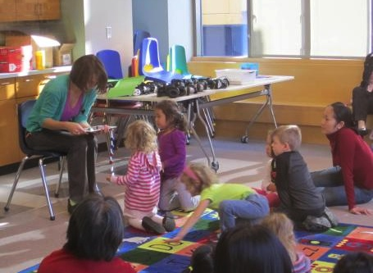
Intended use
Different things to consider when using one-on-one with a child versus in a large group/storytime setting

Slide 8
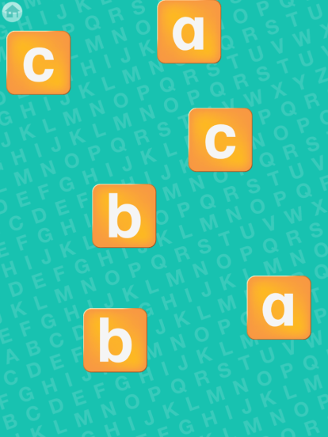
Support for early literacy skills
Print motivation
Print awareness
Letter knowledge
Vocabulary
Phonological awareness
Narrative skills

Slide 9
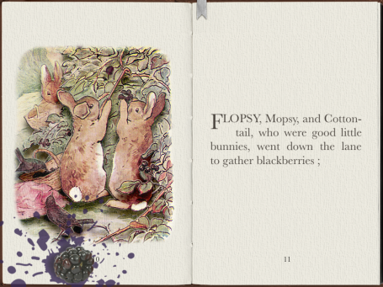
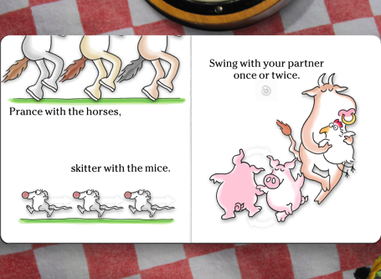
Interactive Elements
Should enhance, not distract
Weigh the merits - can be a mix of good and bad

Slide 10
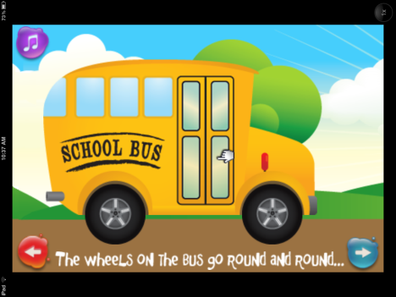
Design elements
Where are the controls?
Are they easy to find?
Are they easy to hit by accident?

Slide 11
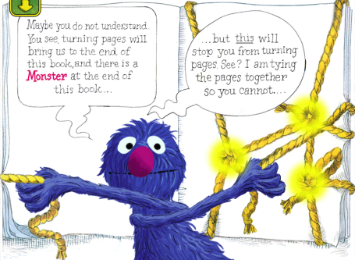

Affordances
Does the app or ebook give cues to tell the user what to do,
or help identify interactive elements?

Slide 12
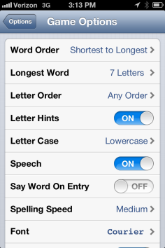
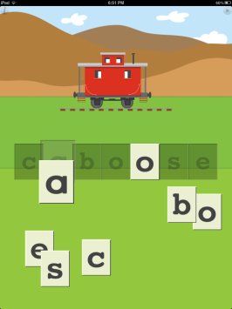
Customizability

Slide 13

Reviews Please!
LittleeLit
Pinterest
Digital Storytime
Children’s Technology Review
Common Sense Media
Kirkus
Horn Book
School Library Journal

Slide 14
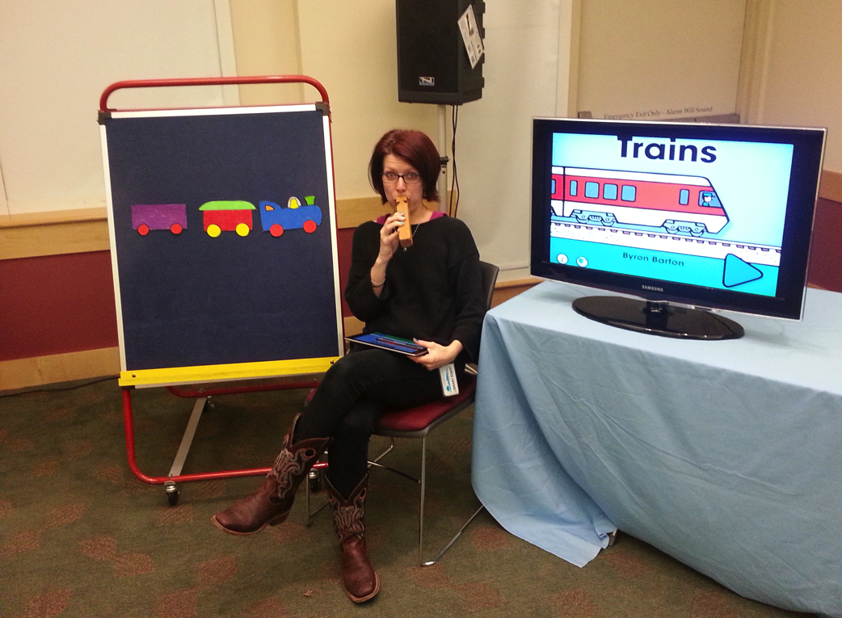
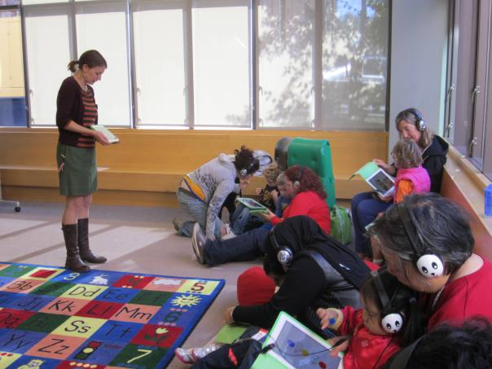
What does it look like?
That depends on your budget, set-up and community needs.

Slide 15
What’s going on?
Programs in Libraries
Libraryland
Hand-held iPad
Mirrored iPad
Mounted Tablets
Take-home Tablets
In-house Tablets
Curation
Crowd sourcing
Content creation
Complaining
Creative collaboration

Slide 16
Great! Where do I start?
Device (What do you have? Mirrored or hand-held?)
Budget (free apps? Large storytelling collection? Fleet of devices?)
Storytime Set-up (Large group? Small group?)
Community needs (Appvisory? Access? Enagagement?)

Slide 17
What should I use?
App Developers
Oceanhouse Media
Toca Boca
Nosy Crow
Loud Crow Interactive
We are Wheelbarrow
Software Smoothie
eBook Providers
iBooks
Amazon
Nook
Bookboard.com (Full disclosure: I manage their library)

Slide 18
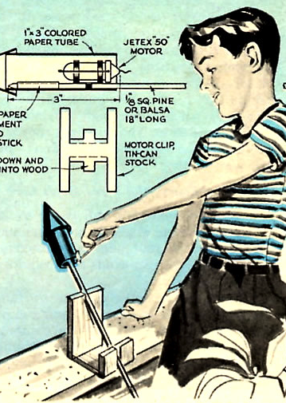
Not Rocket Science
Start with a book you love in print; find a digital version
Post lyrics plus an image of your favorite song (multiple literacies for parents!)
Use the digital version of a felt board story (either from app or photographs)

Slide 19
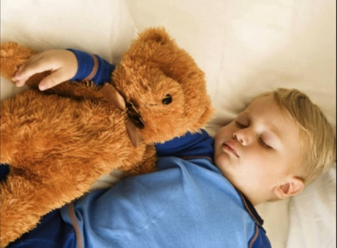
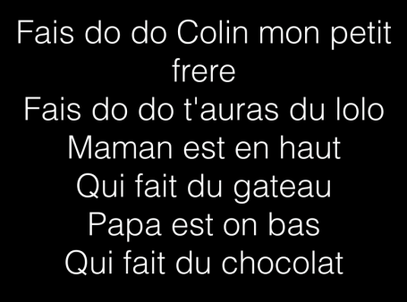
Getting parents to participate!
Make it easy for them to remember the songs, rhymes, games and books you read in storytime!

Slide 20
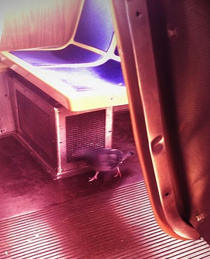
Bring the world to storytime!
Digital tool allow us to record the world as text Technology and Critical Literacy in early Childhood
Extension activities, content creation, joint media engagement and modeling for parents

Slide 21
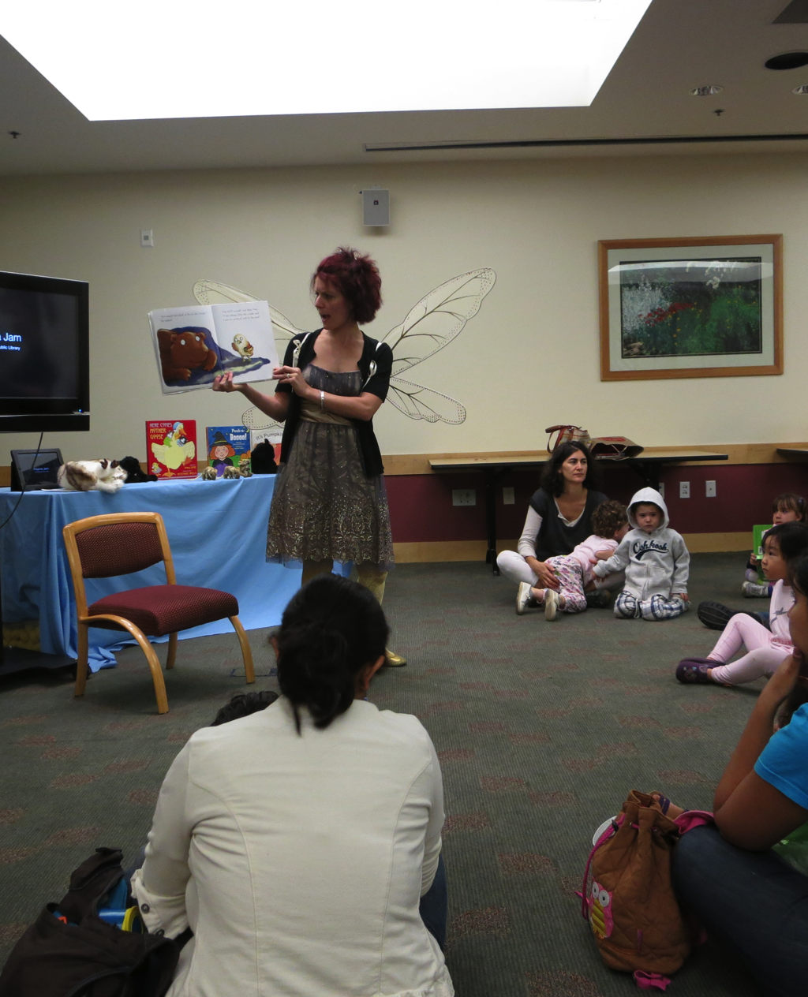
List-o-Apps
Field tested Apps for Storytime from LittleeLit.com
Little eLit Pinterest
Other Pinterest Accounts

Slide 22
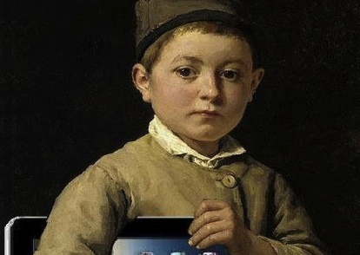
There are no experts.
Saddle up, try it out and join us!
LittleeLit.com

Slide 23
We know you have questions.
Now’s the time to ask.

Slide 24
Thanks!
Cen Campbell – cenlibrarian@gmail.com
Genesis Hansen – ghansen@cityofmissionviejo.org

Slide 25
Infopeople webinars are supported in part by the U.S. Institute of Museum and Library Services under the provisions of the Library Services and Technology Act, administered in California by the State Librarian. This material is licensed under a Creative Commons 3.0 Share & Share-Alike license. Use of this material should credit the author and funding source.

