Slide 1

An Infopeople Webinar
Inclusive Library Programs
for People with Intellectual Disabilities
Tuesday, August 20, 2013
Noon to 1:00pm Pacific Time
Presenters:
Noelle Burch, Alison McKee and Kathy Middleton

Slide 2
Agenda
Introduction to Contra Costa County Library Inclusive Plan
Definition, Philosophy and Goals
Volunteer Programs: How to be Inclusive
“Library Insiders”: Definition and Ways to be Inclusive
Inclusive Storytimes
Q & A

Slide 3
I. Introduction to Contra Costa County Library Inclusive Plan
Kathy Middleton

Slide 4
I. inclusive LIBRARY plan
Accessible Library “Products” and Services
  Accessibility Committee
Volunteers (teens and adults)
“Library Insiders” (adults)
Inclusive Storytime (children)
Summer Reading (all ages/abilities)

Slide 5
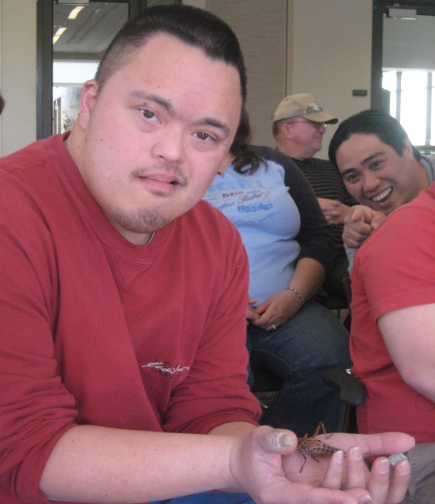
I. inclusive LIBRARY plan
Accessible Library
“Products” and Services
Accessibility Committee
  Contra Costa County Library Accessibility Mission Statement:
  Bringing People and Ideas Together: Improving access for people with disabilities means
  improved access for all.

Slide 6
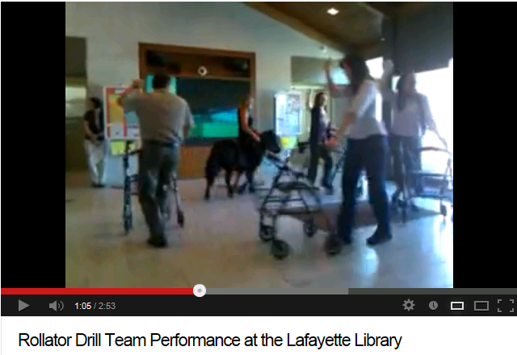
Celebrate accessibility!

Slide 7
inclusive LIBRARY plan
Volunteers
  Jobs for all abilities--adults and teens
Library Insiders
  Monthly library programs for adults with developmental/intellectual disabilities
Inclusive Storytime
  Children of all abilities--in welcome environment
Summer Reading
  Babies through Adult--Inclusive reading programs

Slide 8
II. Definition, Philosophy and Goals
Kathy Middleton

Slide 9
Definition, philosophy and goals
What is Inclusion? –Importance of Attitude
  Encouraging people of all abilities to feel comfortable and confident using the library
  Presenting library programs that provide a variety of opportunities for learning

Slide 10
Definition, philosophy and goals
What is Inclusion? –Importance of Attitude
  Encouraging reading (or spending time with a book) according to ability
  Using “People-First” Language
  What the public perceives

Slide 11
III. Volunteer programs how to be inclusive
Alison McKee

Slide 12
Volunteer programs
How to be inclusive
  Benefits to volunteers and library
  Tasks volunteers perform
  How to recruit: Partners
  Staff cooperation and sensitivity
  Group brainstorm: How to get staff on board

Slide 13
Volunteer programs
How to be inclusive
  Benefits to volunteers and library

Slide 14
Volunteer programs
How to be inclusive
  Benefits to volunteers and library
  Tasks volunteers perform

Slide 15
Volunteer programs
How to be inclusive
  Benefits to volunteers and library
  Tasks volunteers perform
  How to recruit: Partners

Slide 16
Volunteer programs
How to be inclusive
  Benefits to volunteers and library
  Tasks volunteers perform
  How to recruit: Partners
  Staff cooperation and sensitivity

Slide 17
Volunteer programs
  How to get staff on board
  GROUP BRAINSTORM EXERCISE
?

Slide 18

IV. “LIBRARY INSIDERS” definition and ways to be inclusive
Noelle Burch
Thank you for inviting us in. – Eva, Library Insider

Slide 19
“library insiders” definition & ways to be inclusive
Someone who feels at ease navigating the library.
An individual who approaches the desk with a question or comment.
An individual who uses resources and/or attends programs that are available, as a library user.

Slide 20

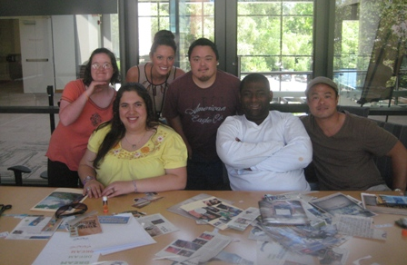
Dream Collage Activity
Library Insiders, Walnut Creek Library

Slide 21
creating an “insider” experience for everyone
For some individuals with intellectual disabilities, the library can be an intimidating environment.
The goal of Library Insiders is to cultivate an “insider” experience for adults with intellectual disabilities.
Specialized programs give library staff an opportunity to welcome someone who feels like an “outsider” into to an “inside” library experience.

Slide 22
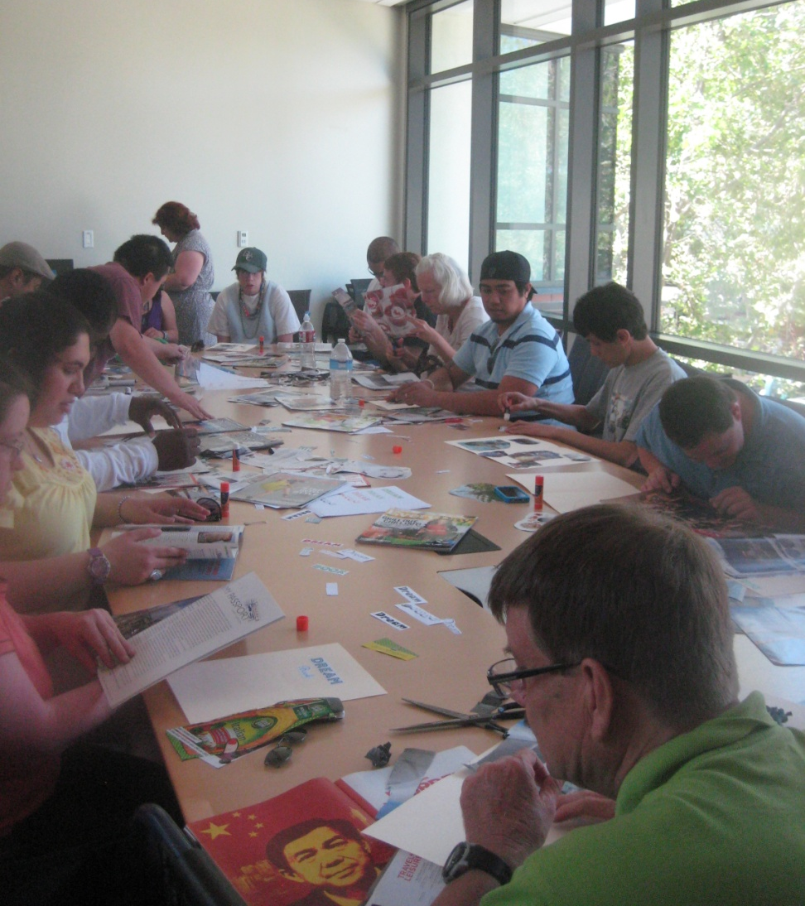
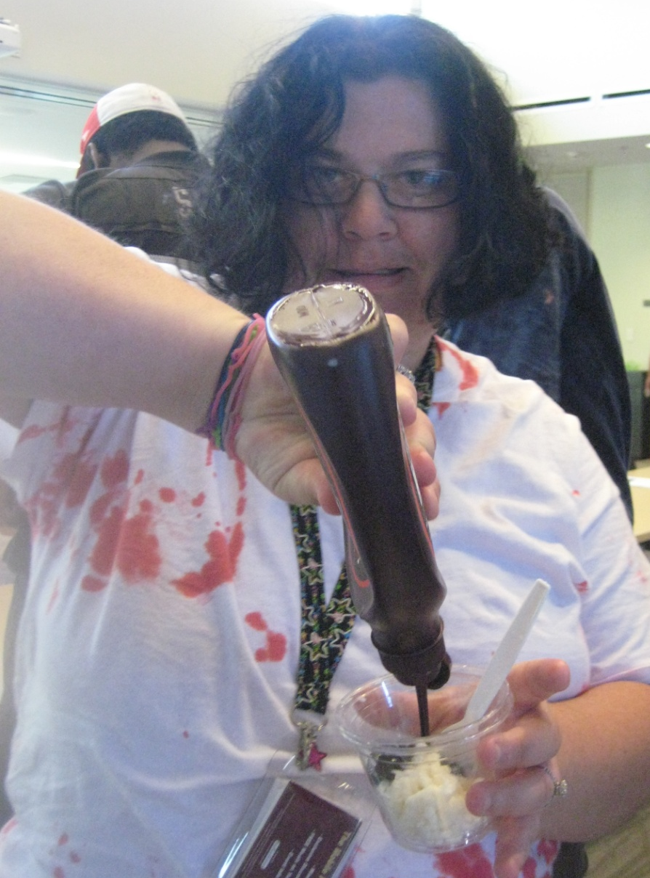
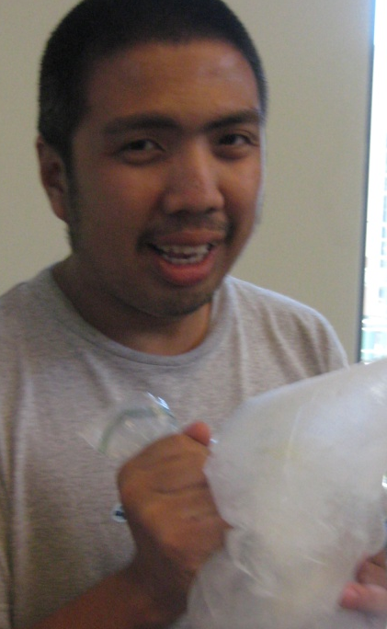
library insiders program walnut creek library
Dream Collage
Ice Cream making

Slide 23
How to get started
Do you have adults in community-based groups visiting your libraries on a daily basis?
Introduce yourself to individuals already in your library.
Call local town/city/county adult community-based organizations (for example, ARC)

Slide 24
Types of programs
Programs that encourage adults with developmental disabilities to feel comfortable and confident using all resources in the public library.
  Behind the scenes library tour
  Scavenger hunts (handout)
  Library technology and computer tutorials
  Summer Reading (reading record handout)

Slide 25
Types of programs
Programs that provide a variety of opportunities for lifelong learning.
Exercise, Nutrition, Well-being
Fire Safety
Scrapbooking, Gaming, Picture Bingo
Cooking, Measuring
Local Environment (Ranger talks)
Zine making (recipes, poetry, drawings, photos or other interests)
Yoga

Slide 26
Partners: agencies & presenters
Friends of the Library
Library Foundation
City Parks and Recreation Department
Local Businesses
Police and Fire Department
Reading Therapy Dogs (ARF)
Local Music Performers

Slide 27
Frequency of programs and scheduling
When working with local adult organizations it is helpful to determine a set schedule for programs.
Most programs meet on a monthly or
bi-weekly basis.
Programs are publically promoted.

Slide 28
Summer reading records
Example of literacy activities listed in Adult Summer Reading Record (see handout)
  Visit the library!
  Ask a librarian a question.
  Listen to music or books.
  Read or spend time with a book or magazine.
  Watch a movie.
  Write or draw a picture about your summer.

Slide 29
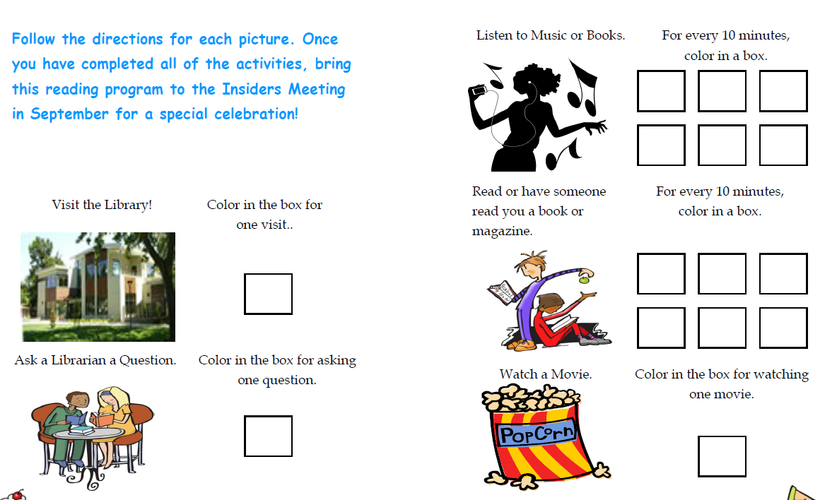
Example of accessible summer reading record: library insiders

Slide 30
How can you make summer reading more accessible?
2012 Adult Summer Reading Record Instructions
Read a book and write a short review to enter in the Library’s prize drawing. Ages 18 and older.
2013 Adult Summer Reading Record Instructions
Read a book and write a short review to enter in the Library’s prize drawing. Ages 18 and older. For other ways to participate, visit ccclib.org/summer. Ages 18 and older.

Slide 31
Staff cooperation
Communication
  Explain the importance of including everyone.
  Share program feedback.
  Foster introductions and relationships with staff and Insiders.
  Get everyone involved.

Slide 32
Impact
Participants report that they use the library more, feel comfortable asking questions of library staff, and are now attending a variety of library programs.
Library Insiders gain independent public library skills and are equipped to navigate most public library resources/services.
Staff appreciate the kindness and positive interactions received from Library Insiders.

Slide 33
V. Inclusive storytimes
Content provided by Gina Worsham
Presented by Alison McKee

Slide 34
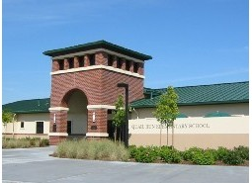
Partners
A good place to start: Your Community!

Slide 35
partners
Schools
  Special Day Classes
      Observe classes
      Host a storytime
  Special Education Departments
Parenting Groups
  Parent to Parent Networks
  School affiliated parenting groups

Slide 36
Partners
Local Organizations Serving Children with Disabilities (211.org)
Early Intervention Programs (WeCareChildren.org, Milestonesforautism.net)
Any organization that reaches out to families, with services for children with disabilities

Slide 37
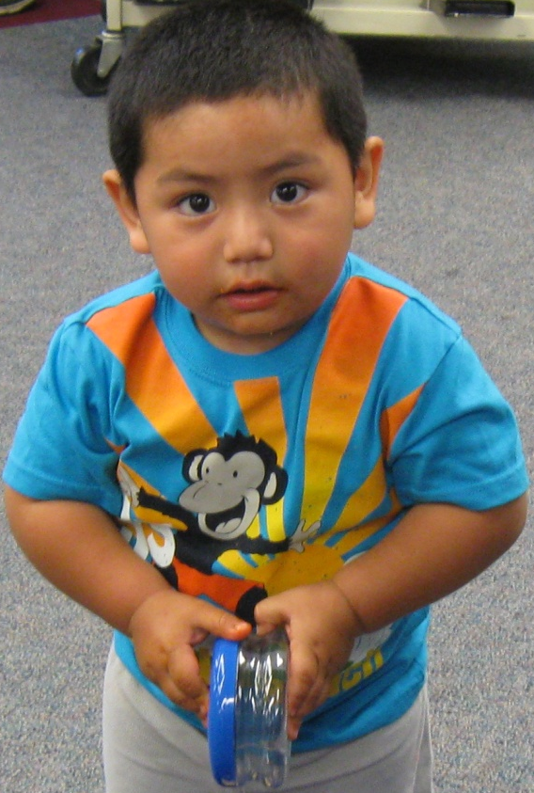
What is inclusive storytime?
A time to learn and grow for children of all abilities
  Inclusive storytimes are for all children, including children with disabilities.
  Inclusive storytime does not mean a storytime that is only for children with disabilities.

Slide 38
What makes storytime inclusive?
Provide adaptations that enable all children, including those with disabilities, to participate.
Modify books to make them easier to use and to comprehend.
Add visuals, such as a picture schedule, along
with “rules”/expectations.
Slow down the pace.
Provide fidget toys.

Slide 39
Inclusive storytimes
  GROUP BRAINSTORM EXERCISE
  HOW CAN YOU MAKE
  STORYTIMES INCLUSIVE?
?

Slide 40
adaptations
Adapted, or modified books expand learning opportunities for all children, but particularly for children with vision, hearing and learning disabilities.
For example:
  Laminate loose book pages
  Add page turners
  Create Velcro icons/images in order to clarify meaning

Slide 41
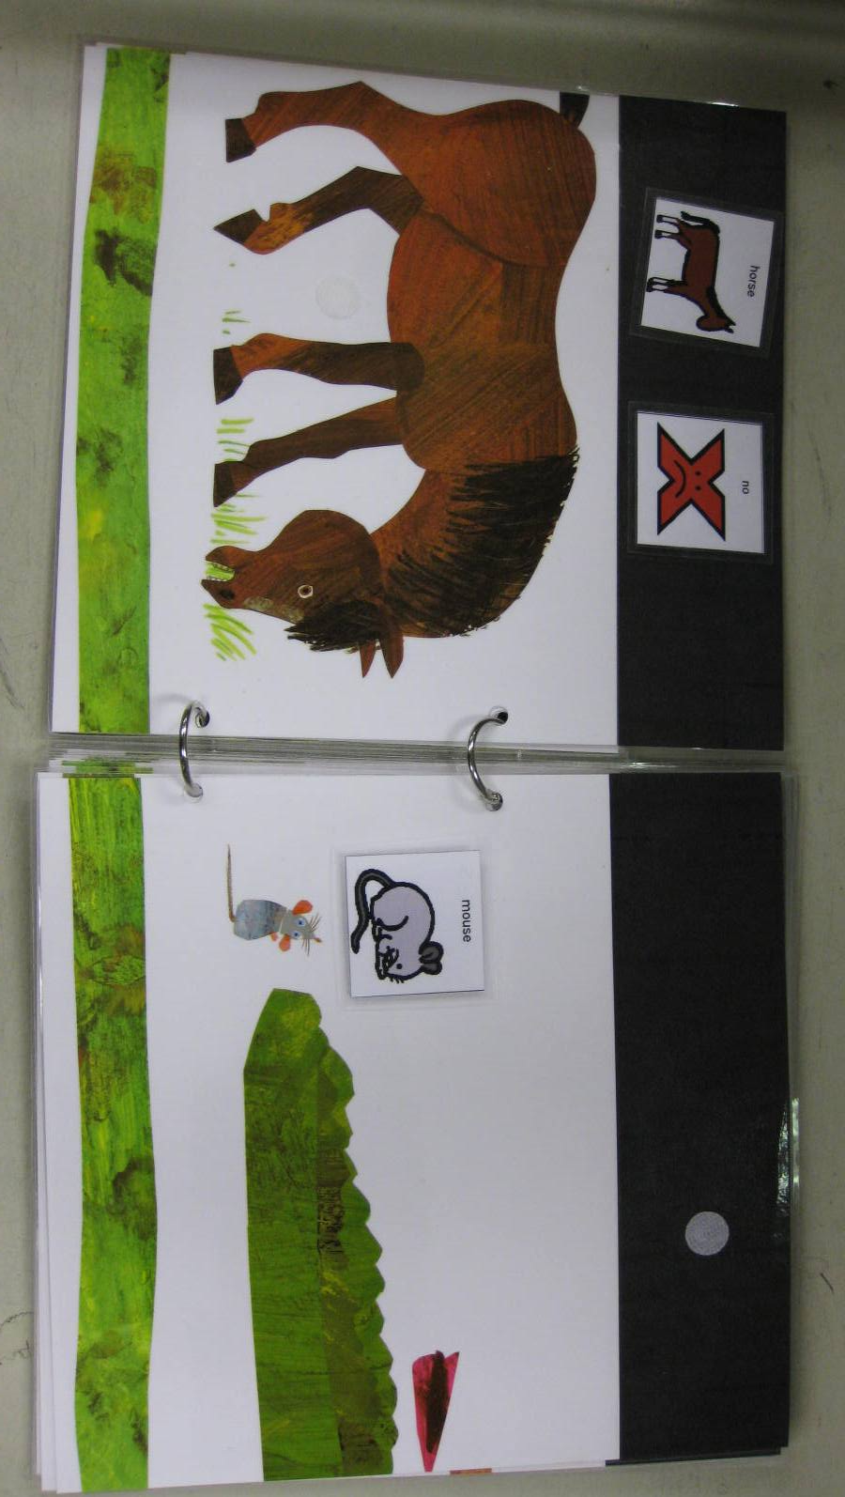
ADAPTED BOOK

Slide 42
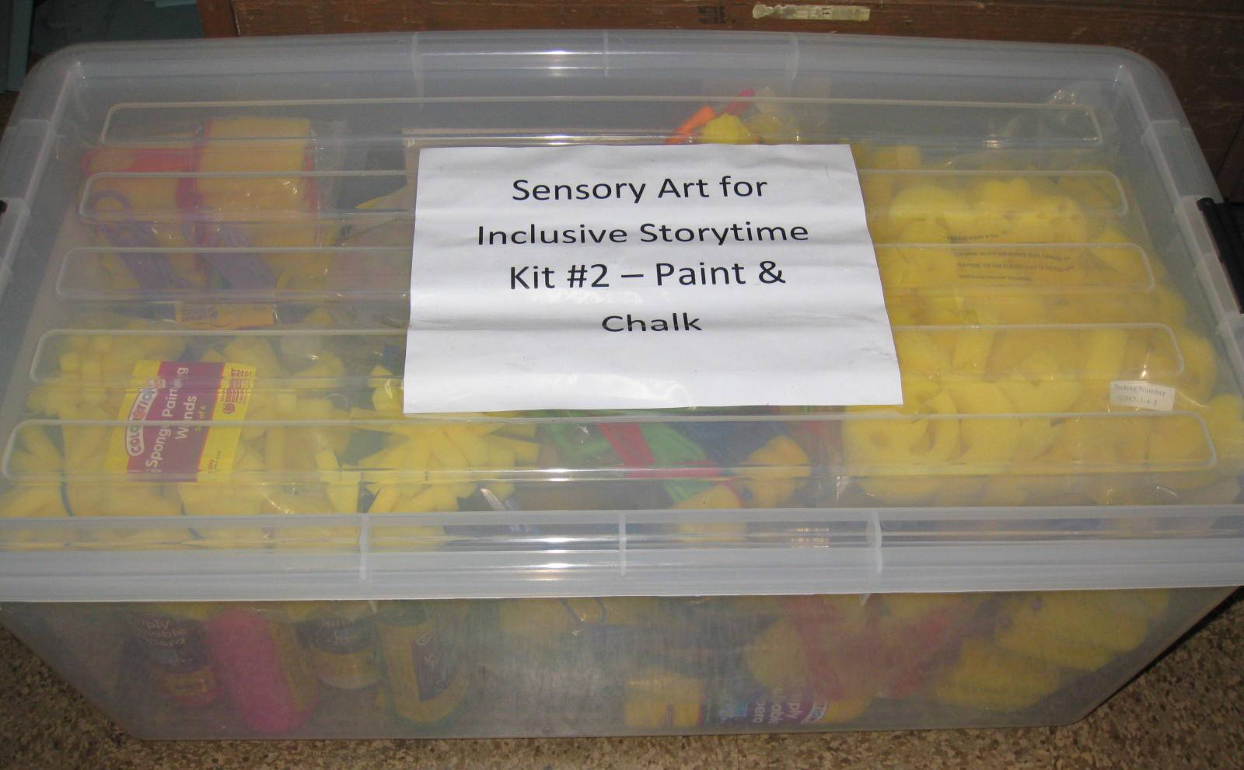
INCLUSIVE STORYTIME KITS TRAVEL

Slide 43
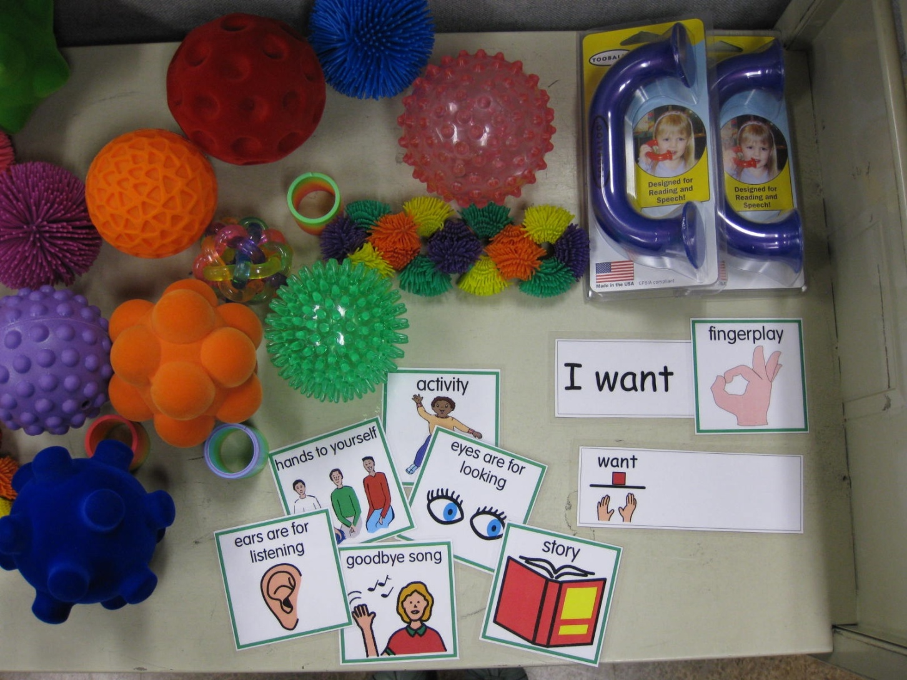
Inclusive storytime fidget toys, pictograms, echo-phone

Slide 44
STAFF COOPERATION AND TRAINING
Biggest challenge -- staff unfamiliar with learning differences and may fear failure.
  Provide information on most common youth
  disabilities in your community.
  Observe Special Day Class or Special Education class.
  Present storytime to Special Day Class, utilize
  teacher’s support.
  Contact school district or literacy organization for workshop information.

Slide 45

VI. Questions about Inclusive Library Programs?
I. Inclusive Plan
?
II. Accessibility Goals
III. Volunteers
V. Inclusive Storytimes
IV. Library Insiders

Slide 46
Thank You
Noelle Burch - NBurch@ccclib.org
Alison McKee - amckee@ccclib.org
Kathy Middleton - kmiddlet@ccclib.org

Slide 47
Infopeople webinars are supported in part by the U.S. Institute of Museum and Library Services under the provisions of the Library Services and Technology Act, administered in California by the State Librarian. This material is licensed under a Creative Commons 3.0 Share & Share-Alike license. Use of this material should credit the author and funding source.

