Slide 1
Get Covered @ the Library:
Affordable Care Act
Resources for Libraries
An Infopeople Webinar
Monday, September 9, 2013
Presented by Barbara Bibel and Kelli Ham
Monday, September 9, 2013
Presented by:
Barbara Bibel and Kelli Ham
with guest Diane Stanton, CoveredCA

Slide 2
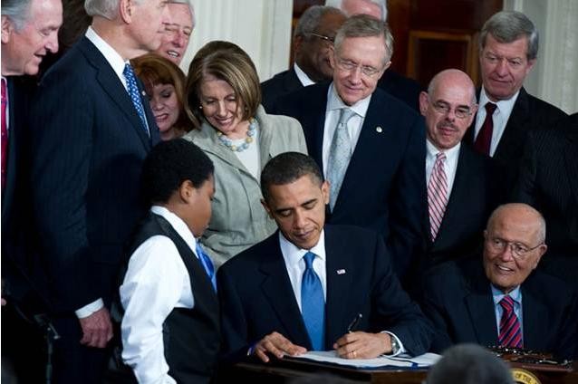
What Does the Affordable Care Act Do?
Provides health care coverage to the uninsured
Expands Medi-Cal eligibility by raising income threshold
Offers subsidies and/or tax credits to make premiums affordable
Allows families to keep adult children on existing policies until age 26
Requires most people of the age of 18 to have coverage by January 2014
Assesses a penalty of 1 percent of annual income or $95 on those not covered
Penalty will increase to 2.5 percent or $695 by 2016

Slide 3

What Is Covered
Ambulatory patient care
Emergency care
Hospitalization
Maternity and newborn care
Mental health and substance abuse treatment
Prescription drugs
Rehabilitation services
Lab services
Preventive and wellness services
Chronic disease support
Pediatric services, including dental and vision care

Slide 4

Some Major New Features
Coverage includes pre-existing conditions
Insurance cannot be canceled if you get sick
Insurers must justify rate increases
No lifetime limits on benefits

Slide 5

Covered California
California has an insurance marketplace called
Covered California.
coveredca.com

Slide 6

What About in California?
The marketplace offers coverage from a variety of carriers at four levels: bronze, silver, gold, and platinum.
The premiums vary-bronze is cheapest and platinum is the most expensive.
The lower the premium, the higher the out-of-pocket deductible.
Premiums are monthly.
Carriers vary by county. Consult your local agency for a list.

Slide 7
For More Information
healthcare.gov Federal site with information for all states and background about the program
Telephone assistance for the federal site available at 1-800-318-2596
The website and phone system offer help in many languages
coveredca.com California consumer site
For help, call Covered California at 800-300-1506
kff.org/health-reform/video/youtoons-obamacare-video A cartoon that explains the program
medlineplus.gov From the National Library of Medicine. A search for health insurance or Affordable Care Act provides lots of information

Slide 8

What can libraries do to help?
Provide information, not advice for patrons
Offer programs that explain the Affordable Care Act
Provide computers and scanners so that patrons can apply for coverage
Provide certified enrollment counselors at designated times
Partner with local agencies to help get it all done: county health departments, health care agencies, non-profits, community groups

Slide 9

Questions?

Slide 10

Resources and Tools
The library’s role
Managing the information overload
Efficient use of federal and state exchange sites
Training opportunities
LibGuides and resources just for libraries
Consumer education and promotional materials
Staying up-to-date

Slide 11

Determining the Library’s Role
Do an inventory of resources – staff, computers, time for training
Decide types and levels of service
Maintain neutrality; act as information providers, not insurance experts or advisors
Be knowledgeable about appropriate resources and services
Communicate with staff; ongoing communication between management and staff is key

Slide 12
Managing the ACA Information Overload
Know your own state’s situation
          Federal, partnership, or state exchange?
Anticipate the who, how, and what scenarios
          Individuals, families, and small business
          How to compare options, find forms, and sign up for coverage
          Timeline, deadlines, and details about the law
  Know key resources for different scenarios

Slide 13
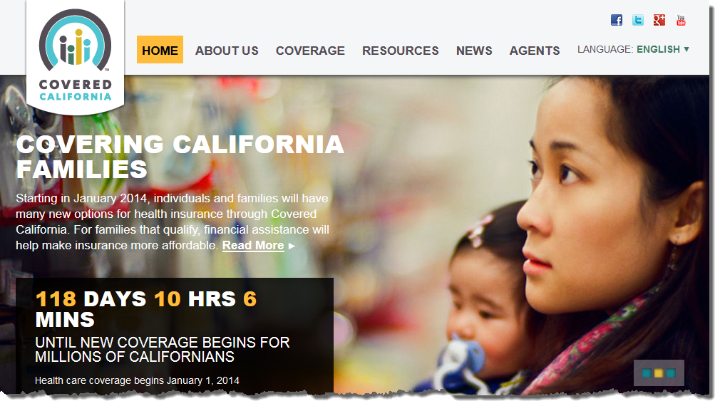
Your First Stop: Covered California

Slide 14
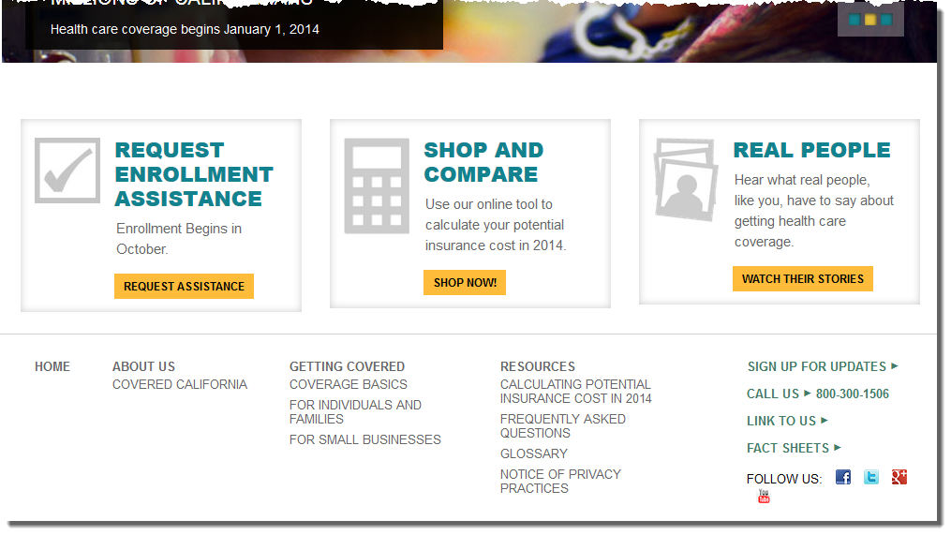
Covered California Website (Continued)

Slide 15
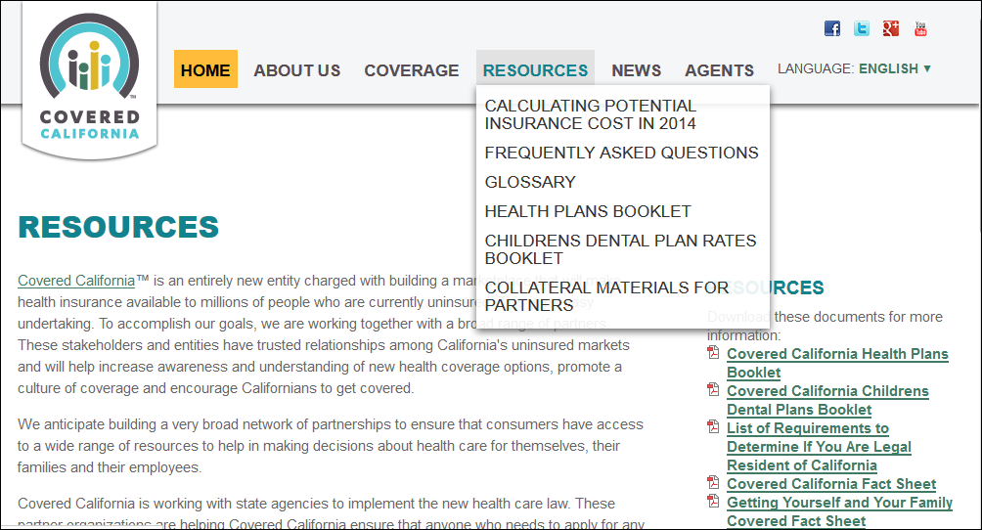
Covered California Resources

Slide 16
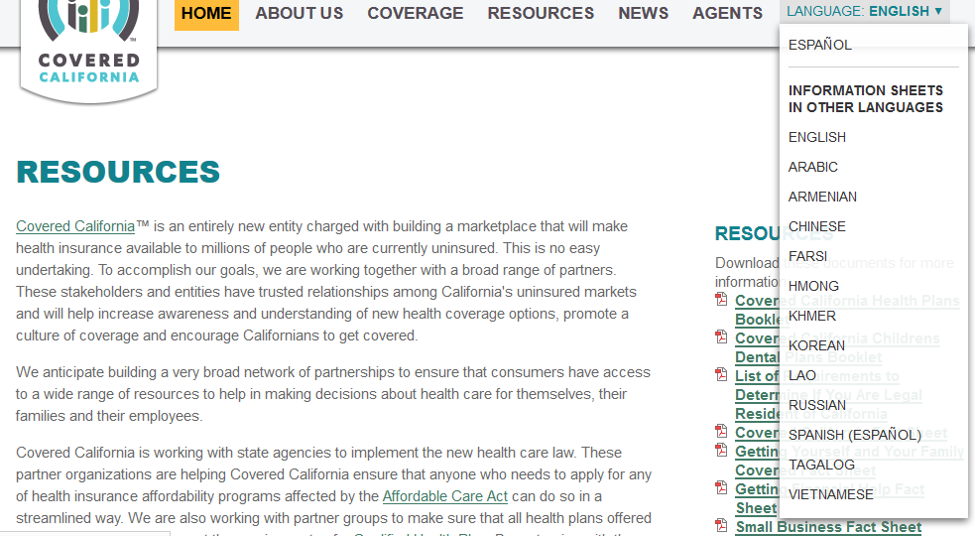
Materials in Other Languages

Slide 17
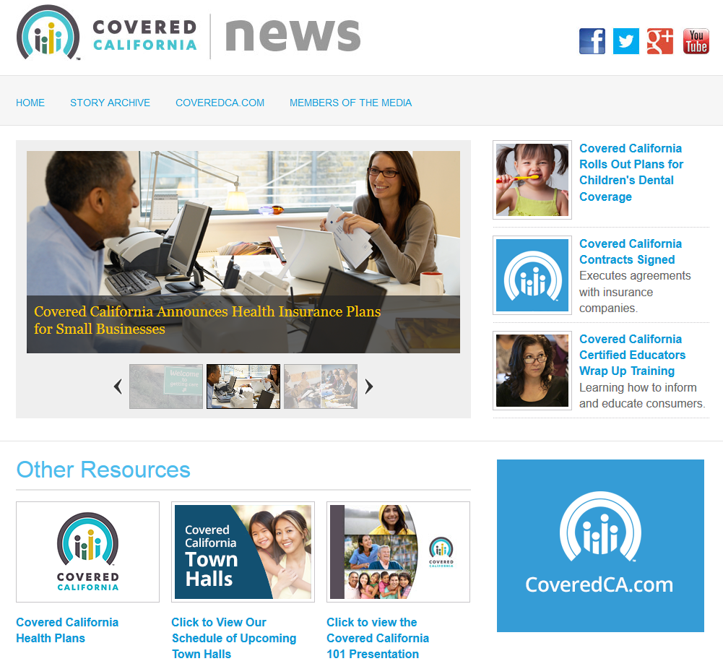
Learning More and Current News

Slide 18
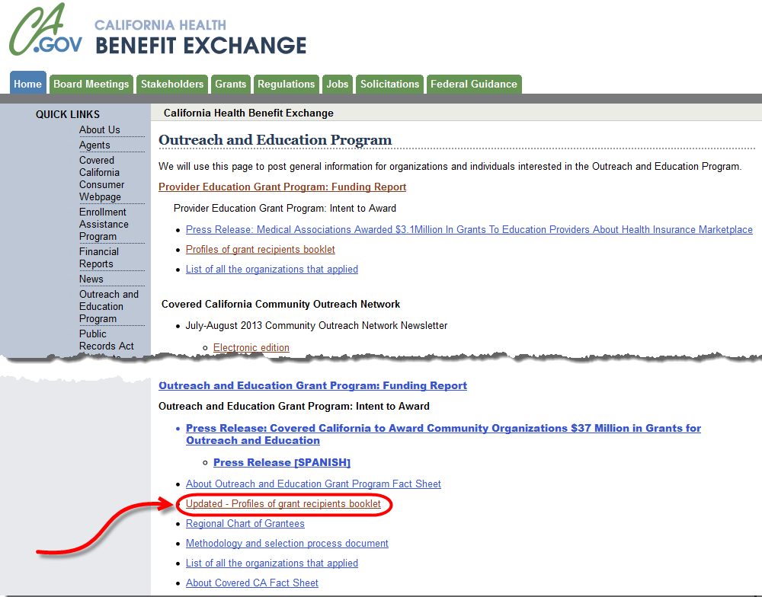
California Outreach and Education Organizations healthexchange.ca.gov/Pages/OutrchandEdProg.aspx

Slide 19
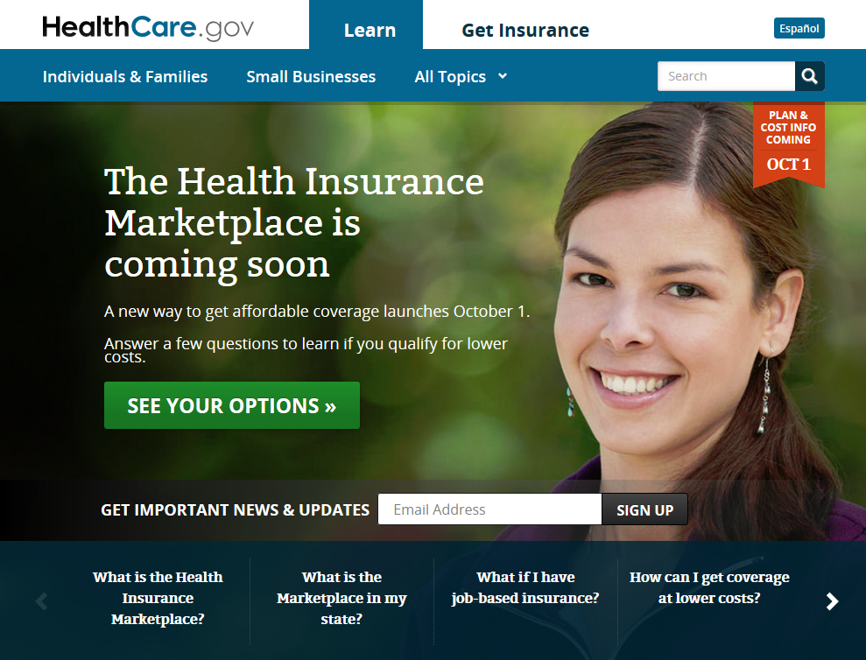
Healthcare.gov

Slide 20
Healthcare.gov

Slide 21
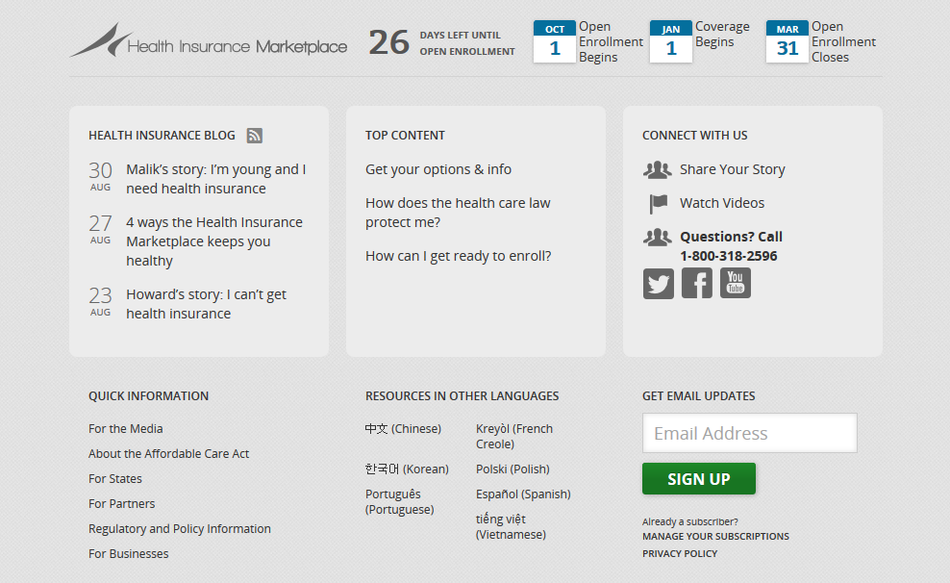
Healthcare.gov (continued)

Slide 22
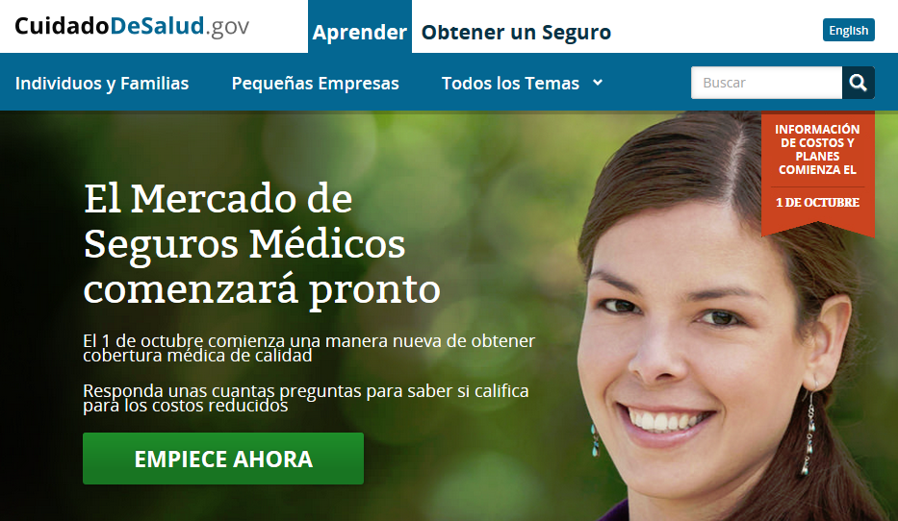
CuidadoDeSalud.gov

Slide 23
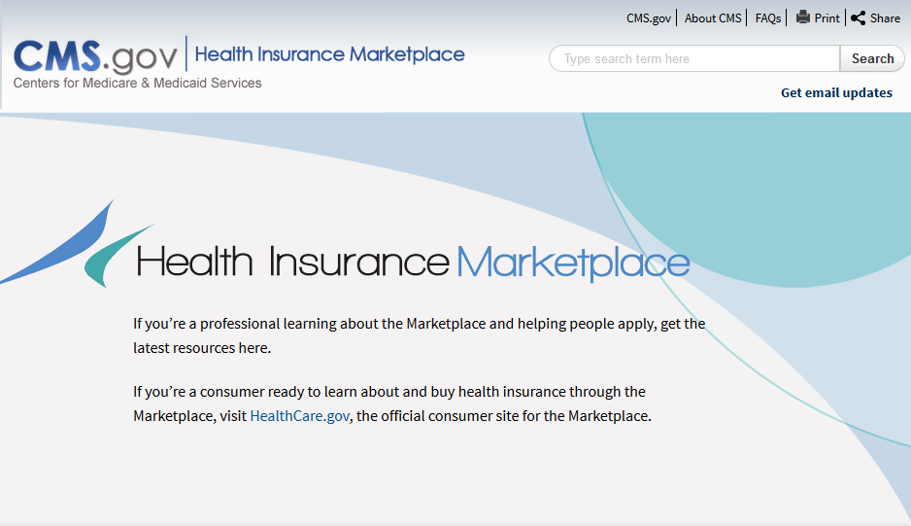
marketplace.cms.gov

Slide 24
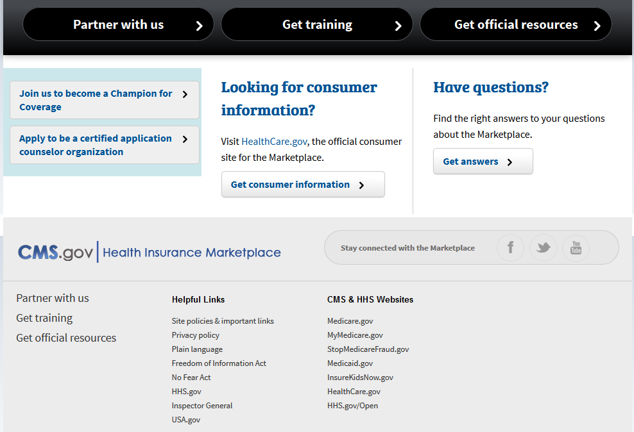
marketplace.cms.gov (continued)

Slide 25
State-Specific Information
What is the Marketplace in my state?
      Search for other states using this tool to find individual state marketplace information
      healthcare.gov/what-is-the-marketplace-in-my-state/
Is Medicaid expanding in my state?
        The health care law provides states the choice to expand Medicaid. Learn more about your state’s decision here:
        healthcare.gov/what-if-my-state-is-not-expanding-medicaid/

Slide 26
Special Populations and State Details
Fact sheets about the Affordable Care Act and women, middle class families, Latinos, African Americans, Asian Americans and Pacific Islanders, and more
State-by-state: Click on the map to find out how the Affordable Care Act is helping people in individual states
      http://www.hhs.gov/healthcare/facts/index.html

Slide 27
Training and Educational Opportunities
Webjunction webinars and blog
CMS training schedule
State town hall meetings
Navigator programs
NN/LM webinars and classes
Infopeople tutorials
See the handout for details about these and more!

Slide 28
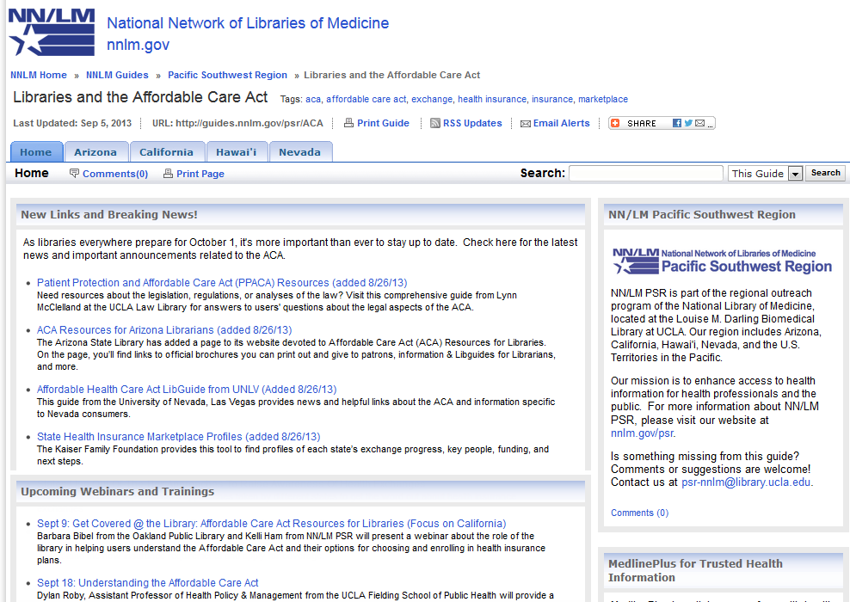
Libraries and the Affordable Care Act LibGuide guides.nnlm.gov/psr/aca

Slide 29
ACA LibGuide Content
New Links and Breaking News
Upcoming Webinars and Trainings
State-specific Resources
State Health Insurance Marketplaces
State Medicaid Expansion
Getting Up To Speed – The Essentials
Get Official Resources
Resources for Libraries
Readings of Interest
Pacific SW Region tabs for Arizona, California, Hawai’i, and Nevada

Slide 30
Promotional Materials and Handouts
Determine the needs in your library:
Utilize marketplace.cms.gov for general handouts
Go to state exchange site for state-specific materials coveredca.com/collateral.html
Create plain language in-house materials such as pathfinders, signage, schedules, and computer sign-up sheets. Learn how to write easy-to-read materials at medlineplus.gov/etr

Slide 31
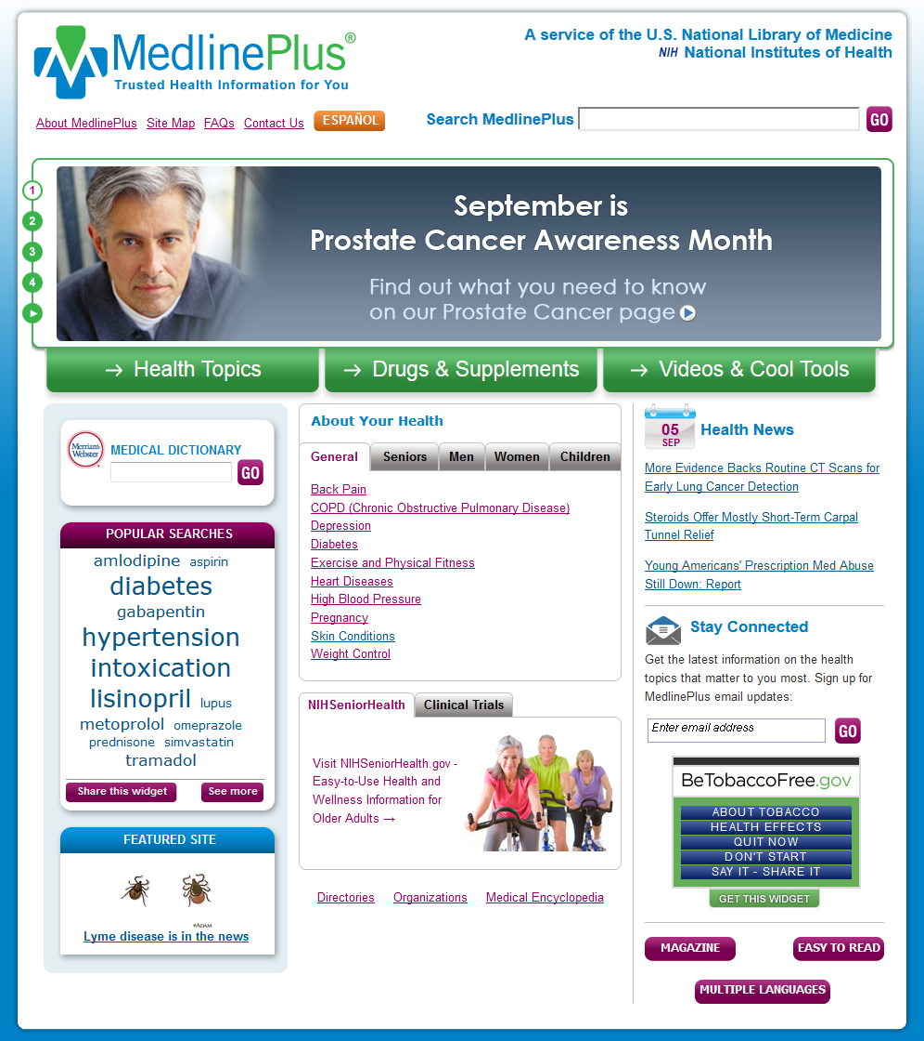
MedlinePlus.gov
MedlinePlus has an extensive collection of links on its Health Insurance Health Topic page.
When talking with library users about health insurance and health topics, introduce them to MedlinePlus for quality health information of all kinds!

Slide 32
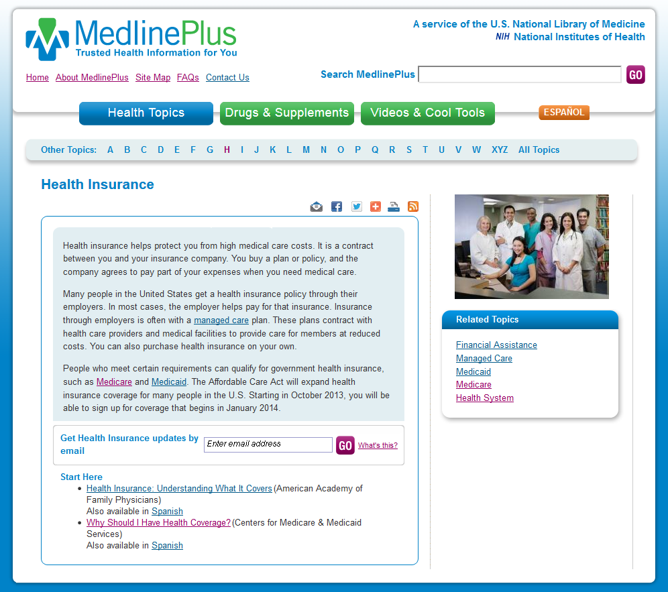
Health Insurance Health Topic Page

Slide 33
Moving Target
Expect that library services will evolve as deadlines come and go and as needs change.
Get informed and take advantage of trainings
Sign up for updates from state site, healthcare.gov, and MedlinePlus
Sign up for email updates from Webjunction and other organizations
Watch the PSR LibGuide for timely new information

Slide 34

Questions
QUESTIONS for us today?
Barbara Bibel
Kelli Ham
Diane Stanton
MORE QUESTIONS about Covered California?
Check the website at CoveredCA.com
or call 1-800-300-1506

Slide 35


THANKS!
Barbara Bibel
bbibel@gmail.com
Kelli Ham
kkham@library.ucla.edu

Slide 36
Infopeople webinars are supported in part by the U.S. Institute of Museum and Library Services under the provisions of the Library Services and Technology Act, administered in California by the State Librarian. This material is licensed under a Creative Commons 3.0 Share & Share-Alike license. Use of this material should credit the author and funding source.

