Slide 1

Teen Volunteer Programs
There's More than Simply Shelving!
Wednesday, October 23, 2013
Dolly Goyal and Angie Miraflor

Slide 2

Why Teens?
Social activity with friends
Enhance college applications
Leadership opportunity
Extra support for US!

Slide 3

Research shows that people who begin volunteering in middle and high school, no matter what the initial reason, become adults who volunteer.

Slide 4

Short-Term Volunteers
Usually have set hours they’re looking for
Community Service
  High School
  Juvenile Detention
Bored teens

Slide 5

Change the Name of the Game!
If you focus on making sure students have a meaningful experience, the attitude usually changes from, “I have to do this” to “I want to be here.”

Slide 6
Managing
Short-Term Volunteers
Create a Volunteer Binder
Avoid “busy work”
  Engage in competition
Create ownership and titles
  Collection Champion
  Adopt-a-Shelf
Identify opportunities for drop-in volunteering

Slide 7

Long-Term Volunteers
Usually do not have set hours – limitless possibilities!
Teen Advisory Group
Summer Help
Teen-led Programs

Slide 8

Teen Advisory Groups
Develop library programs
Book buying parties
Help the Friends or
Foundation
Partner with Youth Commission or
other City youth
organizations

Slide 9
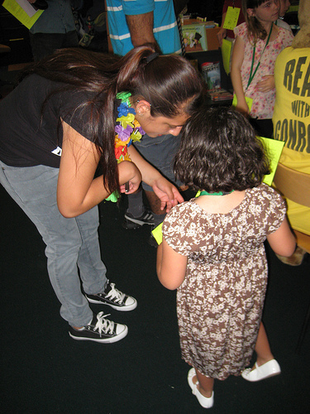
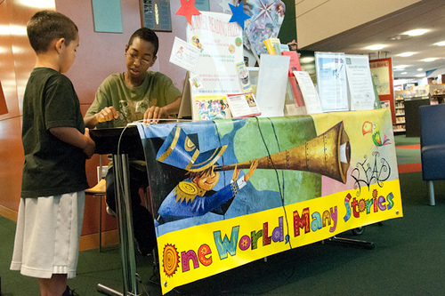
Summer Reading Helpers
Can be critical to success
More “fun” volunteer jobs
Leadership opportunity by having teens train teens
Develop life-long / return volunteers

Slide 10
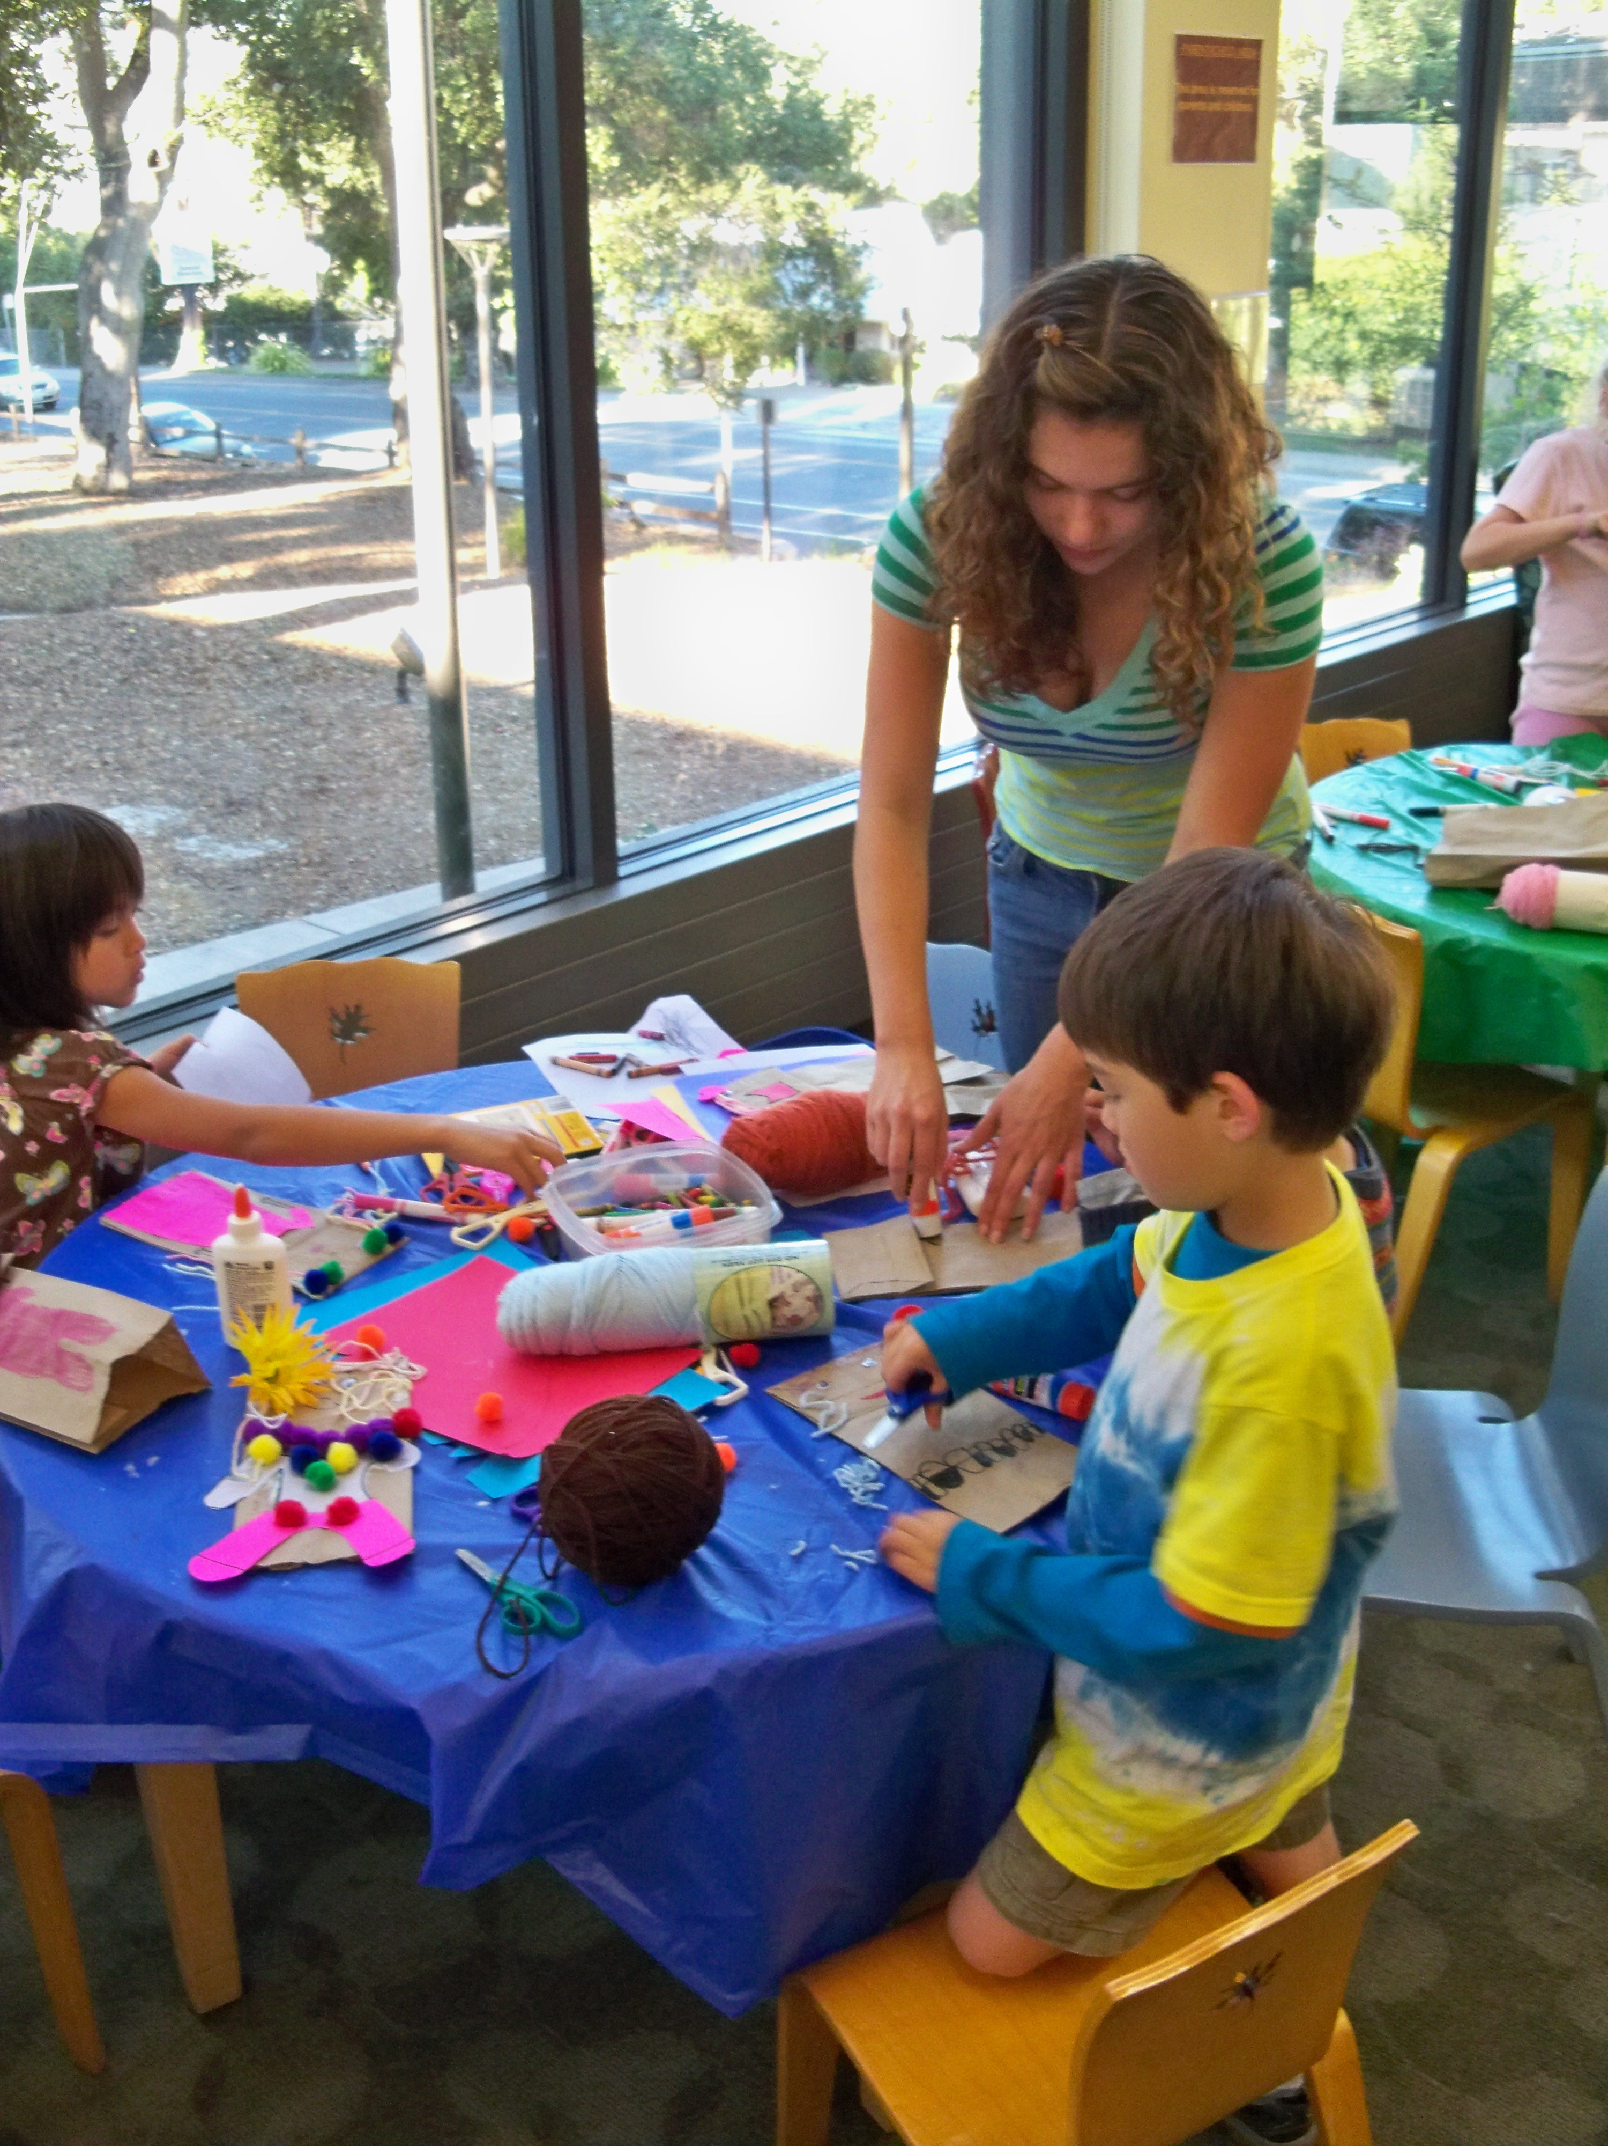
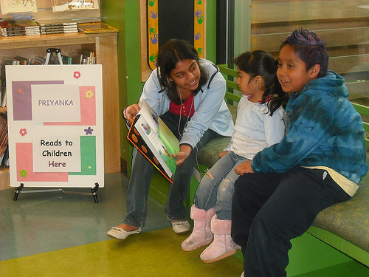
Teen-led Programs
Children’s Craft Leaders
Computer Intergenerational Coach
Leader Reader / Reading Buddies
Homework Tutors / Helpers
Video Game Programs

Slide 11

Volunteer Recognition!

Slide 12

Volunteer Appreciation
Letter or certificate of completion
Letter of recommendation
Choosing set times: Volunteer Appreciation Week (April 21-27, 2014)
Volunteer parties
Ask what they want!

Slide 13

Troubleshooting

Slide 14

Training & Staff Time
Set volunteer orientations and frequency
Pairing volunteers
Back-up systems on days without a volunteer coordinator
Staff support and awareness of volunteers

Slide 15

Recruiting
Target students going back
to school
Utilize social media or other sites like VolunteerMatch.org
Post opportunities in local organizations
Conduct Interviews
Use former volunteers or
friends they recommend!

Slide 16
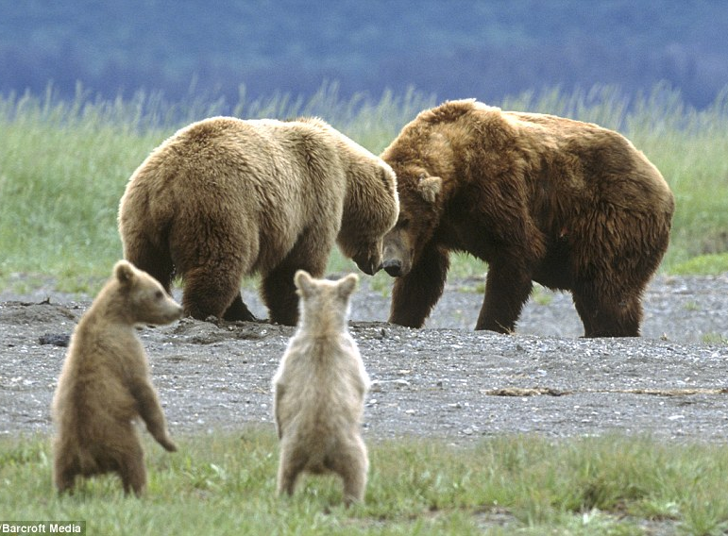
Parental Involvement
Clear, documented volunteer policies
Talking points for set age or grade limitations
Have teens take responsibility!

Slide 17

Expectations
Set immediately, documented, signed
Point out actions inconsistent with policy
  Ex: Talking on cell phone, chatting with friends
Letting a volunteer go or saying, “No.”

Slide 18
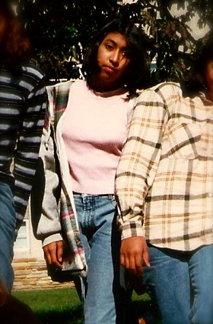
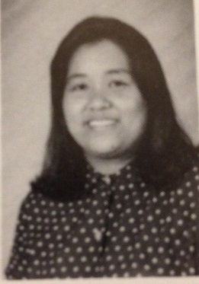
Questions and Thanks
Dolly Goyal
goyal@smcl.org
San Mateo County Library
Angie Miraflor
angie.miraflor@sjlibrary.org
San Jose Public Library

Slide 19
Infopeople webinars are supported in part by the U.S. Institute of Museum and Library Services under the provisions of the Library Services and Technology Act, administered in California by the State Librarian. This material is licensed under a Creative Commons 3.0 Share & Share-Alike license. Use of this material should credit the author and funding source.

