Slide 1
Responsive Web Design (RWD)
Building a single web site for the desktop, tablet and smartphone
An Infopeople Webinar
November 13, 2013
Jason Clark
Head of Digital Access & Web Services
Montana State University Library

Slide 2


Slide 3
pinboard.in tag
pinboard.in/u:jasonclark/t:rwd/

Slide 4
twitter as channel (#hashtag)
  @jaclark #rwd

Slide 5
Terms: HTML + CSS
Does everybody know what these elements are?
CSS
- style rules for HTML documents
HTML
- markup tags that structure docs
- browsers read them and display according to rules

Slide 6
Overview
What is Responsive Web Design?
RWD Principles
Live RWD Redesign
Getting Started
Questions

Slide 7
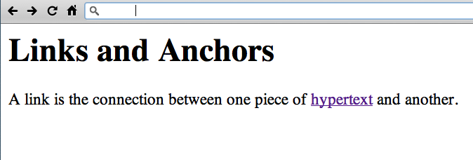
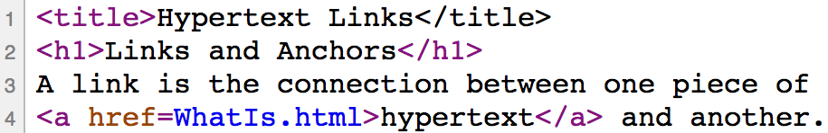
http://www.w3.org/History/19921103-hypertext/hypertext/WWW/Link.html

Slide 8
Responsive design = 3 techniques
Media Queries
A Fluid Grid
Flexible Images or Media Objects

Slide 9
RWD Working Examples
  HTML5 Mobile Feed Widget
  www.lib.montana.edu/~jason/files/html5-mobile-feed/
  Mobilize Your Site with CSS (Responsive Design)
  www.lib.montana.edu/~jason/files/responsive-design/
  www.lib.montana.edu/~jason/files/responsive-design.zip
Learn more by viewing source
OR
Download from jasonclark.info & github.com/jasonclark

Slide 10
Media Queries
switch stylesheets based on width and height of viewport
same content, new view depending on device
@media screen and (max-device-width:480px) {… mobile styles here… }
* note “em” measurements based on base sizing of main body font are becoming standard (not pixels)

Slide 11
Media Queries in Action
  <link rel="stylesheet" type="text/css” media="screen and (max-device-width:480px) and (resolution: 163dpi)” href="shetland.css" />
  Responsive Web Design, Ethan Marcotte
  http://www.alistapart.com/articles/responsive-web-design

Slide 12
Define the Breakpoints
3 major breaks
480 / 768 / 1024

Slide 13
Define the Breakpoints
3 major media query rules
< 480
< 768
> 768

Slide 14
A Fluid Grid
Create Flexible Layouts with Relative Sizing
| 200 px | 300 px | 800 px |
| 15.38% | 23.07% | 61.5384% |

Slide 15
Box Sizing
Set how the browser calculates the width of an element to include (or not include) padding, borders, and margins
  div.doc {
  width: 200px;
  padding: 0 30px;
  -webkit-box-sizing: border-box;
  -moz-box-sizing: border-box;
  box-sizing: border-box;
  }

Slide 16
Flexible Images & Media
Adaptive Sizing
img {width:100%;}
img {max-width:100%;}

Slide 17
Flexible Images & Media ...
Adaptive Sizing
<div class="video-container">
<iframe src="http://player.vimeo.com/video/6284199?title=0&byline=0&portrait=0" width="800" height="450" frameborder="0"></iframe>
</div>
.video-container {position:relative;padding-bottom:56.25%;padding-top: 30px;height:0;overflow:hidden;}
.video-container iframe {position:absolute;top:0;left:0;width:100%;height: 100%;}

Slide 18
Ensure Device Screen Size
meta viewport tag in <head>
<meta name="viewport" content="width=device-width, initial-scale=1">

Slide 19
Linearize Layout for Mobile
Turn all block level elements into full width to create single column layout
width -> 100%

Slide 20
Hide Non-Essential Content
As screen sizes shrink, remove elements from view
Apply a .hide class
@media screen and (max-width:480) {
.hide {display:none;}
}

Slide 21
RWD Gotchas
Hidden page weights
Be lean with your markup
Minify if performance bottleneck

Slide 22
Minification + Optimization
Removing unnecessary characters and spacing from code to reduce size, and optimizing the code to improve load times
  Minify
  www.cleancss.com
  Optimize
  csstidyonline.com
  stidyonline.com/

Slide 23
What Type of Support?
  see "When can I use…"
    http://a.deveria.com/caniuse/
  Mobile browsers leading the way
  Modernizr
    http://www.modernizr.com/
  HTML5 enabling script
    http://remysharp.com/2009/01/07/html5-enabling-script/

Slide 24
RWD Tools
Twitter Bootstrap
  twitter.github.io/bootstrap/
Responsify
  responsify.it/
960 Grid System
  http://960.gs/

Slide 25
Resources
  HTML5 & CSS3 Cheat Sheets
    webresourcesdepot.com/html-5-and-css3-cheat-sheets-collection/
  HTML5 Boilerplate
    http://html5boilerplate.com/
  HTML5rocks
    html5rocks.com
  HTML5 Please
    html5please.com/#use

Slide 26
Next version of RWD = Flexbox
  A flexible box model?
  body>div#main {
  display: -webkit-flexbox;
  display: -moz-flexbox;
  display: -ms-flexbox;
  display: -o-flexbox;
  height: 500px;
  padding: 1em;
  background-color: gray;
  }

Slide 27
Live RWD redesign
Taking off the training wheels....

Slide 28
RWD in Libraries
Matthew Reidsma
  matthew.reidsrow.com
  @mreidsma
Brad Czerniak
  brad.hawidu.com
  @ao5357

Slide 29


Slide 30
Questions?
twitter.com/jaclark
www.lib.montana.edu/~jason/talks.php

Slide 31
Infopeople webinars are supported in part by the U.S. Institute of Museum and Library Services under the provisions of the Library Services and Technology Act, administered in California by the State Librarian. This material is licensed under a Creative Commons 3.0 Share & Share-Alike license. Use of this material should credit the author and funding source.

