Slide 1
Preservation best Practices
Session 1: Fundamentals and Facilities
Notes:
Thank you to CPP and Julie and Barclay for having me. First in series

Slide 2
Topics
Session 1: Fundamentals and Facilities
Session 2: The Role of Environment in Collections Care
Session 3: Collection Care: Handling, Access, Storage, and Exhibition
Session 4: Planning and Prioritizing

Slide 3
Goals for the Series
Establish targets for collections care in cultural institutions
Understand indictors of success in each area
Have the tools to evaluate the conditions in your own institutions
Notes:
We’ll be setting baseline, good and better preservation actions for a variety of topics – and I’ll talk about that more in a moment. Concrete ideas. Give you some tools for self evlautions

Slide 4
Areas of Discussion
Policies
Facilities
Environment
Lighting
Emergency Preparedness
Security
Housekeeping
Pest Management
Handling and Access
Collections Storage
Exhibition
Preservation Planning
Conservation
Additional Considerations
Notes:
We’ll go from the largest global factors to more detail oriented projects. We’re going to discuss benchmarks for each of these areas.
Additional consideration: Staffing
Board Involvement
Continued Training

Slide 5
Today
Terminology
Making the case
Establishing a preservation program
Facilities
Security
Housekeeping

Slide 6
Poll
Notes:
Ask question – what percentage of your job responsibilities relate to collections care?
0-25%
25 -50%
50 – 75%
75% - 100%

Slide 7
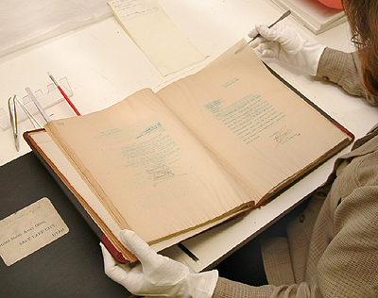
Terminology
Preservation
  - Refers to all those activities aimed at caring for your collection.
Conservation
  - Refers to those activities that stabilize collections chemically or strengthen them physically.
Image: NARA.gov

Slide 8
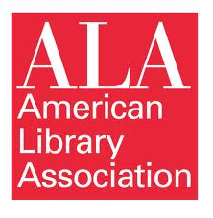
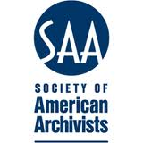


Professional Mandate
American Library Association
(ALA)
The Association's policy on
preservation is based on its goal of ensuring that every person has access to information at the time needed and in a usable format
Society of American Archivists
(SAA)
Archivists select, preserve, and
make available documentary
materials of long-term value that have lasting value to the organization or public that the archivist serves
American Alliance of
Museums (AAM)
Museums make their unique contribution to the public by collecting, preserving, and interpreting the things of this world
American Association for State
and Local History (AASLH)
Members shall give priority to the care and management of the collections within their care and always shall act to preserve their physical and intellectual integrity

Slide 9
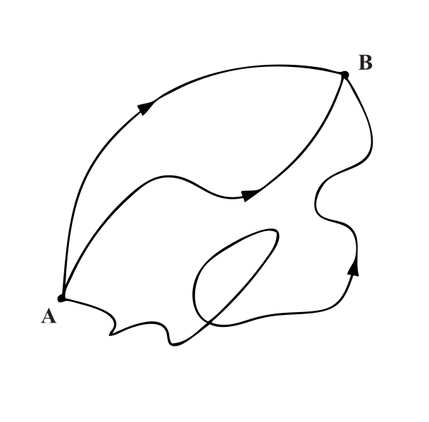
Preservation Program
Establish preservation goals and systems.
  A preservation plan is a document that “defines and charts a course of action to meet an institution’s overall preservation needs for its collections.”
  Source: Preservation Planning: Guidelines for Writing and Long-Range Plan
Notes:
Elements of a Preservation Program
Although there is general consensus within the preservation community on the basic elements of a systematic preservation program, where the emphasis falls will depend on the type of institution, since institutional and user needs will vary. For example, the primary interest of a public library may be to keep materials in good repair so that they can be used until they become obsolete and are withdrawn, while a research library or an archives would emphasize preservation of intellectual content over the long term and/or preservation of original items with artifactual value.

Slide 10
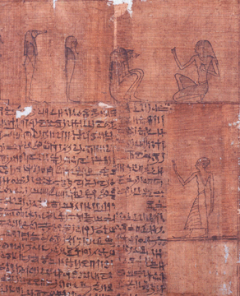
Benefits of Planning
Continues and fulfills mission
Saves collections
Good use of resources
Systematic approach

Slide 11
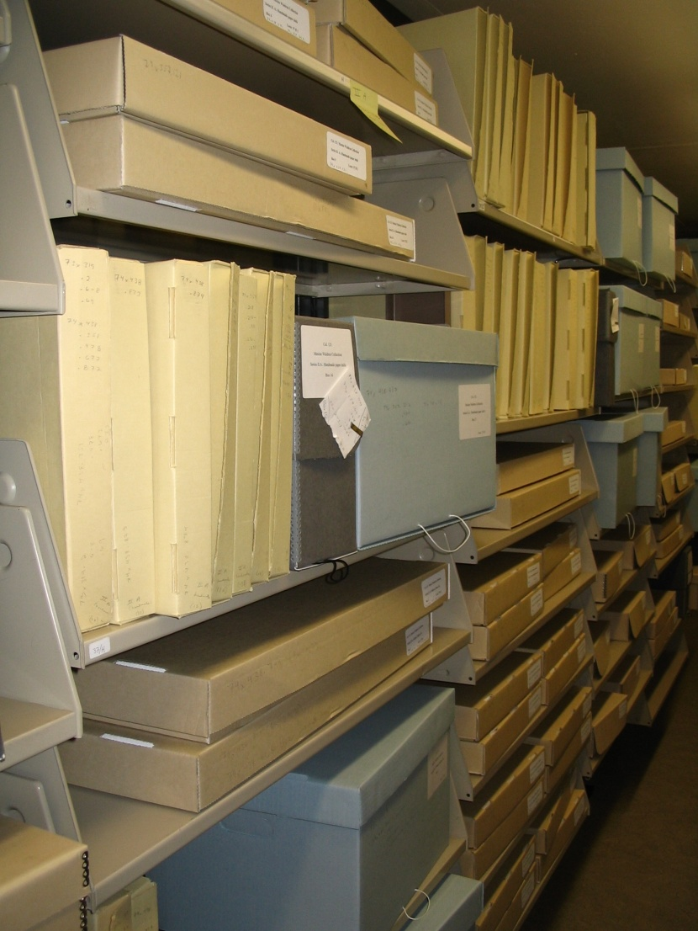
Who is Responsible for Preservation?
Director
Board
Staff
  * Librarians
  * Curators
  * Archivists
Exhibit Preparators
Facility Staff
Janitorial Staff
Security Staff
Patrons/Visitors
Notes:
One of the things to think about is that everyone at your institution has some role in preservation. I know many of you are looking at this list saying we don’t have all of these people, but I guarantee you that someone is doing all of these jobs.
Director and Board – must be advocates for preservation
Staff – actual caretakers
Building and Facilities – all have a role
Patrons- we need to educate our patrons.

Slide 12
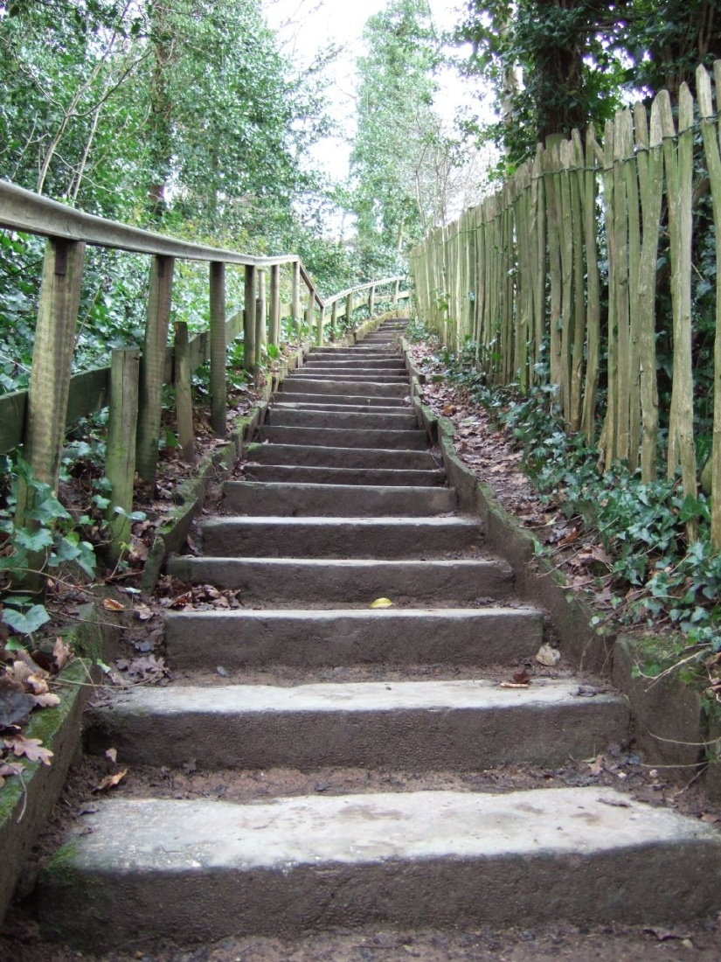
Establishing the Benchmarks
Getting Started
  The minimum level of care necessary for responsible stewardship
Good
  Taking actions that are above the “Getting started”, but there is still room for improvement
Better
  Best possible stewardship of cultural collections based on current research and methods
Image via Nicola Whitaker

Slide 13
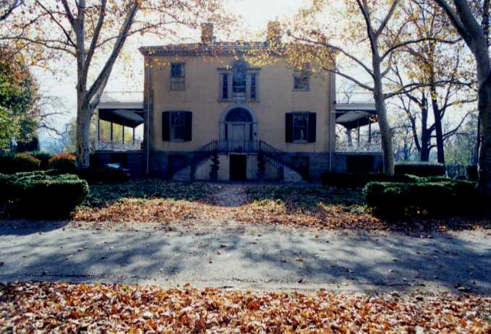
Building and Facilities

Slide 14
Poll
Notes:
How old is you building?
1-20 years old
20 -50 years old
50 – 75 years old
70++
I have no idea but it leaks all the time

Slide 15
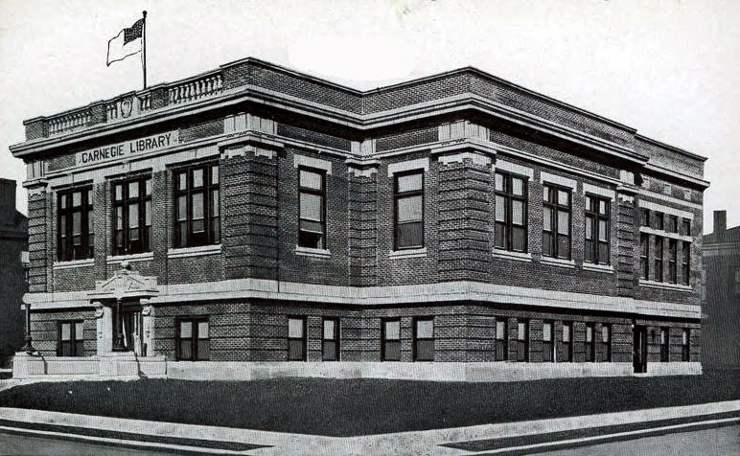
Building and Facilities: Getting Started
  The building structure is sound and can support necessary weight loads for the collections
  The building interior is protected from water and weather intrusions
  Maintenance issues are addressed as they occur
Image: Illinois Digital Archives

Slide 16
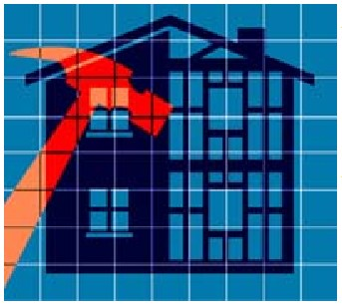
Building and Facilities: Getting Started
  The building is inspected on a regular basis to ensure that changes in building condition are noted and addressed
  Contractors are informed of regulations for working around collections

Slide 17
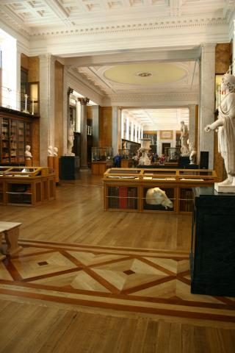
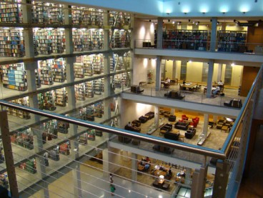
Building and Facilities: Good
  A facilities maintenance program is in place
Thompson Library, OSU
Library of George III
Notes:
These two buildings have different needs

Slide 18
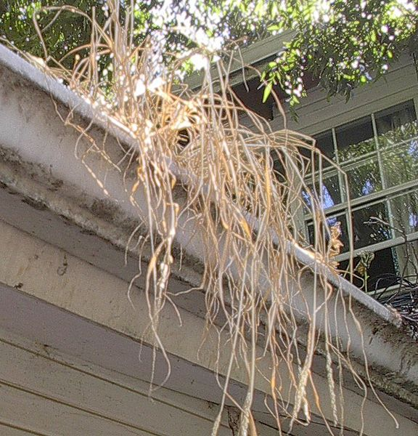
Building and Facilities: Good
Facilities Maintenance Program
Schedules and guidelines for inspection and preventative maintenance for any location where collections are stored
Notes:
Examples of annual maintenance
Roof inspection
HVAC maintenance
Examples of seasonal maintenance
Gutter cleaning
Air Filter changes
Inspect major building systems regularly- special attention paid to plumbing and electrical. Keep recrods of all maintenance and inspections

Slide 19
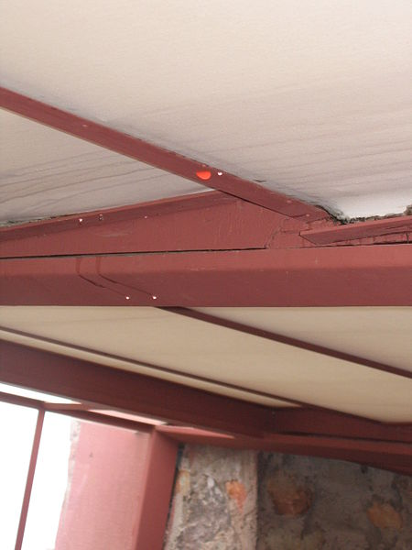
Building and Facilities: Good
  Building vulnerabilities are known and monitored as necessary
Notes:
Roof leak Taliesen West

Slide 20
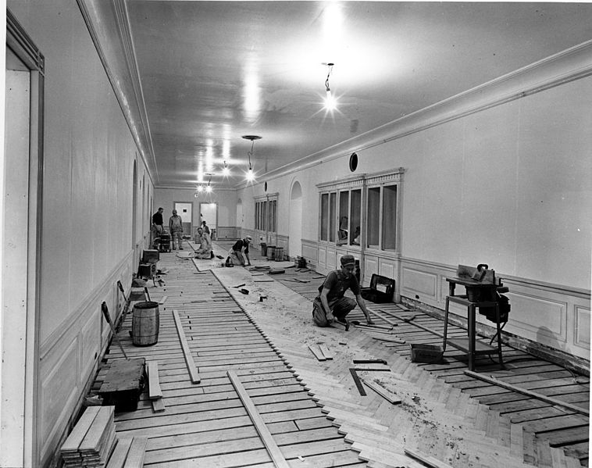
Building and Facilities: Better
  A dedicated facilities maintenance position is on staff full-time
  Plans for regular building upgrades are incorporated into the institutional long-range plan
Image: NARA
Notes:
Image of renovation of the White House in 1951. If the white house needs upgrades, so do you.

Slide 21
Security

Slide 22
Poll
Notes:
Do you believe your local history collections and/or special collections are secure against theft and vandalism?
Yes
No
Do you have control over staff access to local history and/or special collections?
Yes
No

Slide 23
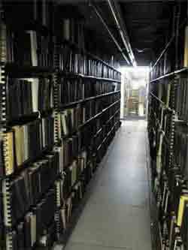
Security: Getting Started
  All storage rooms are kept locked when not in use
  Access to collections storage spaces is limited to essential staff
  All facilities in which collections are stored are alarmed with a centrally monitored security system
Image: NewYorkology

Slide 24
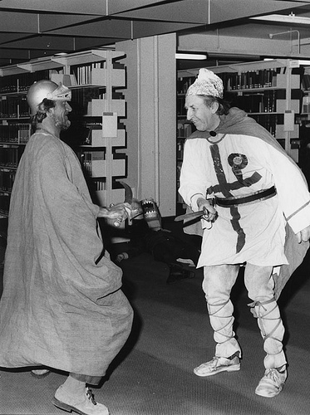
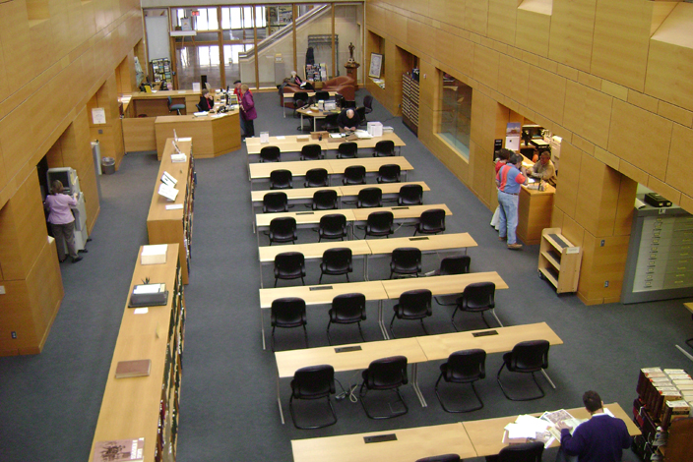
Security: Getting Started
  Researchers sign in and are monitored at all times while using collections materials
Image: Kansas Historical Society
Image: British Library of Political and Economic Science

Slide 25
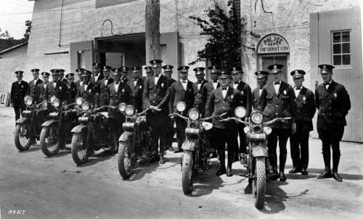
Security: Good
  Security procedures are in place and are followed by all staff
  A system is in place for tracking everyone that enters a secure collections storage location
  Research spaces are monitored with security cameras
  Regular contact is maintained with local law enforcement
Image: State Library and Archives of Florida

Slide 26
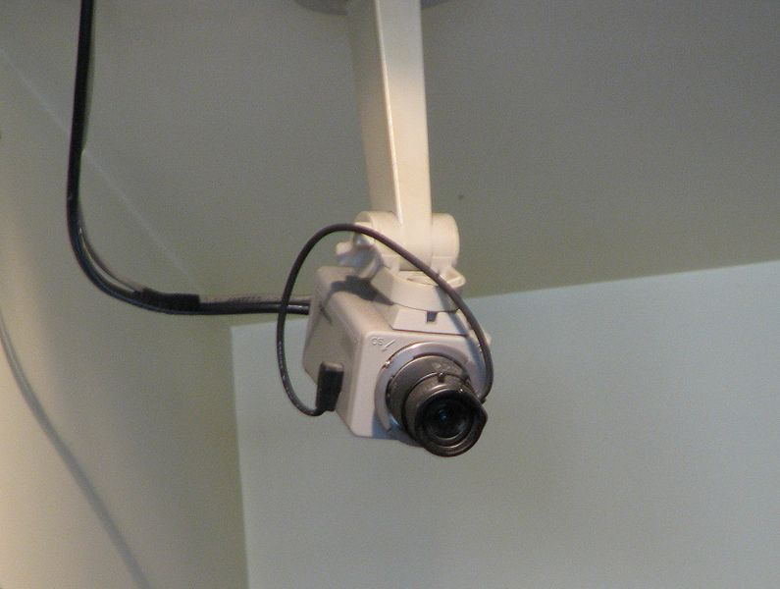
Security: Better
  Security procedures are reviewed and assessed annually
  A security specialist has analyzed the institution and has made recommendations for mitigating security risks
  Security personnel are on staff and monitor facilities 24 hours a day

Slide 27
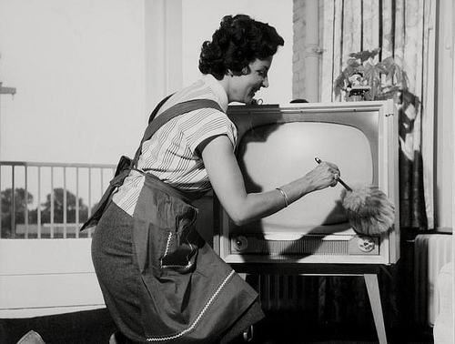
Housekeeping

Slide 28
Poll
Notes:
When was the last time your special collections stacks, archives, books, or boxes were cleaned?
We clean quarterly or more often
We clean once a year
Cleaning, what’s that?

Slide 29
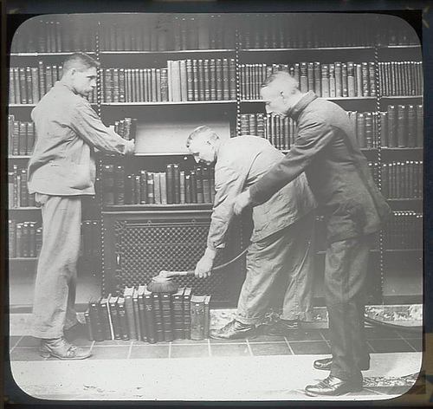
Housekeeping: Getting Started
  Storage and stacks areas are cleaned on a regular schedule
  All garbage containing food is removed from the facility on a daily basis
  Cleaning supplies and tools are kept in stock
  Staff are trained in what techniques are appropriate when cleaning around collections
Image: NY Public Library

Slide 30
Housekeeping Supplies
General Supplies
Brushes
Gloves
Muslin
Mylar
Orvus
Vacuum
Murphy’s Oil Soap
Renaissance Wax
Dust Cloths
Screening
List developed by the Minnesota Historical Society. Historic Housekeeping Handbook, 2000
Do Not Use
Lemon Oil
Turpentine
Bees Wax
Endust or other dusting products
Any Aerosol products
Saddle soap
Cleansers
Plexiglas cleaner on other surfaces
Glass cleaner on Plexiglas
Bleach
Abrasive Cleaners
Feather Dusters
Acid-based Cleaners

Slide 31
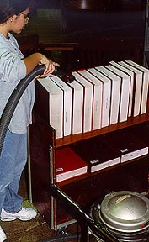
HEPA (High Efficiency Particulate Air) filter
Rheostat attachment to adjust the vacuum pressure

Slide 32
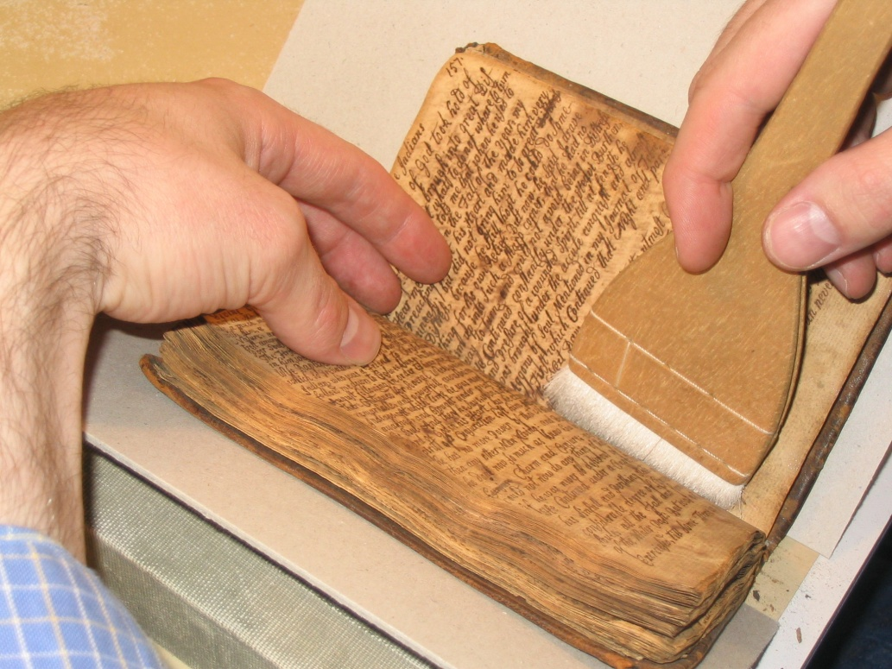
Housekeeping: Good
  A conservator has been consulted about what cleaning products are appropriate for use around collections materials
  A formalized housekeeping policy and manual are established

Slide 33
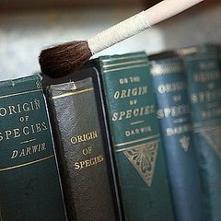
Housekeeping: Good
  Staff are trained to notice
  and report changes in the
  collection that are observed
  during cleaning (pests, missing
  pieces, damage)

Slide 34
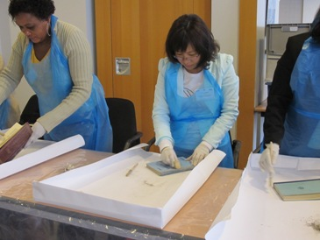
Housekeeping: Better
  A system is in place for basic cleaning of stacks/boxes/artifacts
  An annual training session is held for those staff members involved in housekeeping for collections areas
Image: University of Iowa Libraries

Slide 35
Thank you and Questions
Questions about collections care?
Contact the California Preservation Program info@calpreservation.org

Slide 36
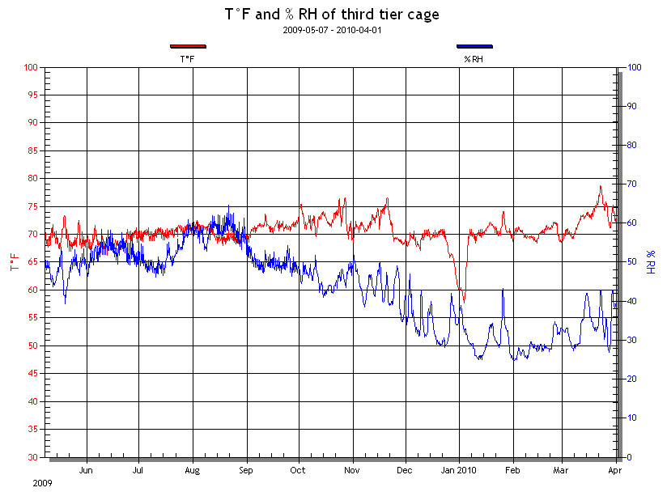
Next Session
Session 2: Environment
December 5, 2013
Temperature
Relative Humidity
Lighting
Pests

