Slide 1

Life After Desk:
Implementing the New Service Models
Presented by
Joan Frye Williams
Wednesday, December 4, 2013

Slide 2
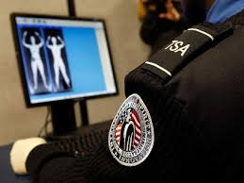
I do this so you don’t have to

Slide 3
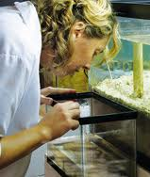
My observations of new service models in action
What’s working well
What may need some rethinking
How successful libraries manage implementation

Slide 4


Slide 5

Reference desk trends
Public libraries:
Academic libraries:
25-35% “real” reference
15-20% basic catalog lookup and/or holds
30-35% technology
10-30% directional
40-50% “real” reference
20-25% printing and copying
10-15% other technology
10-30% directional

Slide 6

Changing responsibility for
Intercept
Triage
Response
Follow-up

Slide 7

Key concepts
Excellence defined by the user experience
Service delivery at the point of need
Right person, right task
Cross-functional teamwork
Improved efficiency
Change, not loss

Slide 8
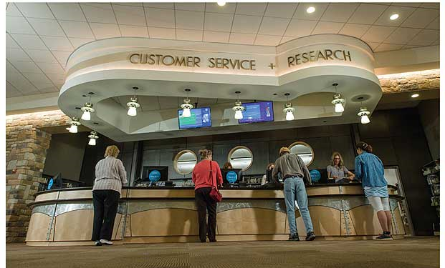
Co-located service desks
Notes:
Howard County, MD

Slide 9

Co-located service desks so far
No guesswork about where to go for service
Right person always available
Minimal adjustment for staff
Not clear which staff member to ask for assistance
Not clear where line is
Requires at least 2 on desk “just in case”
Service not at point of need

Slide 10
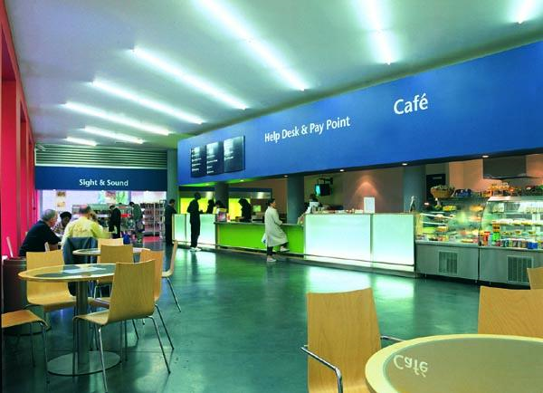
Consolidated service desk
Notes:
Bow Idea Store, UK

Slide 11
Consolidated service desks so far
No guesswork about where to go or which staff member to ask for service
One stop shopping for a variety of services
If librarians work “on call,” they can focus more intently on other tasks
Service not at point of need
If professional staff work on desk rather than on call, they spend considerable time on tasks that do not require their level of training

Slide 12
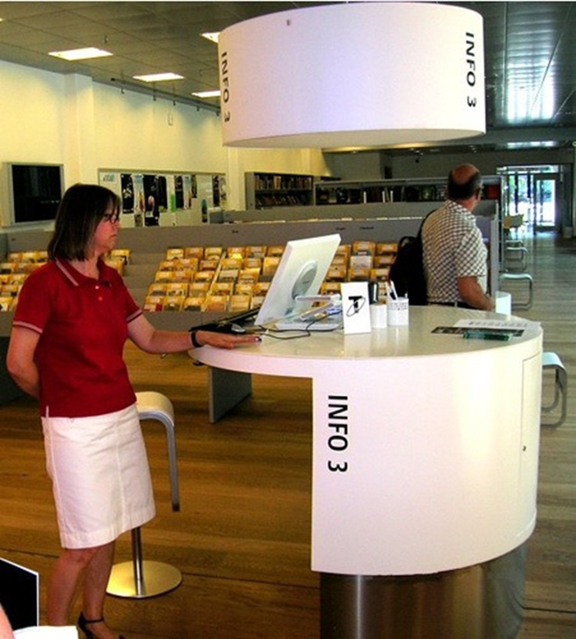
Distributed service kiosks

Slide 13
Distributed service kiosks so far
Closer to point of need
May function as landing place for roving service
Frequently unstaffed – worse than no desk from the user’s standpoint
Not clear who is entitled to use equipment

Slide 14
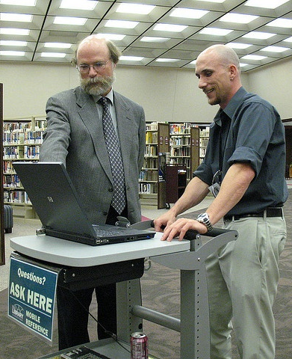
Flexible alternative: mobile desk
Notes:
Rapid City PL

Slide 15
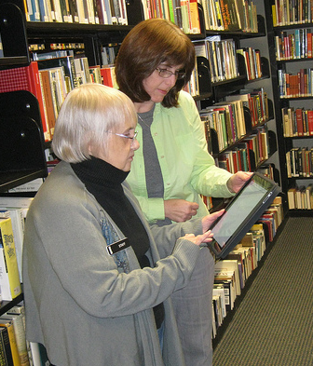
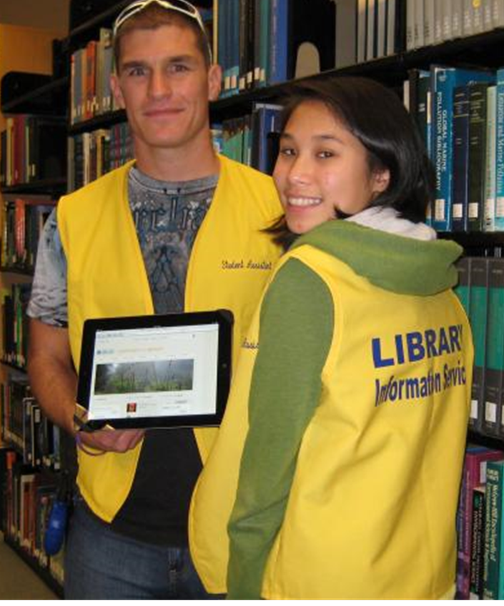
Roving reference
Notes:
L: Ridley Library, PA
R: UC Santa Cruz

Slide 16
Roving reference so far
Service delivered at the point of need
Users less reluctant to approach staff
No line – can work to completion
Good way to learn exactly where users get stuck
Especially useful for tech assistance
Rovers not always clearly identifiable as library staff
Can be seen as intrusive
Some staff have trouble adjusting to proactive role

Slide 17
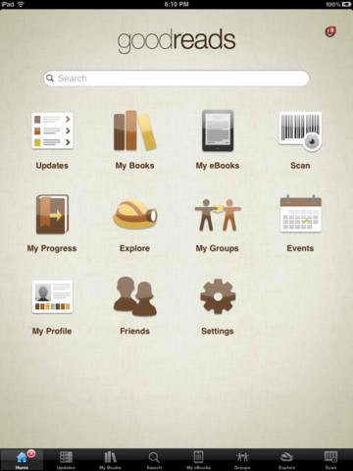
Examples of pre-loaded apps/links on public library rovers’ tablets
OPAC
Overdrive
Google search
Google maps
City/county web page
Transit information
Wikipedia
FindLaw
Goodreads
FictFact
Fantastic Fiction
BiblioTravel
Series and Sequels
Juvenile Series and Sequels
Common Sense Media

Slide 18

When staff won’t rove
Listen to their concerns
Support them with training,
tools, and content
Link roving to user outcomes
Schedule in 1-hour increments
Be open to adjustments based on actual results
Resist attempts to go back to “normal”
Reconfigure the furniture
As a last resort, reassign them

Slide 19
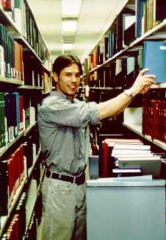
Flexible alternative: prepare everyone to be a first responder

Slide 20
Zone staffing
Service point
Arrivals and departures
Collections
Children
Tech
Notes:
Tulsa City County Library “Librarium”

Slide 21
Zone staffing so far
Integrates all types of service, not just reference
Holistic – staff are responsible for all that happens in their zone
Easy to combine or divide zones to adjust to fluctuations in demand
Opportunities for spontaneous programming
Most work performed standing up
Some staff have trouble adjusting to security/ behavioral responsibilities
Notes:
Dallas PL recommends: Black Belt Librarian, by Warren Graham

Slide 22
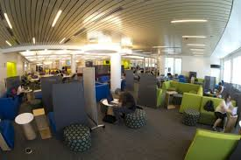
Trendy learning commons
Notes:
Snell Library, Northeastern U

Slide 23
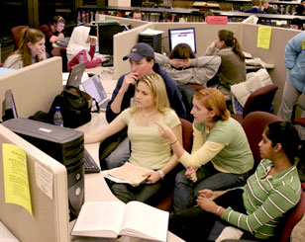
Effective learning commons
Notes:
Wells Library, Indiana U

Slide 24
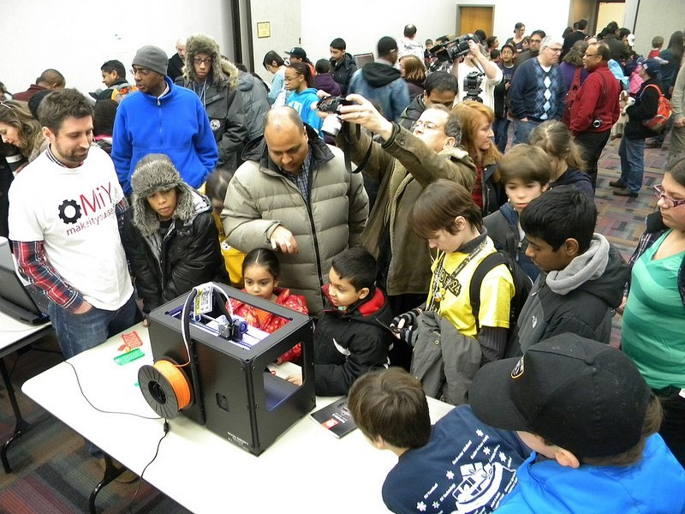
Trendy maker space

Slide 25
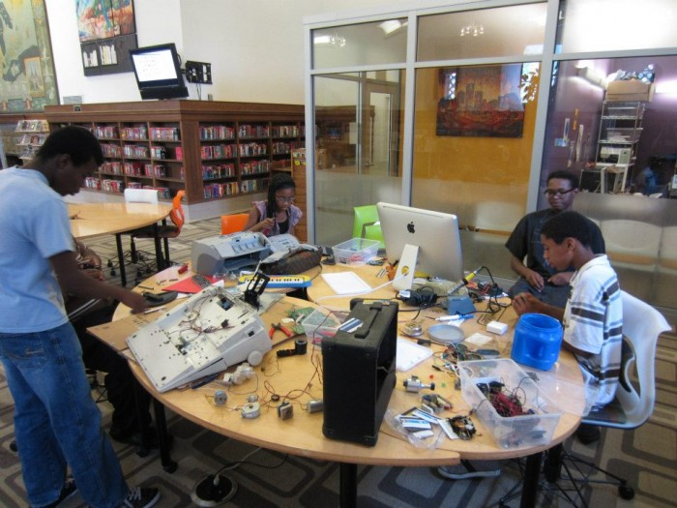
Effective maker space
Notes:
Detroit PL

Slide 26
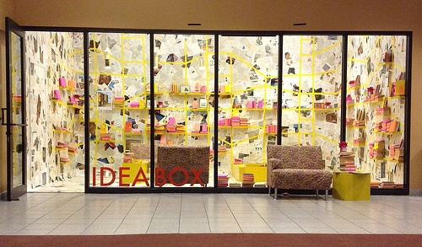
Another effective maker space
Notes:
Oak Park, IL

Slide 27

All of these service models work best when
The service desk faces into the library, not out the door
Engagement with users is at eye level
Self check is the main form of checkout
Collections are merchandised and well signed
Phone calls and email requests are handled away from the desk
Staff are trained well enough for the first response to add value

Slide 28

If staff are no longer on desk, make sure they’re visible elsewhere

Slide 29
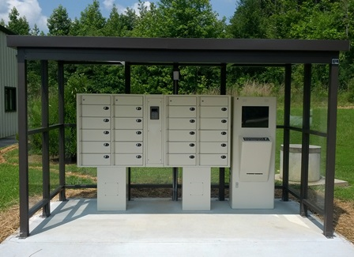
After-hours circulation
Notes:
Grandville County, NC

Slide 30

After-hours circulation so far
Lockers seem most successful as “express library” in an area not otherwise served - 24/7 alternative to bookmobile stop
Dispensers seem better suited to areas with high foot traffic or long waits
Interest from hospitals, corporate campuses
Weather sensitive
Best to combine with catalog/holds function and book return
Lockers much less temperamental – and less interesting to new users – than dispensers
More activity during morning hours

Slide 31
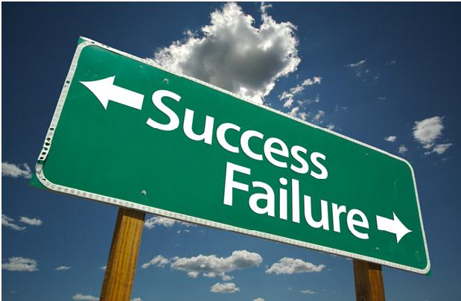

Slide 32
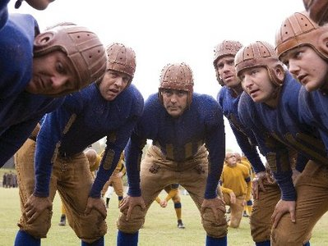
Consult with front line staff

Slide 33

Be forthright about why you want to do this

Slide 34

Be specific about what you know will change

Slide 35

Acknowledge what remains uncertain

Slide 36
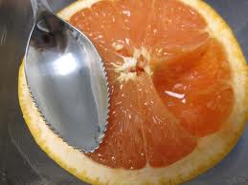
Anticipate new situations and develop tools to match them

Slide 37

Prototype with volunteer staff, then have them train others

Slide 38
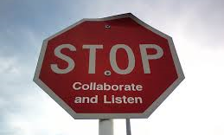
Set clear behavioral expectations

Slide 39

Hold everyone accountable

Slide 40

Report progress from the user’s perspective

Slide 41
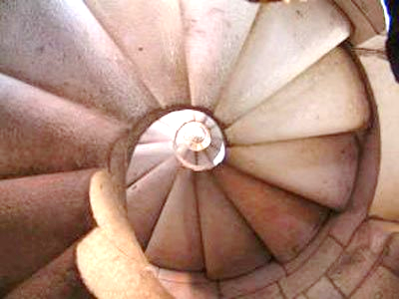
Expect an iterative, non-linear process, with plenty of adjustments

Slide 42
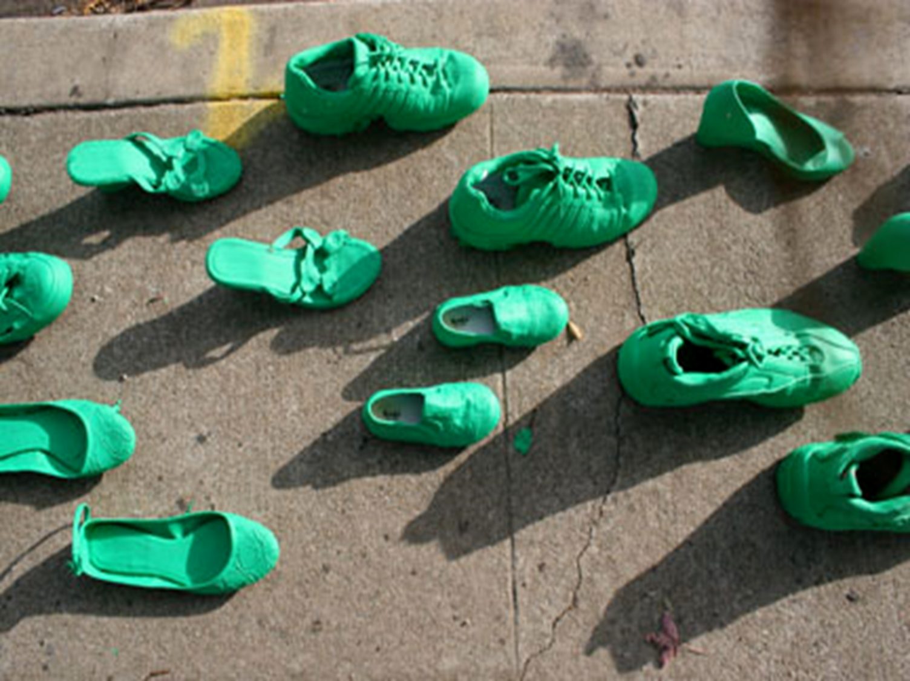
Keep moving forward

Slide 43

What could we accomplish if we didn’t spend so much time covering all those desks?

Slide 44
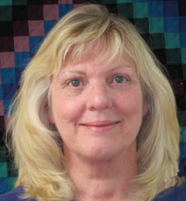
joan@jfwilliams.com
Let’s continue the conversation…
Photo by Martin Helmke

Slide 45

Infopeople webinars are supported in part by the U.S. Institute of Museum and Library Services under the provisions of the Library Services and Technology Act, administered in California by the State Librarian. This material is licensed under a Creative Commons 3.0 Share & Share-Alike license. Use of this material should credit the author and funding source.

