Slide 1
Preservation Best Practices
Session 2
The Role of environment in Collections Care: Temperature & Rh, Lighting and Pest management

Slide 2
Today
Environment and Environmental Monitoring
Lighting
Pest Management

Slide 3
Environment and Environmental Monitoring
Notes:
Stabilizing Environment is probably the largest factor in preservation of collections.
Temperature, relative humidity, and fluctuations in those cause chemical reactions and speed deterioration

Slide 4
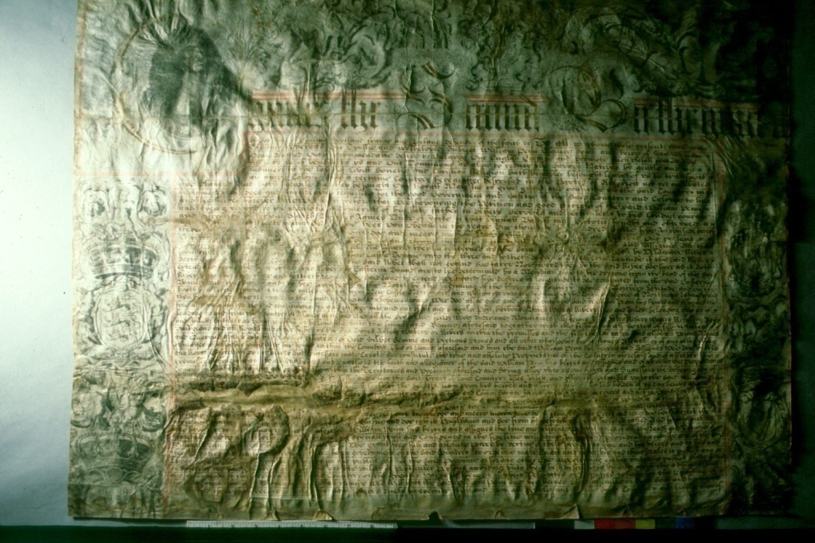
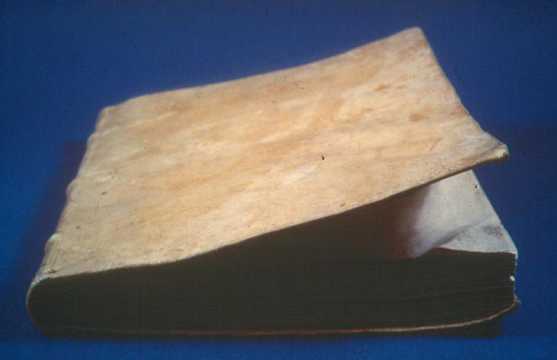

Slide 5
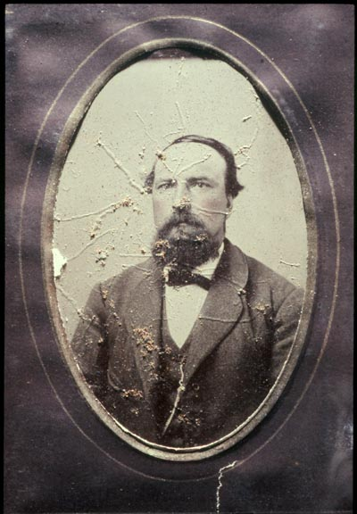
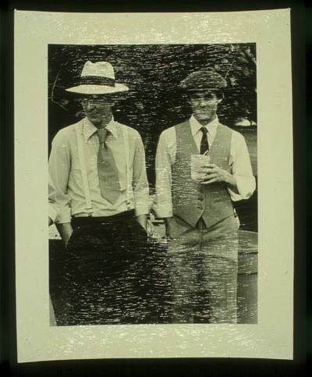
Notes:
High Humidity

Slide 6
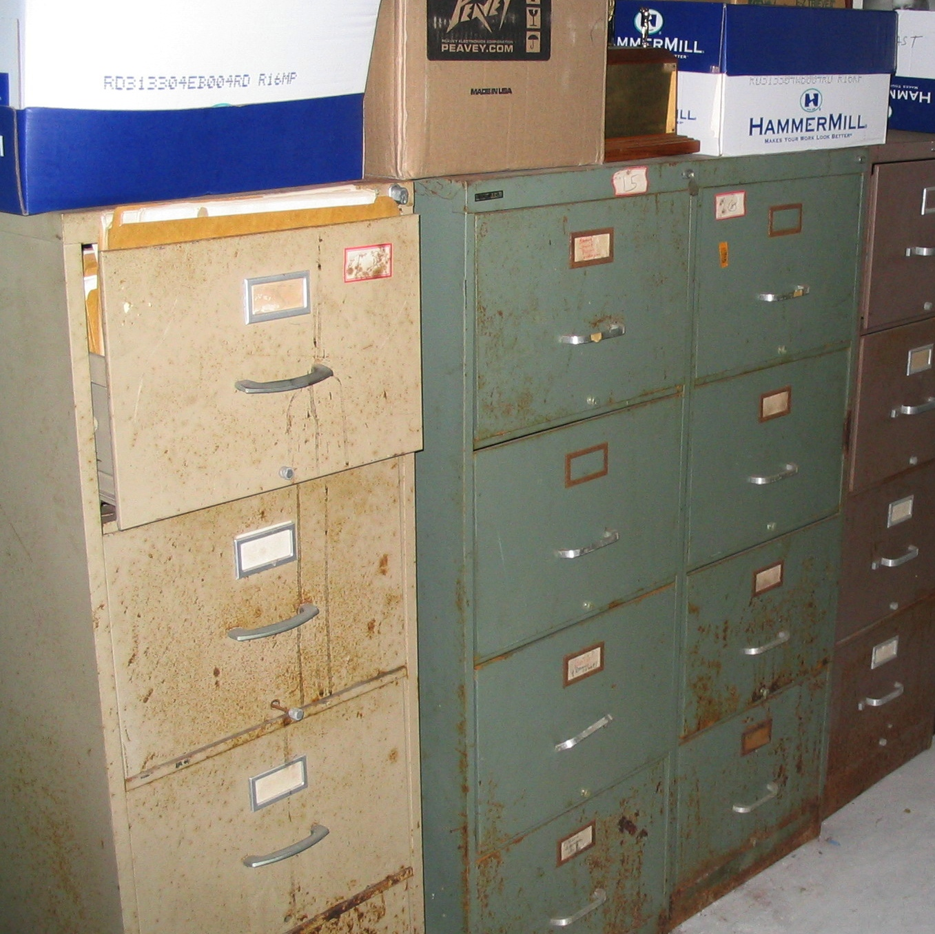

Slide 7
Poll
Notes:
Would you say the environment in your building is:
Stable
Always too hot
Always too cold
I never know until I get there

Slide 8
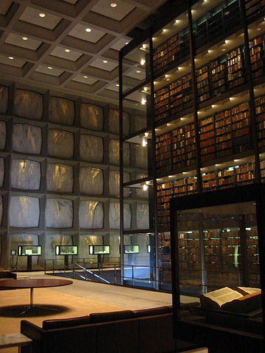
Environment and Environmental Monitoring: Getting Started
  Simple measures to improve environmental conditions are in place, such as closing doors, using fans etc.
  Collections are housed in a manner that protects materials from extremes in environmental fluctuations
  Collections are stored and exhibited in spaces that are capable of maintaining stable environmental conditions

Slide 9
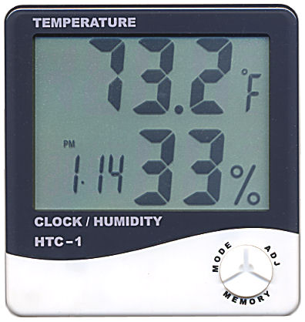
Environment and Environmental Monitoring: Getting Started
  Monitoring equipment is available to spot check temperature and relative humidity levels
  Environmental data is regularly collected and retained

Slide 10

Ideal Environmental Standards
Control temperature and relative humidity
  NISO TR01-1995- Environmental Guidelines for the Storage of Paper Records
Combined Stack and User Areas:
70˚max 30-50% RH
Closed Stacks:
  65˚max 30-50% RH
Preservation Stacks:
  30˚ -65˚ 30-50% RH
Notes:
Discuss how standards are changing. Don’t get hung up on these numbers.
HVAC system ideal, but sometimes impractical
Low-cost improvements

Slide 11
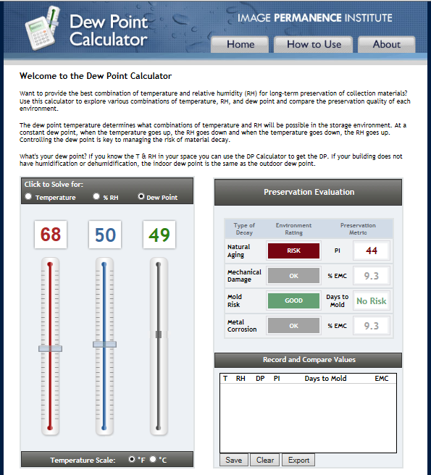
http://www.dpcalc.org/

Slide 12
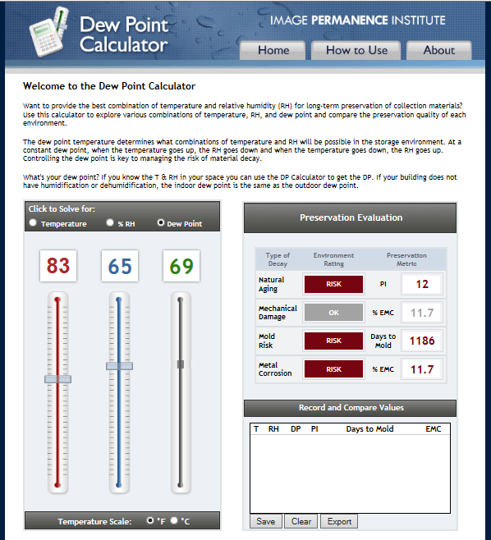
http://www.dpcalc.org/

Slide 13
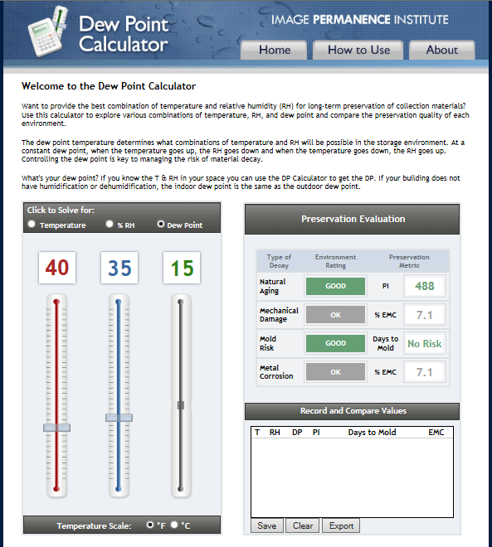
http://www.dpcalc.org/

Slide 14
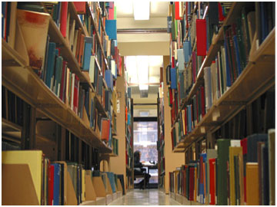
Environment and Environmental Monitoring: Good
  A systematic program to measure humidity and temperature is in place with hygrothermographs or dataloggers. The system is based on defined monitoring objectives

Slide 15
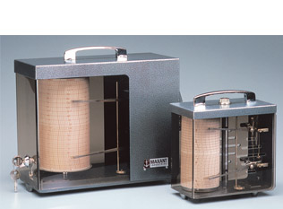
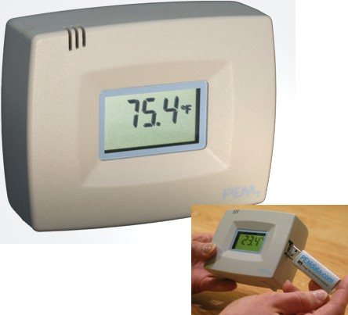
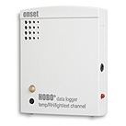
http://www.familyarchives.com/products/Hygrothermograph.html
https://www.imagepermanenceinstitute.org/environmental/pem2-datalogger
http://www.microdaq.com/occ/hobo.php

Slide 16
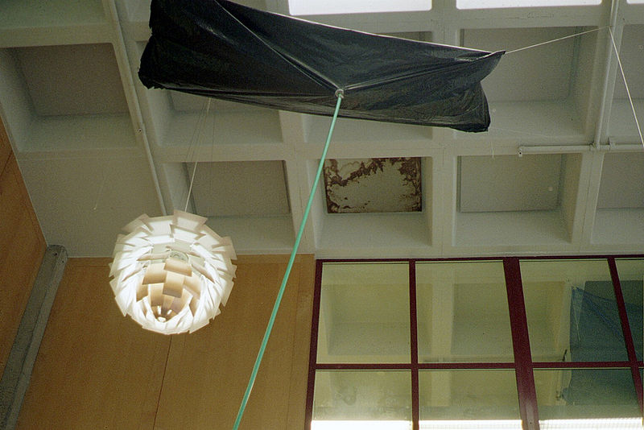
Environment and Environmental Monitoring: Good
  Staff is trained in use of monitoring equipment
  Monitoring equipment is recalibrated as recommended by the manufacturer
  A record is kept of events that might affect environmental conditions, such as receptions, leaks, systems failures, outside weather conditions etc.
  Desired set points are established that are achievable for the storage and exhibition areas
Notes:
UC Santa Cruz

Slide 17
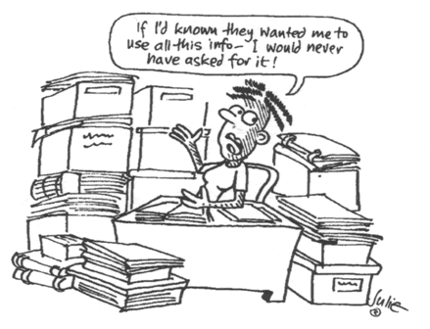
Environment and Environmental Monitoring: Better
  Qualified staff members or
  consultant analyzes and prepares a summary of
  environmental data
http://www.semwisdom.com/blog/wp-content/uploads/data-analysis-cartoon-1.gif

Slide 18
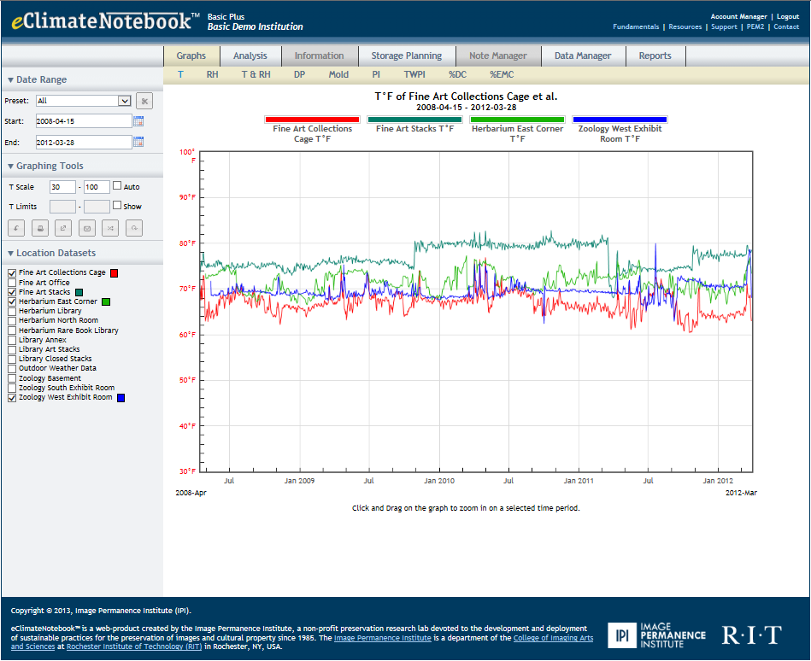
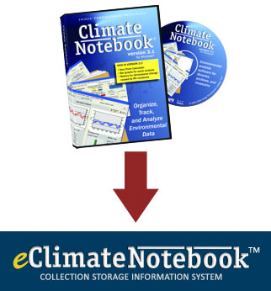
Environment and Environmental Monitoring
  Environmental Analysis
https://www.eclimatenotebook.com/graphs.php

Slide 19
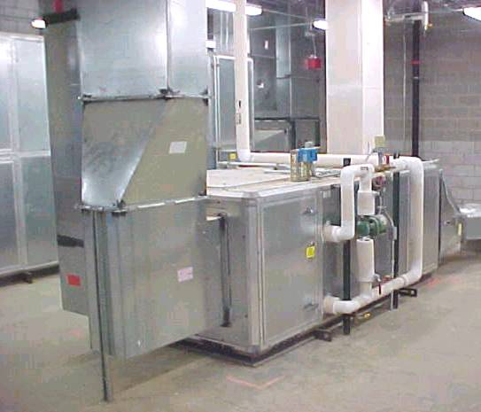
Environment and Environmental Monitoring: Better
  Environmental monitoring data is used to adjust environmental control systems and procedures
  The monitoring program is reviewed at regular intervals
  An environmental engineer is hired on an annual basis to ensure systems are working at their highest efficiency
  Specialized environments are established for sensitive collections materials
  Monitoring is done for levels of air pollutants

Slide 20
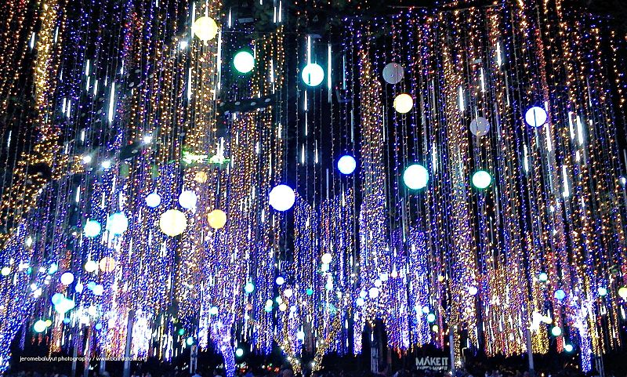
Lighting
Notes:
Ayala Triangle gardens

Slide 21
Poll
Notes:
My special collections/archives storage is:
Wonderfully airy and light
Usually as dark as a cave

Slide 22
Light Damage
Cumulative
Irreversible
Fading
Color change
Brittle

Slide 23
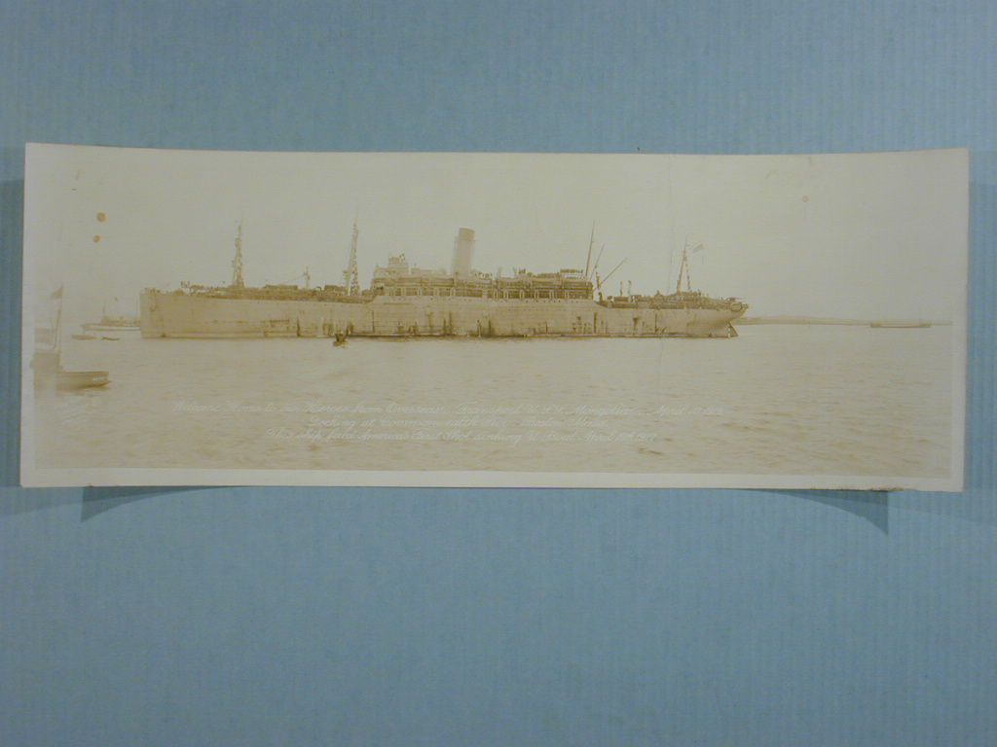

Slide 24
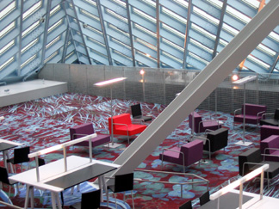
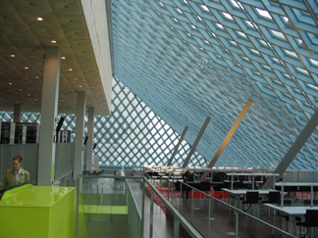
http://www.lynnbecker.com/repeat/seattle/seattlepl.htm
Notes:
Seattle Public Library Reading Room

Slide 25
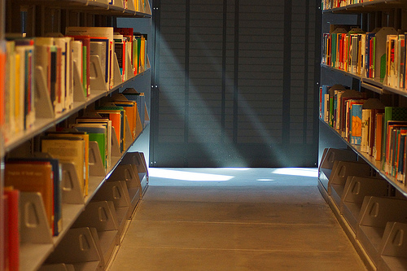
Recommended Light Levels
Storage
    0-5 Footcandles;
    0-55 Lux
Display/Exhibitions
    5-15 Footcandles;
    5-165 Lux
Reading/Work
    30-60 Footcandles;
    330-660 Lux
Ultraviolet Content
    < 50 microwatts per lumen;
    < 2-4% UV
“In the Library” By Yuri Levchenko, www.flickr.com

Slide 26
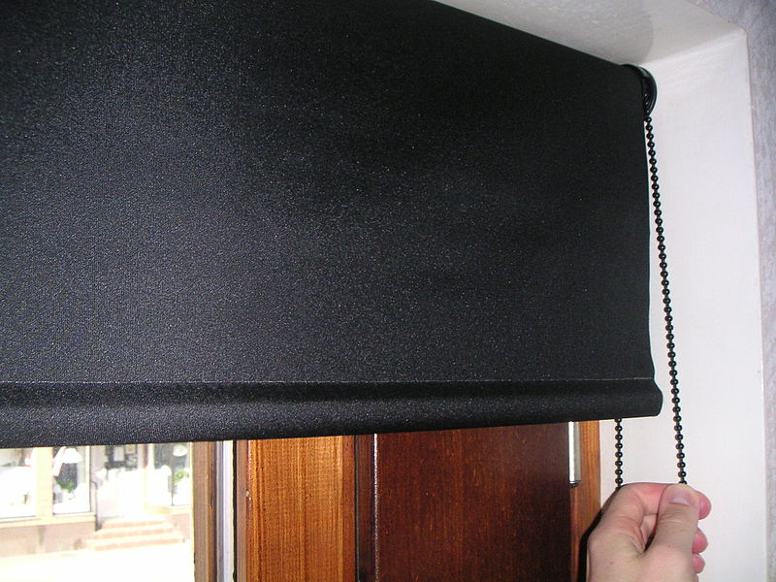
Lighting: Getting Started
  All windows in storage and exhibition areas are covered
  Light sources are not placed directly over collections materials
  Lights are turned on in storage areas only when materials are being retrieved
  Fluorescent lights are covered using ultraviolet filtering films

Slide 27
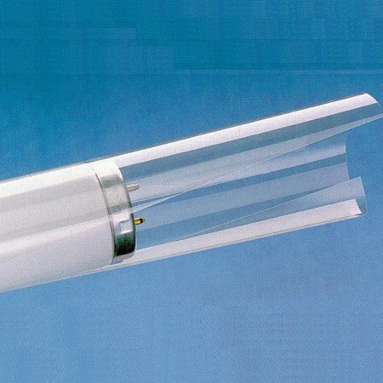
https://www.preservationequipment.com/Store/Products/Equipment-$4-Tools/Lighting/UV-Fluorescent-Light-Filters

Slide 28

Lighting: Good
  Light sensitive materials on exhibit are regularly rotated
  Records are kept on light exposure for materials placed on exhibition
  A schedule is in place for testing and replacement of ultraviolet filtering film
  Light sensitive materials are not left out in work areas for extended periods of time

Slide 29
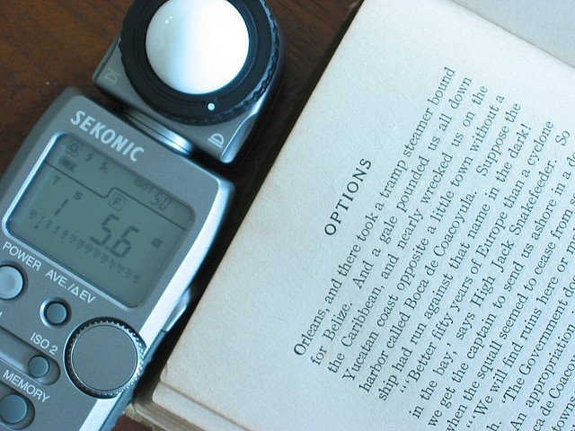
Lighting: Better
  Light meters are owned by the institution and light levels are checked regularly
“Metered Light” By Chad Miller, www.flickr.com

Slide 30

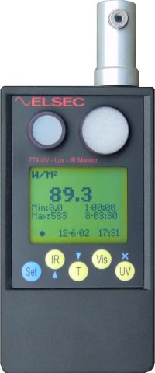
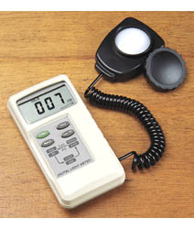
Light Meters
http://www.conservation-resources.co.uk/index.php?main_page=index&cPath=44
http://www.gaylord.com/adblock.asp?abid=157
http://www.scottech.net/pages/littlemore_scientific_engineerin/

Slide 31
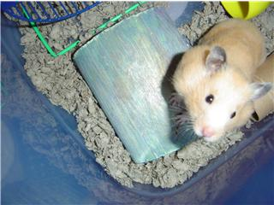
Pest Management

Slide 32
Poll
Notes:
Is there a regular pest management program for your building:
Yes
No
No, but I don’t mind sharing my office with critters

Slide 33
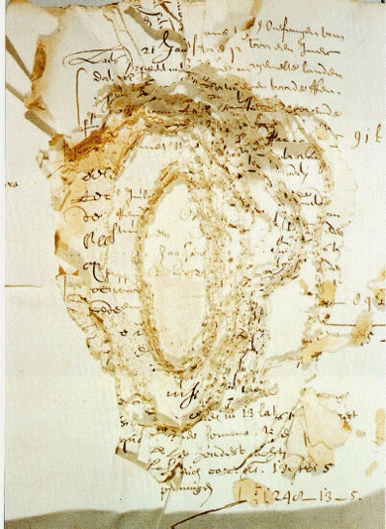
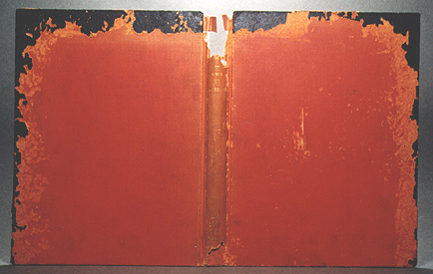
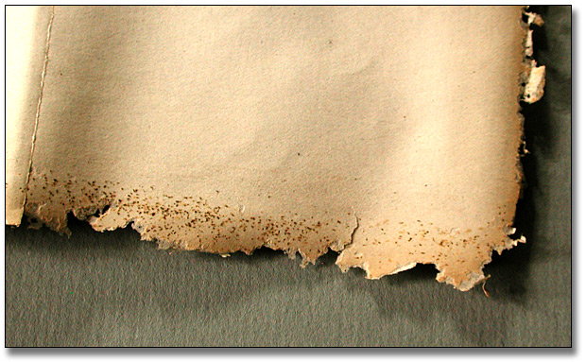
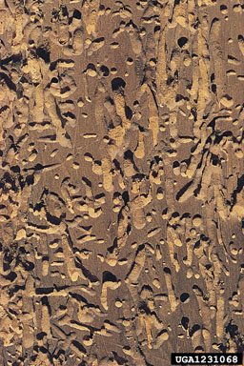
Silverfish Damage
Mouse Damage
Insectimages.org
Library.nyu.edu
Powder Post Beetle
Damage
Insectimages.org
Cockroach Damage
archives.gov.on.ca

Slide 34
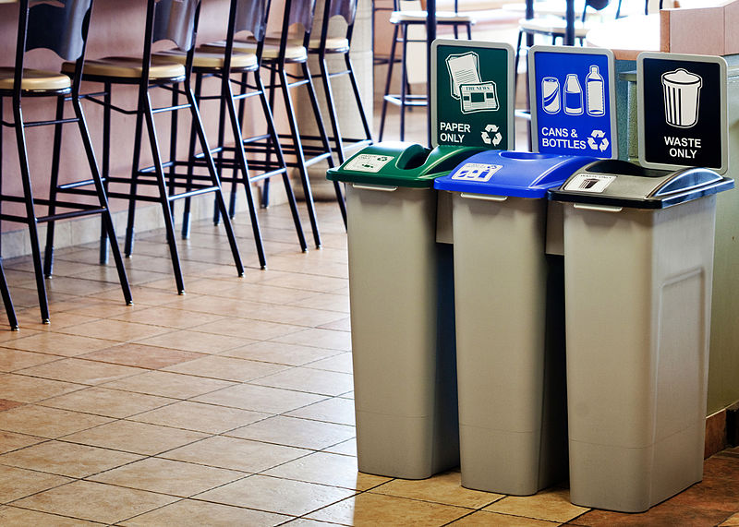

Pest Management: Getting Started
  Storage areas and furniture are cleaned on a regular basis
  All trash containing food is removed from the building on a daily basis
  Staff keeps food in airtight containers and cleans all eating areas daily
“Waste Watcher Recycling Bin” By Busch Systems, http://en.wikipedia.org/wiki/File:Waste_Watcher_Recycling_Station.jpg
http://uncrate.com/stuff/oxo-pop-containers/

Slide 35
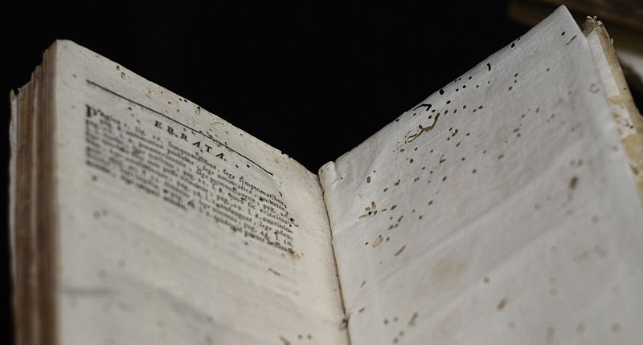
Pest Management: Getting Started
  All incoming items are examined for pest and mold infestations. Remedial action is taken to prevent the spread to the rest of the collection.
  Any items exhibiting signs of pests are isolated from the rest of the collection until treated
“Bookworm Damage on Errata Page” Bu Ragesoss, http://en.wikipedia.org/wiki/File:Bookworm_damage_on_Errata_page.jpg

Slide 36
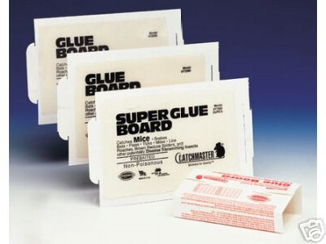
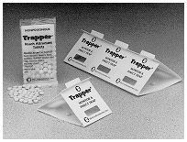
Pest Management: Good
  Vulnerabilities for an infestation are mitigated, such as sealing possible infiltration areas, use of outside lighting, correction of draining problems, sweeping gasket on exterior doors, and use of screens
  Storage and exhibition areas are monitored for the presence of pests with glue boards
http://www.thefind.com/garden/info-catchmaster-glue-boards
http://www.stonybrook.edu/ehs/pest/

Slide 37
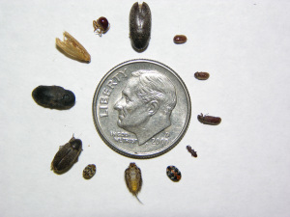
Pest Management: Good
  All pests are identified and records are kept about location, number found, as well as records of special events that might affect environmental conditions, such as receptions, leaks, systems failures etc.
  The institution’s selected pest management company understands the specific pest control needs for safety of staff, visitors, and the collection. No insecticides are used consistently as a pest deterrent
  Advice is sought from a conservator before treating any affected materials
http://ellencarrlee.wordpress.com/2009/03/19/integrated-pest-management-made-easy/

Slide 38
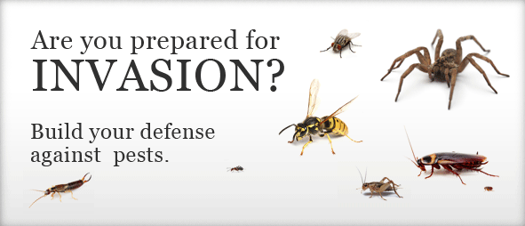
Pest Management: Better
  Instructions for cleaning storage and exhibition areas are written and followed
  An formalized integrated pest management program is in place for monitoring and responding to an infestation
http://www.propacificpestcontrol.com/

Slide 39
IPM
“Preservation professionals increasingly recommend a strategy called integrated pest management (IMP). This approach relies primarily on non-chemical means (such as controlling climate, food sources, and building entry points) to prevent and manage pest infestation. Chemical treatments are used only in a crisis situation threatening rapid losses or when pests fail to succumb to more conservative methods.”
- Beth Lindblom Patkus

Slide 40
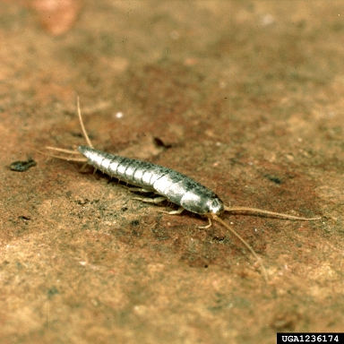
Principles of IPM
Prevention
  Take necessary measures to prevent the need to use chemical extermination
    Facilities, Environment, Housekeeping
Early Detection
  Consistent monitoring and inspection
Elimination
  Take necessary actions to eliminate pests, preferably through non-chemical means
http://nature.berkeley.edu/upmc/insectlist.php

Slide 41
Pest Management: Better
  Selection of pest infestation treatments, traps, and bailing are appropriate for the safety of collections and people
  A specialist in integrated pest management programs for cultural institutions review the IPM program at regular intervals
  A separate space is available for segregation of infested materials or those suspected of infestation

Slide 42
Thank you and Questions
Questions about collections care?
Contact the California Preservation Program info@calpreservation.org

Slide 43
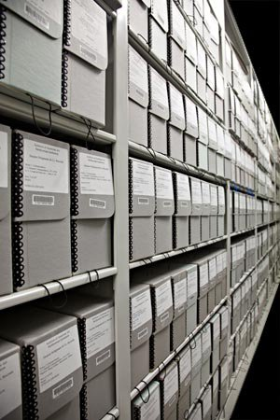
Next Session
Session 3: Handling, Access, Storage, and Exhibition
December 12, 2013
Archives of American Art

